Slide 1
A Template for Markdown Beamer Slides with Pandoc
Jing Hua Zhao 23 February 2025

Slide 2
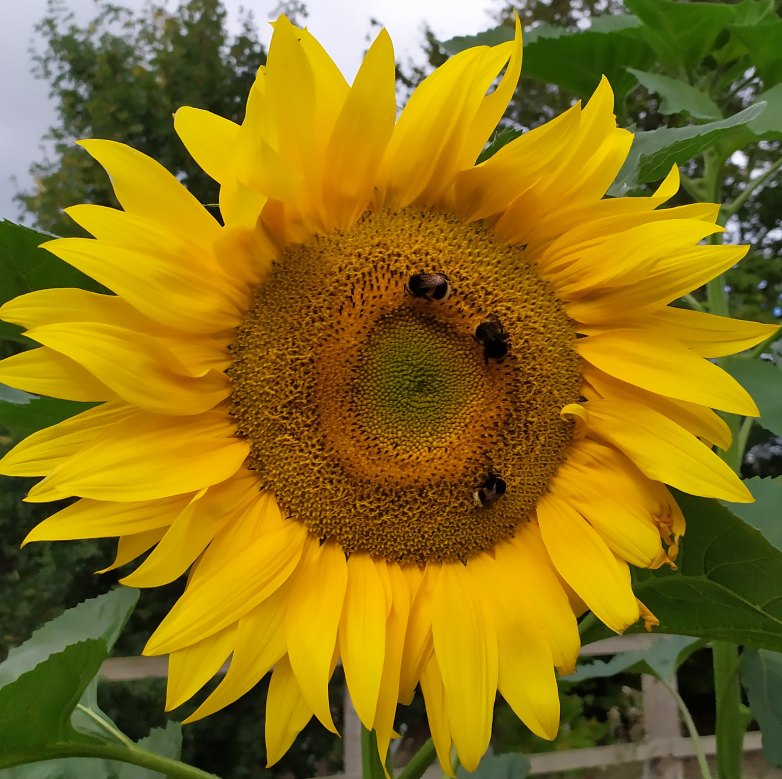
Key Features of the Template
YAML Front Matter: Set metadata like the title, author, theme, and transitions.
Headings: Use # for slide titles, ## or ### for smaller headers.
Horizontal Slide Separation: Use --- to separate individual slides.
Code Blocks: Wrap code in triple backticks for syntax highlighting.
A Dozen Others: Bookmarks, title page image, icon on title, background shading, embedded image, citation¹, colored URLs, figure numbering, table numbering, multiple columns, page / total numbering, link to videos.

Slide 3
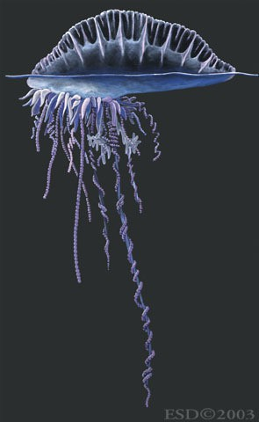
Slide with Image
Figure 1: physalis

Slide 4
Code/Math (φ(x, y)) Example
# Sample Python code
def hello_world(): print("Hello, world!")
,_{Σn}
n
Σ
 _{Σ}n _{Σ}n
φ(x, y) = φ _{i=1} x_{i}e_{i}, _{j=1} y_{j}e_{j}  = _{i=1 j=1} x_{i}y_{j}φ(e_{i}, e_{j} ) =
, φ(e₁, e₁) · · · φ(e₁, e_{n})  , y₁ 
. . .
. . .
(x₁, . . . , x_{n}) .
. . .

. . .
  
φ(e_{n}, e₁) · · · φ(e_{n}, e_{n})
y_{n}

Slide 5
A Numbered Table
Table 1:
A summary of files
File
Description
nature-genetics.csl premeable.tex REFERENCES.bib
slides.html slides.md slides.pdf slides.sh* sunflower.jpg*
style premeable
reference library
.html output markdown file
.pdf output
Bash command file sunflower as a logo

Slide 6
Two Columns
Bullet points
Point 1
Point 2
Point 3
Ordered list
First item
Another item
A third item
Figure 1 and Table 1 can be referred, too!

Slide 7
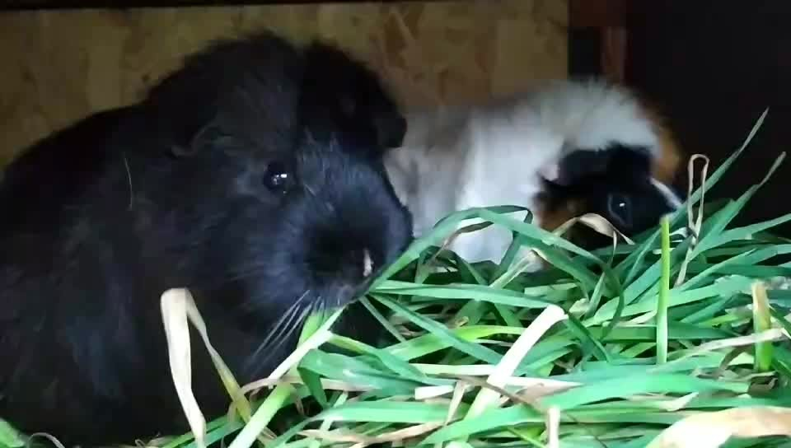
Videos
Figure 2: Plum and Popcorn (video) on 18/2/2025

Slide 8
Tools to Render Markdown Slides
Four of them are indicated here,
Pandoc: Convert Markdown to various formats, including slides in HTML5 or LaTeX Beamer. The current presentation is rendered with v2.18.
Marp: A tool for creating slides directly from Markdown and the .html in this presentation is rendered with v4.1.1.
Reveal.js: Use Reveal.js for beautiful web-based presentations. A wonderful demo is by quarto below.
quarto: Contain comprehensive facilities for rendering presentations including support for pandoc/Reveal.js, see https://quarto.org/.

Slide 9
References
1.
Zhao, J. H. & Tan, Q. Integrated analysis of genetic data with R. Hum Genomics 2, 258–65 (2006).

