Slide 1
Towards a Unified Platform for Genetic Data Analysis
Jing Hua Zhao
Department of Epidemiology & Public Health
University College London
1-19 Torrington Place, London WC1E 6BT
UCL 29/4/2005
Comments sent to j.zhao@ucl.ac.uk

Slide 2
OUTLINE OF THE TALK
The motivation
Why R?
Genetic data analysis
Some examples (population data, family data by several R packages)
Summary and further information

Slide 3
THE MOTIVATION
My own account
A general gap between theory and practice, lack of cohesion (e.g. HGMP)
The current perspectives, linkage/association: LIPED, LINKAGE (FASTLINK, MFLINK), MENDEL, SAGE, PAP, GENEHUNGER (MAPMAKER/SIBS, MAPMAKER/HOMOZ, GENEHUNTER PLUS/IMPRINTING/TWOLOCUS), ALLEGRO, MERLIN, MORGAN, VITESSE, SIMWALK, SOLAR

Slide 4
MORE TO THE LIST …
Specific programs APM, SPLINK, ASPEX, MIM, GAS, HOMOG, HAPLO
Further analysis: SIMLINK, SLINK, SIMULATE
Derivatives, DOLINK/QDB, GLUE, QUICKLINK, easyLINKAGE
Pedigree drawing: PEDDRAW, CYRILLIC, PROGENY, psdraw, PedSys, Pedraw

Slide 5
AND LIST FOR ASSOCIATION…
46 programs for unrelated individuals alone (Salem et al. 2005, Hum Genomics)
Family studies: AFBAC, ETDT, GASSOC, PDT, TRANSMIT, UNPHASED, QTDT, FBAT
Confusions, e.g. HAPLO, therefore Mega2
A call for a flexible environment (e.g. Guo and Lange 2000)

Slide 6
WHY R?
It is a general computing environment for both practitioners and programmers. Standard statistical and genetic analyses can be conducted in a reliable and unified fashion. It makes efficient statistical modelling possible.
A large number of packages maintained by a large and dedicated team with quality controls

Slide 7
THE USE OF R IN GENETIC DATA ANALYSIS
A short history
sma,genetics,haplo.score,qtl,etc.
The BioConductor project (http://www.bioconductor.org)
Ported and developed packages
R/gap, tdthap and kinship (lmm, pan)
More information is available from CRAN (http://cran.r-project.org)

Slide 8
A SIMPLE SESSION
> a1 <- c(1,1,2,3,3,2,3,1,1,2)
> a2 <- c(1,2,3,3,2,2,1,3,2,1)
> a <- c(a1,a2)
> count.a <- table(a)
> count.a
a
1 2 3
7 7 6
> freq.a <- count.a / 2 / 10
> freq.a
a
1 2 3
0.35 0.35 0.30
> b1 <- rep(0,10)
> b2 <- rep(0,10)
> for (i in 1:10) b1[i] <- min(a1[i],a2[i])
> for (i in 1:10) b2[i] <- max(a1[i],a2[i])
> g <- b1 + b2 * (b2-1) / 2
> table(g)
g
1 2 3 4 5 6
1 3 1 2 2 1
> freq.g <- table (g) / 10
> freq.g
g
1 2 3 4 5 6
0.1 0.3 0.1 0.2 0.2 0.1
> q()

Slide 9
THE R/GAP PACKAGE
# to the default directory under Windows
> install.packages("gap")
> library()
# to directory R under Unix
> install.packages("gap","R")
> library(lib.loc="R")
# Both Windows and Unix
> library(gap)
> library(help=gap)
> ? hwe
> help.start()
> demo(gap)

Slide 10
HARDY-WEINBERG EQUILIBRIUM
> library(gap)
> data(nep499)
> attach(nep99)
> snps <- nep499[,-(1:7)]
> controls <- snps[status==0,]
> for(i in 1:8) hwe(controls[,(2*i-1):(2*i)]
x2= 0.549 df= 1 p= 0.4588277
x2= 0.191 df= 1 p= 0.6621736
x2= 0.017 df= 1 p= 0.8968542
x2= 0.659 df= 1 p= 0.4170008
x2= 0.983 df= 1 p= 0.3214397
x2= 0.659 df= 1 p= 0.4170008
x2= 0.907 df= 1 p= 0.3410179
x2= 0.051 df= 1 p= 0.8217595

Slide 11
HAPLOTYPE ANALYSIS
> hla.gc<- genecounting(hla[,3:8])
> names(hla[,3:8])
[1] "DQR.a1" "DQR.a2" "DQA.a1" "DQA.a2" "DQB.a1" "DQB.a2"
> hla.gc<- genecounting(hla[,3:8])
> summary(genecounting(hla[,3:8]))
Length Class Mode
h 3750 -none- numeric
h0 3750 -none- numeric
prob 271 -none- numeric
l0 1 -none- numeric
l1 1 -none- numeric
hapid 1 -none- numeric
npusr 2 -none- numeric
npdat 2 -none- numeric
htrtable 1 -none- numeric
iter 1 -none- numeric
converge 1 -none- numeric
di0 1 -none- numeric
di1 1 -none- numeric
resid 271 -none- numeric
> 2*(hla.gc$l1-hla.gc$l0)
[1] 3172.276

Slide 12
PAIRWISE LD STATISTICS
> LDtable <- matrix(rep(0,8*8),nrow=8)
> for (i in 1:8) {
+ for (j in 1:i) {
+ gc <- genecounting(controls[,c(2*i-1,2*i,2*j-1,2*j)])
+ ij <- tbyt(gc$h,2*242)
+ LDtable[i,j] <- ij$Dprime
+ LDtable[j,i] <- 1-pchisq(ij$x2,1)
+ }
+ }
> round(LDtable,4)
[,1] [,2] [,3] [,4] [,5] [,6] [,7] [,8]
[1,] 0.0000 0.0000 0.1047 0.0000 0.0006 0.0000 0.0000 0.0000
[2,] 0.3173 0.0000 0.4456 0.0000 0.0000 0.0038 0.0000 0.0644
[3,] 0.1763 0.1109 0.0000 0.0000 0.6121 0.0000 0.0000 0.4941
[4,] 0.2530 0.3715 0.7243 0.0000 0.0000 0.0000 0.0000 0.0391
[5,] 0.1817 0.2786 -1.0000 0.2536 0.0000 0.0348 0.0000 0.5756
[6,] 0.4578 0.1682 0.7243 0.4590 0.1061 0.0000 0.0000 0.0000
[7,] 0.5722 0.4235 0.4572 0.4566 0.2773 0.7858 0.0000 0.0003
[8,] 0.7129 0.2062 0.2437 0.2940 0.0722 0.9036 0.5621 0.0000

Slide 13
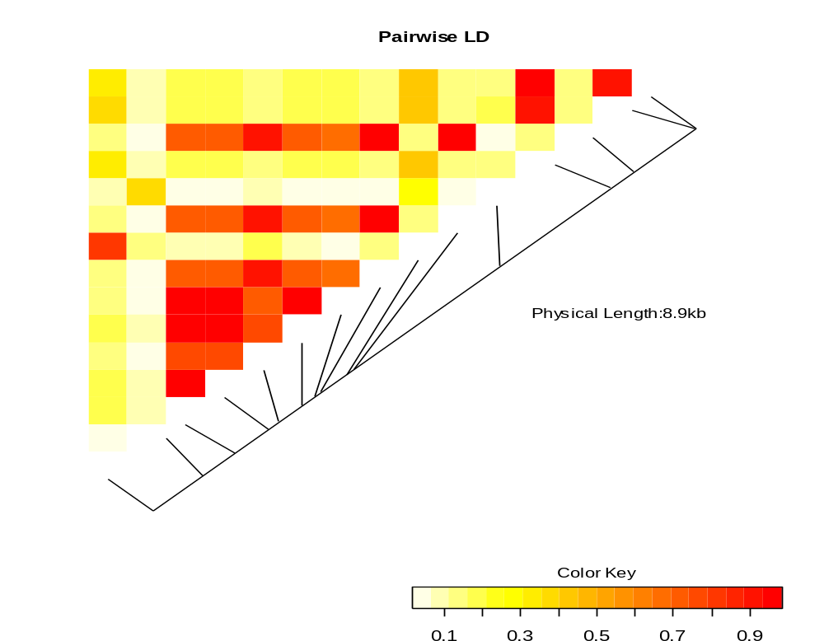
THE LD HEAT MAP

Slide 14
HAPLOTYPE-SPECIFIC TESTS
> locus.label <- c("R6", "N4", "N6", "N11", "N15", "N18","N22","N24")
> gcp(status,1,snps, locus.label=locus.label, n.sim=1000)
LRT = 115.7548 p = 1 sim p = 0
z-test of individual haplotypes
hap.id z sim p R6 N4 N6 N11 N15 N18 N22 N24
1 1 0.785 0.306 1 1 1 1 1 1 1 1
2 2 -1.557 0.058 1 1 1 1 1 1 1 2
3 3 0.910 0.306 1 1 1 1 1 1 2 1
4 4 1.747 0.037 1 1 1 1 1 1 2 2
5 5 1.601 0.067 1 1 1 1 1 2 1 1
6 6 -0.323 0.762 1 1 1 1 1 2 1 2
7 7 0.000 0.610 1 1 1 1 1 2 2 1
8 8 2.691 0.000 1 1 1 1 1 2 2 2
9 9 -1.259 0.149 1 1 1 1 2 1 1 1
10 10 -0.665 0.607 1 1 1 1 2 1 1 2
11 11 0.000 0.131 1 1 1 1 2 1 2 1
12 12 0.000 0.335 1 1 1 1 2 1 2 2
13 13 0.000 0.489 1 1 1 1 2 2 1 1
14 14 0.963 0.274 1 1 1 1 2 2 1 2
15 15 0.000 0.118 1 1 1 1 2 2 2 1
...
> hap.score(status, snps, method="hap", locus.label=locus.label, n.sim=1000)
Global Score Statistics
global-stat = 40.06154, df = 14, p-val = 0.00025, sim. p-val = 0,
max-stat sim. p-val = 0.002
Haplotype-specific Scores
R6 N4 N6 N11 N15 N18 N22 N24 Hap-Freq Hap-Score p-val sim p-val
[1,] 1 1 1 1 1 1 1 2 0.21913 -2.1282 0.03332 0.03
[2,] 1 1 1 1 2 1 1 1 0.0126 -1.75864 0.07864 0.108
[3,] 1 2 1 1 1 1 1 2 0.00568 -1.45885 0.14461 0.244
[4,] 1 2 1 1 2 1 1 2 0.00528 -0.89652 0.36997 0.44
[5,] 1 2 1 1 1 1 1 1 0.02153 -0.84432 0.39849 0.425
[6,] 1 1 1 1 1 2 1 2 0.00844 -0.11809 0.906 0.904
[7,] 2 1 1 1 1 1 1 1 0.00711 0.3817 0.70268 1
[8,] 1 1 1 2 1 1 1 1 0.00736 0.94315 0.3456 0.591
[9,] 1 1 1 1 1 1 2 1 0.0059 0.94315 0.3456 0.633
[10,] 1 1 1 1 1 1 1 1 0.59627 1.32973 0.18361 0.192
[11,] 1 2 1 2 1 1 1 1 0.00962 1.73777 0.08225 0.089
[12,] 1 1 1 1 1 2 1 1 0.00654 2.1786 0.02936 0.061
[13,] 1 1 1 1 1 1 2 2 0.00567 2.53976 0.01109 0.016
[14,] 1 1 1 1 1 2 2 2 0.01637 3.57003 0.00036 0

Slide 15
THE GENETICS PACKAGE
> data(mendelABC, package="hwde")
> sum(mendelABC[,4])
[1] 736
> clist <- c(9,11,12,19,20,21)
> cdata <- c(11,49,20,8,19,10)
> mendelABC[clist,4] <- cdata
> mendelABC
seedshape cotylcolor coatcolor Observed
1 AA BB CC 8
2 AA Bb CC 15
3 AA bb CC 9
4 AA BB Cc 22
5 AA Bb Cc 45
6 AA bb Cc 17
7 AA BB cc 14
8 AA Bb cc 18
9 AA bb cc 11
10 Aa BB CC 14
…
> sum(mendelABC[,4])
[1] 639
> dim(w)
[1] 639 4
> library(genetics)
> g <- makeGenotypes(w,1:3,sep=1)
> summary(g[,1])
Number persons typed: 639 (100%)
Allele Frequency: (2 alleles)
Count Proportion
A 639 0.5
a 639 0.5
Genotype Frequency:
Count Proportion
a/a 159 0.25
A/a 321 0.50
A/A 159 0.25
Exact Test for Hardy-Weinberg Equilibrium
N11 = 159, N12 = 321, N22 = 159, N1 = 639, N2 = 639, p-value = 0.937

Slide 16
THE LOG-LINEAR MODEL
> library(hwde)
> data(IndianIrish)
> attach(IndianIrish)
> ii <- hwde(IndianIrish)
[1] "Analysis of Deviance Table"
Resid. Df Resid. Dev Df Deviance
1 17 1724.07
2 16 1090.41 1 633.66
3 14 486.72 2 603.69
4 12 480.31 2 6.41
5 11 463.76 1 16.55
6 10 218.42 1 245.34
7 8 217.15 2 1.28
8 6 37.94 2 179.21
9 4 35.46 2 2.48
10 3 26.29 1 9.16
11 2 5.94 1 20.36
12 0 -4.885e-14 2 5.94

Slide 17
PEDIGREE DRAWING
pid id father mother sex affected
10081 1 2 3 2 1
10081 2 0 0 1 2
10081 3 0 0 2 1
10081 4 2 3 2 1
10081 5 2 3 2 2
10081 6 2 3 1 2
10081 7 2 3 2 2
10081 8 0 0 1 2
10081 9 8 4 1 2
10081 10 0 0 2 2
10081 11 2 10 2 2
10081 12 2 10 2 1
10081 13 0 0 1 2
10081 14 13 11 1 2
10081 15 0 0 1 2
10081 16 15 12 2 2

Slide 18
PEDIGREE DRAWING (cont)
We can use the following R statements
> pre <- read.table("10081.pre",header=T)
> library(kinship)
> attach(pre)
> ped <- pedigree(id,father,mother,sex,affected)
> plot(ped)

Slide 19
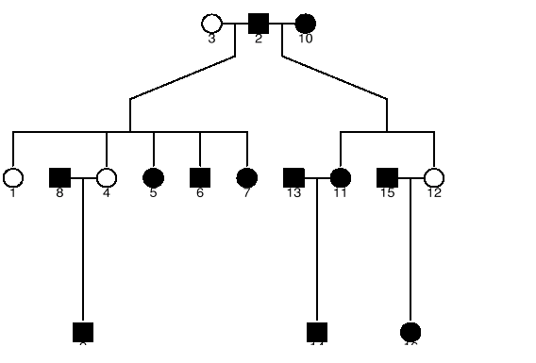
DIAGRAM BY KINSHIP

Slide 20
DIAGRAM BY R/GAP
> library(gap)
> pedtodot(ped)
> dir()
Then under Unix (Linux, Cygwin)
% dot –Tps 10081.dot –o 10081.ps
% ps2pdf 10081.ps

Slide 21
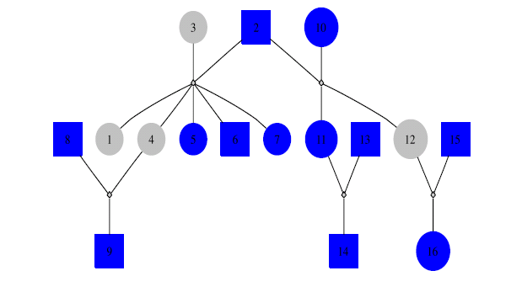
DIAGRAM BY R/GAP and DOT

Slide 22
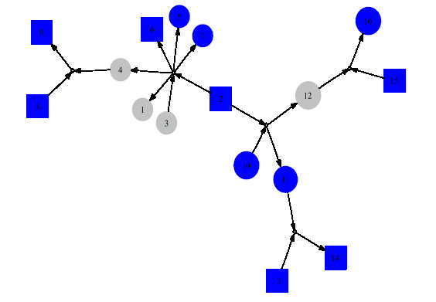
DIAGRAM BY R/GAP and LNEATO

Slide 23
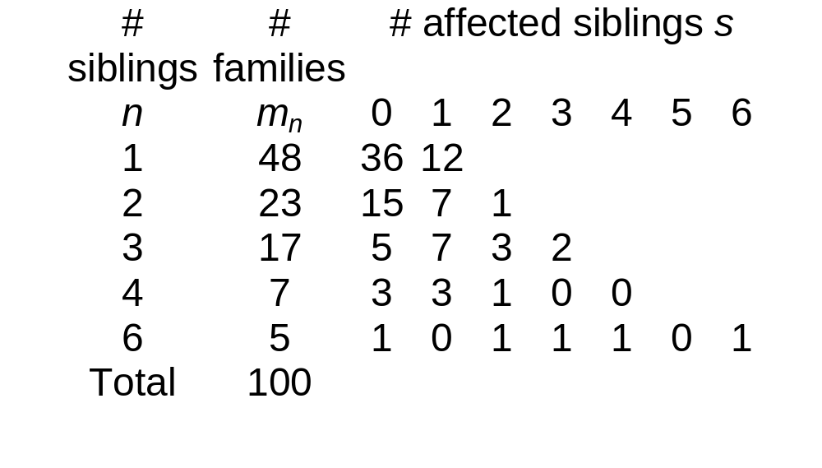
IPF CASES IN 100 FAMILIES

Slide 24
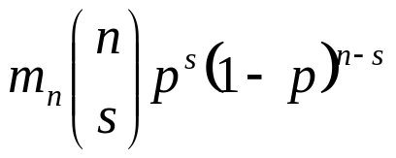
AGGREGATION OF IPF CASES
A bin(n,p) for the counts in the nth row can be fitted with expected frequencies
We estimate p with 60/203=0.296 leading to Pearson chi-square 312 (15df) indicating poor fit, but we can use pfc and pfc.sim to get the exact p-value 0.00883 for the table.

Slide 25
KINSHIP COEFFICIENTS
> library(kinship)
> attach(ped)
> round(8*(kinship(id,momid,dadid)))
1 2 3 4 5 6 7 8 9 10 11 12 13 14 15 16
1 4 2 2 2 2 2 2 0 1 0 1 1 0 0 0 0
2 2 4 0 2 2 2 2 0 1 0 2 2 0 1 0 1
3 2 0 4 2 2 2 2 0 1 0 0 0 0 0 0 0
4 2 2 2 4 2 2 2 0 2 0 1 1 0 0 0 0
5 2 2 2 2 4 2 2 0 1 0 1 1 0 0 0 0
6 2 2 2 2 2 4 2 0 1 0 1 1 0 0 0 0
7 2 2 2 2 2 2 4 0 1 0 1 1 0 0 0 0
8 0 0 0 0 0 0 0 4 2 0 0 0 0 0 0 0
9 1 1 1 2 1 1 1 2 4 0 0 0 0 0 0 0
10 0 0 0 0 0 0 0 0 0 4 2 2 0 1 0 1
11 1 2 0 1 1 1 1 0 0 2 4 2 0 2 0 1
12 1 2 0 1 1 1 1 0 0 2 2 4 0 1 0 2
13 0 0 0 0 0 0 0 0 0 0 0 0 4 2 0 0
14 0 1 0 0 0 0 0 0 0 1 2 1 2 4 0 0
15 0 0 0 0 0 0 0 0 0 0 0 0 0 0 4 2
16 0 1 0 0 0 0 0 0 0 1 1 2 0 0 2 4

Slide 26
THE TRANSMISSION DISEQULIBRIUM TEST (TDT)
x <- matrix(c(0,0, 0, 2, 0,0, 0, 0, 0, 0, 0, 0,
0,0, 1, 3, 0,0, 0, 2, 3, 0, 0, 0,
2,3,26,35, 7,0, 2,10,11, 3, 4, 1,
2,3,22,26, 6,2, 4, 4,10, 2, 2, 0,
0,1, 7,10, 2,0, 0, 2, 2, 1, 1, 0,
0,0, 1, 4, 0,1, 0, 1, 0, 0, 0, 0,
0,2, 5, 4, 1,1, 0, 0, 0, 2, 0, 0,
0,0, 2, 6, 1,0, 2, 0, 2, 0, 0, 0,
0,3, 6,19, 6,0, 0, 2, 5, 3, 0, 0,
0,0, 3, 1, 1,0, 0, 0, 1, 0, 0, 0,
0,0, 0, 2, 0,0, 0, 0, 0, 0, 0, 0,
0,0, 1, 0, 0,0, 0, 0, 0, 0, 0, 0),nrow=12)
> mtdt(x)
Spielman-Ewens Chi-square: 22.85975
Stuart Chi-square 18.82734
Value of Chi-square if diagonal elements are kept: 22.08668
> bt.ex<-bt(x)
> anova(bt.ex$bt.glm)
Analysis of Deviance Table
Model: binomial, link: logit
Response: y
Terms added sequentially (first to last)
Df Deviance Resid. Df Resid. Dev
NULL 58 349.35
allele 11 19.36 47 329.99

Slide 27
TDT WITH HAPLOTYPES
> library(tdthap)
> data(crohn,package="gap")
> ped <- crohn
> ped$pid <- as.integer(gl(129,3))
> haps <- hap.transmit(ped, markers=1:10)
> hap.use <- tdt.select(haps, markers=1:10)
> table(hap.use$trans)
1 2 3 4 5 6 7 8 9 10 11 12 13 14 15
0 1 8 1 0 0 0 0 2 42 6 0 0 0 0
> table(hap.use$untrans)
1 2 3 4 5 6 7 8 9 10 11 12 13 14 15
1 0 15 4 1 1 1 1 6 13 11 2 2 1 1
> rr <- tdt.rr(hap.use)
> rr

Slide 28
TDT WITH MARKER 10
> haps <- hap.transmit(ped,markers=10)
> hap.use <- tdt.select(haps,markers=1)
> tdt.rr(hap.use)
Trans Untrans p.value RR.est RR.low RR.high
Prior 0 0 NA 1.0000000 0.006193959 161.4476388
1 19 42 0.004444019 0.4588235 0.284913961 0.7069276
2 42 19 0.004444019 2.1794872 1.414571995 3.5098315

Slide 29
THE AGE OF ONSET ANALYSIS
library(kinship)
gaw14pheno <- read.table("pheno.dat",
col.names=c("fid","id","father","mother","sex",...))
attach(gaw14pheno)
gaw14check <- familycheck(fid,id,father,mother)
gaw14fam <- makefamid(id, father, mother)
gaw14kin <- makekinship(gaw14fam, id, father, mother)
temp <-matrix(scan("pedindex.out"), ncol=8, byrow=T)
pedindex <- temp[,c(1,8)]
temp <- read.table("gaw14ibd/ibd.ADH3", row.names=NULL,
col.names=c("id1", "id2", "phi2", "delta7", "dummy"))
ibd.ADH3 <- bdsmatrix.ibd(temp$id1, temp$id2, temp$phi2, pedindex)
kfit <- coxme(Surv(ageon1,alc1) ~1, gaw14pheno, random=~1|id,
varlist=list(gaw14kin, ibd.ADH3))

Slide 30
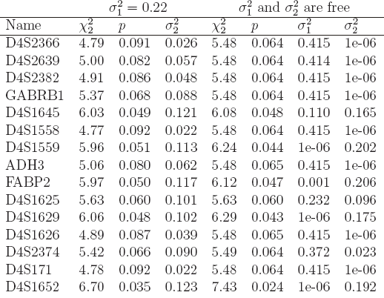
THE RESULTS ON CHROMOSOME 4

Slide 31
OTHER INFORMATION
POINTER, PATHMIX the models and diagrams, with control cards PA, IT, CC, etc.
Internet, read.table(URL), source(URL)
MySQL, ODBC
> library(RODBC)
> channel2 <- odbcConnectAccess("c:/aedata.mdb")
> tblOutput <- sqlQuery(channel2,paste("select * from tblOutput"))
> class(tblOutput)

Slide 32
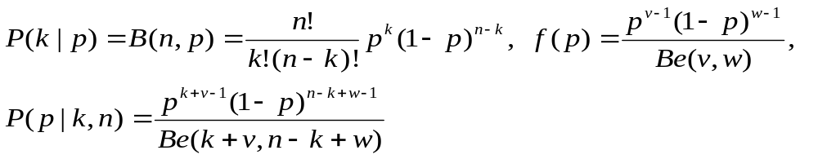
BAYESIAN METHODS
# bs-model.txt:
model {
# likelihood
k ~ dbin(p, n)
# prior
p ~ dbeta(nu, omega)
}

Slide 33
R2WinBUGS
> library(R2WinBUGS)
> s <- list(k = 201, n = 372, nu = 1, omega = 1)
> parms <- "p“
> inits <- function() list(p=0.5)
> s.bugs <- bugs(s,inits,parms,"c:/bs-model.txt", n.chains=1, n.burnin=1000, n.iter=11000)
> s.bugs
mean sd 2.5% 25% 50% 75% 97.5%
p 0.5 0.0 0.5 0.5 0.5 0.6 0.6
deviance 7.3 1.4 6.4 6.5 6.8 7.7 11.0
pD = 0.9 and DIC = 8.3
> plot(s.bugs)

Slide 34
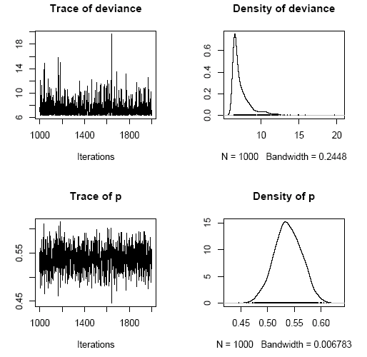
MCMC PLOT FOR BIONOMIAL SAMPLING

Slide 35
A BRIEF SUMMARY AND FURTHER INFORMATION
R is a powerful environment for statistical computing, among others (e.g. recent issue of J Stat Soft)
Genetic data analysis can be greatly facilitated by R packages
For the latest updates available on http://www.ucl.ac.uk/~rmjdjhz and http://www.hgmp.mrc.ac.uk/~jzhao

