Slide 1

Haplotype analysis
Genetic Forum 24/4/2008
Jing Hua Zhao

Slide 2
Outline
Background
Chromosome X analysis
Power calculation
Associate issues

Slide 3
Start with a Problem …
5HT2 and Schizophrenia
HLA markers and Schizophrenia
Further work from an early report in Lancet
Using unrelated individuals rather than the popular TDT
But
  Too many analyses
  Available program (EH) would not work

Slide 4
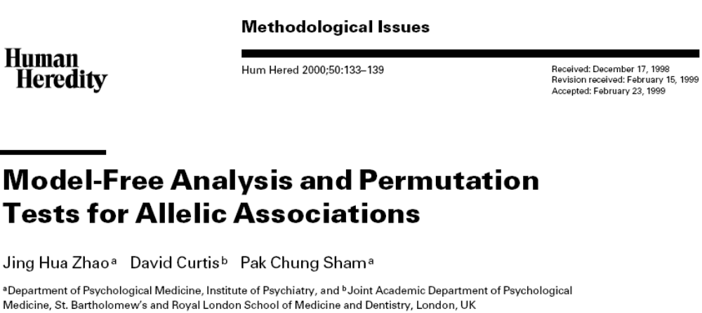

Slide 5
Advances and Problems …
Advances
  Easier analysis of gene-trait association
  Model-free statistics
  Permutation tests
  Some haplotype-specific statistics (F-T)
Problems
  Too slow
  Potentially useful model-based measure of LD

Slide 6
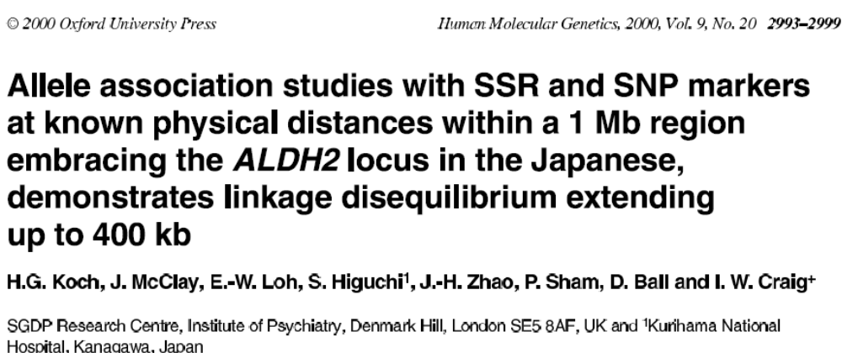

Slide 7
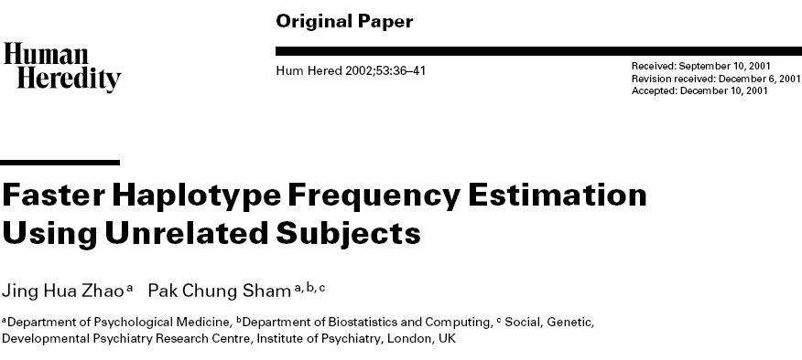

Slide 8
Advances and Problems…
Advances
  Faster computation
  Likelihood-based LD statistics
Problems
  Abandon model-specific statistics
  Do not handle missing data
  Still use global association test
  Do not handle covariates

Slide 9
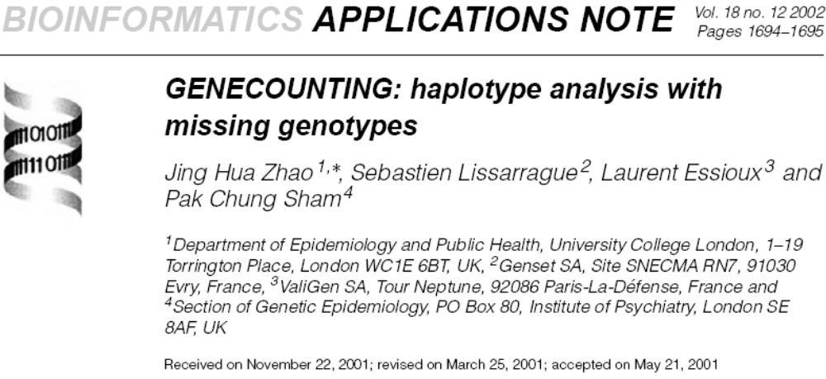

Slide 10
Advances and Problems
Advances
  Provide generic algorithm for missing genotype data as well as likelihood estimation and handle multiallelic markers
  Some haplotype specific tests
  Considerable easier than HAPLO (Yale)
Problems
  Chromosome X data
  Slow for large problem

Slide 11
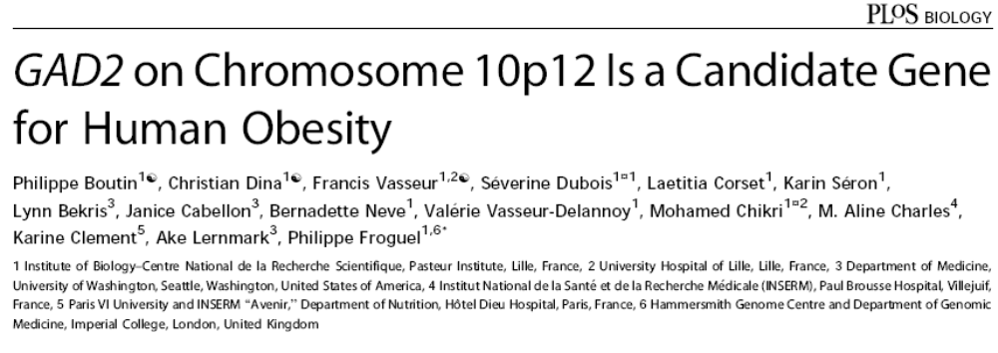

Slide 12
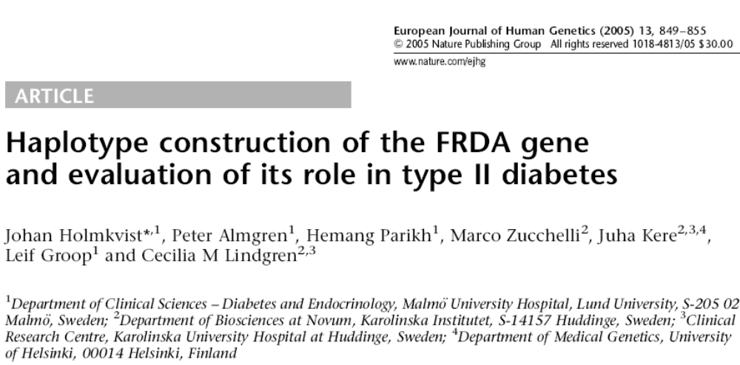

Slide 13
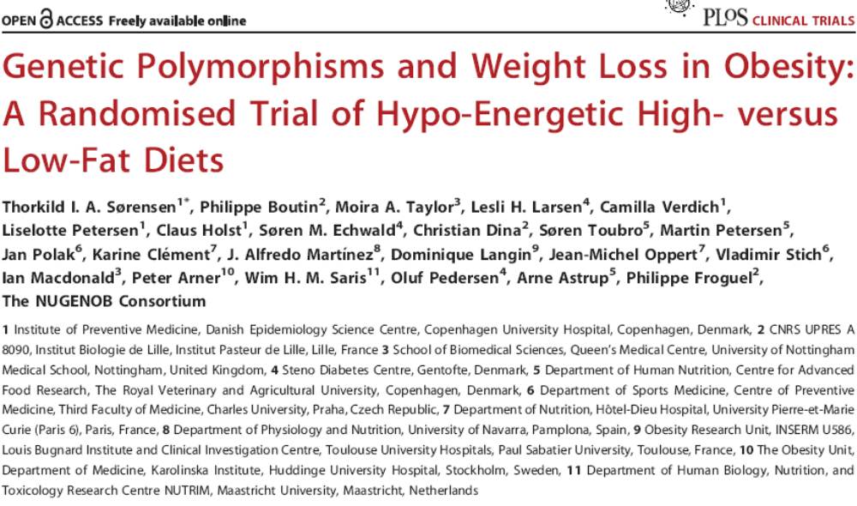

Slide 14
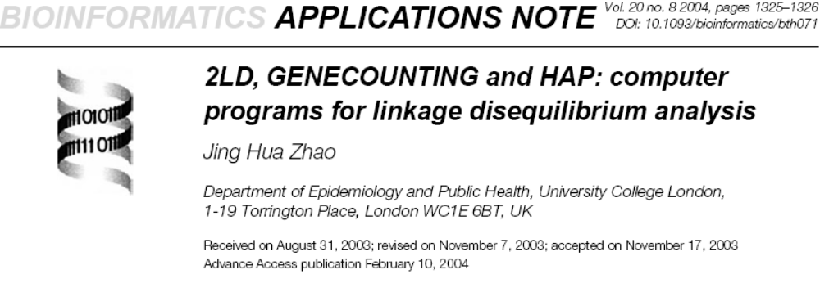

Slide 15
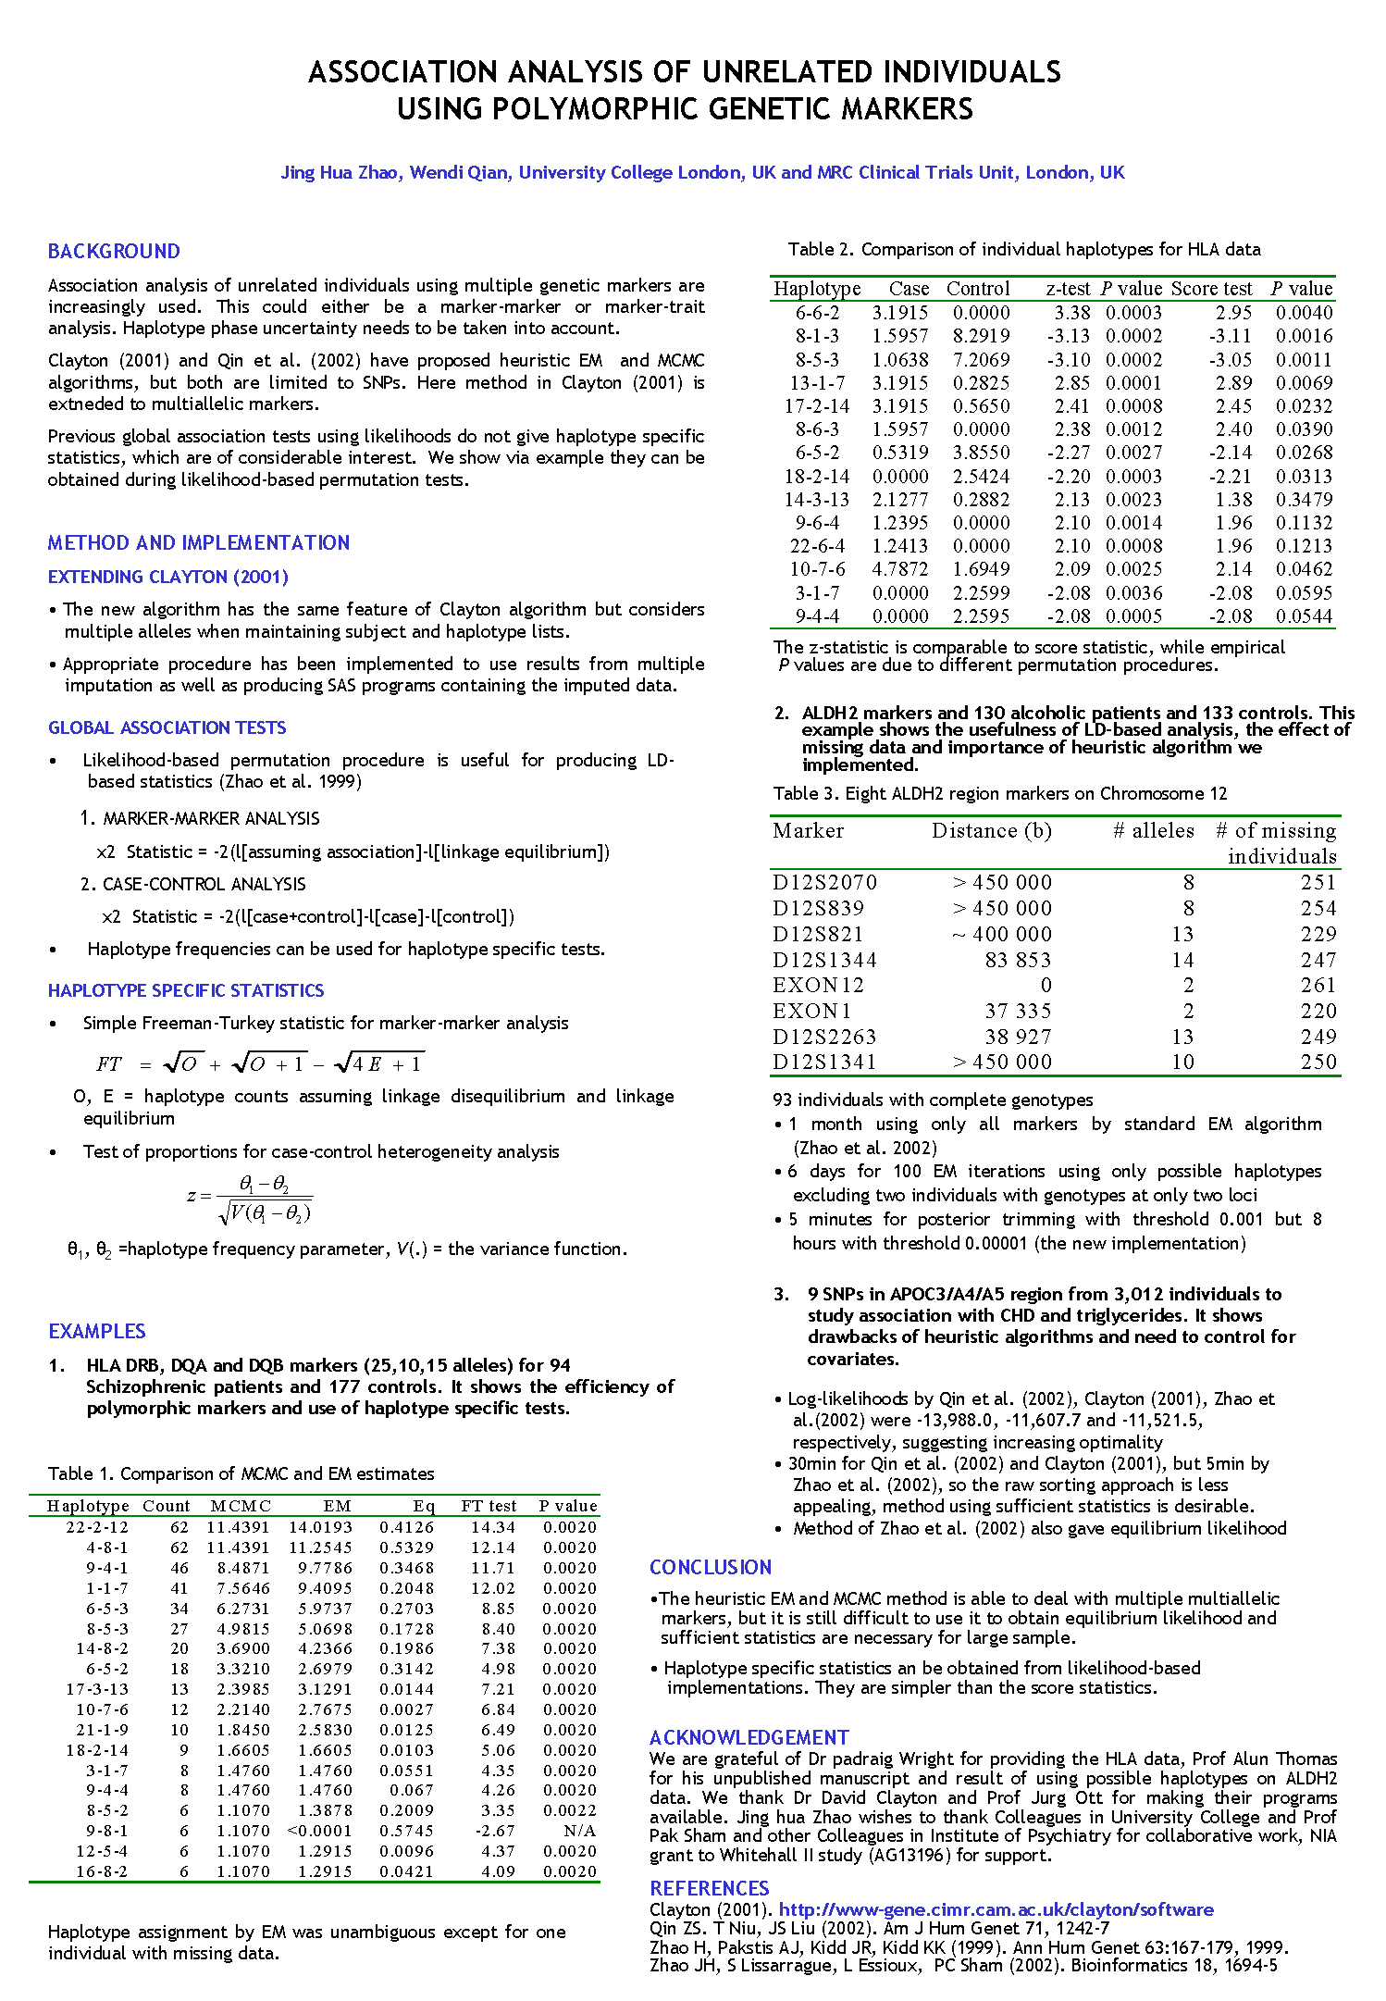

Slide 16
Advances and Problems…
Advances
  D’ and SE(D’), etc. (nontrivial since authors got wrong, and developed their MIDAS system later on)
  Kullback-Leibler information (later AJHG paper)
  Chromosome X data
  Faster algorithm for multiallelic system (extension of SNPHAP)
Problems
  Covariates, R haplo.score, hapassoc
  GEI interactions, R haplo.stats

Slide 17
The Latest?
SAS/Genetics
HTR
WHAP/PLINK
ZAPLO
  Some ~60 programs
But a synthesis is preferable, e.g., R
  gap, hapassoc
  snpMatrix, SNPassoc, GenABEL, pbatR

Slide 18
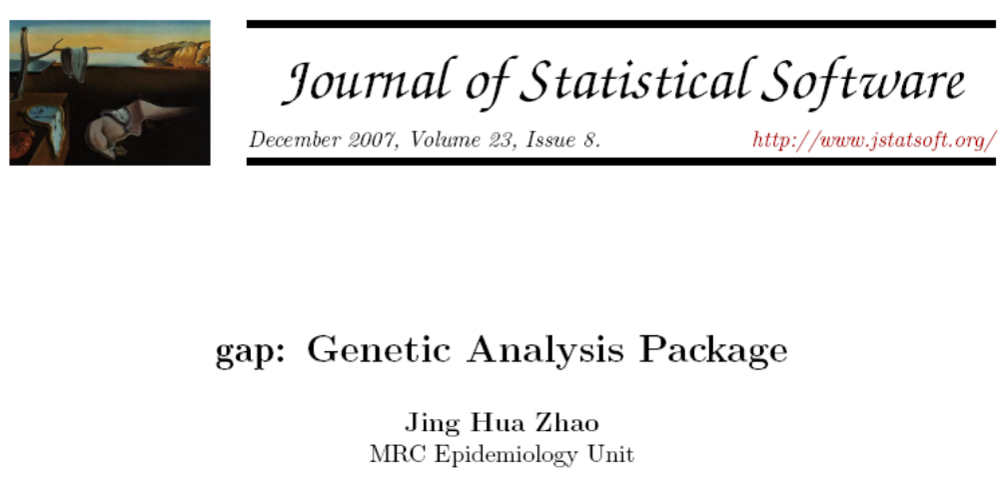

Slide 19
GWAS
Hapmap
IMPUTE and MACH
HAPVLMC, HMM.map

Slide 20
Returning to chr. X
Review of gene-counting
Modification

Slide 21
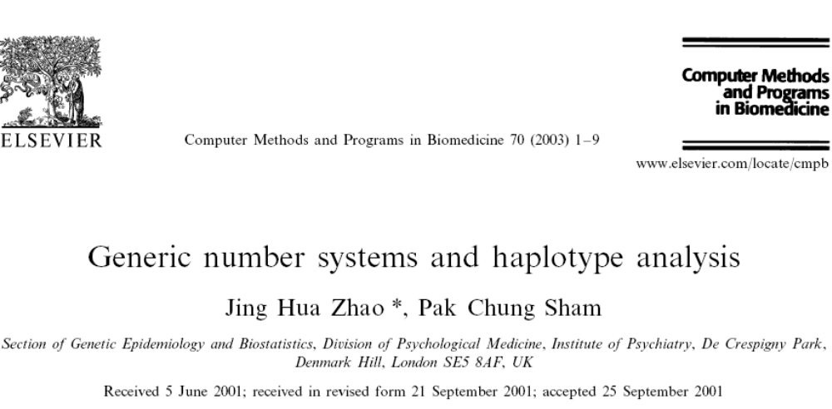

Slide 22
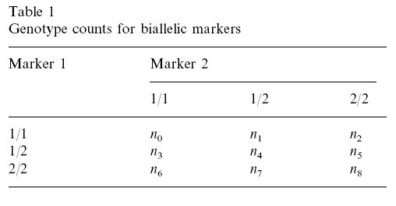
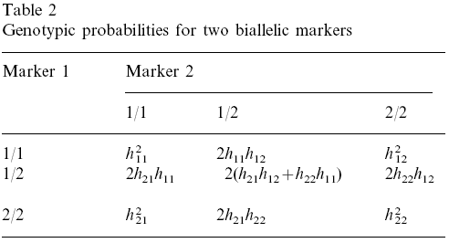

Slide 23
Now Steps for X Data
Run GENECOUNTING
  gcx HTR2c.inp HTR2c.gc
Run awk to extract assignment
  awk –f HTR2c.awk HTR2c.gc > HTR2c.gco
  HTR2c.awk has
    /\[1\]|\[2\]/{gsub(/\[|\]/,""); print;}
Create indicator variables for haplotypes
  infile id chr snp1-snp4 p hid using 4snps.gco
  tab hid, gen(h)
  savasas using snps4.sas7bdat,replace

Slide 24
We Have Two Choices
Stata with probability weighting
  Limited success with output of parameters
PROC SURVEYREG of SAS
  It has ODS system such that estimates can be stacked for all six models
How about single-locus analysis?
  We can use a dummy variable and go through the same procedure, effectively an allellic analysis

Slide 25
Any Solution from R?
Possibly with library survey

Slide 26
Another Example …
LRRK2 gene G2019S mutation and SNPs [haplotypes] in subtypes of Parkinson’s disease
Biswanath Patra1, Azemat J. Parsian2, Brad A. Racette3, Jing Hua Zhao4, Joel S. Perlmutter3, Abbas Parsian*
1) Simmons Comprehensive Cancer Center, University of Texas Southwestern Medical Center at Dallas,
Dallas, TX 2) Department of Radiation Oncology, University of Arkansas for Medical Sciences, Little Rock,
AR; 3) Department of Neurology, Washington University School of Medicine, St. Louis, MO;
4) MRC Epidemiology Unit, Strangeways Research Laboratory, Cambridge, UK

Slide 27
Reviewer #1:
The major limitation of this paper is the genetic association study since the study sample size does not appear to be sufficiently powered to detect the effect size differences between cases and controls. A control size of 186 is disproportionate
to the cases. The authors should provide the following information:
1.A power calculation to determine if their studied sample size is sufficent to detect the effect size differences (6-loci haplotypes).
2.Provide an explanation why and how the six SNPs were selected. Have these SNPs been examined in previous published studies? Any bioinformatic data on these SNPs?
3.The age of the cases and controls does not appear to be matched. Has this been taken into account in the analysis?
4.A comment on the potential heterogeneity of the American white population since LRRK2 mutationla frequency appear to vary across some European populations.

Slide 28
… the study was envisaged such that it has a good though not optimal power as compared what is available in the literature. Given findings from the study, the information regarding power would only be supplementary, esp. there are also arguments that post-hoc calculation is questionable.
Nevertheless, in the case of ordinal regression (control, sporadic, familial) ~ six-SNP haplotype analysis, (via R haplo.stats library) assuming that the global association is comparable to that of a standard chi-squared statistic with value of 20.03, df=15, for a type-I error of 0.05 and a sample size of 684 used in the final analysis there would be 83% power. As this is a rough estimate, an alternative based on the 122221 haplotype between no association (haplotype frequency 0.0145) and association (haplotype freqnency 0.00874), with type-I error 0.05, a two-sided test, roughly has 30% power (32.4% with N=759 and 29.7% with N=684) according to pwr.p.test of R package pwr.
The reason to choose the six SNPs is clear from the manuscript, though not yet based on bioinformatics. The information from EMSEMBL and HapMap is consistent. In the case of HapMap which contains CEU sample (from http://www.hapmap.org/cgi-perl/gbrowse/Density_test/, type LRRK2 and search). The LRRK2 gene spans 144.3kb. Three SNPs (rs1491938, rs10784486, and rs1365763) tag 74 SNPs. The coverage is impressive although they do not cover the whole region. APART FROM rs1006151, THE OTHER TWO WERE NOT LISTED – I assume they are new relative to HapMap? Use HaploView option HapMap download for Chromosome 12 start and end positions (in Kb), Tagger, Load Includes (a column containing the six SNPs).

Slide 29
The R Trick
# 1-4-2008 MRC-Epid JHZ
# LRRK2 rely
# haplotype frequency under linkage equilibrium
p1 <- prod(c(0.15611, 0.64853, 0.84187, 0.96233, 0.58542, 0.30294))
# observed
p2 <- 0.00874
library(pwr)
p1
p2
h<-ES.h(p1,p2)
h
# had no missing data
pwr.p.test(h=h,n=759,sig.level=0.05,alternative="two.sided")
# as it is
pwr.p.test(h=h,n=684,sig.level=0.05,alternative="two.sided")
p1 <- 0.02093
p2 <- 0.00246
n1 <- 186
n2 <- 304+194
h<-ES.h(p1,p2)
h
pwr.2p2n.test(h=h,n1=n1,n2=n2,sig.level=0.05,alternative="two.sided")
n2 <- 350+225
pwr.2p2n.test(h=h,n1=n1,n2=n2,sig.level=0.05,alternative="two.sided")

Slide 30
Work from 2003 Onwards
We can do more with R …
  A tutorial
  Graphics: Q-Q plot, Manhanttan plot, LD plot Regional Association plot

Slide 31
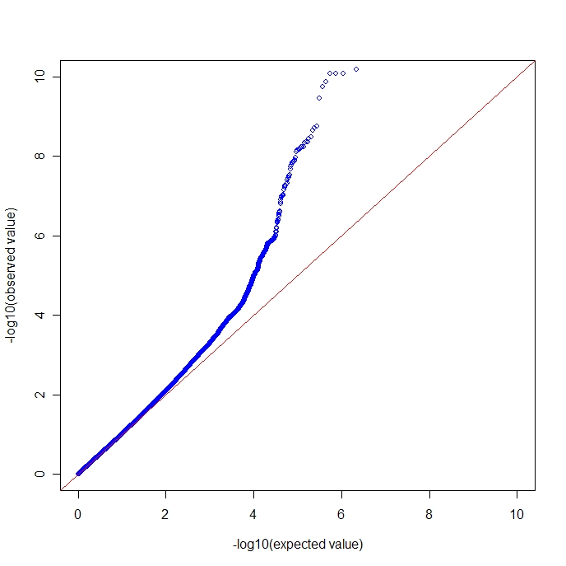

Slide 32
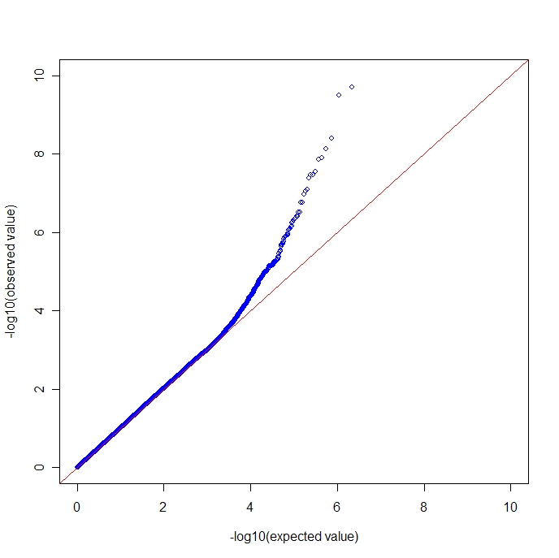

Slide 33
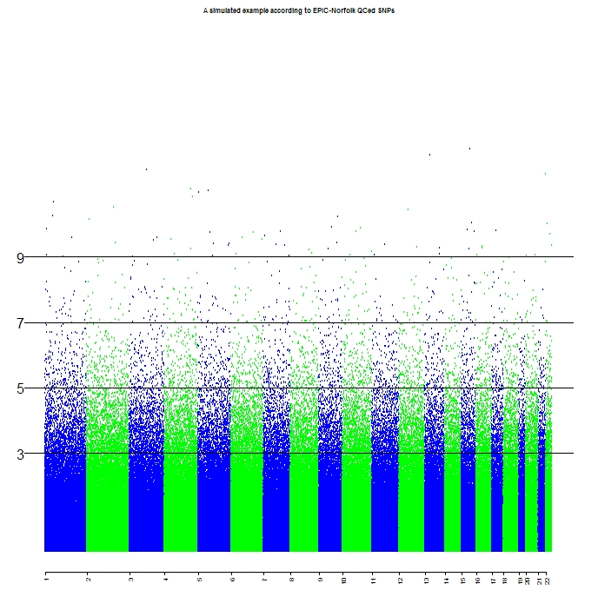

Slide 34
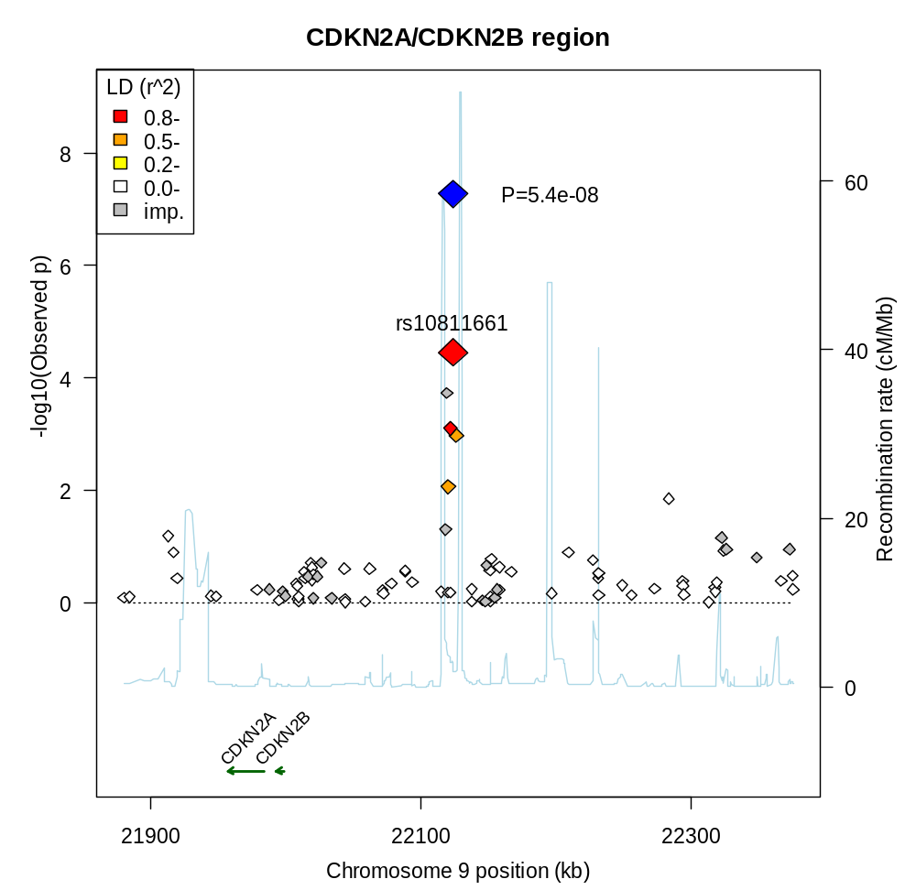

Slide 35
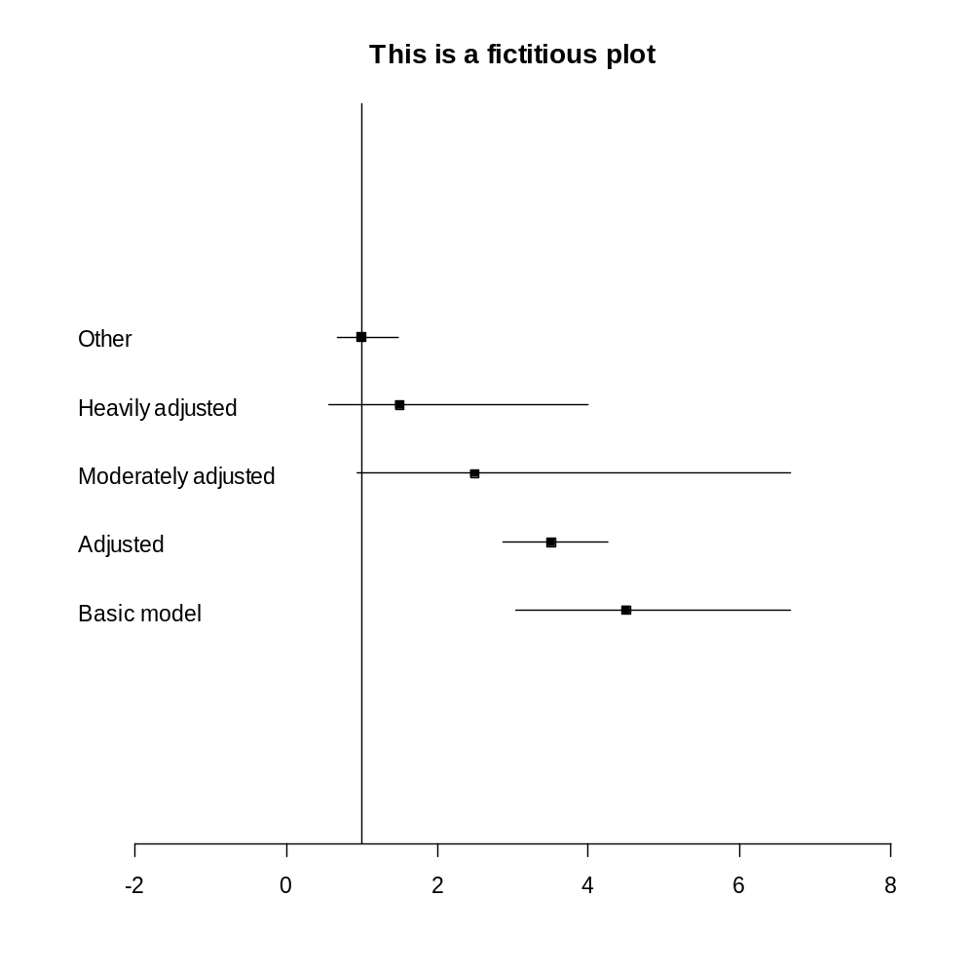

Slide 36
More to go, but we stop here …

