Slide 1
A Brief Overview of Affected Relative Pair analysis
Jing Hua Zhao
Institute of Psychiatry
j.zhao@iop.kcl.ac.uk

Slide 2
Current Paradigm of Genetic Mapping
Linkage (parametric, model-free)
  well-established and effective for Mendelian disorders
  low resolution
Association (case-control, TDT)
  dense map, large amount of genotyping, multiple testing and stringent criteria of significance

Slide 3
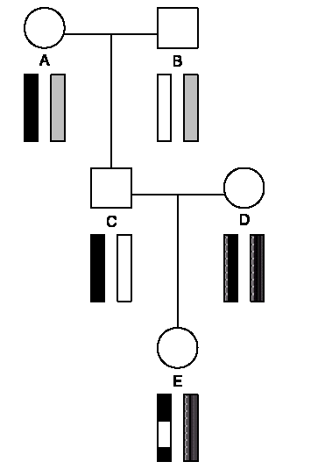
Linkage and Recombination
Shih & Whittemore (2001)
SMMR 10: 27-55
Notes:
An example of three-generation pedigree. The female E inherits a chromosome from her father (C) contining some blocks of DNA from her paternal grandmother (A) and some from her paternal grandfather (B).

Slide 4
Motivations
For disease with low penetrance, it is more likely familial aggregation would be more more genetic rather than environmental
Clinically more accessible

Slide 5
IBD/IBS
IBD if sharing the same allele of a ancestor
IBS if sharing the same allele, regardless the ancestral origin
Notes:
IBS is close to IBD for highly polymorphic loci

Slide 6
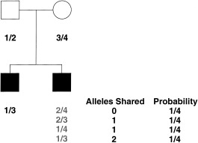
Expected IBD sharing
Nyholt (2000) AJHG 67:282-288
Notes:
Diagram of affected sib pairs with their parents, assuming a fully informative marker. Marker genotype of sib 1 is set arbitrarily to 1/3 whereas that of sib 2 can have four possible genotypes.

Slide 7
Notations
Let z_{i}= the probability that a sib pair shares i alleles identical by descent at a genomic location
Under the null hypothesis of no linkage are 1/4, 1/2 and 1/4, under linkage formulae by Suarez et al. (1978)

Slide 8
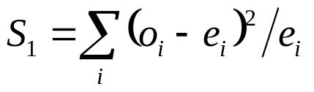
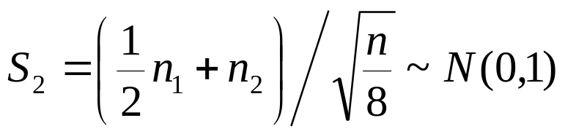
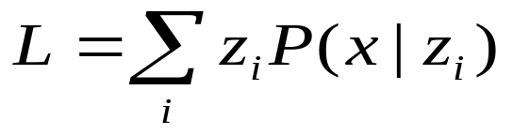
Tests using ASPs
Simple χ² test
Means test
MLS
Sham & Zhao (1998)
Notes:
The chi-square statistic tests the observed if allele sharing is different from proportions (1/4,1/2,1/4).

Slide 9
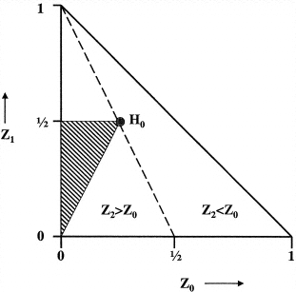
Parameter space of Sib-pairs allele sharing
Elston (2001) AJHG 69: 1149-50
Notes:
Parameter space for sib-pair allele sharing. H₀ (z=(1/4,1/2,1/4)) corresponds to the null hypothesis of no linkage. The hatched triangle represents the parameter space for concordant sib pairs when there is monogenic inheritance. The dashed line reflects evidence of linkage for concordant and discordant sib pairs.

Slide 10
Thresholds for MLS_{PT}
Autosomal locis
  .402χ₀², .50χ₁², and .098χ₂²
  For P < .05, MLS_{PT} > .74 is necessary
For X-linked marker
  .375χ₁², .375χ₂², and .125χ₃²
Nyholt (2000)

Slide 11
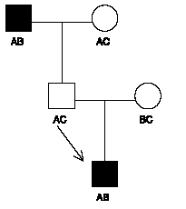
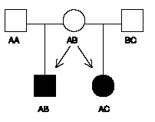
Affected relative pairs
Shih & Whittemore (2001)
Notes:
Gandfather-grandson pair shaing one allele IBD
The half-sibs shares zero allele IBD

Slide 12
NPL statistics
NPL_{pair}
  measures the number of alleles shared IBD by a pair of affected relatives
NPL_{all}
  captures information regarding the sharing between larger sets of affected relatives
Both available from GENEHUNTER

Slide 13
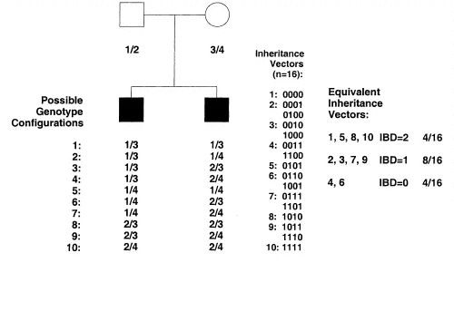
Two affected siblings
Nyholt (2000)
Notes:
Nuclear family with two affected siblings.. The genotypes are denoted as “1,” “2,” “3,” and “4,” and are written in paternal/maternal order. These genotype configurations may also be represented as vectors, where 0 or 1 represents transmission of the paternal or maternal allele, respectively. Representation of inheritance patterns as vectors facilitates their interpretation by computer programs. For example, in panel A, (0,0,0,0) indicates that both siblings have inherited the (grand)paternal allele from both parents, whereas (1,1,1,1) indicates that both siblings have inherited the (grand)maternal allele from both
parents. Also, (0,0,0,1) and (0,1,0,0) both indicate that one sibling has inherited one (grand)paternal allele from the father and one (grand)maternal
allele from the mother, whereas the other sibling has inherited the (grand)paternal alleles from both parents. Inheritance-vector probabilities
may be calculated by enumerating over all possibilities and may subsequently be used in tests examining allele sharing between any set of affected relatives.

Slide 14
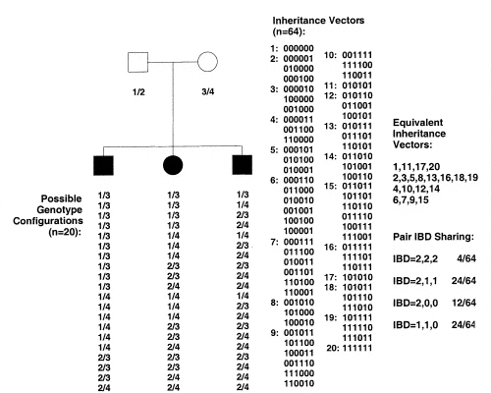
Three affected siblings
Nyholt (2000)
Notes:
Nuclear family with three affected siblings.

Slide 15
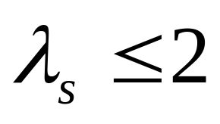
Power
Relative risk
TDT and ASP (Risch & Merikangas 1996)
Power comparison of linkage statistics (Sham et al. 2000)

Slide 16
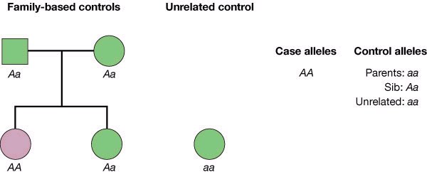
Association
Risch (2000) Nature 405:847-56
Notes:
Candidate-gene association analysis using parents (TDT), sib (STDT, SDT, etc) and unrelated controls

Slide 17
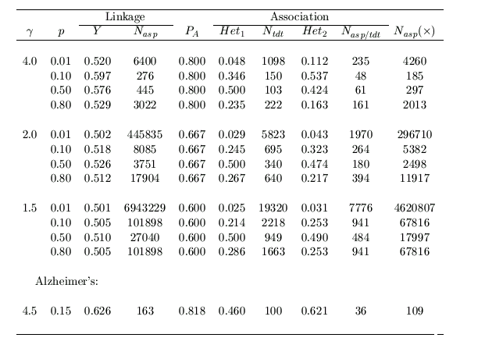
Power Comparisons
Notes:
This table is based on Risch & Merikangas (1996), but some figures were corrected x.

Slide 18
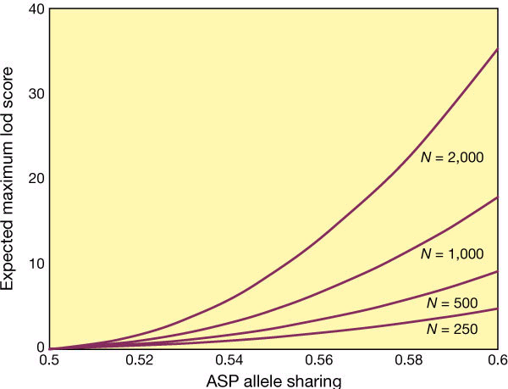
ASPs Required to Detect Linkage
Risch (2000)

Slide 19
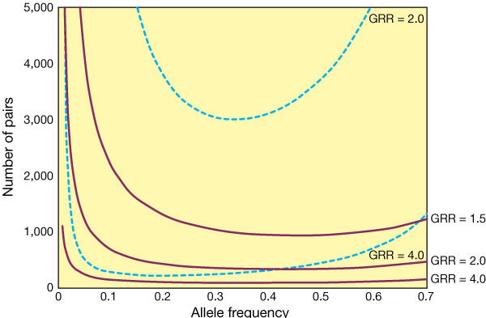
Linkage vs Association
Linkage (dashed)
Association (solide)
Risch (2000)
Notes:
Linkage is based on ASPs with a completely linked and informative marker. Association is based on case-conrtol pairs testing the causative locus. Results are obtained via multiplicative models with different genotypic relative risks (GRRs).

Slide 20
Software
ASPEX (ASP, TDT)
SPLINK (PTT)
GENEHUNTER and associates (General relative pairs)
Others: ESPA, APM, ANALYZE, SAGE

Slide 21
Bibliography
Bibliography
Available from
  Rockefeller (HTML, by subjects and year)
  IoP EndNote (>1,500, statistical genetics)
Chapter 4 of Guide to Human Genome Computing, Second edition
PubMed

Slide 22
Applications
Alzheimer’s
IDDM
Anorexia Nervosa
  Kaye et al. (2000) BP 47:794-803
  Grice et al. (2001) AJHG (to appear)
Notes:
Kaye et al. (2000) used GENEHUNTER/AFBAC
Grice et al. (2001) reported results for Chromosome 1

