Slide 1
Discordant Sibling Design and Gene-Environment Interaction
Jing Hua Zhao, Pak Sham
Institute of Psychiatry London
Notes:
Thanks for Drs & Collier for inviting me for this talk. I would like to take this opportunity to bring interesting discussions on these important questions.

Slide 2
Outline
A summary of statistical developments, Software, and examples
Some perspectives on GxE interactions

Slide 3
Motivation
  Although the pace of molecular technology is yielding undreamed of advances in efficiency of typing individuals for large number of markers, it is unlikely that the goal of typing unselected samples of individuals of the order of the several thousands pairs of relatives necessary to detect by linkage QTLs with effects of modest size is desirable or attainable in the near-future
  Eaves & Meyer (1994)
Notes:
The motivation of using selected samples is best described by Eaves and Meyer back in 1994, as is true today.
Blackwelder & Elston (1982) showed that the proportion of the total variance (heritability) in a trait attributable to a contributing locus would need to be large (~50%) to detect linkage in a reasonably-sized sample by sib pair analysis when the sibs are sampled at random. 2953 pairs would be needed to detect linkage with 90% power for a locus that is responsible for 30% of the variation.

Slide 4
EDSP Bibliography
Carey & Williamson (1991) AJHG 49:786-96
Eaves & Meyer (1994) BG 24:443-55
Risch & Zhang (1995) Science 268:1584-9
Gu et al. (1996) GE 13: 513-33
Karwautz et al. (2001) PM 31:317-29
Purcell et al. (2001) HH 52:1-13
Notes:
Carey & Williamson (1991) showed that sample sizes could be reduced dramatically to achieve the same power by ascertaining sib pairs through a proband as opposed to random pairs.
Eaves & Meyer (1994) conducted extensive computer simulations to examine various selection.

Slide 5
Genetic Model
Genotypic values
aa Aa AA
-a d a
Dominant, additive, and recessive models
The phenotype distribution of one individual is a mixture of three normal distributions
Notes:
Quantitative traits are whose phenotypes are measured in continuous scale.
Any gene that influences a quantitative trait is called a quantitative trait locus (QTL).
Without loss of generality we assume QTL is biallelic.
d=a, dominant
d=0, additive
d=-a, recessive
The most important parameters are the mean and the standard deviation of the underlying normal distribution.

Slide 6
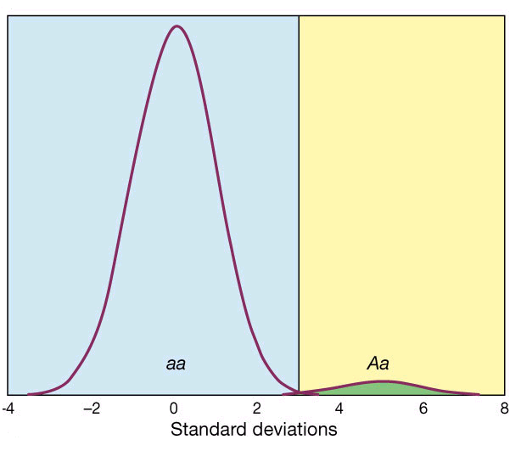
Mendelian (dominant)
Risch (2000)
Notes:
Dominant Mendelian locus with allele frequency p=0.00275 and displacement t=5sd. Disease occurs above the threshold of 3sd. Disease risk for heterozygotes (Aa) is 98% and for hmozygotes (aa) it is 0.13%. The population prevalence K=0.67%.

Slide 7
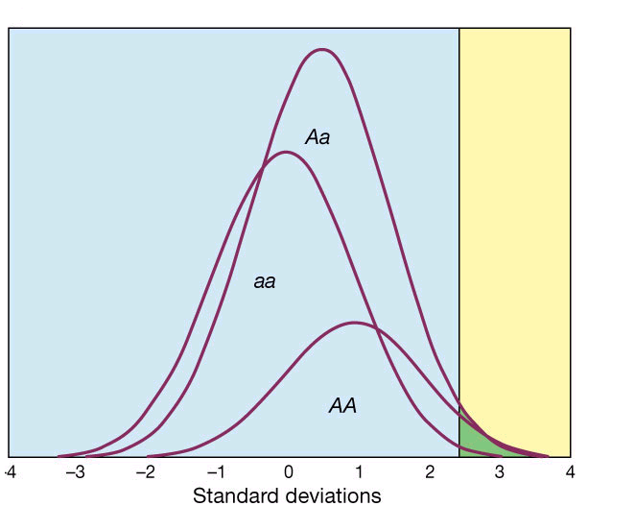
Non-Mendelian (additive)
Risch (2000)
Notes:
Non-Mendelian additive locus with allele frequency p=0.40 and displacement t=0.5sd for each A allele (or total displace t=1). Disease occurs above the threshold of 2.5sd. Disease risk for high-risk homozygotes (AA) is 6.7%, for heterozyotes (Aa) it is 2.3% and for low-risk homozygotes (aa) it is 0.62%. The population disease prevalence K=2.4%

Slide 8
Family Case-control Design
Conditional Logistic Regression
  Suitable for matched design
  Able to account for risk factors and GxE
  Give interpretable results
Liang & Beaty (2001) SMMR 9:543-562
Notes:
GEE for unmatched design
“Specifically, with the consent of cases and controls, their relatives are recruited and interviewed directly for detailed evaluations on their disease status, laboratory assessments and demographic and risk factor information relevant to the disease. For this design, the phrase ‘case (control) proband’ has been coined for cases (controls) as they represent individuals through which the family is ascertained. Just as in Section 2, the data can be summarised in a 2 x 2 table”

Slide 9
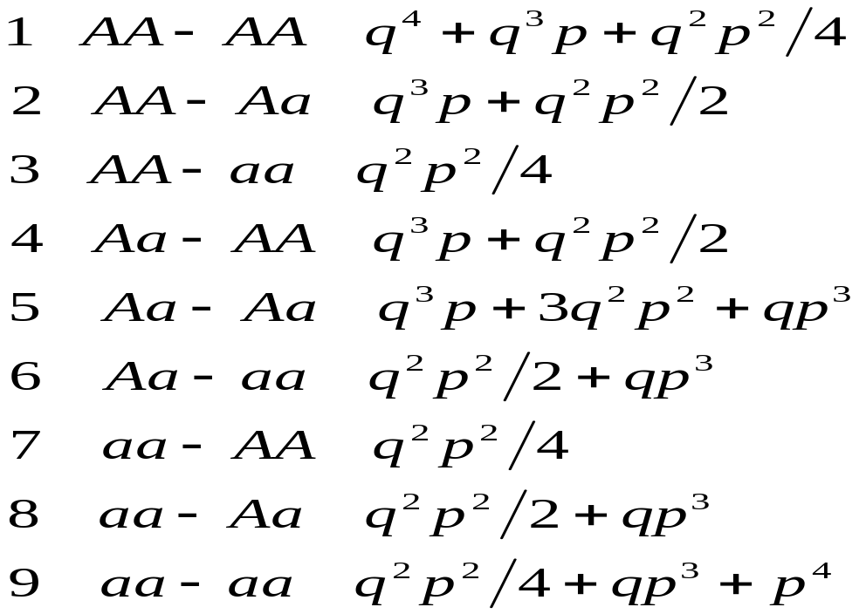
Frequencies of Traits of Siblings
Sib1-sib2 (Karwautz et al. 2001)
Notes:
The major message is that types 1, 5, 9 are not the genetic basis of discordant sib pairs.
See also Dudoit & Speed (2000) Biostatistics 1: 1-26

Slide 10
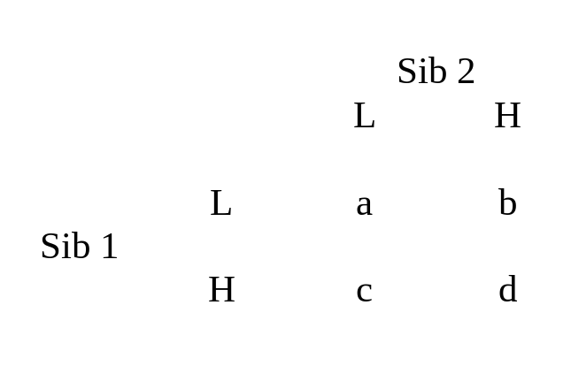
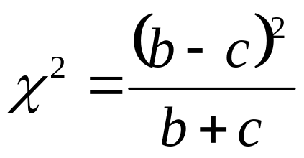
The McNemar’s test
Note 1,5,9 are noninformative, 2, 3, 6 are H-L, 4, 7, 8 are L-H. Let b=p₄+p₇+p₈, c=p₂+p₃+p₆

Slide 11
Power and Sample Size
Set a, heritability, QTL heritability and percentiles (e.g. 10%, 25%)
Sample sizes obtain from NCP
  For α=0.01, 14.9/χ²
  For α=0.001, 20.9/χ²
SAS program (Newton-Raphson)

Slide 12
Variance Components
Purcell et al. (2001)
Additive (V_{D})
Dominance (V_{A})
Shared environment (V_{S})
Nonshared environment (V_{N})

Slide 13
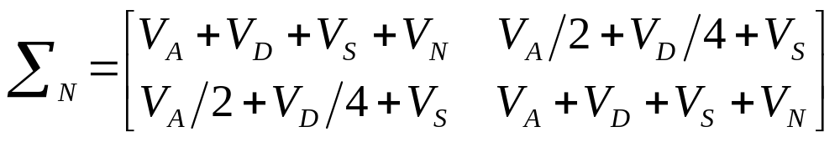
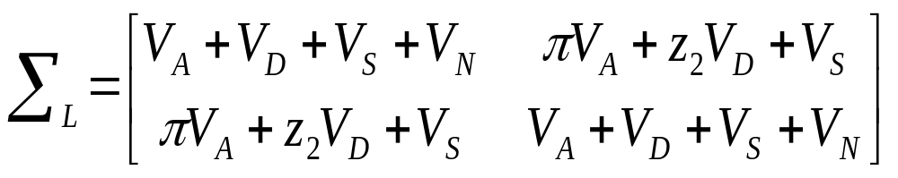
NCP for linkage
Under no linkage
Under linkage (π=z₁/2+z₂)

Slide 14
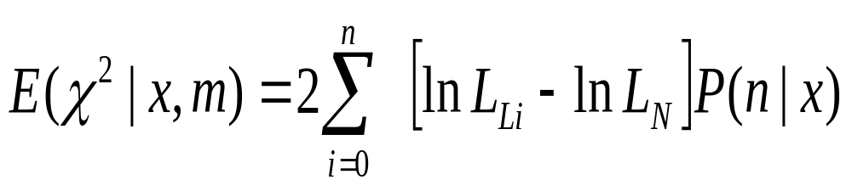
E(χ²)
Consider all possible configurations (n) under different parental mating types and disease model (m)
Notes:
Note the likelihood function is defined as in standard variance components model for linkage analysis, but with an adjustment that we recently developed for analysis of selected samples. This adjustment is based on conditioning on the observed trait values of the sibship.
Fulker et al. (1999) AJHG 64:259-67
Sham et al. (2000) GE19(Suppl l):S22-528

Slide 15
When EDSP design fails
Assume oligogenic models
  some QTLs have asymmetric allele frequencies with large displacements, others the opposite
Then
  more extreme sampling could reduce power
Allison et al. (1998) HH 48: 97-107

Slide 16
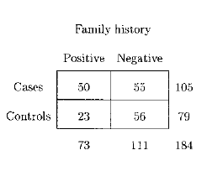
COPD Example
Chronic obstructive pulmonary disease
Liang & Beaty (2001)
Notes:
In the absence of knowledge regarding specific susceptibility genes, one may use either FH or FHS variable as a surrogate measure of ‘genetic loading’ or one can use markers in candidate genes. To test the hypothesis of interaction between environmental factors and genetic factors, such as family history (FH
or FHS), one can consider the logistic regression model with interaction term, commonly adopted in case-control studies

Slide 17
GENESiS
Community-based QTL study
600 optimally informative sibships from a sample of approximately 10,000 phenotypically screened sibships
SEL program, available from SGDP site
Notes:
GENESiS stands for Genetic Environment Study of Emotional States in Siblings

Slide 18
Genome Scan for Blood Pressure
Xu et al. (1999) AJHG 64:1694-1701
  367 markers
  207 discordant, 258 high concordant, 99 low concordant, defined to be top/bottom age-adjusted population deciles
  ASPEX, MapMaker/Sibs
  D2S2387, D11S2019, D15S657, D16S3396, D17S1303 (MLOD>2.0)

Slide 19
Gene-environment Interaction
Yang & Khoury (1997) GR 19:33-43
Garcia-Closas & Lubin (1999) AJE 149:689-92
Gauderman & Faucett (1997) AJHG 61:1189-99
Gauderman & Siegmund (2001) HH 52:34-46
Notes:
Gauderman & Faucett (1997) considered GEI in joint segregation and linkage analysis
Gauderman & Siegmund (2001) derived expressions in linkage analysis in terms of GEI parameters

Slide 20

Software for Power Analysis
EPITOME/POWER (Garcia-Closas & Lubin 1999)
Quanto (Morrison & Gauderman 2000)

Slide 21
Example (quanto)
G x E interaction by case-sibling design
Dominant gene with allele frequency : 0.0200
Exposure prevalence: 0.40, Sibling exposure OR: 2.0
Disease-model parameters Summary parameters
------------------------ ------------------
*P0: 0.008332 kp: 0.010000
R0: 1.2706 *RGBar: 3.0000
R1: 1.3125 *REBar: 1.5000
RGE: 4.0000
* indicates calculated value
Required number of match sets
(80% Power 5% significance level, 2-sided)
Gene: 499, Environment: 518, Interaction: 587

Slide 22
Software for Data Analysis
Logistic regression
SOLAR
FBAT
QTDT

