Slide 1

INTEGRATED ANALYSIS OF GENETIC DATA
Jing Hua Zhao
MRC Epidemiology Unit
Strangeways Research Laboratory
Worts Causeway
Cambridge CB1 8RN
Comments sent to jinghua.zhao@mrc-epid.cam.ac.uk
Odense 1/2/2006

Slide 2
What do I mean by “integrated”?
In-house facility for traditional analysis
An environment of statistical analysis that provides facility for database accessibility, graphics, mathematical/statistical routines, flexible programming language, ability to incoporate available sources, Internet connectivity
So
Analysis can be done in a unified fashion

Slide 3
Outline
A brief overview of current practice and motivation
An examination of emerging alternatives
  SAS, Stata, S-PLUS/R
  Summarised in two reviews, a paper and an application note
    Hum Genomics (R)
    Curr Bioinformatics (SAS, Stata, S-PLUS/R)
    BMC Genetics (R/kinship, age of onset analysis)
    Bioinformatics (R/kinship/gap, pedigree drawing)
  Examples on database, graphics and analysis
  Haplotype analysis as an example -- DiOGenes

Slide 4
Current practice and the motivation
My own account
A general gap between theory and practice, lack of cohesion (e.g. HGMP, LITBIO)
The current perspectives, linkage/association: LIPED, LINKAGE (FASTLINK, MFLINK), MENDEL, SAGE, PAP, GENEHUNGER (MAPMAKER/SIBS, MAPMAKER/HOMOZ, GENEHUNTER PLUS/IMPRINTING/TWOLOCUS), ALLEGRO, MERLIN, MORGAN, VITESSE, SIMWALK, SOLAR

Slide 5
More to the list …
Specific programs APM, SPLINK, ASPEX, MIM, GAS, HOMOG, HAPLO
Further analysis: SIMLINK, SLINK, SIMULATE
Derivatives, DOLINK/QDB, GLUE, QUICKLINK, easyLINKAGE
Pedigree drawing: PEDDRAW, CYRILLIC, PROGENY, psdraw, PedSys, Pedraw

Slide 6
and the list for association…
46 programs for unrelated individuals alone (Salem et al. 2005, Hum Genomics)
Family studies: AFBAC, ETDT, GASSOC, PDT, TRANSMIT, UNPHASED, QTDT, FBAT
Confusions, e.g. HAPLO, therefore Mega2
A call for a flexible environment (e.g. Guo and Lange 2000)

Slide 7
Why R
It is a general computing environment for both practitioners and programmers. Standard statistical and genetic analyses can be conducted in a reliable and unified fashion. It makes efficient statistical modelling possible.
A large number of packages maintained by a large and dedicated team

Slide 8
The use of R in genetic data analysis
A short history
sma,genetics,haplo.score,qtl,etc.
The BioConductor project (http://www.bioconductor.org)
Ported and developed packages
R/gap, tdthap and kinship (lmm, pan)
More information is available from CRAN (http://cran.r-project.org)

Slide 9
A simple session
> a1 <- c(1,1,2,3,3,2,3,1,1,2)
> a2 <- c(1,2,3,3,2,2,1,3,2,1)
> a <- c(a1,a2)
> count.a <- table(a)
> count.a
a
1 2 3
7 7 6
> freq.a <- count.a / 2 / 10
> freq.a
a
1 2 3
0.35 0.35 0.30
> b1 <- rep(0,10)
> b2 <- rep(0,10)
> for (i in 1:10) b1[i] <- min(a1[i],a2[i])
> for (i in 1:10) b2[i] <- max(a1[i],a2[i])
> g <- b1 + b2 * (b2-1) / 2
> table(g)
g
1 2 3 4 5 6
1 3 1 2 2 1
> freq.g <- table (g) / 10
> freq.g
g
1 2 3 4 5 6
0.1 0.3 0.1 0.2 0.2 0.1
> q()

Slide 10
Hardy-Weinberg equilibrium
> library(gap)
> data(nep499)
> attach(nep99)
> snps <- nep499[,-(1:7)]
> controls <- snps[status==0,]
> for(i in 1:8) hwe(controls[,(2*i-1):(2*i)]
x2= 0.549 df= 1 p= 0.4588277
x2= 0.191 df= 1 p= 0.6621736
x2= 0.017 df= 1 p= 0.8968542
x2= 0.659 df= 1 p= 0.4170008
x2= 0.983 df= 1 p= 0.3214397
x2= 0.659 df= 1 p= 0.4170008
x2= 0.907 df= 1 p= 0.3410179
x2= 0.051 df= 1 p= 0.8217595

Slide 11
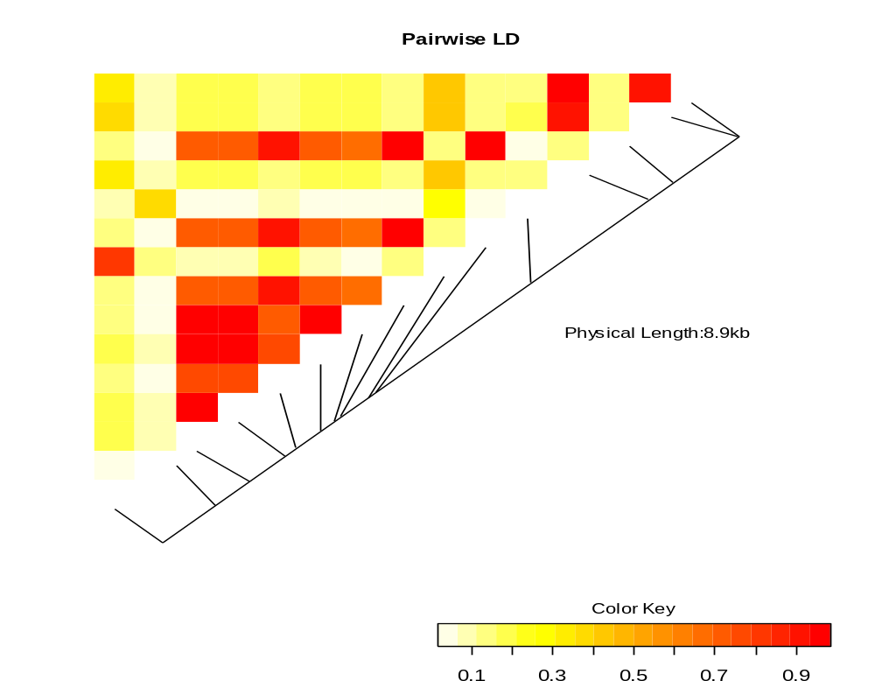
The LD heatmap

Slide 12
The log-linear model
> library(hwde)
> data(IndianIrish)
> attach(IndianIrish)
> ii <- hwde(IndianIrish)
[1] "Analysis of Deviance Table"
Resid. Df Resid. Dev Df Deviance
1 17 1724.07
2 16 1090.41 1 633.66
3 14 486.72 2 603.69
4 12 480.31 2 6.41
5 11 463.76 1 16.55
6 10 218.42 1 245.34
7 8 217.15 2 1.28
8 6 37.94 2 179.21
9 4 35.46 2 2.48
10 3 26.29 1 9.16
11 2 5.94 1 20.36
12 0 -4.885e-14 2 5.94

Slide 13
Kinship coefficients
> library(kinship)
> attach(ped)
> round(8*(kinship(id,momid,dadid)))
1 2 3 4 5 6 7 8 9 10 11 12 13 14 15 16
1 4 2 2 2 2 2 2 0 1 0 1 1 0 0 0 0
2 2 4 0 2 2 2 2 0 1 0 2 2 0 1 0 1
3 2 0 4 2 2 2 2 0 1 0 0 0 0 0 0 0
4 2 2 2 4 2 2 2 0 2 0 1 1 0 0 0 0
5 2 2 2 2 4 2 2 0 1 0 1 1 0 0 0 0
6 2 2 2 2 2 4 2 0 1 0 1 1 0 0 0 0
7 2 2 2 2 2 2 4 0 1 0 1 1 0 0 0 0
8 0 0 0 0 0 0 0 4 2 0 0 0 0 0 0 0
9 1 1 1 2 1 1 1 2 4 0 0 0 0 0 0 0
10 0 0 0 0 0 0 0 0 0 4 2 2 0 1 0 1
11 1 2 0 1 1 1 1 0 0 2 4 2 0 2 0 1
12 1 2 0 1 1 1 1 0 0 2 2 4 0 1 0 2
13 0 0 0 0 0 0 0 0 0 0 0 0 4 2 0 0
14 0 1 0 0 0 0 0 0 0 1 2 1 2 4 0 0
15 0 0 0 0 0 0 0 0 0 0 0 0 0 0 4 2
16 0 1 0 0 0 0 0 0 0 1 1 2 0 0 2 4

Slide 14
Pedigree drawing
We can use the following R statements
> pre <- read.table("10081.pre",header=T)
> library(kinship)
> attach(pre)
> ped <- pedigree(id,father,mother,sex,affected)
> par(xpd=T)
> plot(ped)

Slide 15
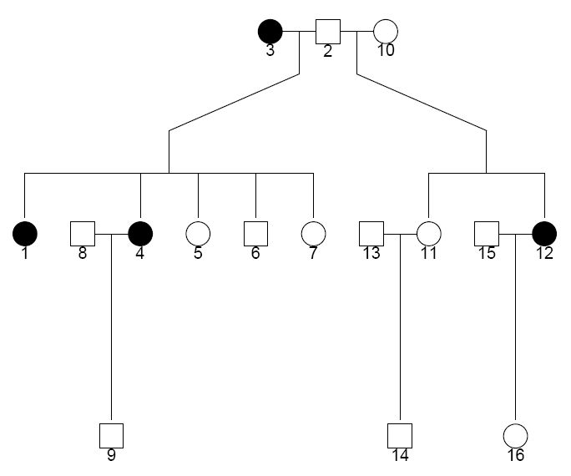
Diagram by kinship

Slide 16
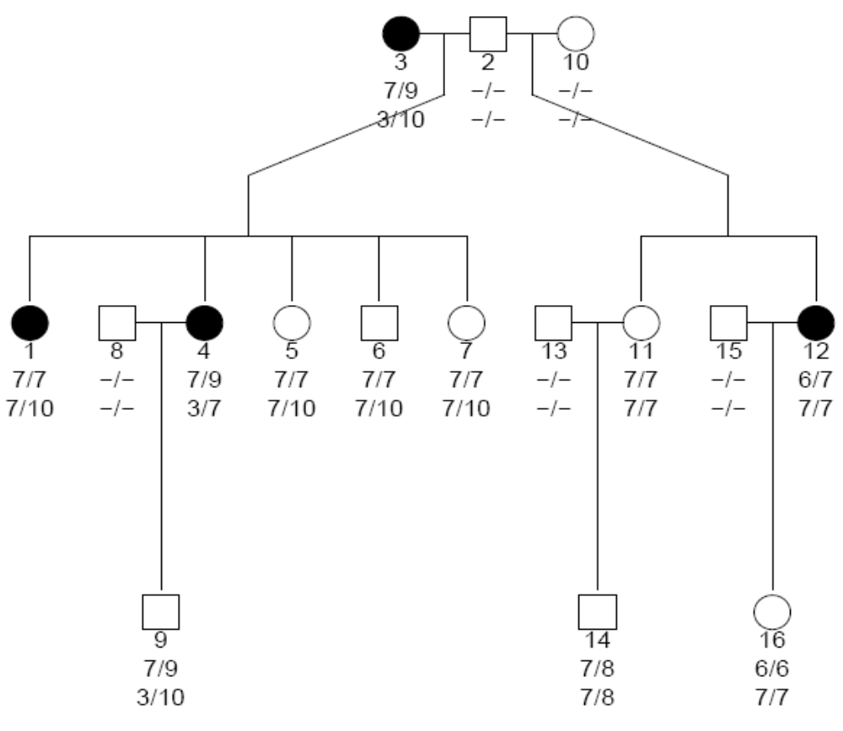
Diagram with marker information

Slide 17
Diagram by R/gap
> library(gap)
> pedtodot(pre)
> dir()
Then under Unix (Linux, Cygwin)
% dot –Tps 10081.dot –o 10081.ps
% ps2pdf 10081.ps

Slide 18
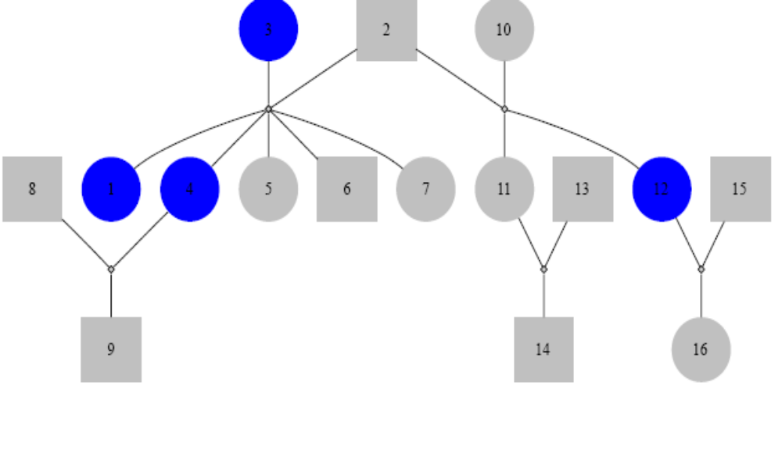
Diagram 1

Slide 19
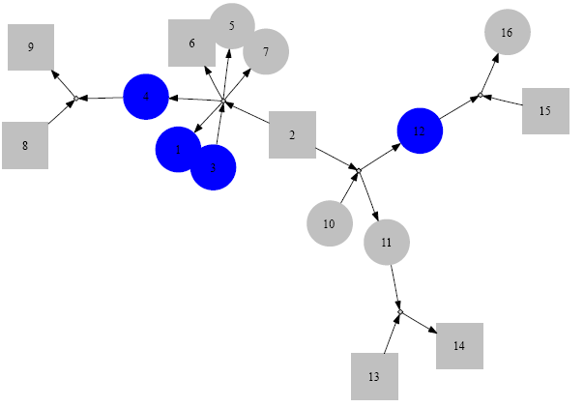
Diagram 2

Slide 20
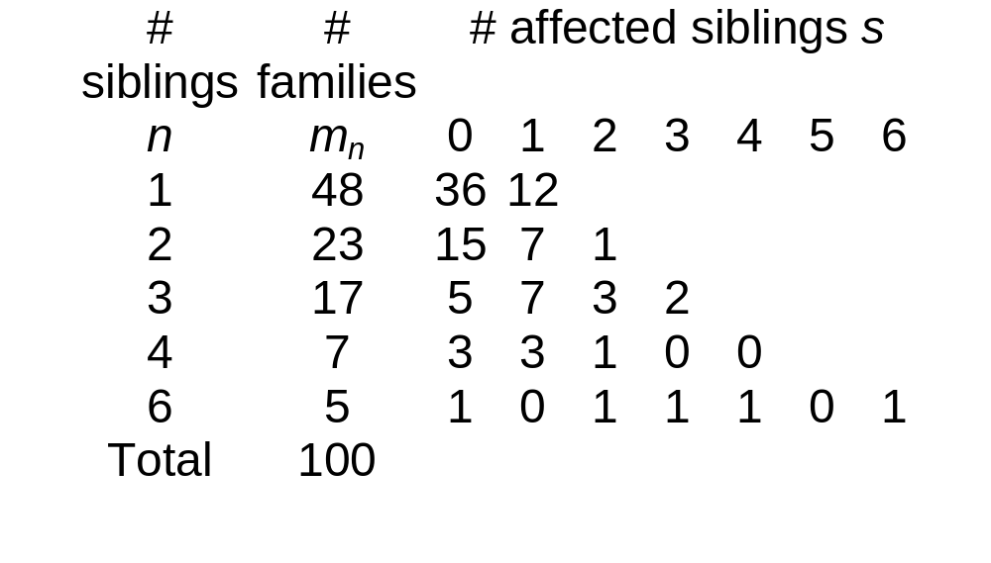
IPF cases in 100 families

Slide 21
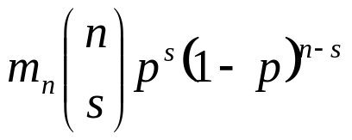
Aggregation of IPF cases
A bin(n,p) for the counts in the nth row can be fitted with expected frequencies
We estimate p with 60/203=0.296 leading to Pearson chi-square 312 (15df) indicating poor fit, but we can use pfc and pfc.sim to get the exact p-value 0.00883 for the table.

Slide 22
The age of onset analysis
library(kinship)
gaw14pheno <- read.table("pheno.dat",
col.names=c("fid","id","father","mother","sex",...))
attach(gaw14pheno)
gaw14check <- familycheck(fid,id,father,mother)
gaw14fam <- makefamid(id, father, mother)
gaw14kin <- makekinship(gaw14fam, id, father, mother)
temp <-matrix(scan("pedindex.out"), ncol=8, byrow=T)
pedindex <- temp[,c(1,8)]
temp <- read.table("gaw14ibd/ibd.ADH3", row.names=NULL,
col.names=c("id1", "id2", "phi2", "delta7", "dummy"))
ibd.ADH3 <- bdsmatrix.ibd(temp$id1, temp$id2, temp$phi2, pedindex)
kfit <- coxme(Surv(ageon1,alc1) ~1, gaw14pheno, random=~1|id,
varlist=list(gaw14kin, ibd.ADH3))

Slide 23
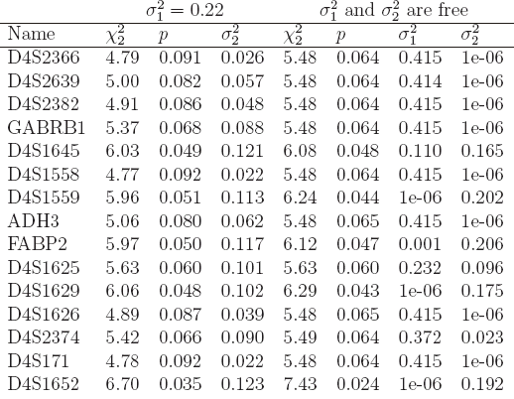
The results on chromosome 4

Slide 24
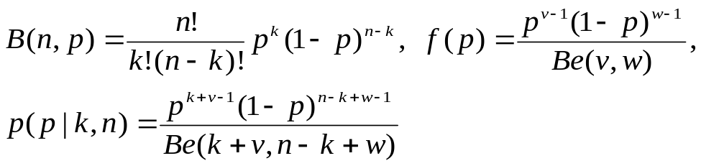
Bayesian methods
# bs-model.txt:
model {
# likelihood
k ~ dbin(p, n)
# prior
p ~ dbeta(nu, omega)
}

Slide 25
R2WinBUGS
> library(R2WinBUGS)
> s <- list(k = 201, n = 372, nu = 1, omega = 1)
> parms <- "p“
> inits <- function() list(p=0.5)
> s.bugs <- bugs(s,inits,parms,"bs-model.txt", n.chains=1, n.burnin=1000, n.iter=11000)
> s.bugs
mean sd 2.5% 25% 50% 75% 97.5%
p 0.5 0.0 0.5 0.5 0.5 0.6 0.6
deviance 7.3 1.4 6.4 6.5 6.8 7.7 11.0
pD = 0.9 and DIC = 8.3
> plot(s.bugs)

Slide 26
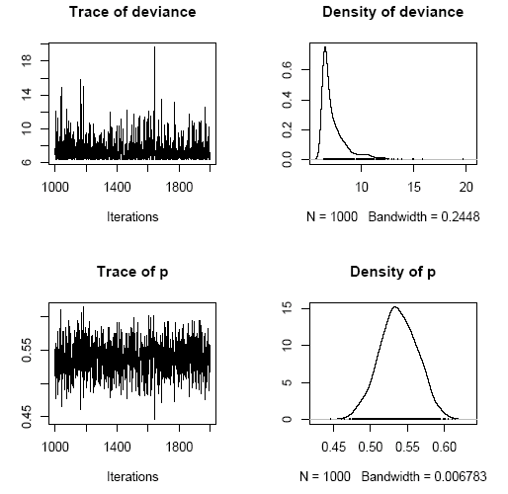
MCMC plot for bionomial sampling

Slide 27
Haplotype-traits association
Introduction
Resolving phase ambiguity
Haplotype-traits association
Related issues
Available software
Examples
Summary

Slide 28
Introduction
The rationale
Advantage: use of full information and increase power
  Akey et al. (2001) Eur J Hum Genet
  Klein et al. (2005) Science
  Grant et al. (2006) Nat Genet
Challenge: number of observed haplotypes << large number of parameters plus rare haplotypes are in the dustbin category

Slide 29
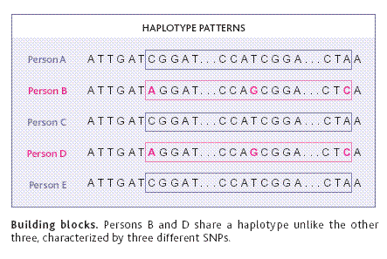
Haplotype-trait association
Couzin (2002) Science

Slide 30
Algorithms for haplotype inference
Some are now well-recognised
Excoffier & Slatkin (1995) Mol Biol Evol
Zhao et al. (2002), Zhao (2004) Bioinformatics
Stephens et al. (2001), Niu et al. (2002) Am J Hum Genet

Slide 31
Statistical methods
Zhao et al. (2000) Hum Hered
Zaykin et al. (2002) Hum Hered
Schaid et al. (2002), Lake et al. (2003) Hum Hered
Zhao et al. (2003) Am J Hum Genet
Epstein & Satten (2003) Am J Hum Genet
Tzeng et al. (2006) Am J Hum Genet

Slide 32
Analytical procedures and issues
Steps of analysis
  SNP-wise descriptive analysis (HWE, allele-wise, genotype-wise, disease models), staged analysis
  LD analysis
  haplotype, haplotype clustering-traits
Related issues
  Power and Statistical significance
  G x E interactions
  Alternatives

Slide 33
Power comparisons
Prospective (Schaid et al. 2002) versus retrospective likelihood (Epstein & Satten 2003; Tan et al. 2005; Tan et al. in press)
Simulation
  Satten & Epstein (2004) Genet Epidemiol:
    Comparable performance for multiplicative model
    Retrospective likelihood more powerful for dominant/recessive models
Empirical studies
  de Bakker et al. (2005) Nat Genet
  van Steen et al. (2005) Nat Genet

Slide 34
Statistical significance
Potentially there is a large number of degrees of freedom
Monte Carlo/permutation tests often necessary
Adjustment for p-value

Slide 35
G x E interactions
The null hypothesis of no association
  Zaykin et al. (2002), Schaid et al. (2002)
The alternative hypothesis
  Lake et al. (2003)
Confusion
  Dong et al. (2004) Hypertension

Slide 36
Alternative methods
Hotelling’s T methods
  Fan & Knapp (2003) Am J Hum Genet
  Wallace et al. (2006) Am J Hum Genet
  Lin (2006) Am J Hum Genet

Slide 37
Available software
Standalone programs
  ehplus, hplus, chaplin, haploview, snphap
  Salem (2005) Hum Genomics
SAS
Stata
  sampling weight
S-PLUS/R
  gap, hapassoc, haplo.score, haplo.stats
  haplotype clustering of Tzeng et al. (2006)

Slide 38
Now …
Connection to database and haplotype analysis

Slide 39
SAS/GENETICS
Mainly designed for association tests
Available as PROCs named ALLELE, CASE-CONTROL, HAPLOTYPE, HTSNP, FAMILY, PSMOOTH, MULTTEST, INBREED
Easy access to database, graphics and other procedures if covariates are involved, e.g. haplotype trend regression but less powerful (e.g. X-chromosome data)

Slide 40
A SAS/ACCESS example
%let dbname = c:\hapmap\db1.mdb ;
%let uid = xxxx;
%let pwd = *****;
%let wgdb = c:\hapmap\db1.mdw;
proc import out = objects
datatable = "Genotypes_chr11_CEU"
dbms = access97 replace;
database = "&dbname";
userid = "&uid";
password = "&pwd";
workgpdb = "&wgdb";
run;

Slide 41
PROC HAPLOTYPE
proc haplotype data=ccc out=outhap;
var m1-m12;
run;
proc print data=outhap;
title ‘Marker-marker analysis with haplotype assignments’;
run;
proc haplotype data=ccc noprint;
var m1-m12;
trait cc / testall perms=1000;
run;
proc print data=outhap noobs round;
title’Tests for haplotype-trait association’;
run;

Slide 42
Haplotype-trait association
Tests for Haplotype-Trait Association
Trait Trait Num Chi- Pr > Prob
Number Value Obs DF LogLike Square ChiSq Exact
1 1 871 49 -1779
2 0 1257 49 -2479
Combined 2128 49 -4269 20.2716 0.9999 0.3740
Tests for Haplotype-Trait Association
----------Frequencies---------
Chi- Pr > Prob
Number Haplotype Trait1 Trait2 Combined Square ChiSq Exact
1 1-1-1-1-1-1 0.58563 0.62571 0.60931 6.9463 0.0084 0.0080
2 1-1-1-1-1-2 0.00000 0.00000 0.00000 0 1.0000 1.0000
……
The results are an omnibus heterogeneity test, followed by simple proportion tests for individual haplotypes

Slide 43
STATA
Share many generic features of SAS
Gaining popularity among epidemiologists and econometricians
Able to use probability weight
Easy to install and comprehensive on-line documentation
  CIMR site
  Biostatistics Resources

Slide 44
Stata ODBC
. odbc list
. odbc query "MySQL database“
. odbc desc "Genotypes_chr4_HCB", dialog(complete)
. set mem 50M
. odbc load, exec("select * from Genotypes_chr4_HCB")

Slide 45
Stata with sampling weight
% Under MS-DOS or Unix/Linux prompt
% snphap -nf ccc.nam
% snphap -th 0.001 -ss -q ccc.txt snphap.out assign.out
insheet using assign.out
sort id
save assign, replace
use ccc,clear
keep id cc
rename id oldid
gen id=_n
sort id
save id, replace
merge id using assign
logit cc locus* [pw=probability]

Slide 46
S-PLUS/R
S-PLUS
  Known for its OOP and powerful graphics
  Limited number of packages including haplo.score, haplo.stats, kinship
R
  An emerging platform compatible with S-PLUS
  A variety of packages, now over 500
  Under GNU public license

Slide 47
RODBC
library(RODBC)
# to call ODBC
library(RODBC)
c2 <- odbcConnectAccess(“db1.mdb”)
# select the table
tblOutput <- sqlQuery(c2,paste(“select * from Genotypes_chr11_CEU”))
# the property of tblOutput
class(tblOutput)

Slide 48
The R/gap package
# to the default home directory under Windows
> install.packages("gap")
> library()
# to directory R under Unix/Linux
> install.packages("gap","R")
> library(lib.loc="R")
# Both Windows and Unix/Linux
> library(gap)
> library(help=gap)
> ? hwe
> help.start()
> demo(gap)

Slide 49
R/gap functions
Primary a template for extension to illustrate
  Possibility to include a range of functions
  Ability to use both SNPs and microsatellite markers
A range of statistics for association analysis
  HWE
  LD statistics
  Haplotype analysis, including Chromosome X data
Some functions for family data
  Pedigree plotting

Slide 50
Haplotype frequency estimation
> library(gap)
> hla.gc<- genecounting(hla[,3:8])
> names(hla[,3:8])
[1] "DQR.a1" "DQR.a2" "DQA.a1" "DQA.a2" "DQB.a1" "DQB.a2"
> hla.gc<- genecounting(hla[,3:8])
> summary(genecounting(hla[,3:8]))
Length Class Mode
h 3750 -none- numeric
h0 3750 -none- numeric
prob 271 -none- numeric
l0 1 -none- numeric
l1 1 -none- numeric
hapid 1 -none- numeric
npusr 2 -none- numeric
npdat 2 -none- numeric
htrtable 1 -none- numeric
iter 1 -none- numeric
converge 1 -none- numeric
di0 1 -none- numeric
di1 1 -none- numeric
resid 271 -none- numeric
> 2*(hla.gc$l1-hla.gc$l0)
[1] 3172.276

Slide 51
Pairwise LD statistics
> LDtable <- matrix(rep(0,8*8),nrow=8)
> for (i in 1:8) {
+ for (j in 1:i) {
+ gc <- genecounting(controls[,c(2*i-1,2*i,2*j-1,2*j)])
+ ij <- tbyt(gc$h,2*242)
+ LDtable[i,j] <- ij$Dprime
+ LDtable[j,i] <- 1-pchisq(ij$x2,1)
+ }
+ }
> round(LDtable,4)
[,1] [,2] [,3] [,4] [,5] [,6] [,7] [,8]
[1,] 0.0000 0.0000 0.1047 0.0000 0.0006 0.0000 0.0000 0.0000
[2,] 0.3173 0.0000 0.4456 0.0000 0.0000 0.0038 0.0000 0.0644
[3,] 0.1763 0.1109 0.0000 0.0000 0.6121 0.0000 0.0000 0.4941
[4,] 0.2530 0.3715 0.7243 0.0000 0.0000 0.0000 0.0000 0.0391
[5,] 0.1817 0.2786 -1.0000 0.2536 0.0000 0.0348 0.0000 0.5756
[6,] 0.4578 0.1682 0.7243 0.4590 0.1061 0.0000 0.0000 0.0000
[7,] 0.5722 0.4235 0.4572 0.4566 0.2773 0.7858 0.0000 0.0003
[8,] 0.7129 0.2062 0.2437 0.2940 0.0722 0.9036 0.5621 0.0000

Slide 52
Haplotype-specific tests
> locus.label <- c("R6", "N4", "N6", "N11", "N15", "N18","N22","N24")
> gcp(status,1,snps, locus.label=locus.label, n.sim=1000)
LRT = 115.7548 p = 1 sim p = 0
z-test of individual haplotypes
hap.id z sim p R6 N4 N6 N11 N15 N18 N22 N24
1 1 0.785 0.306 1 1 1 1 1 1 1 1
2 2 -1.557 0.058 1 1 1 1 1 1 1 2
3 3 0.910 0.306 1 1 1 1 1 1 2 1
4 4 1.747 0.037 1 1 1 1 1 1 2 2
5 5 1.601 0.067 1 1 1 1 1 2 1 1
6 6 -0.323 0.762 1 1 1 1 1 2 1 2
7 7 0.000 0.610 1 1 1 1 1 2 2 1
8 8 2.691 0.000 1 1 1 1 1 2 2 2
9 9 -1.259 0.149 1 1 1 1 2 1 1 1
10 10 -0.665 0.607 1 1 1 1 2 1 1 2
11 11 0.000 0.131 1 1 1 1 2 1 2 1
12 12 0.000 0.335 1 1 1 1 2 1 2 2
13 13 0.000 0.489 1 1 1 1 2 2 1 1
14 14 0.963 0.274 1 1 1 1 2 2 1 2
15 15 0.000 0.118 1 1 1 1 2 2 2 1
...
> hap.score(status, snps, method="hap", locus.label=locus.label, n.sim=1000)
Global Score Statistics
global-stat = 40.06154, df = 14, p-val = 0.00025, sim. p-val = 0,
max-stat sim. p-val = 0.002
Haplotype-specific Scores
R6 N4 N6 N11 N15 N18 N22 N24 Hap-Freq Hap-Score p-val sim p-val
[1,] 1 1 1 1 1 1 1 2 0.21913 -2.1282 0.03332 0.03
[2,] 1 1 1 1 2 1 1 1 0.0126 -1.75864 0.07864 0.108
[3,] 1 2 1 1 1 1 1 2 0.00568 -1.45885 0.14461 0.244
[4,] 1 2 1 1 2 1 1 2 0.00528 -0.89652 0.36997 0.44
[5,] 1 2 1 1 1 1 1 1 0.02153 -0.84432 0.39849 0.425
[6,] 1 1 1 1 1 2 1 2 0.00844 -0.11809 0.906 0.904
[7,] 2 1 1 1 1 1 1 1 0.00711 0.3817 0.70268 1
[8,] 1 1 1 2 1 1 1 1 0.00736 0.94315 0.3456 0.591
[9,] 1 1 1 1 1 1 2 1 0.0059 0.94315 0.3456 0.633
[10,] 1 1 1 1 1 1 1 1 0.59627 1.32973 0.18361 0.192
[11,] 1 2 1 2 1 1 1 1 0.00962 1.73777 0.08225 0.089
[12,] 1 1 1 1 1 2 1 1 0.00654 2.1786 0.02936 0.061
[13,] 1 1 1 1 1 1 2 2 0.00567 2.53976 0.01109 0.016
[14,] 1 1 1 1 1 2 2 2 0.01637 3.57003 0.00036 0

Slide 53
The R/genetics package
library(genetics)
ccc<-read.table("u:/mrc/DiOGenes/ccc.raw")
geno <- ccc[,-(1:6)]
names(geno)<-c("a1","a2","a3","a4","a5","a6","b1","b2","b3","b4","b5","b6")
attach(geno)
g1 <- genotype(a1,a2,alleles=1:2)
g2 <- genotype(a3,a4,alleles=1:2)
g3 <- genotype(a5,a6,alleles=1:2)
g4 <- genotype(b1,b2,alleles=1:2)
g5 <- genotype(b3,b4,alleles=1:2)
g6 <- genotype(b5,b6,alleles=1:2)
geno.new <-data.frame(g1,g2,g3,g4,g5,g6)
for(i in 1:6) {
print(summary(geno.new[,i]))
print(HWE.chisq(geno.new[,i]))
}

Slide 54
LD statistics and tagging
# table of LD statistics
geno.LD<-LD(geno.new)
LDtable(geno.LD,which=‘r’)
# tagging using distance
r2 <- (geno.LD$r)^2
dist <- as.dist(t(1-r2))
hier <- hclust(dist,method="complete")
plot(hier)
clusters<-rect.hclust(heri,h=0.9)

Slide 55
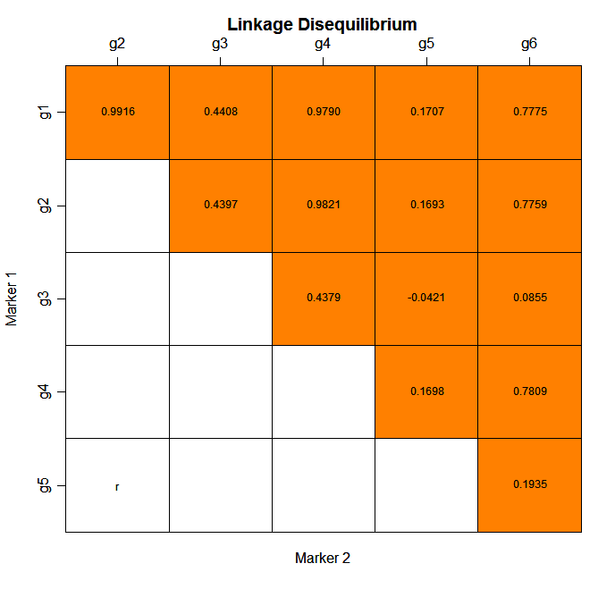

Slide 56
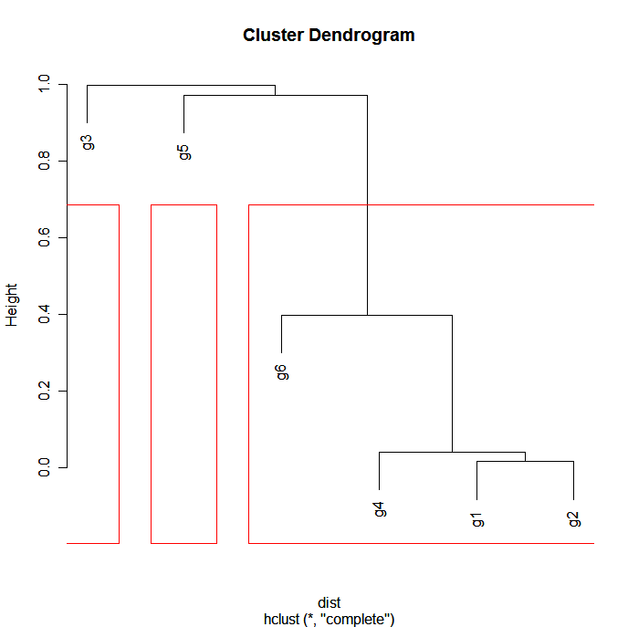

Slide 57
q-values
library(qvalue)
pvalues <- scan("ant.out")
# qvalues <- qvalue(pvalues)
# qwrite(qvalues,"qvalues.txt")
# necessary due to the U shape of the p-value histogram
qvalues.boot <- qvalue(pvalues,pi0.method="bootstrap") # fdr.level=0.05
plot(qvalues.boot)
qsummary(qvalues.boot,cut=c(0.0001,0.001,0.01,0.05))

Slide 58
q-values
Call:
qvalue(p = pvalues, pi0.method = "bootstrap")
pi0: 0.4117211
Cumulative number of significant calls:
<1e-04 <0.001 <0.01 <0.05
p-value 88 231 611 1042
q-value 2 58 407 990
pi0 is the true negative rate using observed p values which exceeds a value lambda

Slide 59
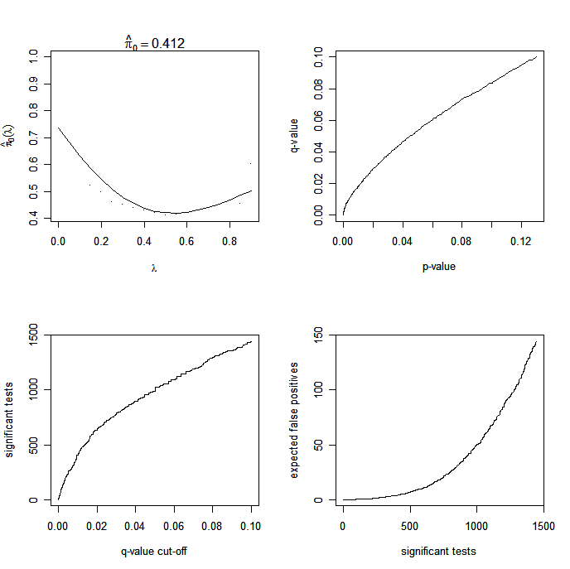

Slide 60
Summary
SAS is a powerful package but SAS/GENETICS relatively recent
Stata has unique features for haplotype analysis, so far slightly cumbersome to prepare data
R is a powerful environment for statistical computing, among others (e.g. recent issue of J Stat Soft); genetic data analysis can be greatly facilitated by R packages

Slide 61
Further information
SAS
  http://www.sas.com
  A SAS macro for haplotype trend regression
Stata, http://www.stata.com
S-PLUS, http://www.insightful.com
R, http://cran.r-project.org

Slide 62
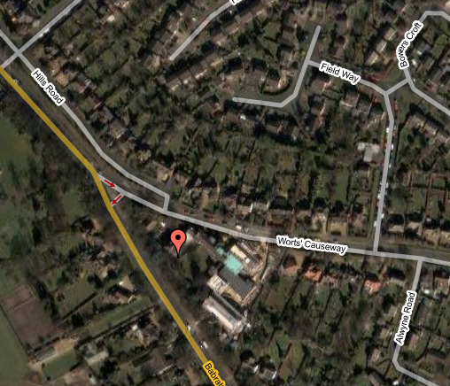
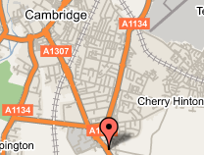
Acknowlegements
Qihua Tan
Ruth Loos
Jian’an Luan

Slide 63
