Slide 1

INTEGRATED ANALYSIS OF GENETIC DATA
Jing Hua Zhao
MRC Epidemiology Unit
Strangeways Research Laboratory
Worts Causeway
Cambridge CB1 8RN
Comments sent to jinghua.zhao@mrc-epid.cam.ac.uk
Copenhagen 2/2/2006

Slide 2
What do I mean by “integrated”?
In-house facility for traditional analysis
An environment of statistical analysis that provides facility for database accessibility, graphics, mathematical/statistical routines, flexible programming language, ability to incorporate available codes, Internet connectivity
So
All analyses can be done effectively and efficiently

Slide 3
Outline
A brief overview of current practice and motivation
An examination of emerging alternatives including SAS, Stata, S-PLUS/R as given in two reviews, a paper and two application notes
    Hum Genomics (R)
    Curr Bioinformatics (SAS, Stata, S-PLUS/R)
    BMC Genetics (R/kinship, age of onset analysis)
    R News and Bioinformatics (R/kinship/gap, pedigree drawing)
  A demo of variety of applications
Haplotype analysis as an example -- DiOGenes

Slide 4
Current practice and the motivation
My own account (ATRIBUTE/PATHMIX)
A general gap between theory and practice, lack of cohesion (e.g. HGMP, LITBIO)
Linkage: LIPED, LINKAGE (FASTLINK, MFLINK), MENDEL, SAGE, PAP, MAPMAKER (SIBS, HOMOZ) and GENEHUNGER (PLUS, IMPRINTING, TWOLOCUS, MODSCORE, SAD and those in ACT), ALLEGRO, MERLIN, MORGAN, VITESSE, SIMWALK, SOLAR

Slide 5
More to the list …
Specific programs APM, SPLINK, ASPEX, MIM, GAS, HOMOG, HAPLO
Further analysis: SIMLINK, SLINK, SIMULATE
Other derivatives, DOLINK/QDB, GLUE, QUICKLINK, easyLINKAGE
Pedigree drawing: PEDDRAW, CYRILLIC, PROGENY, psdraw, PedSys, Pedraw

Slide 6
and the list for association…
46 programs for unrelated individuals alone (Salem et al. 2005, Hum Genomics)
Family studies: AFBAC, ETDT, GASSOC, PDT, TRANSMIT, UNPHASED, QTDT, FBAT
So
Confusions, e.g. HAPLO, therefore Mega2
It is untenable with individual efforts to integrate
A call for a flexible environment (e.g. Guo and Lange 2000)

Slide 7
Why R?
The call for integration is reminiscent of the development of Linux system
It is a general computing environment for both practitioners and programmers. Standard statistical and genetic analyses can be conducted in a reliable and unified fashion. It makes efficient statistical modelling possible.
It is accessible and free
It is easy to extend and a large number of packages maintained by a large and dedicated team

Slide 8
The use of R in genetic data analysis
A short history
sma,genetics,haplo.score,qtl,etc.
The BioConductor project (http://www.bioconductor.org)
Ported and developed packages
R/gap, tdthap and kinship (lmm, pan)
More information is available from CRAN (http://cran.r-project.org)

Slide 9
A simple session
> a1 <- c(1,1,2,3,3,2,3,1,1,2)
> a2 <- c(1,2,3,3,2,2,1,3,2,1)
> a <- c(a1,a2)
> count.a <- table(a)
> count.a
a
1 2 3
7 7 6
> freq.a <- count.a / 2 / 10
> freq.a
a
1 2 3
0.35 0.35 0.30
> b1 <- rep(0,10)
> b2 <- rep(0,10)
> for (i in 1:10) b1[i] <- min(a1[i],a2[i])
> for (i in 1:10) b2[i] <- max(a1[i],a2[i])
> g <- b1 + b2 * (b2-1) / 2
> table(g)
g
1 2 3 4 5 6
1 3 1 2 2 1
> freq.g <- table (g) / 10
> freq.g
g
1 2 3 4 5 6
0.1 0.3 0.1 0.2 0.2 0.1
> q()

Slide 10
The R/gap package
# to the default home directory under Windows
> install.packages("gap")
> library()
# to directory R under Unix/Linux
> install.packages("gap","R")
> library(lib.loc="R")
# Both Windows and Unix/Linux
> library(gap)
> library(help=gap)
> ? hwe
> help.start()
> demo(gap)

Slide 11
R/gap functions
Primary a template for extension to illustrate
  Possibility to include a range of functions
  Ability to use both SNPs and microsatellite markers
A range of statistics for association analysis
  HWE
  LD statistics
  Haplotype analysis, including Chromosome X data
Some functions for family data
  Pedigree plotting
Bundle with POINTER and PATHMIX

Slide 12
Hardy-Weinberg equilibrium
> library(gap)
> data(nep499)
> attach(nep99)
> snps <- nep499[,-(1:7)]
> controls <- snps[status==0,]
> for(i in 1:8) hwe(controls[,(2*i-1):(2*i)]
x2= 0.549 df= 1 p= 0.4588277
x2= 0.191 df= 1 p= 0.6621736
x2= 0.017 df= 1 p= 0.8968542
x2= 0.659 df= 1 p= 0.4170008
x2= 0.983 df= 1 p= 0.3214397
x2= 0.659 df= 1 p= 0.4170008
x2= 0.907 df= 1 p= 0.3410179
x2= 0.051 df= 1 p= 0.8217595

Slide 13
Haplotype frequency estimation
> library(gap)
> hla.gc<- genecounting(hla[,3:8])
> names(hla[,3:8])
[1] "DQR.a1" "DQR.a2" "DQA.a1" "DQA.a2" "DQB.a1" "DQB.a2"
> hla.gc<- genecounting(hla[,3:8])
> summary(genecounting(hla[,3:8]))
Length Class Mode
h 3750 -none- numeric
h0 3750 -none- numeric
prob 271 -none- numeric
l0 1 -none- numeric
l1 1 -none- numeric
hapid 1 -none- numeric
npusr 2 -none- numeric
npdat 2 -none- numeric
htrtable 1 -none- numeric
iter 1 -none- numeric
converge 1 -none- numeric
di0 1 -none- numeric
di1 1 -none- numeric
resid 271 -none- numeric
> 2*(hla.gc$l1-hla.gc$l0)
[1] 3172.276

Slide 14
Pairwise LD statistics
> LDtable <- matrix(rep(0,8*8),nrow=8)
> for (i in 1:8) {
+ for (j in 1:i) {
+ gc <- genecounting(controls[,c(2*i-1,2*i,2*j-1,2*j)])
+ ij <- tbyt(gc$h,2*242)
+ LDtable[i,j] <- ij$Dprime
+ LDtable[j,i] <- 1-pchisq(ij$x2,1)
+ }
+ }
> round(LDtable,4)
[,1] [,2] [,3] [,4] [,5] [,6] [,7] [,8]
[1,] 0.0000 0.0000 0.1047 0.0000 0.0006 0.0000 0.0000 0.0000
[2,] 0.3173 0.0000 0.4456 0.0000 0.0000 0.0038 0.0000 0.0644
[3,] 0.1763 0.1109 0.0000 0.0000 0.6121 0.0000 0.0000 0.4941
[4,] 0.2530 0.3715 0.7243 0.0000 0.0000 0.0000 0.0000 0.0391
[5,] 0.1817 0.2786 -1.0000 0.2536 0.0000 0.0348 0.0000 0.5756
[6,] 0.4578 0.1682 0.7243 0.4590 0.1061 0.0000 0.0000 0.0000
[7,] 0.5722 0.4235 0.4572 0.4566 0.2773 0.7858 0.0000 0.0003
[8,] 0.7129 0.2062 0.2437 0.2940 0.0722 0.9036 0.5621 0.0000

Slide 15
Haplotype-specific tests
> locus.label <- c("R6", "N4", "N6", "N11", "N15", "N18","N22","N24")
> gcp(status,1,snps, locus.label=locus.label, n.sim=1000)
LRT = 115.7548 p = 1 sim p = 0
z-test of individual haplotypes
hap.id z sim p R6 N4 N6 N11 N15 N18 N22 N24
1 1 0.785 0.306 1 1 1 1 1 1 1 1
2 2 -1.557 0.058 1 1 1 1 1 1 1 2
3 3 0.910 0.306 1 1 1 1 1 1 2 1
4 4 1.747 0.037 1 1 1 1 1 1 2 2
5 5 1.601 0.067 1 1 1 1 1 2 1 1
6 6 -0.323 0.762 1 1 1 1 1 2 1 2
7 7 0.000 0.610 1 1 1 1 1 2 2 1
8 8 2.691 0.000 1 1 1 1 1 2 2 2
9 9 -1.259 0.149 1 1 1 1 2 1 1 1
10 10 -0.665 0.607 1 1 1 1 2 1 1 2
11 11 0.000 0.131 1 1 1 1 2 1 2 1
12 12 0.000 0.335 1 1 1 1 2 1 2 2
13 13 0.000 0.489 1 1 1 1 2 2 1 1
14 14 0.963 0.274 1 1 1 1 2 2 1 2
15 15 0.000 0.118 1 1 1 1 2 2 2 1
...
> hap.score(status, snps, method="hap", locus.label=locus.label, n.sim=1000)
Global Score Statistics
global-stat = 40.06154, df = 14, p-val = 0.00025, sim. p-val = 0,
max-stat sim. p-val = 0.002
Haplotype-specific Scores
R6 N4 N6 N11 N15 N18 N22 N24 Hap-Freq Hap-Score p-val sim p-val
[1,] 1 1 1 1 1 1 1 2 0.21913 -2.1282 0.03332 0.03
[2,] 1 1 1 1 2 1 1 1 0.0126 -1.75864 0.07864 0.108
[3,] 1 2 1 1 1 1 1 2 0.00568 -1.45885 0.14461 0.244
[4,] 1 2 1 1 2 1 1 2 0.00528 -0.89652 0.36997 0.44
[5,] 1 2 1 1 1 1 1 1 0.02153 -0.84432 0.39849 0.425
[6,] 1 1 1 1 1 2 1 2 0.00844 -0.11809 0.906 0.904
[7,] 2 1 1 1 1 1 1 1 0.00711 0.3817 0.70268 1
[8,] 1 1 1 2 1 1 1 1 0.00736 0.94315 0.3456 0.591
[9,] 1 1 1 1 1 1 2 1 0.0059 0.94315 0.3456 0.633
[10,] 1 1 1 1 1 1 1 1 0.59627 1.32973 0.18361 0.192
[11,] 1 2 1 2 1 1 1 1 0.00962 1.73777 0.08225 0.089
[12,] 1 1 1 1 1 2 1 1 0.00654 2.1786 0.02936 0.061
[13,] 1 1 1 1 1 1 2 2 0.00567 2.53976 0.01109 0.016
[14,] 1 1 1 1 1 2 2 2 0.01637 3.57003 0.00036 0

Slide 16
The R/genetics package
library(genetics)
ccc<-read.table("u:/mrc/DiOGenes/ccc.raw")
geno <- ccc[,-(1:6)]
names(geno)<-c("a1","a2","a3","a4","a5","a6","b1","b2","b3","b4","b5","b6")
attach(geno)
g1 <- genotype(a1,a2,alleles=1:2)
g2 <- genotype(a3,a4,alleles=1:2)
g3 <- genotype(a5,a6,alleles=1:2)
g4 <- genotype(b1,b2,alleles=1:2)
g5 <- genotype(b3,b4,alleles=1:2)
g6 <- genotype(b5,b6,alleles=1:2)
geno.new <-data.frame(g1,g2,g3,g4,g5,g6)
for(i in 1:6) {
print(summary(geno.new[,i]))
print(HWE.chisq(geno.new[,i]))
}

Slide 17
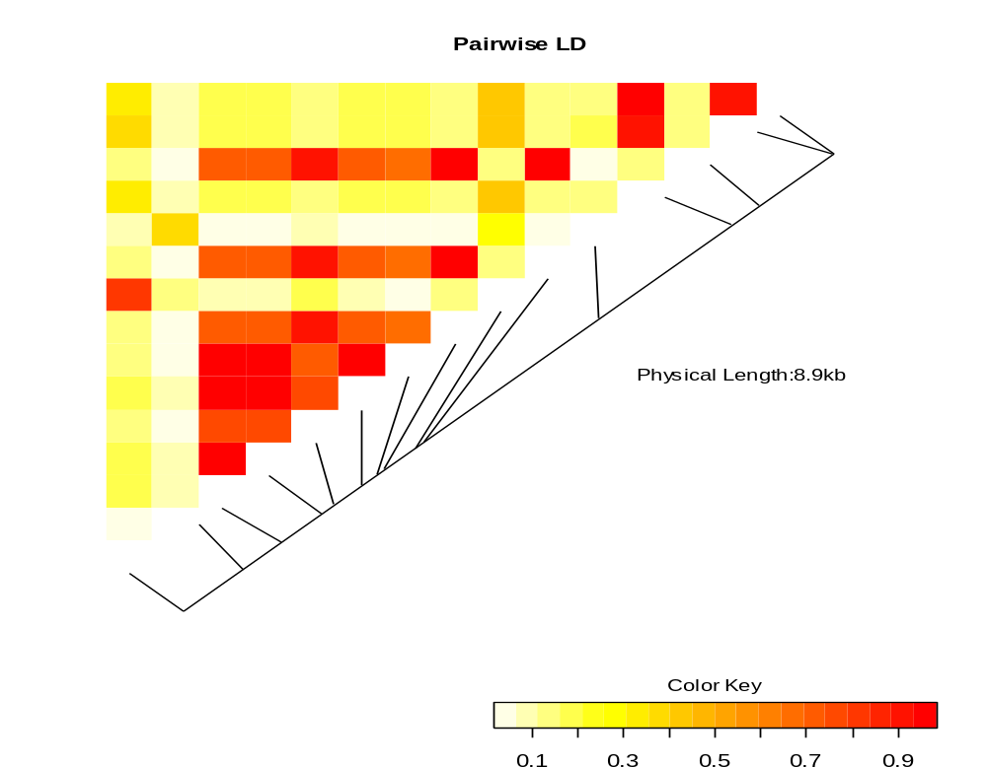
The LD heatmap

Slide 18
The log-linear model
> library(hwde)
> data(IndianIrish)
> attach(IndianIrish)
> ii <- hwde(IndianIrish)
[1] "Analysis of Deviance Table"
Resid. Df Resid. Dev Df Deviance
1 17 1724.07
2 16 1090.41 1 633.66
3 14 486.72 2 603.69
4 12 480.31 2 6.41
5 11 463.76 1 16.55
6 10 218.42 1 245.34
7 8 217.15 2 1.28
8 6 37.94 2 179.21
9 4 35.46 2 2.48
10 3 26.29 1 9.16
11 2 5.94 1 20.36
12 0 -4.885e-14 2 5.94

Slide 19
Kinship coefficients
> library(kinship)
> attach(ped)
> round(8*(kinship(id,momid,dadid)))
1 2 3 4 5 6 7 8 9 10 11 12 13 14 15 16
1 4 2 2 2 2 2 2 0 1 0 1 1 0 0 0 0
2 2 4 0 2 2 2 2 0 1 0 2 2 0 1 0 1
3 2 0 4 2 2 2 2 0 1 0 0 0 0 0 0 0
4 2 2 2 4 2 2 2 0 2 0 1 1 0 0 0 0
5 2 2 2 2 4 2 2 0 1 0 1 1 0 0 0 0
6 2 2 2 2 2 4 2 0 1 0 1 1 0 0 0 0
7 2 2 2 2 2 2 4 0 1 0 1 1 0 0 0 0
8 0 0 0 0 0 0 0 4 2 0 0 0 0 0 0 0
9 1 1 1 2 1 1 1 2 4 0 0 0 0 0 0 0
10 0 0 0 0 0 0 0 0 0 4 2 2 0 1 0 1
11 1 2 0 1 1 1 1 0 0 2 4 2 0 2 0 1
12 1 2 0 1 1 1 1 0 0 2 2 4 0 1 0 2
13 0 0 0 0 0 0 0 0 0 0 0 0 4 2 0 0
14 0 1 0 0 0 0 0 0 0 1 2 1 2 4 0 0
15 0 0 0 0 0 0 0 0 0 0 0 0 0 0 4 2
16 0 1 0 0 0 0 0 0 0 1 1 2 0 0 2 4

Slide 20
Pedigree drawing
We can use the following R statements
> pre <- read.table("10081.pre",header=T)
> library(kinship)
> attach(pre)
> ped <- pedigree(id,father,mother,sex,affected)
> par(xpd=T)
> plot(ped)

Slide 21
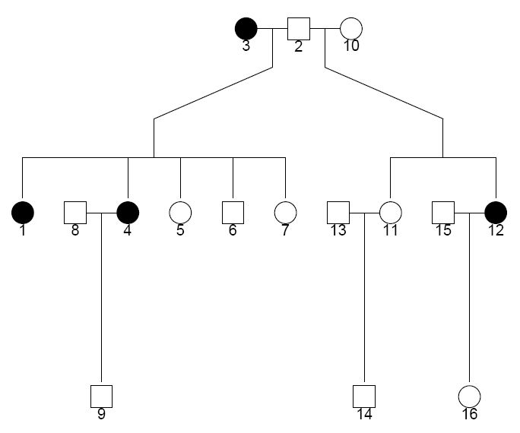
Diagram by kinship

Slide 22
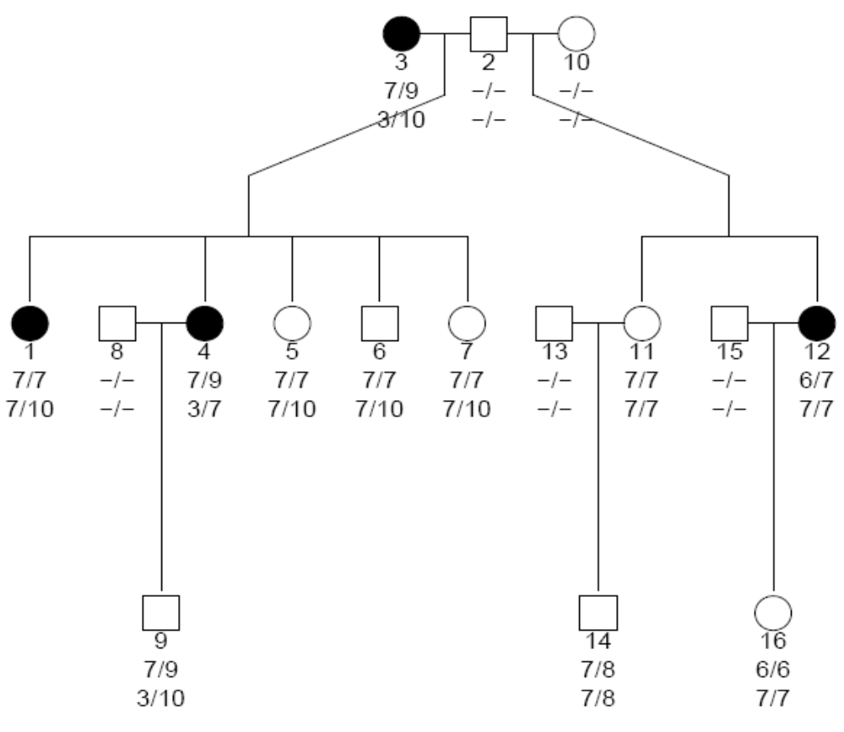
Diagram with marker information

Slide 23
Diagram by R/gap
> library(gap)
> pedtodot(pre)
> dir()
Then under Unix (Linux, Cygwin)
% dot –Tps 10081.dot –o 10081.ps
% ps2pdf 10081.ps

Slide 24
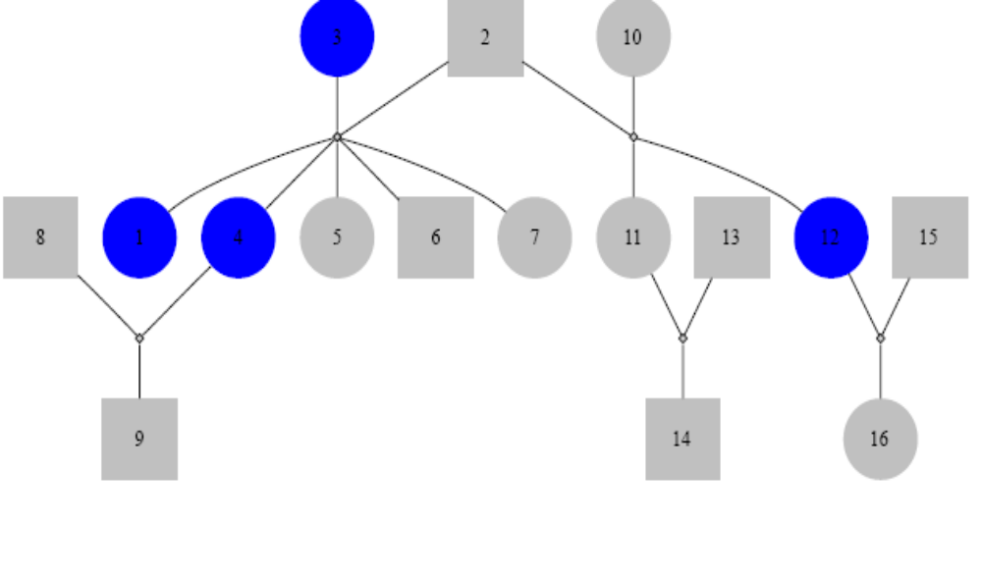
Diagram 1

Slide 25
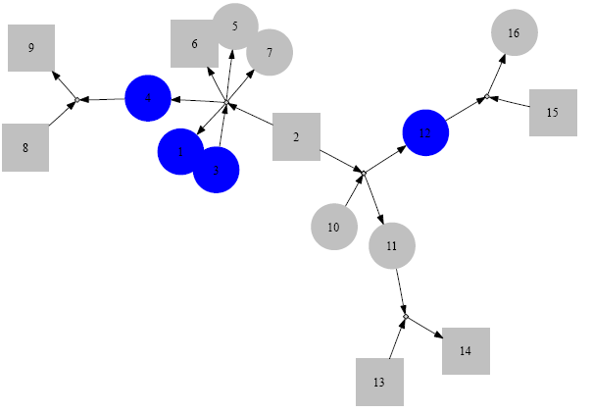
Diagram 2

Slide 26
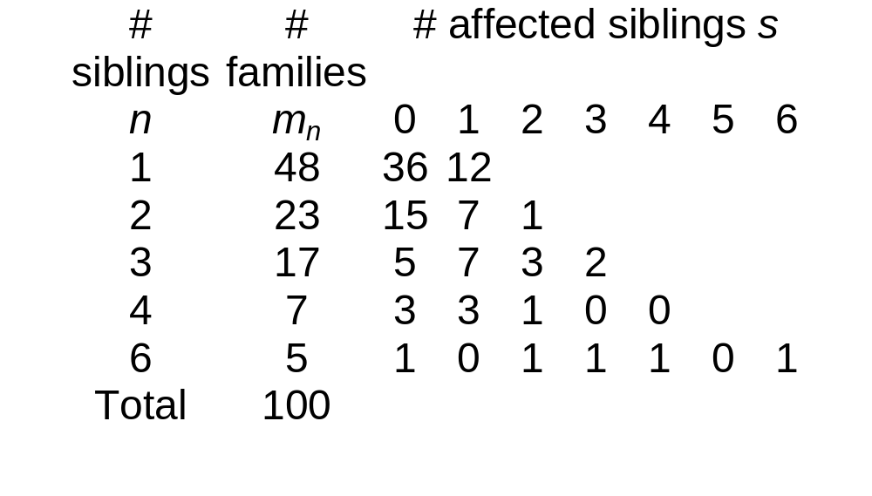
IPF cases in 100 families

Slide 27
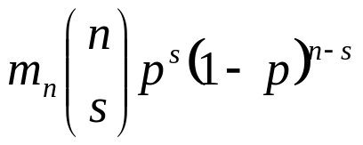
Aggregation of IPF cases
A bin(n,p) for the counts in the nth row can be fitted with expected frequencies
We estimate p with 60/203=0.296 leading to Pearson chi-square 312 (15df) indicating poor fit, but we can use pfc and pfc.sim to get the exact p-value 0.00883 for the table.

Slide 28
The age of onset analysis
library(kinship)
gaw14pheno <- read.table("pheno.dat",
col.names=c("fid","id","father","mother","sex",...))
attach(gaw14pheno)
gaw14check <- familycheck(fid,id,father,mother)
gaw14fam <- makefamid(id, father, mother)
gaw14kin <- makekinship(gaw14fam, id, father, mother)
temp <-matrix(scan("pedindex.out"), ncol=8, byrow=T)
pedindex <- temp[,c(1,8)]
temp <- read.table("gaw14ibd/ibd.ADH3", row.names=NULL,
col.names=c("id1", "id2", "phi2", "delta7", "dummy"))
ibd.ADH3 <- bdsmatrix.ibd(temp$id1, temp$id2, temp$phi2, pedindex)
kfit <- coxme(Surv(ageon1,alc1) ~1, gaw14pheno, random=~1|id,
varlist=list(gaw14kin, ibd.ADH3))

Slide 29
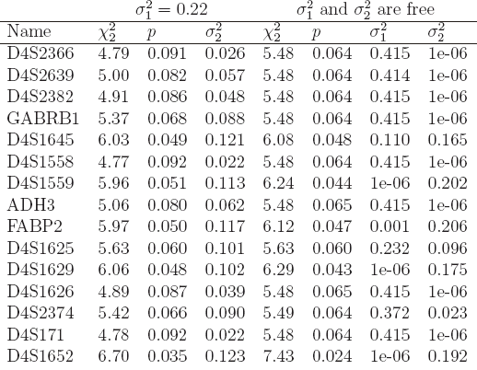
The results on chromosome 4

Slide 30
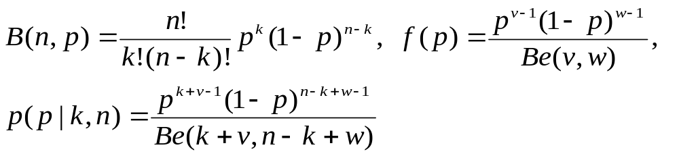
Bayesian methods
# bs-model.txt:
model {
# likelihood
k ~ dbin(p, n)
# prior
p ~ dbeta(nu, omega)
}

Slide 31
R2WinBUGS
> library(R2WinBUGS)
> s <- list(k = 201, n = 372, nu = 1, omega = 1)
> parms <- "p“
> inits <- function() list(p=0.5)
> s.bugs <- bugs(s,inits,parms,"bs-model.txt", n.chains=1, n.burnin=1000, n.iter=11000)
> s.bugs
mean sd 2.5% 25% 50% 75% 97.5%
p 0.5 0.0 0.5 0.5 0.5 0.6 0.6
deviance 7.3 1.4 6.4 6.5 6.8 7.7 11.0
pD = 0.9 and DIC = 8.3
> plot(s.bugs)

Slide 32
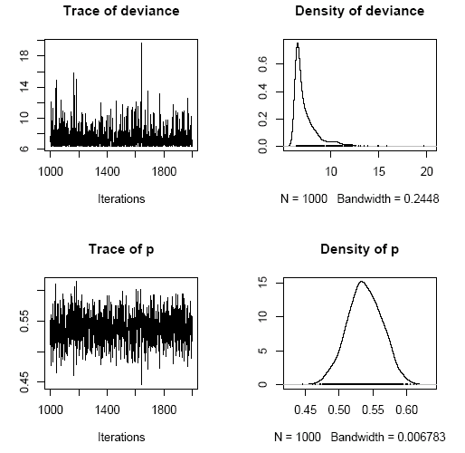
MCMC plot for bionomial sampling

Slide 33
Comparative example: haplotype-traits association
The rationale
Resolving phase ambiguity
Haplotype-traits association
Related issues
Available software
Examples
Summary

Slide 34
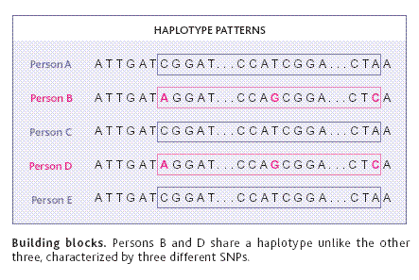
An illustration of haplotype-trait association
Couzin (2002) Science

Slide 35
Performance relative to single-point analysis
Advantage: use of full information and increase power
  Akey et al. (2001) Eur J Hum Genet
  Klein et al. (2005) Science
  Grant et al. (2006) Nat Genet
Challenge: number of observed haplotypes << large number of parameters plus rare haplotypes are in the dustbin category

Slide 36
Analytical procedures and issues
Steps of analysis
  SNP-wise descriptive analysis (HWE, allele-wise, genotype-wise, disease models), staged analysis
  LD analysis
  haplotype, haplotype clustering-traits
Related issues
  Alternatives
  Power and Statistical significance
  G x E interactions

Slide 37
Alternative methods
Hotelling’s T methods
  Fan & Knapp (2003) Am J Hum Genet
  Wallace et al. (2006) Am J Hum Genet
  Lin (2006) Am J Hum Genet

Slide 38
Algorithms for haplotype inference
Some are now well-recognised
Excoffier & Slatkin (1995) Mol Biol Evol
Zhao et al. (2002), Zhao (2004) Bioinformatics
Stephens et al. (2001), Niu et al. (2002) Am J Hum Genet

Slide 39
Haplotype association
Zhao et al. (2000) Hum Hered
Zaykin et al. (2002) Hum Hered
Schaid et al. (2002), Lake et al. (2003), Burkett et al. (2004) Hum Hered
Zhao et al. (2003) Am J Hum Genet
Epstein & Satten (2003) Am J Hum Genet
Tzeng et al. (2006) Am J Hum Genet

Slide 40
Power comparisons
Prospective (Schaid et al. 2002) versus retrospective likelihood (Epstein & Satten 2003; Tan et al. 2005; Tan et al. in press)
Simulation
  Satten & Epstein (2004) Genet Epidemiol:
    Comparable performance for multiplicative model
    Retrospective likelihood more powerful for dominant/recessive models
Empirical studies
  de Bakker et al. (2005) Nat Genet
  van Steen et al. (2005) Nat Genet
Multiple imputation is applicable to all methods

Slide 41
Advantages and disadvantages
Global tests serve as a universal test base but only applies to binary outcome and do not account for covariates, HWE
Score statistics can be rapidly calculated along with simulation but not allow for nested models
HTR is applicable to large number of designs
Current retrospective methods do not account for covariates
The general GLM and GEE frameworks allow for G x E interactions but more involved

Slide 42
Statistical significance
Potentially there is a large number of degrees of freedom
Monte Carlo/permutation tests are often necessary
Adjustment for p-value is required

Slide 43
G x E interactions
The null hypothesis of no association
  Zaykin et al. (2002), Schaid et al. (2002)
The alternative hypothesis
  Lake et al. (2003)
Confusion in the literature
  Dong et al. (2004) Hypertension

Slide 44
Available software
Standalone programs
  ehplus, hplus, chaplin, haploview, snphap
  Salem (2005) Hum Genomics
SAS
Stata
  sampling weight
S-PLUS/R
  gap, hapassoc, haplo.score, haplo.stats
  haplotype clustering of Tzeng et al. (2006)

Slide 45
Now …
Database connection and analysis

Slide 46
SAS/GENETICS
Mainly designed for association tests
Available as PROCs named ALLELE, CASE-CONTROL, HAPLOTYPE, HTSNP, FAMILY, PSMOOTH, MULTTEST, INBREED
Easy access to database, graphics and other procedures if covariates are involved, e.g. haplotype trend regression but less powerful (e.g. X-chromosome data)

Slide 47
A SAS/ACCESS example
%let dbname = c:\hapmap\db1.mdb ;
%let uid = xxxx;
%let pwd = *****;
%let wgdb = c:\hapmap\db1.mdw;
proc import out = objects
datatable = "Genotypes_chr11_CEU"
dbms = access97 replace;
database = "&dbname";
userid = "&uid";
password = "&pwd";
wgdb = "&wgdb";
run;

Slide 48
PROC HAPLOTYPE
proc haplotype data=ccc out=outhap;
var m1-m12;
run;
proc print data=outhap;
title ‘Marker-marker analysis with haplotype assignments’;
run;
proc haplotype data=ccc noprint;
var m1-m12;
trait cc / testall perms=1000;
run;
proc print data=outhap noobs round;
title’Tests for haplotype-trait association’;
run;

Slide 49
Haplotype-trait association
Tests for Haplotype-Trait Association
Trait Trait Num Chi- Pr > Prob
Number Value Obs DF LogLike Square ChiSq Exact
1 1 871 49 -1779
2 0 1257 49 -2479
Combined 2128 49 -4269 20.2716 0.9999 0.3740
Tests for Haplotype-Trait Association
----------Frequencies---------
Chi- Pr > Prob
Number Haplotype Trait1 Trait2 Combined Square ChiSq Exact
1 1-1-1-1-1-1 0.58563 0.62571 0.60931 6.9463 0.0084 0.0080
2 1-1-1-1-1-2 0.00000 0.00000 0.00000 0 1.0000 1.0000
……
The results are an omnibus heterogeneity test, followed by simple proportion tests for individual haplotypes

Slide 50
STATA
Share many generic features of SAS
Gaining popularity among epidemiologists and econometricians
Able to use probability weight
Easy to install and comprehensive on-line documentation
  CIMR site
  Biostatistics Resources

Slide 51
Stata ODBC
. odbc list
. odbc query "MySQL database“
. odbc desc "Genotypes_chr4_HCB", dialog(complete)
. set mem 50M
. odbc load, exec("select * from Genotypes_chr4_HCB")

Slide 52
Stata with sampling weight
% Under MS-DOS or Unix/Linux prompt
% snphap -nf ccc.nam
% snphap -th 0.001 -ss -q ccc.txt snphap.out assign.out
insheet using assign.out
sort id
save assign, replace
use ccc,clear
keep id cc
rename id oldid
gen id=_n
sort id
save id, replace
merge id using assign
logit cc locus* [pw=probability]

Slide 53
S-PLUS/R
S-PLUS
  Known for its OOP and powerful graphics
  Limited number of packages including haplo.score, haplo.stats, kinship
R
  An emerging platform compatible with S-PLUS
  A variety of packages, now over 700
  Under GNU public license

Slide 54
RODBC
library(RODBC)
# to call ODBC
library(RODBC)
c2 <- odbcConnectAccess(“db1.mdb”)
# select the table
tblOutput <- sqlQuery(c2,paste(“select * from Genotypes_chr11_CEU”))
# the property of tblOutput
class(tblOutput)

Slide 55
LD statistics and tagging
# table of LD statistics
geno.LD<-LD(geno.new)
LDtable(geno.LD,which=‘r’)
# tagging using distance
r2 <- (geno.LD$r)^2
dist <- as.dist(t(1-r2))
hier <- hclust(dist,method="complete")
plot(hier)
clusters<-rect.hclust(heri,h=0.9)

Slide 56
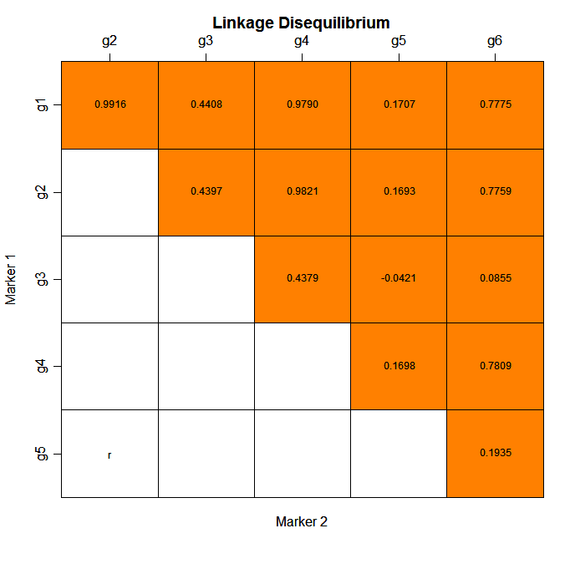

Slide 57
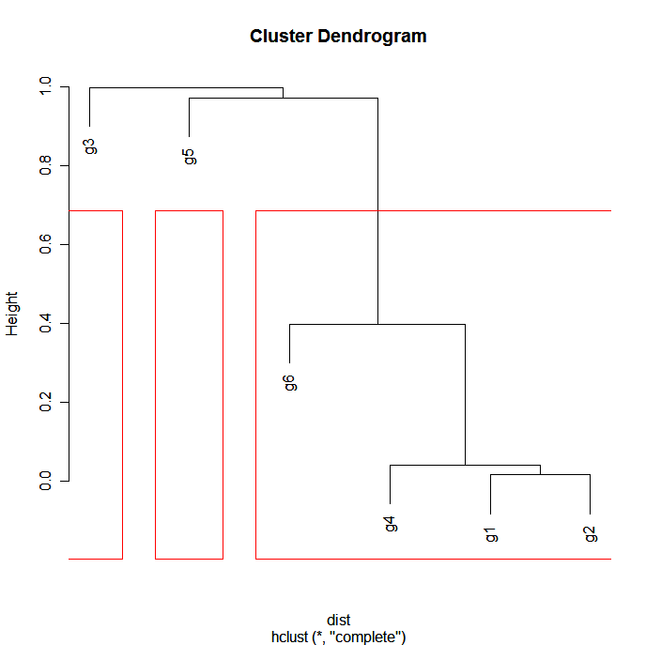

Slide 58
q-values
library(qvalue)
pvalues <- scan("ant.out")
# qvalues <- qvalue(pvalues)
# qwrite(qvalues,"qvalues.txt")
# necessary due to the U shape of the p-value histogram
qvalues.boot <- qvalue(pvalues,pi0.method="bootstrap") # fdr.level=0.05
plot(qvalues.boot)
qsummary(qvalues.boot,cut=c(0.0001,0.001,0.01,0.05))

Slide 59
q-values
Call:
qvalue(p = pvalues, pi0.method = "bootstrap")
pi0: 0.4117211
Cumulative number of significant calls:
<1e-04 <0.001 <0.01 <0.05
p-value 88 231 611 1042
q-value 2 58 407 990
pi0 is the true negative rate using observed p values which exceeds a value lambda

Slide 60
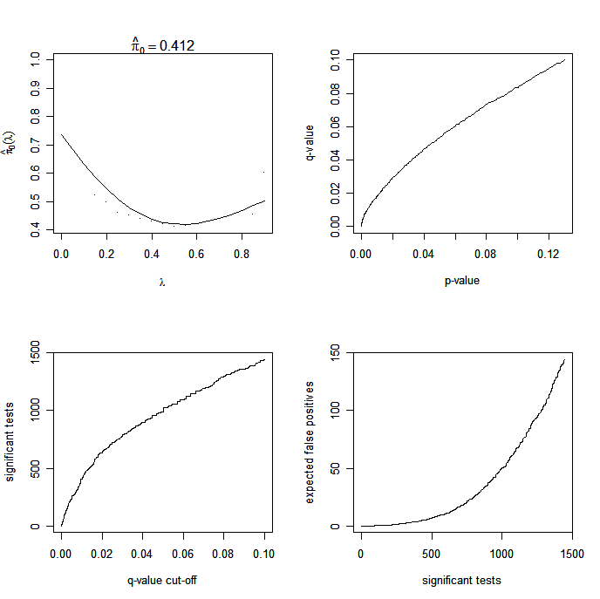

Slide 61
Summary
SAS is a powerful package but SAS/GENETICS relatively recent
Stata has unique features for haplotype analysis, so far slightly cumbersome to prepare data
R is a powerful environment for statistical computing, among others (e.g. recent issue of J Stat Soft); genetic data analysis can be greatly facilitated by R packages

Slide 62
Further information
SAS
  http://www.sas.com
  A SAS macro for haplotype trend regression
Stata, http://www.stata.com
S-PLUS, http://www.insightful.com
R, http://cran.r-project.org

Slide 63
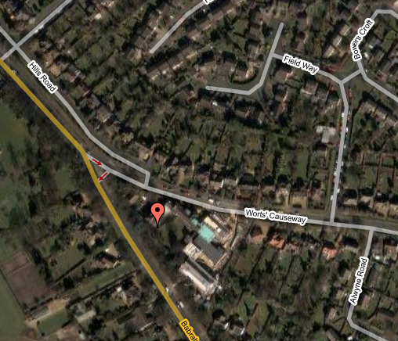
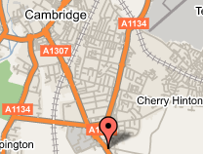
Acknowlegements
Qihua Tan
Ruth Loos
Jian’an Luan

Slide 64
