Slide 1

HAPLOTYPE ANALYSIS
Jing Hua Zhao
MRC Epidemiology Unit
Strangeways Research Laboratory
Worts Causeway
Cambridge CB1 8RN
Comments sent to jinghua.zhao@mrc-epid.cam.ac.uk
Copenhagen 3/2/2006

Slide 2
Outline
The rationale
  What? Why? How?
  Options for most groups
Focus two aspects
  Approaches of haplotype-trait association and associate tools
  Software systems
Related issues

Slide 3
What are haplotypes and why we study them?
Statistically, haplotypes are collection of alleles from neighbouring loci and have biological significance
Genetic epidemiology has moved from positional cloning, linkage disequilibrium (LD) mapping towards whole genome-wide association
The use of haplotypes is a sensible approach towards using the full available information

Slide 4
The uses of haplotype analysis
Marker-maker analysis
  The purpose is to understand the sequence features of the markers involved, including correlation and patterns, e.g. study of recombination hot spots (or haplotype blocks), SNP selection (or tagging)
  These are usually shown as summary statistics
  It is often used to study ethnic differences, evolution, etc
Marker-trait analysis
  The trait could either be discrete or continuous
  It is of primary interest

Slide 5
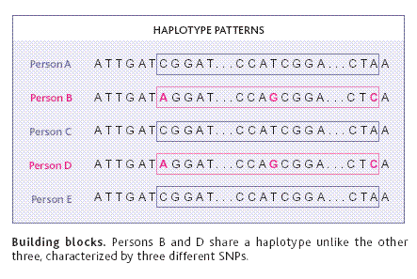
A cartoon of haplotype-trait association
Couzin (2002) Science

Slide 6
Main advantage and problems
Increase of power compared to single-locus analysis
  Akey et al. (2001) Eur J Hum Genet, Klein et al. (2005) Science, Grant et al. (2006) Nat Genet
Challenges
  Phase ambiguity
  number of observed haplotypes << large number of parameters and rare haplotypes are in the dustbin category (allele X)
  While the importance is well-recognised, no single method is now universally accepted or applicable

Slide 7
Links with other methods and related issues
Links with other types of analyses
  Usually followed by single-locus analysis (HWE, allele-wise, genotype-wise, disease models), staged analysis
  Then proceed to marker-marker and marker-trait analyses
  There are alternative methods, such as Hotelling’s T statistics as in Fan & Knapp (2003), Wallace et al. (2006), Lin (2006) Am J Hum Genet, summary score method by Schaid et al. (2005), Composite LD as in Schaid (2004) Genetics
Related issues
  Population stratification with “unrelated” individuals
  Statistical significance
  G x E interactions

Slide 8
Haplotype inference
To obtain haplotype and associated probabilities for individuals
  Expectation-Maximisation (EM) algorithm
    Excoffier & Slatkin (1995) Mol Biol Evol
    Zhao et al. (2002), Zhao (2004) Bioinformatics
  Bayesian methods
    Stephens et al. (2001), Niu et al. (2002) Am J Hum Genet
This is necessary even with family data

Slide 9
Tools for haplotype-traits association
Zhao et al. (2000) Hum Hered
  EHPLUS/GENECOUNTING, global+haplotype specific tests
Zaykin et al. (2002) Hum Hered
  HTR, Haplotype trend regression
Schaid et al. (2002), Lake et al. (2003), Burkett et al. (2004) Hum Hered
  haplo.score, haplo.stats and hapassoc, generalised linear model (GLM) framework
Zhao et al. (2003) Am J Hum Genet
  Hplus, generalised estimation equations (GEE) framework
Epstein & Satten (2003) Am J Hum Genet
  CHAPLIN, logistic regression
Tzeng et al. (2006) Am J Hum Genet
  R program, GLM with haplotype clustering

Slide 10
Advantages and disadvantages
Global test serves as a universal test base but only applies to categorical outcome and do not account for covariates, HWE
Score statistics can be rapidly calculated along with simulation but not allow for nested models
HTR is applicable to large number of designs
Current retrospective methods do not account for covariates
The GLM and GEE frameworks allow for G x E interactions but more involved

Slide 11
Power considerations
Prospective (Schaid et al. 2002) versus retrospective likelihood (Epstein & Satten 2003; Tan et al. 2005; Tan et al. in press)
Simulation
  Satten & Epstein (2004) Genet Epidemiol:
    Comparable performance for multiplicative model
    Retrospective likelihood more powerful for dominant/recessive models
Empirical studies
  de Bakker et al. (2005) Nat Genet
  van Steen et al. (2005) Nat Genet
Multiple imputation is applicable to all methods

Slide 12
Software systems (MRC/CAM, Windows/Linux)
SAS/GENETICS, based on the well-established and powerful package system but relatively recent
Stata
  Currently, phase inference is often through other programs such as snphap and use the posterior probabilities as sampling weight in the analysis
S-PLUS/R
  gap, haplo.score, haplo.stats, hapassoc, haplo.cc
  haplotype clustering of Tzeng et al. (2006)

Slide 13
SAS/GENETICS
Mainly designed for association tests with procedures ALLELE, CASE-CONTROL, HAPLOTYPE, HTSNP, FAMILY, PSMOOTH, MULTTEST, INBREED
Easy access to database, graphics and other procedures, particularly appropriate if covariates are involved, e.g. haplotype trend regression but less powerful (e.g. X-chromosome data)

Slide 14
A MicroSoft ACCESS example
%let dbname = c:\hapmap\db1.mdb ;
%let uid = xxxx;
%let pwd = *****;
%let wgdb = c:\hapmap\db1.mdw;
proc import out = objects
datatable = "Genotypes_chr11_CEU"
dbms = access97 replace;
database = "&dbname";
userid = "&uid";
password = "&pwd";
wgdb = "&wgdb";
run;

Slide 15
An example of PROC HAPLOTYPE
proc haplotype data=ccc out=outhap;
var m1-m12;
run;
proc print data=outhap;
title ‘Marker-marker analysis with haplotype assignments’;
run;
proc haplotype data=ccc noprint;
var m1-m12;
trait cc / testall perms=1000;
run;
proc print data=outhap noobs round;
title’Tests for haplotype-trait association’;
run;

Slide 16
Tests for haplotype-trait association
Global tests for haplotype-trait association
Trait Trait Num Chi- Pr > Prob
Number Value Obs DF LogLike Square ChiSq Exact
1 1 871 49 -1779
2 0 1257 49 -2479
Combined 2128 49 -4269 20.2716 0.9999 0.3740
Haplotype-specific tests
----------Frequencies---------
Chi- Pr > Prob
Number Haplotype Trait1 Trait2 Combined Square ChiSq Exact
1 1-1-1-1-1-1 0.58563 0.62571 0.60931 6.9463 0.0084 0.0080
2 1-1-1-1-1-2 0.00000 0.00000 0.00000 0 1.0000 1.0000
……
The results include an omnibus heterogeneity test, followed by simple proportion tests for individual haplotypes as would be from EHPLUS and GENECOUNTING (if missing data is used)

Slide 17
Stata
It is a general-purpose system and popular among epidemiologists and econometricians
It facilitates extension, easy installation and on-line documentation, examples include,
  CIMR site (http://www-gene.cimr.cam.ac.uk)
  Biostatistics Resources (http://www.biostat-resources.com)
It has unique features appropriate for haplotype analysis, so far slightly cumbersome to prepare data

Slide 18
An example of ODBC in Stata
. odbc list
. odbc query "MySQL database“
. odbc desc "Genotypes_chr4_HCB", dialog(complete)
. set mem 50M
. odbc load, exec("select * from Genotypes_chr4_HCB")

Slide 19
Stata with sampling weight
% Under MS-DOS or Unix/Linux prompt
% snphap -nf ccc.nam
% snphap -th 0.001 -ss -q ccc.txt snphap.out assign.out
insheet using assign.out
sort id
save assign, replace
use ccc,clear
keep id cc
rename id oldid
gen id=_n
sort id
save id, replace
merge id using assign
logit cc locus* [pw=probability]

Slide 20
S-PLUS/R
S-PLUS
  Known for its object-oriented programming language and powerful graphics
  Limited number of packages including haplo.score, haplo.stats, multigene, kinship
R
  an integrated environment for statistical computing and genetic data analysis
  compatible with S-PLUS but with more variety of packages, now over 700
  Freely available

Slide 21
An example of RODBC
library(RODBC)
# to call ODBC
library(RODBC)
c2 <- odbcConnectAccess(“db1.mdb”)
# select the table
tblOutput <- sqlQuery(c2,paste(“select * from Genotypes_chr11_CEU”))
# the property of tblOutput
class(tblOutput)

Slide 22
Haplotype frequency estimation
> library(gap)
> hla.gc<- genecounting(hla[,3:8])
> names(hla[,3:8])
[1] "DQR.a1" "DQR.a2" "DQA.a1" "DQA.a2" "DQB.a1" "DQB.a2"
> hla.gc<- genecounting(hla[,3:8])
> summary(genecounting(hla[,3:8]))
Length Class Mode
h 3750 -none- numeric
h0 3750 -none- numeric
prob 271 -none- numeric
l0 1 -none- numeric
l1 1 -none- numeric
hapid 1 -none- numeric
npusr 2 -none- numeric
npdat 2 -none- numeric
htrtable 1 -none- numeric
iter 1 -none- numeric
converge 1 -none- numeric
di0 1 -none- numeric
di1 1 -none- numeric
resid 271 -none- numeric
> 2*(hla.gc$l1-hla.gc$l0)
[1] 3172.276

Slide 23
Haplotype-specific tests
> locus.label <- c("R6", "N4", "N6", "N11", "N15", "N18","N22","N24")
> gcp(status,1,snps, locus.label=locus.label, n.sim=1000)
LRT = 115.7548 p = 1 sim p = 0
z-test of individual haplotypes
hap.id z sim p R6 N4 N6 N11 N15 N18 N22 N24
1 1 0.785 0.306 1 1 1 1 1 1 1 1
2 2 -1.557 0.058 1 1 1 1 1 1 1 2
3 3 0.910 0.306 1 1 1 1 1 1 2 1
4 4 1.747 0.037 1 1 1 1 1 1 2 2
5 5 1.601 0.067 1 1 1 1 1 2 1 1
6 6 -0.323 0.762 1 1 1 1 1 2 1 2
7 7 0.000 0.610 1 1 1 1 1 2 2 1
8 8 2.691 0.000 1 1 1 1 1 2 2 2
9 9 -1.259 0.149 1 1 1 1 2 1 1 1
10 10 -0.665 0.607 1 1 1 1 2 1 1 2
11 11 0.000 0.131 1 1 1 1 2 1 2 1
12 12 0.000 0.335 1 1 1 1 2 1 2 2
13 13 0.000 0.489 1 1 1 1 2 2 1 1
14 14 0.963 0.274 1 1 1 1 2 2 1 2
15 15 0.000 0.118 1 1 1 1 2 2 2 1
...
> hap.score(status, snps, method="hap", locus.label=locus.label, n.sim=1000)
Global Score Statistics
global-stat = 40.06154, df = 14, p-val = 0.00025, sim. p-val = 0,
max-stat sim. p-val = 0.002
Haplotype-specific Scores
R6 N4 N6 N11 N15 N18 N22 N24 Hap-Freq Hap-Score p-val sim p-val
[1,] 1 1 1 1 1 1 1 2 0.21913 -2.1282 0.03332 0.03
[2,] 1 1 1 1 2 1 1 1 0.0126 -1.75864 0.07864 0.108
[3,] 1 2 1 1 1 1 1 2 0.00568 -1.45885 0.14461 0.244
[4,] 1 2 1 1 2 1 1 2 0.00528 -0.89652 0.36997 0.44
[5,] 1 2 1 1 1 1 1 1 0.02153 -0.84432 0.39849 0.425
[6,] 1 1 1 1 1 2 1 2 0.00844 -0.11809 0.906 0.904
[7,] 2 1 1 1 1 1 1 1 0.00711 0.3817 0.70268 1
[8,] 1 1 1 2 1 1 1 1 0.00736 0.94315 0.3456 0.591
[9,] 1 1 1 1 1 1 2 1 0.0059 0.94315 0.3456 0.633
[10,] 1 1 1 1 1 1 1 1 0.59627 1.32973 0.18361 0.192
[11,] 1 2 1 2 1 1 1 1 0.00962 1.73777 0.08225 0.089
[12,] 1 1 1 1 1 2 1 1 0.00654 2.1786 0.02936 0.061
[13,] 1 1 1 1 1 1 2 2 0.00567 2.53976 0.01109 0.016
[14,] 1 1 1 1 1 2 2 2 0.01637 3.57003 0.00036 0

Slide 24
Statistical significance
Potentially, there is a large number of degrees of freedom
Monte Carlo method or permutation test is often necessary
Adjustment for p-value is often required in view of the multiple-testing involved

Slide 25
q-values
library(qvalue)
pvalues <- scan("ant.out")
# qvalues <- qvalue(pvalues)
# qwrite(qvalues,"qvalues.txt")
# necessary due to the U shape of the p-value histogram
qvalues.boot <- qvalue(pvalues,pi0.method="bootstrap") # fdr.level=0.05
plot(qvalues.boot)
qsummary(qvalues.boot,cut=c(0.0001,0.001,0.01,0.05))

Slide 26
q-values
Call:
qvalue(p = pvalues, pi0.method = "bootstrap")
pi0: 0.41
Cumulative number of significant calls:
<1e-04 <0.001 <0.01 <0.05
p-value 88 231 611 1042
q-value 2 58 407 990
pi0 is the true negative rate using observed p values which exceeds a value lambda

Slide 27
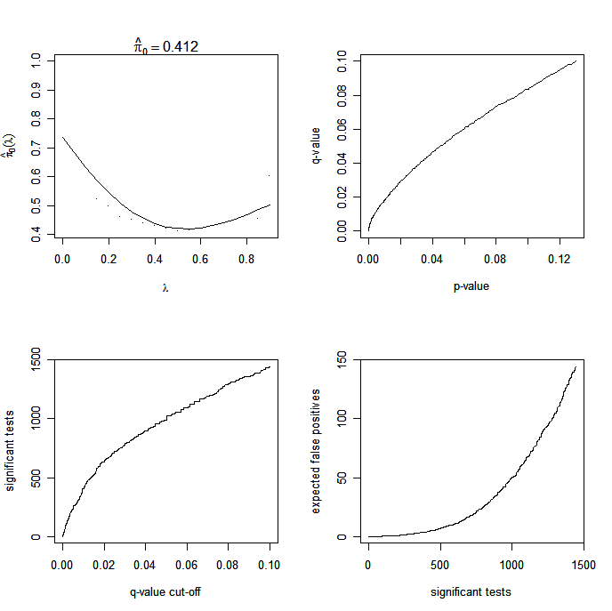

Slide 28
G x E interactions
The null hypothesis of no association
  Zaykin et al. (2002), Schaid et al. (2002) Hum Hered
The alternative hypothesis
  Lake et al. (2003) Hum Hered
  Zhao et al. (2003) Am J Hum Genet
Confusion in the literature: haplotype estimates are based on the null hypothesis
  Dong et al. (2004) Hypertension

Slide 29
Further information
SAS
  http://www.sas.com, the full documentation is available
  A SAS macro for haplotype trend regression
Stata, http://www.stata.com
S-PLUS, http://www.insightful.com
R, http://cran.r-project.org
Linkage server
  http://linkage.rockefeller.edu

Slide 30
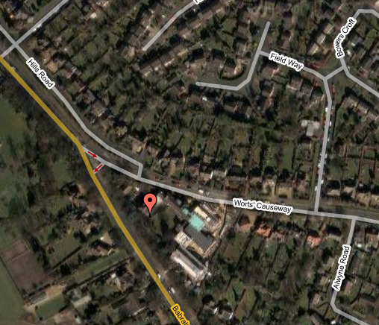
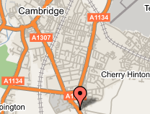
Acknowledgements
Ruth Loos
Jian’an Luan
http://maps.google.co.uk

