Slide 1
Gene Counting
Data structures, algorithms and applications
Jing Hua Zhao
Date: 17 Jan 2002

Slide 2
Gene counting
Used for haplotype frequency estimates
A special form of EM algorithm involving counting genes
Ceppellini et al (1953) AHG 20: 97-115;
Xie, Ott (1993) AJHG 53: 1107

Slide 3
Gene counting (cont)
The computational problem
  enumerate all possible phases
  house keeping haplotype frequencies and likelihood calculation
  tracking observed haplotypes

Slide 4
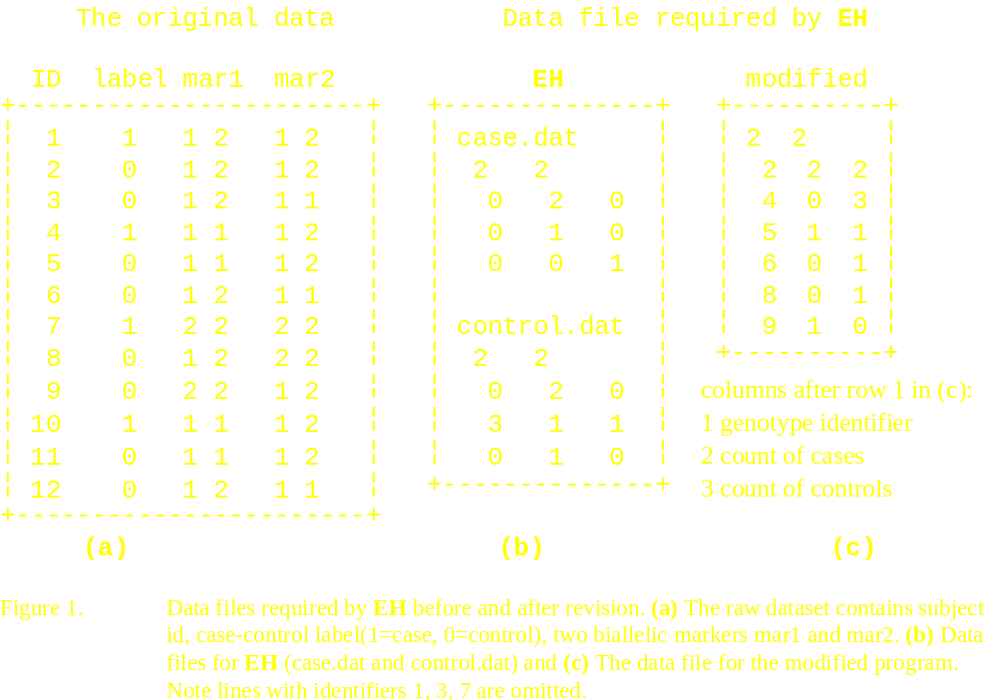
Gene counting (cont)

Slide 5
Gene counting (cont)
Binary number routing to switch phases
Mixed-radix number routine to collect haplotypes, sorting routine and binary search trees for data preparation
  typedef struct t_date { int day; int month; int year;} date;
Zhao & Sham (to appear) CMPB

Slide 6
Twin zygosity problem
An array of n-digit ternary number
Recursive algorithm
Zhao & Sham (1998) CSDA 28:225-32
Locus 1 locus 2 …. Locus n

Slide 7
Mutation detection
One polymorphic marker with m mutations
M-ary number (e.g. DNA and protein each have radices 4 and 20).
Sham, Curtis, Zhao (2000) AHG 64: 161-9
allele 1 allele 2 … allele n

Slide 8
Gene counting (cont)
Problems:
  awkward data preparation
  unreliable asymptotic approximation
  model unknown
  limitations in memory and speed
  missing data

Slide 9
Gene counting (cont)
Solutions:
  linked list and genotype identifier
  model-free statistics
  permutation tests
  dealing with missing data using EM
  Zhao, Curtis, Sham (2000) HH 50: 133-9

Slide 10
Gene counting (cont)
Further improvement:
  use binary search tree instead of linked list
  iterate over non-zero elements in the sparse contingency table
  Zhao, Sham (2002) HH (to appear)

Slide 11
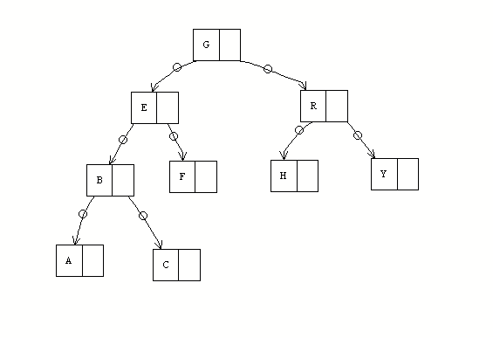
Binary search tree

Slide 12
Mixed-radix sorting
Radix sort
Mixed-radix sort because of different number of alleles
Gonnet GH, Baeza-Yates R (1991) Handbook of algorithms and Data Structures. Addison-Wesley.

Slide 13
Gene counting (cont)
Missing data
MCAR
Little, Rubin (1987) Statistical Analysis with Missing Data. Wiley, NY

Slide 14
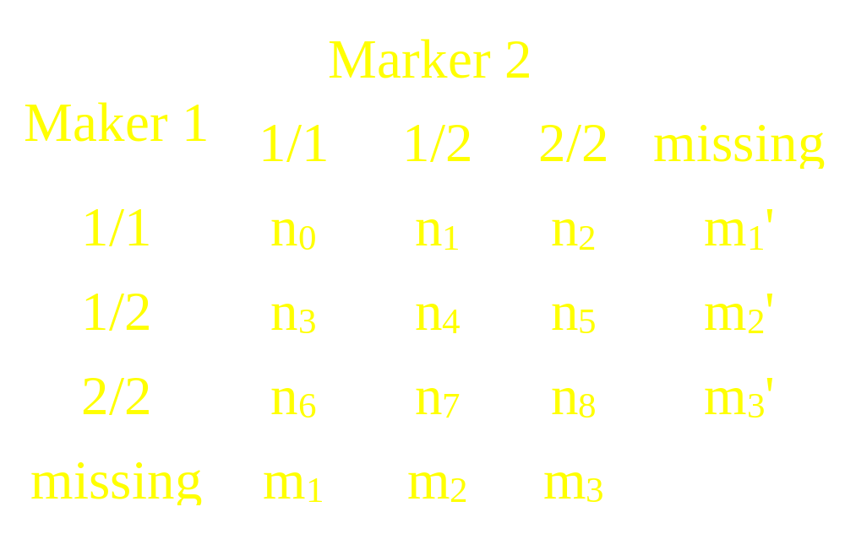
Gene counting (cont)
Simple 2 SNPs

Slide 15
Gene counting (cont)
Let g’s be genotype probabilities, and
i.e., the marginal probabilities
t₁=g₀+g₃+g₆, t₂=g₁+g₄+g₇, t₃=g₂+g₅+g₈
t₁'=g₀+g₁+g₂, t₂'=g₃+g₄+g₅, t₃'=g₆+g₇+g₈

Slide 16
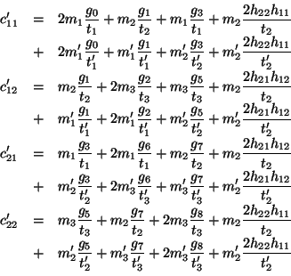
Gene counting (cont)

Slide 17
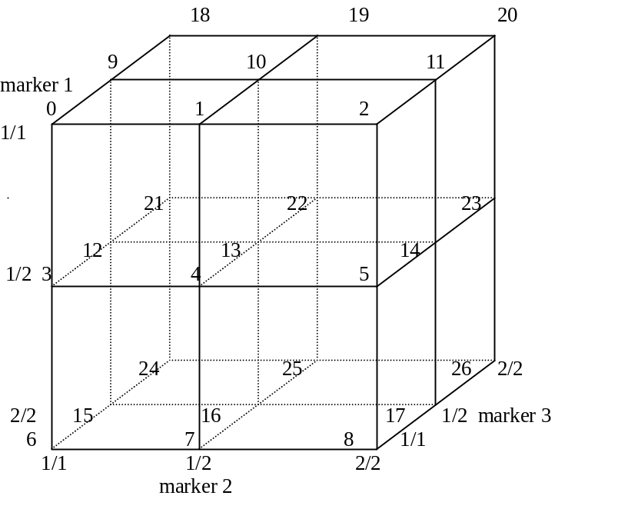
Gene counting (cont)
3 SNPs (geometry)
A general algorithm is necessary

Slide 18
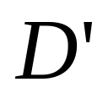
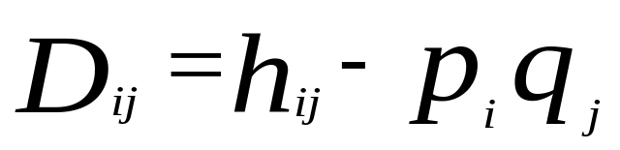

definition
Lewontin (1964) Genetics 49:49-67; Hedrick (1987) Genetics 117:331-41; Zapata et al. (2001) AHG 60: 395-406
=

Slide 19
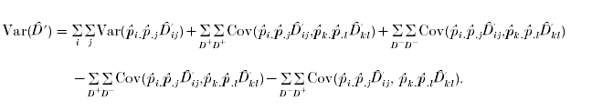
SE( ) (cont)
dilemma in implementation (+/- D, I,j,k,l)
use +/- as indicator to couple with I,j,k,l
implemented in 2LD

Slide 20
Gene counting (cont)
MCMC methods
Not without problems (model-dependent, heuristics)
Lazzeroni, Lange (1997) AS 25:138-68; Stephens et al. (2001) AJHG 68:978-89; Niu et al. (2002) AJHG 70: 157-69

Slide 21
NP-completeness
Try all possibilities
Now 2^{h-1} possible phases, where h is the number of heterozygous sites
Aho AV, Hopcrof JE, Ullman JD (1983) Data Structures and Algorithms, Addison-Wesley

Slide 22
Heuristics
An algorithm that quickly produces good not necessarily optimal solution
  TSP algorithms, used for physical mapping
  Linear integer programming, e.g. Gusfield (2001) JCB 8: 305-23

Slide 23
Mutation detection (cont)
Mixed language programming
Algorithms from Applied Statistics (AS91, AS170, AS245, AS275 in Fortran (http://lib.stat.cmu.edu)
PAP, ACT and early versions of Morgan

Slide 24
Summary
Current paradigm
  variable utilities and problem specific
    Sham et al (2000) GE 19: S22-8. QTL asertainment problem, SAS/Fortran/Unix
    ESF data analysis, LINKAGE, C/Unix scripts
Needs consortium work
  GUI: Mx; Guo, Lange (2000) TPB 57: 1-11
  Integrated tools

Slide 25
Summary (cont)
It is of interests in
  population genetics
  mathematics
  statistics
  algorithm design

Slide 26
Software
Twin
2LD
EHplus
Genecounting
Available from http://www.iop.kcl.ac.uk/IoP/Departments/GEpiBSt/software.stm

