Slide 1
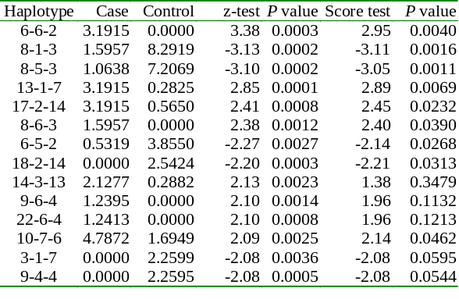
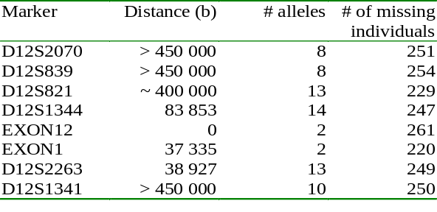

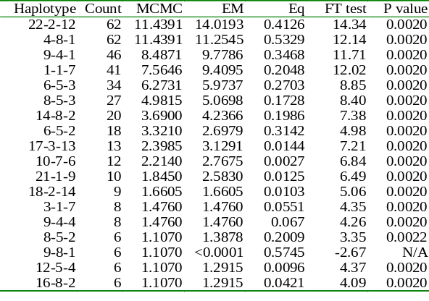
ASSOCIATION ANALYSIS OF UNRELATED INDIVIDUALS
USING POLYMORPHIC GENETIC MARKERS
Jing Hua Zhao, Wendi Qian, University College London, UK and MRC Clinical Trials Unit, London, UK
BACKGROUND
Association analysis of unrelated individuals using multiple genetic markers are increasingly used. This could either be a marker-marker or marker-trait analysis. Haplotype phase uncertainty needs to be taken into account.
Clayton (2001) and Qin et al. (2002) have proposed heuristic EM and MCMC algorithms, but both are limited to SNPs. Here method in Clayton (2001) is extneded to multiallelic markers.
Previous global association tests using likelihoods do not give haplotype specific statistics, which are of considerable interest. We show via example they can be obtained during likelihood-based permutation tests.
METHOD AND IMPLEMENTATION
EXTENDING CLAYTON (2001)
The new algorithm has the same feature of Clayton algorithm but considers multiple alleles when maintaining subject and haplotype lists.
Appropriate procedure has been implemented to use results from multiple imputation as well as producing SAS programs containing the imputed data.
Table 2. Comparison of individual haplotypes for HLA data
The z-statistic is comparable to score statistic, while empirical
P values are due to different permutation procedures.
2. ALDH2 markers and 130 alcoholic patients and 133 controls. This example shows the usefulness of LD-based analysis, the effect of missing data and importance of heuristic algorithm we implemented.
Table 3. Eight ALDH2 region markers on Chromosome 12
GLOBAL ASSOCIATION TESTS
Likelihood-based permutation procedure is useful for producing LD- based statistics (Zhao et al. 1999)
1. MARKER-MARKER ANALYSIS
χ2 Statistic = -2(l[assuming association]-l[linkage equilibrium])
2. CASE-CONTROL ANALYSIS
χ2 Statistic = -2(l[case+control]-l[case]-l[control])
Haplotype frequencies can be used for haplotype specific tests.
HAPLOTYPE SPECIFIC STATISTICS
Simple Freeman-Turkey statistic for marker-marker analysis
O, E = haplotype counts assuming linkage disequilibrium and linkage equilibrium
Test of proportions for case-control heterogeneity analysis
θ₁, θ₂ =haplotype frequency parameter, V(.) = the variance function.
93 individuals with complete genotypes
1 month using only all markers by standard EM algorithm
(Zhao et al. 2002)
6 days for 100 EM iterations using only possible haplotypes excluding two individuals with genotypes at only two loci
5 minutes for posterior trimming with threshold 0.001 but 8 hours with threshold 0.00001 (the new implementation)
3. 9 SNPs in APOC3/A4/A5 region from 3,012 individuals to study association with CHD and triglycerides. It shows drawbacks of heuristic algorithms and need to control for covariates.
Log-likelihoods by Qin et al. (2002), Clayton (2001), Zhao et al.(2002) were -13,988.0, -11,607.7 and -11,521.5, respectively, suggesting increasing optimality
30min for Qin et al. (2002) and Clayton (2001), but 5min by Zhao et al. (2002), so the raw sorting approach is less appealing, method using sufficient statistics is desirable.
Method of Zhao et al. (2002) also gave equilibrium likelihood
EXAMPLES
1. HLA DRB, DQA and DQB markers (25,10,15 alleles) for 94 Schizophrenic patients and 177 controls. It shows the efficiency of polymorphic markers and use of haplotype specific tests.
Table 1. Comparison of MCMC and EM estimates
CONCLUSION
The heuristic EM and MCMC method is able to deal with multiple multiallelic markers, but it is still difficult to use it to obtain equilibrium likelihood and sufficient statistics are necessary for large sample.
Haplotype specific statistics an be obtained from likelihood-based implementations. They are simpler than the score statistics.
ACKNOWLEDGEMENT
We are grateful of Dr padraig Wright for providing the HLA data, Prof Alun Thomas for his unpublished manuscript and result of using possible haplotypes on ALDH2 data. We thank Dr David Clayton and Prof Jurg Ott for making their programs available. Jing hua Zhao wishes to thank Colleagues in University College and Prof Pak Sham and other Colleagues in Institute of Psychiatry for collaborative work, NIA grant to Whitehall II study (AG13196) for support.
REFERENCES
Clayton (2001). http://www-gene.cimr.cam.ac.uk/clayton/software
Qin ZS. T Niu, JS Liu (2002). Am J Hum Genet 71, 1242-7
Zhao H, Pakstis AJ, Kidd JR, Kidd KK (1999). Ann Hum Genet 63:167-179, 1999.
Zhao JH, S Lissarrague, L Essioux, PC Sham (2002). Bioinformatics 18, 1694-5
Haplotype assignment by EM was unambiguous except for one individual with missing data.

