Slide 1
Association Analysis Using Genetic Markers
Jing Hua Zhao
Department of Epidemiology & Public Health
University College London

Slide 2
Outline of Talk
Scope of genetic association analysis
Theory meets data: association analysis using population data
  Methodology and application
  Issues to be dealt with in practice
    Sparse table, model-dependent, missing data, haplotype-specific tests, haploid data, covariates

Slide 3
Genetic Association Analysis
The study of frequency differences between cases/controls, which plays a crucial role in genetic mapping (e.g. HLA and autoimmune diseases)
  Assumption (functional locus itself, LD)
  Study design (family, population)
Lander & Schork (1994) Science; Risch & Merikangas (1996) Science; Botstein & Risch (2003) Nat Genet

Slide 4
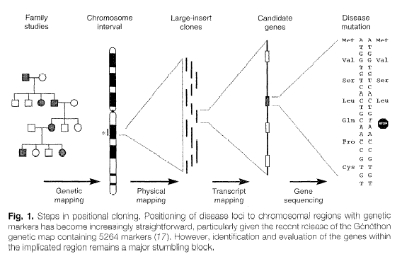
Steps in Positional Cloning
Schuler (1996) Science

Slide 5
Methods
Single markers
  2xk table
  χ² test, allele-wise, genotype-wise
Multiple markers
  Haplotype association
  Functional haplotype, or LD
Sasieni (1997) Biometrics

Slide 6
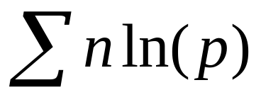
Haplotype Analysis
Log-likelihood =
  where n,p are the genotype count and probability
  H₀: p is made of independent haplotype frequencies;
  H₁:p is formed by haplotype frequencies
LRT provides a test of genetic association

Slide 7
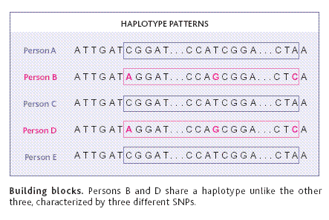
Haplotype Association
Couzin (2002) Science

Slide 8
War Stories
Study of Schizophrenia and HLA markers
  94 Schizophrenic patients and 177 controls
  HLA markers DRB, DQA, DQB, with 25, 10, 15 alleles
  Is there any association between these markers and Schizophrenic status?

Slide 9
Issues to be Resolved
The genotype table is too large
  memory problem, (e.g 25*26*10*11*15*16/8 cells and 25*10*15 possible haplotypes)
  too slow
  asymptotic theory invalid
Disease model (q,f’s) needs to be specified

Slide 10
The Solutions
An improved algorithm
  Efficient data structures according to linked list
  Sentinel variable to control for loops
  Permutation and Model-free tests
  Implemented in EHPLUS
  Results of analysis
Zhao et al. (2000) Hum Hered

Slide 11
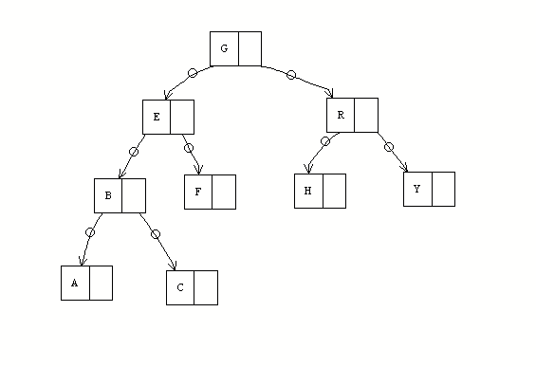
Further Improvement
The implementation is too slow
To speed up
  Binary tree
  Iterate over observed data
  Likelihood-based LD statistics
  Implemented in fastEHPLUS
Zhao & Sham (2002) Hum Hered

Slide 12
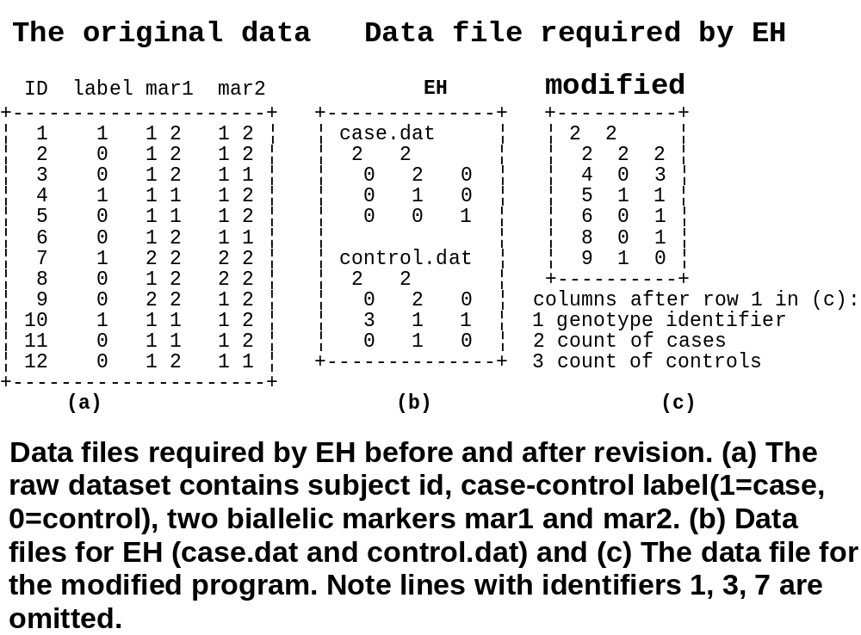
Data Structure

Slide 13
Missing data
Alcoholism and ALDH2 Markers
  130 alcoholics and 133 controls, only 93 with incomplete data
  D12S2070, D12S839, D12S821, D12S1344, EXONXII, EXON1, D12S2263, D12S1341 with alleles 8, 8, 13, 14, 2, 2, 13, 10
  More sophisticated algorithm
  No haplotype specific tests

Slide 14
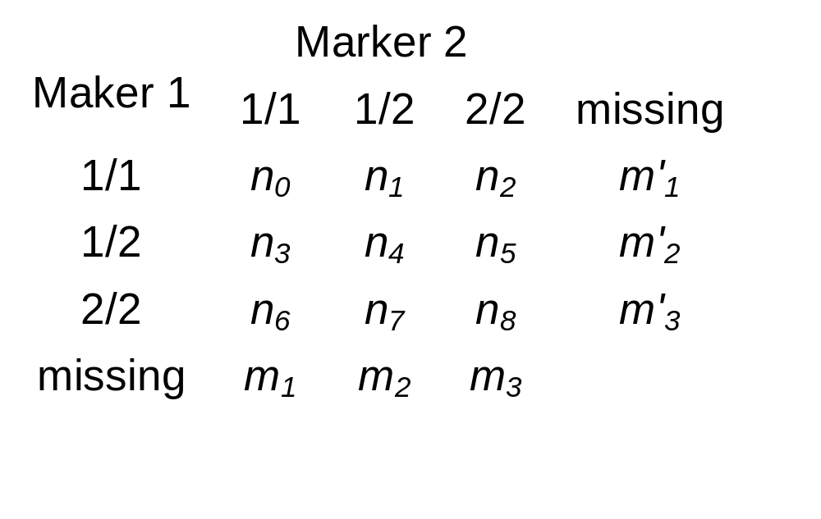
Gene-counting with Missing Data
Simple 2 SNPs

Slide 15
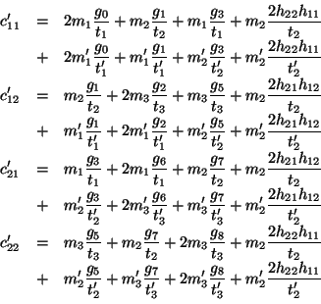
Gene-counting with Missing Data

Slide 16
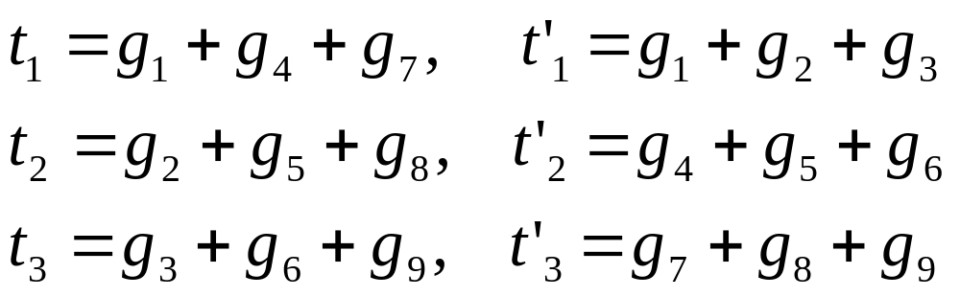
Gene-counting with Missing Data
  Where
  i.e., the marginal probabilities. The g’s are genotype probabilities

Slide 17
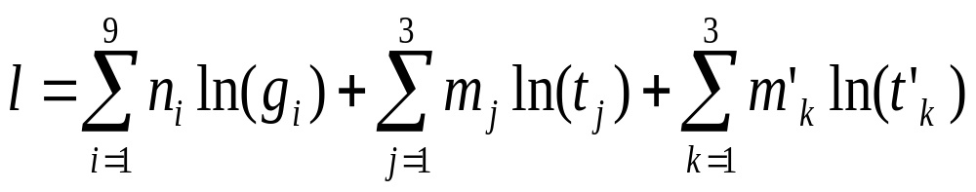
Gene-counting with Missing Data
The log-likelihood is now
To implement using mixed-radix number
Zhao et al. (2002) Bioinformatics; Zhao & Sham (2003) Comp Prob Meth Biomed

Slide 18
Haplotype-specific Tests and Covariates
Solutions
  To use simple Freeman-Tukey and z tests
  To incorporate core algorithms into available software, haplo.score
  To integrate a number of programs under a unified framework
  To incorporate other available methods
Zhao & Qian (submitted)

Slide 19
Haploid data and More Markers
Study of Parkin’s and MAO markers
  183 Parkinson’s and 157 controls (150 Males, 190 Females)
  Five MAO region genes
Revise gene counting algorithm, including Quicksort and trimming algorithms in HAP
Zhao (submitted)

Slide 20
Reflections on Assumptions
Hardy-Weinberg equilibrium
A simple Dirichlet prior assuming neutrality
To assume free of population stratification
Can we relax these assumptions?

Slide 21
Further Challenging Issues
Longitudinal data
  Whitehall II data, e.g. Cognitive function and APOE/APOC1 haplotypes
BioBank project?

Slide 22
Conclusions
Genetic association analysis using cases and controls is a powerful design
It is widely used yet there are many interesting problems and challenging issues
Software and references available from http://www.hgmp.mrc.ac.uk/~jzhao

Slide 23
Related Work
Power of sib pair linkage in longevity
Homozygosity mapping of PARM
Whitehall II study
  APOE and cognitive function (Whites)
  Plasma fibrinogen (Karasek-Theorell model, SEM, LGC, MI)
  Statistical methodology

Slide 24
LD Statistics
For commonly used LD statistics
  To devise more appropriate algorithms to obtain sampling errors, better than that reported by Zapata et al. (2001)
  To handle for multiallelic markers
  To include a variety of other statistics
  Implemented in 2LD
Zapata et al. (2001) Ann Hum Genet

