Slide 1
ANALYSIS OF CHANGE AND GENETIC POLYMORPHISMS
Jing Hua Zhao
Department of Epidemiology & Public Health
University College London
1-19 Torrington Place, London WC1E 6BT
IOP 1/9/2005
Comments to j.zhao@ucl.ac.uk

Slide 2
OUTLINE
The Whitehall II Study
The motivating example
The difficulty of defining change
The problem of phase ambiguity with genetic polymorphisms
The joint model of change and haplotypes
Some results
Summary

Slide 3
THE WHITEHALL II STUDY
A closed cohort of 10,308 British civil servants in London
Baseline data collection in 1985 and phase 8 onging
Seven waves of follow-ups alternating clinical screen and postal questionnaire
Cohort profile described in
  Marmot, et al. Lancet 337:1387-1393, 1991.
  Marmot, Brunner. IJE 34:251-256, 2005
  http://www.ucl.ac.uk/whitehallII

Slide 4
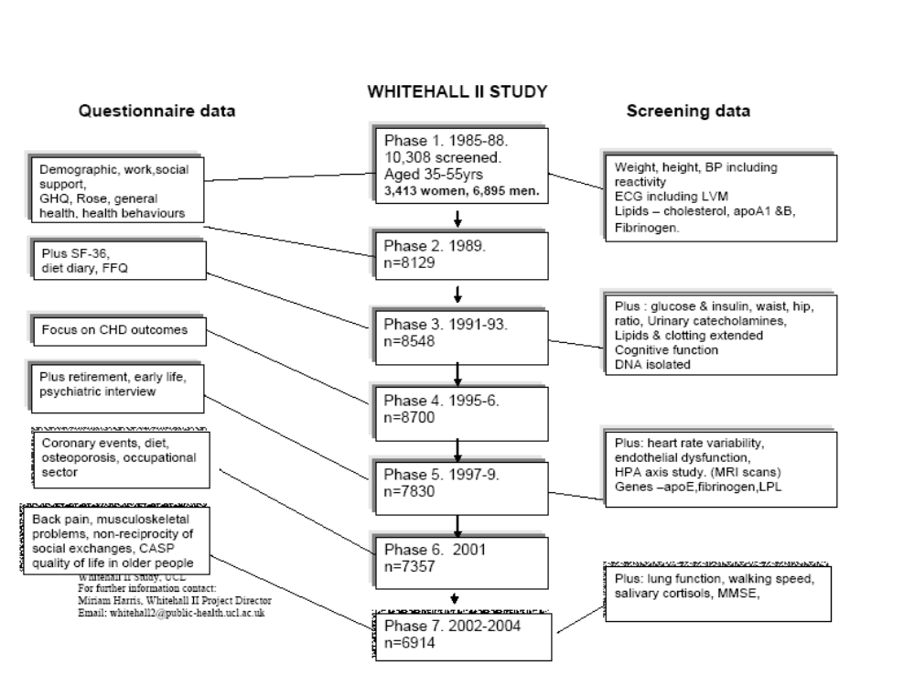

Slide 5
THE MOTIVATING EXAMPLE
The five scores of cognitive function
  Memory, AH4, Mill Hill, phonemic and semantic fluency
  Data available for 40% participants at phase 3, all participants at phase 5, expecting data from all participants at phase 7
The aim is to assess association between SES, APOE (and other polymorphisms) and cognitive function
Important for healthy aging, e.g. cognitive decline and dementia

Slide 6
THE STATISTICAL PROBLEMS
The difficulty of assessing change
Associate problems
  Ceiling and floor effects
  Regression towards the mean
  Cohort and practice effects

Slide 7
DEFINING CHANGE
Difference score
ANCOVA
Longitudinal models (repeated measures, growth curves)
Can be unified in structural equation modelling (SEM)

Slide 8
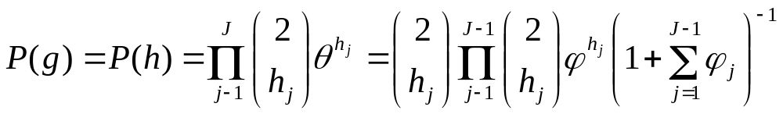
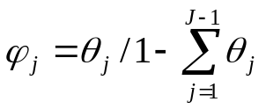
THE PROBLEM OF UNKNOWN PHASE
Haplotype is a collection of alleles from neighbouring loci
There are 2^(L-1) possible phases if L loci are heterozygous
Letθ=(θ1, θ2, …, θJ) be the vector of haplotype frequencies. Assuming Hardy-Weinberg equilibrium,
and

Slide 9
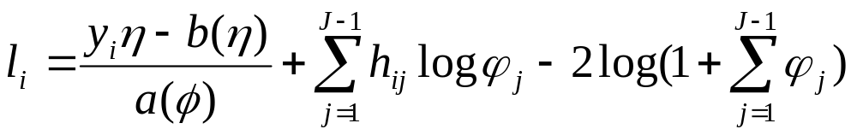
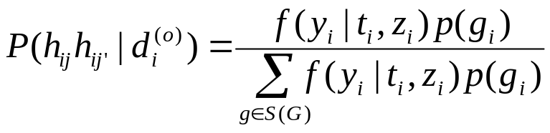
THE COMBINED MODEL
The complete data log-likelihood for the ith individual ignoring some constants is given by LMM and more general GLMM
where η=Xβ+Zγ. If t_{i} indicates both genetic and environmental effects, then an EM algorithm involves,

Slide 10
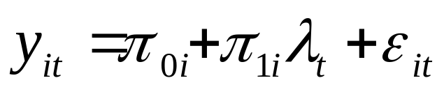

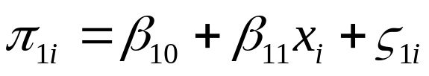

A GROWTH CURVE MODEL
The model has the form
where is a function of occasion t

Slide 11
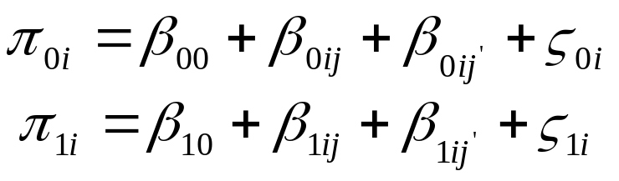
A GROWTH MODEL WITH HAPLOTYPES
The properties can be examined using Monte Carlo simulation involves published haplotype frequencies, given sample sizes and growth model parameters

Slide 12
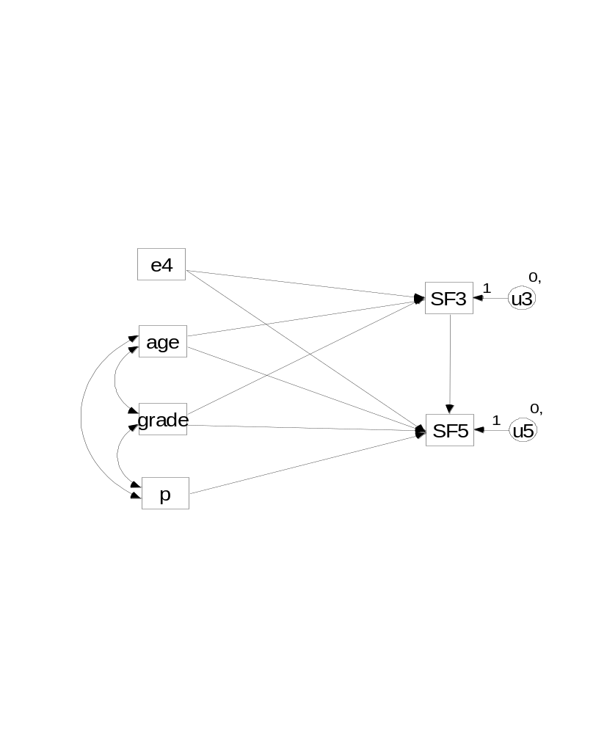
SEM (TWO-PHASE DATA)
e4 is APOE-ε4 carrier status, p is an indicator for practice effect, grade is civil service employment grade (SES), SF is semantic fluency

Slide 13
REGRESSION TOWARDS THE MEAN
 | Age | Memory | AH4 | Mill Hill | P. fluency | S. Fluency
 | Group† | Mean (SD) | Mean (SD) | Mean (SD) | Mean (SD) | Mean (SD)
Low | 1 | 3.63 (0.31) | 4.00 (0.60) | 1.23 (0.19) | 3.00 (0.36) | 2.71 (0.31)
 | 2 | 3.25 (0.27) | 5.08 (0.58) | 1.24 (0.20) | 2.16 (0.29) | 2.33 (0.26)
 | 3 | 2.69 (0.32) | 5.57 (0.54) | 1.00 (0.28) | 2.57 (0.39) | 2.49 (0.29)
 | 4 | 3.16 (0.30) | 3.56 (0.55) | 1.24 (0.25) | 1.79 (0.30) | 1.69 (0.30)
Medium | 1 | 2.10 (0.13) | 2.17 (0.33) | 0.44 (0.11) | 1.07 (0.19) | 1.56 (0.18)
 | 2 | 1.91 (0.12) | 1.67 (0.31) | 0.22 (0.11) | 1.21 (0.20) | 1.59 (0.19)
 | 3 | 1.87 (0.16) | 0.83 (0.43) | 0.26 (0.15) | 0.49 (0.27) | 1.08 (0.28)
 | 4 | 1.05 (0.13) | 0.18 (0.40) | 0.07 (0.17) | -0.08 (0.20) | 0.43 (0.18)
High | 1 | 0.30 (0.17) | -1.28 (0.42) | -0.35 (0.12) | -0.95 (0.27) | 0.33 (0.23)
 | 2 | 0.27 (0.18) | -1.05 (0.31) | -0.32 (0.12) | -1.01 (0.29) | -0.60 (0.26)
 | 3 | -0.25 (0.23) | -2.14 (0.45) | -0.16 (0.13) | -1.62 (0.36) | -0.28 (0.30)
 | 4 | -1.08 (0.28) | -1.84 (0.47) | -0.32 (0.13) | -3.03 (0.44) | -1.09 (0.33)

Slide 14
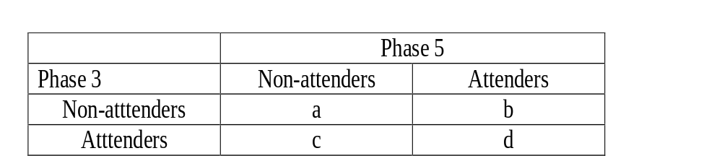
COHORT AND PRACTICE EFFECTS
Note by design 40% participants at phase 3 but all at phase 5. We compare (a). b and c for a given age range to test for cohort effect, (b). c and d for practice effect

Slide 15
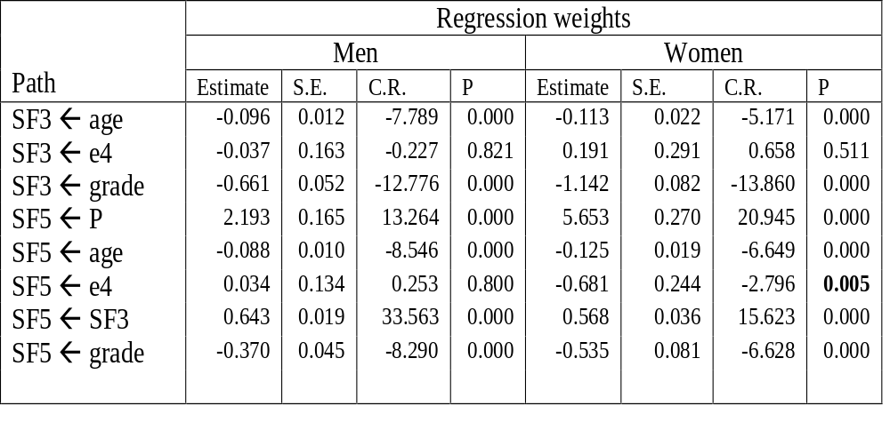
SEM FOR TWO-PHASE DATA

Slide 16
A BRIEF SUMMARY
The different methods of assessing change are closely-linked and can give comparable results, as shown with the two-phase cognitive data in the Whitehall II study
Further consideration is required with unphased genetic data, and a growth model is appealing if multi-wave data is available
A framework such as gllamm (?) would be valuable for longitudinal studies

