Slide 1


Some Perspectives of Graphical Methods for Genetic Data
Zhao JH, Q Tan, S Li, J Luan, W Qian, RJF Loos, NJ Wareham
jinghua.zhao@mrc-epid.cam.ac.uk
http://www.mrc-epid.cam.ac.uk/~jinghua.zhao
14 August 2008, Dortmund, Germany
2008

Slide 2
Outline
Background
Case studies
Examples from R
General discussion

Slide 3
Background
This can be seen as an addition to a useR!2007 presentation.
  ctv for genetics
  identity, powerpkg, multic, lodplot, qtl
  gap, genetics, haplo.stats (hapassoc,…), GenABEL, pbatR, SNPassoc, snpMatrix
The general context is the promise of genetic analysis of complex traits (useR!2008 Tutorials) due to recent genotyping technology and characterization of human genome:
  HapMap, http://www.hapmap.org
  One thousand genome project

Slide 4
Consortium
Wellcome Trust Case-Control Consortium (WTCCC): >17000 individuals on BD, CAD, CD, HT, RA, T1D, T2D
DIAbetes Genetic Replication And Meta-analysis (DIAGRAM), >50000 individuals on T2D
Genetic Investigation of ANthropometric Traits (GIANT): >32000 individuals followed by >58000 on obesity, weight, height and central adiposity
Meta-Analysis of Glucose- and Insulin-related traits Consortium (MAGIC), >45000 individuals

Slide 5
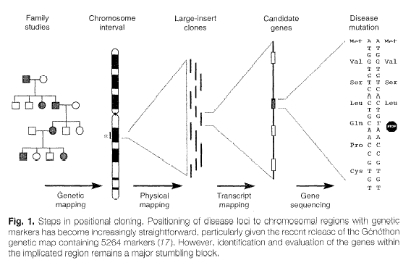
Steps in Positional Cloning
Schuler (1996) Science

Slide 6
Aspects in need of graphical representation
Phenotypic data
  Individual data, e.g., two-way plot, conditional plot
  Summary statistics
  Specific features, e.g., pedigree diagram
Genotypic data
  Genome level, regional level, functional level
Genotype-phenotype correlation
  Q-Q plot
  Manhattan plot
  Regional plot
  Forest plot
  Receiver-operating-characteristic (ROC) curve

Slide 7
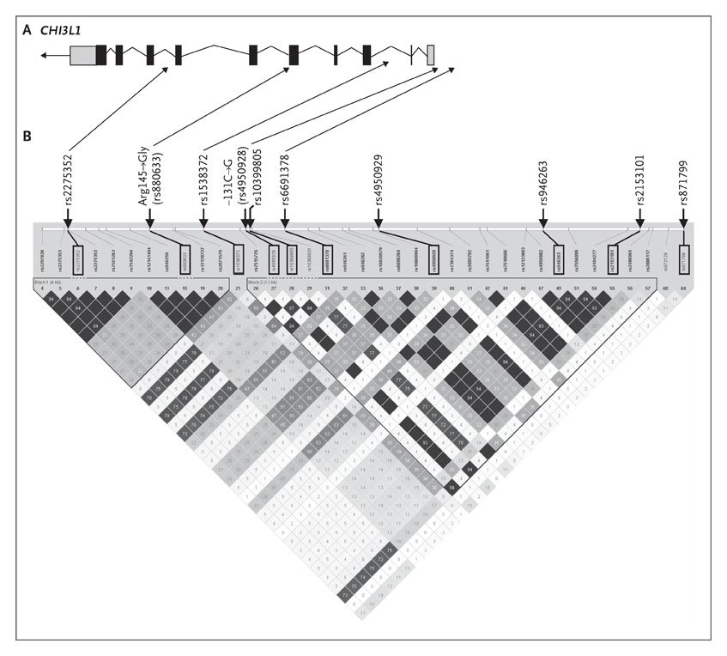
Single-Nucleotide polymorphisms (SNPs) in CHI3L1 and its upstream region on chromosome 1q32.1
Ober et al. NEJM 2008

Slide 8
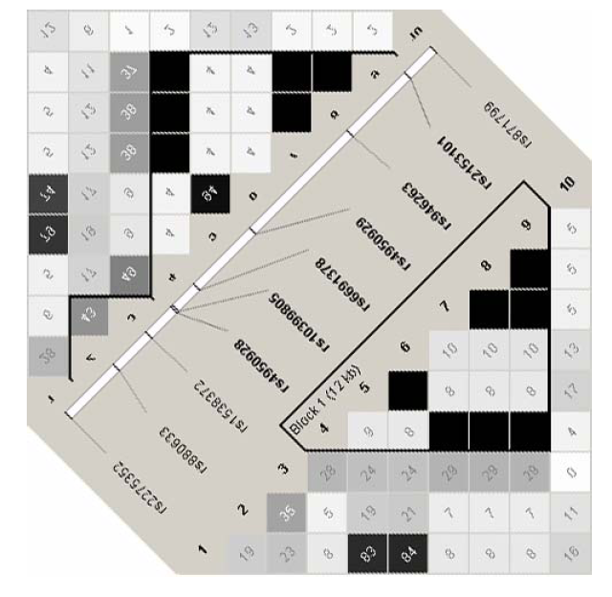
LD (r2) between
10 SNPs of CHI3L1 in Europeans (UL) and Hutterites (LR)
Ober et al. NEJM 2008

Slide 9
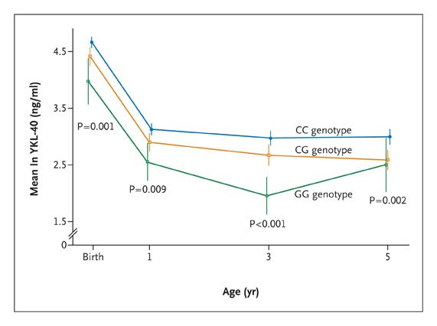
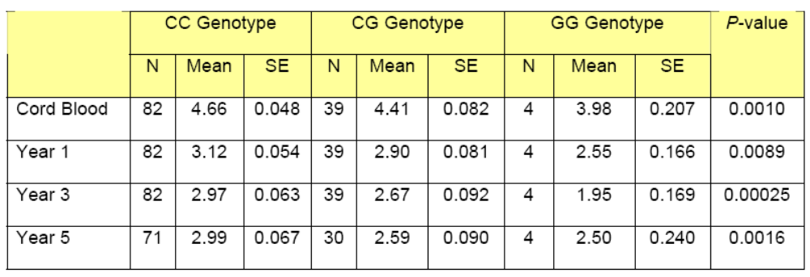
Mean serum YKL-40 levels in Asthma
Ober et al. NEJM 2008

Slide 10
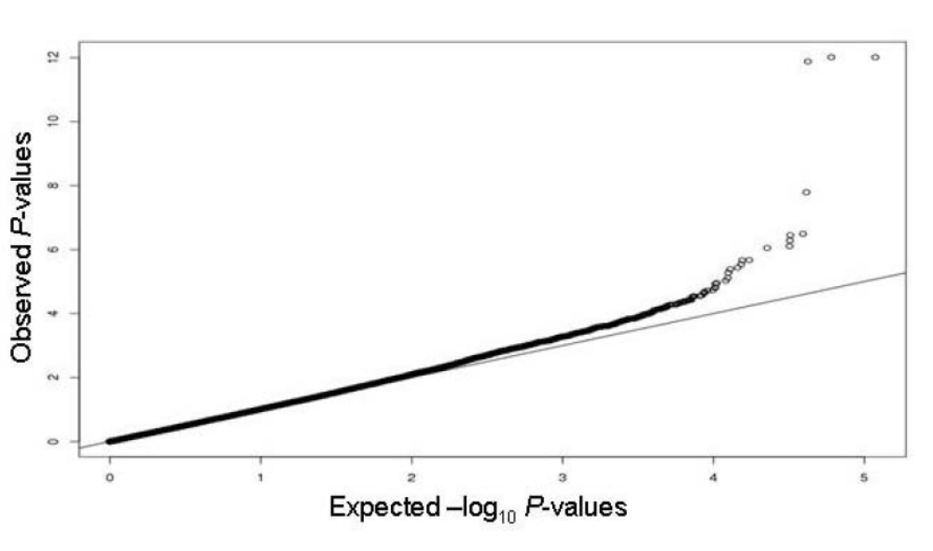
Q-Q Plot of the genome-wide P-values
Ober et al. NEJM 2008

Slide 11
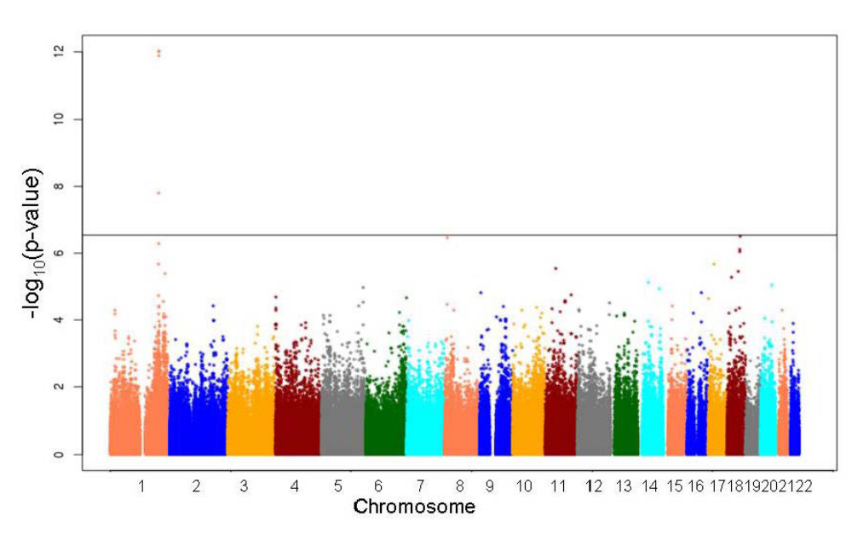
Genome-wide P-values and serum YKL-40 levels.
Ober et al. NEJM 2008

Slide 12
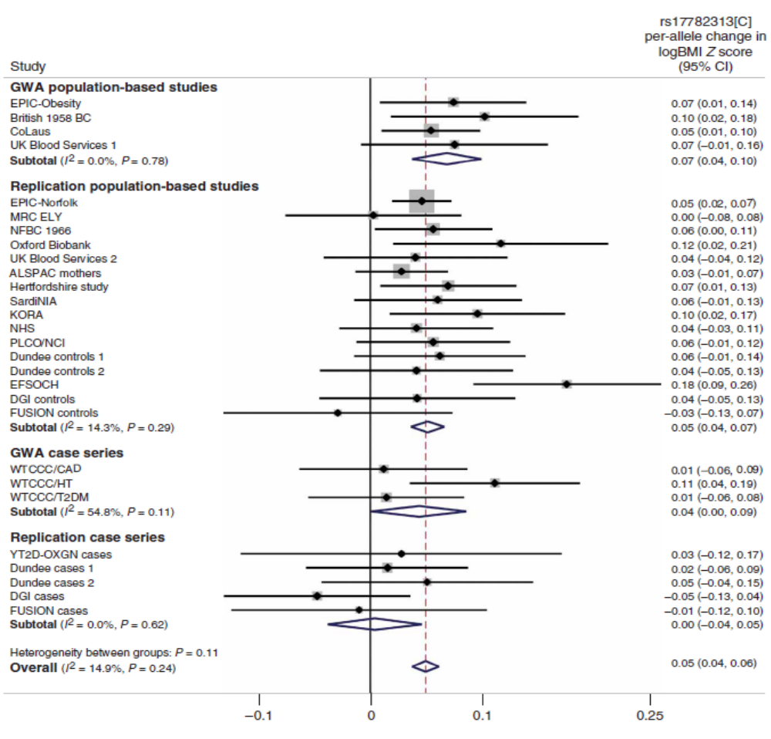
Loos et al. Nat Genet 2008

Slide 13
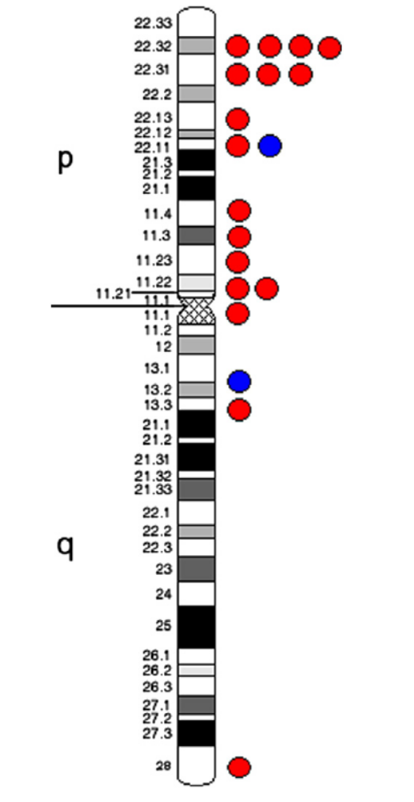
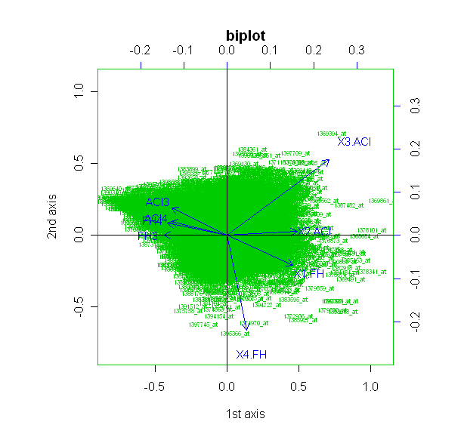
Tan et al. Genomics 2008 (and unpublished)

Slide 14
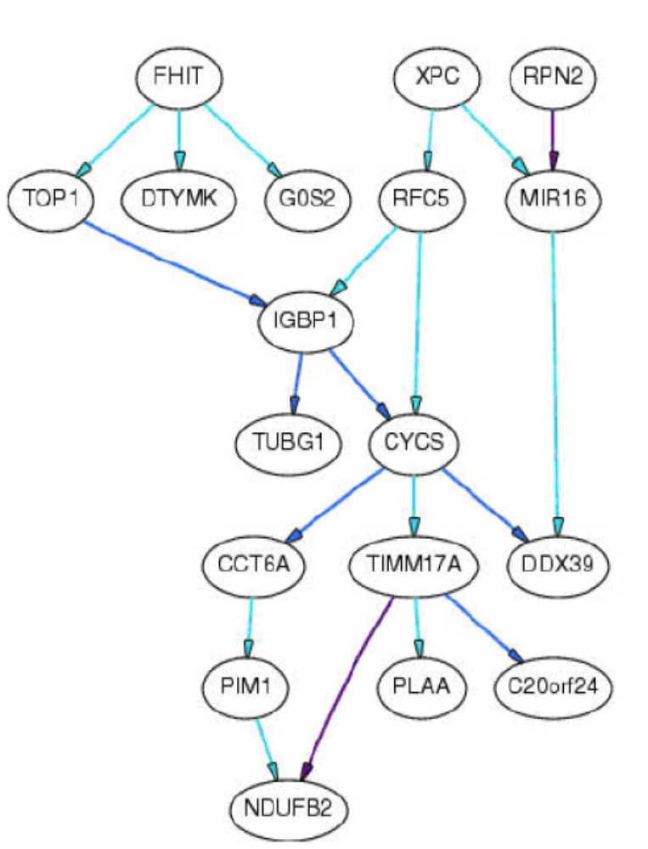
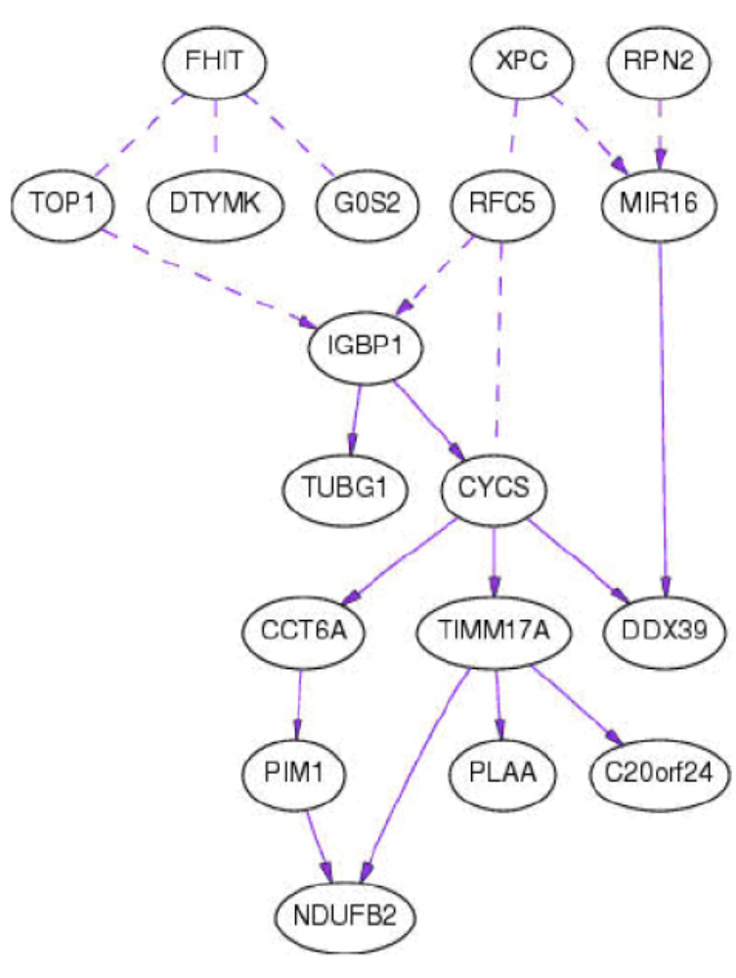
Zhao et al. BMC Proc 2007

Slide 15
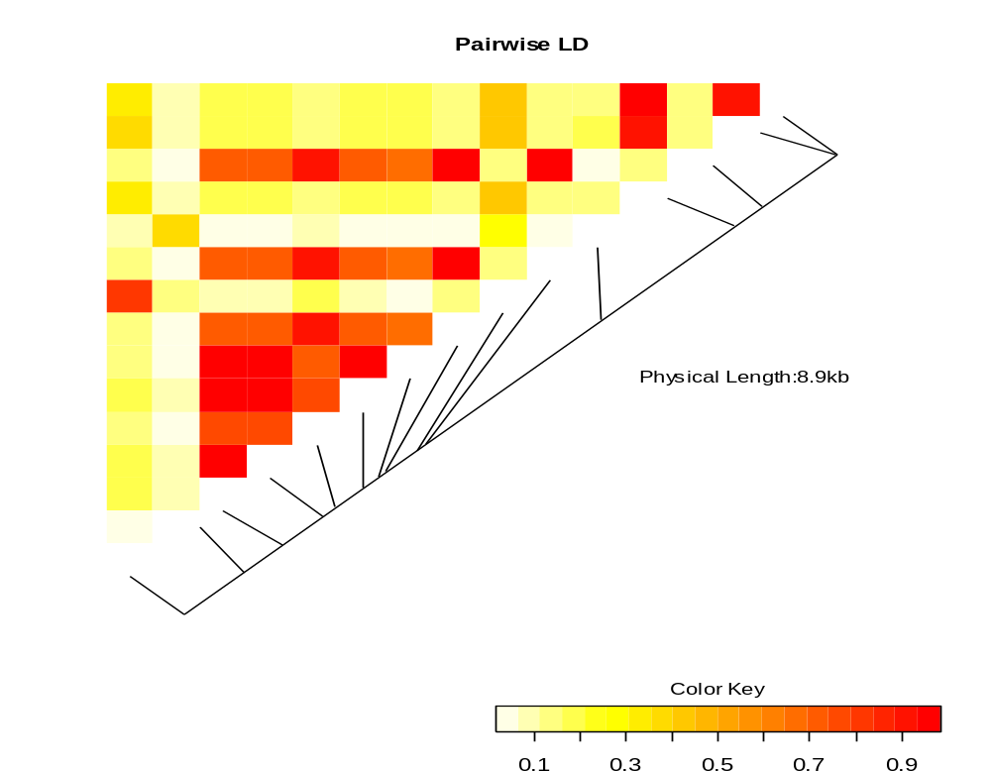
LD heatmap

Slide 16
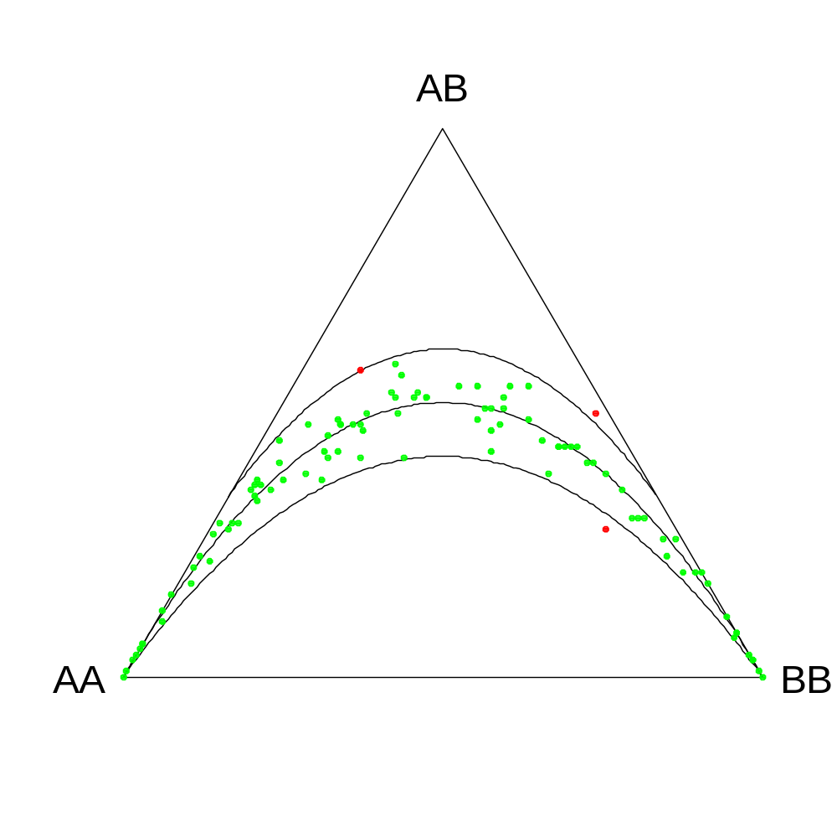
Ternary plot showing distributions of 100 markers for 100 SNPs
Graffelman & Morales-Camarena Hum Hered 2008

Slide 17
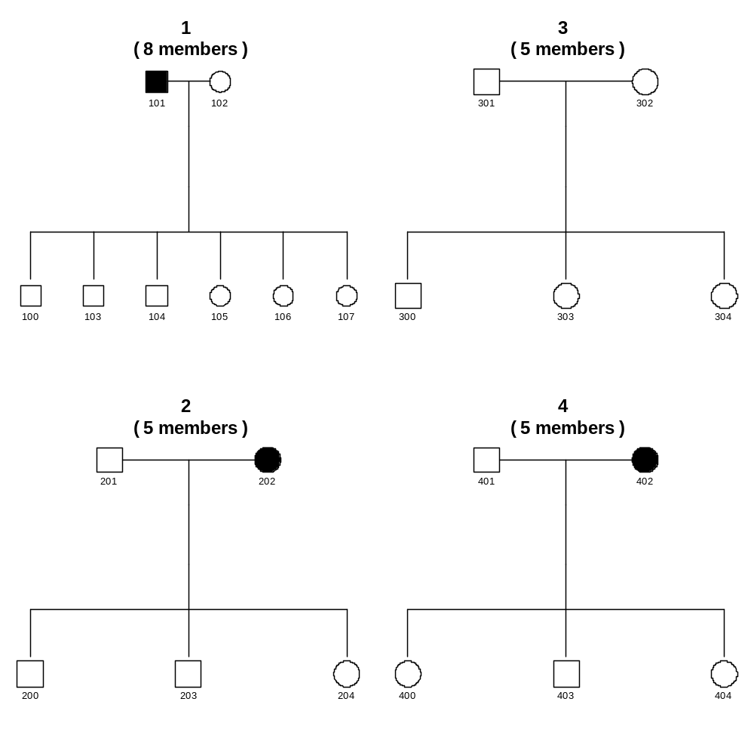

Slide 18
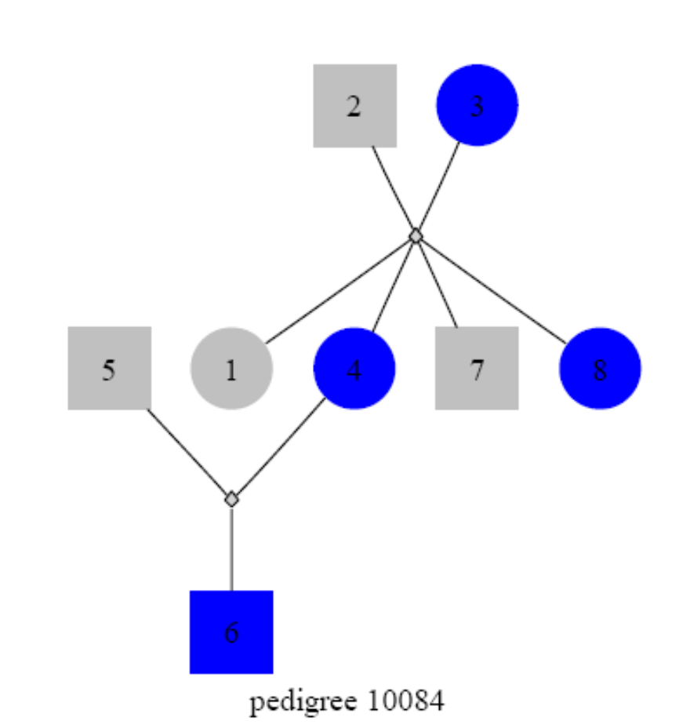
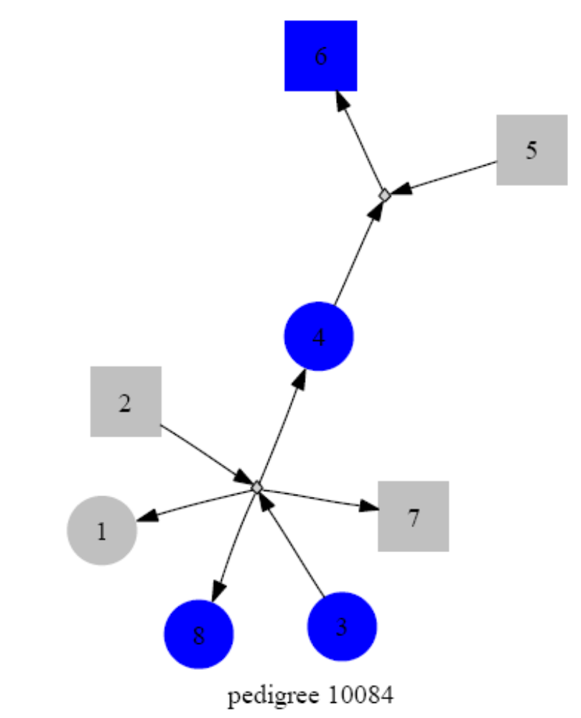

Slide 19
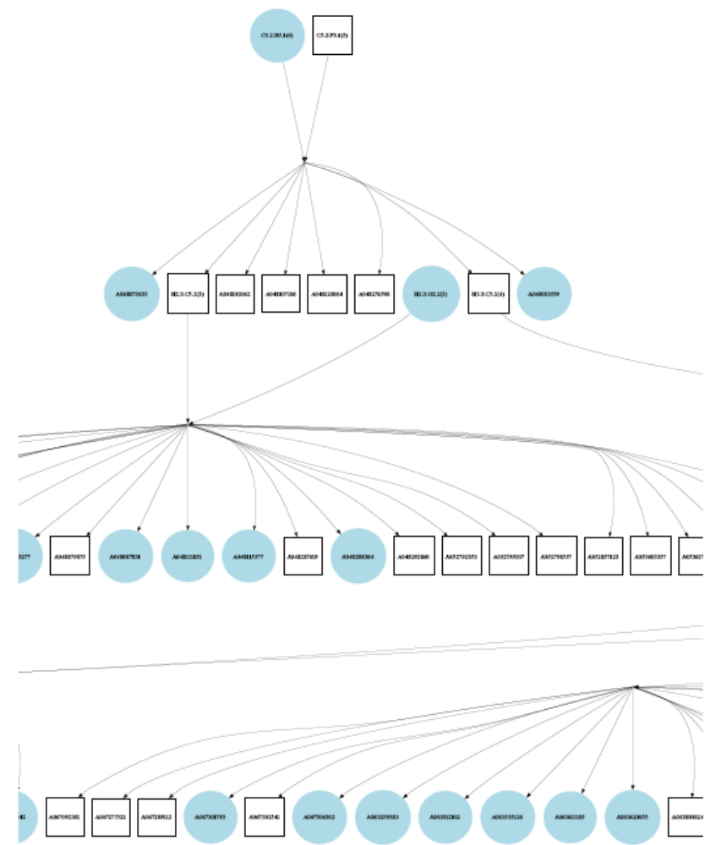
Part of the mouse pedigree from Richard Mott
Similar functionality exists in Rgraphviz package but ideally it can also accept .dot file directly

Slide 20
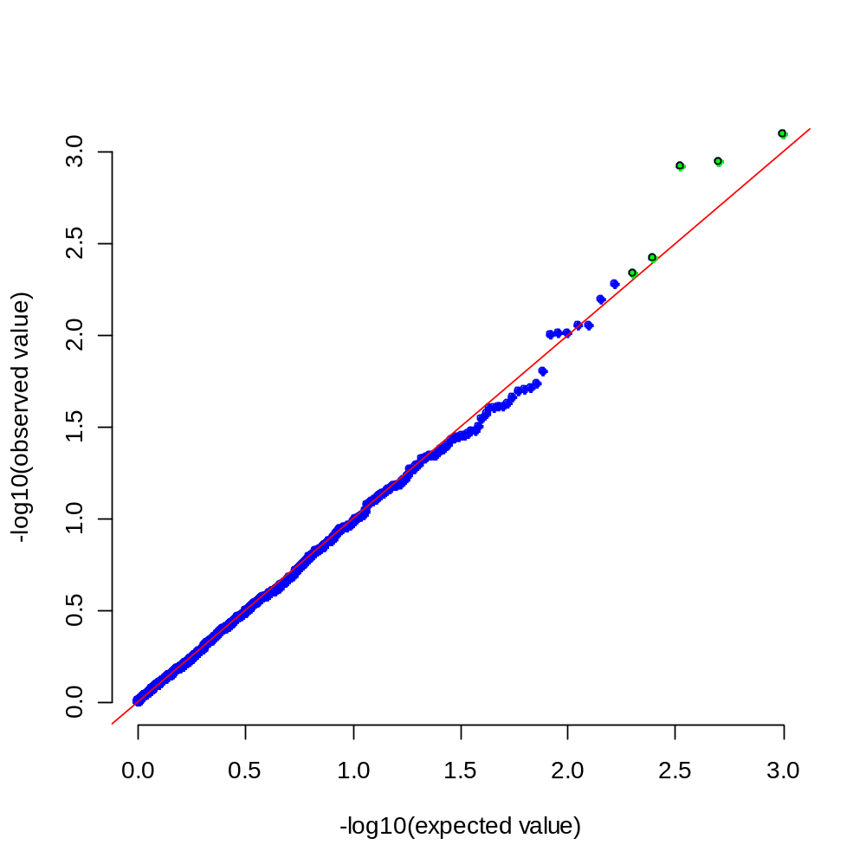
This is unlike qq.plot, qqmath, the former uses robust statistics, but with information such as population substructure

Slide 21
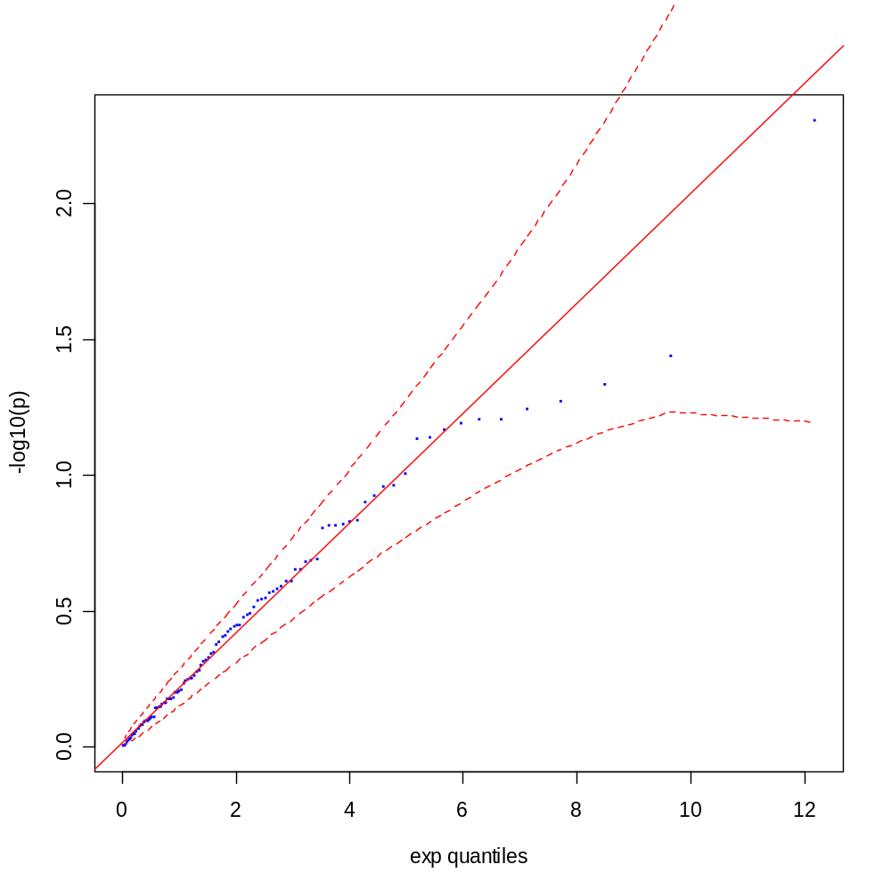
A 95%CI is added, based generally on the order statistics

Slide 22
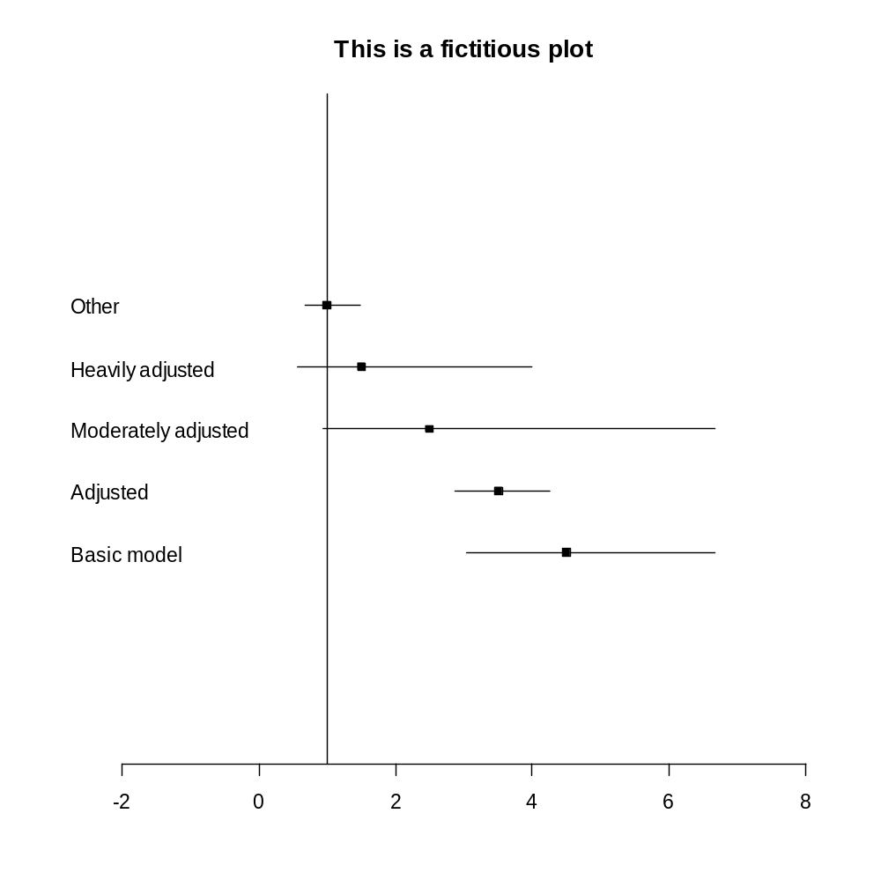
A way of effect-size visualisation
Not unlike forest plot in meta-analysis

Slide 23
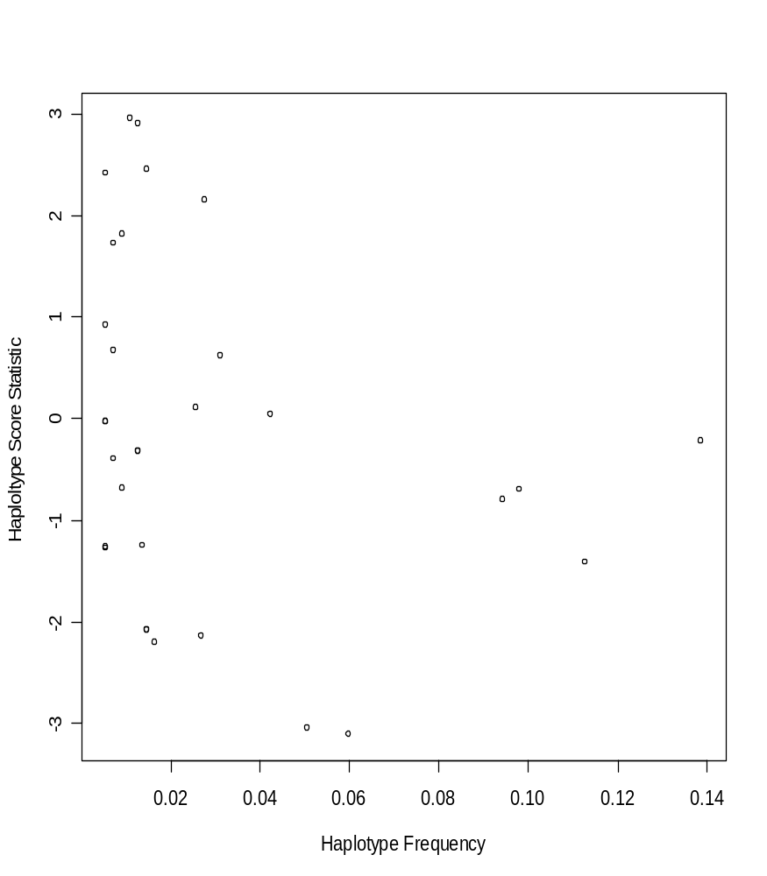
The graph is used to identify particular haplotype with strong effect on phenotype

Slide 24
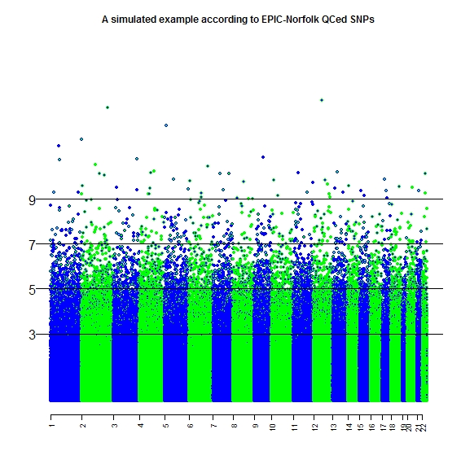
A random colour scheme can be used, highlight or identify points of interests

Slide 25
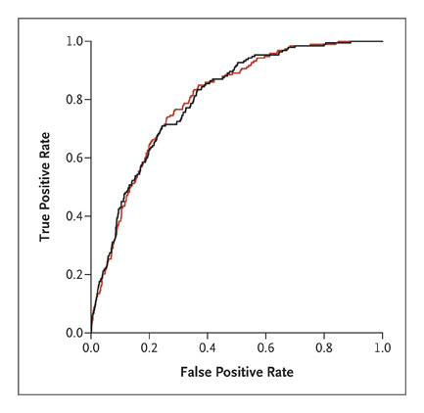
ROC curves for MI, stroke and death with (black)/without (red) genotype.
Kathiresan et al. NEJM 2008

Slide 26
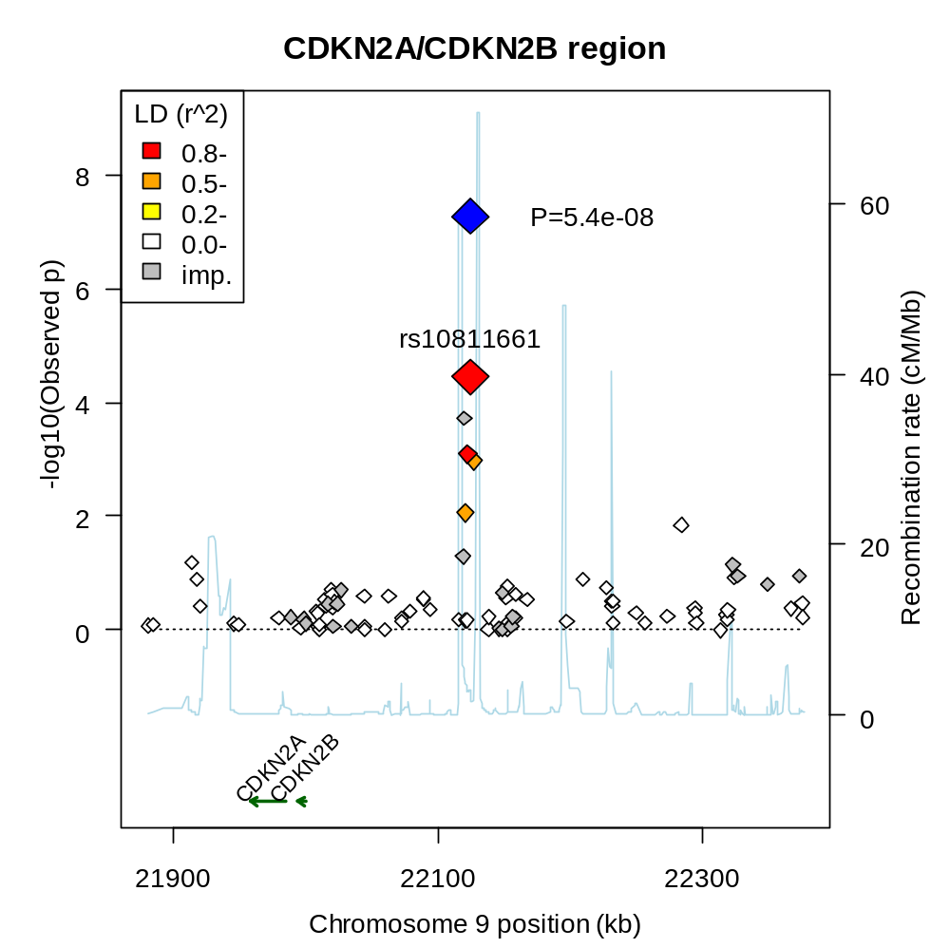
It requires the recombination map, chromosomal position, both available from HapMap, and correlation (r²) between (observed and imputed) SNPs associated with the top-hit SNP

Slide 27
R packages used
HardyWeinberg
LDheatmap
kinship
  plot.pedigree
gap
  pedtodot
  qqunif, qqfun, plot.hap.score
  esplot, asplot
ROCR

Slide 28
Summary
The use of summary statistics and graphics is classic technique for descriptive analysis.
Graphical representation is one of the major driving forces for using R.
There is still a gap between specialized program and a need for more rigorous work in R, e.g., HaploView and a number of R packages (genetics, snpMatrix, LDheatmap). It would be great to have some dynamic flavour, e.g.,
  To implement in rggobi?, optional from spRay?
  To modify code under GPL for R (e.g., HaploView)?
This hopes to be a call for more inputs from the R community, perhaps as motivated from familiarity with both practices.

