Slide 1
BENEFI
Predict EMployMENT
RMIT University
XIAN JING WONG: s3772149
JUHAL SIBY: S3792902
Notes:
Hi everyone today me myself juhal siby and my groupmate Xian Jing will be presenting our postgraduate project Predicting employment in collaboration with our client company Benefi.

Slide 2

Introduction: Benefi
Benefi aims to help employees keep more of their money, escape debt, and improve their overall financial wellness.
Provide loan and financial advice to employees.
Believe employees who have well financial status are better employees.
Notes:
Benefi is a new kind of group benefit that aim to improve the financial wellness of employees. The main concept of the company is in its name, Benefi, which stands for beneficial and Financial. Benefi aims to help employees keep more of their money, escape debts, and improve their financial status. They provide low-interest loan and financial guidance to the employee so employers will have financially empowered employees.Benefi believes that employees who have well financial status are better employees.

Slide 3
Project AIM: Predict Employment
Create a machine learning model to predict the job tenure of the specified loan applicant.
Get better accuracy than what the previous student team of Benefi has achieved which was an r score of 0.62.
Explore how other features affect the job tenure of an individual.
It will help the evaluation of loan application term with the predicted job tenure of applicant.
Notes:
In our project we aim to create a data science prediction model that predict the job tenure of a specified loan applicant.
We try to get better accuracy than what the previous student team of benefi has achieved which was an r score of 0.62.
Other than that, we aim to study how specific features may impact the employability as well as job tenure of an employee and get valuable insight by plotting out different kinds of exploration plot.It will help us to evaluate the loan application term with the predicted job tenure of the applicant.

Slide 4
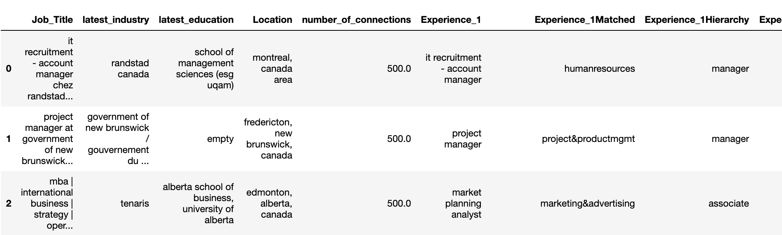

Dataset Provided: Linkedin Dataset
Dataset with LinkedIn profile details (job experiences, education history, number of connections, etc.) in Canada.
Consisted of 4996 rows with 107 features.
Data was crawled and structured by Benefi’s previous student team.
Supporting features from other sources were added into datasets.
Notes:
The dataset that we have been provided in our project has been crawled from LinkedIn by benefi’s previous student team. They have crawled the information of LinkedIn user who were from different variety of job field in Canada.This dataset had 4996 rows with 107 features. Other than basic information that has been mentioned just now, other supporting features were also added into the dataset.

Slide 5
Dataset Provided: Linkedin Dataset
Basic Information
Unemployment Rate (CANADA)
Average Job Tenure PeRiod (months)
Average Attrition Rate
Working experience (1-9), educational history (1-3), location, job position (associate, senior, manager, president), industry, etc.
Matched unemployment rate with the starting & ending date for each job experience stated.
Matched tenure period value based on the industry field of each job experience stated from government data [1].
Matched attrition rate based on different type of industries of each job experience stated.
Notes:
Now coming to the features the dataset has,it includes the basic information of individual profiles such as job experiences with the respective starting date, ending date and total length of period, educational history, number of connections, etc. Other than that, several supporting features like social and economical factors were included into the dataset such as unemployment rate, and average job tenure period by different kinds of job field.It also had average attrition rate which was based on different type of industries of each job experience stated. All these two data was sourced from the Canada Government Official Report.

Slide 6
DAtA Preparation
Data cleaning
Missing data imputation
Data transformation for Modelling
Notes:
We divided the data preparation step into three parts which includes Data cleaning,missing data imputation and Transforming the data for able be fitted with any machine learning model

Slide 7
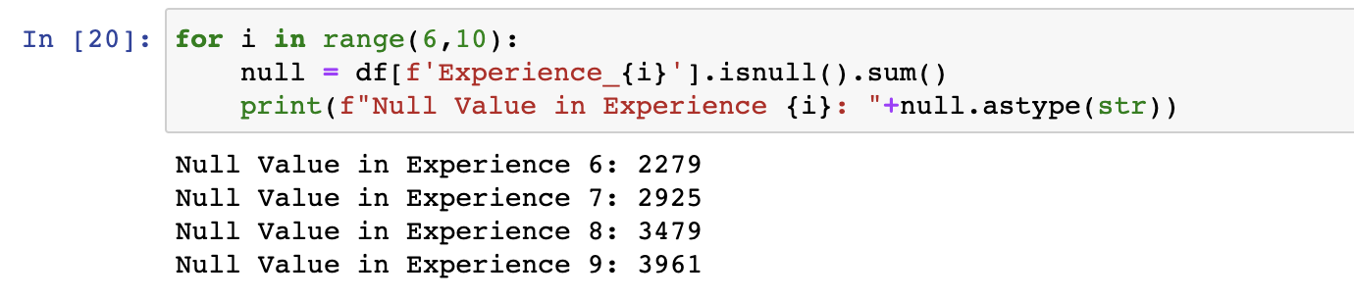
DAtA Preparation
Data cleaning
Drop columns involving Experience 6-9.
Sum of null values in experience columns from 6 to 9 is shown below.
Notes:
we found out that most of the rows had missing values on their Experience 6 to 9 columns.So we decided to drop these columns. This can be explained as people usually don’t change their job so frequently and dont have so many job experience before. The sum of null values in Experience 6 to 9 columns is shown in the figure below.

Slide 8
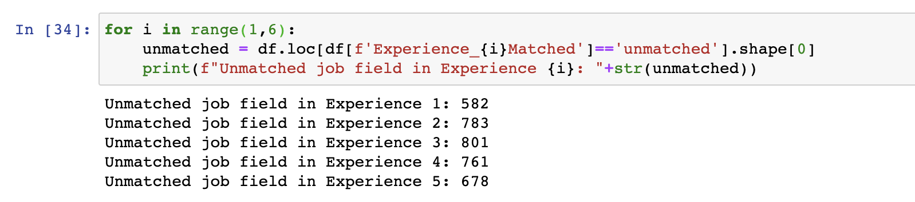
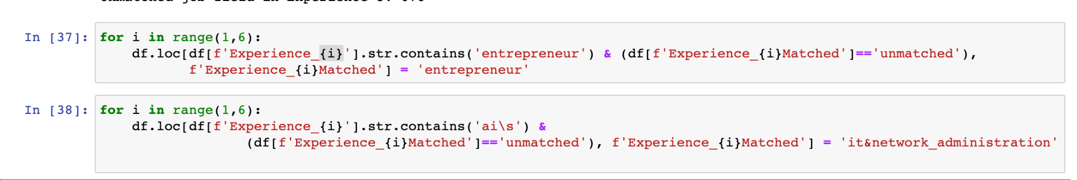
DAtA Preparation
Data cleaning
Unmatched Experiences in 1-5.
Matching Experiences from 1-5.
Notes:
The first figure shows the number of unmatched values in Experiences 1-5 while matching the experience content with the online job field category. So we did we did manual data imputation to match more mismatched job fields with the correct job field in the newly created columns as show in the second figure.

Slide 9
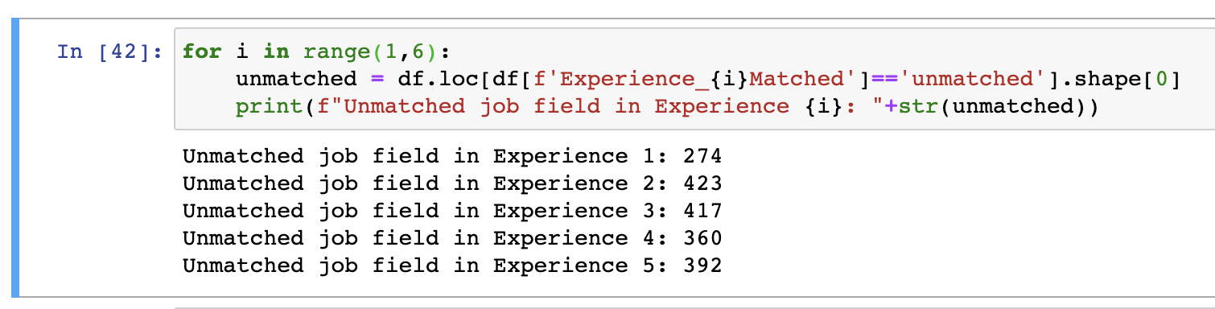
DAtA Preparation
Data cleaning
Improvement of reducing amount of unmatched Experiences in 1-5.
Notes:
The figure here shows the number unmatched values after manual data imputation on experiences 1-5.We see that the numbers have reduced significantly.

Slide 10
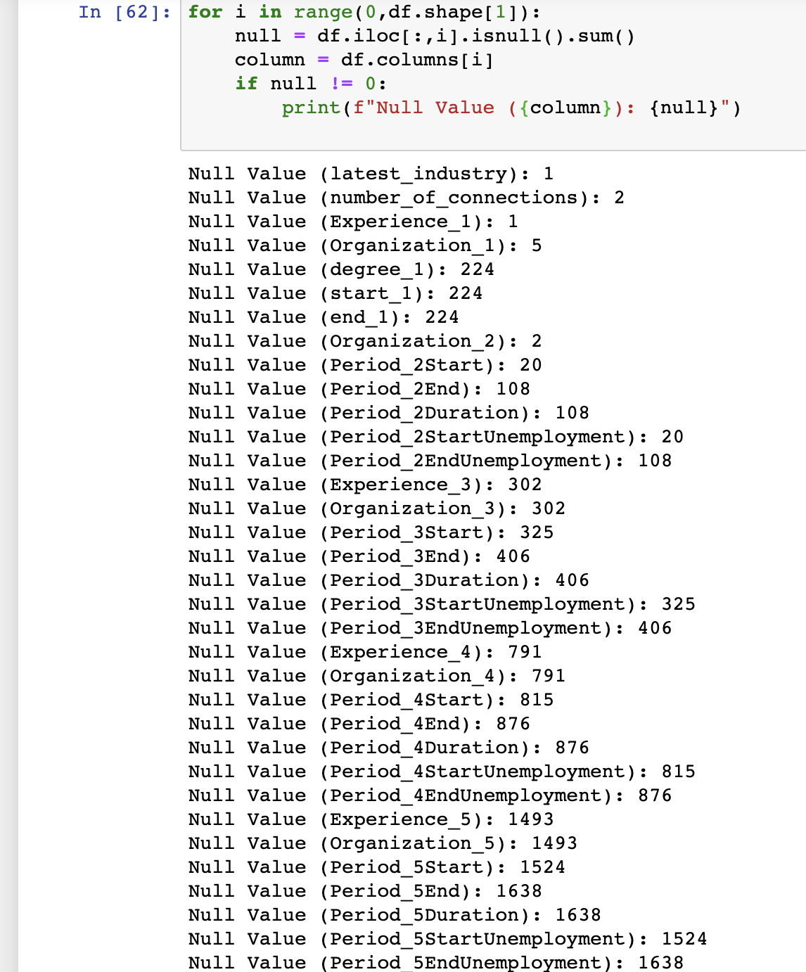
DAtA Preparation
Missing data imputation
Large amount of null values existing in many columns such as starting date/ending date of job experience/educational history, organization of job experience, etc.
Observed that many columns that have missing values are unique value to every individual (educational duration, job experience duration).
Notes:
From the figure We can see that there are large number of missing value or we call it null values in many columns such as starting date/ending date of job experience/educational history, organization of job experience,and these missing values are unique and different for each user.

Slide 11
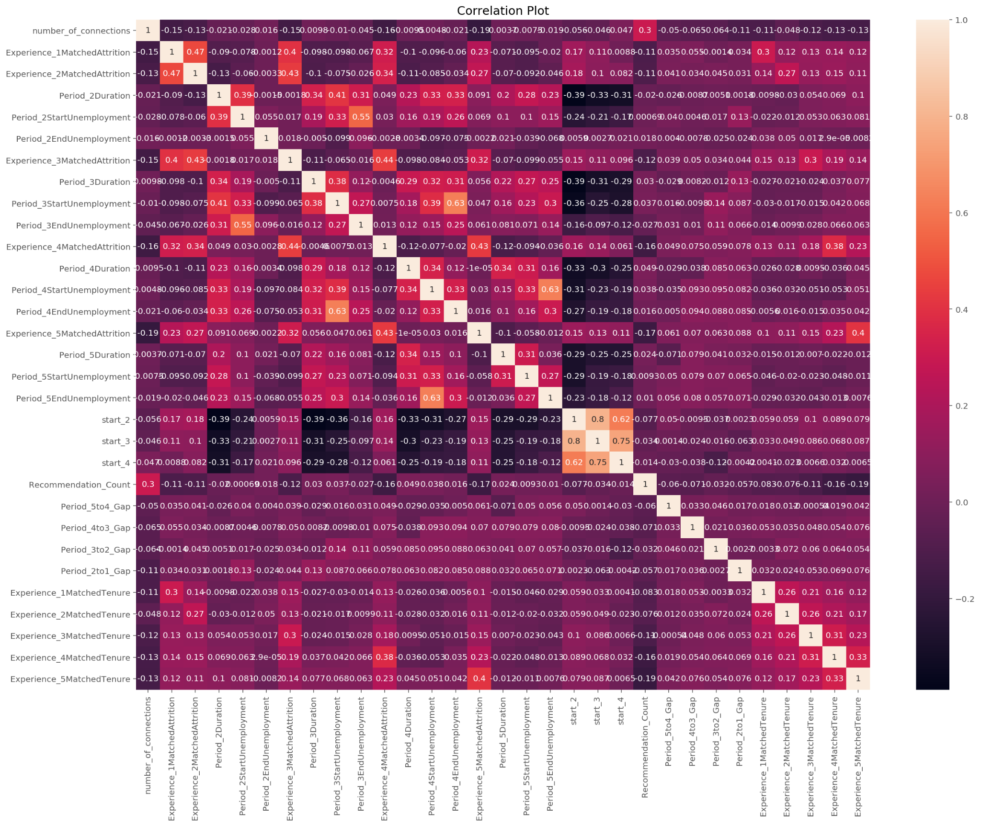
DAtA Preparation
Missing data imputation
From correlation heat map, variables are high correlated to each other.
Drop/replace with column mean/median value will cause data biasness.
Notes:
Coming to the correlation between variables we can see from the heat map that the variables are highly correlated and dropping/replacing these missing values with mean or median value will result in a data bias.

Slide 12
DAtA Preparation
Missing data imputation
Resolve missing values issue using ‘Multivariate Imputation by Chained Equation’ (MICE).
MICE imputes the missing value by considering the correlations of other variables by machine learning model.
Notes:
As a result we have used Multivariate Imputation by Chained Equation’ which is also called mice to impute the missing values.It imputes the missing values by taking the correlation of variables into consideration using a machine learning model. It may help us to create a dataset with no biasness and obtain a good result on the coming modelling stage.

Slide 13
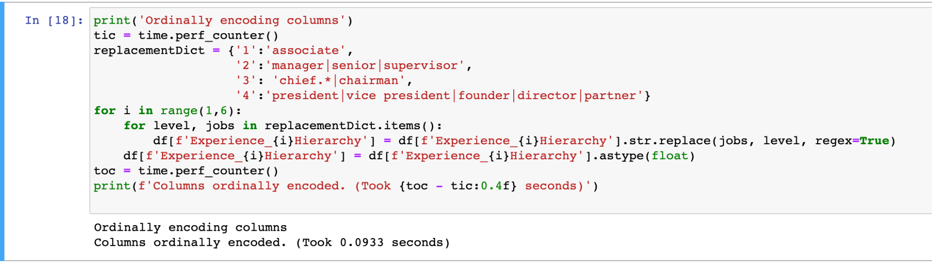
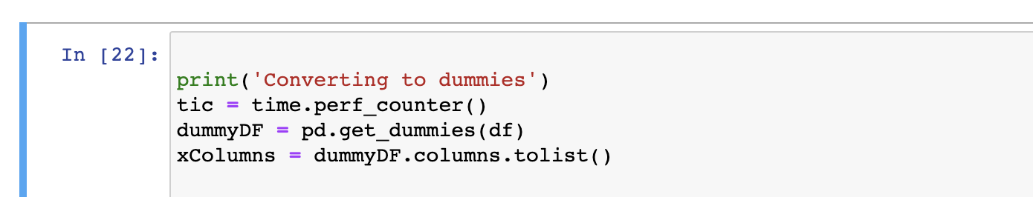
DAtA Preparation
Data transformation for modelling
Encode the job role hierarchy column into 4 different levels of hierarchy in ascending order of job role.
One hot encoder applied on all categorical features to convert to dummy variables.
Notes:
In order to model our dataset, data transformation will be needed to carry out on our dataset.
We encoded numerically the job role hierarchy column into 4 different levels of hierarchy in the ascending order of level.
We need to transform the categorical variables into dummy variables too.As shown in the figure we have used one hot encoder for conversion.

Slide 14
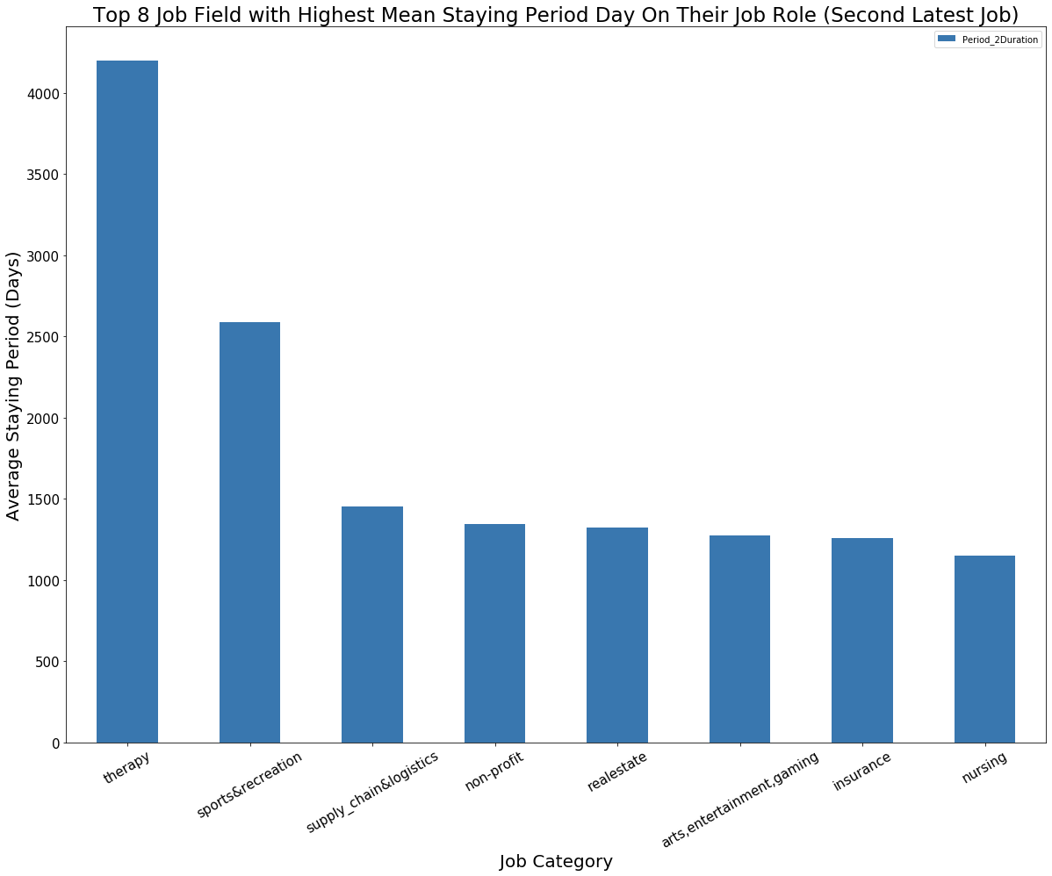
Valuable Insight 1- Exploration
Present the top 8 job field category with longest staying period in their job role based on their second latest job experience.
Therapy field employees have the longest average staying period on their job.
Followed by sports & recreation field.
Notes:
Coming to data exploration we have used different plots to get valuable insights on the dataset.The graph here shows the top 8 job field category with longest average period that a person stays in their job based on their second latest job. The therapy field employees has the longest staying period followed by sports and recreation field.Other fields have comparatively similar average staying period.

Slide 15
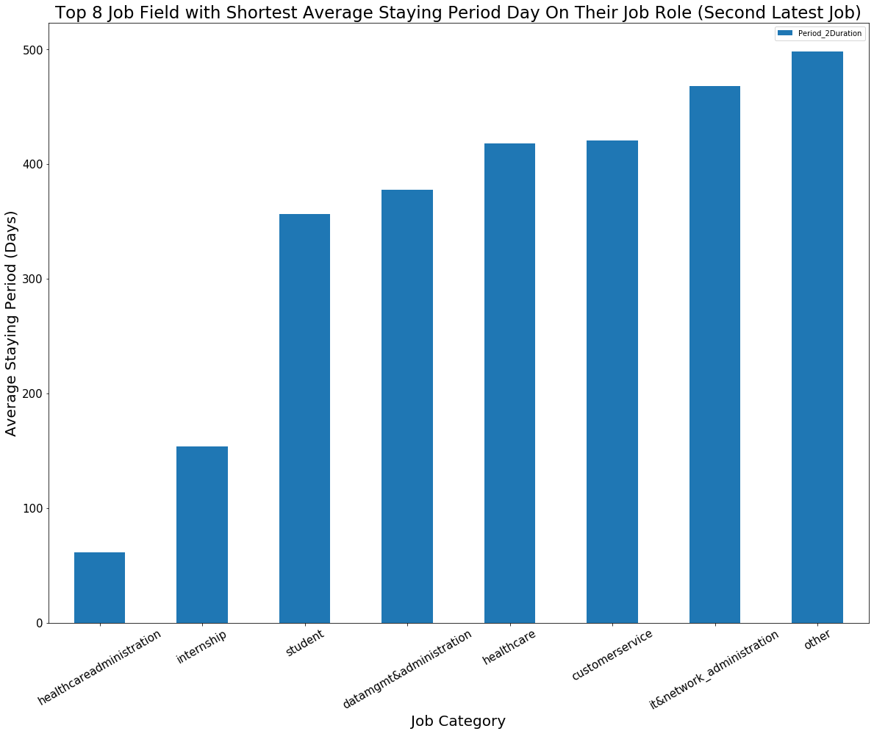
Valuable Insight 1- Exploration
Top 8 job field with shortest average working period time chart was plotted.
Employees in health care administration field stay the shortest period on their job role in overall.
Notes:
On the other hand while plotting the top 8 job field with the shortest average working period we see administration field stays the shortest in their job role.

Slide 16
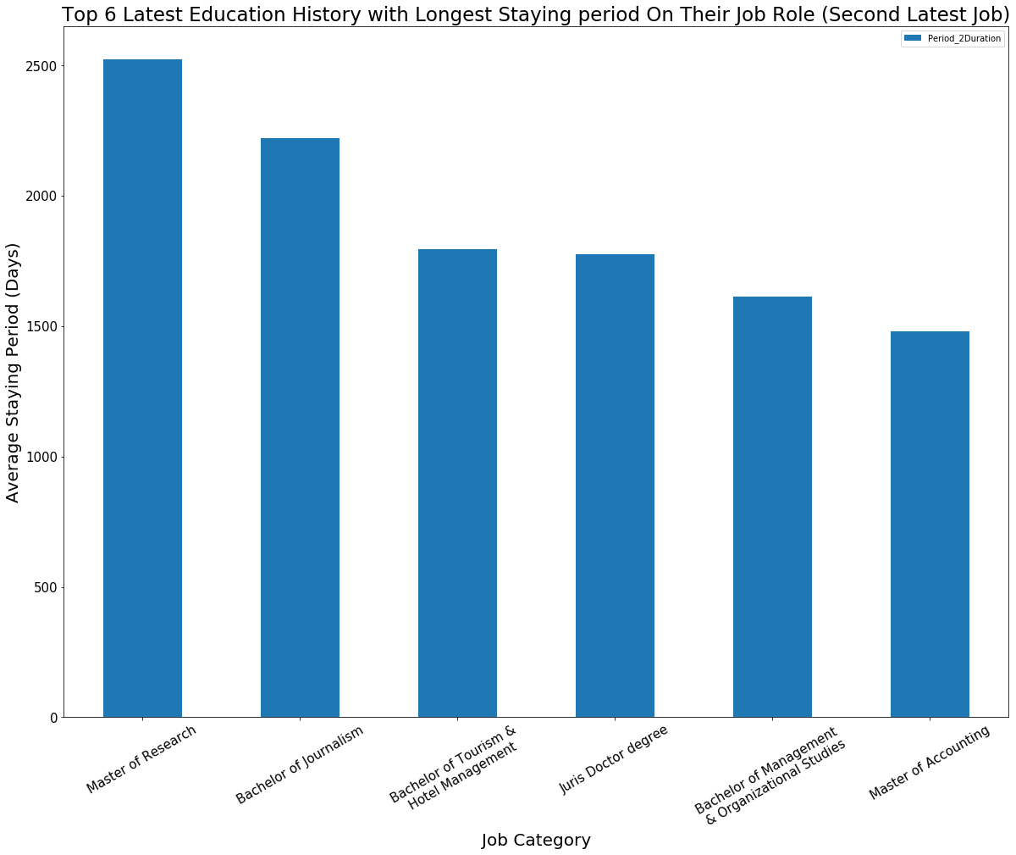
Valuable Insight 1- Exploration
‘Master of research’ degree holder will stay the longest on their current job role based on the second latest of job experience.
Notes:
The plot here shows the top 6 latest education history with longest staying period on their job role.And we see masters of research degree holders are most likely to stay longer on their second latest of job experience.

Slide 17
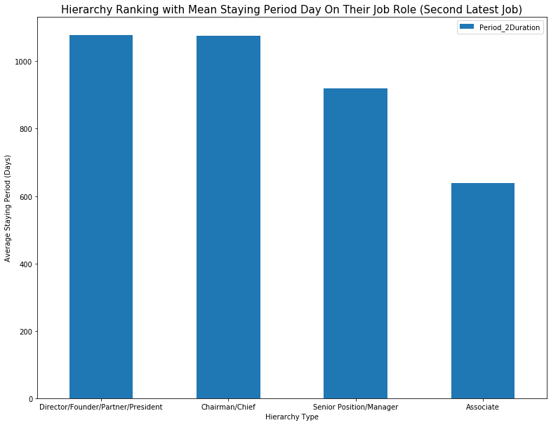
Valuable Insight 1- Exploration
Average staying period of different levels of job position was studied.
From the plot shown, the higher level of hierarchy that employees hold, the longer they will stay on their job role.
Notes:
Coming to the average staying period of different job positions we see that higher positioned employees are likely to stay longer in their job role compared to the ones who are in lower positions.

Slide 18
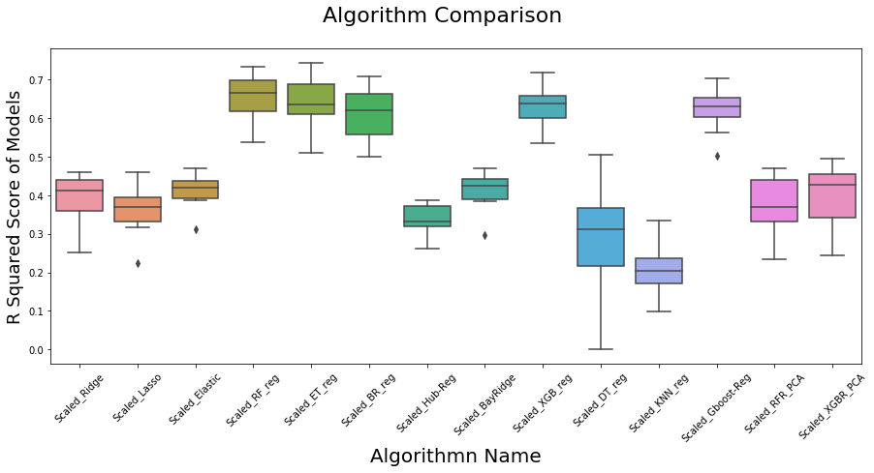
Valuable Insight 2- Machine learning Model
Fitted the dataset with 14 different type of machine learning models like: RandomForestRegressor, ExtraTreesRegressor, etc.
R-squared value will be used to evaluate the model performance.
Top three model (RandomForest Regressor, ExtraTrees Regressor & XGB Regressor) with highest r-squared value was chosen to be applied hyperparameter tuning.
Notes:
Coming to the modelling part we have splitted the data in the ratio 80 to 20 percent as training and testing data. To evaluate performance of machine learning developed, r squared value will be the testing metric in this evaluation stage. This is because r squared value will represent how well is the data point fitted with the model and it will give us an straightforward justification. We applied 14 different machine learning algorithms like random forest,extra tree regressor etc on the dataset to see which one gives the best r-square value. The figure shows that random forest,extra tree and xgb gave the highest r square value.We took these and applied hyper parameter tuning to see which one is the best.

Slide 19
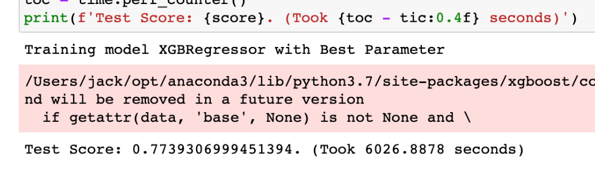
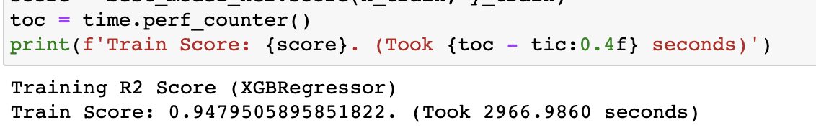
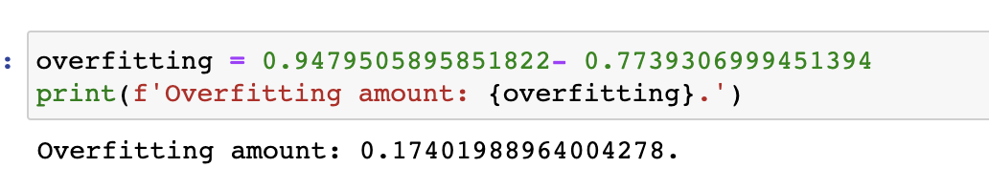
Valuable Insight 2- Machine learning Model
XGBRegressor is the best model with evaluation of r squared value metric.
The test r-squared value for this model obtained is 0.774 and train r squared value obtained is 0.9480.
Overfitting amount for this model is 0.174 which could be considered as not overfitted.
Notes:
Based on the results the XGBRegressor is the best model with a testing r score of 0.774 and 0.9480 as the training r r score. It also gave an overfitting value 0.174 which can be neglected.

Slide 20
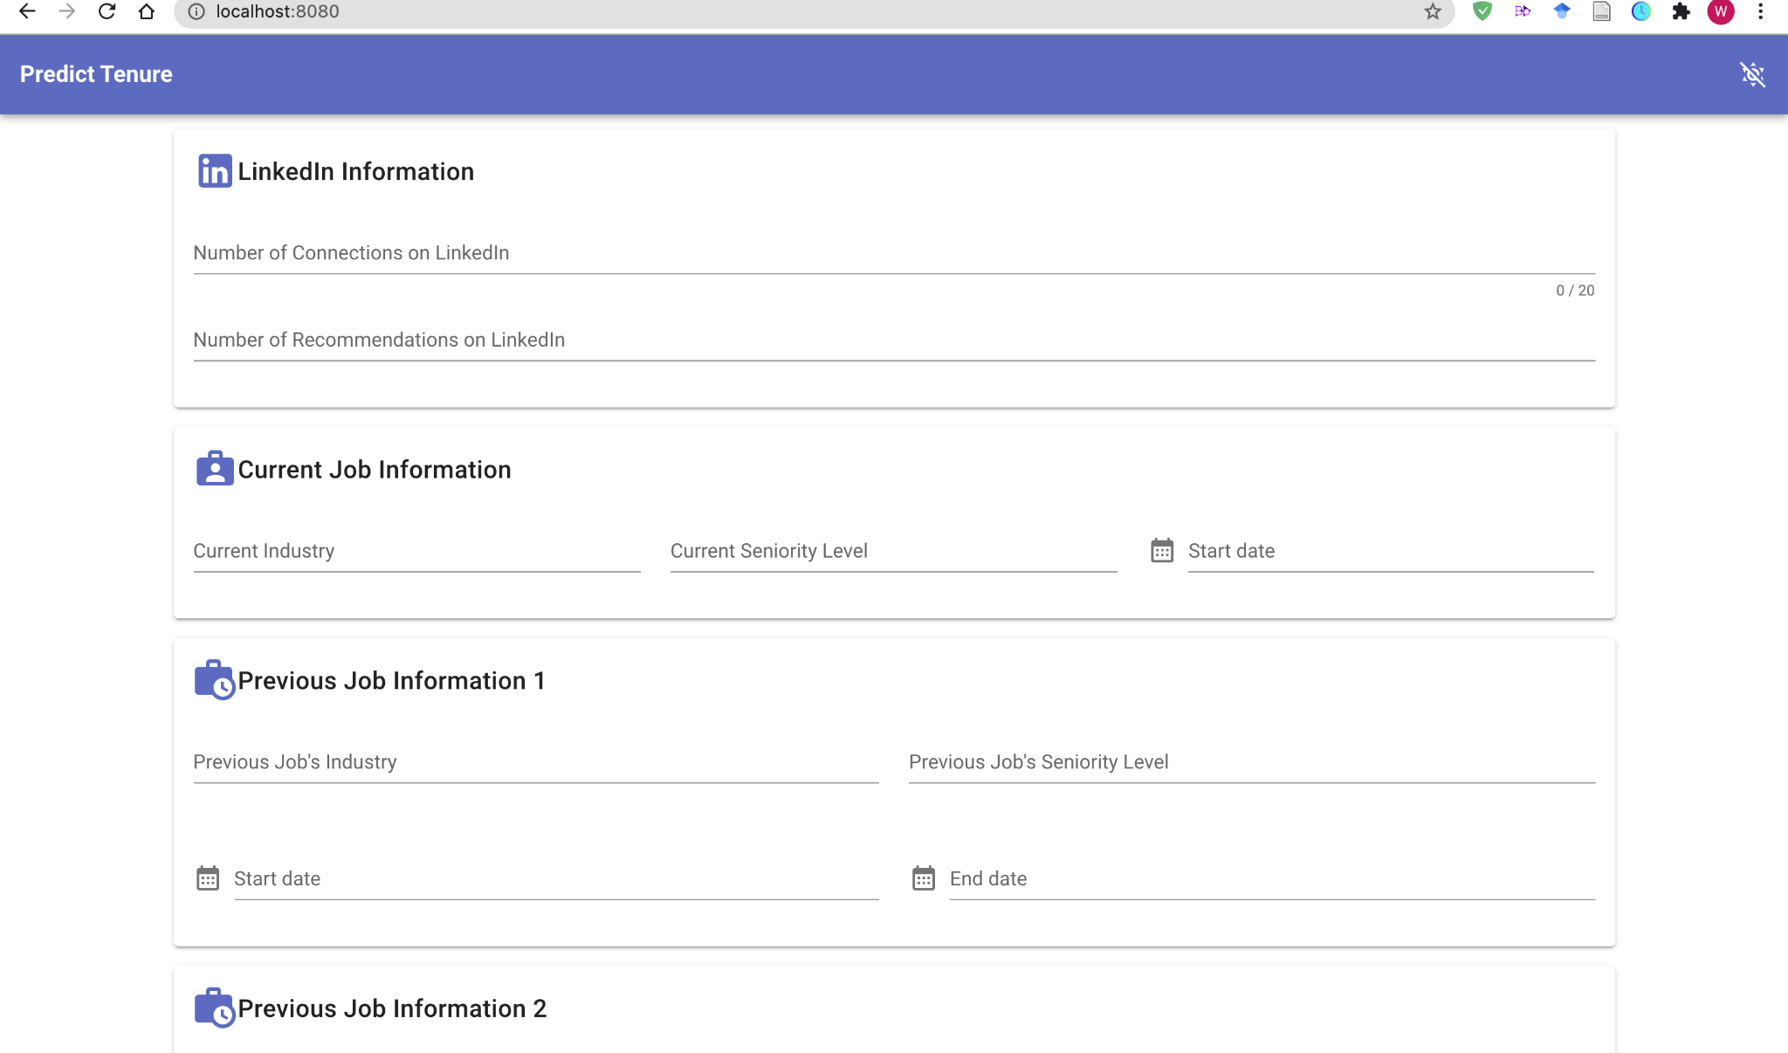
Front end Application (prototype)
Front end application with the deployed machine learning model in backend.
Straightforward control panel for client to just input the details of applicant.
Notes:
To make it more convenient we have created a front end application that can actually give the length of employee tenure just by inputting their details.

Slide 21
Summary
Several visualisations have been created to explore interesting insights among different features with the job tenure.
Prediction model (XGBRegressor) with the best testing r-squared value (0.7739).
Front-end application prototype.
Notes:
Coming to end of our presentation we look at what we have achieved in this project. We created several visualizations that gave interesting insights into the job tenure of an employee and was able to build a prediction model that used xgbregressor which gave the best testing r square value of 0.7739.We also created a front end application prototype that can predict job tenure of an employee by just inputting their details.

Slide 22
01
Continue More data crawling
02
Include more Sensitive features
03 Automation interactive dashboard
Suggestion
Notes:
As we know there can be improvements to this project.We think that additional information can give more prediction accuracy.This information can be obtained from other job search and networking sites like Seek, Indeed, etc. that will help to gain more information on employees as the training dataset.
Inclusion of features like gender and age will also help in getting more accuracy and enrich dataset features with multi category variables.
Lastly an automotive interactive dashboard will help to explore the dataset more efficiently.

Slide 23



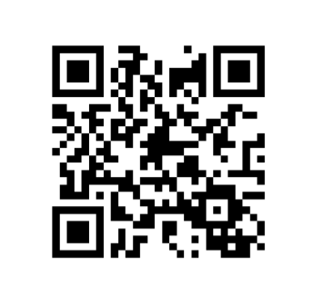
Our team
XIAN JING WONG
S3772149
MASTER OF DATA SCIENCE
JUHAL SIBY
S3792902
MASTER OF DATA SCIENCE
Notes:
We have come to the end of our presentation and we thank everyone for listening.Thank you.

