Slide 1
HTML, Web Scraping & Beautiful Soup

Slide 2
HTML
HTML – “Hypertext Markup Language”
Markup = code that has information about how to display
Along with CSS (“cascading style sheets”), defines appearance of web pages
JSON = Machine to Machine
HTML=Machine to Human
SI 539 on Coursera – “Web Design for Everybody”

Slide 3
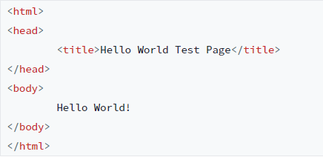
HTML Basics
Everything between <html> and </html> is the “HTML document.”
Everything between <head> and </head> is the “header.” It is not displayed to the user.
Everything between <body> and </body> is the “page body.” It is displayed to the user.
Every open tag (e.g., <body>) is matched with a close tag (e.g., </body>) — generally speaking
We will see some exceptions, and also some “self closing tags” e.g., <img …. />) where the slash is within the open tag.
A “tag” applies to everything between it’s open and close tags. The section of the document between the open and close tag is called an “element.”
Elements can, and usually are, nested. E.g. <body> … </body> is nested inside <html> … </html>

Slide 4
Example 1
Make a new file called hello.html with the following:
Open in a browser
<!DOCTYPE html>
<html>
<head>
<meta charset="UTF-8"/>
<title>Hello World Test Page</title>
</head>
<body>
Hello World!
</body>
</html>

Slide 5
Example 1 (Cont’d)
Change the body as follows:
Take a look at it in the browser and then add the following to the body
<body>
<h1>Hello World!</h1>
<p>This is the page where we say hello!</p>
</body>
<ul>
<li> Hola! </li>
<li> Bonjour! </li>
<li> Ni hao! </li>
<li> Namaste! </li>
<li> Salaam! </li>
</ul>
What is <ul>
Change <ul> to <ol>
What is <li>

Slide 6
Example 1 (Cont’d)
Add an image
Add an image of a specified width
Add text and link
href element indicates destination page
<a> </a> indicates text to display to browser (URL is hidden)
<img src="https://media.giphy.com/media/cOWnBRSMwW7o036wB6/giphy.gif"/>
<img src="https://media.giphy.com/media/cOWnBRSMwW7o036wB6/giphy.gif" width=200 />
<p>And now, <a href="http://www.omniglot.com/language/phrases/hello.htm">say hello in lots of languages!</a></p>

Slide 7

Example 1 Cont’d
Use <div> to separate html code logically into sections.
So wrap our list in its own div (check code against next page if you have a problem
<!-- comment -->
<div id="hello-list">
We say hello!
<ul>
<li> Hola! </li>
<li> Bonjour! </li>
<li> Ni hao! </li>
<li> Namaste! </li>
<li> Salaam! </li>
</ul>
</div>

Slide 8
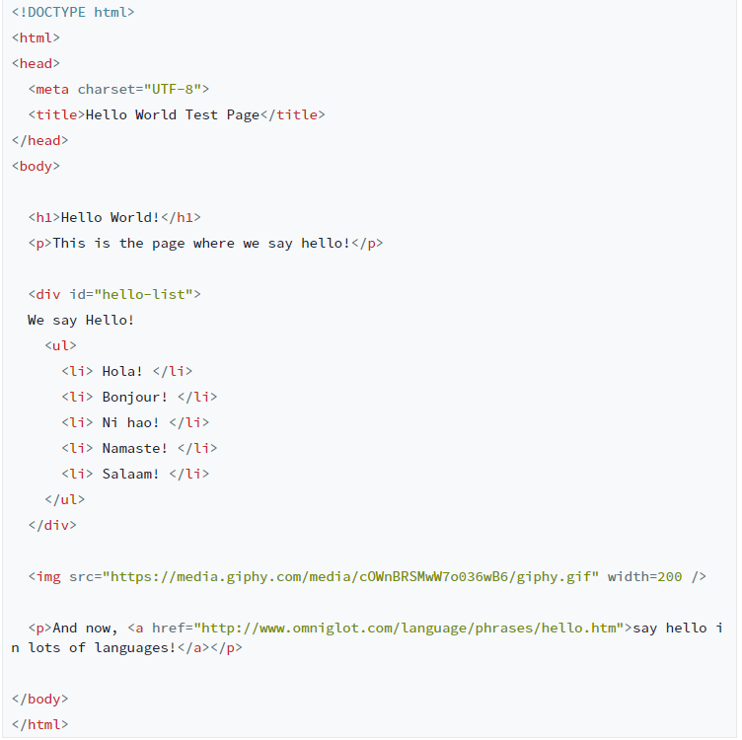
Full html file
HTML can be very complicated
Resource: https://www.w3schools.com/tags/tag_a.asp

Slide 9
Extension – Add a section on saying goodbye
Using the html file we have created as a template, make a section of the page that has a list that says goodbye in several languages and includes a goodbye gif.
If you have problems – ask in office hours/lab
Notes:
<div id="goodbye-list"> We say goodbye! <ol> <li> Adios! </li> <li> Au Revior! </li> <li> Zaijian! </li> <li> Alavida! </li> <li> Wadaeaan! </li> </ol> </div> <img src=" https://www.pngkey.com/png/full/148-1485118_wave-smiley-emoticon-computer-icons-hand-waving-sad.png" width=400/>

Slide 10
Styles (CSS)
HTML is for structure;
Headers
Paragraphs
CSS is for style
“Cascading Style Sheets”
Gives instruction to change the way that html elements appear
Add the following code to the header of your hello.html file
What do you expect it to do?
Note: if the code doesn’t work when you copy and paste – you can copy into a text editor first and then paste it in. Or you can copy the code from the helloFinal.html file provided.
<style>
div {
color: orange;
font-size: 48pt;
}
</style>

Slide 11
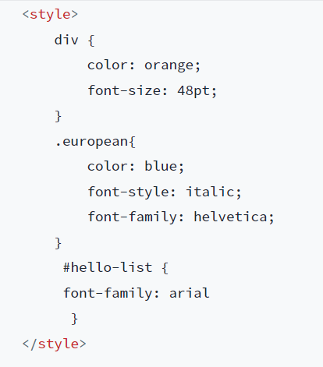
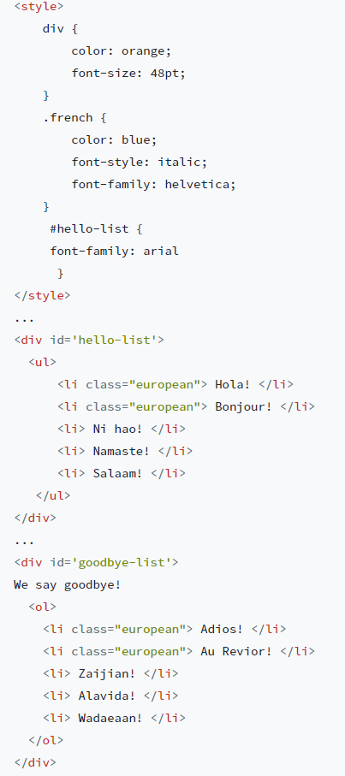
CSS classes and ids
class can be used to identify a handful of elements
CSS class start with a period
Class attribute identified by a HTML tag
id can be used to identify one element at a time
Note: One element can mean one div or one p etc…
CSS id has # at the front
Note: CSS style sheets are often located in a separate file linked into the HTML
Can be located in head as well
Predict how the following elements will look

Slide 12
Beautiful Soup
“Scraping” = writing programs to extract data from web pages
Takes advantage of HTML structure to find desired info
First step is to get HTML page in text format
Next parse to extract content from specific tags
You could do by hand with string.find() etc
Better to use powerful librarys such as Beautiful Soup
Please install via pip install bs4 or pip3 install bs4

Slide 13
Example 2
Create a new file called scrapehello.py, and enter the following
What is soup?
An instance of the imported python class BeautifulSoup
Use print(soup.prettify()) to see how Beautiful Soup sees our file
We can use find_all() to search for all alements that match certain criteria
We can search by class, tag, id etc
#scrapehello.py
from bs4 import BeautifulSoup
f = open("helloFinal.html")
html_text = f.read()
soup = BeautifulSoup(html_text, 'html.parser')
# searching by tag
all_list_items = soup.find_all('li')
all_divs = soup.find_all('div')
# searching by tag AND class
all_french_list_items = soup.find_all('li', class_='european')
# searching by id
all_hello_elements = soup.find_all(id='hello-list')
Why does class_ have an underscore?

Slide 14
Example 2 Contd
Print the output of our searches using the following commands
print("RESULTS OF find_all()")
print("soup.find_all('li'):", all_list_items)
print("------")
print("soup.find_all('div'):", all_divs)
print('------')
print("soup.find_all('li', class_=french')", all_french_list_items)
print("------")
print("soup.find_all(id='hello-list')", all_hello_elements)
print("------")

Slide 15
Tags
Tag is a class in Beautiful Soup
Each tag corresponds to an html element inside a BeautfiulSoup object
A Beautiful Soup Tag is not just the html tag (such as <head>)
Also includes the contents of a given element
https://www.crummy.com/software/BeautifulSoup/bs4/doc/#tag
Tag.string is a method associated with a tag
li.string is not a python string
It is a bs4.element.NavigableString
Acts like a python string but has extra capabilities.
Typically the text between an open and close html tag
print("TYPE OF LIST ELEMENTS RETURNED BY find_all()")
print("------")
print(type(all_list_items[0]))
print('------')
for li in all_list_items:
print(li.string)
print("EXTRACTING STRINGS FROM LIST ITEMS AND PRINTING THEM UPPERCASE")
for li in all_list_items:
print(li.string.upper(), type(li.string))
print('------')

Slide 16
Contents of Tags
HTML is a nested language.
You can look at the nested tags within a tag using the Beautiful soup method contents
Did you notice something funny about the spacing of the first child?
We can eliminate blank space values using strip()on NavigableStrings
print("EXAMINING THE CHILDREN OF THE 'HELLO' LIST")
for child in all_hello_elements[0].contents:
print(child)
print(type(child))
print('------')
print("USING strip() TO GET RID OF WHITESPACE")
print(all_hello_elements[0].contents[0].strip())
print('------')

Slide 17
Search by type of Tag
Navigating to contents of contents can create problems
Instead you can search for the specific tags you want within a certain tag
all_hello_elements = soup.find_all(id='hello-list')
print("iterating with contents")
for item in all_hello_elements[0].contents[1].contents:
print(item)
all_hello_elements = soup.find_all(id='hello-list')
print("ITERATING THROUGH ITEMS IN A LIST")
hello_list_items = all_hello_elements[0].find_all('li')
for item in hello_list_items:
print(item.text.strip())

Slide 18
Misc
find() provides the first matching element rather than all the matching elements whereas find_all() provides all elements
You can access the attributes of a tag by treating the tag as a dictionary.
print("USING find() INSTEAD OF find_all()")
hello_div = soup.find(id='hello-list')
print(hello_div)
print('------')
print("ACCESSING TAG ATTRIBUTES")
img_tag = soup.find('img')
print('The img source:')
print(img_tag['src'])
print('------')

