Slide 1
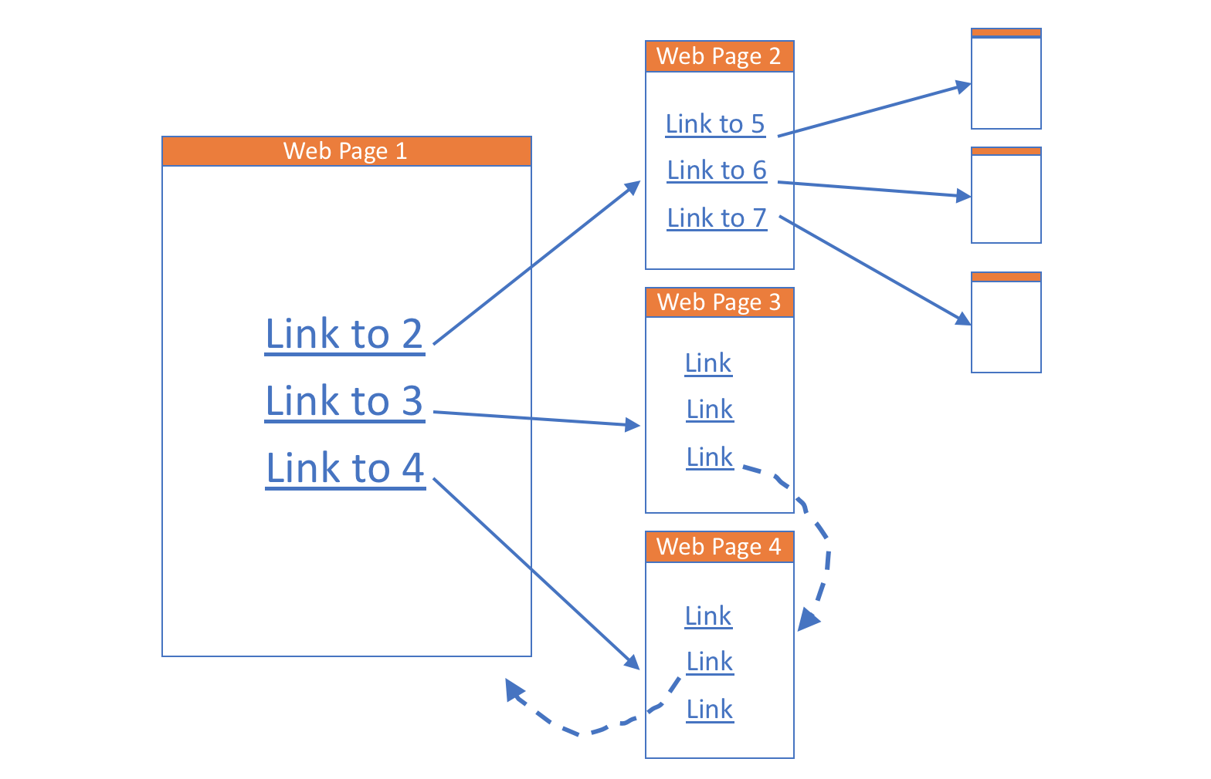
SI_507 – Crawling
Web Crawlers, also known as ‘spiders’ or ‘ants’ are bots that systematically browse the internet in order to map it.
Crawling is simple:
Visit a page
Save the page, index & process it
Visit all the links
Repeat…

Slide 2
Purpose Built Crawlers
Only interested in particular data
(e.g., headlines from Michigan Daily, headers from Beautiful Soup docs)
Only interested in particular links
Extract and follow particular links
Extract particular data from the linked pages
Stop when data is collected
Much easier than general-purpose crawling
A lot of very specific code that only works on one particular page
Your Michigan Daily crawler won’t work at all on Beautiful Soup
Your code might not even work across a whole site
One-shot crawling
Page contents don’t change, but there’s a lot and it’s not organized well for the analysis you want to do
Repeated crawling
Page contents change (e.g., news site, Twitter) and you want to preserve snapshots across time
Probably want to reorganize the data and do analysis too

Slide 3
Example – UMSI Course Catalog
Goal build a crawler for the UMSI Course Catalog
Extract the following info for each course
Course Number
Course Name
Course Description
Required Prerequisites
Number of Credits
Steps:
Reverse engineer the Courses page to figure out where to find
- links to the course details page
Reverse engineer the Course detail page (e.g., https://www.si.umich.edu/programs/courses/106) to figure out where to find
a. course numbers
b. course name
c. course description
d. prereqs
e. number of credits
Given all of this information, make a scraping plan
Write the scraper

Slide 4
Step 1: explore Courses page with Developer Tools
https://www.si.umich.edu/programs/courses
In the Elements Browser, find the section of the page where course listings appear (hint: use the Element Selector tool).
Walk up the element structure to find the closest parent element that contains all of the course listings on this page.
Now find the element that contains the link to the course detail page.

Slide 5
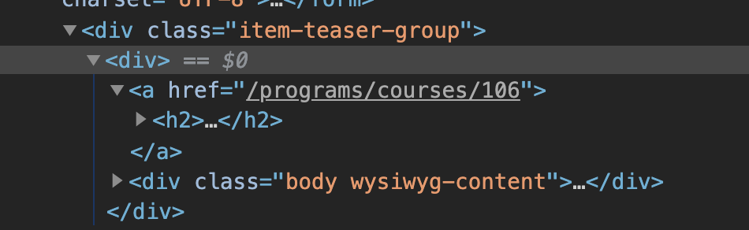
Step 1: explore Courses page with Developer Tools
https://www.si.umich.edu/programs/courses
In the Elements Browser, find the section of the page where course listings appear (hint: use the Element Selector tool).
Walk up the element structure to find the closest parent element that contains all of the course listings on this page.
Now find the element that contains the link to the course detail page.
The approrporate parent tag is <div class="item-teaser-group">.
Note this somewhere
The linkfor a given course is contained in an an <a> tag
Nested two levels below our parent tag.

Slide 6
Step 2: explore Course Details with Developer Tools
https://www.si.umich.edu/programs/courses/206
In the Elements Browser, find the nearest parent element that you believe to be unique within the page for each of the following:
course number and title
course description
credit hours
prerequisites

Slide 7
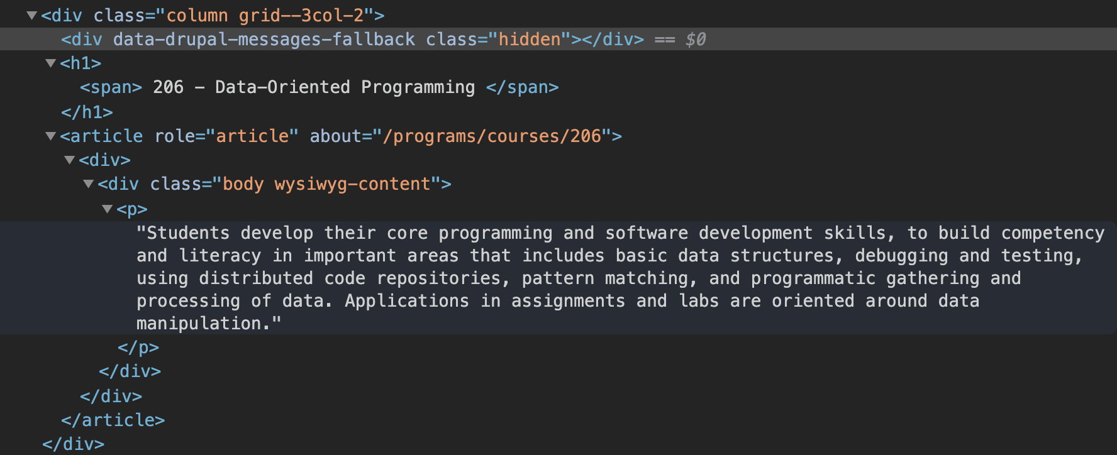
Step 2: explore Course Details with Developer Tools
https://www.si.umich.edu/programs/courses/206
In the Elements Browser, find the nearest parent element that you believe to be unique within the page for each of the following:
course number and title
course description
credit hours
Prerequisites
<div class="column grid--3col-2"> contains both elements and is the nearest common parent of both Number/Title & Description
However <h1> and <p> are unique for each

Slide 8
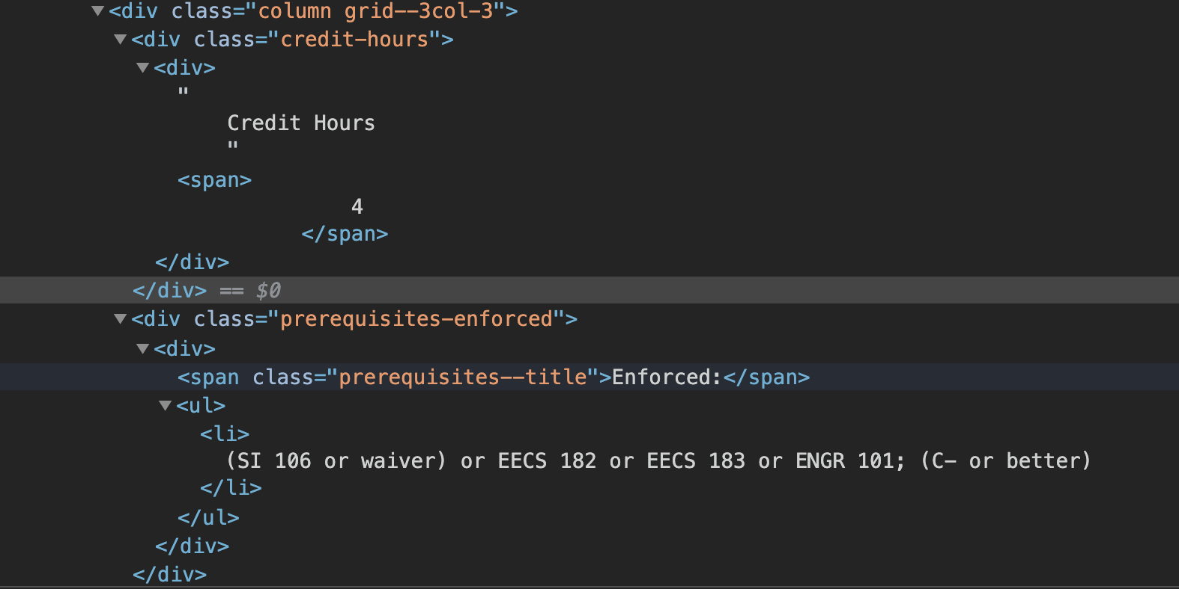
Step 2: explore Course Details with Developer Tools
https://www.si.umich.edu/programs/courses/206
In the Elements Browser, find the nearest parent element that you believe to be unique within the page for each of the following:
course number and title
course description
credit hours
Prerequisites
<div class="column grid--3col-3"> contains both elements and is the nearest common parent of both Credit Hours & Prerequisites
However <div class=“credit-hours”> and <div class=prerequisites-enforced”> are closer for each

Slide 9
Step 3: Develop a Scraping Plan
Make a pseudocode plan for scraping through this catalog to solve our problem
number, name, description, credit hours, and enforced prerequisites for every course listed on https://www.si.umich.edu/programs/courses
Use Beautiful Soup on the https://www.si.umich.edu/programs/courses to Extract all the Course URLs
For Each Extracted URL:
setup bs4 to extract course details
Extract course number and name
Extract course description
Extract credit hours
Extract prereqs

Slide 10
Step 3: Develop a Scraping Plan
Make a pseudocode plan for scraping through this catalog to solve our problem
## Make the soup for the Courses page
## For each course listed
## extract the course details URL
## Make the soup for course details
## extract course number and name
## extract course description
## extract credit hours
## extract prereqs

Slide 11
Step 4A: Make the Soup for the course page
Fill in the code – refer back to the example from lesson 1 if needed.
## Make the soup for the Courses page

Slide 12
Step 4A: Make the Soup for the course page
Fill in the code
import requests
from bs4 import BeautifulSoup
BASE_URL = 'https://www.si.umich.edu' # must use https
COURSES_PATH = '/programs/courses’
## Make the soup for the Courses page
courses_page_url = BASE_URL + COURSES_PATH
response = requests.get(courses_page_url)
soup = BeautifulSoup(response.text, 'html.parser’)
print(soup.prettify()) ## sanity check -- test then delete

Slide 13
Step 4B: Get the <div> with the course listing
Fill in the code – refer back to the example from lesson 1 if needed.
## For each course listed

Slide 14
Step 4B: Get the <div> with the course listing
Fill in the code – refer back to the example from lesson 1 if needed.
## For each course listed
course_listing_parent = soup.find('div', class_='item-teaser-group’)
course_listing_divs = course_listing_parent.find_all('div', recursive=False)
print(course_listing_divs) ## sanity check -- test then delete

Slide 15
Step 4C: Get the URL for each course details page
Fill in the code – refer back to the example from lesson 1 if needed.
## extract course details url

Slide 16
Step 4C: Get the URL for each course details page
Fill in the code – refer back to the example from lesson 1 if needed.
for course_listing_div in course_listing_divs:
## extract the course details URL
course_link_tag = course_listing_div.find('a’)
course_details_path = course_link_tag['href’]
course_details_url = BASE_URL + course_details_path
print(course_details_url) ## sanity check -- test then delete

Slide 17
Step 4D: Crawl to Course Details page and extract Name and Number for each course
Fill in the code – refer back to the example from lesson 1 if needed.
## Make the soup for course details
## extract course number and name
Expected Outcome
106 - Programs, Information and People
110 - Introduction to Information Studies
206 - Data-Oriented Programming
260 - Opportunity in the Age of Intelligent Machines
301 - Models of Social Information Processing
310 - Information Environments and Work
315 - Interpersonal and Psychological Implications of Social Media
320 - Graphic Design
330 - Data Manipulation
334 - Persuasion and Social Influence

Slide 18
Step 4D: Crawl to Course Details page and extract Name and Number for each course
Fill in the code – refer back to the example from lesson 1 if needed.
## Make the soup for course details
response = requests.get(course_details_url)
soup = BeautifulSoup(response.text, 'html.parser’)
## extract course number and name
number_name = soup.find(class_='grid--3col-2').find('h1’)
print(number_name.text.strip())

Slide 19
Step 4E: Extract Course Description
Fill in the code – refer back to the example from lesson 1 if needed.
## extract course description
## extract course number and name

Slide 20
Step 4E: Extact Course Description
Fill in the code – refer back to the example from lesson 1 if needed.
## extract course description
desc = soup.find(class_=‘grid—3col-2’).find(‘p’)
print(desc.text.strip())

Slide 21
Step 4E: Extract credit hours
Fill in the code – refer back to the example from lesson 1 if needed.
## extract credit hours

Slide 22
Step 4E: Extact credit hours
Fill in the code – refer back to the example from lesson 1 if needed.
## extract credit hours
credits = soup.find(class_=‘credit-hours’).find(‘span’)
print(‘Credits:’ credits.text.strip())

Slide 23
Step 4f: Extact Enforced Pre-requisites
Fill in the code – refer back to the example from lesson 1 if needed.
## extract course prereqs
Trickier because varying number of pre-reqs.
# Expected Outcome
106 - Programs, Information and People
Credits: 4
----------------------------------------
110 - Introduction to Information Studies
Credits: 4
----------------------------------------
206 - Data-Oriented Programming
Credits: 4
Prereq: (SI 106 or waiver) or EECS 182 or EECS 183 or ENGR 101; (C- or better)
----------------------------------------
260 - Opportunity in the Age of Intelligent Machines
Credits: 3
----------------------------------------
301 - Models of Social Information Processing
Credits: 4
Prereq: (Prerequisite: EECS 280) or (Co-requisite: SI 206); (C- or better)
----------------------------------------
310 - Information Environments and Work
Credits: 4
----------------------------------------
315 - Interpersonal and Psychological Implications of Social Media
Credits: 3
----------------------------------------
320 - Graphic Design
Credits: 4
---------------------------------------

Slide 24
Step 4f: Extact Enforced Pre-requisites
Fill in the code – refer back to the example from lesson 1 if needed.
## extract prereqs
prereqs_div = soup.find(class_='prerequisites-enforced')
if (prereqs_div is not None):
prereqs = prereqs_div.find_all('li')
for p in prereqs:
print('Prereq:', p.text.strip())
print('-' * 40) # separator

Slide 25
SI_507 Crawling & Caching
Ethical, legal, and practical considerations
Are you respecting site owner’s intellectual property?
May need to read terms of service or contact owner
Is your scraping/crawling going to cause disruptions?
Introduce delays
Caching
Is your use in accordance with site owner’s wishes?
Terms of service
Fair Use
Practical issues
Robots.txt
Supply user-agent
Delay
JavaScript can complicate crawling
Watch out for in final project

Slide 26
Robots.txt
http://<domain_name>/robots.txt
http://si.umich.edu/robots.txt
Tells crawlers where they can and can’t crawl
User-agent: *
Refers to type of software
* means all
If other user-agents are specified * means all other than those specified
Allow:
Specifically grants permission for specific files or file types, or directories
Disallow: is opposite and forbids access to certain types
The more specific will take precedence (think scope)
Allow: /profiles/*.jpg would overrule Disallow: /profiles/
More reading: robotstxt.org

Slide 27
Specify User-Agent as part of GET
All http messages have a header
We haven’t previously discussed
Examine using the following code
import requests
the_url = 'http://si.umich.edu’
response = requests.get(the_url)
print (response.request.headers)
Prints out: {'User-Agent': 'python-requests/2.42.0', 'Accept-Encoding': 'gzip, deflate', 'Accept': '*/*', 'Connection': 'keep-alive’}
User-Agent lets site administrator know traffic is from python
User-Agent from a mobile browser would look like this
Mozilla/5.0 (iPhone; CPU iPhone OS 10_3 like Mac OS X) AppleWebKit/602.1.50 (KHTML, like Gecko) CriOS/56.0.2924.75 Mobile/14E5239e Safari/602.1
You can supply your user info by adding a custom header.
the_url = 'http://si.umich.edu'
headers = {
'User-Agent': 'UMSI 507 Course Project - Python Web Scraping',
'From': 'youremail@domain.com',
'Course-Info': 'https://www.si.umich.edu/programs/courses/507'
}
response = requests.get(the_url, headers=headers)
print (response.request.headers)

Slide 28
Adding a Delay
import time # need this in order to sleep()
for course_listing_div in course_listing_divs:
## extract the course details URL
course_link_tag = course_listing_div.find('a')
course_details_path = course_link_tag['href']
course_details_url = BASE_URL + course_details_path
## extract all the info from the details page
...
## at the end of the loop, before starting again
time.sleep(1) ## sleep for one second

Slide 29
Caching & Crawling
Crawling can be quite slow
Crawling takes up others resources
Just as with Web APIs, caching can help solve these problems for you
An in-memory cache within your program (dictionary)
A persistent cache that you save to your file system. This will be a JSON file that serves as a perfect copy of your in-memory cache.
A unique identifier system to keep track of each new piece of data, and whether you have to retrieve it from source or not
Caching Example - Lab

