Slide 1
SI507 Python - Modules
Modules let you present codes in intuitive ways that allow you to hide the complexity away somewhere else.
Grouping related code into a module makes the code easier to understand and use.
A module is a Python object with arbitrarily named attributes that you can bind and reference.
Simply, a module is a file consisting of Python code.
modules can define functions, classes, and variables.
modules can include executable commands
a module named a_name is typically found in a file named a_name.py.
Here's an example of a simple module, hello.py
def print_func( Var1 ):
print("Hello : ", Var1)
return

Slide 2
The import Statement:
You can use any Python source file as a module by executing an import statement in some other Python source file. import has the following syntax:
import module1, module2,...
When the interpreter encounters an import statement, it imports the module if the module is present in the search path. A search path is a list of directories that the interpreter searches before importing a module.
Example:
import hello
hello.print_func("Miguel")
A module is loaded only once, regardless of the number of times it is imported.
This prevents multiple execution of modules.
When using from modname import *,
Don’t have to write “hello.” (just print_func("Miguel") )

Slide 3
The from...import * Statement:
It is also possible to import all names from a module into the current namespace by using the following import statement:
from modname import *
This provides an easy way to import all the items from a module into the current namespace; however, this statement should be used sparingly.
Locating Modules:
When you import a module, the Python interpreter searches for the module in the following sequences:
The current directory
pwd is the unix shell command for present working directory
each directory in the shell variable PYTHONPATH.
default path. On UNIX, this default path is normally /usr/local/lib/python/.

Slide 4
The PYTHONPATH Variable:
The PYTHONPATH is an environment variable, consisting of a list of directories. The syntax of PYTHONPATH is the same as that of the shell variable PATH.
Here is a typical PYTHONPATH from a Windows system:
set PYTHONPATH=c:\python20\lib;
And here is a typical PYTHONPATH from a UNIX system:
set PYTHONPATH=/usr/local/lib/python

Slide 5
The dir( ) Function:
The dir() built-in function returns a sorted list of strings containing the names defined by a module.
The list contains the names of all the modules, variables, and functions that are defined in a module.
Example:
import math
content = dir(math)
print(content);
This would produce following result:
['__doc__', '__name__', '__package__', 'acos', 'acosh', 'asin', 'asinh', 'atan', 'atan2', 'atanh', 'ceil', 'copysign', 'cos', 'cosh', 'degrees', 'e', 'erf', 'erfc', 'exp', 'expm1', 'fabs', 'factorial', 'floor', 'fmod', 'frexp', 'fsum', 'gamma', 'hypot', 'isinf', 'isnan', 'ldexp', 'lgamma', 'log', 'log10', 'log1p', 'modf', 'pi', 'pow', 'radians', 'sin', 'sinh', 'sqrt', 'tan', 'tanh', 'trunc']

Slide 6
_name_ for modules
download the teach_pets.py file and pet.py file from this weeks lecture into your current working directory.
run teach_pets.py – what do you get?
run pet.py – what happens?
look at the files – why is there a difference?

Slide 7
learning to use __name__ in modules
add print(pets[1].speak()) to the bottom of pet.py
run it and what happens?
run teach_pets.py again – what happened?
add the following lines to each of the python files
#in pet.py
print("in pet.py, my name is ", __name__)
#in teach_pets.py
print("in teach_pets.py, my name is ", __name__)
run them both again and see what happens

Slide 8
if __name__==“__main__”
add the following code to pet.py
if __name__ == "__main__":
print(pets[1].speak())
print("In pet.py, my name is", __name__)
this let the output code only run if the module file is executed directly

Slide 9
The reload() Function:
When the module is imported into a script, the code in the top-level portion of a module is executed only once.
Therefore, if you want to reexecute the top-level code in a module, you can use the reload() function. The reload() function imports a previously imported module again.
Syntax:
The syntax of the reload() function is this:
reload(module_name)
Here module_name is the name of the module you want to reload and not the string containing the module name. For example to re-load hello module, do the following:
reload(hello)
NOTE: reload used to be a built-in function in python, now it can only be called from the importlib library
So you must:
import importlib
import.reload(module)

Slide 10
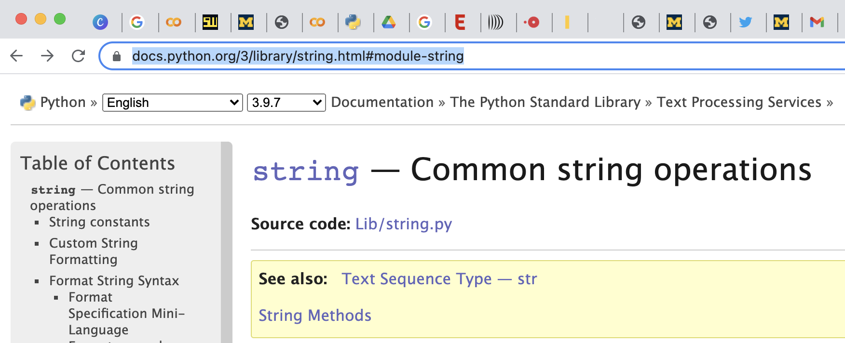
Built-in Modules - String
Documentation for libraries: https://docs.python.org/3/library/string.html#module-string
You can also use dir()
Read documentation for find and substring in string

