Slide 1
Advanced Functions
Week 3 SI 507

Slide 2
Topics
Review - Scope & Return Statements
Built-ins
sorted()
Recursion
Generators & Iterators
Yield
Lambda functions

Slide 3
Review A
def square_this(W):
z = W*W
print(z) #What output do you expect
square_this(12) #What output do you expect

Slide 4
Review B
def square_this(W):
z = W*W
z = 12
z = square_this(z)
print(z) # What output do you expect?

Slide 5
Review C
def square_this(W):
z = W*W
return z
z = 12
square_this(z) #what output do you expect?
print(z) # What output do you expect?

Slide 6
Review D
def square_this(W):
z = W*W
return z
z = 12
square_this(z) #what output do you expect? 144
print(z) # What output do you expect? 12

Slide 7
Review E
def outer_function():
z = 365
def inner_function():
print(“There are “+str(z)+” days in a year”)
print(z) #What output do you expect
inner_function() #What output do you expect
outer_function() #What output do you expect
print(outer_function()) #What output do you expect

Slide 8
Review F
def outer_function():
z = 365
def inner_function():
print(“There are “+str(z)+” days in a year”)
inner_function()
print(z) #What output do you expect error
inner_function() #What output do you expect error
outer_function() #What output do you expect There are…
print(outer_function()) #What output do you expect There are… None.

Slide 9
Review G
def squares_and_cubes(side):
b = side**2
a = side**3
return b, a
squares_and_cubes(4) #what output do you expect

Slide 10
Review G
def squares_and_cubes(side):
b = side**2
a = side**3
return b, a
squares_and_cubes(4) #what output do you expect
>>> (16,64)
#why tuples – why not lists??

Slide 11
Review G-2
def squares_and_cubes(side):
b = side**2
a = side**3
return b, a
a, b = squares_and_cubes(4) #what output do you expect
print(a) #what output do you expect
print(b) #what output do you expect
area, volume = squares_and_cubes(4) #use descriptive variable names!
print(area) #what output do you expect
print(volume) #what output do you expect
a = squares_and_cubes(4) #what type of object is a?
print(a[0]) #what output do you expect
print(a[1]) #what output do you expect

Slide 12
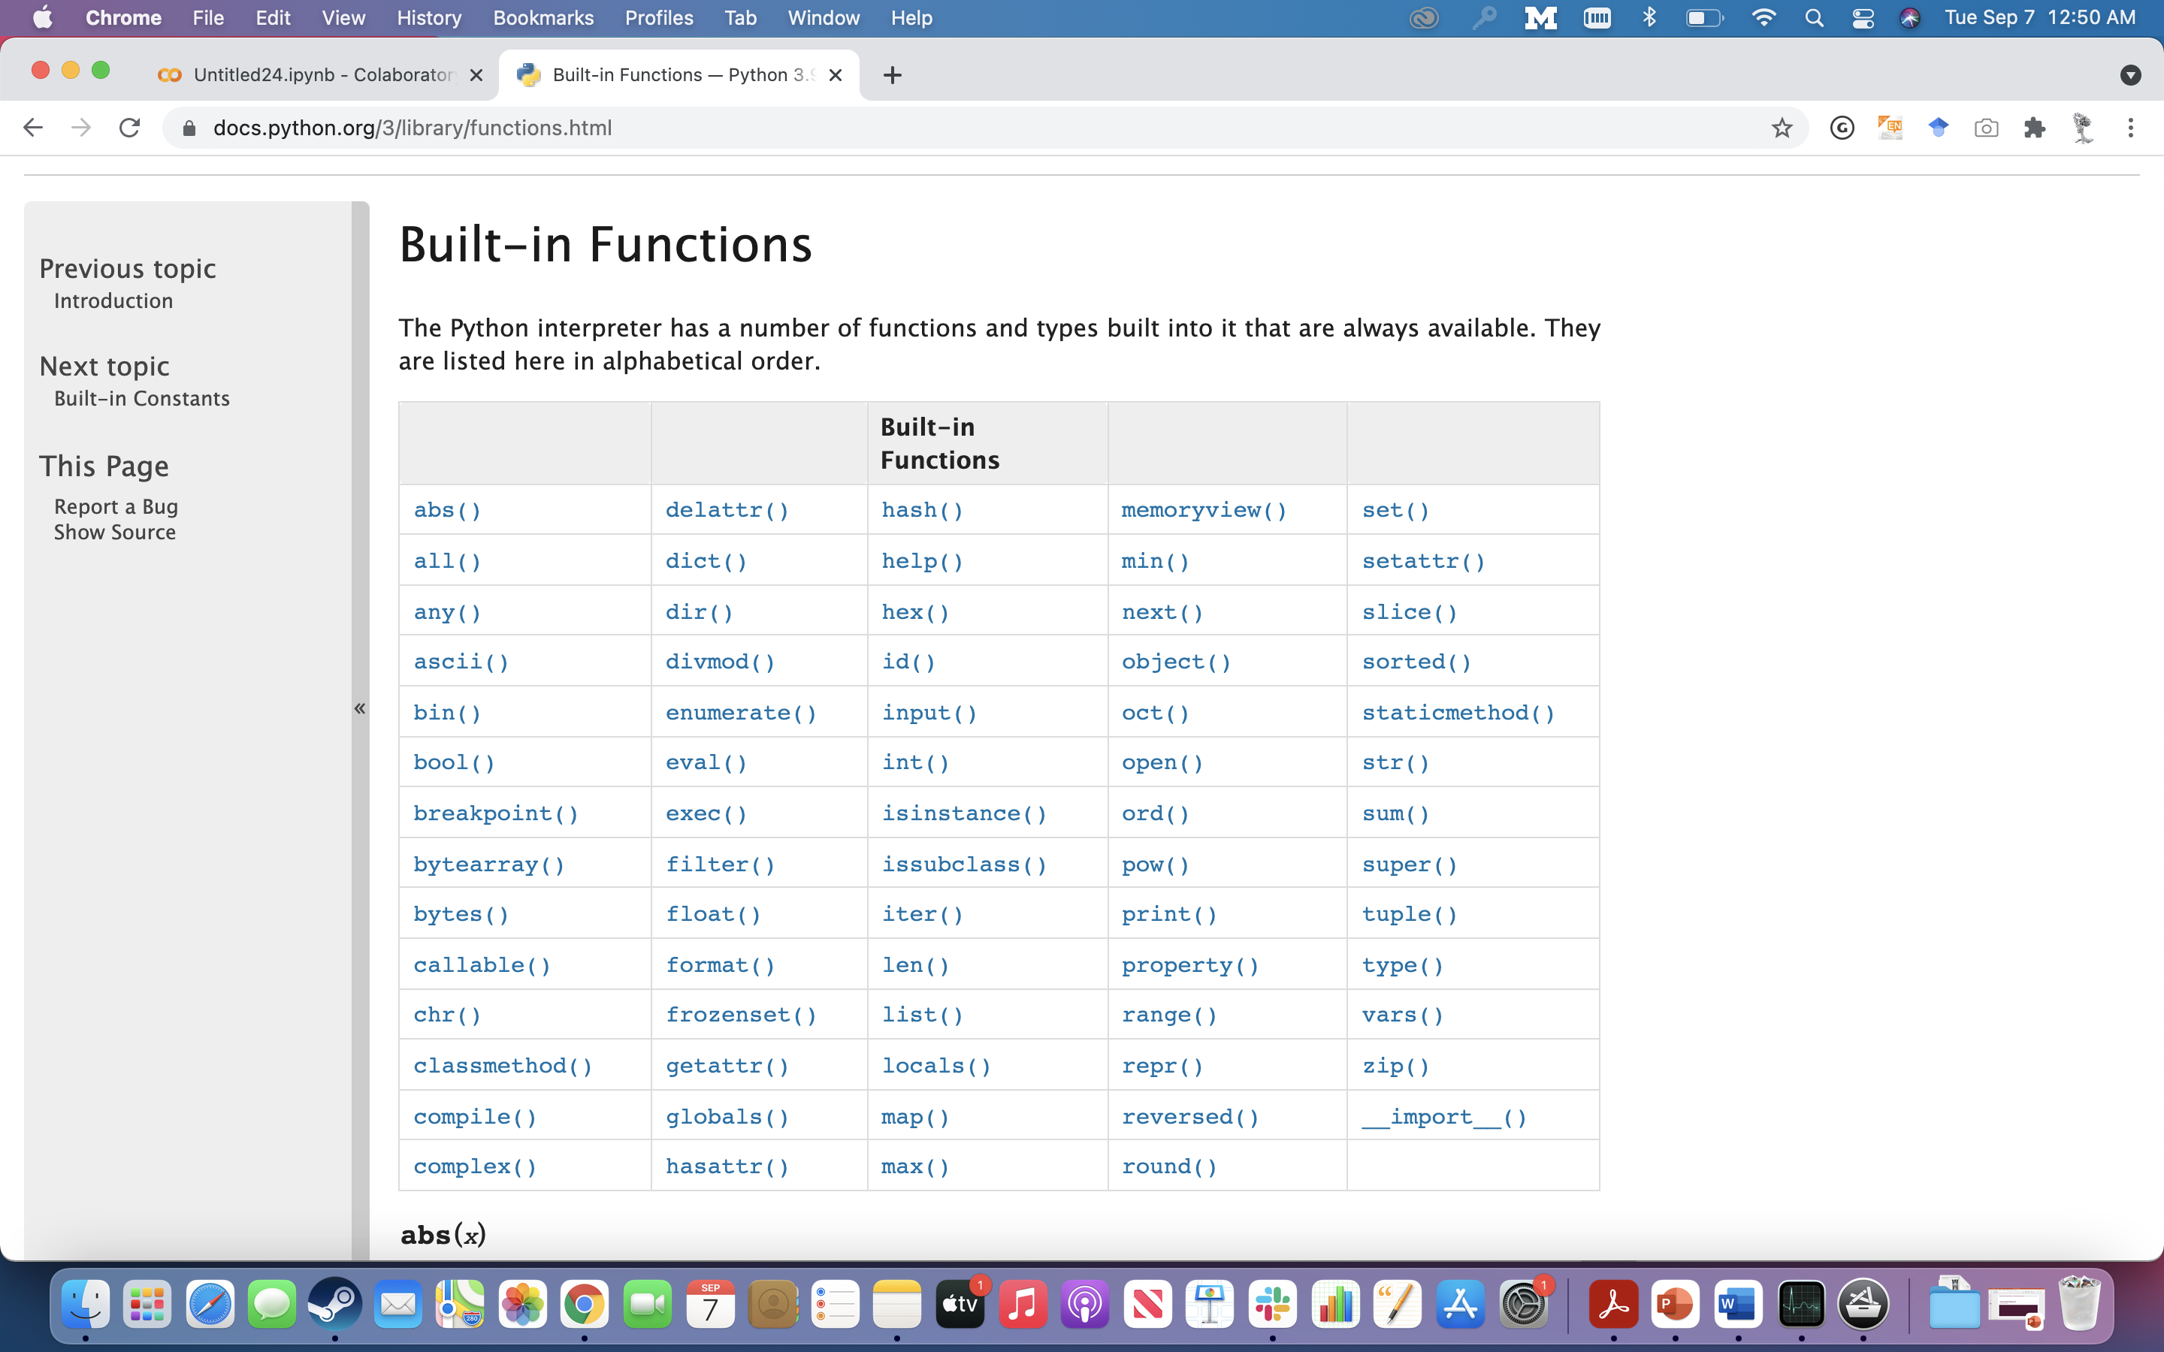
https://docs.python.org/3/library/functions.html

Slide 13
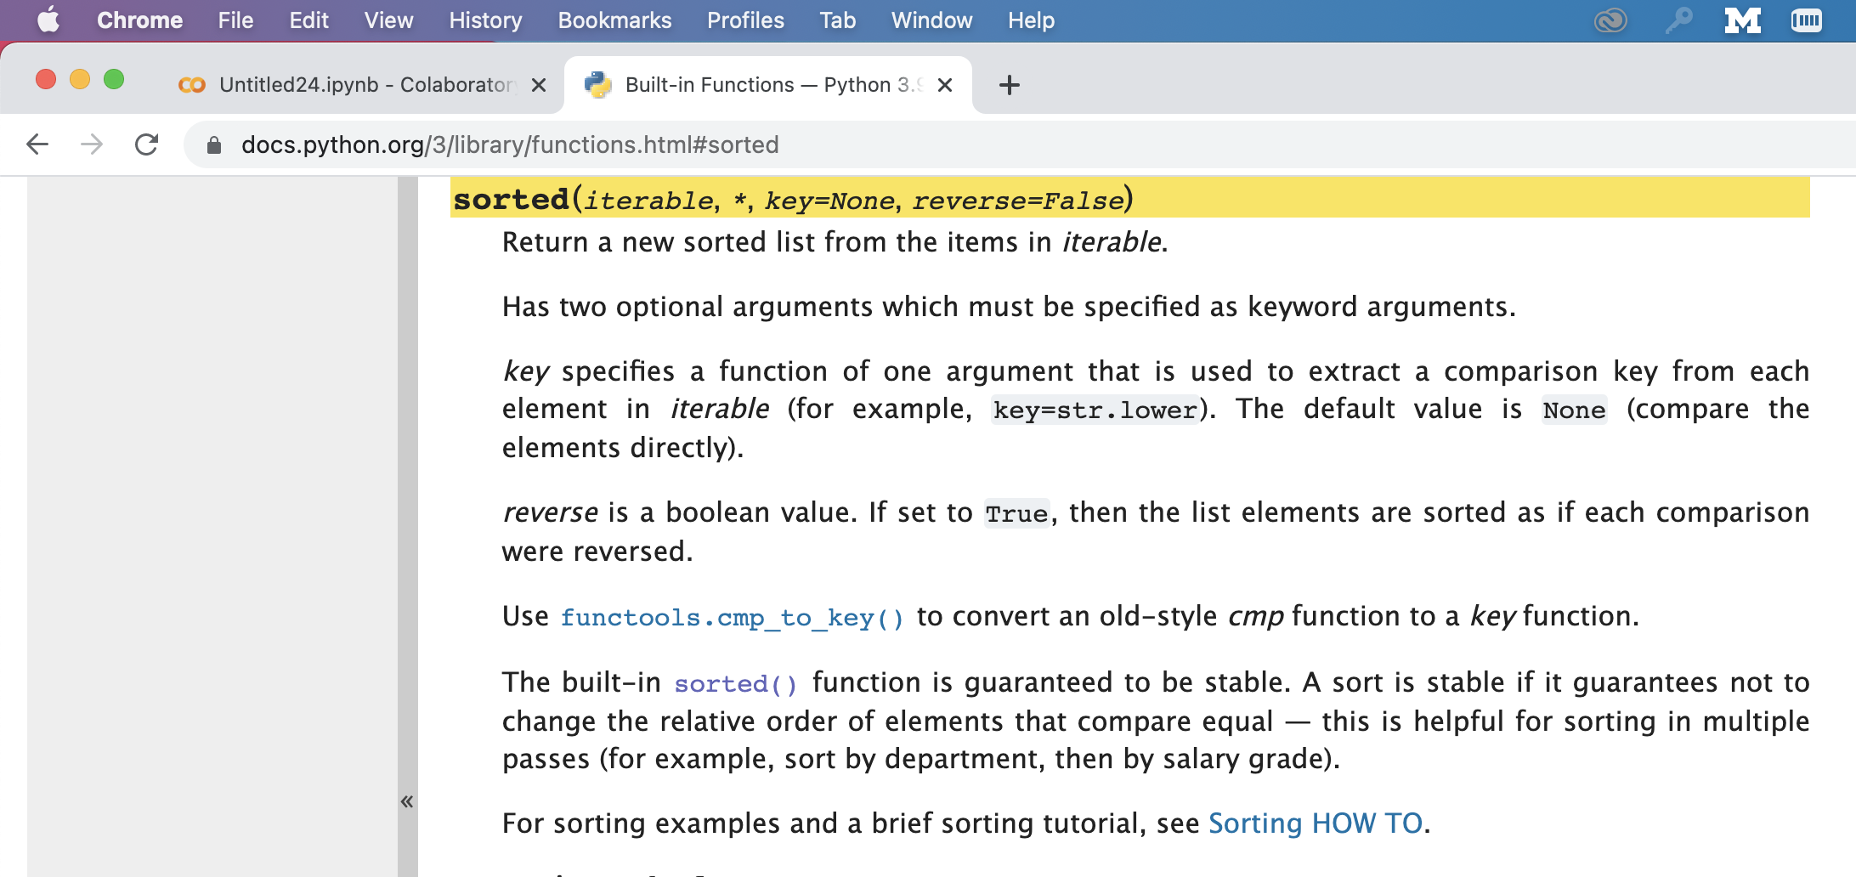
sorted()
https://docs.python.org/3/howto/sorting.html#sortinghowto

Slide 14
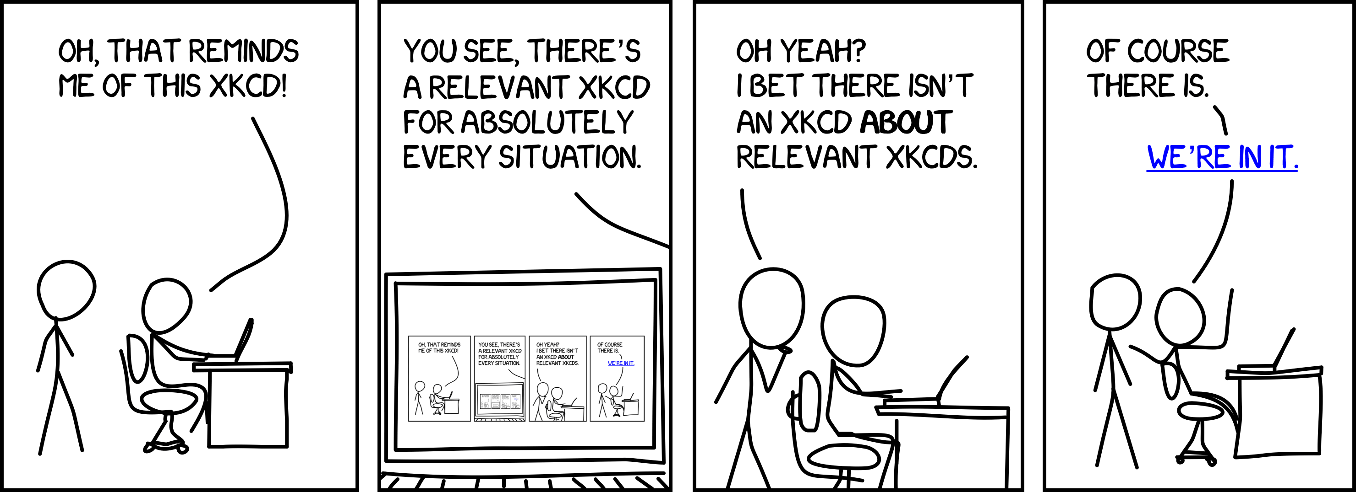
Recursion

Slide 15
Recursion
In programming recursion is an approach that breaks down large problems into repeated smaller sub-problems.
Recursion is implemented by functions calling themselves.
We have already seen that functions can call other functions
But did you know functions can call themselves in certain circumstances?
How does this avoid being an infinite loop?
Recursive functions must have a ‘base case’
this is one of the 3 laws of Recursions

Slide 16
3 Laws of Recursion
Recursive Algorithms must have a ‘base case’
Recursive Algorithms must change its state and move towards the base case
(Remember that word ‘state’ we’ll come back to it)
Recursive Algorithms, by definition, must call themselves

Slide 17
Exercise 1A – work in pairs 6 minutes
Write a function (a regular, iterative function, not a recursive one) sum_of_list that can take a list_of_numbers and returns the_sum

Slide 18
Don’t look at the solution yet
Try it out!

Slide 19
Don’t look at the solution yet
Try it out!

Slide 20
Don’t look at the solution yet
Try it out!

Slide 21
Solution
def sum_of_list(list_of_numbers):
the_sum = 0
for q in list_of_numbers:
the_sum = the_sum + q
return the_sum

Slide 22
How can we make this recursive?
How do we avoid using an iterator? How can we avoid for/while loops?
We can refer smaller and smaller parts of our code back to our function
def recursive_sum(list_of_numbers):
if len(list_of_numbers) == 1:
return list_of_numbers[0]
else:
return list_of_numbers[0] + recursive_sum(list_of_numbers[1:])
#why isn’t this an infinite loop??

Slide 23
Exercise 2 – Recursion for Fibonacci (5 Minutes)
Draw a recursive pseudocode that can find the Nth number in the following sequence
0, 1, 1, 2, 3, 5, 8, 13, 21, 34, 55, 89, 144,…

Slide 24
5 minute break
def fib(n):
if (n == 1): return 0
elif (n == 2): return 1
else:
return fib(n-1) + fib(n-2)

Slide 25
Generators vs Iterators (yield)
This is very abstract
Don’t stress if this doesn’t click yet – you just need to be aware that there are different ways of doing things. We want you to have literacy not competency with this concept
This doesn’t really come into play until you’re using big data in your remaining courses

Slide 26
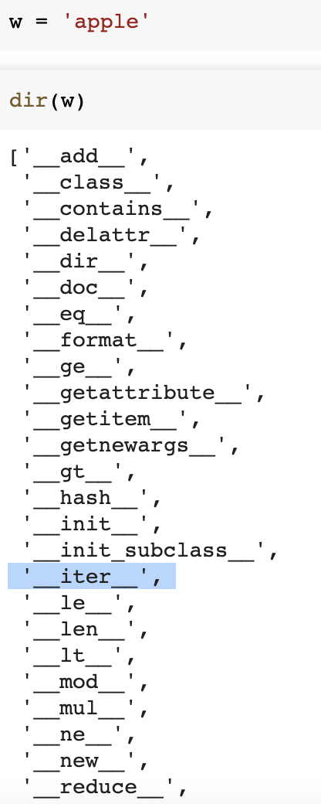
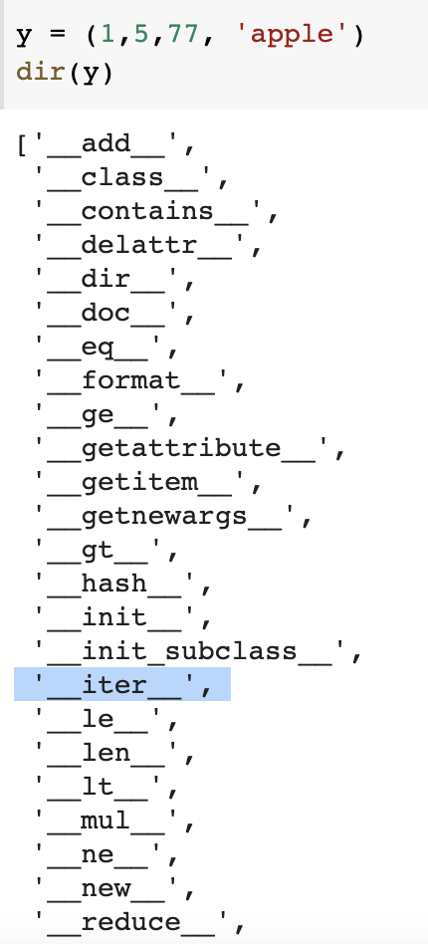
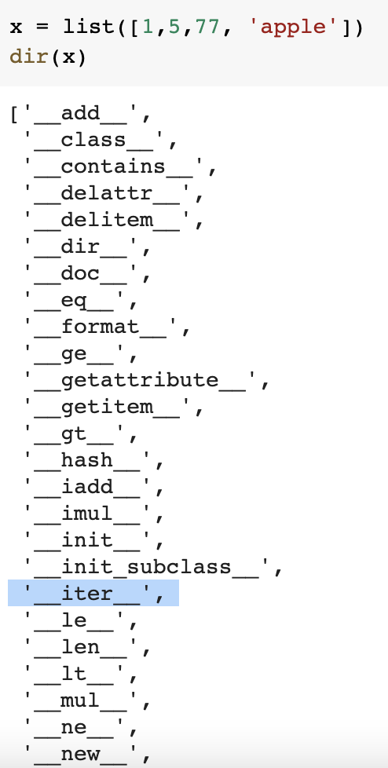
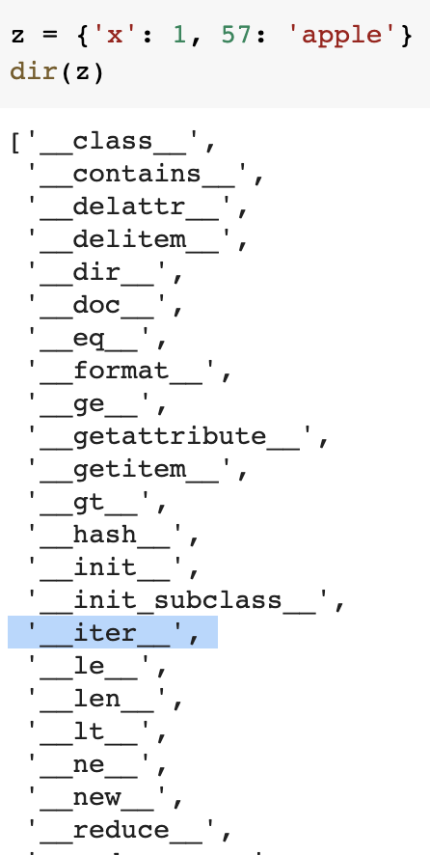
What are iterables?
Lists, tuples, strings, dictionaries etc…all kinds of things that you can iterate through.
If you look under the hood at the technical definition they all have an iter() method get an iterator

Slide 27
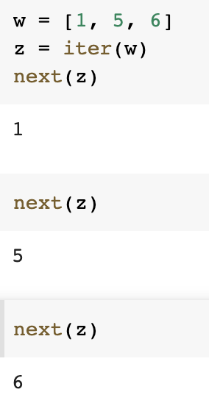
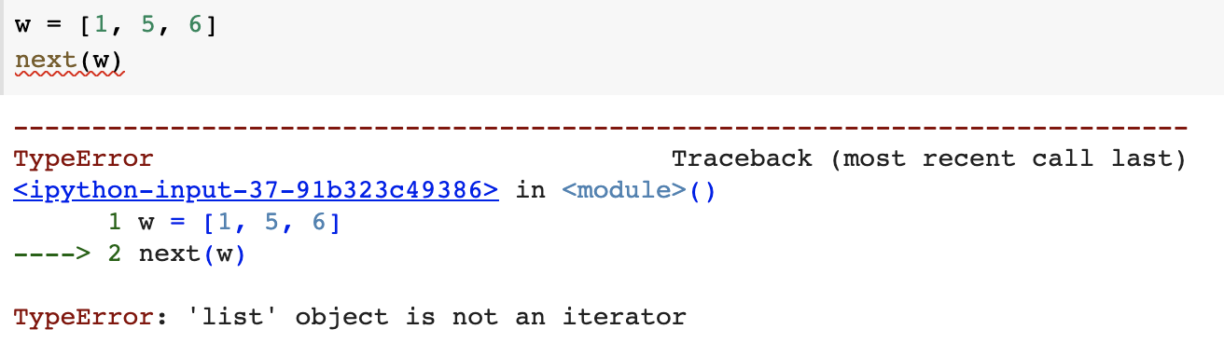
Iterables can give you iterators
an iterator is an object with a next() method that has a countable set of elements
This is what is happening when you use a for loop
You don’t have to memorize this – just understand that python is object-oriented and that has upsides & downsides
And sometimes we have to get away from OO to avoid the downsides – particularly when working with big data

Slide 28
Generators & yield
When you work with big enough data sets you can’t afford the memory to create a big iterator and then do stuff to each element in it.
You have to use a functional (or near functional) programming approach
https://docs.python.org/3/howto/functional.html please read intro and section on generators
“Generators are a special class of functions that simplify the task of writing iterators. Regular functions compute a value and return it, but generators return an iterator that returns a stream of values.”

Slide 29
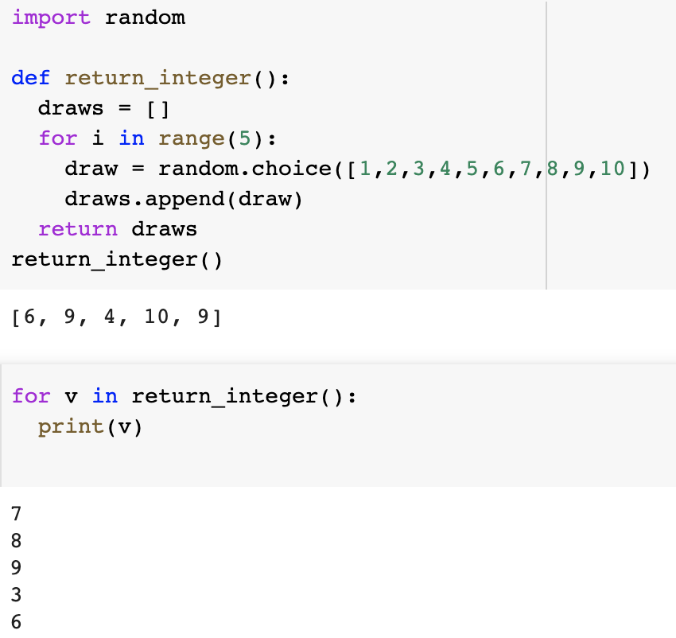
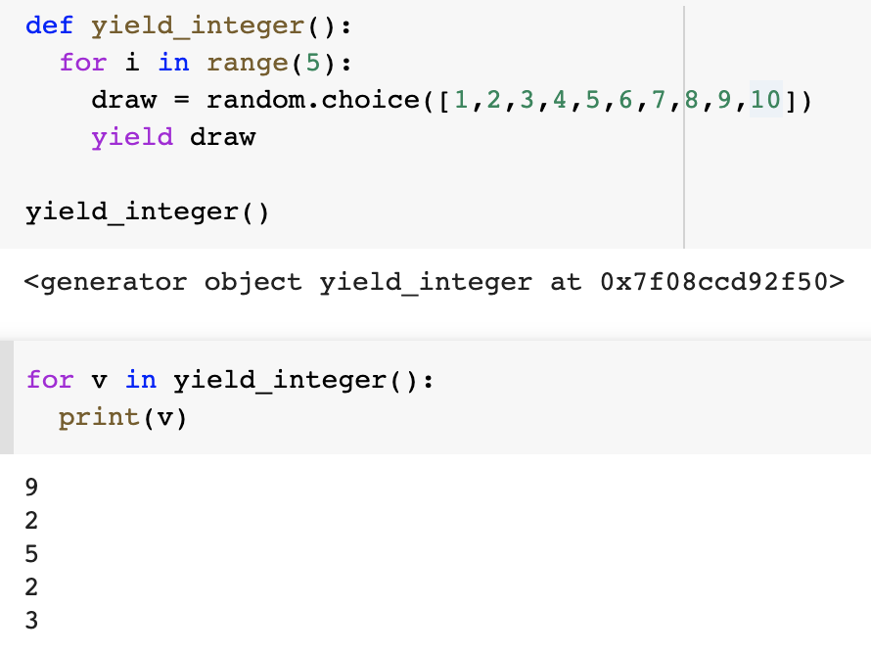
Can you imagine how this might make a difference?
Yield 每次运行到这个yield结束（包括这个yield），有next（）时才会运行

Slide 30
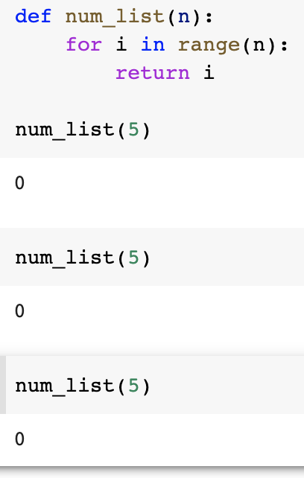
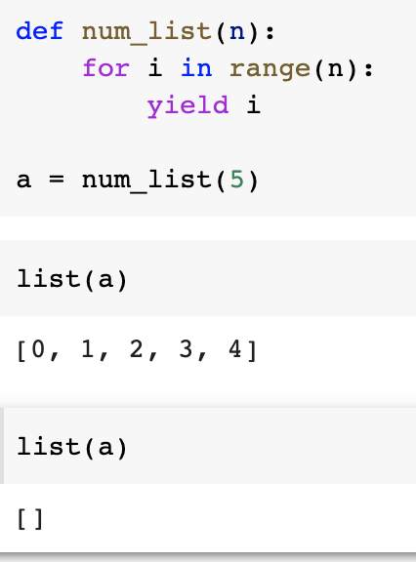
Generators dynamically ‘generate’ but can only be used once
TL;DR
Iterator on list: next() returns the next element of the list
Iterator generator: next() will compute the next element on the fly (execute code)
You can see the yield/generator as a way to manually run the control flow from outside (like continue loop one step), by calling next, however complex the flow.
Note: The generator is NOT a normal function. It remembers the previous state like local variables (stack). See other answers or articles for detailed explanation. The generator can only be iterated on once.
yield是一次性的

Slide 31
Lambda functions
Syntax
lambda argument: expression
Examples:
Do these to test your understanding
http://rockos.co.jp:3009/runestone/static/pip2/Sort/Anonymousfunctionswithlambdaexpressions.html
def squares(x): return x**2 | lambda x: x**2
def hypotenus_via_pythagorean(sideA, sideB): a = sideA**2 b = sideB**2 c = (a +b)**.5 return c | ?

Slide 32
Your brain is not a machine
Your brain is not a muscle
Your brain is a magpie
Surround it with beautiful habits and things.

