Slide 1
Project 21 : Compairing two given random requences
Author: Jingjing XU / Student ID: 0180092002 / University of Luxembourg
Advisor: Prof. Raymond Bisdorff

Slide 2
Description
This project concerns the validation or not of the claim that two given random sequences, X1 and X2, each of length 10000 : see http://sma.uni.lu/bisdorff/CompStatDec18/project-21Data.csv have been obtained from the same RNG.

Slide 3
Tasks
1. Compare statistically and graphically the two given random sequences X1 and X2.
2. Are the given sequences X1 and X2 potentially drawn from the same RNG ?
3. Motivate your answer with arguments taken from the Computational Statistics Course.

Slide 4
Content
1. get data
1.1 Correlation Test
2. Distribution Test
2.1 Equidistribution Test (Frequecy Test)
2.1.1 Chi-squared Test（chisq.test）
1）Test if 'X1' , 'X2' is uniform distribution.
2）Test if 'X1' and 'X2' is from same uniform distribution.
2.1.2 Kolmogorov–Smirnov test (ks.test)
2.2 Gap Test (gap.test)
1) From 0-0.5
2) From 0.5-1.0
2.3 Serial Test (serial.test)
2.4 Equidistribution Test (Use Frequence Test-freq.test)

Slide 5
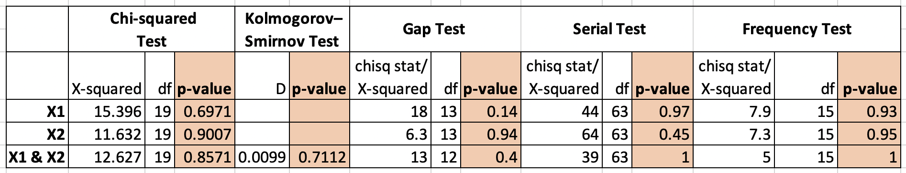
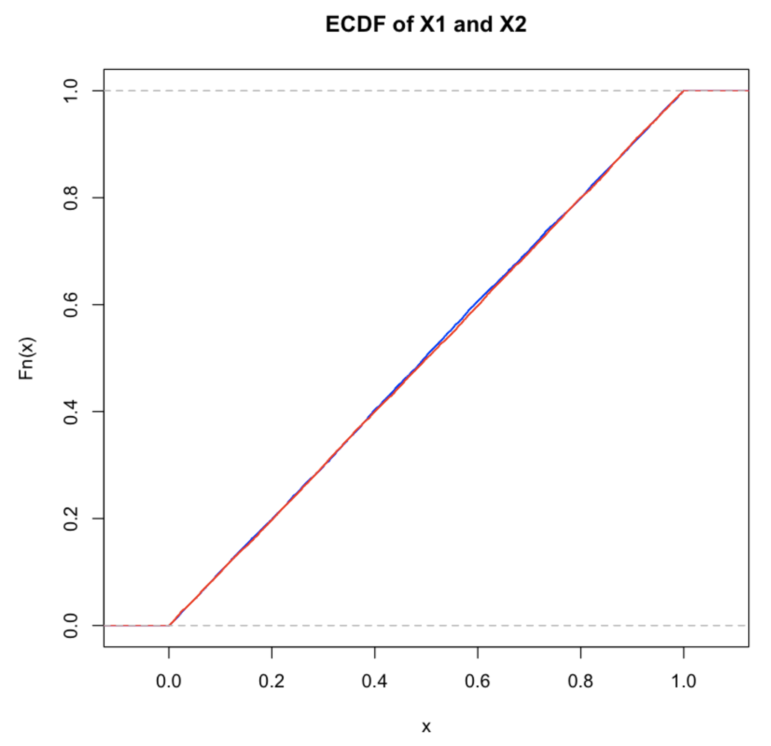
Conclusion
1. According to Cumulative Distribution Function shown below, these two functions are Uniform distribution (continuous) Unif(0,1).
2. According to result of test. [Null hypothesis]: both samples come from the same distribution. [Result]: not rejected (all p-value > 0.05) since they do come from the exact same distribution.

Slide 6
Reference
[1] http://www.physics.csbsju.edu/stats/KS-test.html
[2] https://davetang.org/muse/2012/04/17/comparing-different-distributions/
[3] Slides provided by Prof. Raymond Bisdorff

