Slide 1
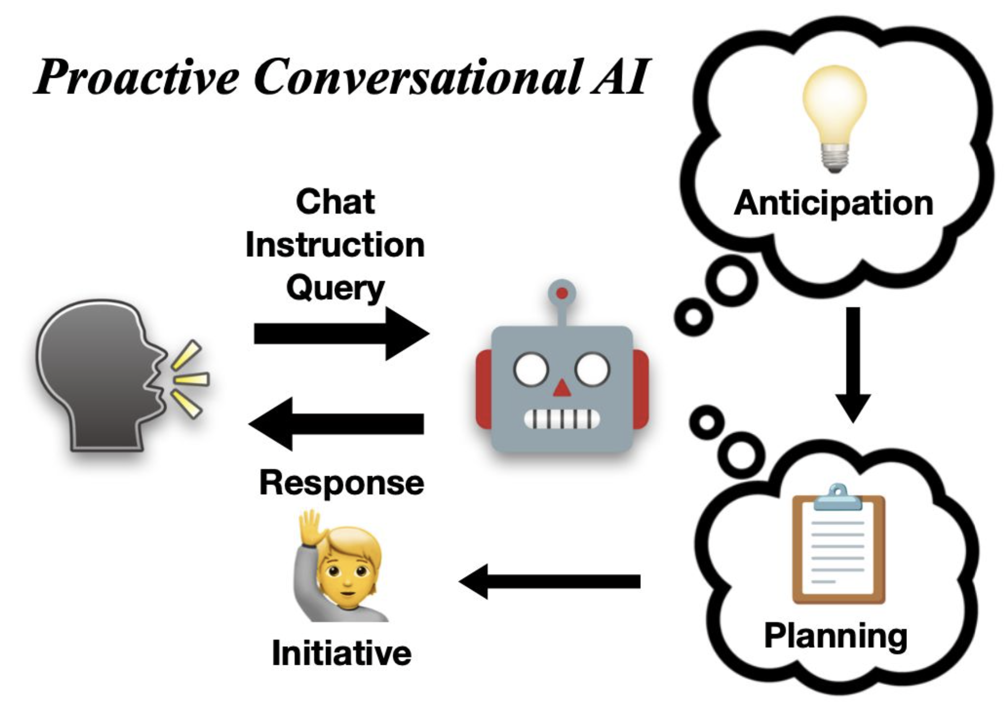

Slide 2


Anticipate
Chat, Query,
Instruction…
Planning
Response
Initiative

