Slide 1

global musical tweets
Exploration of geo-tagged music listening data

Slide 2
Background and motivation
Interest in music and recommendation systems
Inform music industry events (concerts, tours) based on fan bases
Project direction stemmed from data set
Behavioral data from a popular/prolific source (Twitter)
Multi-dimensional: geo-location, time
What does the geographic distribution of music fans look like?
Where is music consumption most prolific?

Slide 3
data
Core dataset: The Million Musical Tweets Dataset (MMTD)
Compiled and provided by scholars at Johannes Kepler University of Linz, Austria along with expository paper
Contains 1M+ data points of listening history as inferred from tweets collected over 17 months tagged with geo-spatial (lat-long, country, city, ...), geo-contextual (country population, languages) and temporal information (timestamp, DOW) with references to song track and artist
Secondary data: Last.fm dataset
Song tag and song similarity dataset built off of the Million Song Dataset

Slide 4
DATA CLEANING & MANIPULATION
MMTD available as zipped text file
Ready-to-use, no NLP necessary
Removed extraneous variables (e.g. dummy categorical columns for each language)
Last.fm song-track data in JSON files
Python script to read and write to csv
Last.fm track-tag data in SQLite database
Pulled out into csv files
Put all data into Postgres database for easier querying
Join MMTD data to Last.fm track-tag data on track title and artist name
~40% match rate, limit 25 default tags from Last.fm

Slide 5
Exploratory analysis
In which lots of bar graphs are created
1.02 M tweets in cleaned data
208 K unique users
24 K unique artists
130 K unique tracks – 89 K unique track titles
Track with most tweets: Someone Like You (Adele)
Artist with most tweets: Rihanna
10 tweets from Antarctica

Slide 6
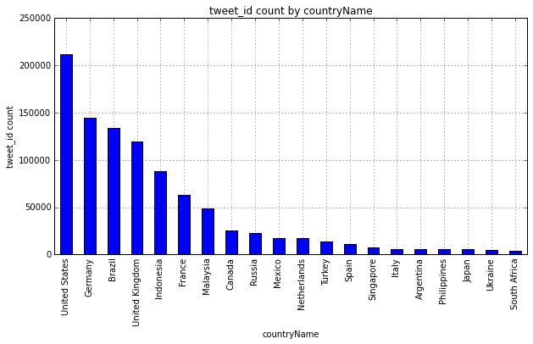
EXPLORATORY ANALYSIS

Slide 7
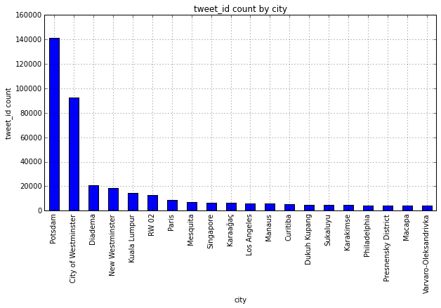
EXPLORATORY ANALYSIS

Slide 8
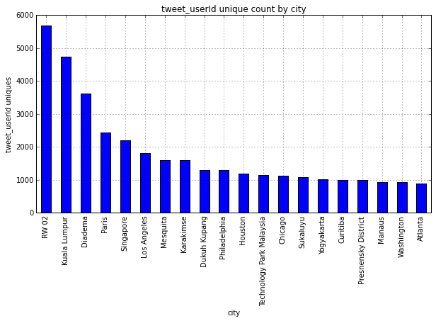
Exploratory analysis

Slide 9
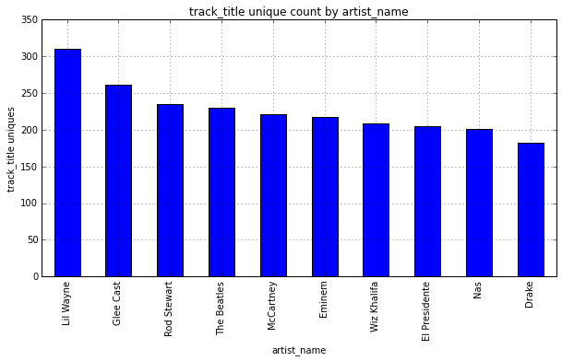
EXPLORATORY ANALYSIS

Slide 10
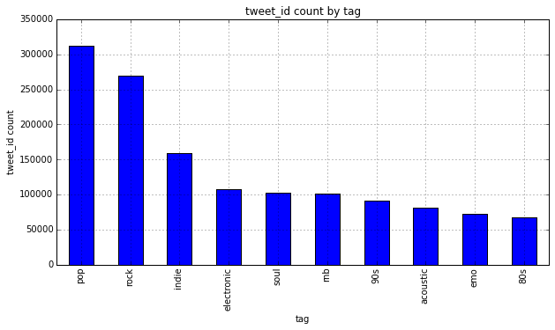
Exploratory analysis

Slide 11
Geo-spatial clustering
Goal: Use clustering algorithm to determine where people listen to (and share) music
Process considerations:
Pre-processing
Scaling data
Algorithm
Used DBSCAN and K-Means
Parameter refinement
Trial and error
Visualization
Plotting many samples/clusters on world map = visual clutter

Slide 12
K-means v. dbscan
K-means
dbscan
Need to specify number of clusters
Euclidean distance
Effective for two-dimensional or geospatial data
Centroids not necessarily meaningful geographic locations
Density-based – no predefined conception of the ‘correct’ number of clusters required
Finds arbitrarily shaped-clusters and noise
Parameter tuning may be more intuitive with domain knowledge

Slide 13
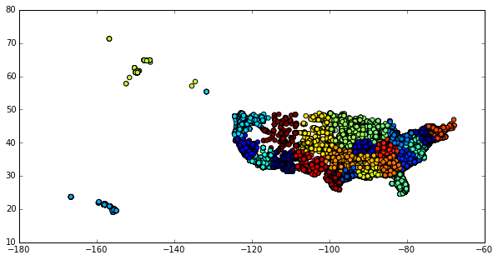
Country-level k-means

Slide 14
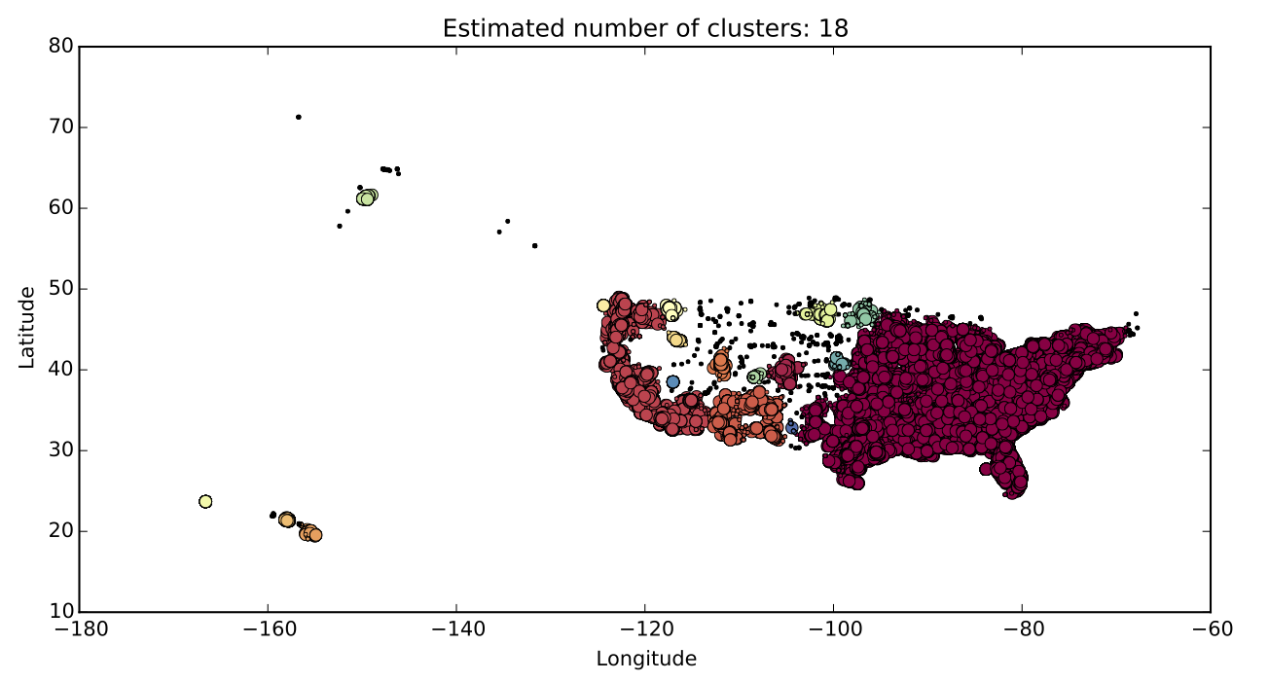
country-level dbscan

Slide 15
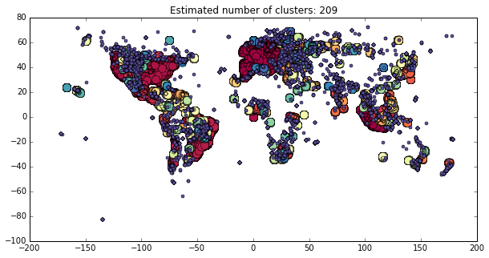
DBSCAN clustering
Default parameters: eps = 1, min_samples = 50
process took 12572.35 seconds

Slide 16
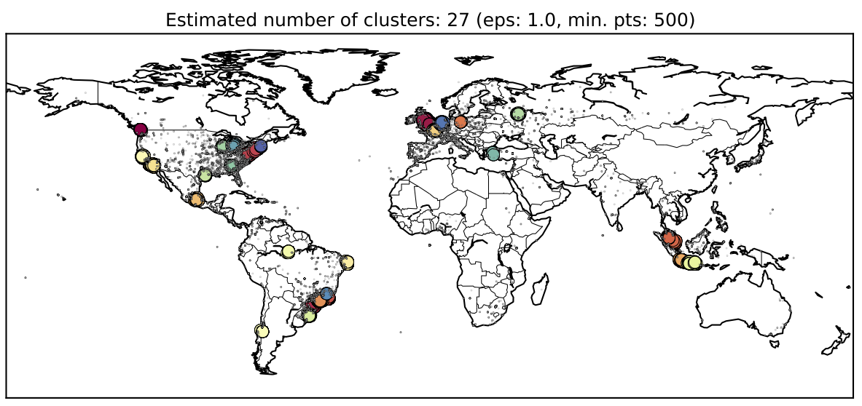
Dbscan clustering

Slide 17
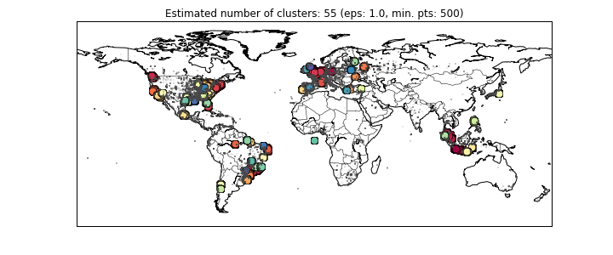
Genre-specific dbscan
Pop

Slide 18
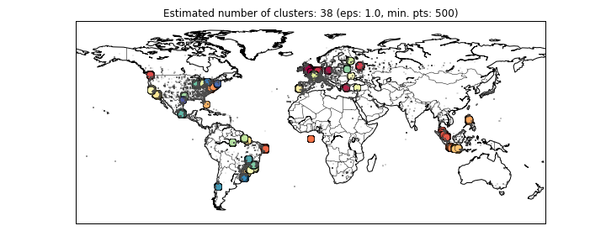
Genre-specific dbscan
Indie

Slide 19
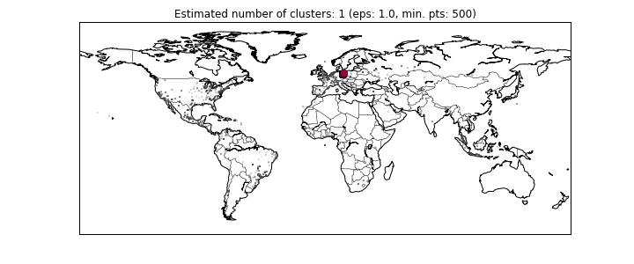
Genre-specific dbscan
Latin

Slide 20
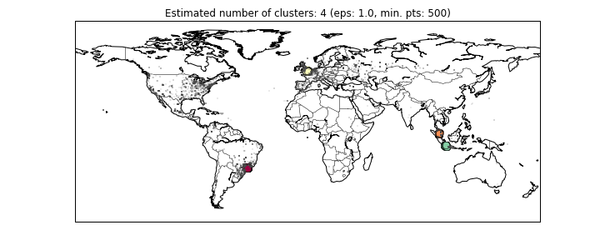
Genre-specific dbscan
Hardcore

Slide 21
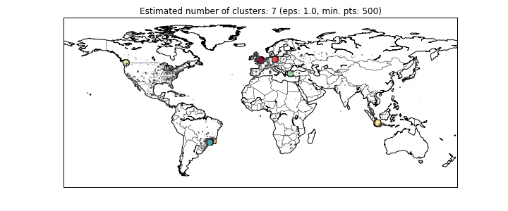
Genre-specific dbscan
Folk

Slide 22
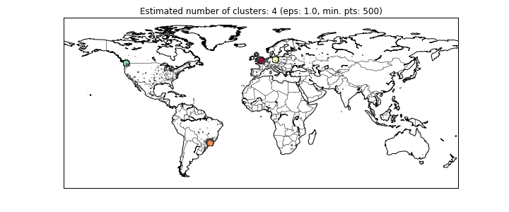
Genre-specific dbscan
60’s

Slide 23
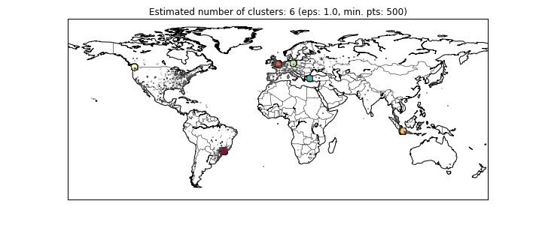
Genre-specific dbscan
70’s

Slide 24
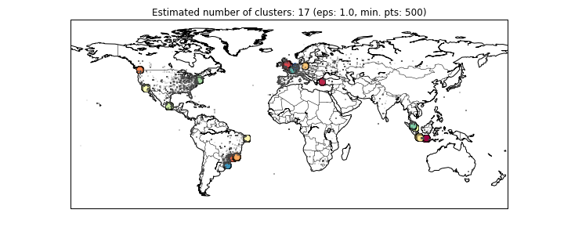
Genre-specific dbscan
80’s

Slide 25
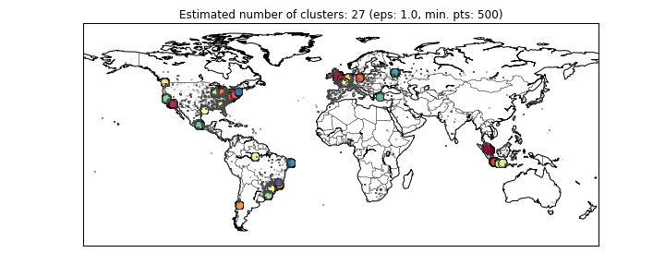
Genre-specific dbscan
90’s

Slide 26
Temporal analysis

Slide 27
Future work
More robust genre/tag information
Impute for unmatched tracks, incorporate tag value
Optimize tuning parameters for DBSCAN
K-distance plot (with k=min_samples) for finding epsilon
Alternative distance metrics
Localized clustering
K-means could be effective on smaller geographical areas
Time series analysis and prediction
Utilize timestamp of tweets in conjunction with song tags to predict popularity of genres
Cool visualizations
Show tweet activity played out in real time for different genres
Correlate tweet activity with music events, concerts, festivals
Songkick, Ticketmaster, Livenation

Slide 28
MANY THANKS
To harish and stu for all their help

