Slide 1
STAT 512 Applied Regression Analysis
Final Project on Liver Steatosis Data Analysis
Clint Alfaro, Jingjing Guo, and Erin Tooley
Dec 6, 2017

Slide 2
Outline
Problem overview
PART I:
1. Piecewise regression of one predictor
2. Extra sums of squares
3. Type I and Type II sums of squares
4. Regression models with different predictors
PART II:
1. Scatterplot and Correlation Matrix
2. Transformation
3&4. Variable Selection: Cp and Stepwise
5&6. Assumption Check and Outliers
7. Best Model
Concluding Remarks

Slide 3
Goal: predict liver steatosis from clinical variables, blood tests, and ultrasonic imaging
Gold standard is tissue biopsy and histopathology
Accuracy of ultrasound diagnosis is not well understood
-invasive
-highly accurate
-non-invasive
Wu, J. et al. Obes. Surg. (2012) 22:240–247

Slide 4
Table of variables used in the project
Variable name | Type of variable |  | Codes,Units,Values | Abbreviation
Age | Clinical | Continuous | Years | Age
Gender | Clinical | Categorical | 1 =male, 2=female | Sex
Height | Clinical | Continuous | cm | Height
Weight | Clinical | Continuous | kg | Weight
Body mass index | Clinical | Continuous | kg/mg2 | BMI
Duration of obesity | Clinical | Continuous | years | Obes
Diabetes | Clinical | Categorical | 0 = absent, 2 = present | DM
Metabolic syndrome | Clinical | Categorical | 0 = absent, 2 = present | Met
Hypertension | Clinical | Categorical | 0 = absent, 2 = present | HTN
Hyperlipidemia | Blood test | Categorical | 0 = absent, 2 = present | HPL
Plasma triglycerides | Blood test | Continuous | % | TG
Cholesterol | Blood test | Continuous | mg/dL | CHOL
High-density lipoprotein cholesterol | Blood test | Continuous | mg/dL | HDL
Low-density lipoprotein cholesterol | Blood test | Continuous | mg/dL | LDL
Very-low-density lipoprotein cholesterol | Blood test | Continuous | mg/dL | VDL
Aspartate aminotransferase | Blood test | Continuous | U/L | AST
Alanine aminotransferase | Blood test | Continuous | U/L | ALT
Nonalcoholic fatty liver disease activity score | Liver biopsy | Categorical | Range from 0 to 8 | NAS
Fibrosis | Liver biopsy | Categorical | 0 = none | Fibrosis
 |  |  | 1 = perisinusoidal or periportal
 |  |  | 2 = perisinusoudal and poral/periportal
 |  |  | 3 = briding fibrosis
 |  |  | 4 = cirrhosis
Positive liver steatosis by ultrasound | Imaging | Categorical | 0 = negative | LS_US
 |  |  | 0.5 = inconclusive
 |  |  | 1 = positive
Positive liver steatosis by biopsy | Liver biopsy | Categorical | 0 = negative | LS_Bi
 |  |  | 0.5 = inconclusive
 |  |  | 1 = positive

Slide 5
Information on study population and data points
The study enrolled patients who had laparoscopic gastric bypass, sleeve, or band surgery.
Included patients who had no clinical evidence of other liver diseases and who had intraoperative needle liver biopsy with or without preoperative right upper quadrant ultrasound between 2005 and 2009.
443 human subjects included, each has the 21 variables listed
65 subjects had missing values, so only 378 subjects were used in analyses
Wu, J. et al. Obes. Surg. (2012) 22:240–247

Slide 6
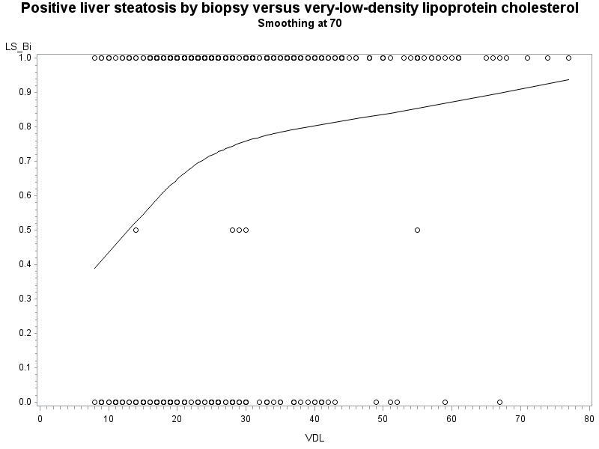
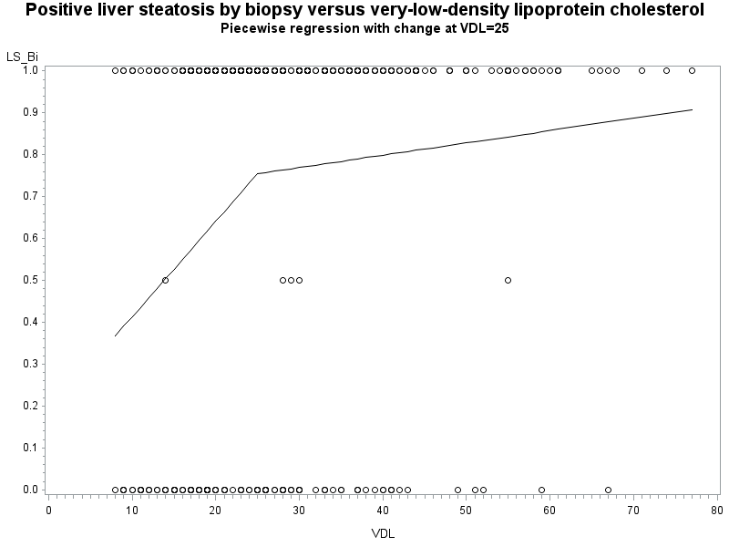
Piecewise regression of one predictor
Test sameline Results for Dependent Variable LS_Bi
Source | DF | Mean square | F Value | Pr > F
Numerator | 2 | 2.77694 | 14.41 | <.0001
Denominator | 390 | 0.19272

Slide 7
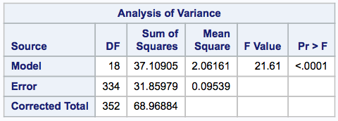
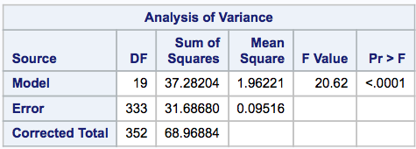
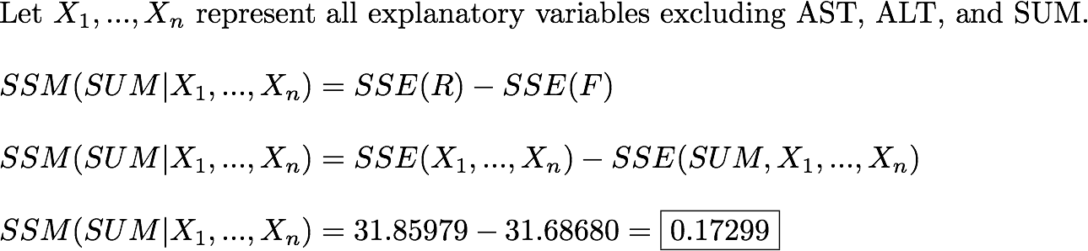
Extra Sum of Squares
New Variable SUM = ALT + AST
ANOVA excluding SUM
ANOVA including SUM

Slide 8
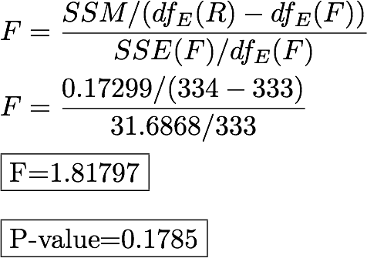
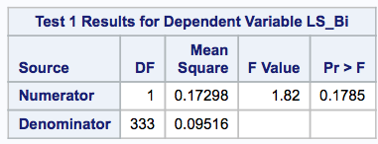
Extra Sum of Squares
Conclusion: inclusion of the variable SUM does not improve the model.

Slide 9
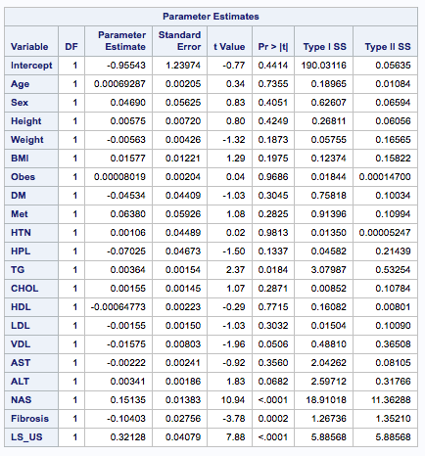
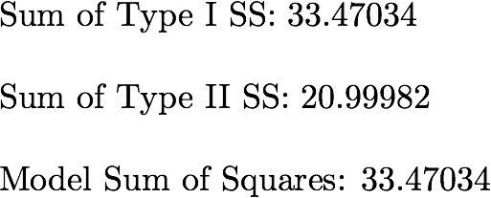
Type I and II Sum of Squares

Slide 10
Different combinations of predictors show that some variables may be useful and others are not
Model DF | Model explanatory variables | R2 | R2 Adj
6 | Age Sex Height Weight BMI SUM | 0.08 | 0.07
6 | Age Sex Height Weight SUM LS_US | 0.31 | 0.30
5 | Age Sex Height Weight SUM | 0.08 | 0.07
16 | Age Sex Height Weight BMI Obes DM Met HTN HPL TG CHOL HDL LDL VDL SUM | 0.15 | 0.11
17 | Age Sex Height Weight BMI Obes DM Met HTN HPL TG CHOL HDL LDL VDL AST ALT SUM | 0.17 | 0.12
18 | Age Sex Height Weight BMI Obes DM Met HTN HPL TG CHOL HDL LDL VDL NAS LS_US SUM | 0.52 | 0.49
16 | Age Sex Height DM Met HTN HPL TG CHOL HDL LDL VDL NAS Fibrosis LS_US SUM | 0.54 | 0.52
Variable selection techniques needed for building a useful model

Slide 11
Model Selection
Part II

Slide 12
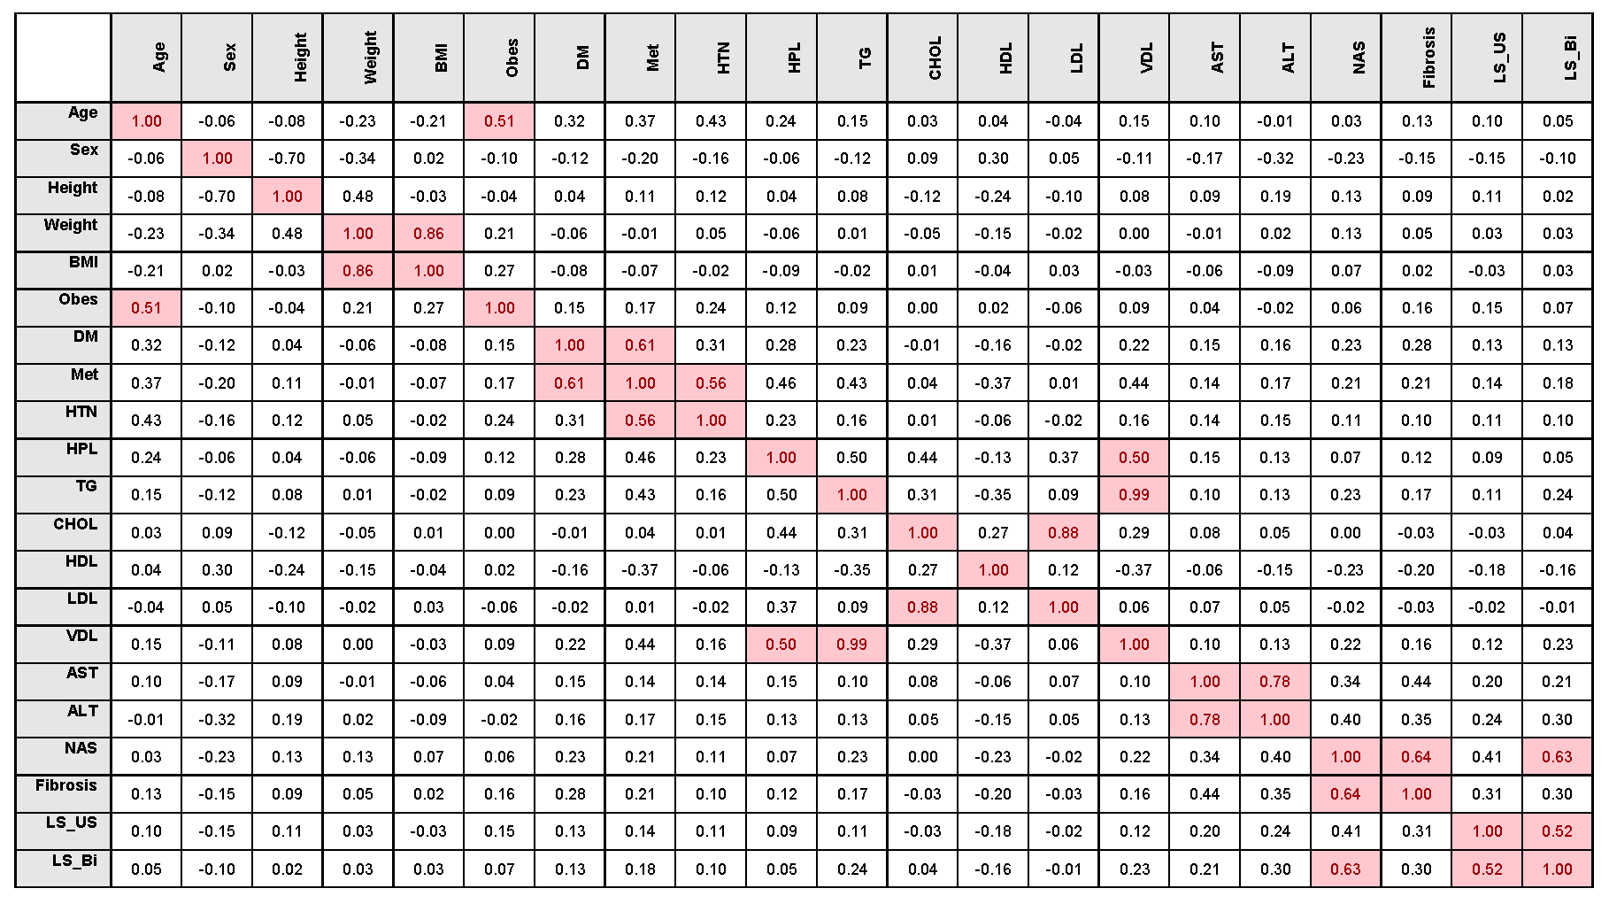
II-1. Scatter Plot and Correlation Matrix
BMI and Weight: 0.86
Met and DM: 0.61
HTN and Met: 0.56
LDL and CHOL: 0.88
VDL and TG: 0.99
ALT and AST: 0.78
Fibrosis and NAS: 0.64
LS_Bi and NAS: 0.63
LS_Bi and LS_US: 0.52

Slide 13
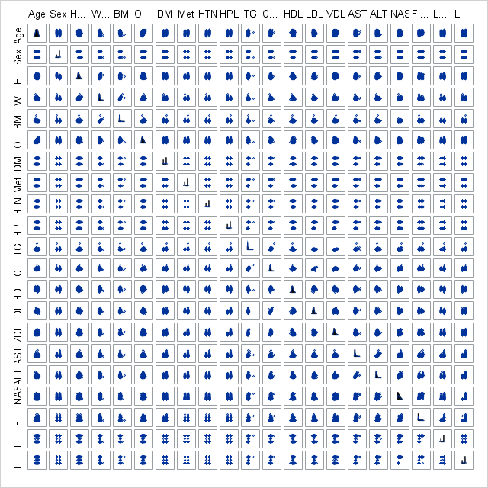
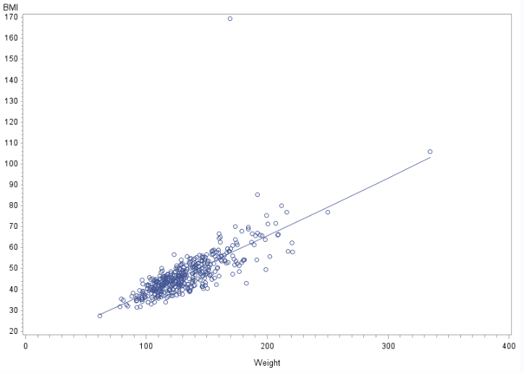
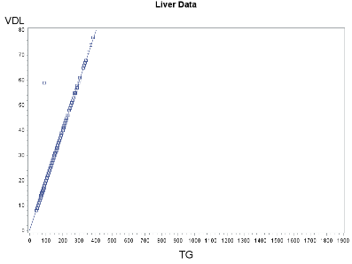
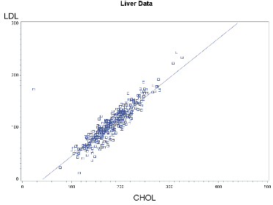
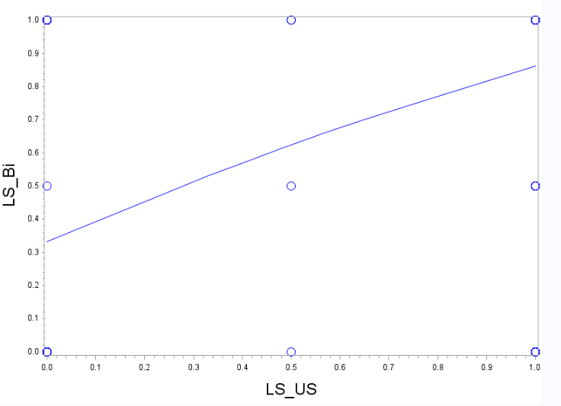
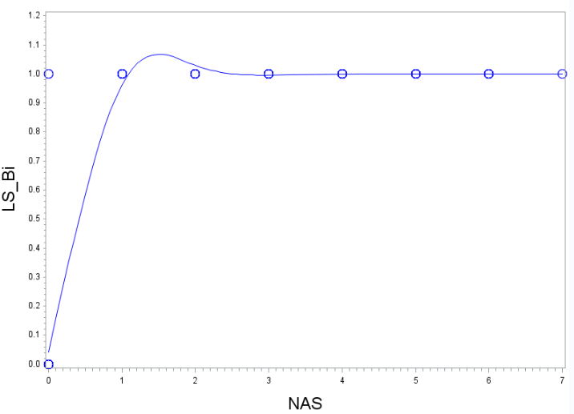
II-1. Scatter Plot and Correlation Matrix
BMI and Weight: 0.86
VDL and TG: 0.99
LDL and CHOL: 0.88
LS_Bi and NAS: 0.63
LS_Bi and LS_US: 0.52

Slide 14
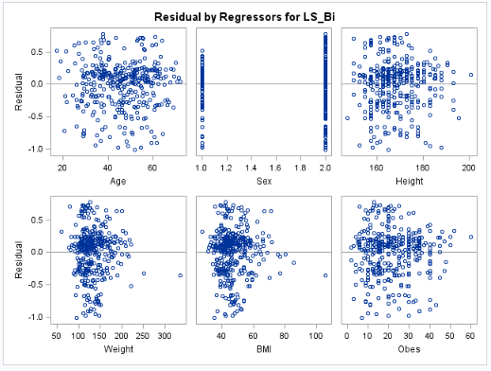
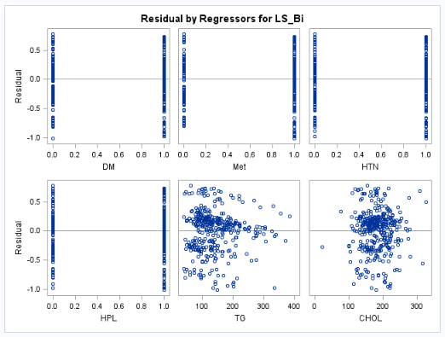
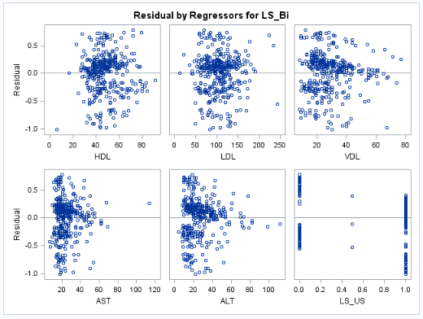
II-2. Variable Transformations - Explanatory Variables
Criteria for transformation of variables:
If residuals appear to be normal with constant variance, but relationship is nonlinear, try transforming the X's to make it a straight line.
If the residuals are badly behaved, try transforming Y. If that stabilizes the variance but wrecks the straight line, try transforming X as well to get the straight line back.
Residual plots for selected predictor variables:
Variance do not appear to the constant, Y transformation did not improve.

Slide 15
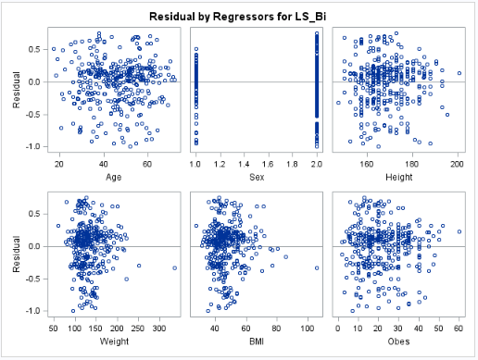
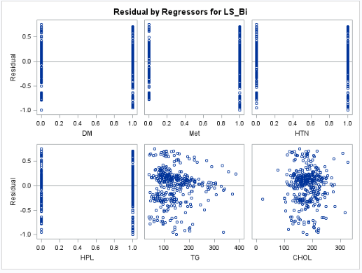
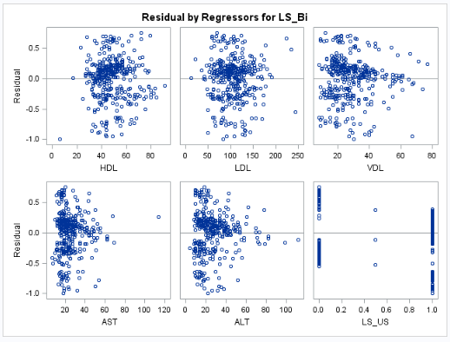
II-2. Variable Transformations - Explanatory Variables
Criteria for transformation of variables:
If residuals appear to be normal with constant variance, but relationship is nonlinear, try transforming the X's to make it a straight line.
If the residuals are badly behaved, try transforming Y. If that stabilizes the variance but wrecks the straight line, try transforming X as well to get the straight line back.
Residual plots for selected predictor variables:
Variance do not appear to the constant, Y transformation did not improve.
No visible nonlinear relationship detected no transformation conducted.

Slide 16
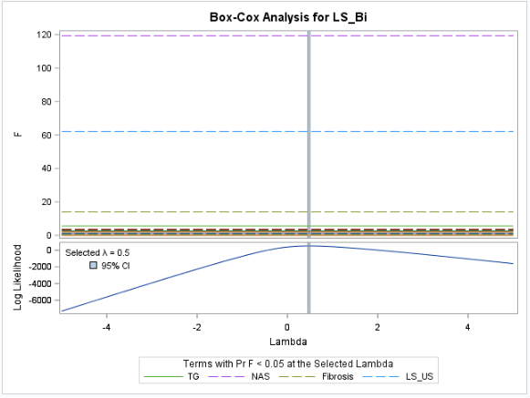
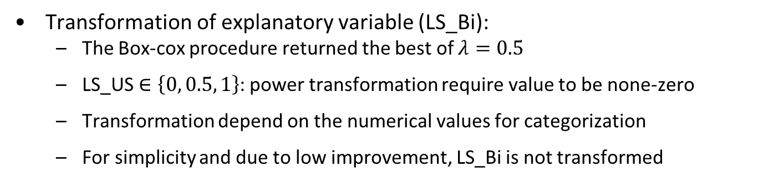
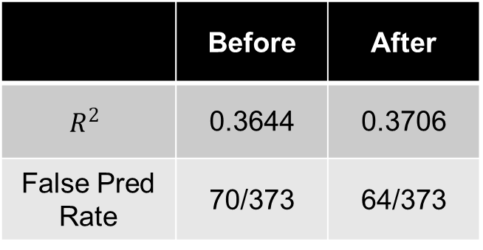
II-2. Variable Transformations - Response Variables
Transformation of explanatory variable (LS_Bi):
The Box-cox procedure returned the best of $λ=0.5$
LS_US $∈\left\{0, 0.5, 1\right\}$: power transformation require value to be none-zero
Transformation depend on the numerical values for categorization
For simplicity and due to low improvement, LS_Bi is not transformed
 | Before | After
$$R^{2}$$ | 0.3644 | 0.3706
False Pred Rate | 70/373 | 64/373

Slide 17
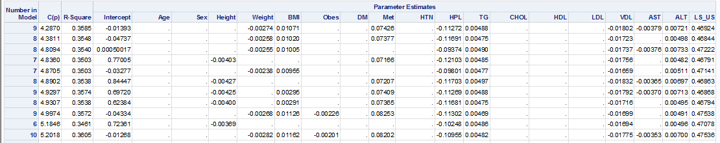
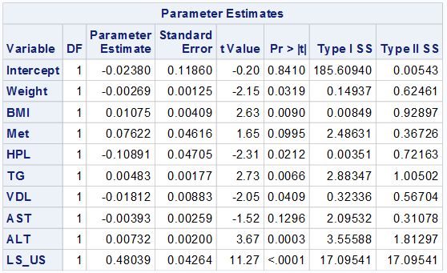
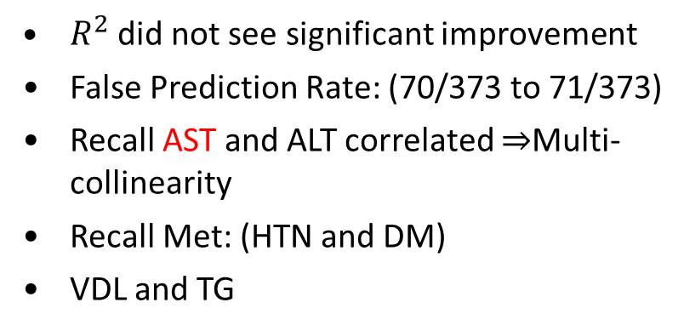
II-3 & 4. Variable Selection - Cp
Cp criteria to determine the best set of explanatory variable:
9 variables: {Weight, BMI, Met, HPL, TG, VDL, AST, ALT and LS_US}
$R^{2}$ did not see significant improvement
False Prediction Rate: (70/373 to 71/373)
Recall AST and ALT correlated $⇒$Multi-collinearity
Recall Met: (HTN and DM)
VDL and TG

Slide 18
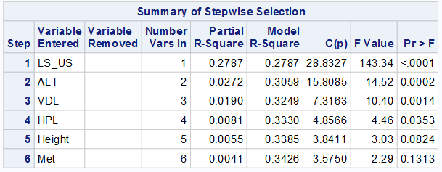
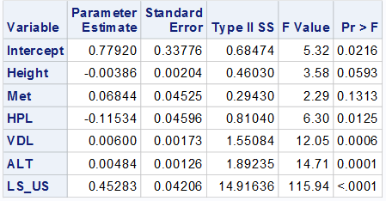
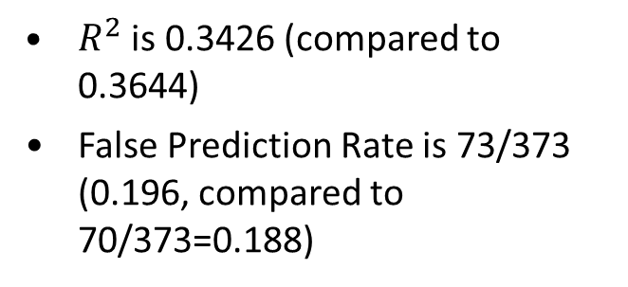
II-3 & 4. Variable Selection - Stepwise
Cp criteria to determine the best set of explanatory variable:
6 variables: {Weight, BMI, Height, Met, HPL, TG, VDL, AST, ALT and LS_US}
$R^{2}$ is 0.3426 (compared to 0.3644)
False Prediction Rate is 73/373 (0.196, compared to 70/373=0.188)

Slide 19
Examination of influential observations and outliers in candidate model
LS_Bi_predicted = b₀ + b_{1*}Weight + b_{2*}BMI + b_{3*}Metabolic syndrome + b_{4*} hyperlipidemia + b_{5*} plasma triglycerides + b_{6*} very low density lipoprotein cholesterol + b_{7 *}aspartate aminotransferase + b_{8 *}alanine aminotransferase + b_{9*} ultrasound
Cutoff for studentized residuals is t_{n-p-1}(1-α/2n) = t₃₇₈₋₉₋₁ (1-0.05/2*378) = t₃₆₈ 0.99 ~ 3
No outliers based on studentized residuals
Cutoff for Cook’s D is 4/n = 0.011
Observations 136,345, 287, 132, 121, 252, 217, 346, 249, 33, 175, 383 considered influential based on Cook’s D
Hat Matrix cutoff 2p/n = 0.0489
Observations 405, 379 ,94, 2, 273, 217, 368, 407, 347, 84, 230, 398, 346, 33, 383 above threshold for influential observations
Weighting may help reduce influence of these observations on the regression parameter estimates

Slide 20
Examination of multicollinearity in candidate model
LS_Bi_predicted = b₀ + b_{1*}Weight + b_{2*}BMI + b_{3*}Metabolic syndrome + b_{4*} hyperlipidemia + b_{5*} plasma triglycerides + b_{6*} very low density lipoprotein cholesterol + b_{7 *}aspartate aminotransferase + b_{8 *}alanine aminotransferase + b_{9*} ultrasound
VIF > 10 suggests significant multicollinearity for TG (plasma triglycerides) and VDL (very low density lipoprotein cholesterol).
Parameter Estimates
Variable | DF | Parameter | Standard | t Value | Pr > |t| | Variance
 |  | Estimate | Error |  |  | Inflation
Intercept | 1 | -0.0248 | 0.1186 | -0.21 | 0.8344 | 0
Weight | 1 | -0.00269 | 0.00125 | -2.15 | 0.0319 | 3.93913
BMI | 1 | 0.01075 | 0.00409 | 2.63 | 0.009 | 3.9549
Met | 1 | 0.07622 | 0.04616 | 1.65 | 0.0995 | 1.34418
HPL | 1 | -0.10891 | 0.04705 | -2.31 | 0.0212 | 1.45724
TG | 1 | 0.00483 | 0.00177 | 2.73 | 0.0066 | 36.48905
VDL | 1 | -0.01812 | 0.00883 | -2.05 | 0.0409 | 36.77166
AST | 1 | -0.00393 | 0.00259 | -1.52 | 0.1296 | 2.53822
ALT | 1 | 0.00732 | 0.002 | 3.67 | 0.0003 | 2.65738
LS_US | 1 | 0.48039 | 0.04264 | 11.27 | <.0001 | 1.08296

Slide 21
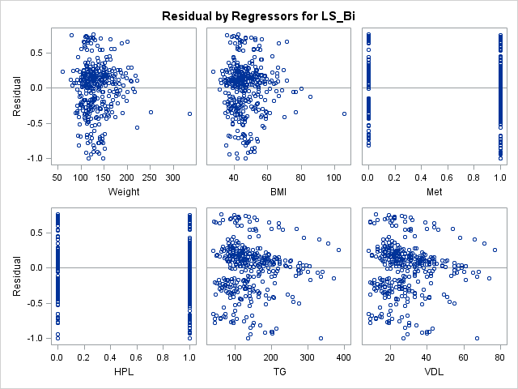
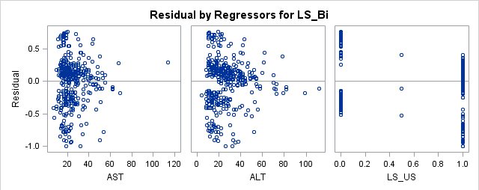
Residual plots for individual explanatory variables seem generally okay
Data clouds fairly random for Weight, BMI, Met, HPL
Non-constant residuals evident in LS_US
Slight correlations in TG, AST, ALT, and VDL

Slide 22
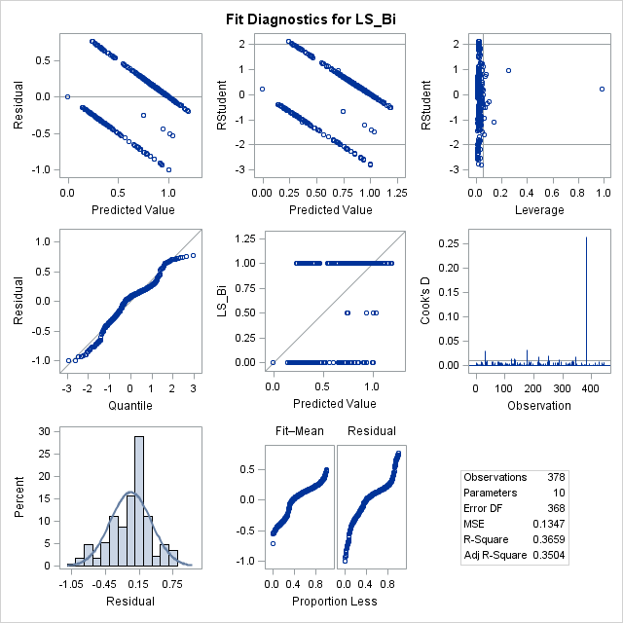
“Best” model shows some ability to predict LS_Bi, but needs improvement
LS_Bi_predicted = b₀ + b_{1*}Weight + b_{2*}BMI + b_{3*}Metabolic syndrome + b_{4*} hyperlipidemia + b_{5*} plasma triglycerides + b_{6*} very low density lipoprotein cholesterol + b_{7 *}aspartate aminotransferase + b_{8 *}alanine aminotransferase + b_{9*} ultrasound
1
LS_Bi_Predicted
0.5
0
0
0.5
1
LS_Bi

Slide 23
Conclusions, limitations and future work
Accuracy of model does not match that of liver biopsy
Model may be useful in screening patients for biopsy
Not clear what parameter estimates mean when predicting categorical variable
Perform analysis with multiple logistic regression model
Add additional explanatory variables to improve predictive performance

