Slide 1
Deloitte Interview Case Study:
Rossmann Store Sales Forecast
Models, Applications and Business Impact
Jingjing Guo
Aug 10, 2019

Slide 2
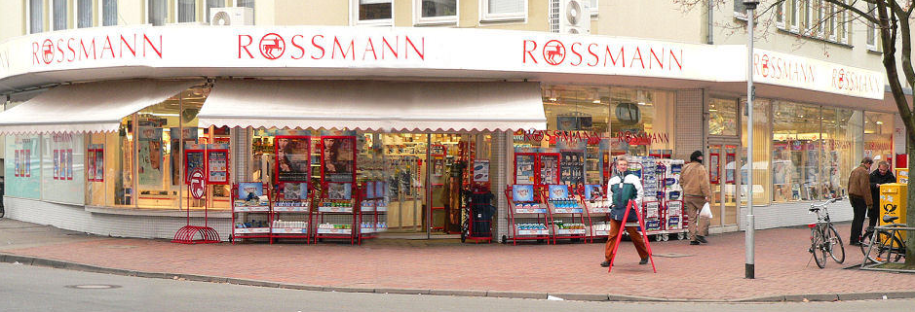
Background
Case Description:
Retail Client of 1115 Stores need to improve business operations
Part of the solution is to develop Machine Learning (ML) models to predict daily sales using:
Historical sales data: daily sales and customers, considering promotion, holidays, and seasonality
Store data: type, assortment, competition, promotions
Case study objectives:
Develop a ‘best’ machine learning model of the given data
Discover data driven insights, and strategies for operations and businesses to improve Rossman store sales

Slide 3
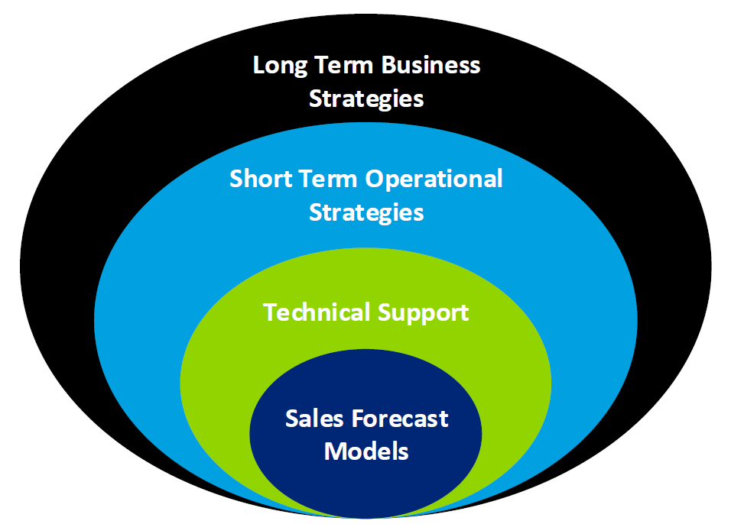
Outline
PART I: Daily Sales Forecast
Data
Feature Selection
Model Selection
Final Models and Prediction
PART II: Technical Support:
Application Architecture
Application Design
Lifecyle Design and Model Improvements
PART III: Data Insights
Feature Importance
Hypothesis Testing
PART IV: Operation and Business impact
Short Term: Staffing, Inventory Management, Customer Experiences …
Long Term: Asset Management, Marketing, E-commerce …

Slide 4
Machine Learning Forecast Model Development
PART I

Slide 5
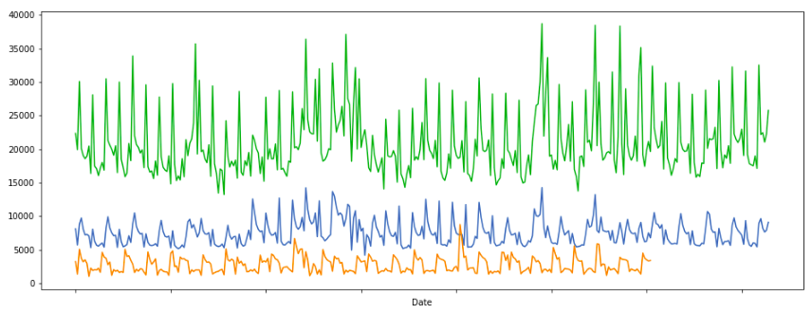
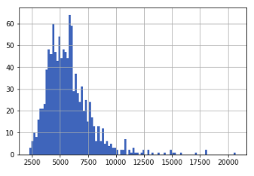
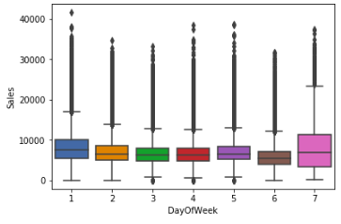
Data Overview
Store data (size: 1115 by 10)
Store Type: a, b, c, d
Assortment: a, b, c
Competition: distance, duration
Seasonal Promotion
Train/Test Data (size: 1M by 9 )
Date
Ongoing promotion
State holiday
School holiday
Figures:
Top: 3 daily sales for 2015 (highest, mean and lowest)
Bottom left: histogram of store sales mean
Bottom right: boxplot of grand sales mean per day of week
2015 Highest, Avg and Lowest Daily Sales
Histogram of Store Sales Mean
Boxplot for Sales Per Day of Week
Sales

Slide 6
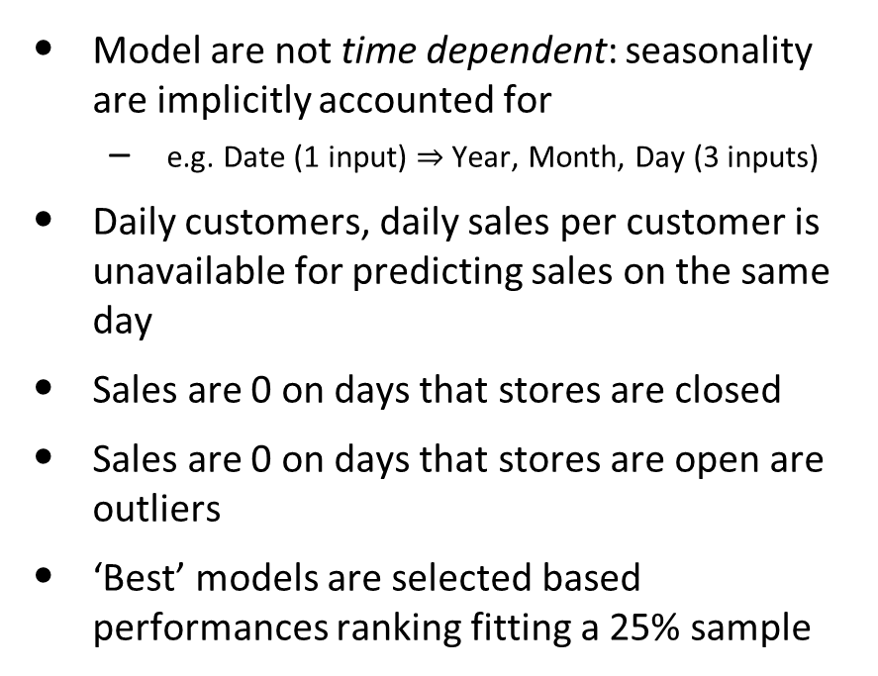
Feature Selection
Assumptions
Final List (25 – 27 feature variables)
Model are not time dependent: seasonality are implicitly accounted for
e.g. Date (1 input) $⇒$ Year, Month, Day (3 inputs)
Daily customers, daily sales per customer is unavailable for predicting sales on the same day
Sales are 0 on days that stores are closed
Sales are 0 on days that stores are open are outliers
‘Best’ models are selected based performances ranking fitting a 25% sample
Store
Store Type
Number of Customers
daily, mean, and variance
Sales per Customer
daily, mean and variance
Assortment
Competition
distance, open month, open year, duration
Promotion
start week, start year, intervals, duration
Date
month, year, day, day of week
State holiday
School holiday

Slide 7
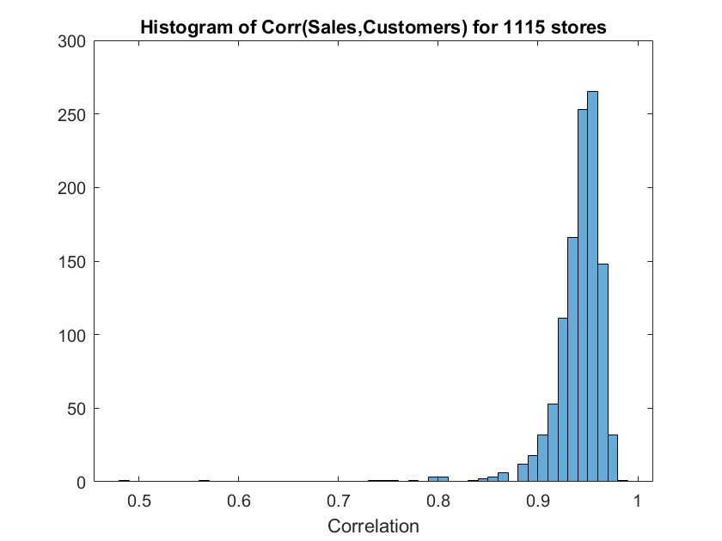

Model Selection
With Daily Customers Columns
Without Daily Customers Columns
Daily Customers highly correlated with Sales:
Select Random Forest Regressor due to
Interpretability
Highest performances among selected models
Computational concurrency: building trees in parallel
 | Decision Tree | Random Forest | AdaBoost | Gradient Boost
RMSPE | 1.2% | 0.6% | 0.6% | 1.3%
CV Mean | 1.4% | 1.0% | 1.0% | 1.6%
CV Variance | 0.00003 | 0.00005 | 0.00004 | 0.00003
 | Decision Tree | Random Forest | AdaBoost | Gradient Boost
RMSPE | 18.7% | 13.7% | 13.5% | 17.0%
CV Mean | 24.7% | 20.6% | 20.7% | 23.2%
CV Variance | 0.012 | 0.015 | 0.015 | 0.015
Note:
Root Mean Squared Percentage Error (RMSPE)
Cross Validation are repeated modeling
Cross Validation Scores are also RMSPE

Slide 8
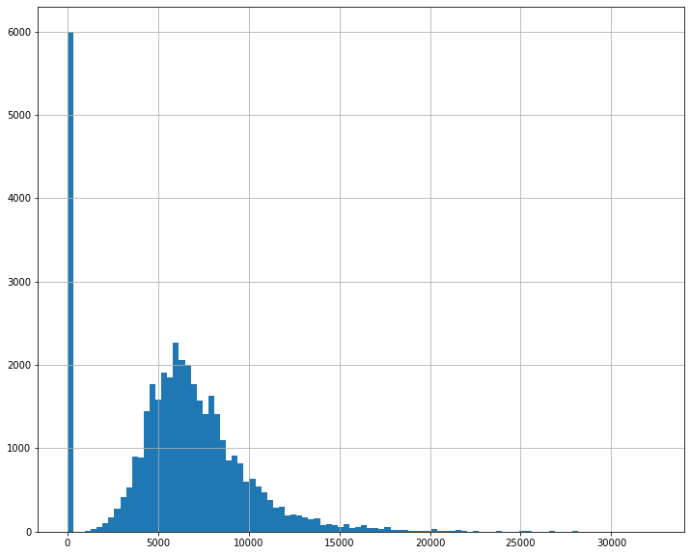
Selected Model and Performances
Model Type: Random Forest
Model Hyperparameters:
Number of trees: 25
Max depth: default (till leaves are pure or contain less than 2 examples)
Inputs:
85% of train data (15% for test)
25 feature variable (no daily customer or sales per customer)
Performances:
Root Mean Percentage Square: 12.4% (on 15% test data)
5-fold cross validation mean: 18.9%
5-fold cross validation variance: 0.004 (6% uncertainty)
Prediction distribution (see bottom right figure)
About 6000 inputs have store closed, set prediction to be 0, hence the high bar on the left
Random Forest Model Performances
RMSPE | 12.4%
CV Mean | 18.9%
CV Variance | 0.004
Distribution of Predicted Sales
Sales

Slide 9
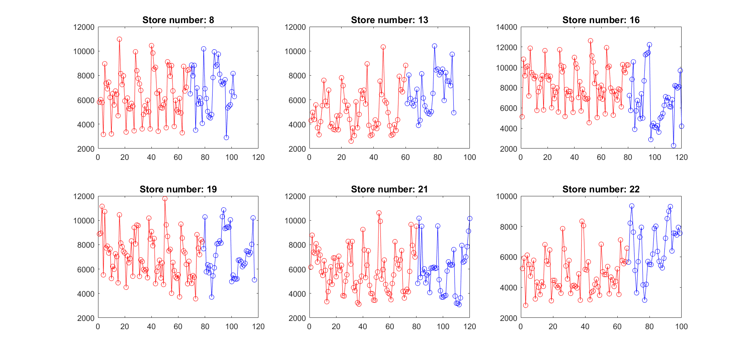
Prediction Visualization
Note: sales on closed days are excluded

Slide 10
Technological Requirements
PART II

Slide 11
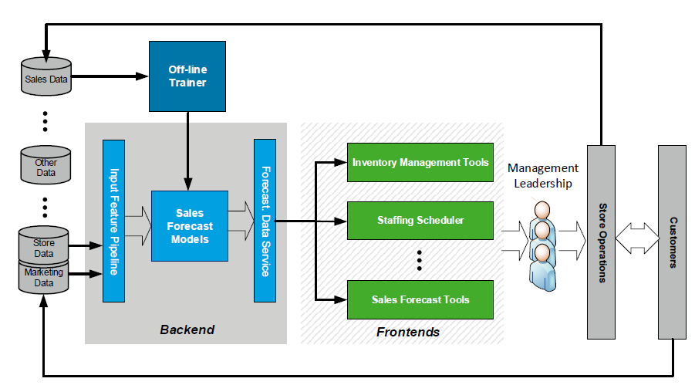
Application Architecture

Slide 12
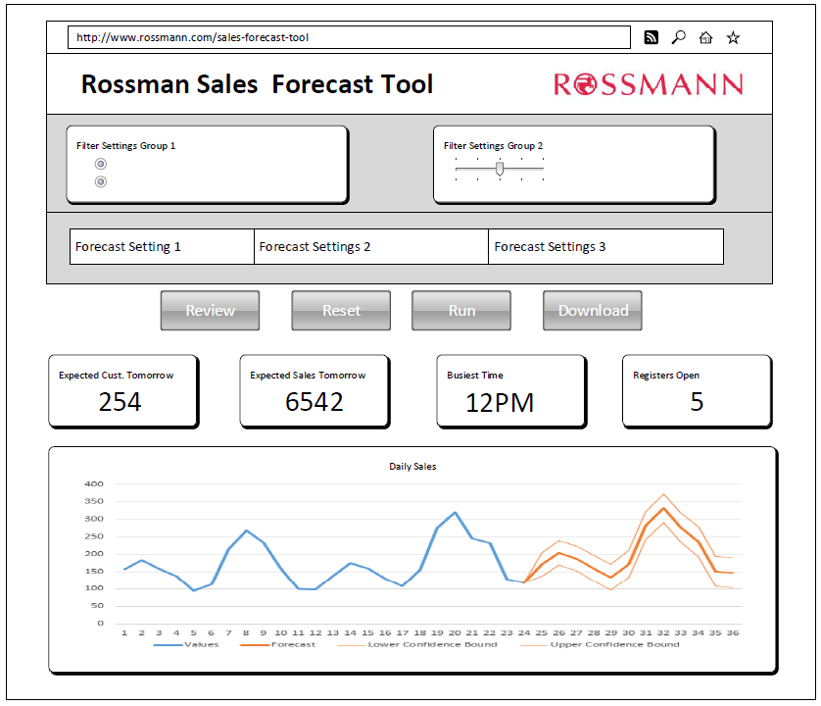
Sales Forecast Tool Design
A web application is recommended for accessibility and real-time prediction
Leverage in-house resources
Leverage cloud tools
Backend services are also needed
A rough UI draft example on the right is conceptual. Redesign after deciding
how the tool will be used
who will use it
and for what purposes
Developers should follow agile principles in designing features, iterations, etc., working closely with target users.

Slide 13
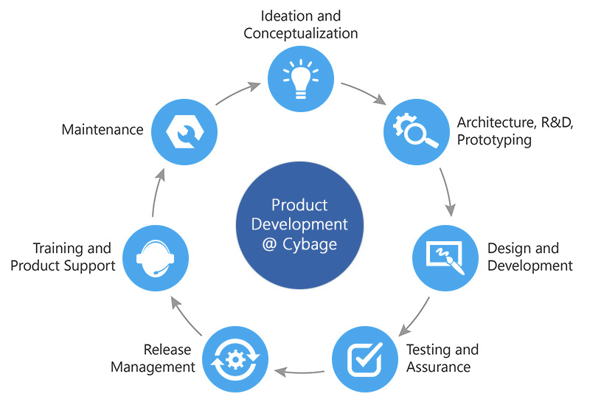
Sale Forecast Tool Lifecycle and Improvements
Lifecycle Design
Software Development: Agile
Assure training and in-house IT support
Deployment: assure compatibility with existing systems, e.g. staffing, inventory manager
Upgrade and decommission: collect data and user feedback to improve model; keep up with latest technologies for new solutions
Improvements:
Acquire additional data on loyalty programs, coupons, marketing, economies, consumers, demographics etc.
Update models as new data become available
Online training
Use timeseries model e.g. Facebook Prophet
Source: www.cybage.com/product-engineering/application-product-development/software-development

Slide 14
Data Insights
PART III

Slide 15
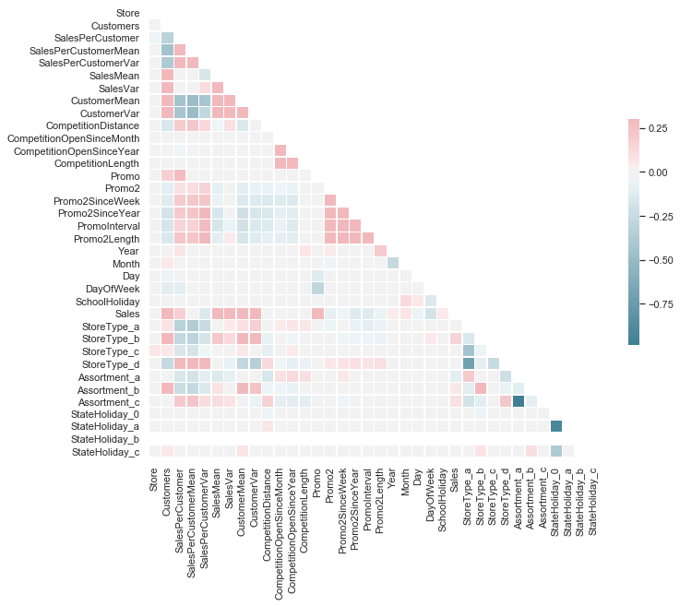
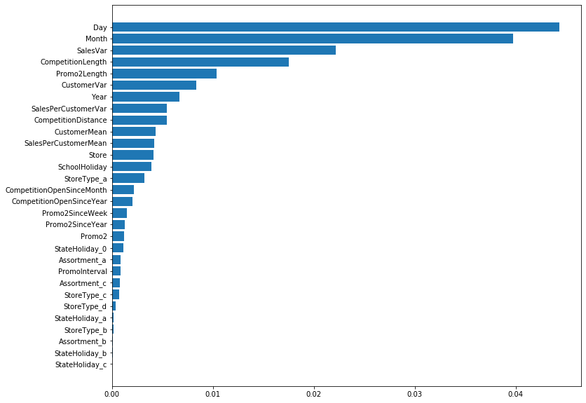
Data Insights and Discussions – Feature Variable Importance
Seasonality:
Date related are consistently among the most important feature variables
Sales History: difference in stores
Competition length among the most important factors
Promotion length among the most important factors
Correlation matrix: sales is shown to have the strongest correlation with:
Customers: 0.82
SalesMean: 0.78
CustomerMean: 0.64
SalesVar: 0.51

Slide 16
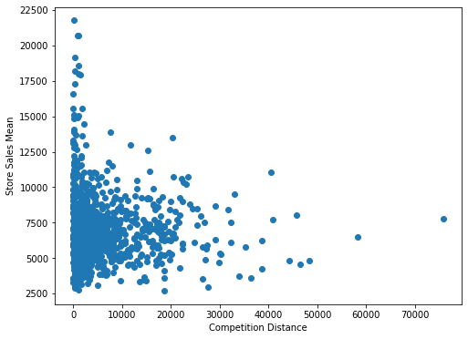
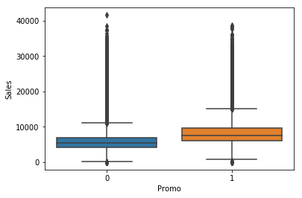
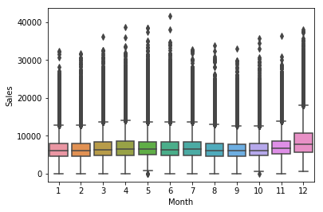
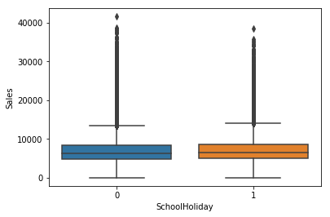
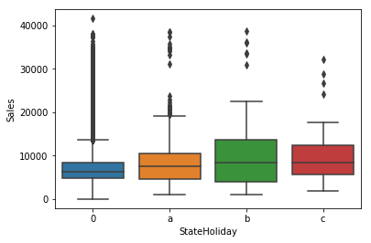
Data Insights and Discussions – Hypotheses
Does Competition affect Sales?
Does Promotion affect Sales?
What are the yearly trends?
Does holiday affect sales?
Appear to be significant are:
Competition
Monthly trends
State holidays
Promotion
More rigorously, use hypothesis tests

Slide 17
Operation and Business impact
PART IV

Slide 18
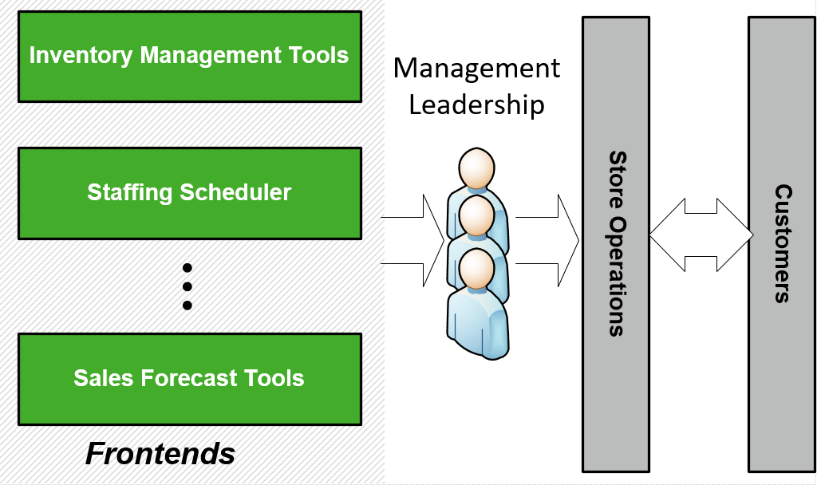
Operation Tactics and Discussion
Staffing and Inventory Management
Leverage Data Insights
Justification to use with staffing:
Daily forecast can maintain reasonable staffing to optimize customer shopping experiences, e.g. short queues. This will also lead to increased utilities of workforce and reduced labor costs
Justification to use with Inventory Management:
In addition to knowledge of the specific product needs, daily customers/sales forecast will help maintain inventory that address local market needs
Conversely, collect data about product sales will open avenues for new types of models and contribute to the improvement of forecast accuracy and effectiveness
Customers and Sales are highly correlated:
Innovate on programs to get customers in the door e.g. membership, rewards, coupons etc.
Assortments are important:
Update inventory list to increase product variety (one-stop shopping), have different price tiers
Strong seasonality:
Gather data about market needs and maintain stock of popular seasonal items
Other unexplored factors:
Store layout
Customer Services e.g. linear return policies
Location/proximity to residential areas, convenience for effective shopping experiences
…
Notes:
- Staffing: However, it does not have the hourly granularity. It might be interesting to understand the distribution of customers over hours in the day

Slide 19
Business Strategies and Discussion
Model give estimates on long term sales:
Monitoring the monthly and year trends will help strategic planning.
However, more comprehensive estimation is needed for high accuracy requirements.
Asset Management:
Case study on lowest ang highest performing stores e.g. Stores 543 and 262
Financial decision may be made on profitability estimation
Marketing:
Model confirms local competition is important
Data insights and strategize on the 4 aspects of customer perspective, measure and diagnose the differentiators between low and high sales stores
E-commerce:
Gather data and explore the need of on-line shopping and pick-up services
Customer Perspective:
Quality Product
Reasonable Prices
Good Shopping Experiences
Good Customer Services

Slide 20
Backup Slides

Slide 21
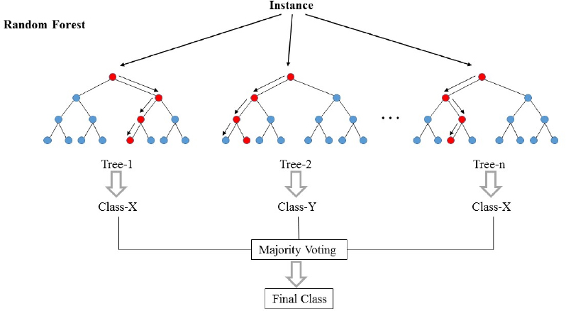
Random Forest
Source: http://www.nrronline.org

Slide 22

Cross Validation

