Slide 1
Self-learnt Image for Medical Image Classification Project Report
Lu Jingjun
Instructor: Dr Huang Weimin
10/04/2021

Slide 2
Outlines
BRATS17 Dataset
Image pre-processing
Auto-encoder training
Classification
Clustering
DeepLesion Dataset
Image pre-processing
Classification
Prediction

Slide 3
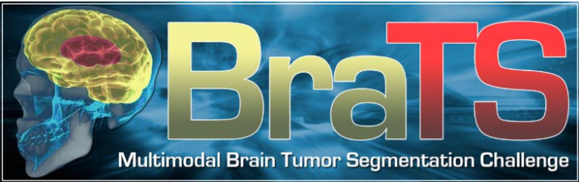
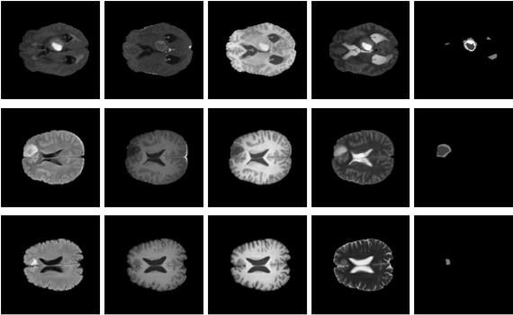
BRATS17 Dataset

Slide 4
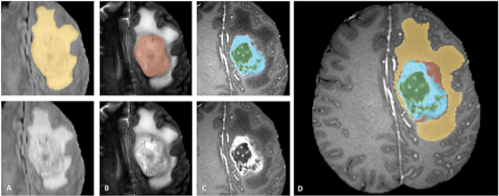
Image Pre-processing
BRATS17 dataset utilizes multi‐institutional pre‐operative 3D MRI scans, which contains high grade glioma (HGG) and low grade glioma (LGG) NIFTI brain tumour images in 4 modalities (T1, T1ce, T2, FLAIR). NiBabel package was used to pre-processed the NIFTI images. Small image patches of size (144, 144, 100) were generated from the original images of size (240, 240, 155) according to the location of the tumour.

Slide 5
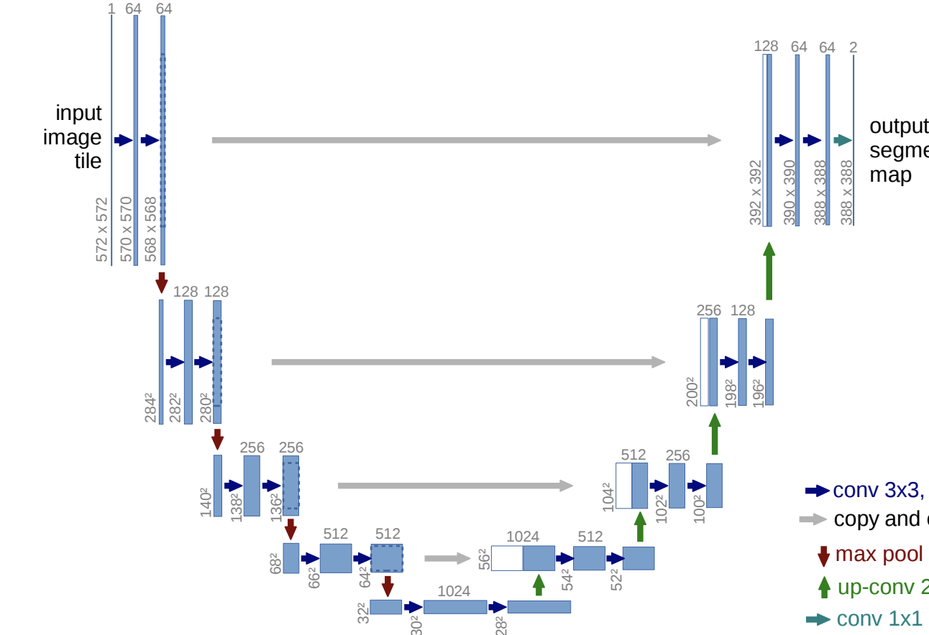
Auto-encoder Training
We trained the pre-processed image patches using an auto-encoder (U-Net) in order to get the vector representation of images’ features. The auto-encoder was trained to output the same images as the input images. After the training of the auto-encoder, we extracted the bottleneck layer of shape (8, 8, 16) out and flatten it to be a feature representation vector of size (1024, 1).

Slide 6
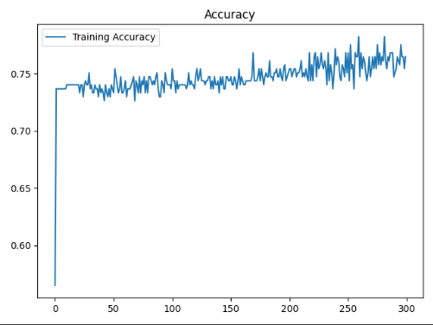
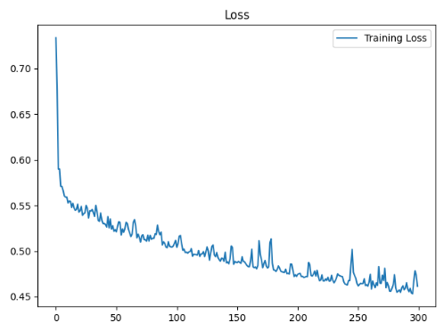
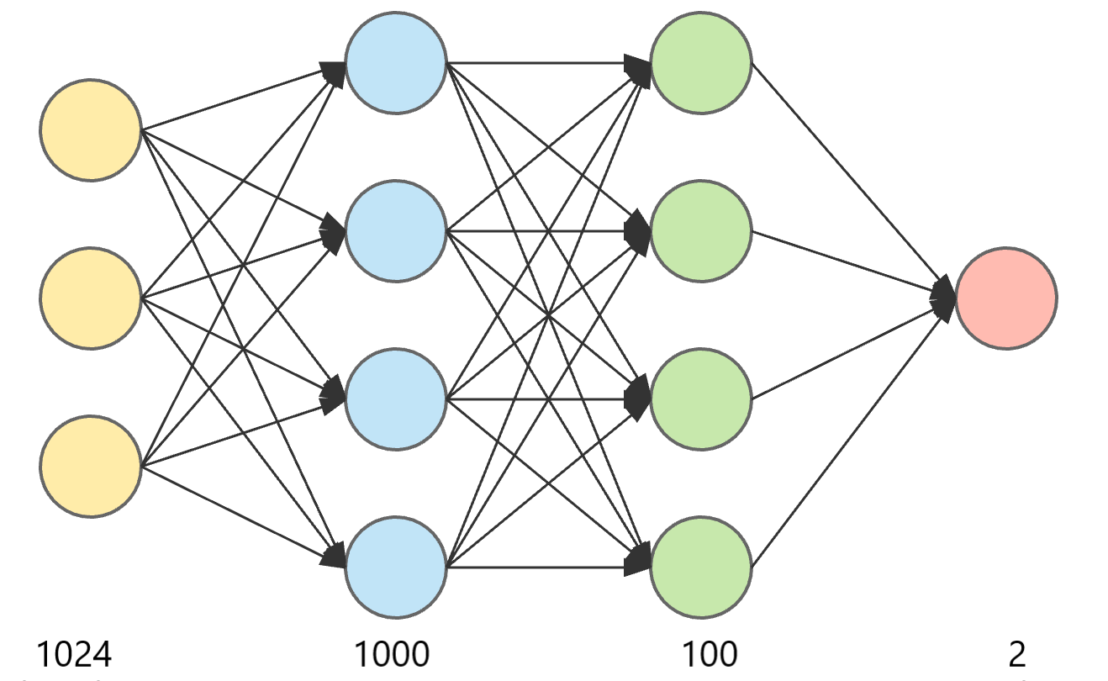
Classification
We used the feature representations of T2 and FLAIR modalities extracted from auto-encoder to do classification. The classification model contains 4 fully-connected layers. The labels are HGG and LGG provided in the original dataset. The classifier achieved an accuracy of 78% after training for 300 epochs.

Slide 7
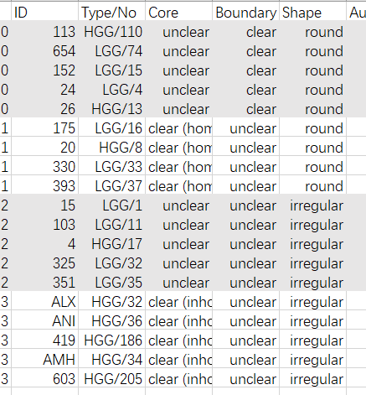
Clustering
We extracted the penultimate layer of the trained classifier out to get a more robust feature representation of the images with size (100, 1). After this we applied K-means clustering to the feature representation above. We checked the clustering performance by manually clustering the images based on the core clarity, boundary clarity and shape of the tumor first and compared to the K-means auto clustering results. By experiments, we found the algorithm performed best with 4 clusters.

Slide 8
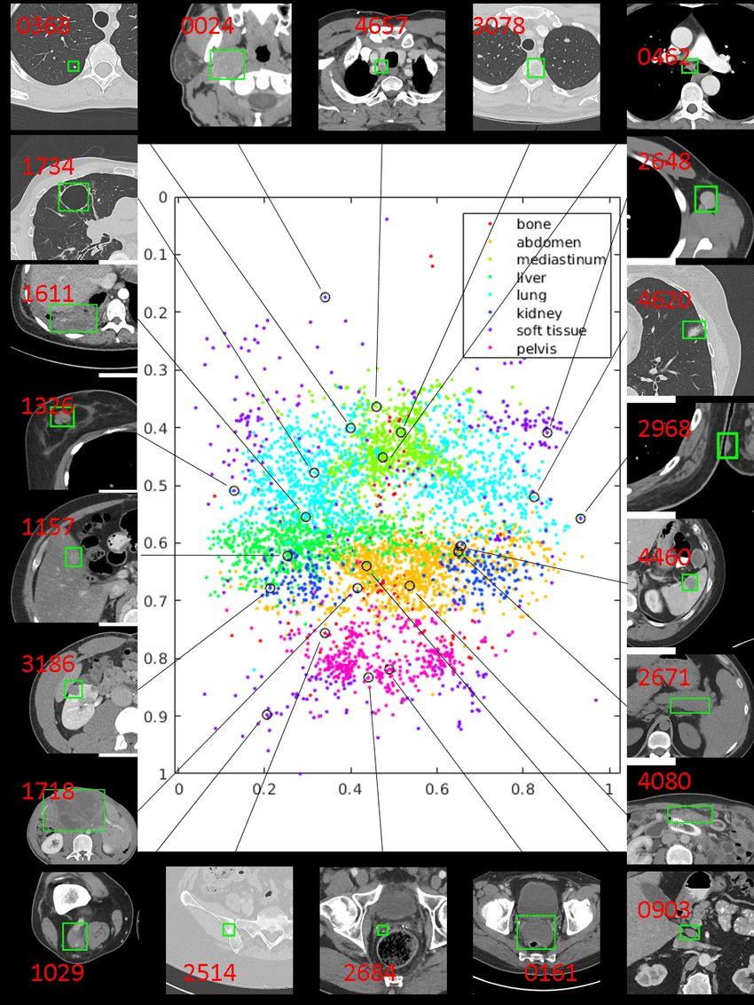
DeepLesion Dataset

Slide 9
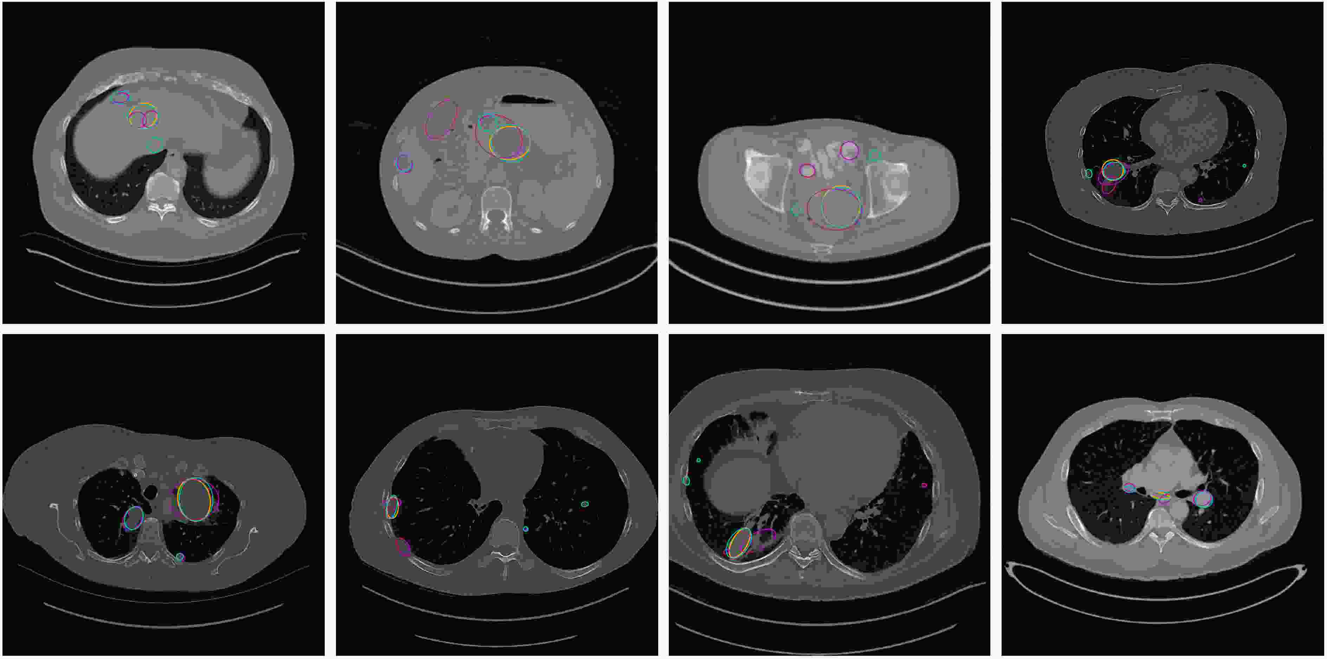
Image Pre-processing
The DeepLesion dataset contains 32,120 axial computed tomography (CT) slices from 10,594 CT scans (studies) of 4,427 unique patients. In this project, we used a subset of about 1400 slices. The images were pre-processed by OpenCV and small image patches of size (224, 224, 3) were generated from the original images of size (512, 512, 3) according to the location of the lesion bounding box.

Slide 10
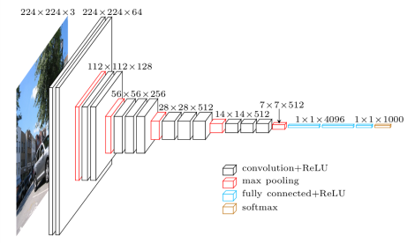
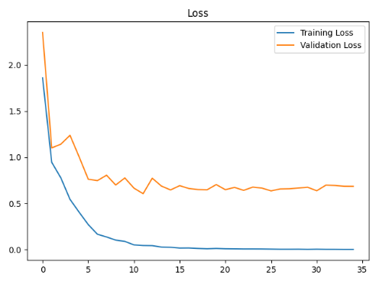
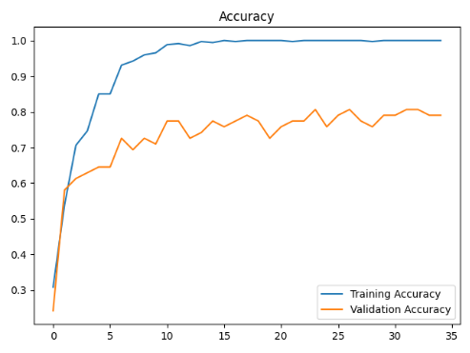
Classification
We built the lesion type classifier on a VGG16 model and ImageNet pretrained weights were applied. There are 8 labels representing lesion in different body parts. The trained model achieved an accuracy of 82% on the validation set.

Slide 11
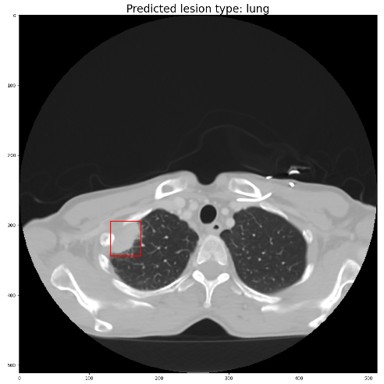
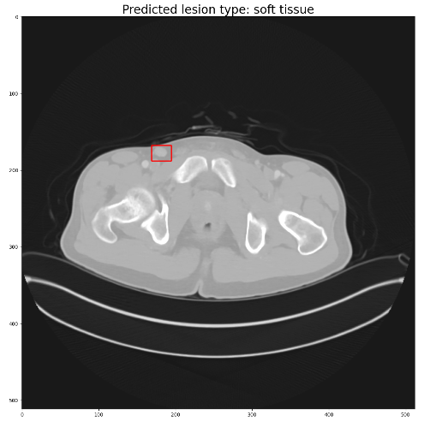
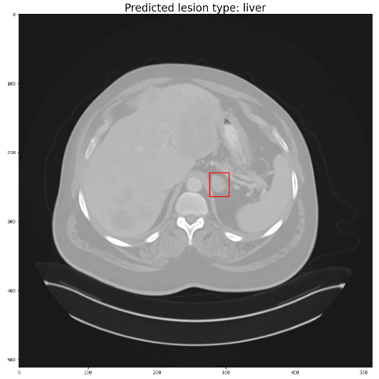
Prediction
Only 30% of the images in DeepLesion dataset were annotated with lesion types. After the training of the supervised VGG16 model with labeled images, we applied the model on unlabeled images (70%) in order to predict the lesion type of them. The algorithm could predict most of the obvious lesion type correctly. Some examples are shown below:

Slide 12
Conclusion
In the Self-learnt Image for Medical Image Classification project, we performed classification and clustering on BRATS17 brain tumour images. We developed a lesion type classifier based on deep lesion images as well. The models can be further improved for the monitoring, diagnosis and grading of diseases by clinicians.

