Slide 1
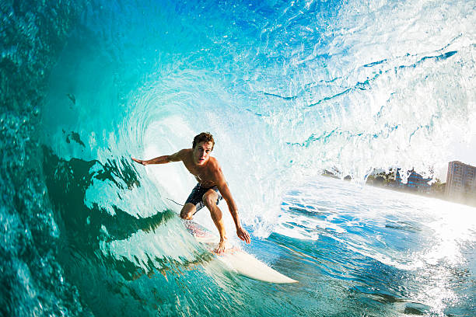
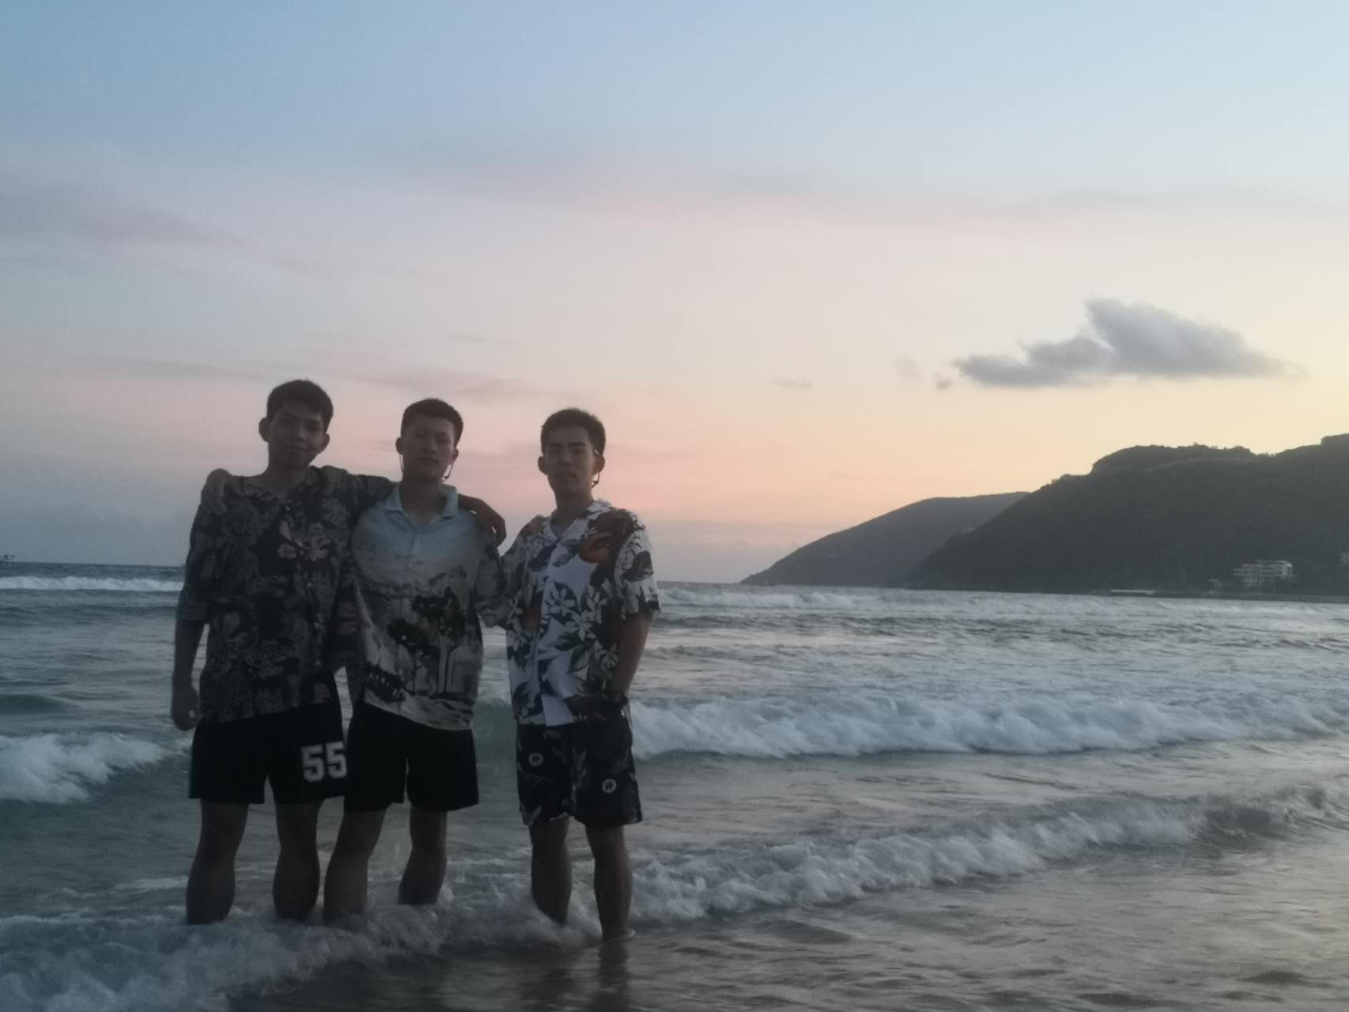
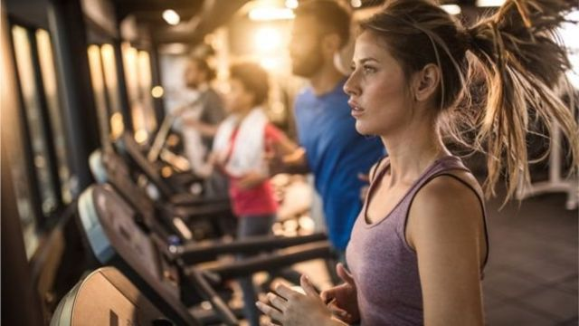
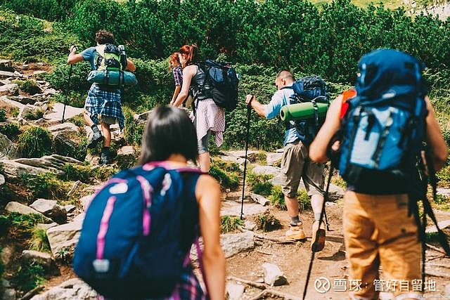
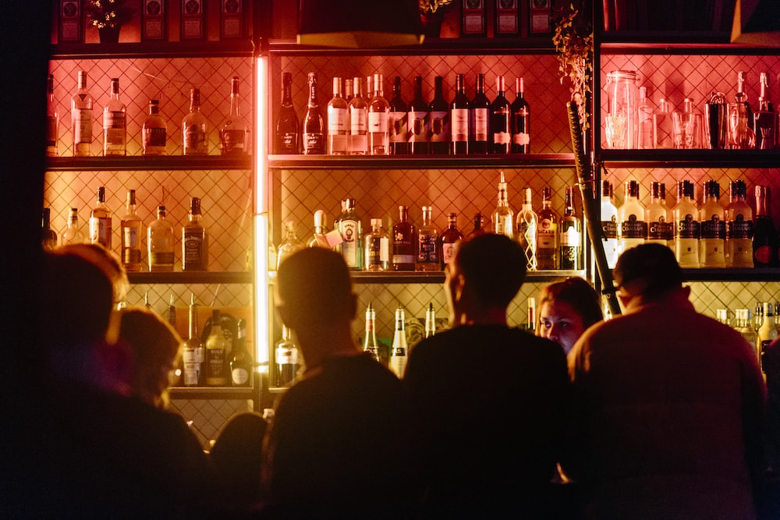
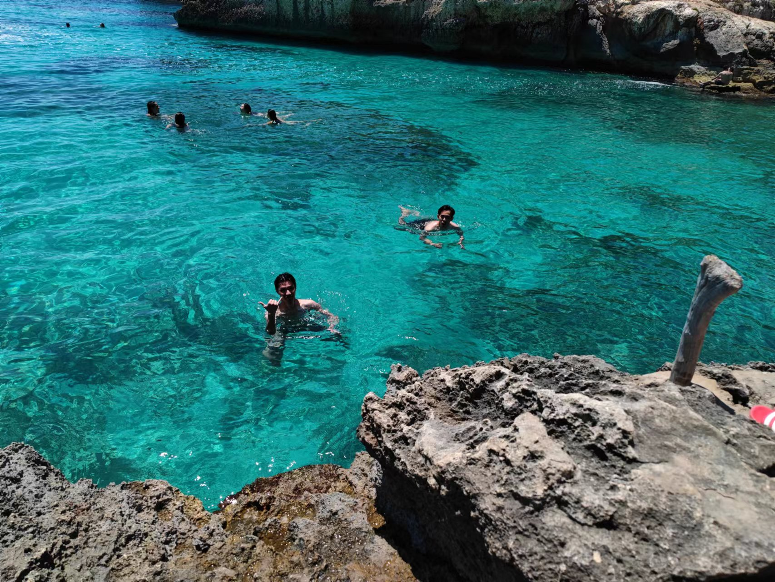
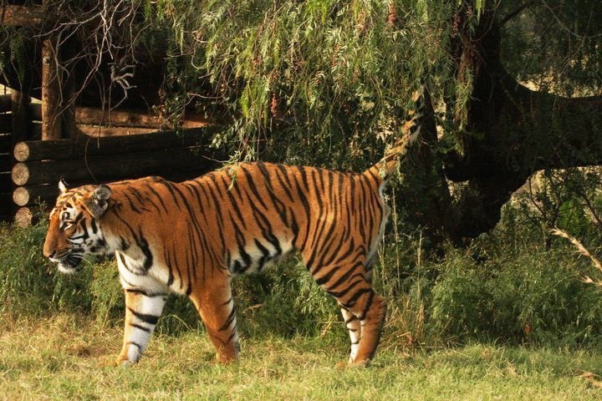
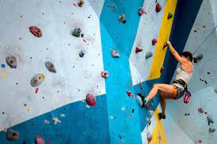
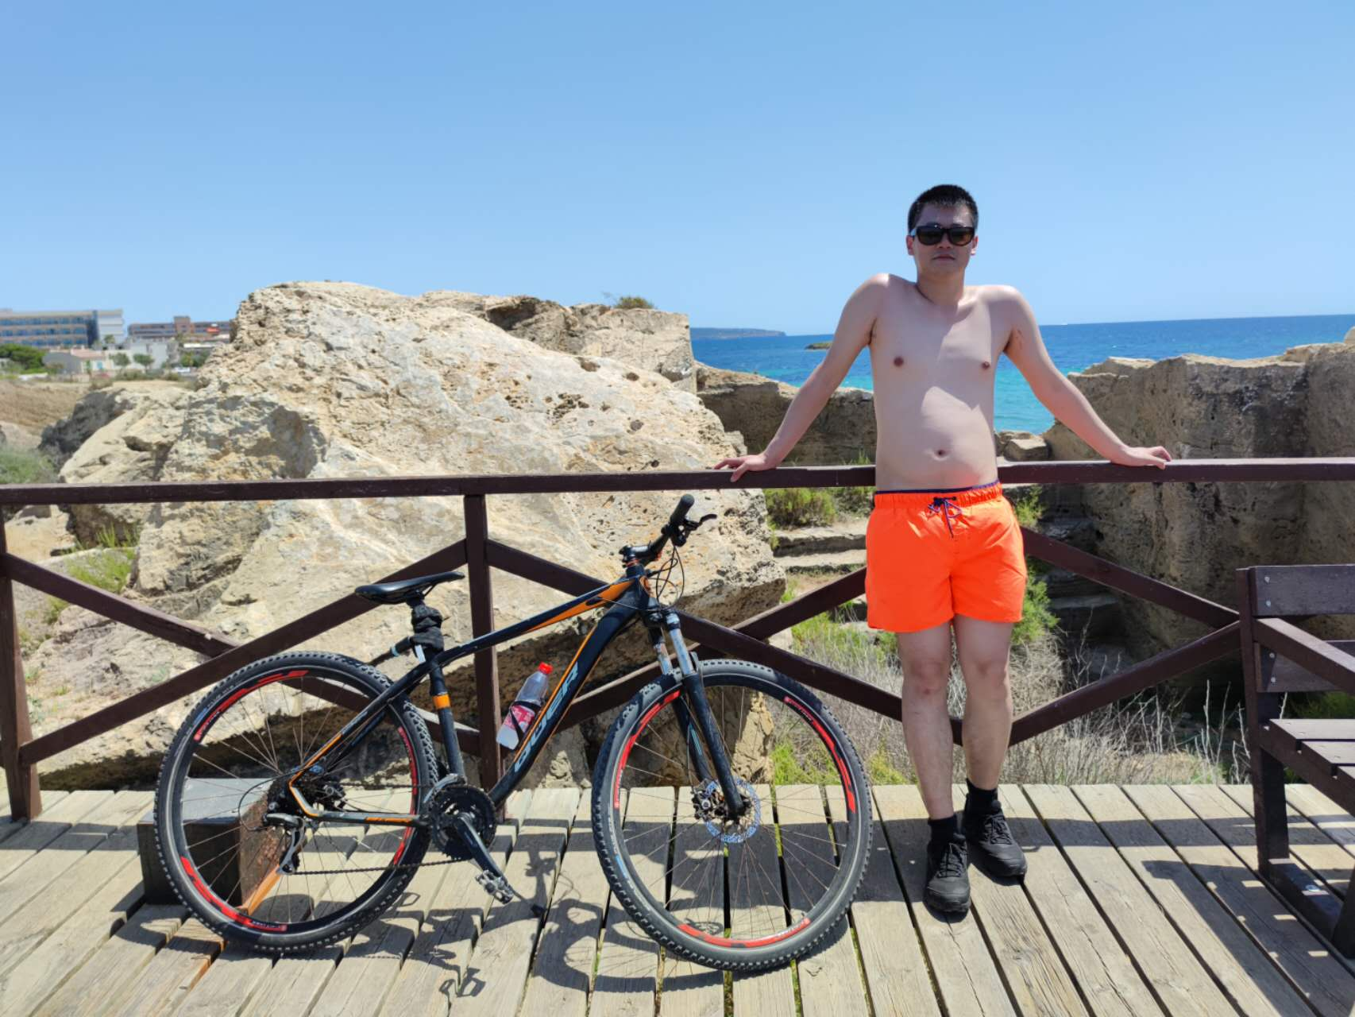
a child is swimming underwater in a pool
a group of people stand in front of the ocean
a woman in a blue tank top is looking at the camera
a group of people are walking in a rural area
Bad
Bad
Precise
CNN+RNN with attention
a group of people are standing in front of a fountain
two people are swimming in a pool
Not bad
a brown and white dog is running through the woods
a little girl in a blue dress is climbing up a blue slide
a boy in red shorts is running on a sidewalk

