Slide 1
Convert competition device into a toy

Slide 2

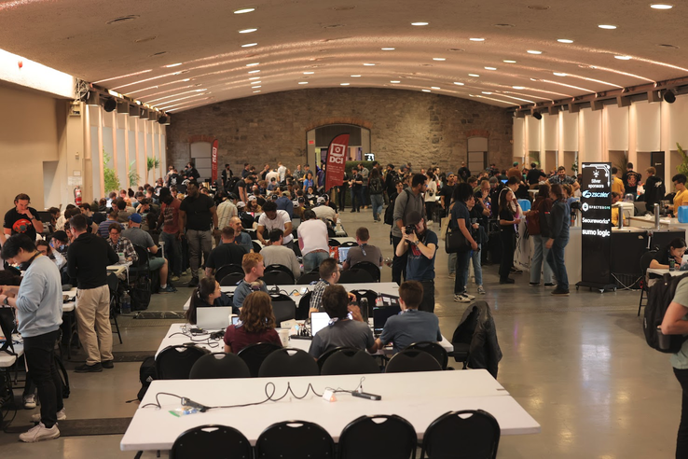
Begin
Device given during North Sec CTF competition in 2023 nsec.io

Slide 3
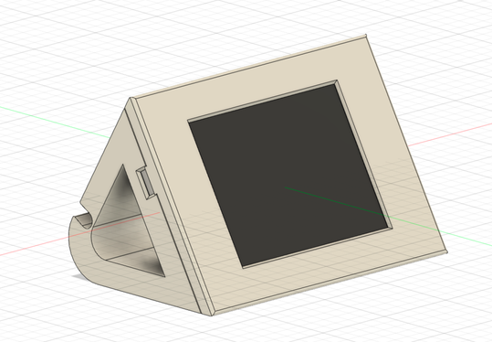
Competition ? NSEC ?
What is Capture The Flag
  Team game play during one weekend
  Objective: Earn points by hacking software or hardware to retrieve a text Flag. FLAG-THIS-IS-A-DEMO
What this device was used
  Used to display information
  using a mesh network
  Many flags available
  Ambiant light linked to
  Competition badge

Slide 4
The Board
Device is `ESP32-2432S028R` as known as ESP Cheap Yellow Display
CHIP `ESP32-D0WDQ6` with wifi and bluetooth.
Development software ESP-IDF `Espressif IoT Development Framework`
Constraint : Device was flashed using secure boot by NSEC team
  They release source code with secure boot keys and building tools
  Not reversible as when enabled it break a fuse to avoid stock back
  Langage C++ and user interface with LVGL v7
  Real Time OS with FreeRTOS

Slide 5
Investigation on repurpose item
FAILED: Evaluated use for other stuff and cancelled as required to many research to use with secure boot as for:
  ESPHome
  ESP development
  Secure Boot on ESP cannot be disabled
New objective: Create a toy
  Idea: Game score for mini figures
  Planned of completion: 1 month
  Real time: 4 months some hours on weekends

Slide 6
How it was
Take source code from NSEC team and modify it
Language C++ with ESP IDF
Update scripts as not working as default
Rebuild and flash to ensure everything works
Remove components not used (Wifi, bluetooth, SD Card, ...)
Build a new user interface
  Modify existing one by try and fail
  Use a simulator in C language
  Adaptation for styling

Slide 7
What it contains / features*
Scoring
Colored items
Teams selection
Sounds
Cups with different teams
Use onboard led with color selection (already available)
Screen backlight to preserve battery
Store settings

Slide 8
DEMO

Slide 9
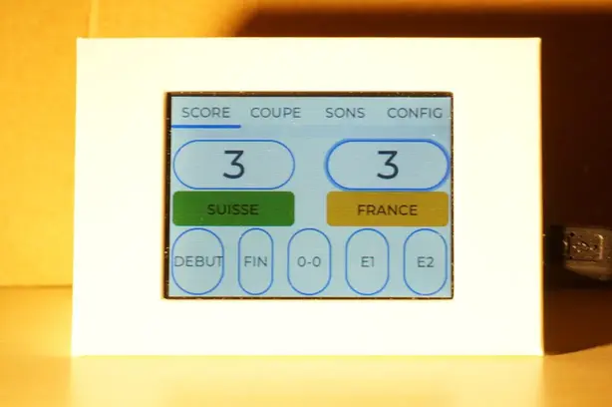
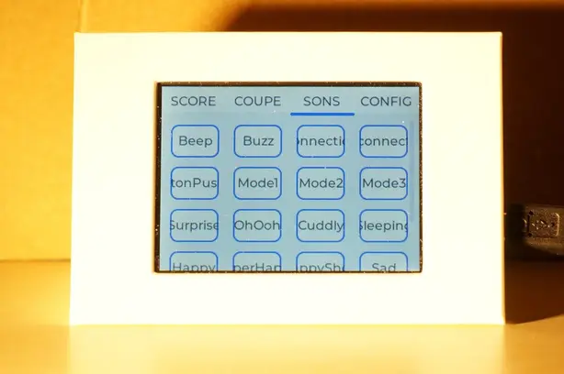
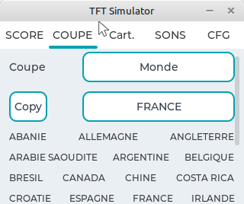
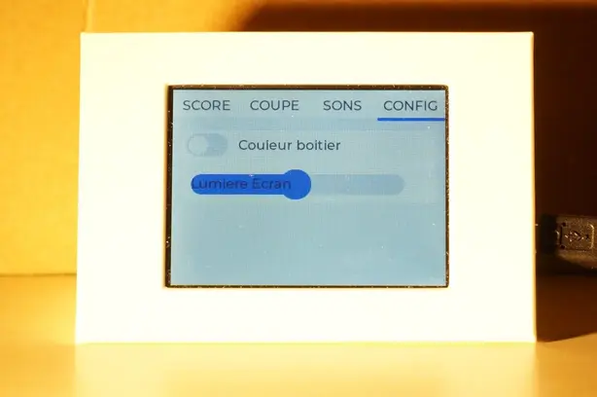
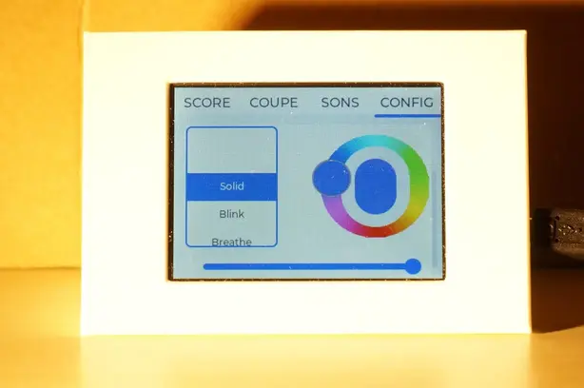
DEMO

Slide 10
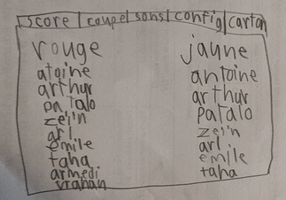
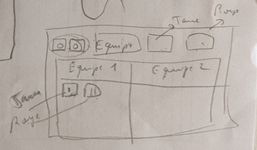
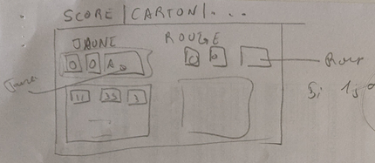
Last feature
On september 2024 for one month, addition of Yellow and Red Cards. Work with my kid on design

Slide 11
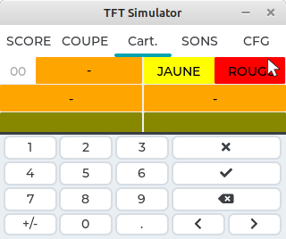
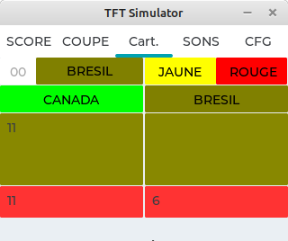
Samples

Slide 12
Challenge
Use LVGL to display exactly at a screen position
No borders to optimize screen space
Remember the code structure
Store settings into non volatile memory

Slide 13
What I learned
LVGL library for embedded device is simple and easy to use
C++ is not as simple as I was aware
  Random seeds
  ESP Libraries modified by Espressif
  Memories on C and C++ with #IFDEF to handle same code
  ESP IDF make many under actions on compilation
Final code is not optimal or even maintenable for a real product
  THIS IS A TOY !
Not able to fix: Remove some margins and borders

Slide 14
The End
GitHub: https://github.com/jingl3s/nsec-badge-display-other

