Slide 1
Stability Selection in High-Dimensional Data
Jinglin Yang
Nicolai Meinshausen, Peter Bühlmann, Stability Selection, Journal of the Royal Statistical Society Series B: Statistical Methodology, Volume 72, Issue 4, September 2010, Pages 417–473, https://doi.org/10.1111/j.1467-9868.2010.00740.x

Slide 2
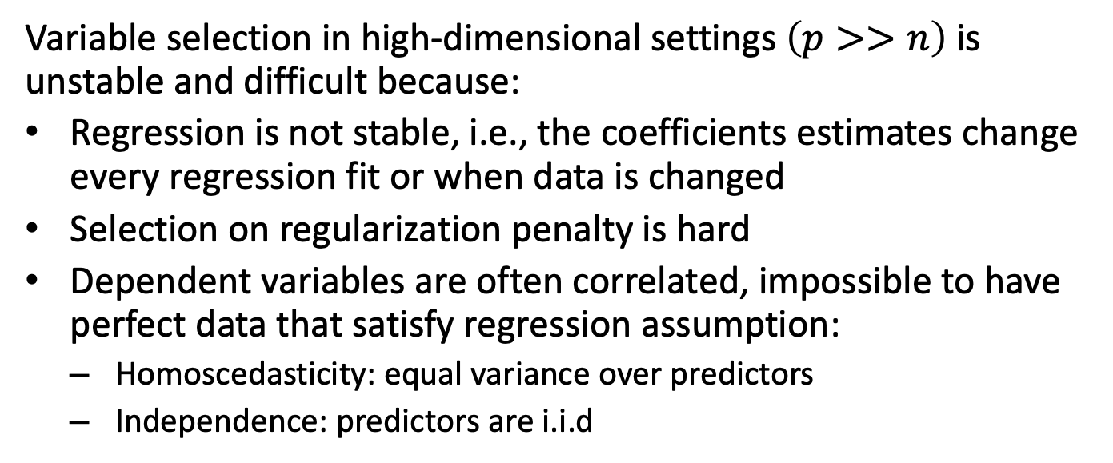
Motivation
Variable selection in high-dimensional settings $\left(p>>n\right)$ is unstable and difficult because:
Regression is not stable, i.e., the coefficients estimates change every regression fit or when data is changed
Selection on regularization penalty is hard
Dependent variables are often correlated, impossible to have perfect data that satisfy regression assumption:
  Homoscedasticity: equal variance over predictors
  Independence: predictors are i.i.d

Slide 3
Motivation
Stability selection (Meinshausen & Bühlmann, 2010) aims to evaluate how consistently variables are selected across resampling and is effective when:
the sample size is small
the number of predictors is large
the assumptions on linear regression is violated

Slide 4
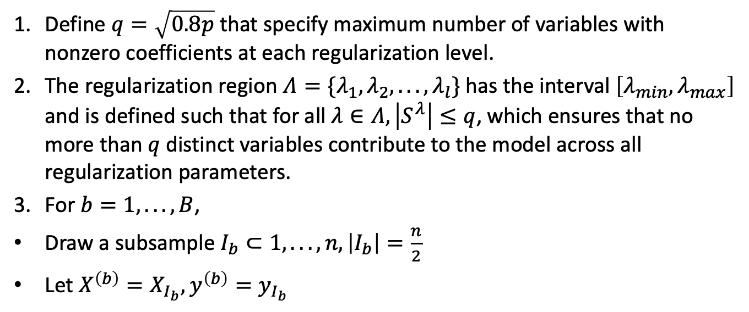
Procedure
Define $q=\sqrt{0.8p}$ that specify maximum number of variables with nonzero coefficients at each regularization level.
The regularization region $Λ=\{λ_{1},λ_{2},...,λ_{l}\}$ has the interval $\left[λ_{min},λ_{max}\right]$ and is defined such that for all $λ∈Λ,\left|S^{λ}\right|≤q$, which ensures that no more than $q$ distinct variables contribute to the model across all regularization parameters.
For $b=1,...,B$,
Draw a subsample $I_{b}⊂1,...,n,\left|I_{b}\right|=\frac{n}{2}$
Let $X^{\left(b\right)}=X_{I_{b}},y^{\left(b\right)}=y_{I_{b}}$

Slide 5
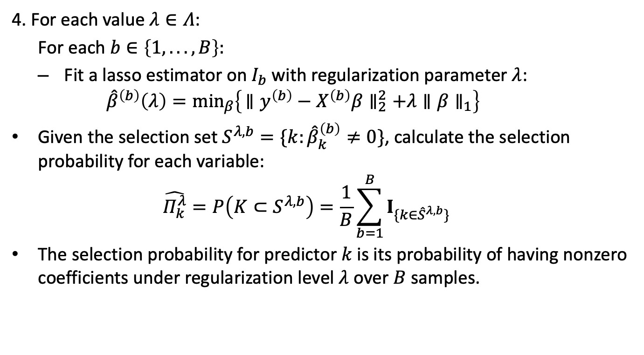
Procedure
4. For each value $λ∈Λ$:
  For each $b∈\left\{1,...,B\right\}:$
  Fit a lasso estimator on $I_{b}$with regularization parameter $λ$:
    $${\hat{β}}^{\left(b\right)}\left(λ\right)=\min_{β}\left\{ ∥y^{\left(b\right)}−X^{\left(b\right)}β∥_{2}^{2}+λ∥β∥_{1}\right\}$$
Given the selection set $S^{λ,b}=\{k:{\hat{β}}_{k}^{\left(b\right)}≠0\}$, calculate the selection probability for each variable:
  $$\hat{Π_{k}^{λ}}=P\left(K⊂S^{λ,b}\right)=\frac{1}{B}\sum_{b=1}^{B}{I_{\{k∈{\hat{S}}^{λ,b}\}}}$$
The selection probability for predictor $k$ is its probability of having nonzero coefficients under regularization level $λ$ over $B$ samples.

Slide 6
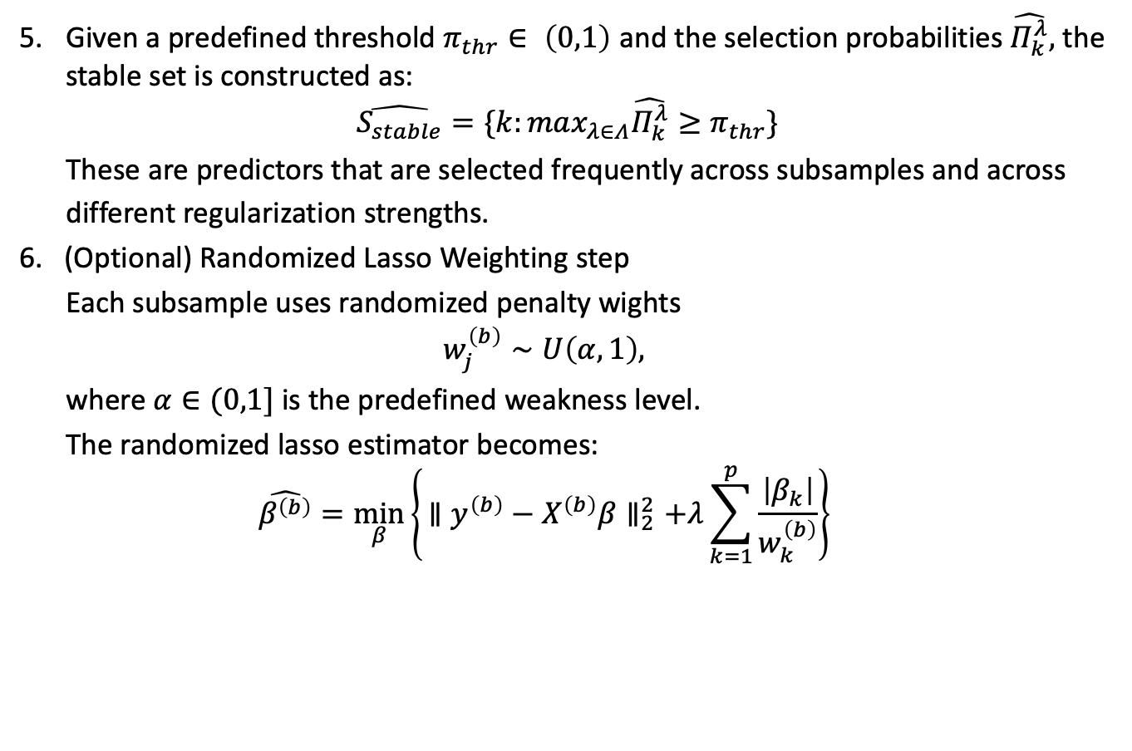
Procedure
Given a predefined threshold $π_{thr}∈ \left(0,1\right)$ and the selection probabilities $\hat{Π_{k}^{λ}},$ the stable set is constructed as:
$$\hat{S_{stable}}=\{k:max_{λ∈Λ}\hat{Π_{k}^{λ}}≥π_{thr}\}$$
These are predictors that are selected frequently across subsamples and across
different regularization strengths.
6. (Optional) Randomized Lasso Weighting step
  Each subsample uses randomized penalty wights
  $$w_{j}^{\left(b\right)}∼U\left(α,1\right),$$
  where $α∈(0,1]$ is the predefined weakness level.
  The randomized lasso estimator becomes:
  $$\hat{β^{\left(b\right)}}=\min_{β}\left\{ ∥y^{\left(b\right)}−X^{\left(b\right)}β∥_{2}^{2}+λ\sum_{k=1}^{p}{\frac{\left|β_{k}\right|}{w_{k}^{\left(b\right)}}}\right\}$$

Slide 7
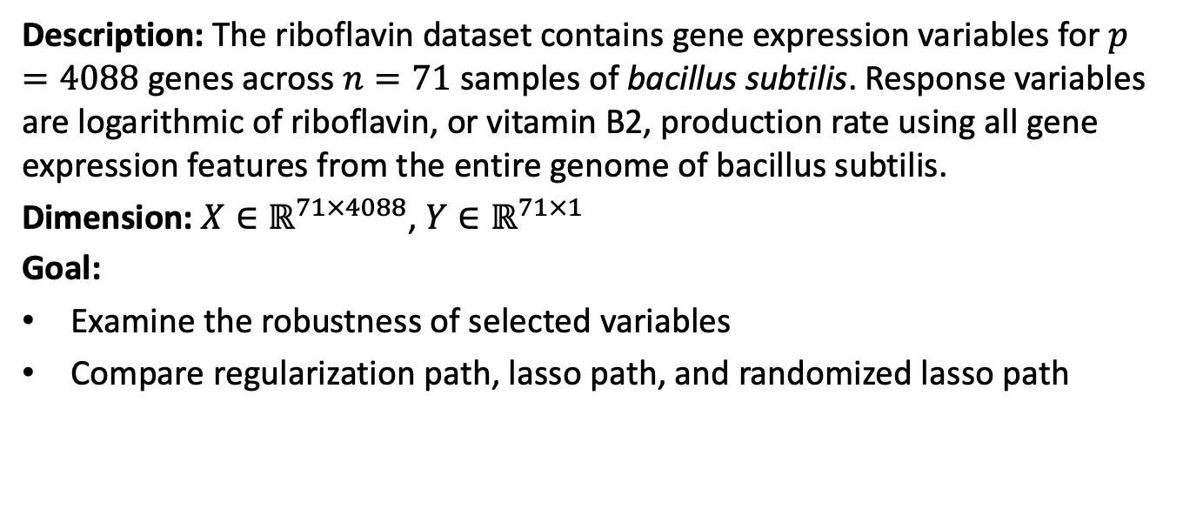
Application: Riboflavin Gene Expression Dataset
Description: The riboflavin dataset contains gene expression variables for $p=4088$ genes across $n=71$ samples of bacillus subtilis. Response variables are logarithmic of riboflavin, or vitamin B2, production rate using all gene expression features from the entire genome of bacillus subtilis.
Dimension: $X∈ℝ^{71×4088}$, $Y∈ℝ^{71×1}$
Goal:
Examine the robustness of selected variables
Compare regularization path, lasso path, and randomized lasso path

Slide 8
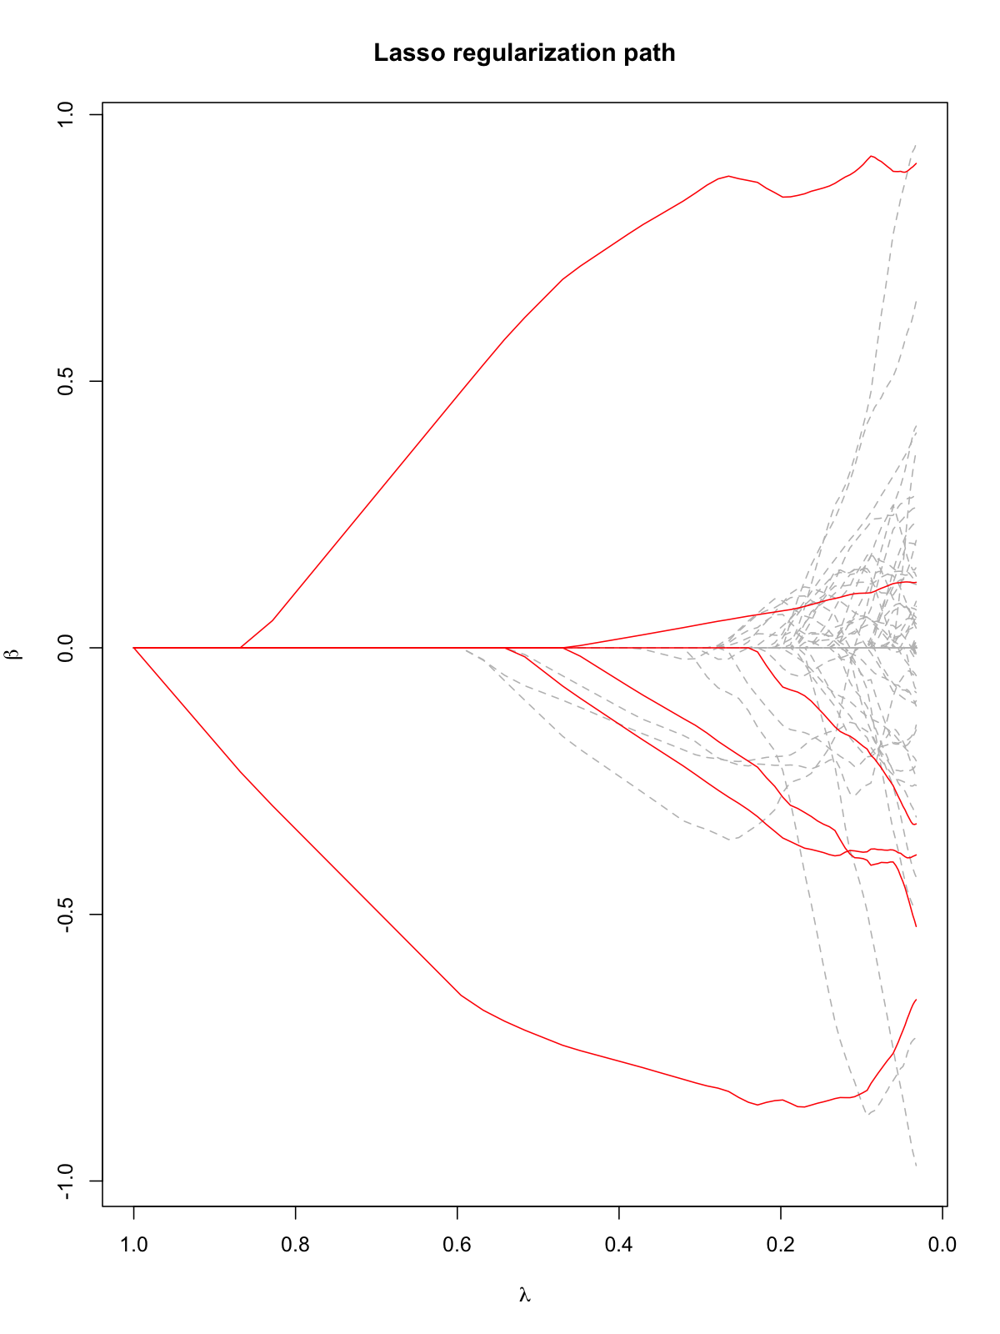
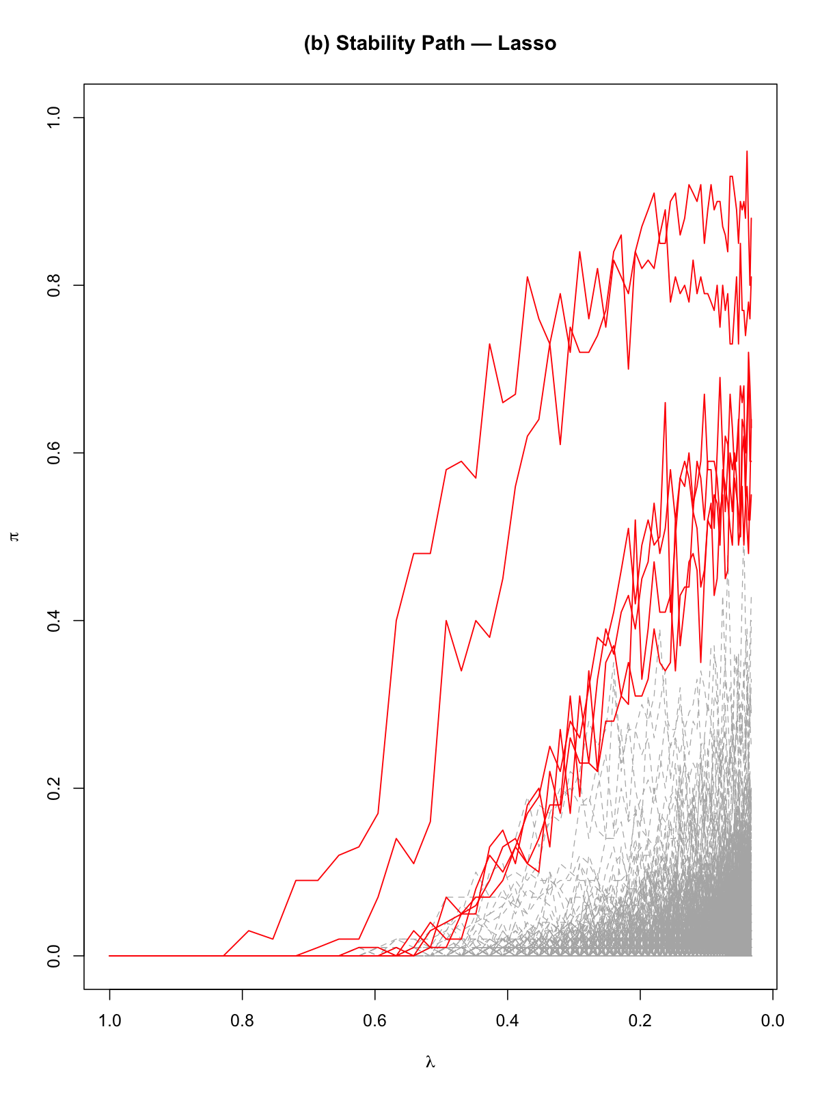
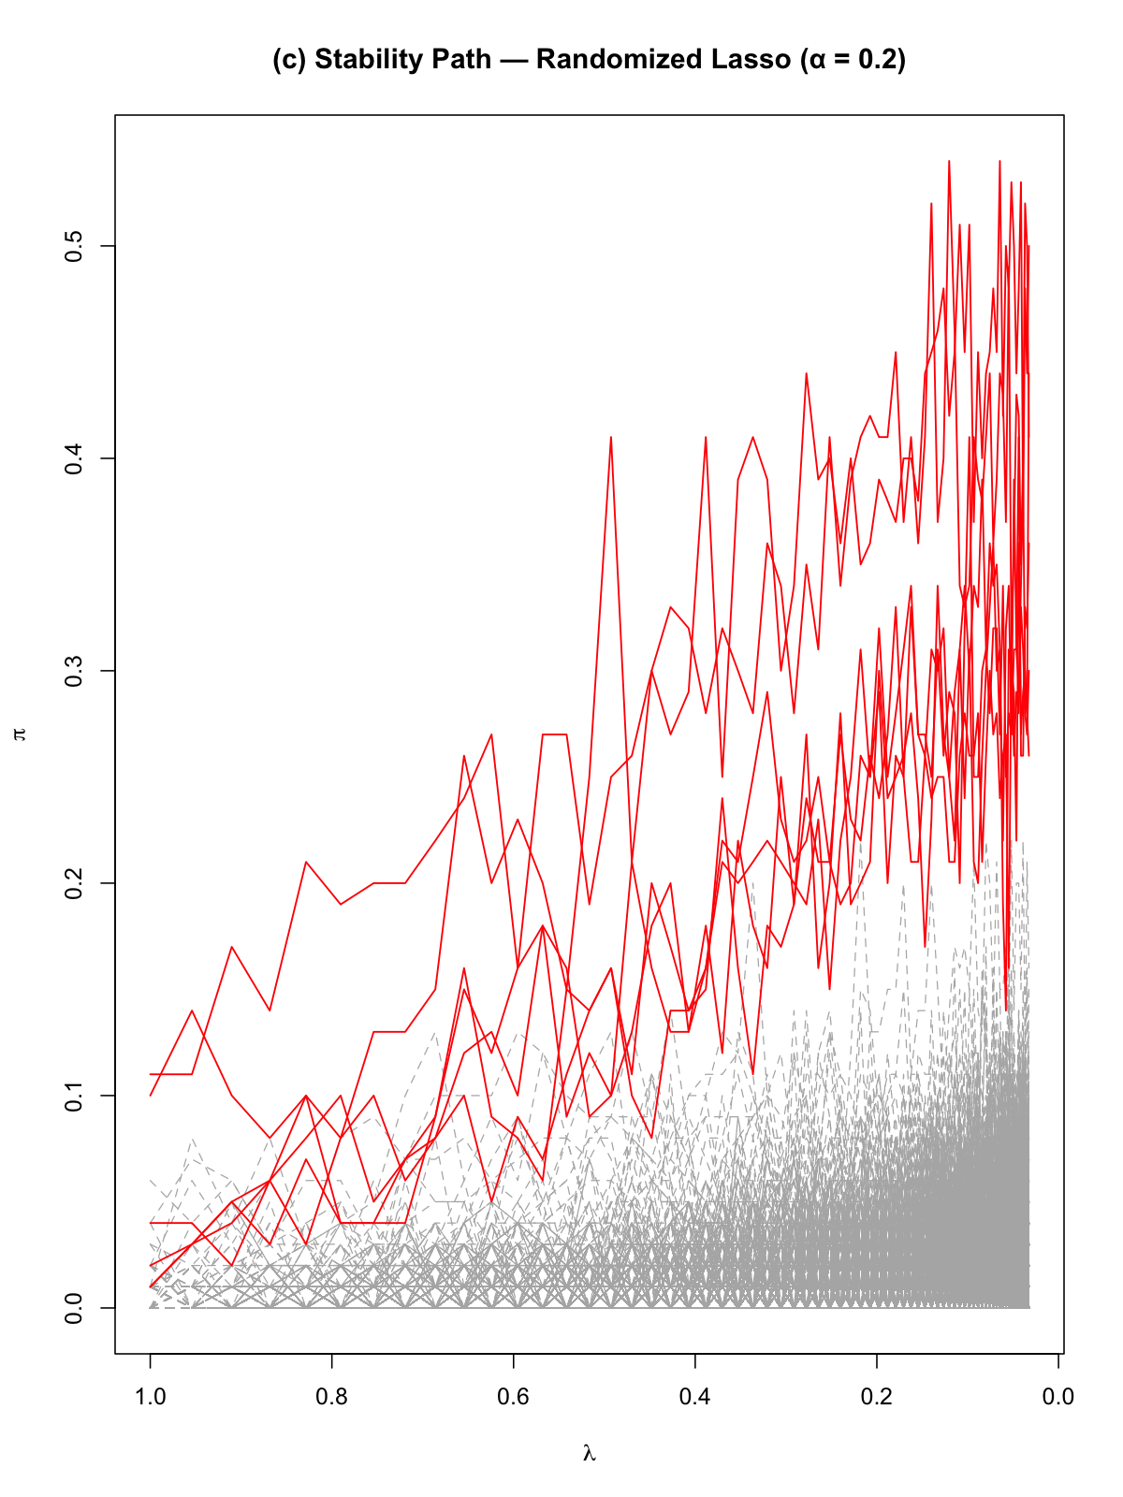
Application: Riboflavin Gene Expression Dataset
Lasso regularization path (‘ ‘are relevant variables, ‘ ’ lines are noise variables; 2) Lasso stability selection path;
3) Randomized Lasso stability path with $α=0.2$

Slide 9
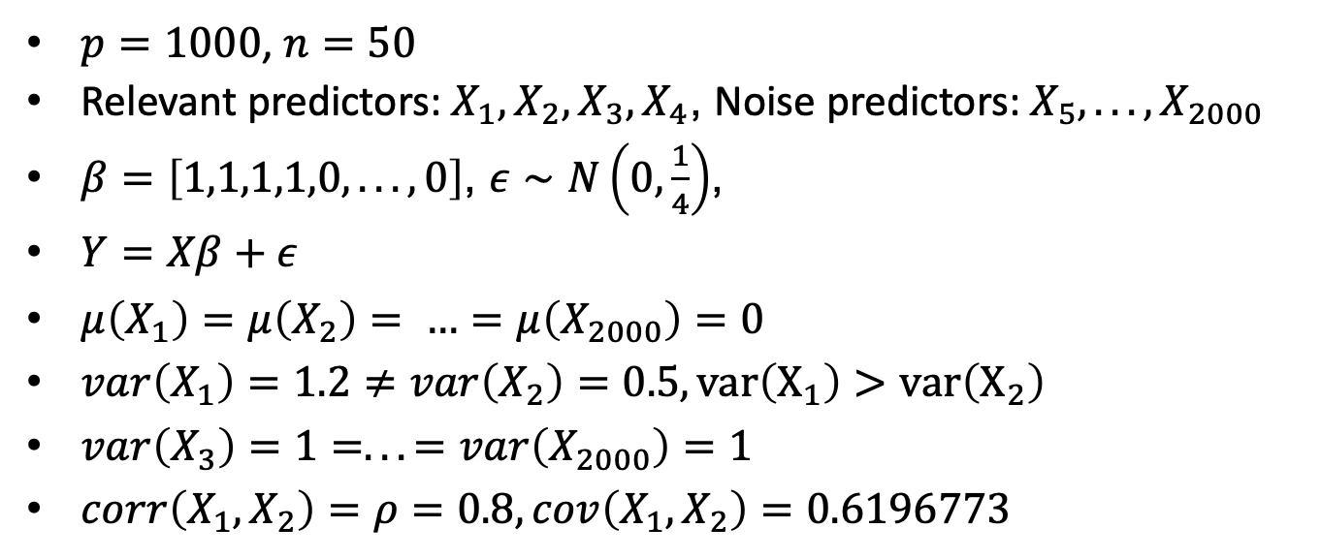
Extension: Mis-specified model
$p=1000$, $n=50$
Relevant predictors: $X_{1},X_{2},X_{3},X_{4}$, Noise predictors: $X_{5},...,X_{2000}$
$β=\left[1,1,1,1,0,...,0\right]$, $ε∼N\left(0,\frac{1}{4}\right)$,
$Y=Xβ+ε$
$μ\left(X_{1}\right)=μ\left(X_{2}\right)= …=μ\left(X_{2000}\right)=0$
$var\left(X_{1}\right)=1.2≠var\left(X_{2}\right)=0.5, var\left(X_{1}\right)>var\left(X_{2}\right)$
$var\left(X_{3}\right)=1=...=var\left(X_{2000}\right)=1$
$corr\left(X_{1},X_{2}\right)=ρ=0.8,cov\left(X_{1},X_{2}\right)=0.6196773$

Slide 10
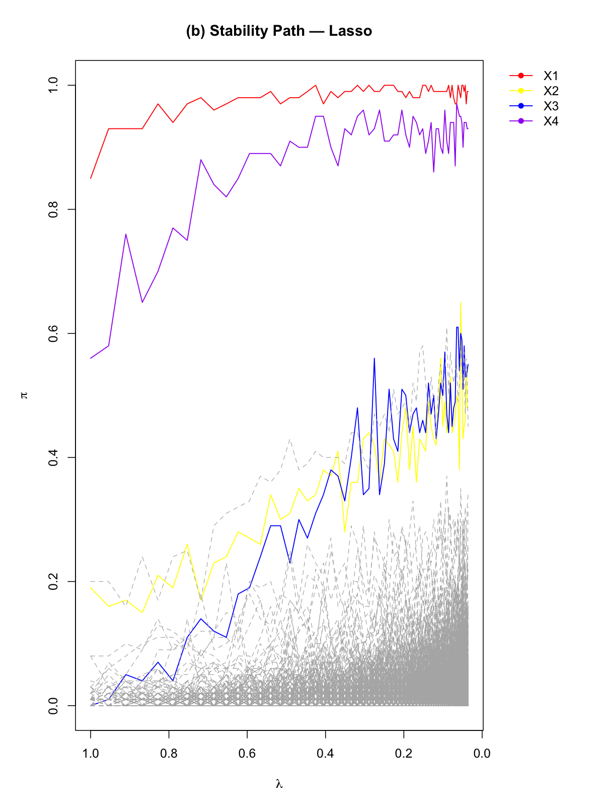
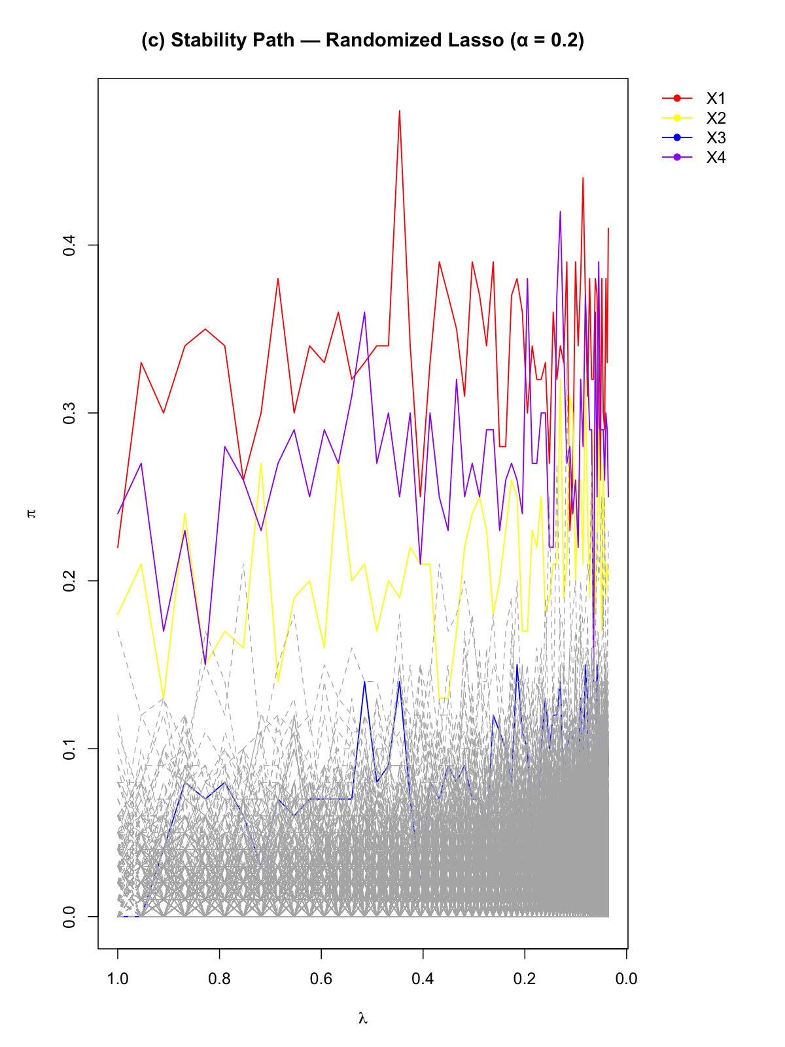
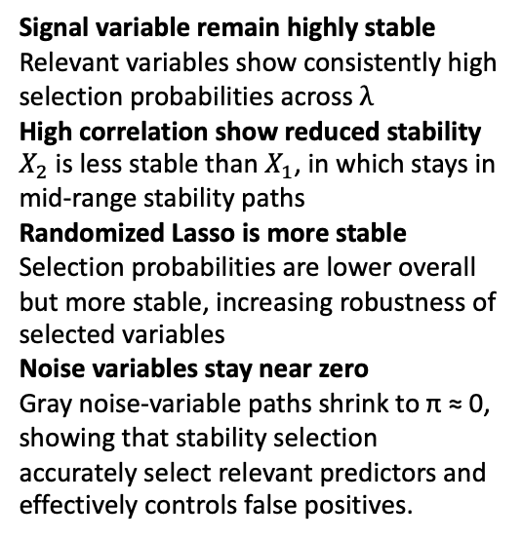
Extension: Mis-specified model
Signal variable remain highly stable
Relevant variables show consistently high selection probabilities across $λ$
High correlation show reduced stability
$X_{2}$ is less stable than $X_{1}$, in which stays in mid-range stability paths
Randomized Lasso is more stable
Selection probabilities are lower overall but more stable, increasing robustness of selected variables
Noise variables stay near zero
Gray noise-variable paths shrink to π ≈ 0, showing that stability selection accurately select relevant predictors and effectively controls false positives.

Slide 11
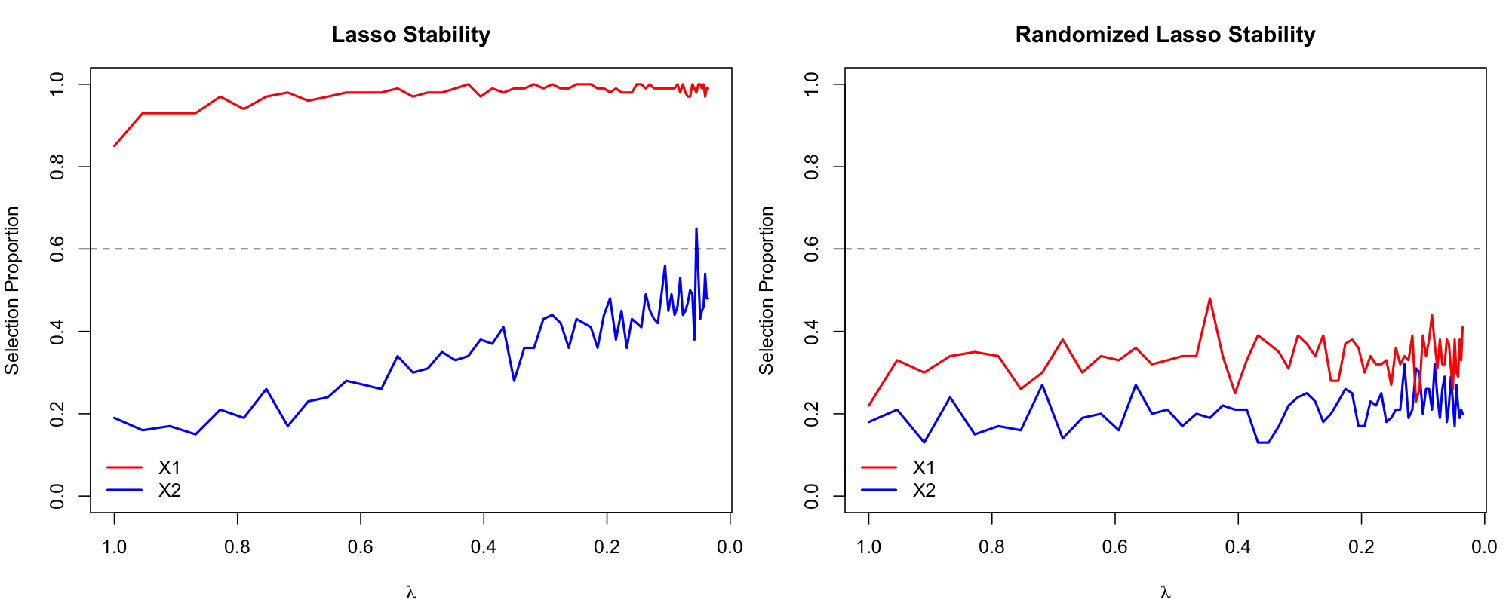
Selection Probabilities Comparison
Lasso stability selection path on correlated predictors; 2) Randomized Lasso stability path on correlated predictors with $α=0.2$

Slide 12

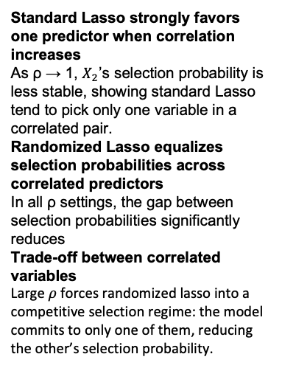
Correlation $ρ$ effects on selection path and stability
Standard Lasso strongly favors one predictor when correlation increases
As ρ → 1, $X_{2}$’s selection probability is less stable, showing standard Lasso tend to pick only one variable in a correlated pair.
Randomized Lasso equalizes selection probabilities across correlated predictors
In all ρ settings, the gap between selection probabilities significantly reduces
Trade-off between correlated variables
Large $ρ$forces randomized lasso into a competitive selection regime: the model commits to only one of them, reducing the other’s selection probability.

Slide 13

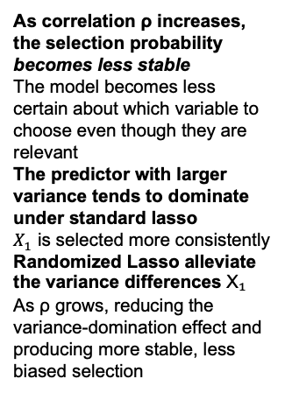
Variance magnitude effects on selection path and stability
$$Ratio=\frac{var\left(X_{1}\right)}{var\left(X_{2}\right)}$$
As correlation ρ increases, the selection probability becomes less stable
The model becomes less certain about which variable to choose even though they are relevant
The predictor with larger variance tends to dominate under standard lasso
$X_{1}$ is selected more consistently
Randomized Lasso alleviate the variance differences X₁ As ρ grows, reducing the variance-domination effect and producing more stable, less biased selection

Slide 14
Limitations
Computationally expensive due to repeated model fitting
Weak signals may not exceed the threshold probabilities
Assumption of exchangeability, violation lead to bias selection probabilities
Standard Lasso struggles on correlated predictors

