Slide 1
Text Mining Project
Nan Zhang

Slide 2
Outline
Project design
Data resource
Data cleaning
Data analysis
Conclusion

Slide 3
Project Design
Analyze focuses of two authors who publish papers in Fast Company magazine
Demonstrate statistical skills in text mining through this small project

Slide 4
Data Resource
Downloaded 12 text files written by Evie Nagy and Morgan Clendaniel from Fast Company magazine

Slide 5
Data Summary
Six text files written by Evie Nagy imported to R
A corpus with 6 text documents
The metadata include two tag-value pairs and one data frame
Available tags: create_date creator
Available variables in the data frame: MetaID
Six text files written by Morgan Clendaniel imported to R
A corpus with 6 text documents
The metadata include two tag-value pairs and one data frame
Available tags: create_date creator
Available variables in the data frame: MetaID

Slide 6
Data Cleaning
Clean data by removing punctuations, numbers, Urls, stopwords, whitespaces and mixed cases
Translate texts into reduced texts with only “stem words”

Slide 7
Data Analysis-TermDocument Matrix
Six text files written by Evie Nagy imported to R
Term-document matrix (1252 terms, 6 documents)
Non-/sparse entries: 1889/5623
Sparsity : 75%
Maximal term length: 19
Weighting : term frequency (tf)
Six text files written by Morgan Clendaniel imported to R
Term-document matrix (1064 terms, 6 documents)
Non-/sparse entries: 1623/4761
Sparsity : 75%
Maximal term length: 24
Weighting : term frequency (tf)

Slide 8
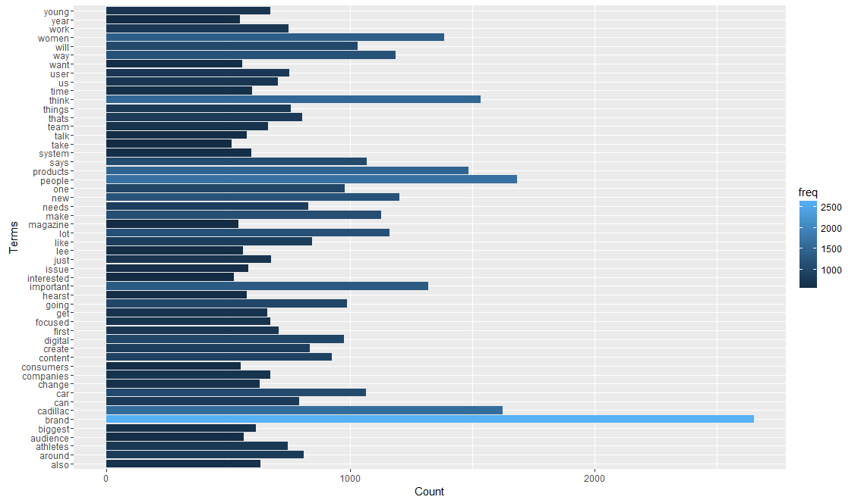
Barplot of Words Frequency for 1st Corpus

Slide 9
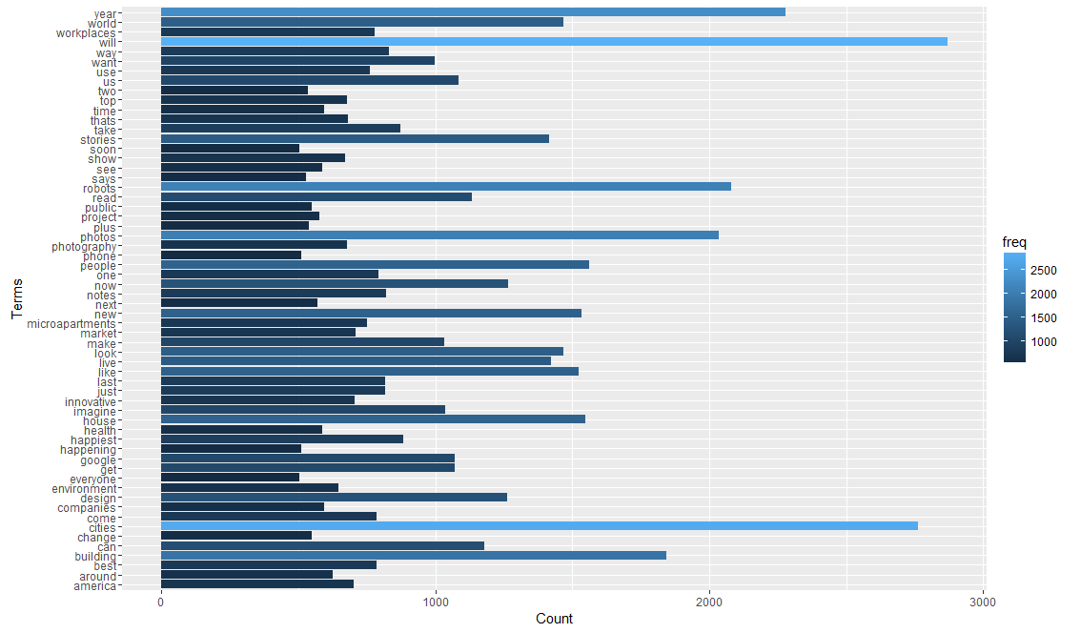
Barplot of Words Frequency for 2nd Corpus

Slide 10
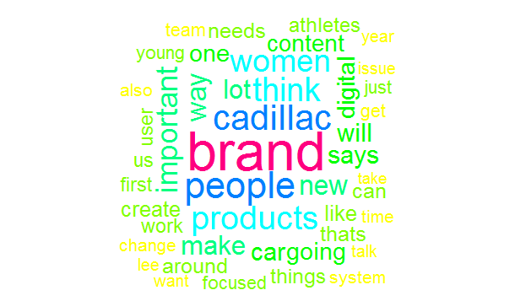
Word Cloud Analysis for 1st Corpus
Results indicate that Evie Nagy focuses on topics including brand, cadillac, women, products and etc.

Slide 11
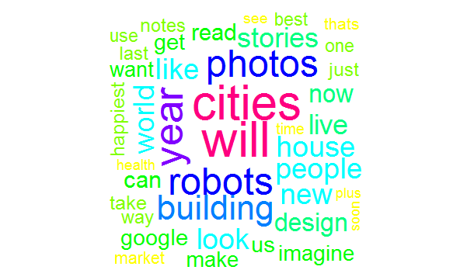
Word Cloud Analysis for 2nd Corpus
Results indicate that Morgan Clendaniel focuses on topics including cities, will, robots, building, photos and etc.

Slide 12
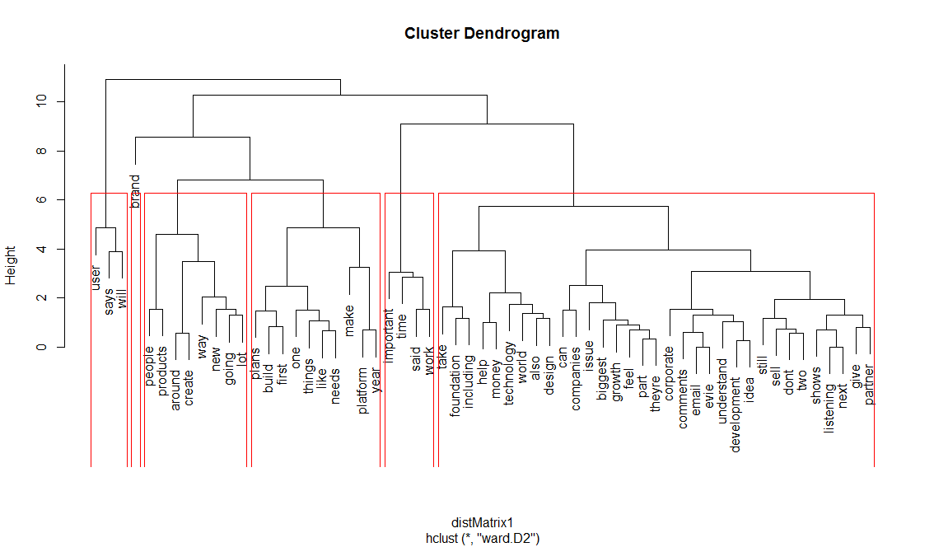
Hierarchical Clustering for 1st Corpus

Slide 13
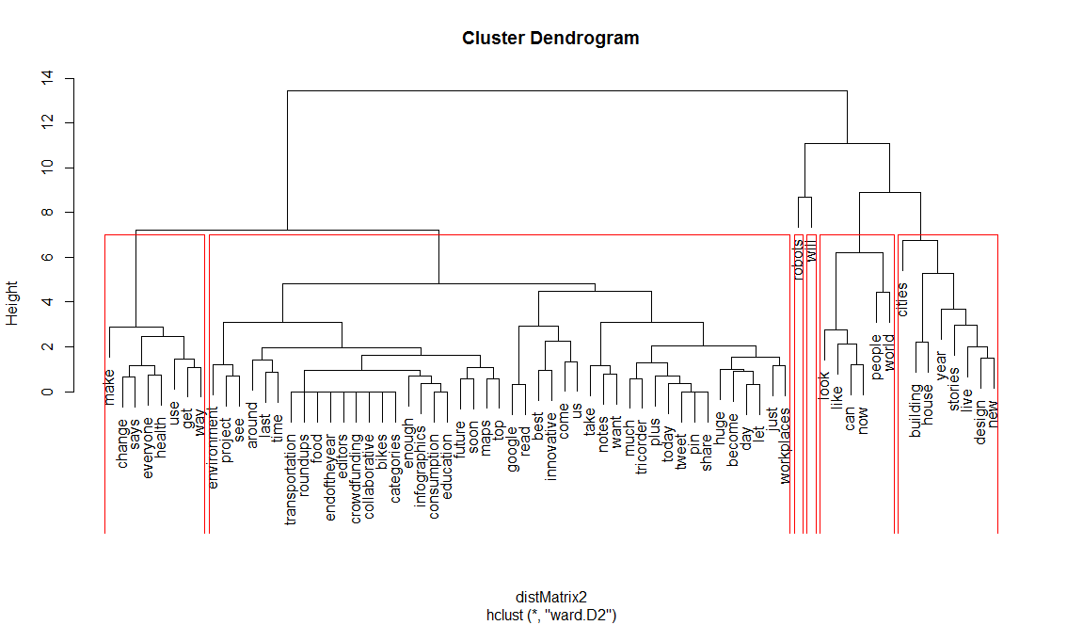
Hierarchical Clustering for 2nd Corpus

Slide 14
K-means Clustering for 1st Corpus
Cluster 1: time, important, work
Cluster 2: people, way, going
Cluster 3: says, user, will
Cluster 4: platform, says, year
Cluster 5: brand, important, products

Slide 15
K-means Clustering for 2nd Corpus
Cluster 1: building, house, new
Cluster 2: will, year, like
Cluster 3: world, make, people
Cluster 4: cities, people, look
Cluster 5: robots, will, us

Slide 16
Conclusion
Several methods are used in this analysis, different methods have its own pros and cons. From results of four analysis, Evie Nagy and Morgan Clendaniel have different preferences.
Evie Nagy focus on the topics about product brand, platform build and work time ect.
Morgan Clendaniel focus on the topics about build new house, will and robot ect.

