Slide 1
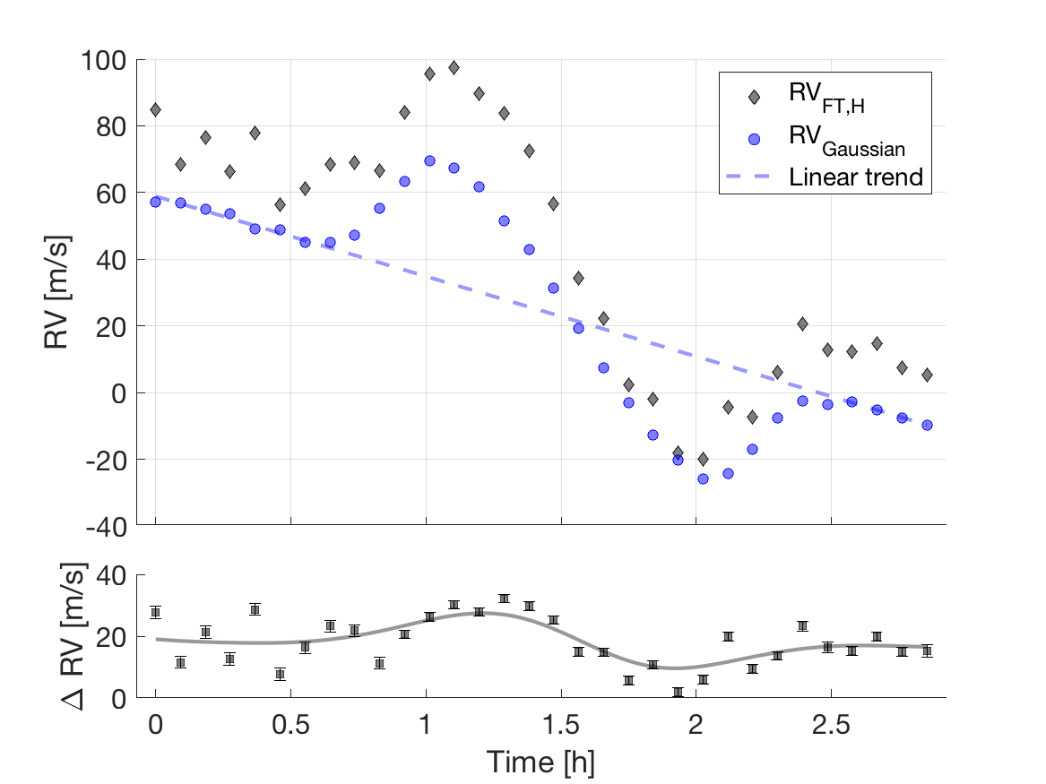
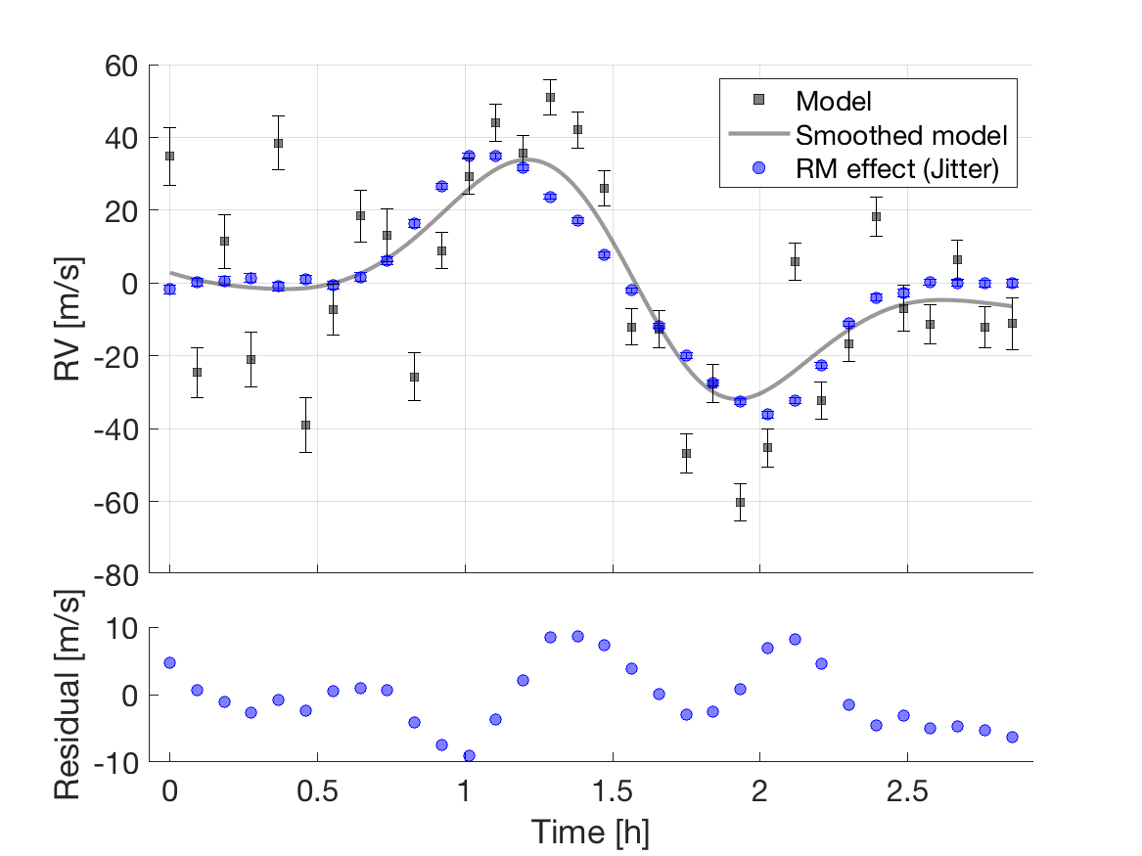
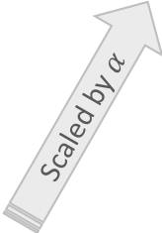

HD189733: Rossiter–McLaughlin effect as jitter
Linear trend removed
$∆$RV$=$ RV_{FT,H} $−$RV_{Gaussian}
Smoothed model $−$ RM effect
Scaled by $α$

