Slide 1
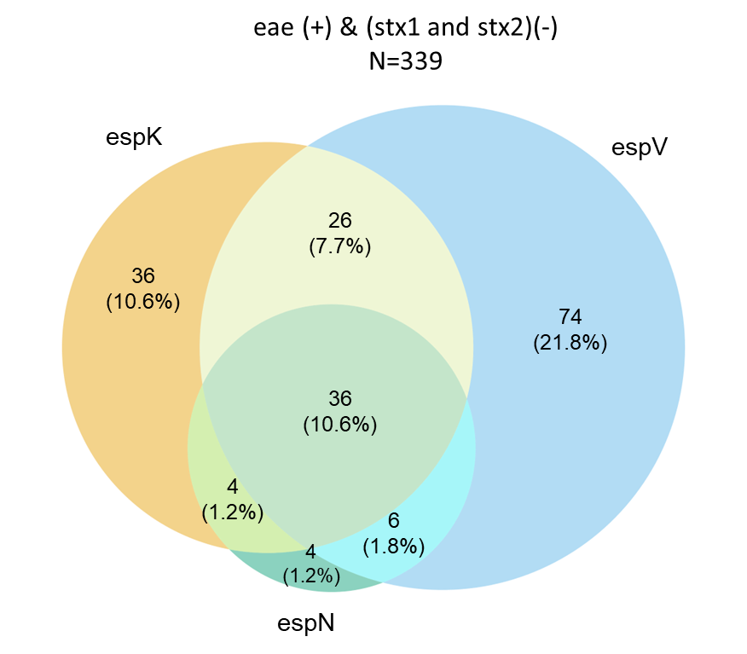
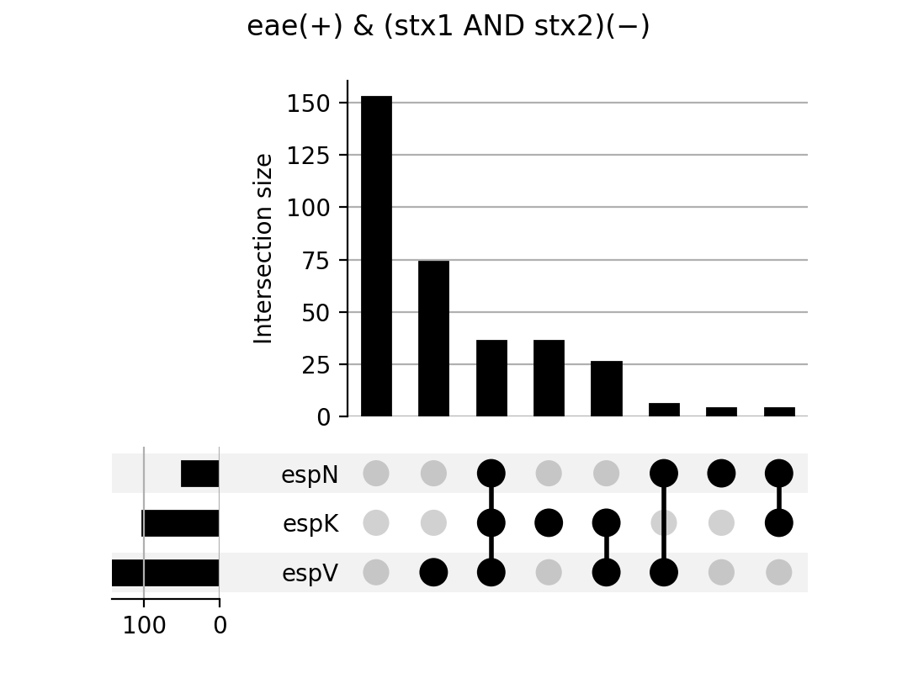
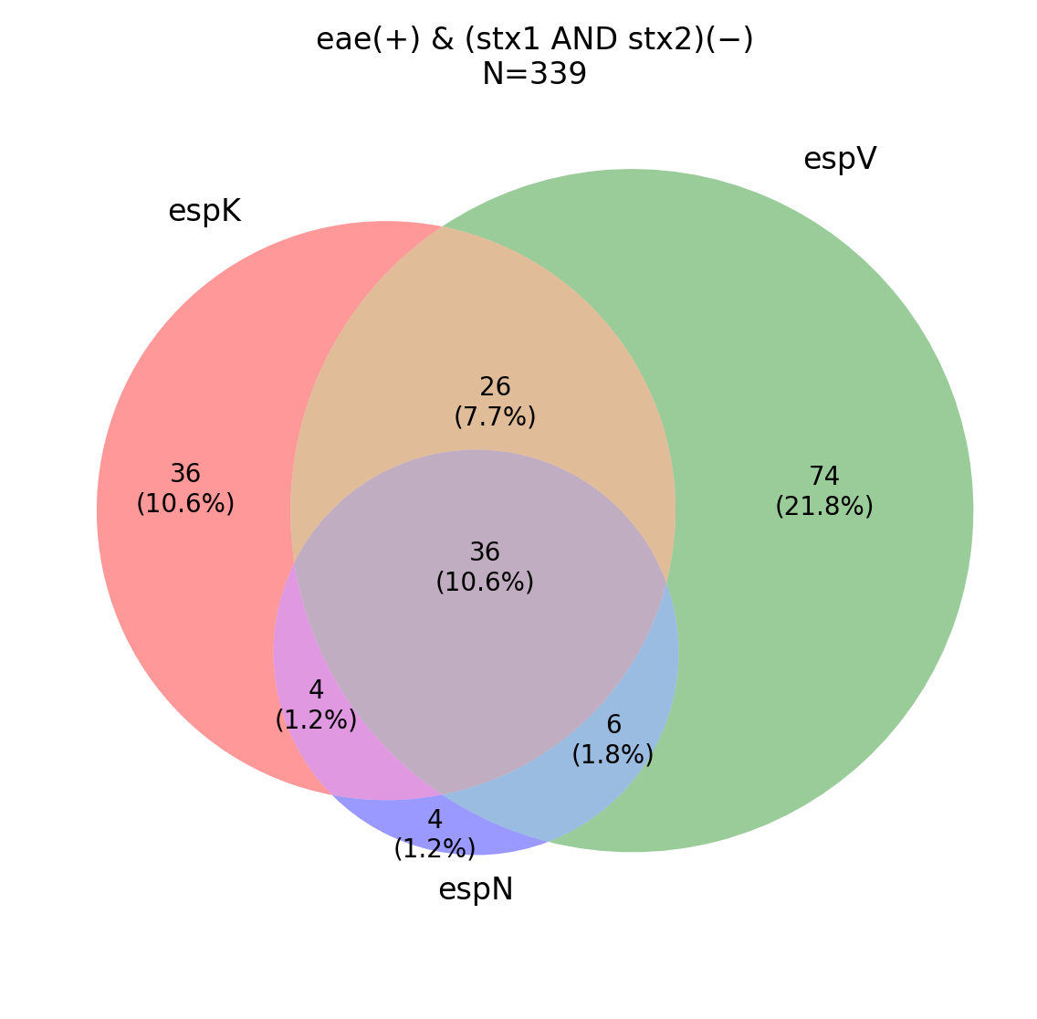
153 74 36 36 26 6 4 4

Slide 2

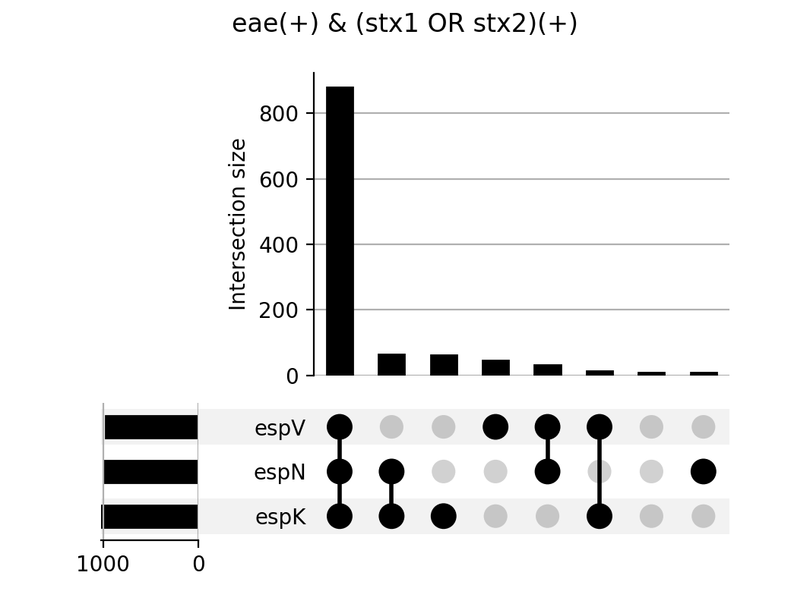
eae (+) & (stx1 OR stx2) (+)
N=1114
13
(1.2%)
espK
espV
46
(4.1%)
61
(5.5%)
880
(79.0%)
32
(2.9%)
64
(5.7%)
9
(0.8%)
880 64 61 46 32 13 9 9
espN

Slide 3
