Slide 1
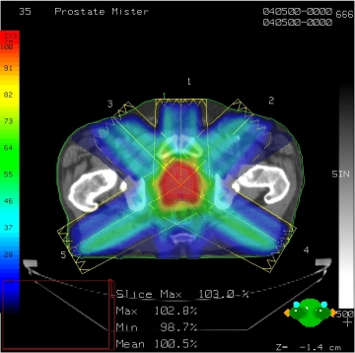
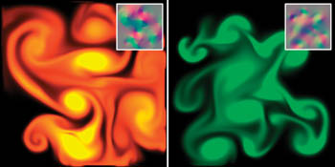
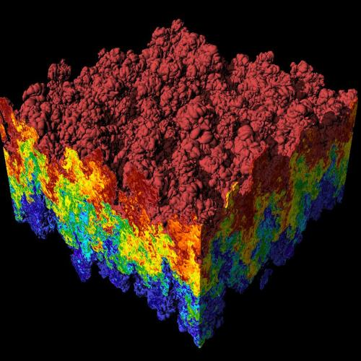
CS 179:
Introduction to GPU Programming.
Lecture 1: Introduction
Images: http://en.wikipedia.org
http://www.pcper.com
http://northdallasradiationoncology.com/
GPU Gems (Nvidia)
Notes:
1

Slide 2
Administration
Main topics covered in course:
(GP)GPU computing/parallelization
C++ CUDA (parallel computing platform)
TAs:
Thomas Barrett (Head TA) (tbarrett@caltech.edu)
Michael Valverde (michael@caltech.edu)
Mario Ruiz (mjruiz@ca.tech.edu)
TBA
Overseeing Instructor:
Al Barr (barr@cms.caltech.edu)
.

Slide 3
Primary Websites:
http://courses.cms.caltech.edu/cs179/
http://www.piazza.com/caltech/spring2022/cs179
Piazza is the primary forum for the course! Make sure you’re enrolled!
Also CS179 Canvas Calendar
Class time:
MW(F) 3pm PDT for classes and HW recitations.
Also TA office hours, some through Zoom (TBA)

Slide 4
Course Requirements
Homework:
6 assignments, in 6 weeks.
Each worth 10% of grade
Also “enough” work before Add Day, to pass!
Final project:
4-week project
40% of grade total
P/F Students must receive at least 60% on every assignment AND the final project.

Slide 5
Homework
Due on Tuesdays 3PM PDT.
First set is due Tuesday April 5th
Use zip on remote GPU computer in Barr lab to submit HW.
Collaboration policy:
Discuss ideas and strategies freely, but all code must be your own
Do NOT look up prior years solutions or reference solution code from github without prior TA approval
Use additional backup method for work, on a different computer.
Make your github repository *Private*!
Office Hours: Most will be in person, some through Zoom.
Times: TBA
Extensions
Ask a TA for one if you have a valid reason
See main website for details.

Slide 6
Your GPU Project
Project can be a topic of your choice
We will also provide many options
Teams of up to 2 people
2-person teams will be held to higher expectations
Requirements
Project Proposal
Progress report(s) and Final Presentation
More info later…

Slide 7
Caltech Machine and your accounts now available.
The Primary GPU machine is set up and available
You will soon receive a user account in email.
Please test access and change your password.
GPU-enabled machine is on the Caltech campus.
Let us know if you have problems!
You’ll be submitting HW on this computer.

Slide 8
Alternative GPU Machines
Alternative: Use your own machine.
You will still have to submit and test HW on the Caltech GPU machine.
Must have an NVIDIA CUDA-capable GPU
At least Compute 3.0
Virtual machines generally won’t work
Exception: Machines with I/O MMU virtualization and certain GPUs
Special requirements for:
Hybrid/Optimus systems (laptops)
Mac/OS X (probably no longer supported?)
Setup guide on the website is likely outdated. Can follow NVIDIA’s posted installation instructions (linked on page). Ubuntu 22.04 or later ay be easiest to install!

Slide 9
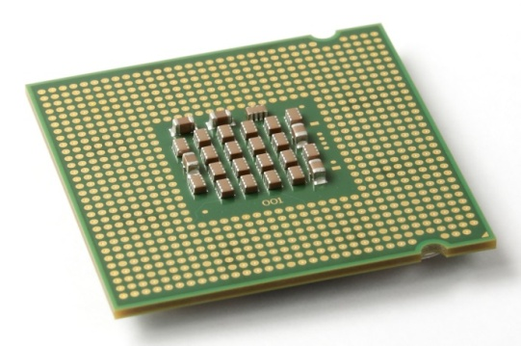
The CPU
The “Central Processing Unit”
Traditionally, applications use CPU for primary calculations
General-purpose capabilities, mostly sequential operations
Established technology
Usually equipped with 8 or fewer, powerful cores
Optimal for some types of concurrent processes but not large scale parallel computations
Wikimedia commons: Intel_CPU_Pentium_4_640_Prescott_bottom.jpg

Slide 10
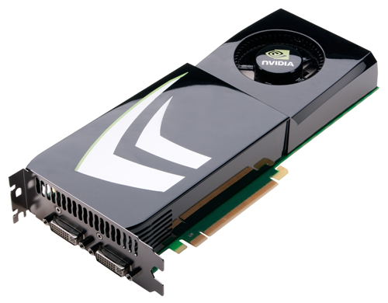
The GPU
The "Graphics Processing Unit"
Relatively new technology designed for parallelizable problems
Initially created specifically for graphics
Became more capable of general computations
Very fast and powerful, computationally
Uses lots of electrical power

Slide 11
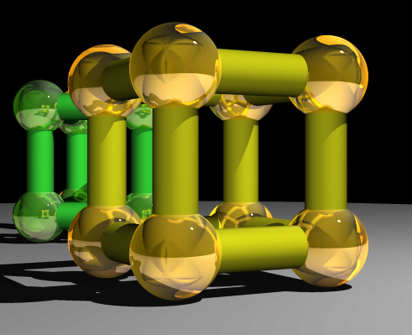
GPUs – Some of the Motivation
Raytracing:
for all pixels (i,j) in image:
From camera eye point,
calculate ray point and direction in 3d space
if ray intersects object:
calculate lighting at closest object point
store color of (i,j)
Assemble into image file
Superquadric Cylinders, exponent 0.1, yellow glass balls, Barr, 1981
Each pixel could be computed simultaneously, with enough parallelism!

Slide 12
SIMPLE EXAMPLE
Add two arrays, A and B to produce array C
A[ ] + B[ ] -> C[ ]
On the CPU:
float *C = malloc(N * sizeof(float));
for (int i = 0; i < N; i++)
C[i] = A[i] + B[i];
return C;
On CPUs the above code operates sequentially, but can we do better, still on CPUs?

Slide 13
A simple problem…
On the CPU (multi-threaded, pseudocode):
(allocate memory for array C)
Create # of threads equal to number of cores on processor (around 2, 4, perhaps 8?)
(Indicate portions of arrays A, B, C to each thread...)
...
In each thread,
For (i from beginning region of thread)
C[i] <- A[i] + B[i]
//lots of waiting involved for memory reads, writes, ...
Wait for threads to synchronize...
This is slightly faster – 2-8x (can be slightly more with other tricks)

Slide 14
A simple problem…
How many threads are available on the CPUs? How can the performance scale with thread count?
(Each CPU can generally have two threads).
Context switching:
The action of switching which thread is being processed
High penalty on the CPU (main computer)
Not a big issue on the GPU

Slide 15
A simple problem…
On the GPU:
(allocate memory for arrays A, B, C on GPU)
Create the “kernel” – where each thread will perform one (or a few) additions
Specify the following kernel operation:
For all i‘s (indices) assigned to this thread:
C[i] <- A[i] + B[i]
Start ~20000 (!) threads all at the same time!
Wait for threads to synchronize...

Slide 16
GPU: Strengths Revealed
Emphasis on parallelism on GPUs means we have lots of cores
This allows us to run many threads simultaneously with virtually no context switches

Slide 17
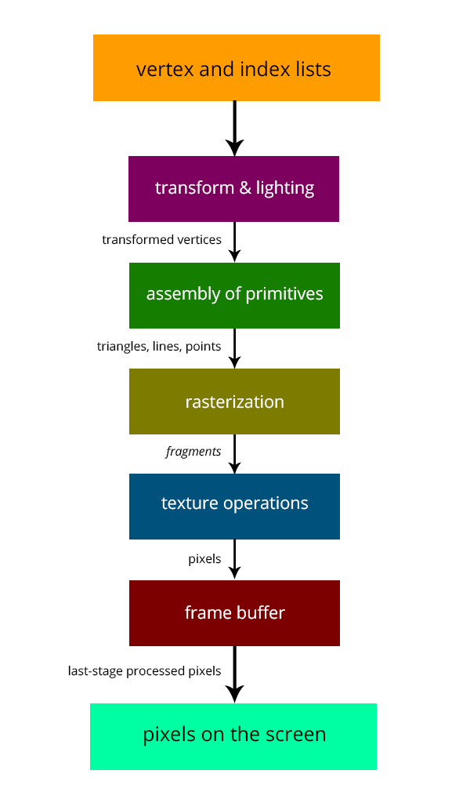
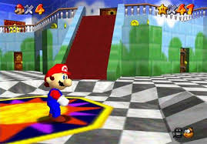
GPUs – Brief History
Initially based on graphics focused fixed-function pipelines (history)
Pre-set pixel/vertex functions, limited options
http://gamedevelopment.tutsplus.com/articles/the-end-of-fixed-function-rendering-pipelines-and-how-to-move-on--cms-21469
Source: Super Mario 64, by Nintendo

Slide 18
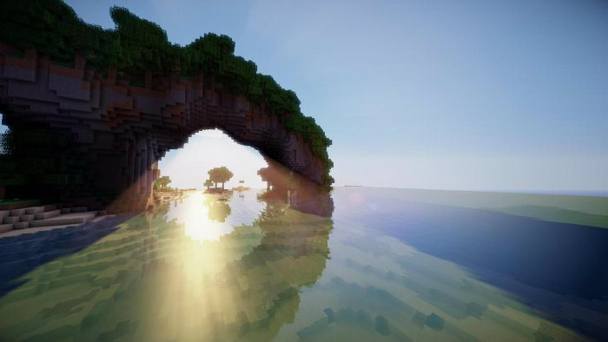
GPUs – Brief History
Shaders
Can implement one’s own functions using graphics routines.
GLSL (C-like language), discussed in CS 171
Can “sneak in” general-purpose programming! Uses pixel and vertex operations instead of general purpose code. Very crude.
Vulkan/OpenCL is the modern multiplatform general purpose GPU compute system, but we won’t be covering it in this course
http://minecraftsix.com/glsl-shaders-mod/

Slide 19
Using GPUs as “supercomputers”
“General-purpose computing on GPUs” (GPGPU)
Hardware has gotten good enough to a point where it’s basically having a mini-supercomputer
CUDA (Compute Unified Device Architecture)
General-purpose parallel computing platform for NVIDIA GPUs
Vulkan/OpenCL (Open Computing Language)
General heterogenous computing framework
Both are accessible as extensions to various languages
If you’re into python, checkout Theano, pyCUDA.
Upcoming GPU programming environment: Julia Language
Notes:
Supercomputers are tons of processing cores sharing the workload of a parallelized task. GPUs are in fact often at the core of most modern supercomputers

Slide 20
GPU Computing: Step by Step
Setup inputs on the host (CPU-accessible memory)
Allocate memory for outputs on the host CPU
Allocate memory for inputs on the GPU
Allocate memory for outputs on the GPU
Copy inputs from host to GPU (slow)
Start GPU kernel (function that executes on gpu – fast!)
Copy output from GPU to host (slow)
NOTE: Copying can be asynchronous, and unified memory management is available

Slide 21
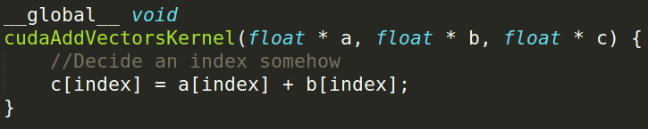
The Kernel
This is our “parallel” function
Given to each thread
Simple example, implementation:

Slide 22
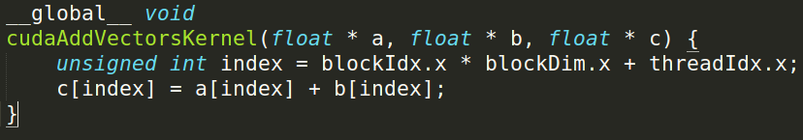
Indexing
Can get a block ID and thread ID within the block:
Unique thread ID!
https://cs.calvin.edu/courses/cs/374/CUDA/CUDA-Thread-Indexing-Cheatsheet.pdf
https://en.wikipedia.org/wiki/Thread_block

Slide 23
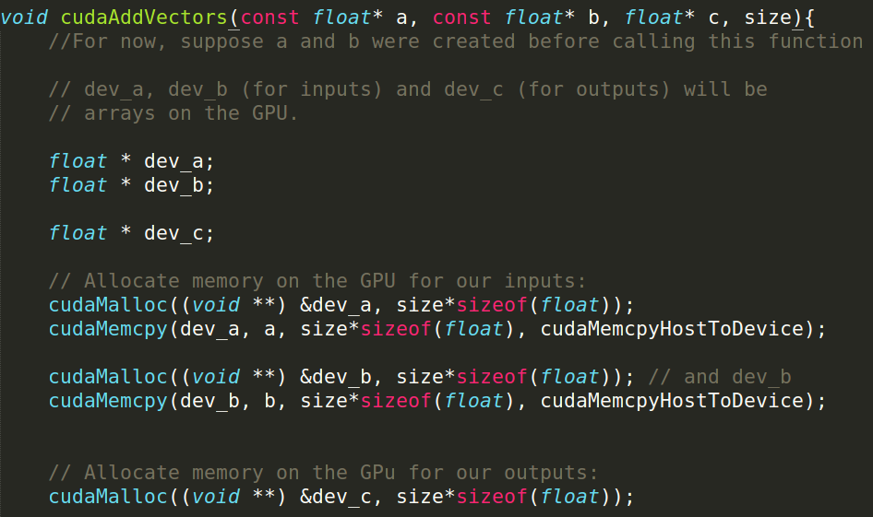
Calling the Kernel

Slide 24
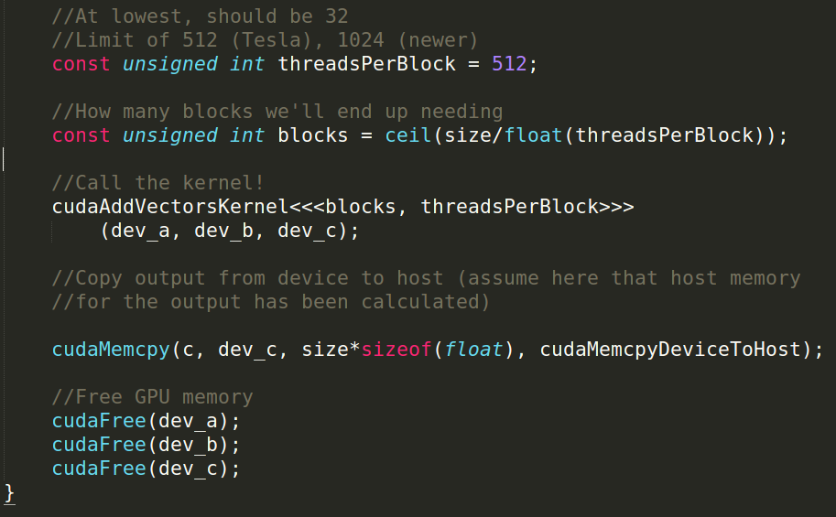
Calling the Kernel (2)

Slide 25
GPU Computing Examples
Solving PDEs on GPUs
GPU vs CPU fluid mechanics
Ray Traced Quaternion fractals and Julia Sets
Deep Learning and GPUs
Real-Time Signal Processing with GPUs

Slide 26

Questions can be live and interactive, on Zoom during office hours. Also can be posted on Piazza.

