Slide 1
CS 179: GPU Computing
Lecture 2: Intro to the simd lifestyle and GPU internals
Notes:
Resume – remarks:
Welcome back
Storytelling/motivational purposes
Introducing

Slide 2
Recap
Can use GPU to solve highly parallelizable problems
Looked at the a[] + b[] -> c[] example
CUDA is a straightforward extension to C++
Separate CUDA code into .cu and .cuh files
We compile with nvcc, NVIDIA’s compiler for CUDA, to create object files (.o files)
Search for “Resource” links on http://courses.cms.caltech.edu/cs179/

Slide 3
A Few GPU Keywords to Remember …
CUDA – Nvidia’s C++ like language for programming GPUs
nvcc – nVidia CUDA compiler
SM -- Streaming Multiprocessor
https://en.wikipedia.org/wiki/Stream_processing
SIMD computation – Single instruction, multiple data (SIMD) is a class of parallel computers in Flynn's taxonomy.
https://en.wikipedia.org/wiki/SIMD
SIMT computation – Single instruction, multiple threads
https://en.wikipedia.org/wiki/Single_instruction,_multiple_threads

Slide 4
More GPU Keywords …
Threads – A thread of execution is the smallest sequence of programmed instructions that can be managed independently by a scheduler, which is typically a part of the operating system
https://en.wikipedia.org/wiki/Thread_(computing)
Blocks – A thread block is a programming abstraction that represents a group of threads that can be executed serially or in parallel.
https://en.wikipedia.org/wiki/Thread_block_(CUDA_programming)
Grids – Nvidia GRID is a family of graphics processing units (GPUs)
https://en.wikipedia.org/wiki/Nvidia_GRID
Warps -- On the hardware side, a thread block is composed of ‘warps’. A warp is a set of 32 threads within a thread block such that all the threads in a warp execute the same instruction. These threads are selected serially by the SM
https://en.wikipedia.org/wiki/Thread_block_(CUDA_programming)#Warps
Warp Divergence – All threads must generally execute the same code (if-then-else).
https://cvw.cac.cornell.edu/gpu/thread_div

Slide 5
NVCC and G++
CUDA is simply an extension of other bits of code you write!!!!
Evident in .cu/.cuh vs .cpp/.hpp distinction
.cu/.cuh is compiled by nvcc to produce a .o file
Since CUDA 7.0 / 9.0 there’s support by NVCC for most C++11 / C++14 language features, but make sure to read restrictions for device code
https://docs.nvidia.com/cuda/cuda-c-programming-guide/index.html#c-cplusplus-language-support
.cpp/.hpp is compiled by g++ and the .o file from the CUDA code is simply linked in using a "#include xxx.cuh" call
No different from how you link in .o files from normal C++ code

Slide 6
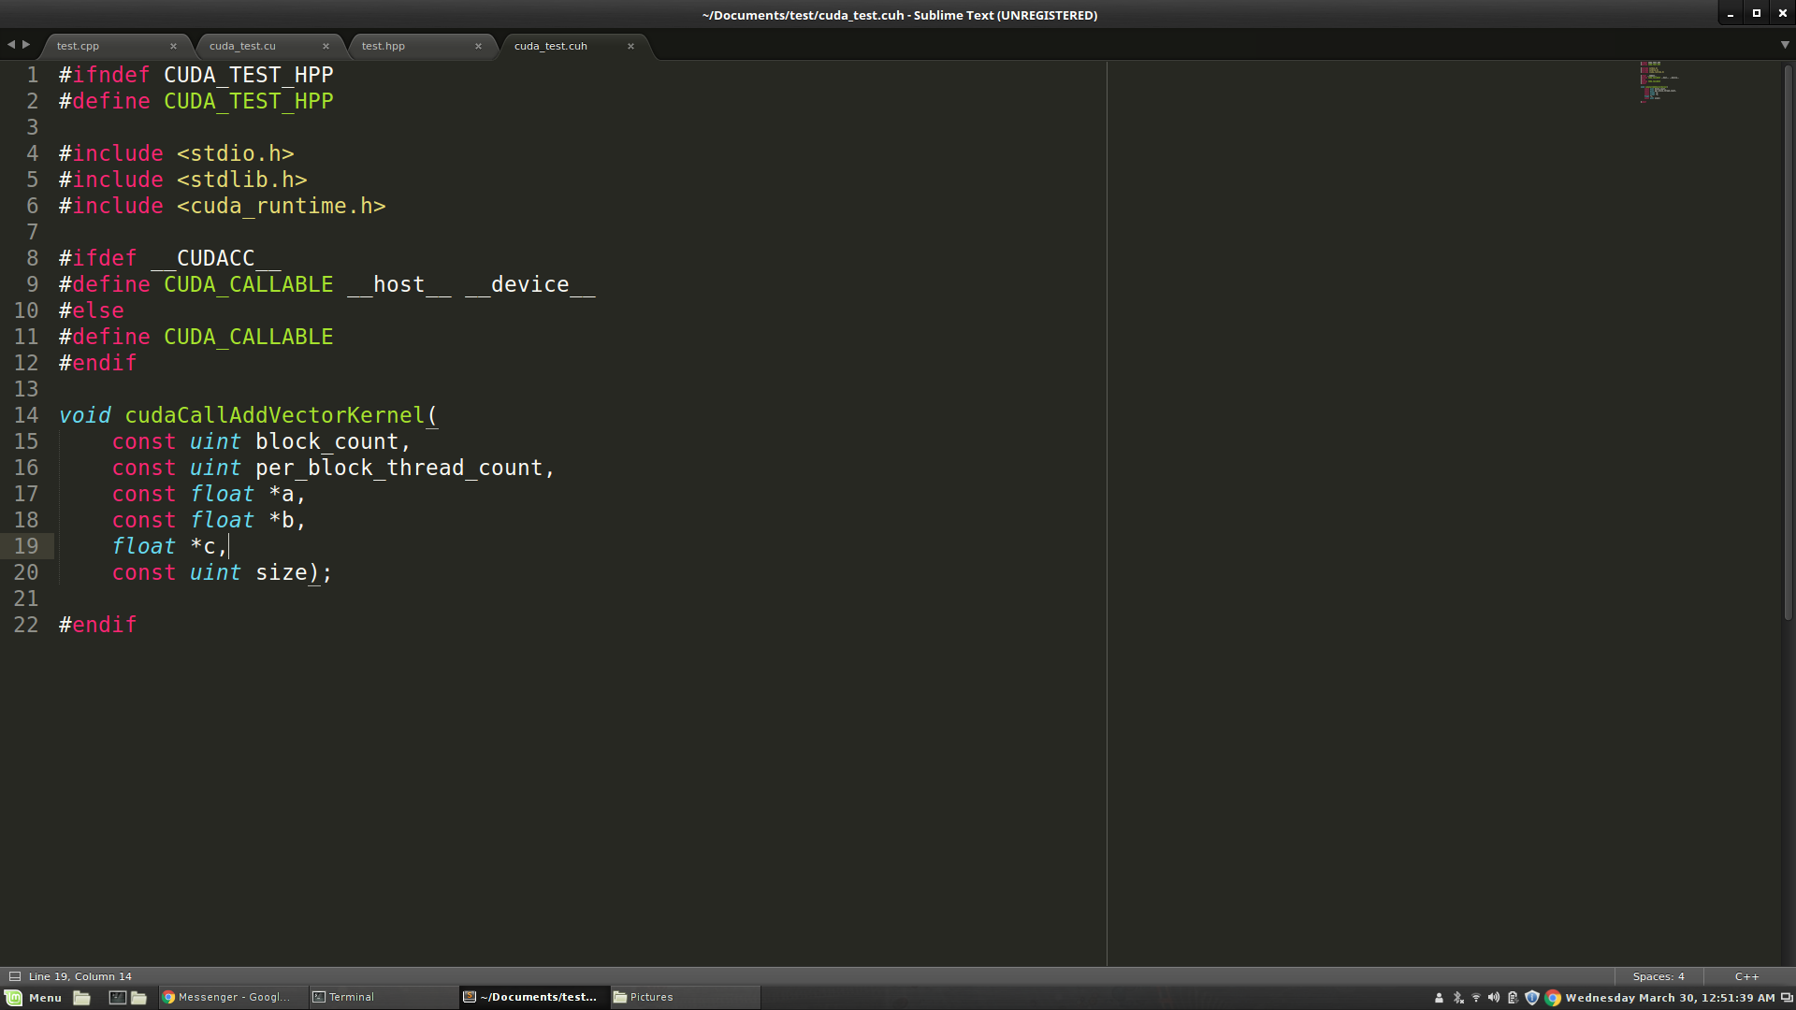
.cu/.cuh vs .cpp/.hpp

Slide 7
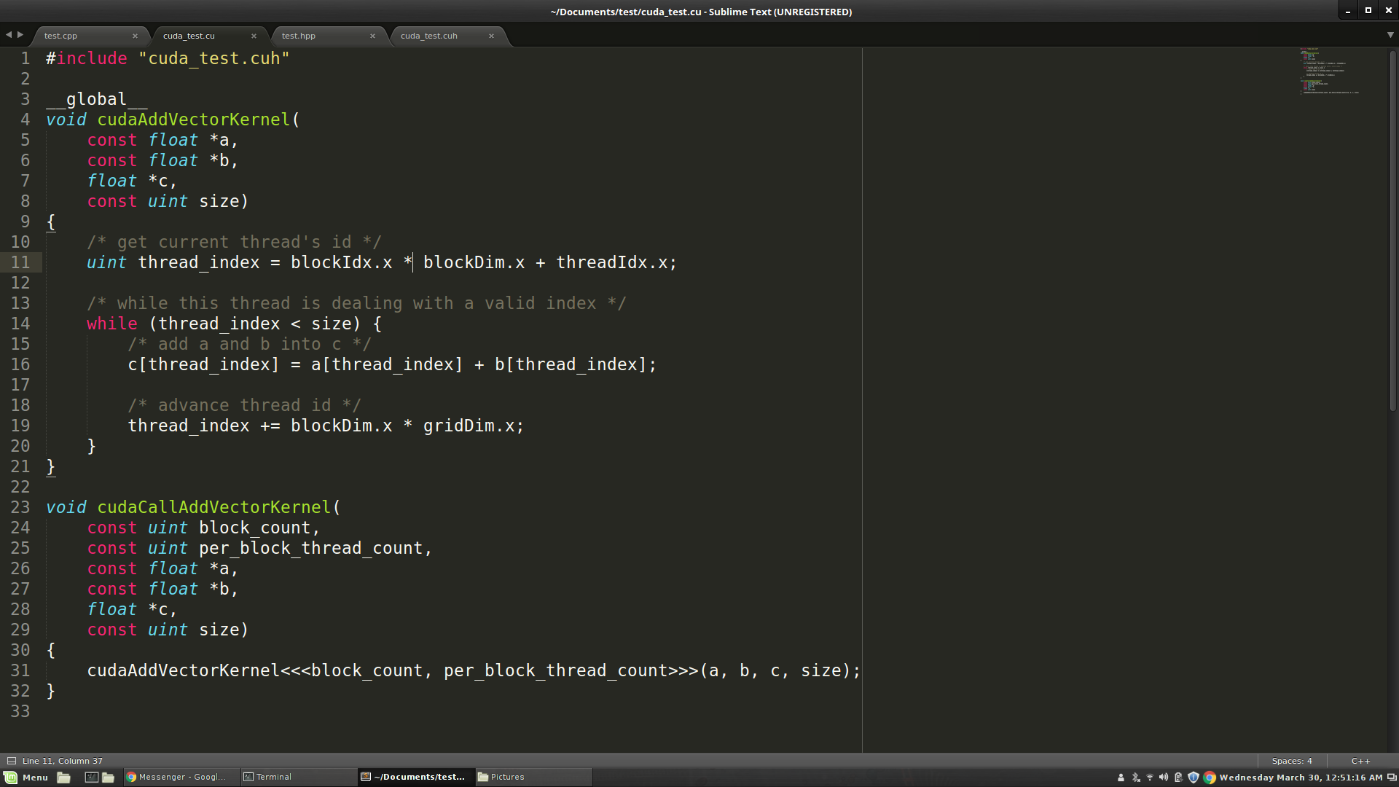
.cu/.cuh vs .cpp/.hpp

Slide 8
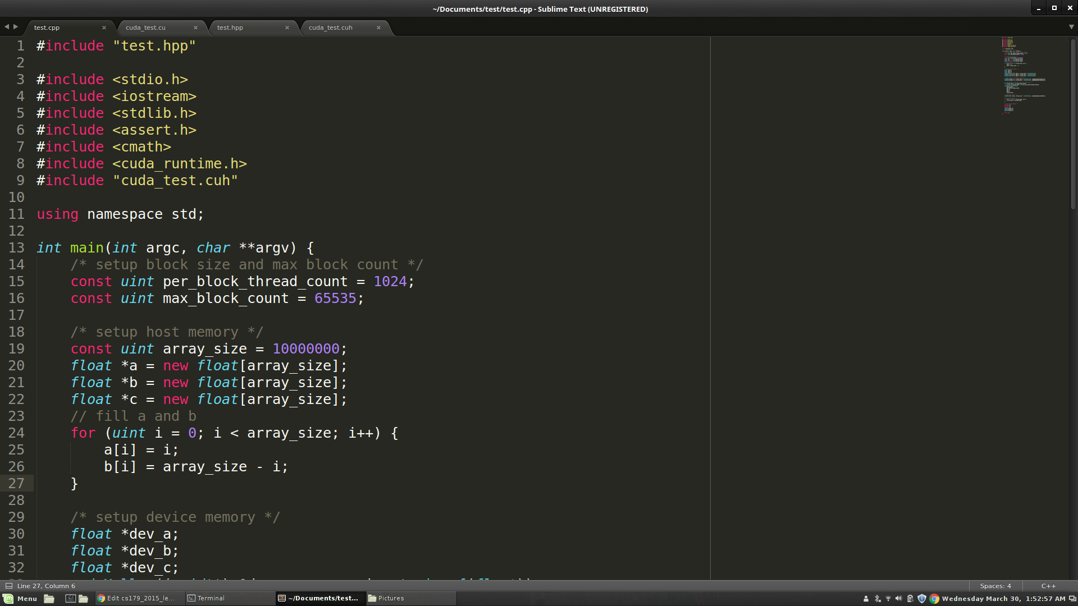
.cu/.cuh vs .cpp/.hpp

Slide 9
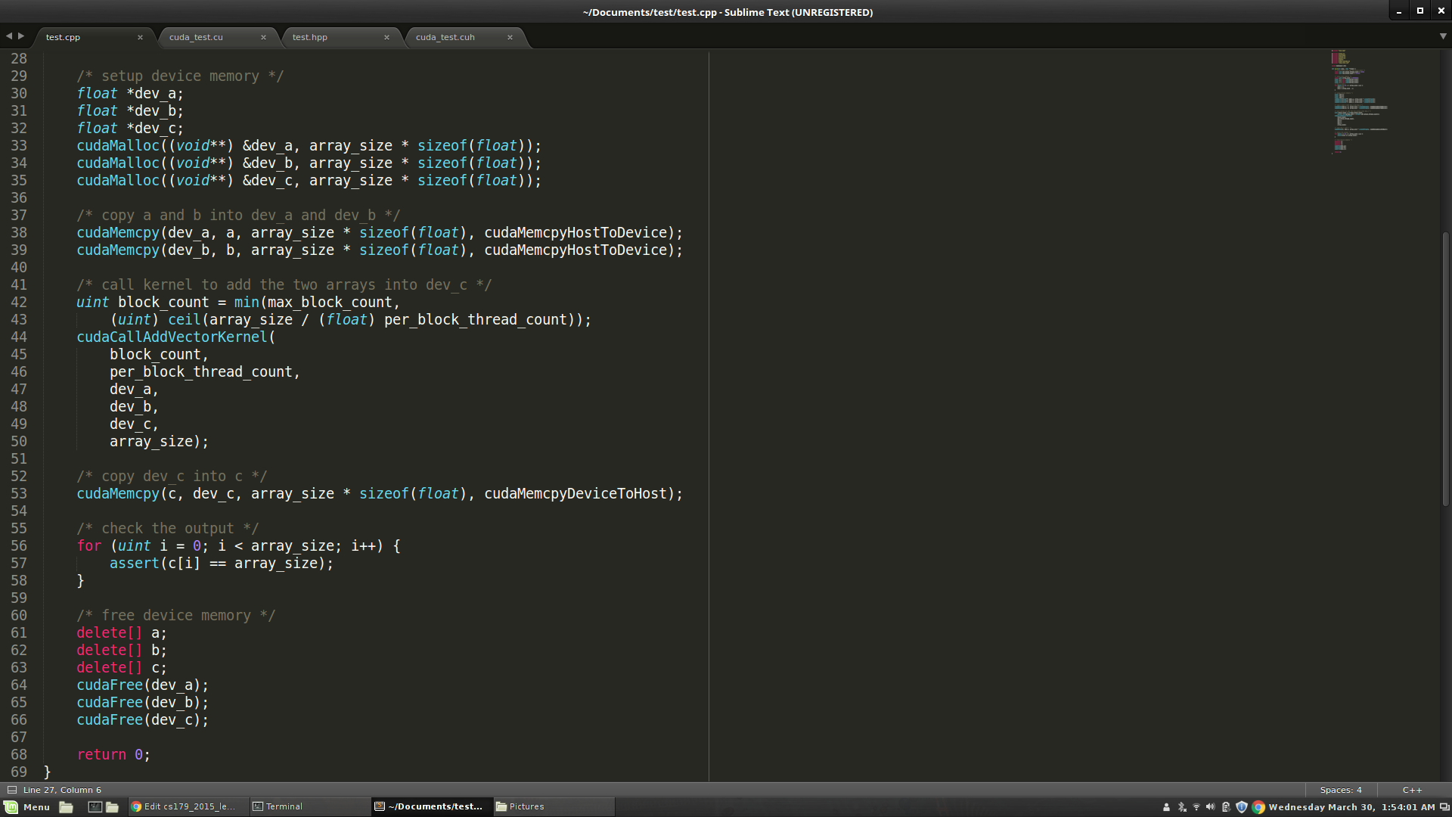
.cu/.cuh vs .cpp/.hpp

Slide 10
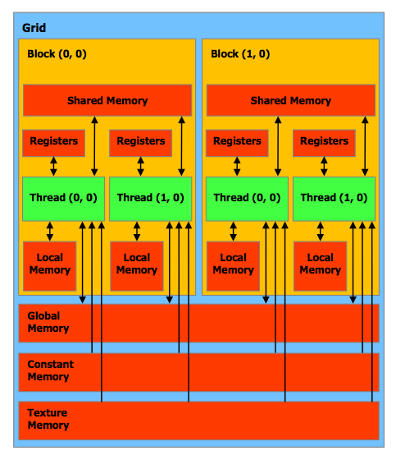
Thread Block Organization
Keywords you MUST know to code in CUDA:
Thread - Distributed by the CUDA runtime (threadIdx)
Block - A user defined group of 1 to ~512 threads (blockIdx)
Grid - A group of one or more blocks. A grid is created for each CUDA kernel function called.
Imagine thread organization as an array of thread indices
Notes:
Point out how the different architectures have different thread per block counts.

Slide 11
Block and Grid Dimensions
For many parallelizeable problems involving arrays, it’s useful to think of multidimensional arrays.
E.g. linear algebra, physical modelling, etc, where we want to assign unique thread indices over a multidimensional object
So, CUDA provides built in multidimensional thread indexing capabilities with a struct called dim3!

Slide 12
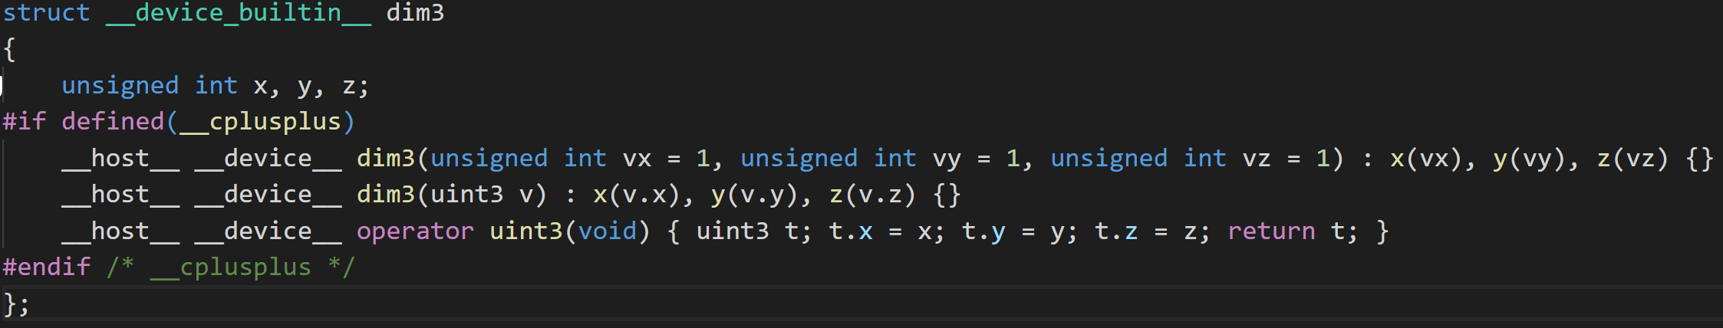
Dim3
dim3 is a struct (defined in vector_types.h) to define your Grid and Block dimensions.
Works for dimensions 1, 2, and 3:
dim3 grid(256); // defines a grid of 256 x 1 x 1 blocks
dim3 block(512, 512); // defines a block of 512 x 512 x 1 threads
foo<<<grid, block>>>(...);

Slide 13
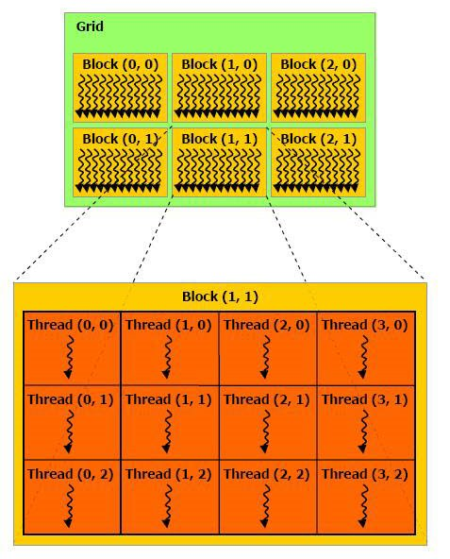
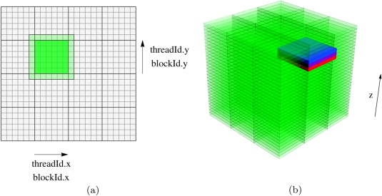
Grid/Block/Thread Visualized

Slide 14
Single Instruction, Multiple Data (SIMD)
SIMD describes a class of instructions which perform the same operation on multiple registers simultaneously.
Example: Add some scalar to 3 registers, storing the output for each addition in those registers.
Used to increase the brightness of a pixel
CPUs also have SIMD instructions and are very important for applications that need to do a lot of number crunching
Video codecs like x264/x265 make extensive use of SIMD instructions to speed up video encoding and decoding.

Slide 15
SIMD continued
Converting an algorithm to use SIMD is usually called “Vectorizing”
Not every algorithm can benefit from this or even be vectorized at all, e.x. Parsing.
Using SIMD instructions is not always beneficial though.
Even using the SIMD hardware requires additional power, and thus waste heat.
If the gains are small it probably isn’t worth the additional complexity.
Optimizing compilers like GCC and LLVM are still being trained to be able to vectorize code usefully, though there has been many exciting developments on this front in the last 2 years and is an active area of study.
https://polly.llvm.org/

Slide 16
SIMT (Single Instruction, Multiple Thread) Architecture
A looser extension of SIMD which is what CUDA’s computational model uses
Key differences:
Single instruction, multiple register sets
Wastes some registers, but mostly necessary for following two points
Single instruction, multiple addresses (i.e. parallel memory access!)
Memory access conflicts! Will discuss next week.
Single instruction, multiple flow paths (i.e. if statements are allowed!!!)
Introduces slowdowns, called ‘warp-divergence.’
Good description of differences
https://yosefk.com/blog/simd-simt-smt-parallelism-in-nvidia-gpus.html
https://docs.nvidia.com/cuda/cuda-c-programming-guide/index.html#hardware-implementation

Slide 17

Thread blocks and Warps – Questions?
Copyright Games Workshop inc.

Slide 18
Important CUDA Hardware Keywords!
Streaming Multiprocessor (SM) – Each contains (usually) 128 single precision CUDA cores (which execute a thread) and their associated cache.
This is a standard based on your machines Compute Capability.
Warp – A unit of up to 32 threads (all within the same block)
Each SM creates and manages multiple warps via the block abstraction. Assigns to each warp a Warp Scheduler to schedule the execution of instructions in each warp.
Warp Divergence – A condition where threads within a warp need to execute different instructions in order to continue executing their kernel.
In order to maintain multiple flow path per instruction, threads in different ‘execution branches’ during an instruction are given no-ops.
Causes threads to execute sequentially, in most cases ruining parallel performance.
As of the Kepler (2012) architecture each Warp can have at most 2 branches, starting with Volta (2017) this condition has been nearly eliminated. For this class assume your code must only branch at most twice as we are not yet allocating Volta GPUs to this class.
Inpendent Thread Scheduling fixes this problem by maintianing an execution state per thread. See Compute Capability 7.x

Slide 19
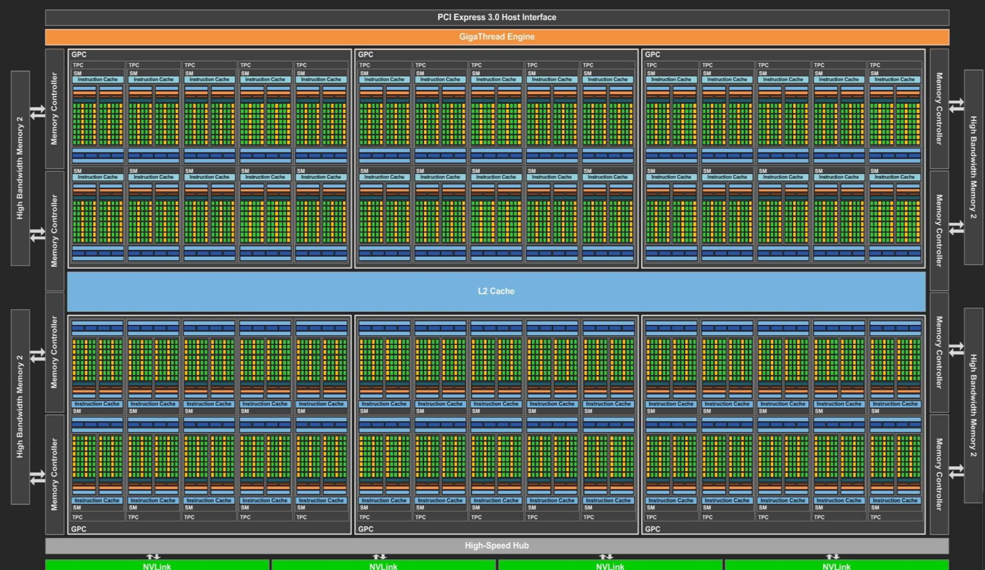
What a modern GPU looks like

Slide 20
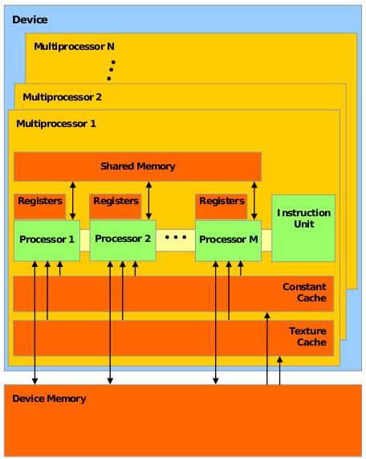
Inside a GPU
The black Xs are just crossing out things you don’t have to think about just yet. We’ll cover memory next week

Slide 21
Inside a GPU
Think of Device Memory (we will also refer to it as Global Memory) as a RAM for your GPU
Faster than getting memory from the actual RAM but still have other options
Will come back to this in future lectures
GPUs have many Streaming Multiprocessors (SMs)
Each SM has multiple processors but only one instruction unit (each thread shares program counter)
Groups of processors must run the exact same set of instructions at any given time with in a single SM

Slide 22
Inside a GPU
When a kernel (the thing you define in .cu files) is called, the task is divided up into threads
Each thread handles a small portion of the given task
The threads are divided into a Grid of Blocks
Both Grids and Blocks are 3 dimensional
e.g.
dim3 dimBlock(8, 8, 8);
dim3 dimGrid(100, 100, 1);
Kernel<<<dimGrid, dimBlock>>>(…);
However, we'll often only work with 1 dimensional grids and blocks
e.g. Kernel<<<block_count, block_size>>>(…);

Slide 23
Inside a GPU
Maximum number of threads per block count is usually 512 or 1024 depending on the machine
Maximum number of blocks per grid is usually 65535
If you go over either of these numbers your GPU will just give up or output garbage data
Much of GPU programming is dealing with this kind of hardware limitations! Get used to it
This limitation also means that your Kernel must compensate for the fact that you may not have enough threads to individually allocate to your data points
Will show how to do this later (this lecture)

Slide 24
Inside a GPU
Each block is assigned to an SM
Inside the SM, the block is divided into Warps of threads
Warps consist of 32 threads
CUDA defined constant in cuda_runtime.h
All 32 threads MUST run the exact same set of instructions at the same time
Due to the fact that there is only one instruction unit
Warps are run concurrently in an SM
If your Kernel tries to have threads do different things in a single warp (using if statements for example), the two tasks will be run sequentially
Called Warp Divergence (NOT GOOD)

Slide 25
Inside a GPU (fun hardware info)
In Fermi Architecture (i.e. GPUs with Compute Capability 2.x), each SM has 32 cores, later architectures have more.
e.g. GTX 400, 500 series
32 cores is not what makes each warp have 32 threads. Previous architecture also had 32 threads per warp but had less than 32 cores per SM
Some early Pascal (2016) GPUs (GP100) had 64 cores per SM, but later chips in that generation (GP104) had 128 core model.
Turing (2018) maintains 128 core standard

Slide 26
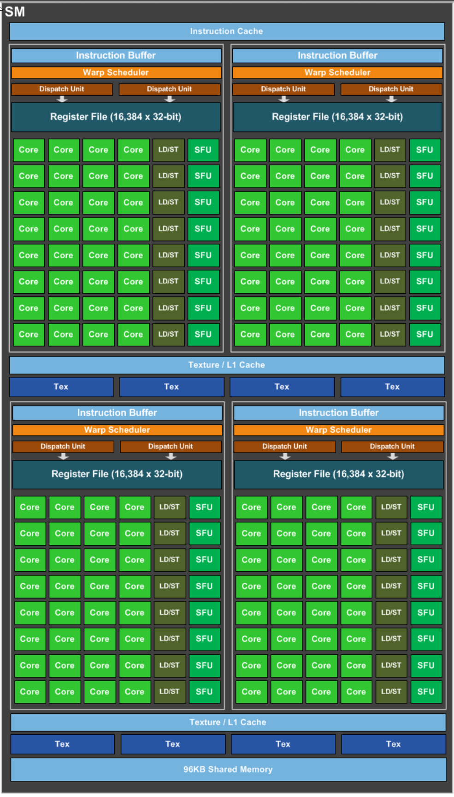
Streaming Multiprocessor
Shown here is a Pascal GP104 GPU Streaming Multiprocessor that can be found in a GTX1080 graphics card.
The exact amount of Cache and Shared Memory differ between GPU models, and even more so between different architectures.
Whitepapers with exact information can be gotten from Nvidia (use Google)
https://international.download.nvidia.com/geforce-com/international/pdfs/GeForce_GTX_1080_Whitepaper_FINAL.pdf
http://www.nvidia.com/content/PDF/product-specifications/GeForce_GTX_680_Whitepaper_FINAL.pdf
“nvidia kepler whitepaper”

Slide 27
A[] + B[] -> C[] (again)

Slide 28
A[] + B[] -> C[] (again)

Slide 29
A[] + B[] -> C[] (new!!)

Slide 30

Questions for hardware?

Slide 31
Stuff that will be useful later

Slide 32
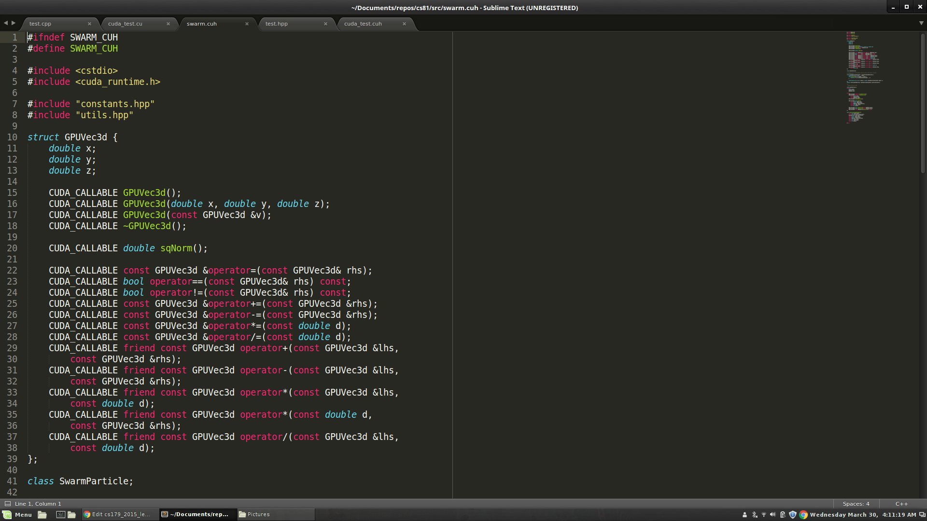
Stuff that will be useful later

Slide 33
Stuff that will be useful later

Slide 34
Next Time...
Global Memory access is not that fast
Tends to be the bottleneck in many GPU programs
Especially true if done stupidly
We'll look at what "stupidly" means
Optimize memory access by utilizing hardware specific memory access patterns
Optimize memory access by utilizing different caches that come with the GPU

