Slide 1
Gene expression data analysis for Pulmonary Arterial Hypertension
Submitted in Partial Fulfillment For
BMI 5330 Introduction to Bioinformatics
Jingqi Wang

Slide 2
Outline
Disease: Hypertension
Gene: Find some genes associated with hypertension
Dataset
Gene expression profiles, downloaded from the GEO repository
Methods
Single-gene analysis
Gene set enrichment analysis
Search on knowledge base
Results

Slide 3
Background
(Li & Liu, 2014) runs meta-analysis on ‘CYP11B2’ gene with hypertension on Chinese patient groups.
(Gu et al., 2006) explores 11 candidate genes associated with hypertension.
(Huan et al., 2015) also performs meta-analysis on six studies that are based on gene expression profiles and 34 genes are identified to have relations with blood pressure or hypertension.
(Geraci et al., 2001) runs the clustering analysis on the gene expression data with two patient groups and found clusters of genes that work together related with hypertension.

Slide 4
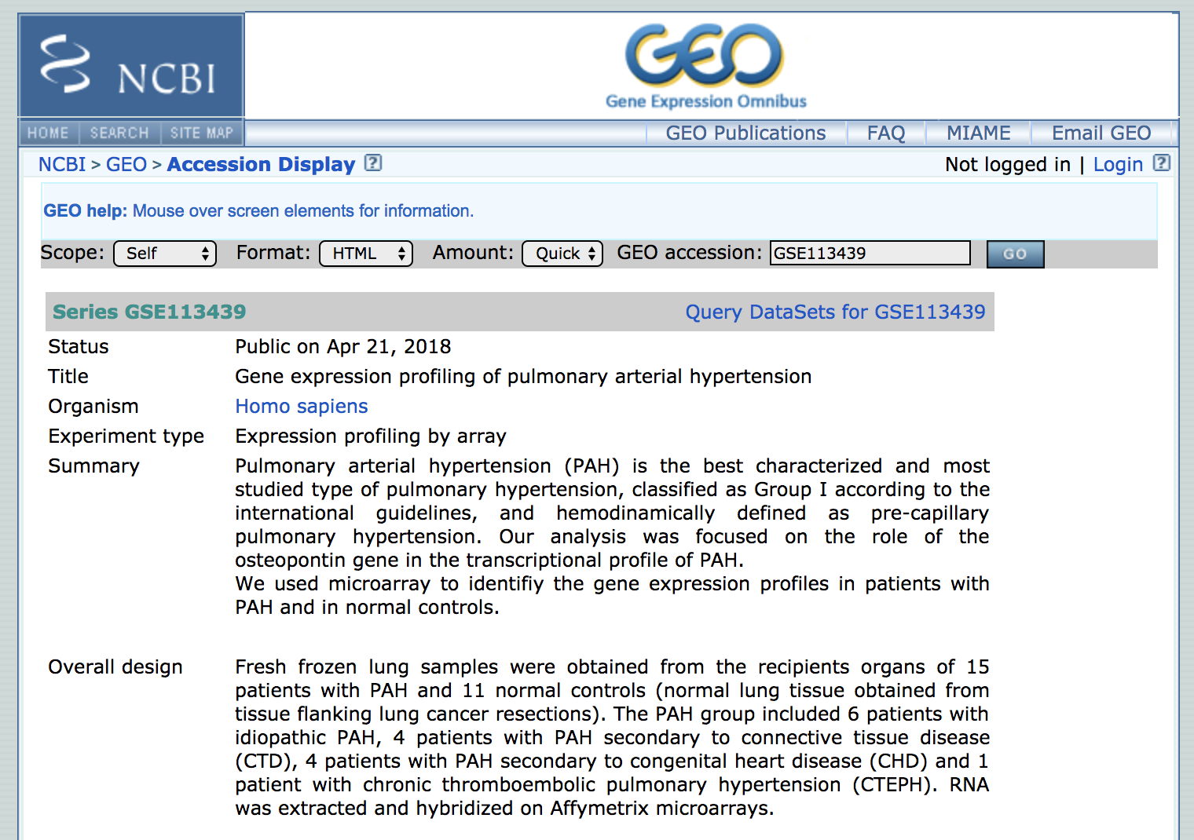
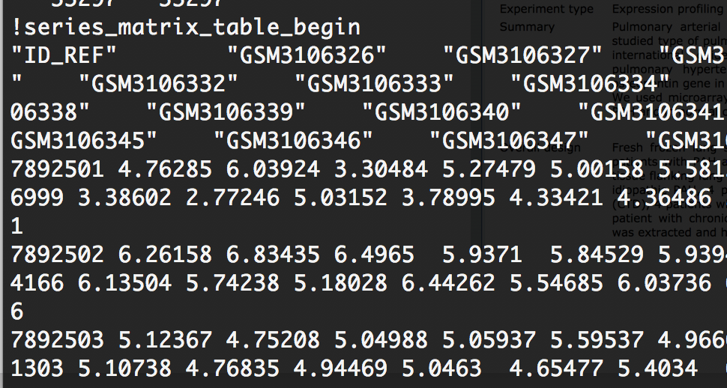
Dataset
Search Hypertension dataset
Gene expression profiles
15 patients with Hypertension
11 normal controls
Downloaded the txt file
Unfortunately, no gene symbols

Slide 5
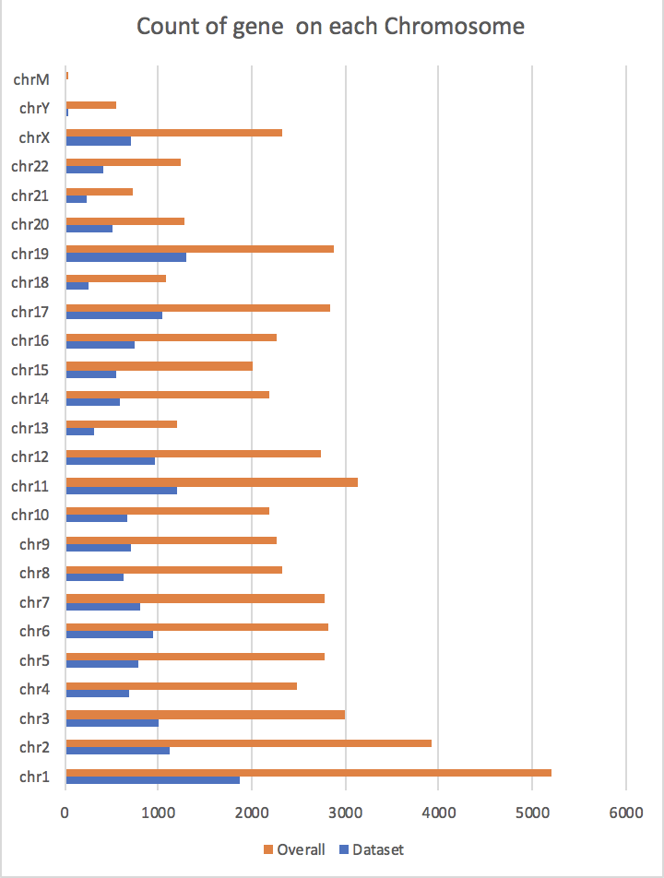
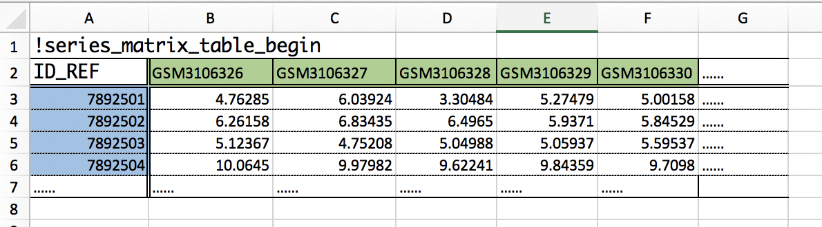
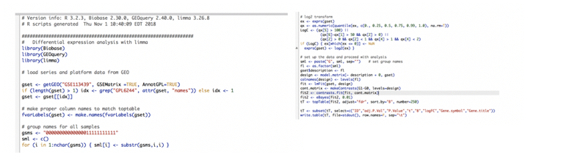
Data processing
Understand the data
Map gene id to gene symbol (GEO2R)
Sample ids
Gene ids
Expression values
Total Gene Symbols: 22,109
Fig. How many genes are covered by this dataset
Notes:
Mitochondrial DNA

Slide 6
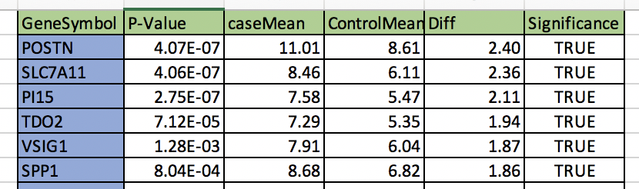
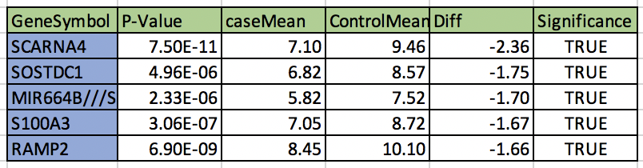
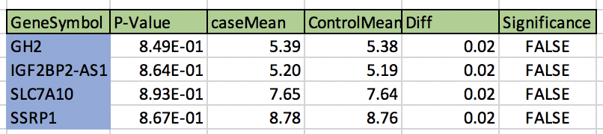
Single-gene analysis
Question: Which genes have significant different expressions between hypertension patients and normal patients?
Calculate the ‘mean of case/control patients’ and the p-value
59.4% of the genes is significantly different (p-value < 0.05)
Define three gene groups
Over-expressed (group1)
Case mean is far more than control mean;
Under-expressed (group2)
Case mean is far less than control mean;
No-difference (group3)
No statistically differences;

Slide 7
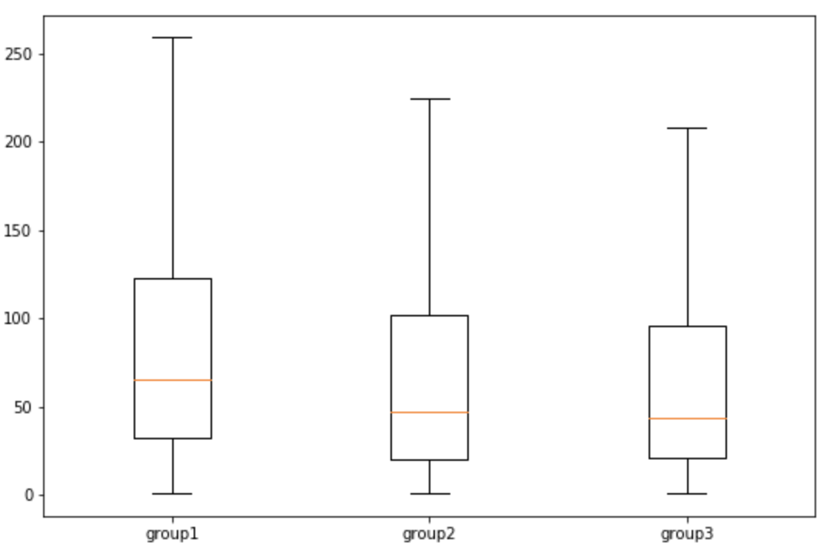
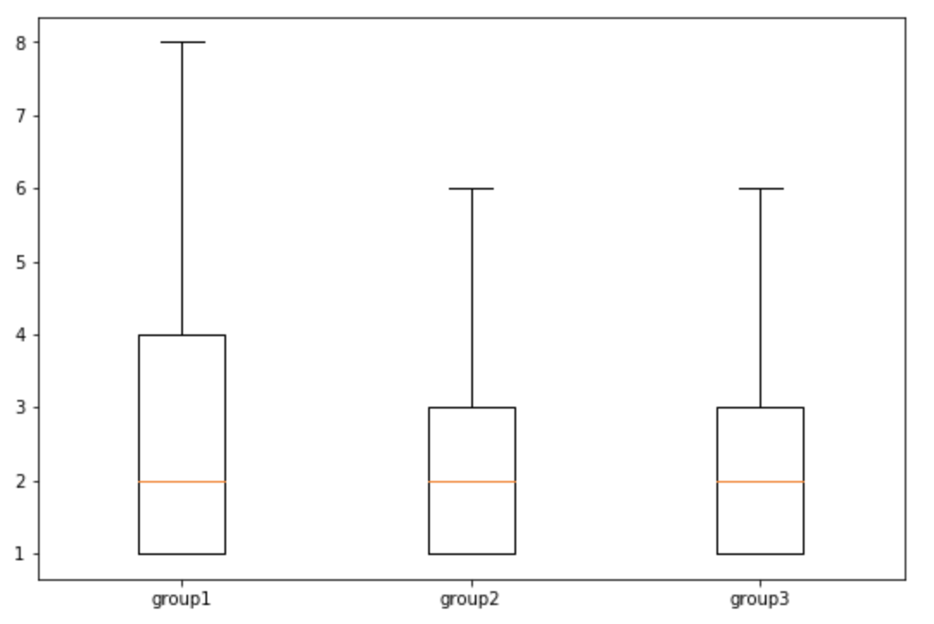
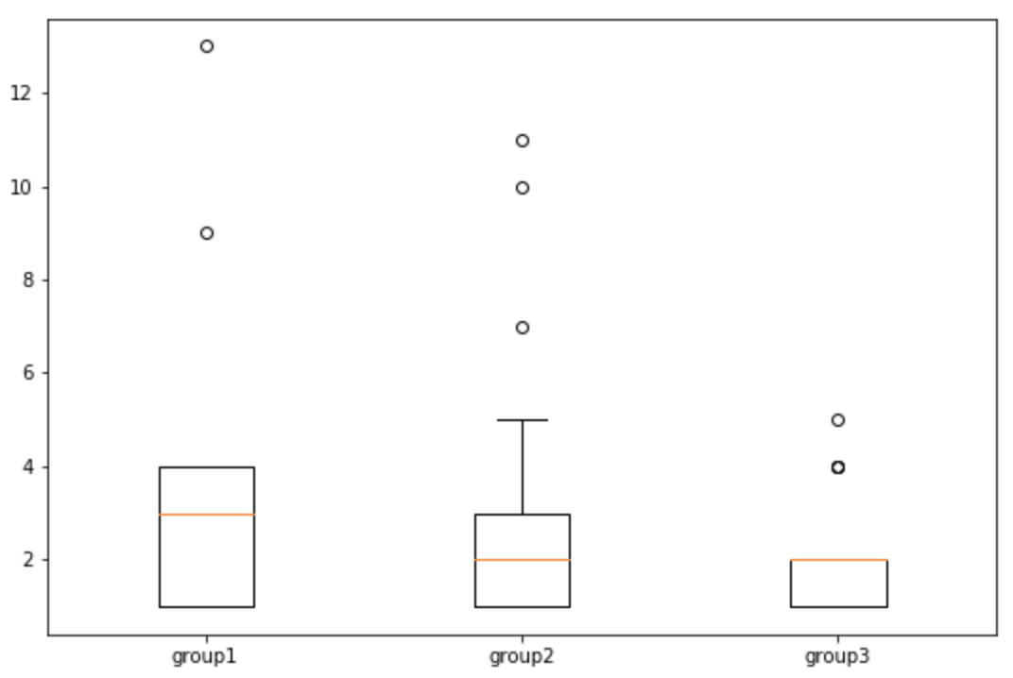
Single-gene analysis
Question: What’s the difference between the three gene groups?
Method
- Match CDS entry by gene symbol using the gene annotations
- Intersect the mutations with the coding sequences using ‘bedtools’
Conclusion: Over-expressed (group1) has more SNPs/INDELs than the other two groups (p= 4.12721e-08)
Fig 1. Count of SNP
Fig 2. Count of INDEL
Fig 3. Count of SV

Slide 8
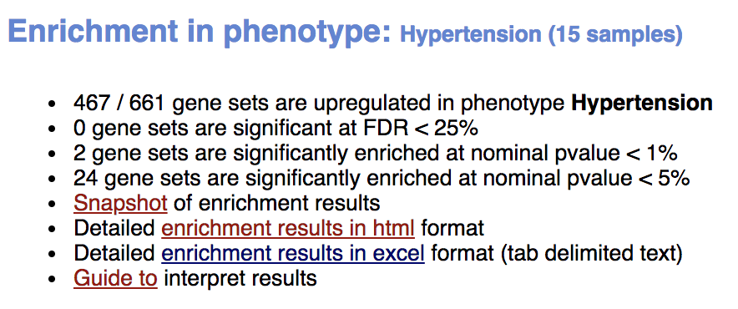
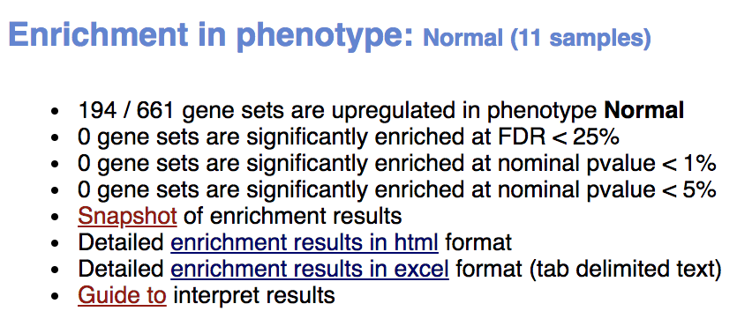
Analysis on gene groups
Gene set enrichment analysis (GSEA)
Paper: Gene set enrichment analysis: A knowledge-based approach for interpreting genome-wide expression profiles
Download GSEA tools (java)
Generate the right file format ( .cls, … )
Run the enrichment with default settings

Slide 9
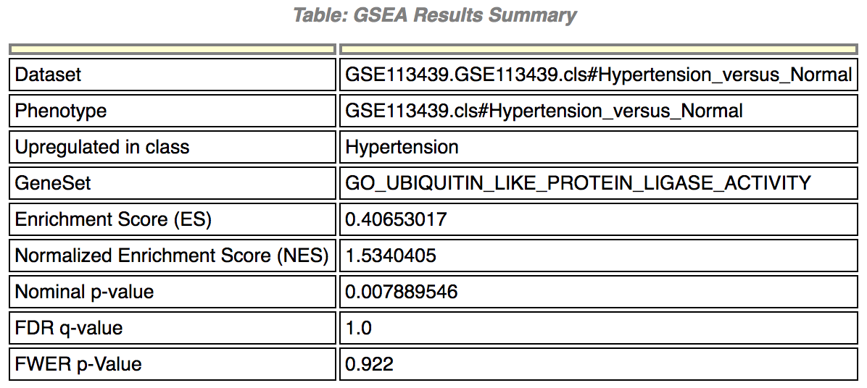
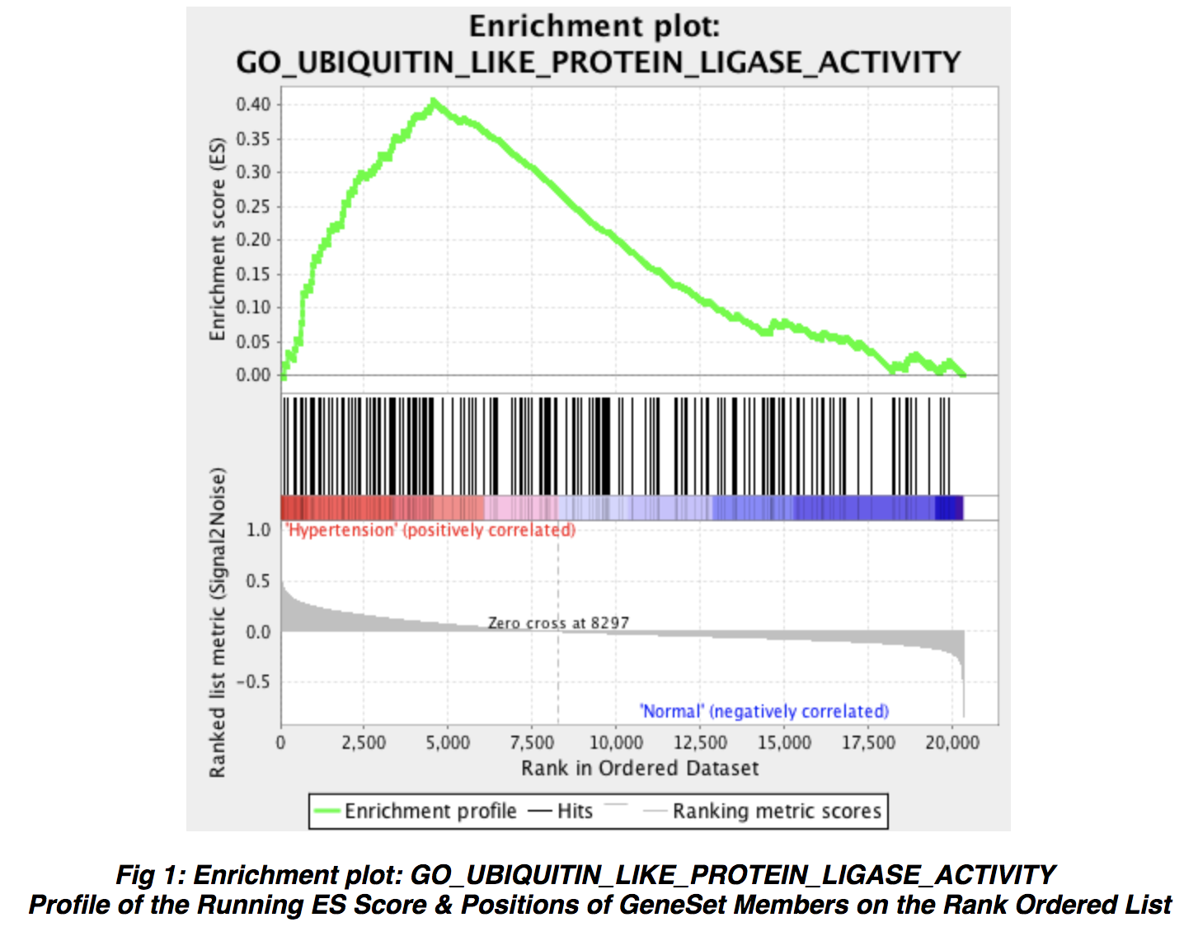
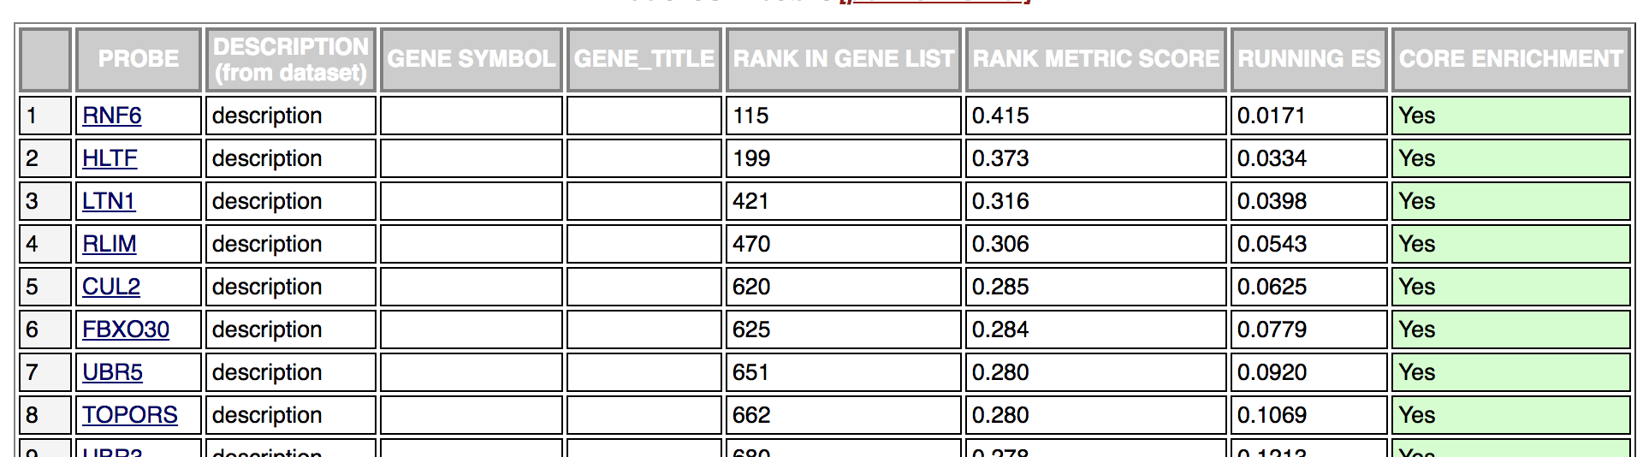
Interpretation of the result

Slide 10
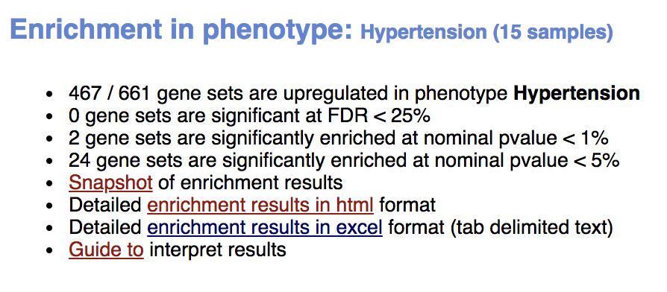
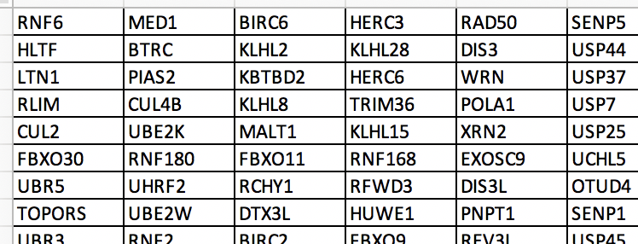
GSEA Results
24 gene sets are identified to have relations with Hypertension, potentially.
520 Genes, 380 unique

Slide 11
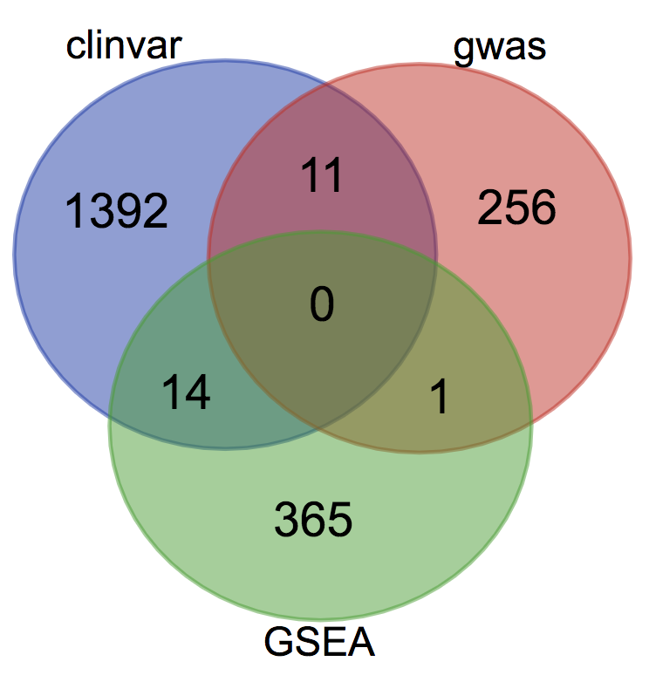
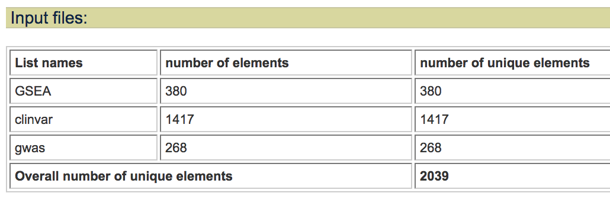
Valid the findings
Search on ClinVar
1417 unique genes
Search on GWAS catalog
268 unique genes
GSEA results
380 unique genes

Slide 12
Take home message
GEO is a very good place to find dataset and tools
https://www.ncbi.nlm.nih.gov/geo/
Gene Set Enrichment Analysis tool
http://software.broadinstitute.org/gsea/index.jsp
Results are in HTML, can be shared on Github as public available webpage;
Findings
Overexpressed genes have more SNPs/Indels
380 Genes recognized by GSEA, 15 of them overlapped with ClinVar/GWAS catalog searching result

Slide 13
Resources
Webpages of GSEA results:
https://jingqihit.github.io/BMI5330-Hypertension/GSEA/
Source code and data:
https://github.com/jingqihit/BMI5330-Hypertension
Tools:
python Jupyter Notebook: http://jupyter.org/
GSEA tool: http://software.broadinstitute.org/gsea/index.jsp

Slide 14
Thanks!
Questions?
Jingqi.Wang@uth.tmc.edu

