Slide 1
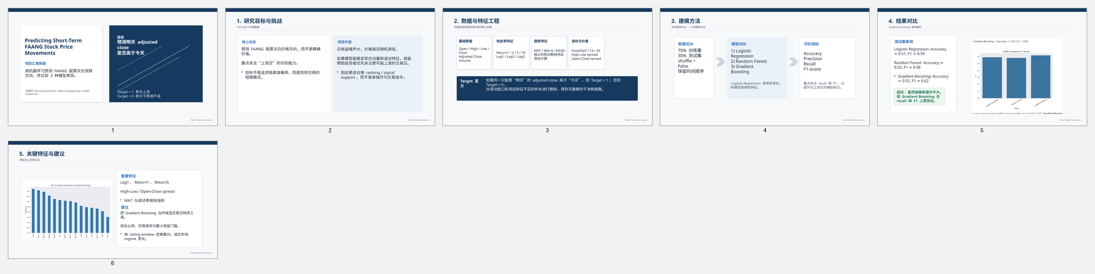
Predicting Short-Term
FAANG Stock Price Movements
Simple summary deck based on the final project report
Goal: predict whether tomorrow's adjusted close will be higher than today's for FAANG stocks.
Models compared
- Logistic Regression
- Random Forest
- Gradient Boosting
Notes:
[Sources] - User-provided report: /mnt/data/Final Project Report.pdf - User-provided chart assets: /mnt/data/user-FAhH7XtF5WXDtlX3sTBpKssX/a925049b0f724cd5b2891c2f1cc9d8a4/mnt/data/f1_chart.png, /mnt/data/user-FAhH7XtF5WXDtlX3sTBpKssX/a925049b0f724cd5b2891c2f1cc9d8a4/mnt/data/feature_importance.png, /mnt/data/user-FAhH7XtF5WXDtlX3sTBpKssX/a925049b0f724cd5b2891c2f1cc9d8a4/mnt/data/FAANG_montage.png [/Sources]

Slide 2
Project Objective
What problem this project tries to solve
Build a binary classification model to predict next-day stock direction for FAANG stocks.
Use daily market data and technical features such as returns, moving averages, volatility, spreads, and lagged returns.
Focus on practical model quality - especially recall and F1-score for "up" days - rather than expecting very high accuracy.
Target Definition
Target = 1
if tomorrow's adjusted close > today's adjusted close
Target = 0 otherwise
Notes:
[Sources] - User-provided report: /mnt/data/Final Project Report.pdf - User-provided chart assets: /mnt/data/user-FAhH7XtF5WXDtlX3sTBpKssX/a925049b0f724cd5b2891c2f1cc9d8a4/mnt/data/f1_chart.png, /mnt/data/user-FAhH7XtF5WXDtlX3sTBpKssX/a925049b0f724cd5b2891c2f1cc9d8a4/mnt/data/feature_importance.png, /mnt/data/user-FAhH7XtF5WXDtlX3sTBpKssX/a925049b0f724cd5b2891c2f1cc9d8a4/mnt/data/FAANG_montage.png [/Sources]

Slide 3
Data and Feature Engineering
Daily price data was transformed into short-horizon predictive features
Base data: Open, High, Low, Close, Adjusted Close, and Volume for FAANG stocks.
Returns: 1-day, 3-day, 5-day, and 10-day percentage returns.
Trend features: 7-day, 14-day, and 30-day moving averages.
Risk features: rolling volatility over 7, 14, and 30 days.
Short-term behavior: intraday spreads and lagged daily returns.
After sorting by Company and Date, rows without enough history were dropped.
Examples of Engineered Features
Return1, Return3, Return5, Return10
MA7, MA14, MA30
Volatility7, Volatility14, Volatility30
High_Low_Spread
Open_Close_Spread
Lag1, Lag2, Lag3
Notes:
[Sources] - User-provided report: /mnt/data/Final Project Report.pdf - User-provided chart assets: /mnt/data/user-FAhH7XtF5WXDtlX3sTBpKssX/a925049b0f724cd5b2891c2f1cc9d8a4/mnt/data/f1_chart.png, /mnt/data/user-FAhH7XtF5WXDtlX3sTBpKssX/a925049b0f724cd5b2891c2f1cc9d8a4/mnt/data/feature_importance.png, /mnt/data/user-FAhH7XtF5WXDtlX3sTBpKssX/a925049b0f724cd5b2891c2f1cc9d8a4/mnt/data/FAANG_montage.png [/Sources]

Slide 4
Modeling Approach
Time order was preserved to respect the nature of stock data
Train/test split: 70% training and 30% test with shuffle = False.
Logistic Regression used as a simple and interpretable baseline.
Random Forest used to capture non-linear patterns and interactions.
Gradient Boosting used as the strongest tabular model candidate.
StandardScaler applied to price-level and spread features for Logistic Regression only.
Evaluation metrics: accuracy, precision, recall, and F1-score.
Why this setup?
Keeping time order helps avoid leakage.
Comparing linear and tree-based models makes it easier to explain trade-offs between simplicity and performance.
Notes:
[Sources] - User-provided report: /mnt/data/Final Project Report.pdf - User-provided chart assets: /mnt/data/user-FAhH7XtF5WXDtlX3sTBpKssX/a925049b0f724cd5b2891c2f1cc9d8a4/mnt/data/f1_chart.png, /mnt/data/user-FAhH7XtF5WXDtlX3sTBpKssX/a925049b0f724cd5b2891c2f1cc9d8a4/mnt/data/feature_importance.png, /mnt/data/user-FAhH7XtF5WXDtlX3sTBpKssX/a925049b0f724cd5b2891c2f1cc9d8a4/mnt/data/FAANG_montage.png [/Sources]

Slide 5
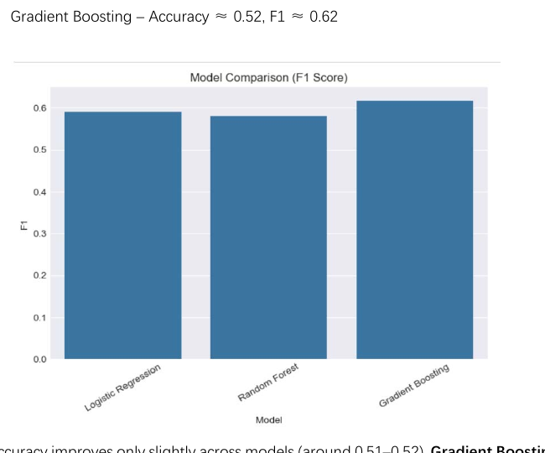
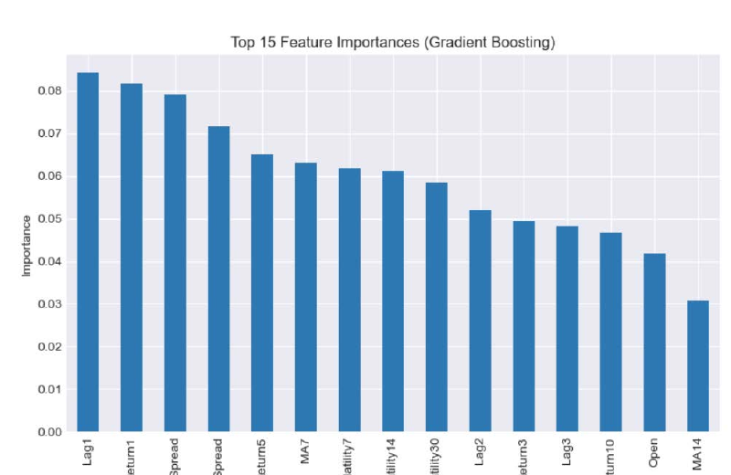
Results
Gradient Boosting delivered the best F1-score among the tested models
Test-set summary
Key takeaway
Logistic Regression: Accuracy ~0.51, F1 ~0.59
Random Forest: Accuracy ~0.52, F1 ~0.58
Gradient Boosting: Accuracy ~0.52, F1 ~0.62
The most influential features were short-term signals such as Lag1, Return1, Return5, spreads, and MA7. This suggests momentum and volatility matter more than raw price level for daily direction.
Notes:
[Sources] - User-provided report: /mnt/data/Final Project Report.pdf - User-provided chart assets: /mnt/data/user-FAhH7XtF5WXDtlX3sTBpKssX/a925049b0f724cd5b2891c2f1cc9d8a4/mnt/data/f1_chart.png, /mnt/data/user-FAhH7XtF5WXDtlX3sTBpKssX/a925049b0f724cd5b2891c2f1cc9d8a4/mnt/data/feature_importance.png, /mnt/data/user-FAhH7XtF5WXDtlX3sTBpKssX/a925049b0f724cd5b2891c2f1cc9d8a4/mnt/data/FAANG_montage.png [/Sources]

Slide 6
Recommendations and Next Steps
How this model can be used more realistically
Use Gradient Boosting as a ranking tool rather than a guaranteed trading signal.
Combine model output with risk controls, stop-loss logic, and transaction-cost thresholds.
Retrain regularly using a rolling window so the model can adapt to changing market regimes.
Future work: probability calibration, backtesting with trading rules, and more robust time-series validation.
Bottom line
The project shows that even with noisy stock data, a carefully designed feature set plus Gradient Boosting can provide a modest but useful edge for identifying likely "up" days.
Notes:
[Sources] - User-provided report: /mnt/data/Final Project Report.pdf - User-provided chart assets: /mnt/data/user-FAhH7XtF5WXDtlX3sTBpKssX/a925049b0f724cd5b2891c2f1cc9d8a4/mnt/data/f1_chart.png, /mnt/data/user-FAhH7XtF5WXDtlX3sTBpKssX/a925049b0f724cd5b2891c2f1cc9d8a4/mnt/data/feature_importance.png, /mnt/data/user-FAhH7XtF5WXDtlX3sTBpKssX/a925049b0f724cd5b2891c2f1cc9d8a4/mnt/data/FAANG_montage.png [/Sources]

