Slide 1
The Mandelbrot set project
Goal: build an application starting from a few building blocks and ending with an user interface
Topic: fractals, in particular the Mandelbrot set

Slide 2

The Mandelbrot set
The Mandelbrot set represents the dynamics of a simple equation at each coordinate c = x+iy
Depending on c, the equation diverges to infinity or not. How fast it diverges (the “escape time”) is represented by a color.

Slide 3
The Mandelbrot set
The set is mathematically interesting because it has fractal properties, and is related to chaos theory
It became really popular in the late 80s mostly because it can produce beautiful, psychedelic images
https://www.youtube.com/watch?v=Pzg4XvaBnT4

Slide 4
The project will take us from this
...............::::::::::::::::::::::::::::::::::::::::::::::::
............:::::::::::::::::::::::::::::::::::::::::::::::::::
.........:::::::::ooooooooooooooooooooooooooo::::::::::::::::::
......::::::ooooooooooooooooooOOOOOO###HHHOOOoooooo::::::::::::
......:::oooooooooooooooOOOOOOOOO000######000OOOoooooo:::::::::
...:::oooooooooooooooOOOOOO000HHHXXX XXX000OOOoooooo::::::
...:::ooooooooooooOOO000000XXX ######oooooo::::::
...oooooooooOOOHHH000HHHXXX XXXOOOoooooo:::
...oooOOOOOO000############ ###OOOoooooo:::
...OOOOOO000###### ###OOOoooooo:::
... XXXOOOoooooo:::
...OOOOOO000###### ###OOOoooooo:::
...oooOOOOOO000############ ###OOOoooooo:::
...oooooooooOOOHHH000HHHXXX XXXOOOoooooo:::
...:::ooooooooooooOOO000000XXX ######oooooo::::::
...:::oooooooooooooooOOOOOO000HHHXXX XXX000OOOoooooo::::::
......:::oooooooooooooooOOOOOOOOO000######000OOOoooooo:::::::::
......::::::ooooooooooooooooooOOOOOO###HHHOOOoooooo::::::::::::
.........:::::::::ooooooooooooooooooooooooooo::::::::::::::::::
............:::::::::::::::::::::::::::::::::::::::::::::::::::
...............::::::::::::::::::::::::::::::::::::::::::::::::

Slide 5
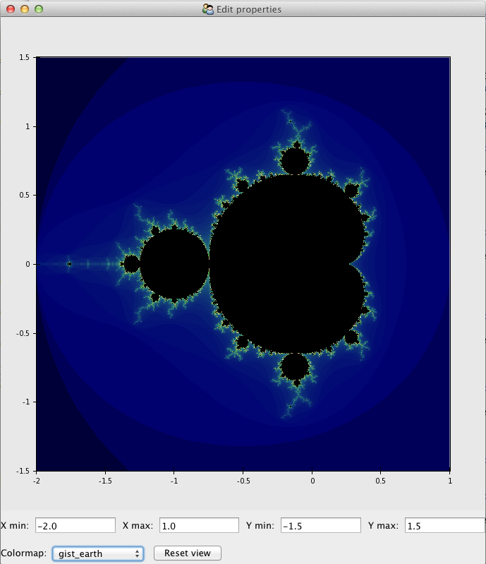
to this

