Slide 1
Predicting Car Accident Severity

Slide 2
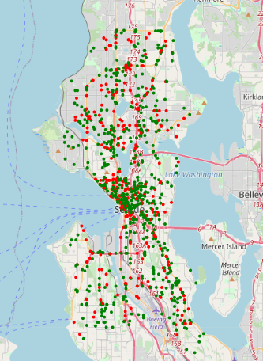
Introduction
Traffic accident is very impact factor to make huge life or property damaged. Nobody want these things happen to himself or any other people. It’s really terrible and horrible thing. So, if that bad thing happens, what should we do first? Especially for government such as traffic management department, hospitals, etc.

Slide 3
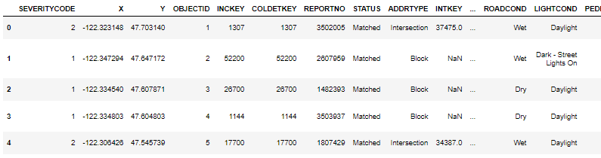
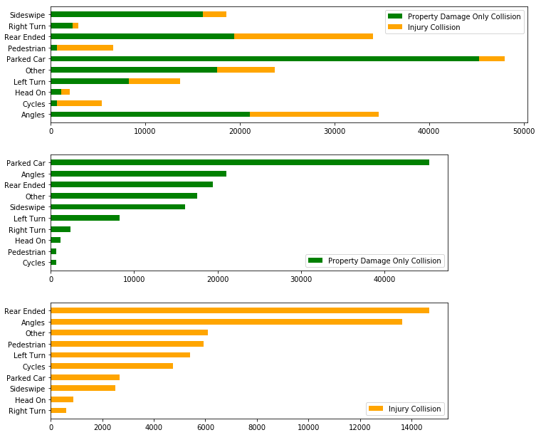
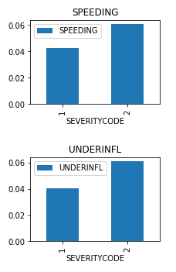
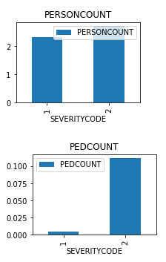
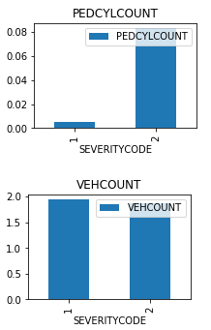
Data analyses

Slide 4
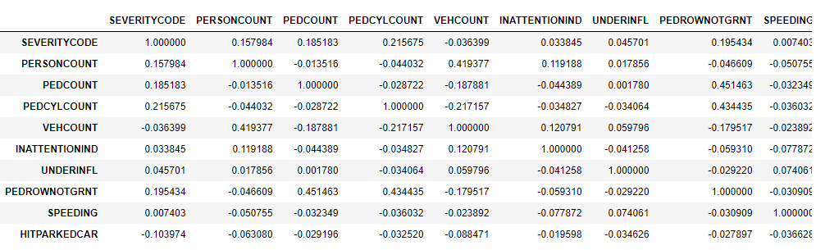

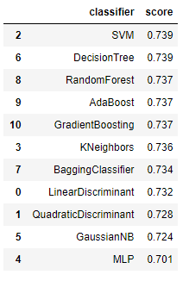
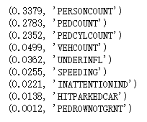
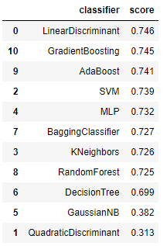
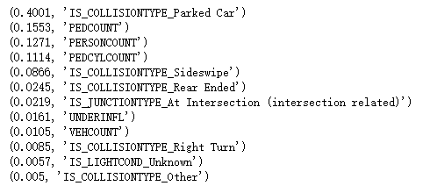
Methodology and Result
Best one. Act quickly sir!

Slide 5
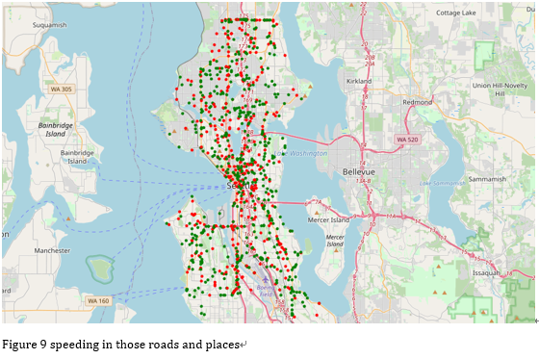
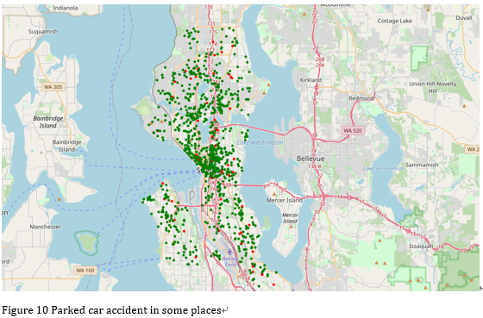
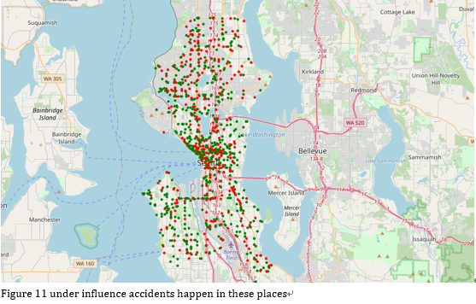
Discussion and Conclusion
Good luck guys! Bless you all are in safe!

Slide 6
Thank you very much!

