Slide 1

Notes:
[Sources]
- Local source: /Users/a747/Documents/ppt/outputs/ability-demo-v5.html
- Conversion: full-slide render preserving the authored HTML layout

Slide 2
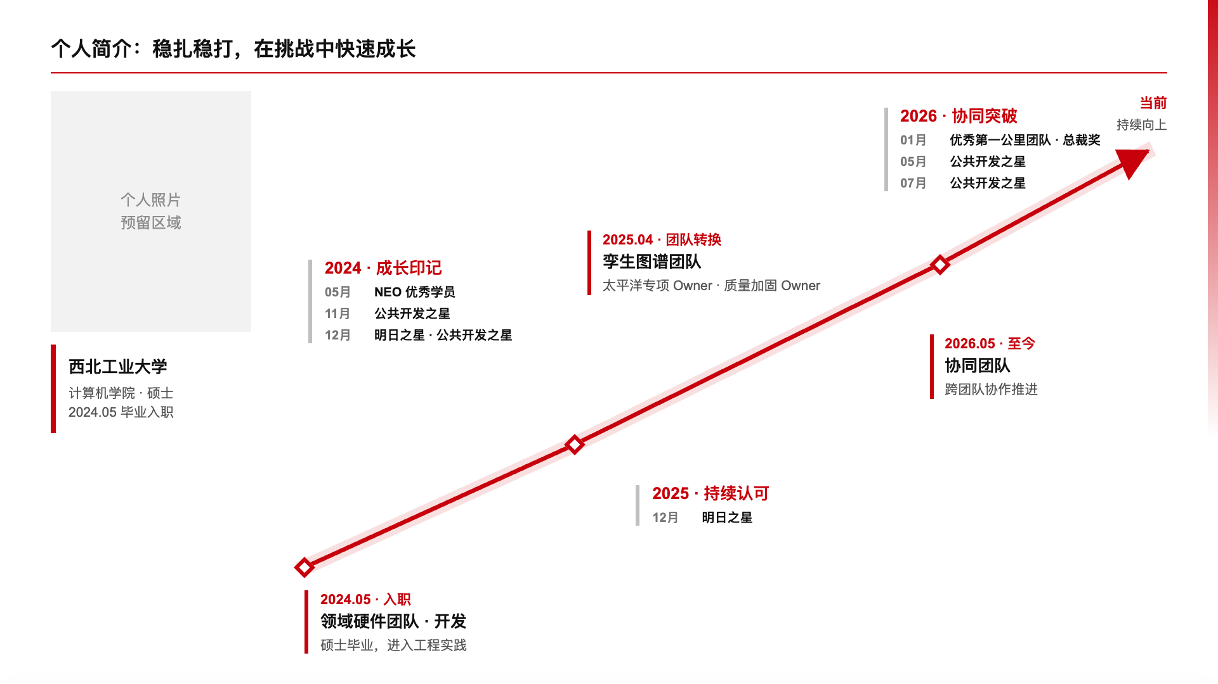
Notes:
[Sources]
- Local source: /Users/a747/Documents/ppt/outputs/ability-demo-v5.html
- Conversion: full-slide render preserving the authored HTML layout

Slide 3
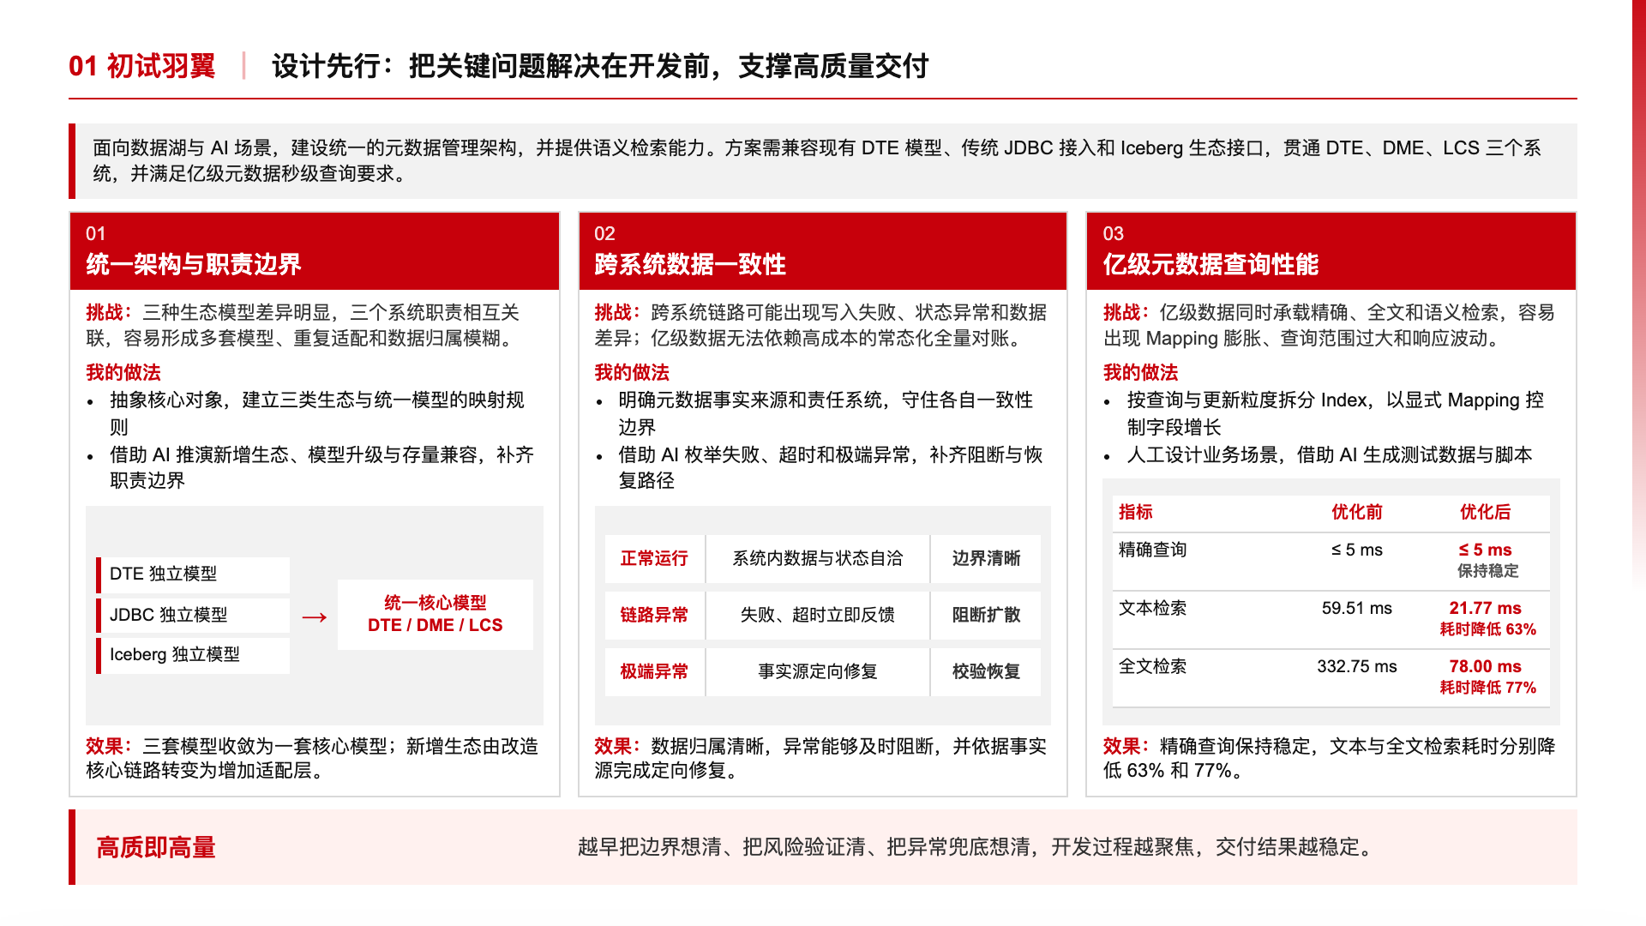
Notes:
[Sources]
- Local source: /Users/a747/Documents/ppt/outputs/ability-demo-v5.html
- Conversion: full-slide render preserving the authored HTML layout

Slide 4
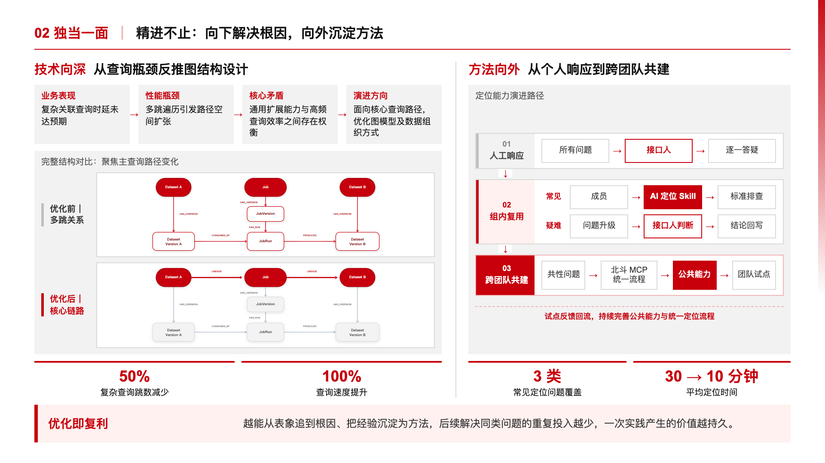
Notes:
[Sources]
- Local source: /Users/a747/Documents/ppt/outputs/ability-demo-v5.html
- Conversion: full-slide render preserving the authored HTML layout

Slide 5
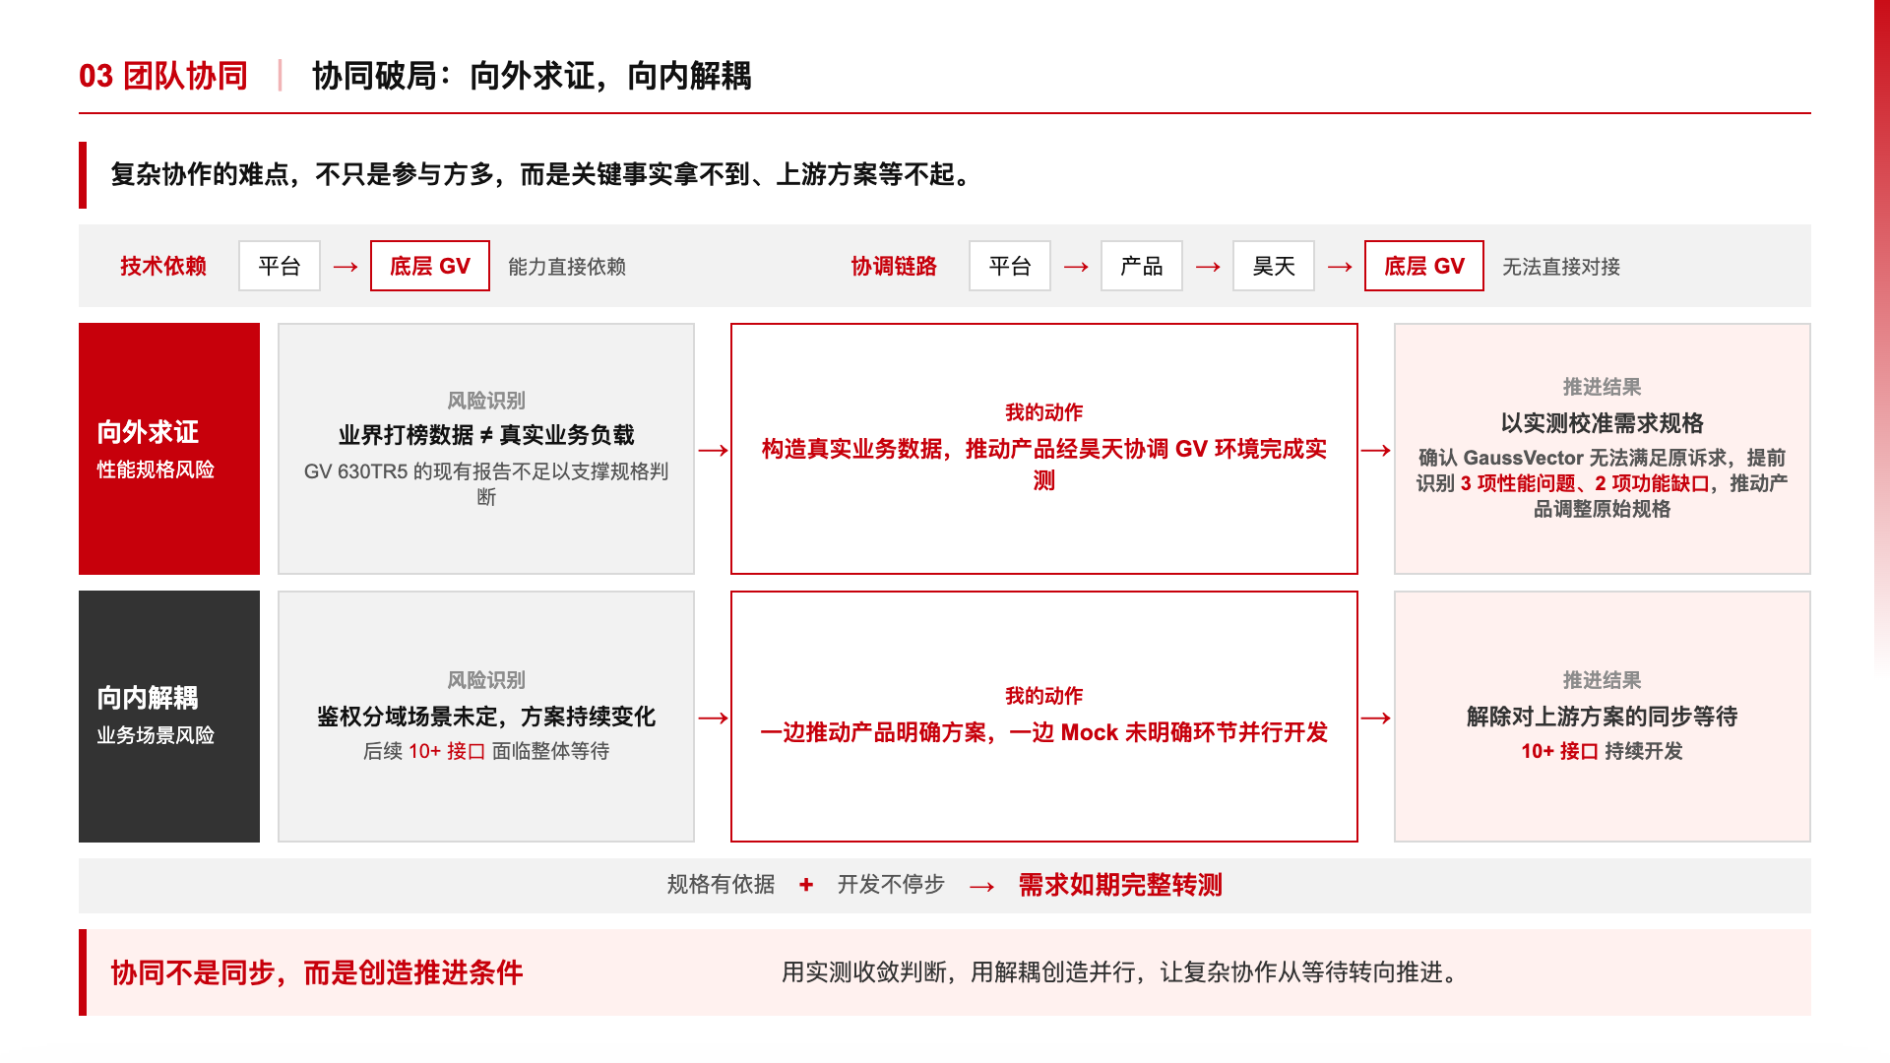
Notes:
[Sources]
- Local source: /Users/a747/Documents/ppt/outputs/ability-demo-v5.html
- Conversion: full-slide render preserving the authored HTML layout

Slide 6
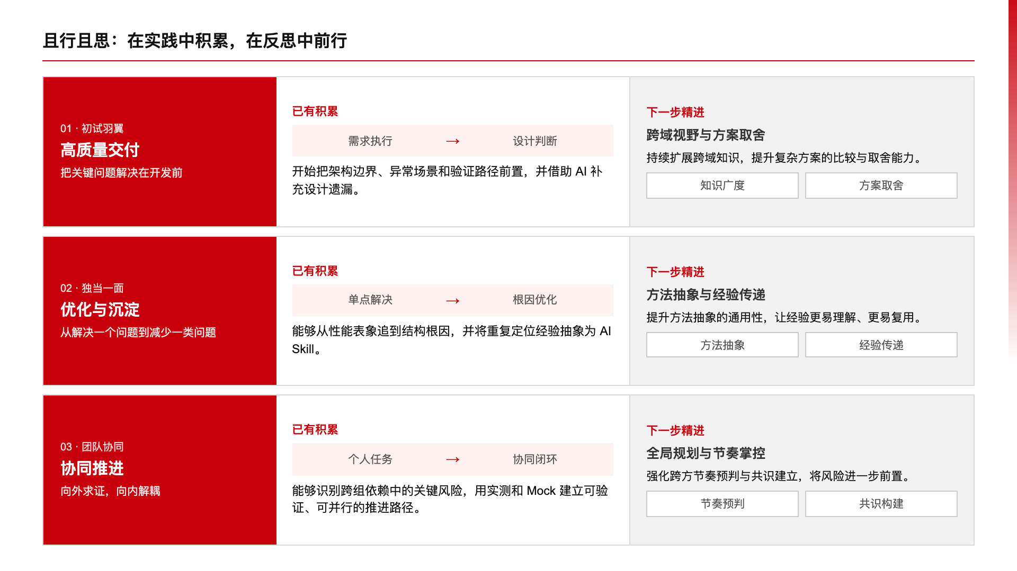
Notes:
[Sources]
- Local source: /Users/a747/Documents/ppt/outputs/ability-demo-v5.html
- Conversion: full-slide render preserving the authored HTML layout

