Slide 1
Protocol-Aware Recovery for Consensus-Based Storage
Ramnatthan Alagappan and Aishwarya Ganesan; Eric Lee, University of Texas at Austin; Aws Albarghouthi, University of Wisconsin—Madison; Vijay Chidambaram, University of Texas at Austin; Andrea C. Arpaci-Dusseau and Remzi H. Arpaci-Dusseau
ATC 2019

Slide 2
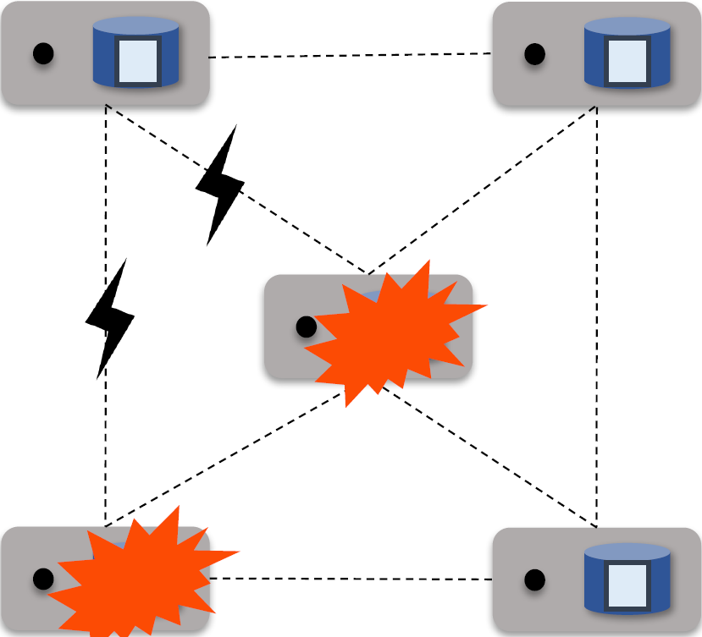
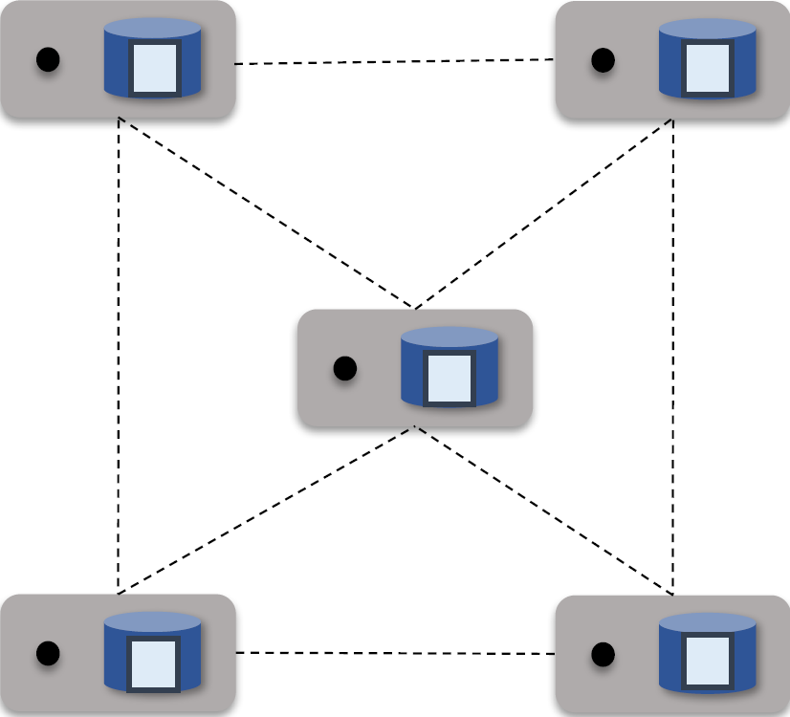
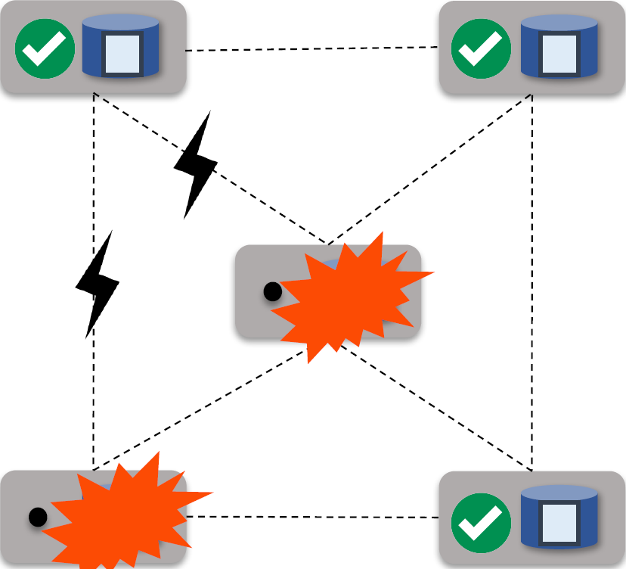
Introduction
Distributed System
Reliability
Consistency
Specifically:
Using RSM
Using redundancy storage
Key idea:
Maintain the consistence of the
majority nodes

Slide 3
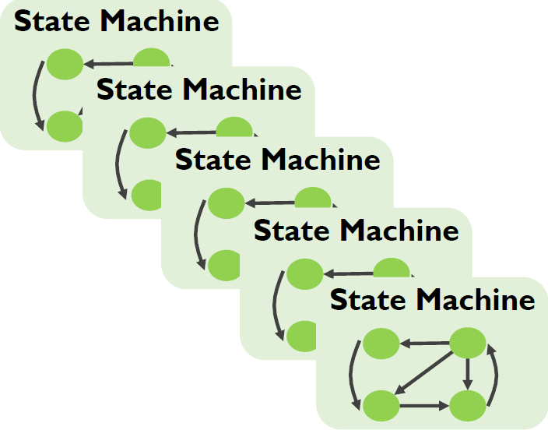
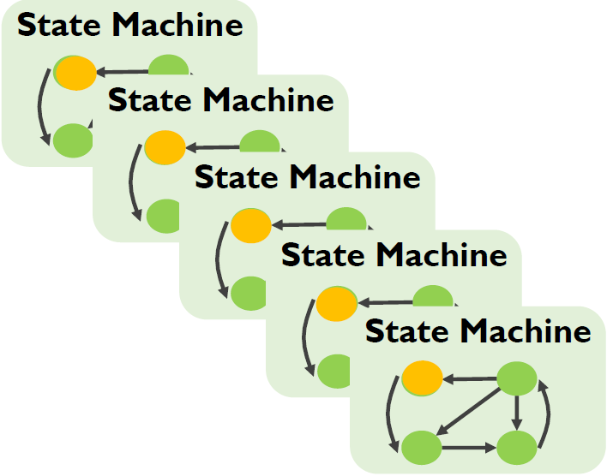
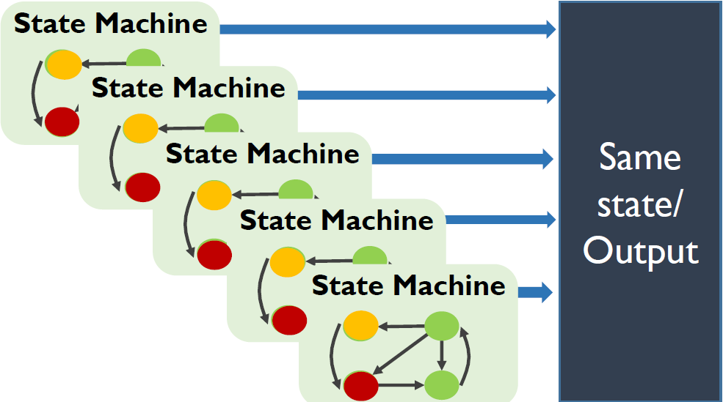
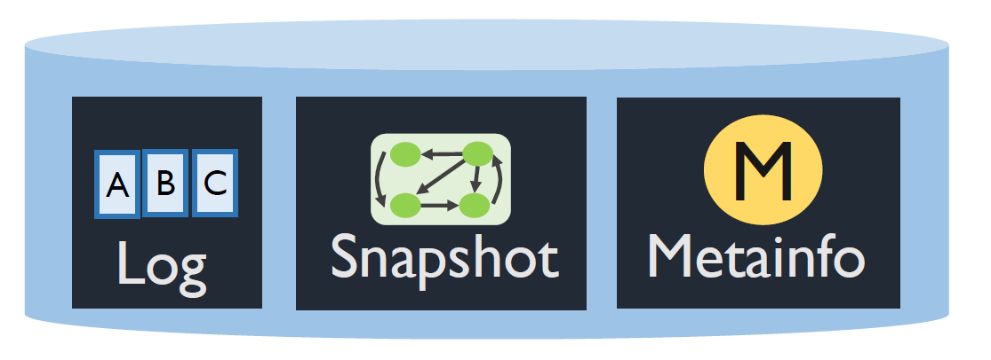
Background: RSM
Replication State Machine
Same initial states
Same sequence of inputs
Three key components
Log
Snapshot
Meta information
Notes:
Because the log can grow indefinitely and exhaust disk
space, periodically, a snapshot of the in-memory state
machine is written to disk and the log is garbage collected.
When a node restarts after a crash, it restores
the system state by reading the latest on-disk snapshot
and the log.

Slide 4
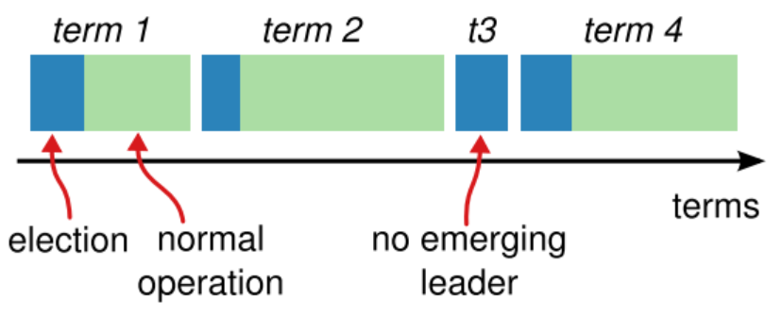
Background: Election
Running time
Election
Normal Operation
Election procedure
Followers turns into Candidate
Candidate send vote request to other nodes
Get sufficient vote, become Leader
Notes:
是一个没有中央权威的分布式对等系统。虽然权力下放可以防止各方的腐败行为，但是它必需要有一个可靠的共识协议来作出决策，让分散在世界各地的节点可以形成一致的意见。常见的共识算法有比特币采用的POW，fabric使用的PBFT，以及分布式系统一般采用的RAFT等。

Slide 5

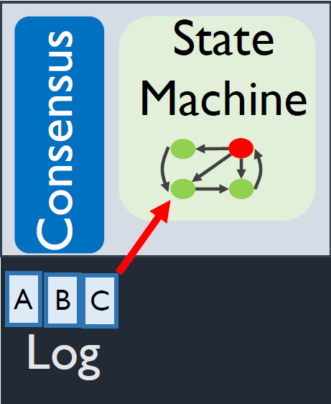
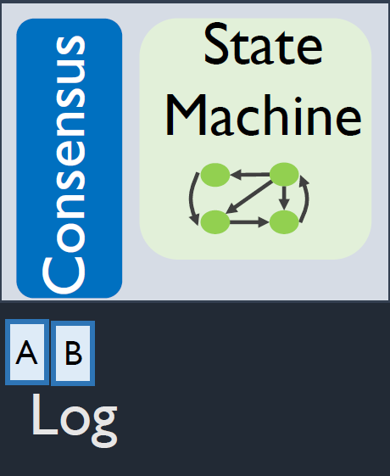

Background: Synchronization
Client to leader
Leader update log
Leader interact with follower
Most follower ACK
Leader process and get results
Results return to client
Leader
Return results
Follower
Follower
COMMITTED!

Slide 6
Outline
Motivation and current problems
Design of the system
Evaluation
Conclusion

Slide 7


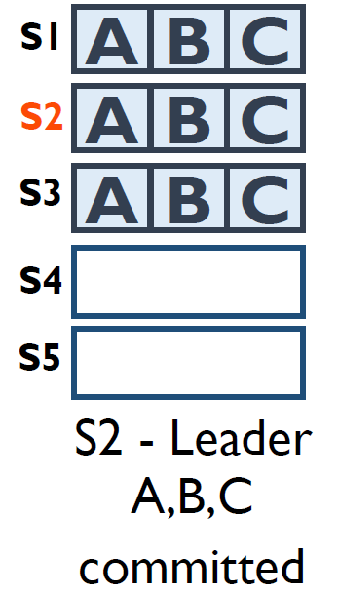
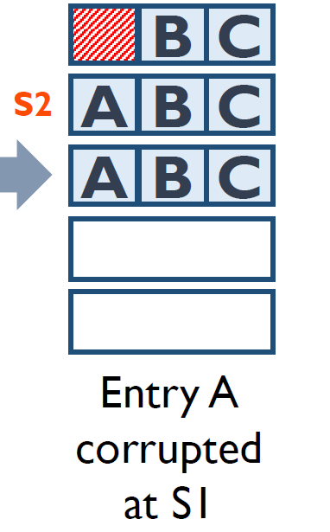
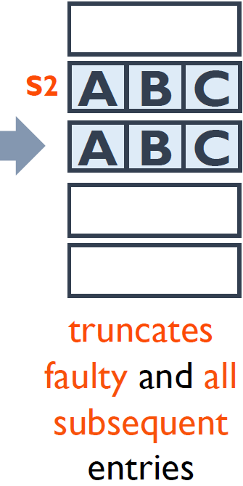
Current Problems
Cannot ensure both Safety and Availability
Crash(LogCabin):
Crash the node upon detection
Truncate(Zookeeper):
Discard the faulty information
Lead to insecure and data loss
Byzantine FT
Expensive, 3f+1 for f nodes

Slide 8
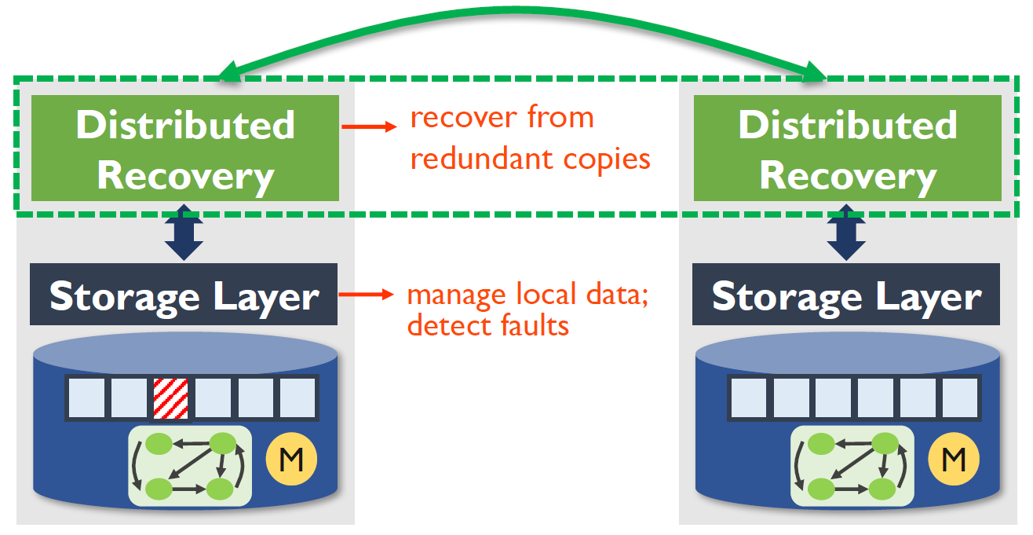
Outline
Motivation and current problems
Design of the system
Local storage layer
Distributed Recovery
Log
Snapshot
Evaluation
Conclusion

Slide 9
Design: Local storage layer
1.Detecting faulty data
Checksum
2.Distinguish Crash and Corruption
Crash can be discarded safely
Corruption cannot be
discarded, may cause data loss
Solution: Add a commit record after the update of log
log update
Commit record
Synchronize
Synchronize
Notes:
pi is checksummed and is
very small; it can be atomically written and thus cannot
be “corrupted” due to a crash.
Conversely, if pi is present, we can
conclude that the mismatch was caused due to a corruption
and not due to a crash.

Slide 10
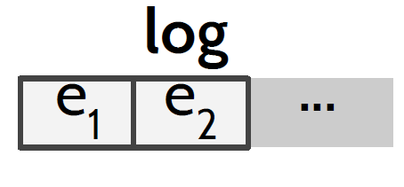
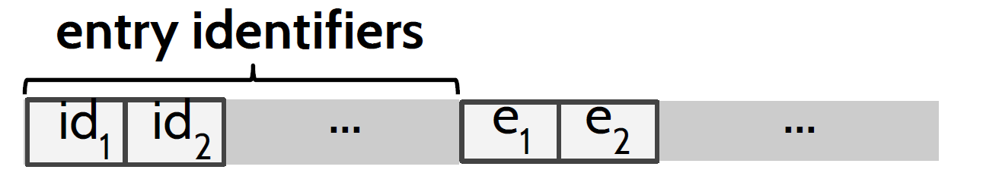
Design: Local storage layer
3.Identify Faulty
By redundantly storing an identifier
Physically separated from the original data
Contents of the identifier:
Log: timestamp and index
Snapshot: snap index and chunk
Typical
Design

Slide 11
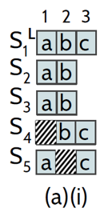
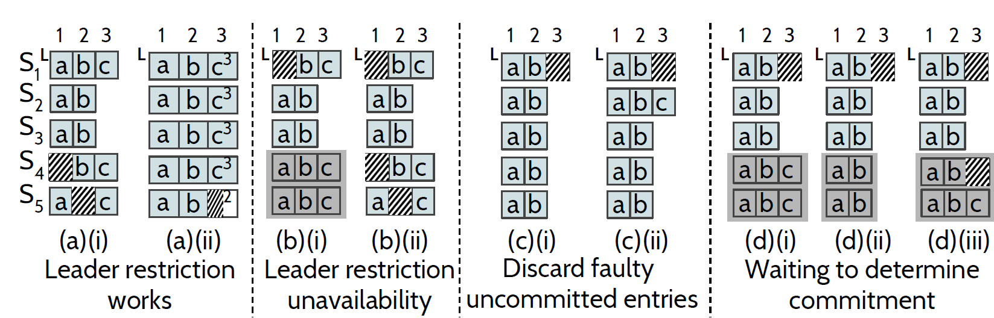
Design: Distributed Recovery - Log
Modified leader election constraint:
Qualified: Nodes with more up-to-date data.
Follower log recovery: recover from leader
Leader log recovery:
Query Follower
One respond have: recover
The majority respond don’t have: discard
Respond have but faulty: wait for other response

Slide 12
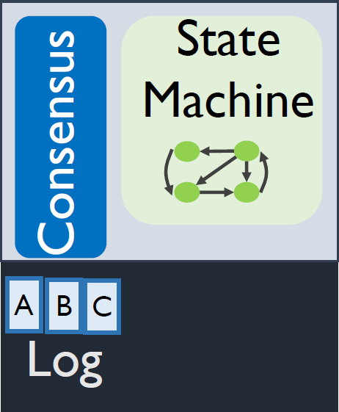

Distributed Recovery – Snapshot
Challenge:
Snapshots are captured independently
Coordinating the identical snapshots
Leader initiate the snapshot
Inform followers at the index
Majority agreed
Leader delete the log
Inform follower to delete
leader
Snapshot at C
Snapshot Recovery:
If logs are not deleted: recover
If deleted, recover from other nodes
Get a copy of snapshot from other nodes
follower
AGREE

Slide 13
Outline
Motivation and current problems
Design of the system
Evaluation
Correctness
Performance
Conclusion

Slide 14
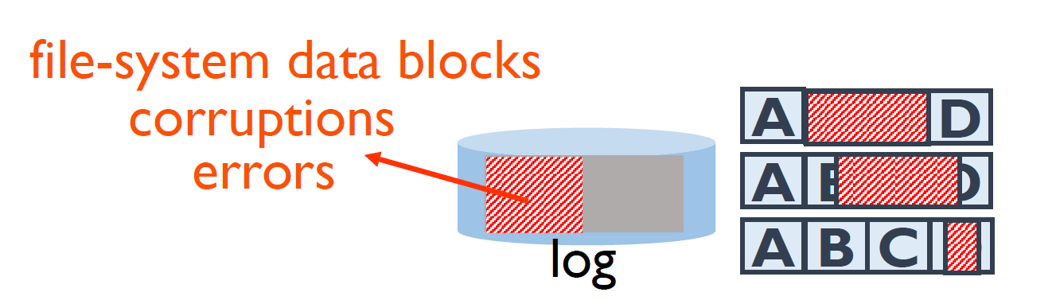
Evaluation: Correctness
Test environment:
LogCabin based on RAFT
ZooKeeper based on ZAB
40-core Intel Xeon CPU E5-2660 machine with 128 GB memory running Linux 3.13, with a 500-GB SSD and a 1-TB HDD managed by ext4
Four log entries,
3 nodes

Slide 15
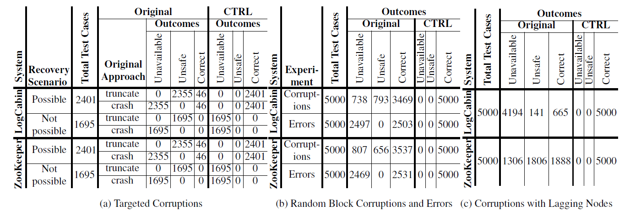
Evaluation: Correctness
Results
The designed system remains the availability at the most possible, no unsafe case occurred.

Slide 16
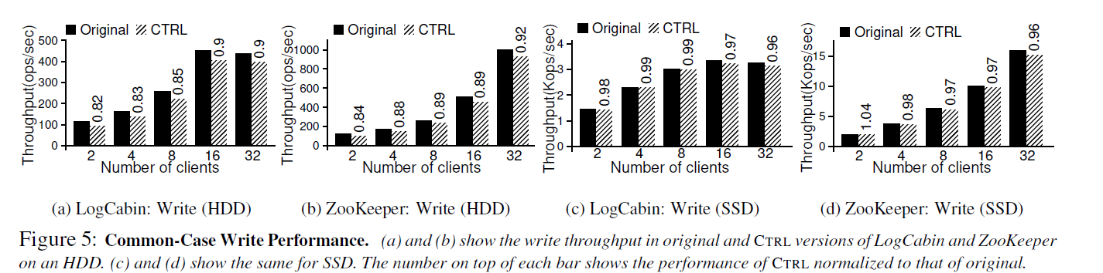
Evaluation: Performance
Results
The performance is nearly not affected by the deployment of the system
Notes:
The
workload runs for 300 seconds, inserting entries each of
size 1K. Both systems batch writes to improve throughput.
Snapshots are taken periodically during the updates.
Numbers reported are the average over five runs.
Figure 5(a) and (b) show the throughput on an
HDD for varying number of clients in LogCabin and
ZooKeeper, respectively. CLSTORE physically separates
the identifier from the entry; this separation induces a
seek on disks in the update path. However, the seek cost
is amortized when more requests are batched; CTRL has
an overhead of 8%-10% for 32 clients on disks. Figure
5(c) and (d) show throughput on an SSD; CTRL adds
very minimal overhead on SSDs (4% in the worst case).
Note that our workload performs only writes and therefore
shows CTRL’s overheads in the worst case; for more
realistic workloads that predominantly perform reads,
the overheads should be even lower.

Slide 17
Conclusion
Introduced protocol-aware recovery (PAR), a new approach that exploits protocol-specific knowledge of the underlying distributed system to correctly recover from storage faults.
Design CTRL, a protocol-aware recovery approach for RSM systems.
Experimentally show that CTRL correctly recovers from a range of storage faults with little performance overhead

