Slide 1
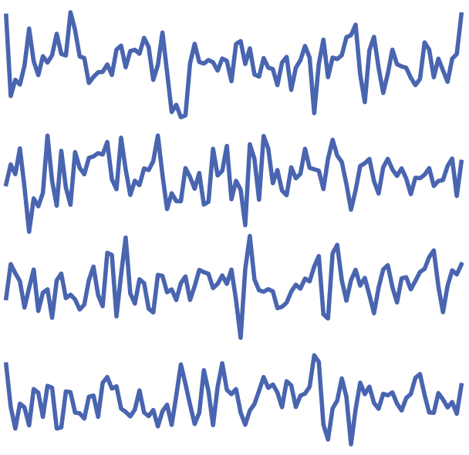




①
Domain Specific
Feature Extraction
MI: CSP
Sleep: PSD
Epilepsy: Band Power
...
PURE
...
1 For each sample in the training set, identify its
𝑘nearest neighbors.
②
③
Active Select
Prompt
Retrieve Demos
& Embed in Text Template
2 Calculate the same-label purity score based on the proportion of neighbors sharing the same label.
Following are feature vectors of ...
Demo1: [1.2, 3.10, 32, 0.19, 0.56]
Label: ‘category1’
Demo2: [3.8, 1.10, 97, 1.19, 4.01]
Label: ‘category2’
Demo3: [5.2, 0.12, 91, 0.39, 0.51]
Label: ‘category3’
...
Category1
④
⑤
score:1.0
3 Rank all samples according to their purity scores and select the top
𝑛samples as demonstrations.
score:0.9
Input to LLMs
Make predictions
Category2
Test1: [9.2, 6.10, 12, 4.19, 6.86]
Test1: ‘category1’
Test2: ‘category3’
Test3: ‘category2’
Test4: ‘category1’
...
score:0.9
score:0.8
Test2: [9.2, 1.23, 12, 3.19, 3.57]
...
Category3
Predict labels of all test samples and return in a json list.
score:1.0
score:0.9

Slide 2
### Task Description ###
Given a set of feature vectors of EEG samples, determine whether the category of the sample to be predicted is A or B.
### Demonstrations ###
Features: [0.23, 1.45, 0.87, ..., 0.91]
Label: A
Features: [1.14, 0.76, 1.09, ..., 0.67]
Label: B
...
### Samples to be predicted ###
Features: [0.41, 1.30, 0.99, ..., 0.80]
Features: [1.08, 0.64, 1.05, ..., 0.72]
Features: [0.27, 1.38, 0.90, ..., 0.76]
Features: [0.37, 4.38, 2.90, ..., 0.16]
...
### Instructions ###
Predict the label of the following input and return in a JSON list.

Slide 3











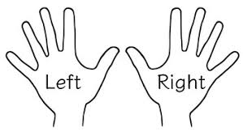




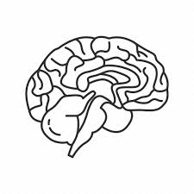
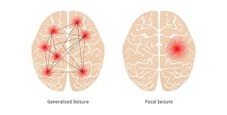
LLMs
NLP
Downstream Tasks
LVMs
CV
Downstream Tasks
Challenge: EEG Data Scarcity
Downstream EEG Decoding Tasks
Huge Text and Image Data
Rare EEG Data
Challenge: Unstructured and High-Dimensional EEG Data
Motor Imagery
LLMs
Underexplored
Indirectly
Challenge: No Professional Large Brain Model
Sleep-Stage Classification
Seizure Detection

