Slide 1
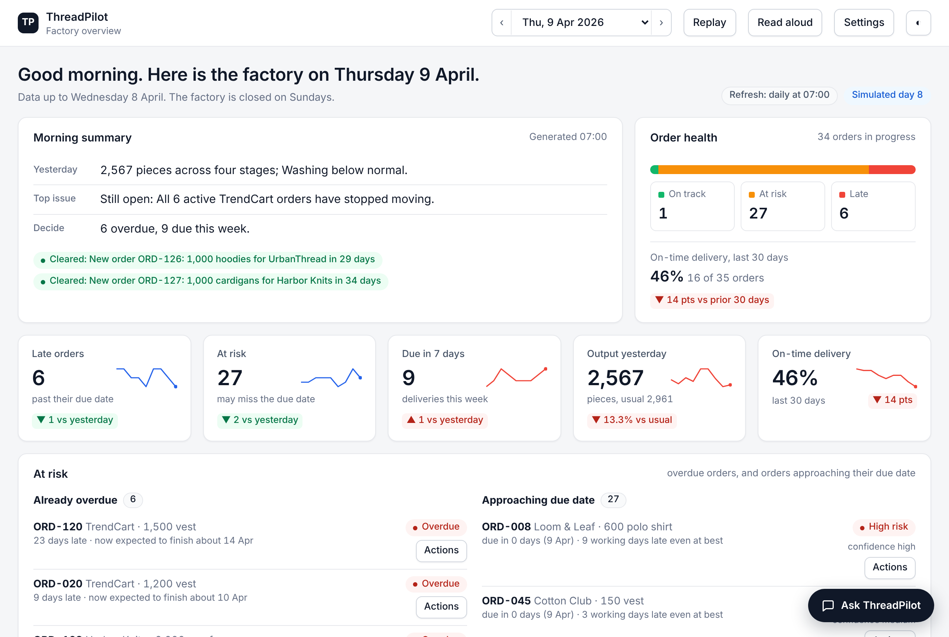
ThreadPilot
The General Manager's Co-Pilot
DSS5105 Capstone · Track 1
Sprint 1 live presentation · Friday 16 October 2026
Matthew · LIU JING · Kevin Royce Thomson
Anqi Lin · Wendy
ADD: sixth team member's name and the group number
The real morning page (simulated day, Thursday 9 April 2026)
Code: github.com/jingweiluo557/DSS5105
ADD: live site link (DEMO_URL=... node build.js adds a QR code)
Notes:
~10 seconds. The whole talk is about 4:25 when spoken (9 main slides), leaving about half a minute before the hard stop at 5:00. Rehearse it with a timer.
We are the Track 1 team. ThreadPilot is a co-pilot for the general manager of a knitwear factory; the picture is our real morning page on a simulated day.
[Add before presenting: group number and the sixth team member's name. Rename the file to Presentation_GroupNN_Sprint1.pptx with the two-digit group number.]

Slide 2



Problem, solution and business value
Problem
Solution
Business value
A general manager runs the factory on the move and does not write SQL. Each question below costs a phone call to a planner, a wait, and an answer that is sometimes wrong.
An agent the manager talks to all day, built on a designed tool set, not a dashboard and not a chat toy.
≈ S$29.6k
07:00 briefing
Three lines: yesterday, top issue, what to decide.
Chat that is honest
Asks when unsure, remembers the order in focus, says what the data cannot answer.
Actions behind a gate
A chase-up, note or reminder only after preview, confirm and log.
Every number traceable
It opens the source rows behind it.
Morning email in Outlook
Written from the briefing; opens in Outlook, filled in.
net value a year, one factory (estimate)
7:00 “Did anything go wrong yesterday?”
9:40 “How is the TrendCart order doing?”
11:15 “A customer wants 800 hoodies by the 25th. Can we take it?”
14:30 “That order hasn't moved in a week. Chase it up.”
17:00 “Remind me tomorrow if packing is still behind.”
+ S$18.4k 62 planner hours a month freed: the morning report and call-backs (about a third of a person)
+ S$13.1k late penalties avoided: about 30 fewer days of lateness every two months (simulated)
− S$1.9k running it: OpenAI, CloudBase and upkeep
Instead of hiring: a full-time assistant for on-call answers costs about S$49.1k a year.
Estimates: task times and prices are assumptions; no planner timed yet (backup 15).
Notes:
~35 seconds.
The brief gives five questions a general manager asks across a day. Today each one costs a phone call to a planner and a wait, and the answer is sometimes wrong.
Our solution is an agent the manager talks to: a morning briefing, a chat that asks when unsure and says what the data cannot answer, and actions only after a confirmation. The morning summary goes out as an email from the manager's own Outlook.
Business value, in money: about S$29.6k a year for one factory. Two parts. First, the planner's time: the morning report and every 'let me check and call you back' add up to about 62 hours a month, a third of a person, about S$18.4k a year at Singapore pay. Second, lateness: in our simulator, finding problems through the briefing cut about 30 working days of lateness every two months; at half of a real retailer's late penalty that is about S$13.1k a year. Running it costs about S$1.9k. These are estimates: the task times and selling prices are assumptions, and backup slide 15 shows every line.
(If asked about hiring: a full-time assistant to give the same on-call answers would cost about S$49.1k a year.)

Slide 3






System architecture: an agentic LLM and its tools
ASK
AGENT
TOOLS CALLED BY THE AGENT
DATA AND GATE
Retrieval
Typed look-ups of orders, customers and stages
Read-only data
120 orders
360 production-log rows
8 workshops
CSV files, or MySQL on the live backend
Orchestrator (LLM)
plan → pick a tool → read the result → answer
Asks when unsure. Says what the data cannot answer. Never computes a number or writes a refusal: code does.
Judgement
“Normal” = previous 8 same weekdays ± a band
General manager
types or speaks a question, reads the answer and its evidence
Tracing
Every number links to its source rows
tool calls / results
Discovery
Stalled customers, weak stages; also runs at 07:00 unasked
Memory
the order in focus and any pending action
Action
Chase-up, note, reminder, morning email: never sent unconfirmed
Human gate
preview → confirm → log
The model chooses the tool and words the answer. Code does the arithmetic and the refusals. The demo runs the same tools with rules instead of a model; the live backend uses OpenAI and MySQL on Tencent CloudBase (next slide).
Notes:
~35 seconds.
The manager's question goes to an orchestrating language model. It plans, picks a tool, reads the result and answers, and it remembers the order in focus.
Tools come in five kinds: retrieval, judgement, tracing, discovery and action. Read tools are read-only; the action tool goes through a human gate: preview, confirm, log.
Two rules: the model chooses the tool and words the answer, but never computes a number or writes a refusal, because code does. The demo uses the same tools with rules instead of a model.

Slide 4
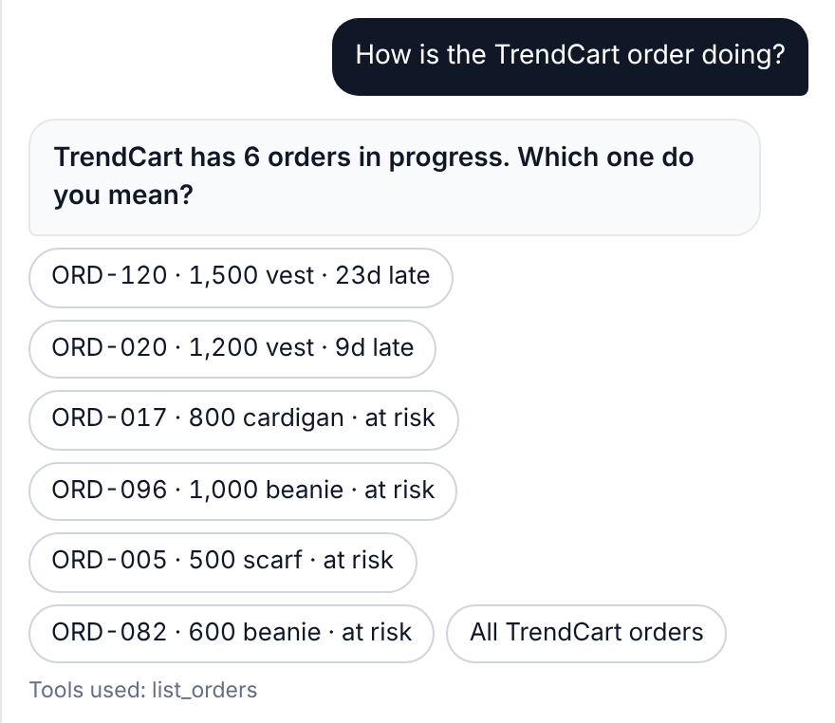
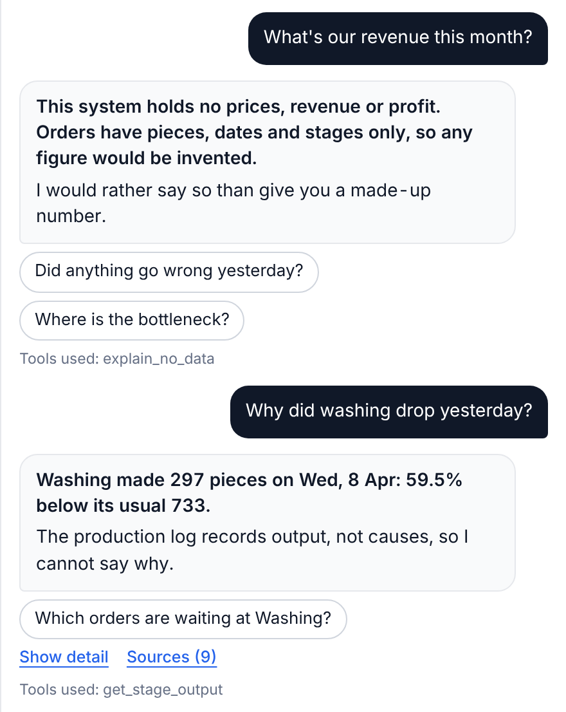
Early wins: it finds, asks and admits
It finds the problem itself
It asks instead of guessing
It admits what it can't know
All 6 active TrendCart orders stopped moving: a shared cause, not the queue. Nobody asked it to look.
“The TrendCart order” could be any of six, so it asks which one.
No prices, so no revenue. For washing: the size of the drop, not an invented cause.
Found by recording: nine scenario scripts exposed six follow-ups that lost the thread. Fixed, and a test re-records them on every run.
Demo chat: built-in tools, no language model. Simulated data; discovery found 5 of 5 planted events, 1 to 4 days after each began.
Notes:
~35 seconds. Live demo or this walk-through; the date picker is on 9 April, 'Simulated day 8'.
Three early wins. Left: discovery noticed all six active TrendCart orders had stopped moving while later-due orders kept moving, so the queue does not explain it. Nobody asked it to look.
Middle: 'the TrendCart order' could be any of six, so it asks. Right: the data has no prices, so no revenue; for washing it gives the size of the drop and says the log holds no causes.
This demo chat uses built-in tools, not a language model, and the planted events are in our own simulator.

Slide 5
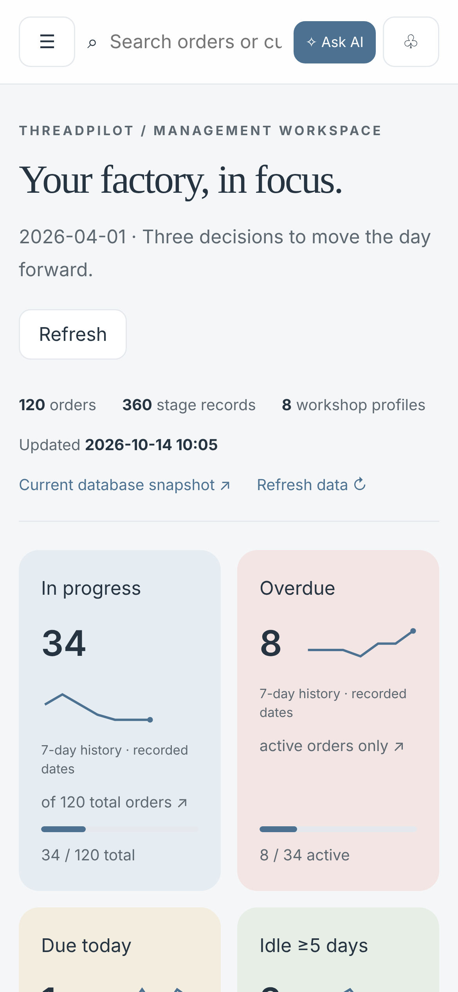
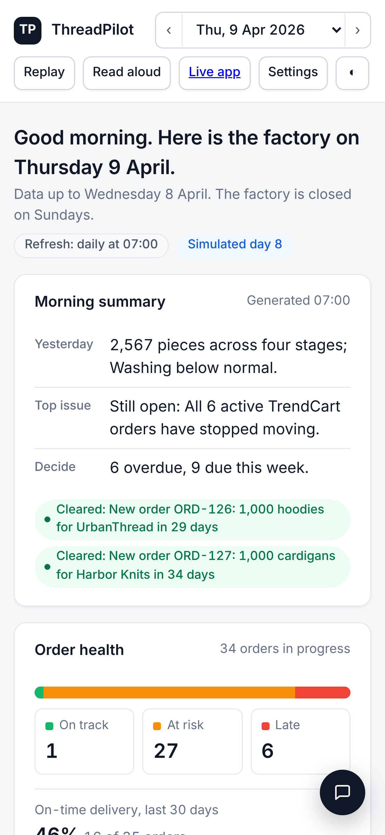
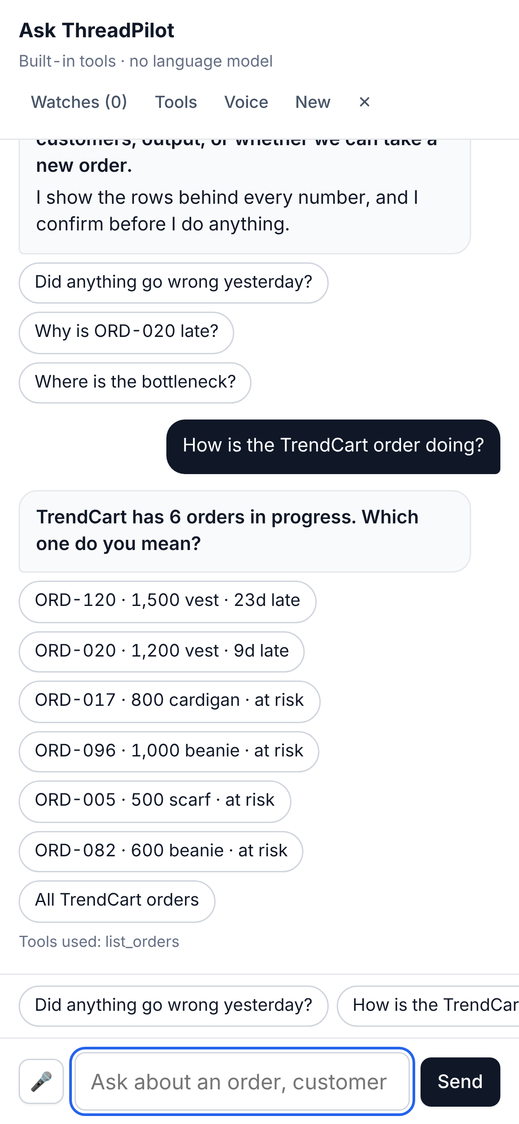





Live on the cloud, in the manager's pocket
Dashboard
07:00 briefing
Chat
TENCENT CLOUDBASE · SINGAPORE
Any phone, tablet or laptop
a web link: nothing to install
Static website hosting
the app itself, served over HTTPS
HTTPS + workspace access token
Cloud function (Python, FastAPI)
tools, chat, briefing, email drafts; holds the OpenAI key
CloudBase MySQL
orders, production log, briefings, drafts
Timer, 07:00 daily: writes the morning briefing
Checked 14 Oct: the cloud backend answers, model switched on. Phones: no page scrolls sideways at 320 to 390 px (tested).
Notes:
~30 seconds. This is what makes it more than a prototype.
First, it is live on Tencent CloudBase, in the Singapore region. The manager opens a web link: no app to install. The website is static hosting; behind it, one Python cloud function runs every tool, the chat and the email drafts, and holds the OpenAI key, so the key never reaches a phone. The data sits in CloudBase MySQL, and a timer function writes the morning briefing at 07:00 every day. The site asks for a workspace access token, so a stranger with the link cannot use it.
Second, it works where a general manager actually is: on the factory floor, on a phone. These are real screenshots at phone width: the dashboard, the 07:00 briefing and the chat. A test checks every page at 320 to 390 pixels wide; it caught one page that scrolled sideways, which we fixed.
(If the QR code is on the slide: invite the audience to scan it.)
[Be accurate if asked: the dashboard, orders, predictions and AI chat are on the cloud site now; the 07:00 briefing page joins it when this week's pull request is merged and redeployed.]

Slide 6
Measured so far: 24 of 36 right on the first try
24 / 36
first pass, nothing fixed yet (67%): the honest figure
18 / 21
held-out questions with new wording (86%)
10 / 16
bait questions resisted first time; every invented-figure bait held
3 / 163
numbers not traced to a tool; read by hand, 1 was a real error
Dashboard chat, no language model. 24 of 36 was first reported as 25: the invented-number check found a false pass.
Live backend (OpenAI model + MySQL): 36 of 45 scripted turns passed on its first full batch (7 hit rate limits). Not yet run on these 36 questions: we will run it once and report that as first pass.
Notes:
~30 seconds.
We wrote 36 questions with answers computed from the CSV files. First pass, nothing fixed: 24 right, 67 percent. That is the number we stand behind; we first reported 25, until our own invented-number check caught a false pass. After fixes, 21 new questions with different wording gave 18.
We also wrote 16 bait questions before running them, to tempt it into inventing: 10 held first time, and every number bait and both prompt injections held. And we checked every number it states against what a tool returned: 3 of 163 were untraced, and one of those was a real error. The live OpenAI backend has not yet been run on these 36 questions; that is our first Sprint 2 task.
(If asked: all 12 first-pass failures are analysed one by one on backup slide 12; one stated a wrong date, found by the provenance check. The same questions now pass 36 of 36, but that is not first-pass and we do not quote it as accuracy.)

Slide 7
Risk assessment: five risks and how we handle them
# | Risk | Probability | Impact | Mitigation
1 | A wrong or invented number reaches the manager | Medium | High | Numbers come from code, never from the model; every figure opens its source rows. Every stated number is checked against tool output: 3 of 163 untraced, 1 a real error, now fixed.
2 | A wrong action: an unwanted chase-up, note or reminder | Low | High | Preview, then a 15-minute single-use confirmation key; every action logged. The chat cannot cancel, delete or change an order. The morning email is sent only by the manager, from their own Outlook.
3 | Alert fatigue: the co-pilot interrupts too often | Medium | Medium | One briefing at 07:00. Stage alerts use 3-sigma + CUSUM: about 2 false alarms a month, against 12 for the old band (measured).
4 | Our evidence flatters us: synthetic data, our own simulator, questions we wrote | High | High | Report first-pass figures only; teammates add at least 10 blind questions each; say in every result that predictions were checked against our own simulator.
5 | The live model and the integration are not proven | Medium | High | Run the live backend once on the 36 questions and report it as first pass. The demo path (same tools, rules instead of a model) is the fallback. On the public link, at most 40 model questions a minute per visitor.
Ratings are our own judgement from the evidence in docs/evaluation.md and docs/failure_analysis.md.
Notes:
~30 seconds.
Five risks. A wrong number: numbers come from code, not the model, and open their source rows. A wrong action: nothing happens without confirmation, and the chat cannot change an order. Alert fatigue: one briefing a day.
Our evidence flatters us: synthetic data and questions we wrote, so teammates add blind ones. And the live model is unproven, so we run it once and report the first pass.
[Team: confirm the probability and impact ratings before presenting; they are drafted from the evidence in the repository.]

Slide 8
Key assumptions we still have to validate
# | Assumption | Validation required | Risk level | Dependency
1 | The five questions in the brief are what a real general manager needs | Ask a real manager or planner; none has used it yet | High | Access to a practitioner
2 | Our rule for “normal” (previous 8 same weekdays ± a band) matches how a manager judges a day | Review the rule with a planner against days they remember | Medium | Planner time
3 | The synthetic data behaves like a real factory | Re-run on a second business date and any real or second dataset; today every question is asked on 1 April 2026 | High | Data beyond the 120 provided orders
4 | A range with stated assumptions is more useful than a yes or no | Teammates and a practitioner judge sample answers | Medium | Feasibility quality: the forecast is no better than repeating the last period
5 | A language model can route a question to the right tool reliably enough | Live run on the 36 questions, then teammates' blind questions | High | OpenAI availability and rate limits
As planned, Sprint 2 tests assumption 5. Assumptions 1 and 3 need a practitioner and a second dataset that we do not have yet.
Notes:
~25 seconds.
Five assumptions, each with how we will check it. The riskiest: that the brief's questions are what a real manager needs, that synthetic data behaves like a real factory, and that a model routes questions reliably.
As planned, Sprint 2 tests the last one; the first two need access we do not have yet, and we say so.
[Team: confirm the risk levels before presenting.]

Slide 9
Sprint 2 roadmap and success criteria
Development area | Priority | Impact | Description
Live-model evaluation | High | High | Run the live backend once on the 36 questions; report it as first pass and analyse every miss.
Blind questions | High | High | Each teammate adds at least 10 questions, with the answer looked up in the CSV.
Briefing on the cloud site | High | Medium | Pull request #4 is ready: no conflicts, all tests pass on the merged code. Merge, redeploy, run one database step.
One feasibility method | Medium | High | The two chats can give different dates for one order. Keep one, use the other as a check.
Sprint 2 video and slides | Medium | Medium | 5-minute video; first slide with group number, student IDs, GitHub and demo links.
Sprint 2 success criteria
Focus: prove it on questions we did not write.
Live first pass reported as run, with every miss analysed
70% or more right on teammates' blind questions (rule-based chat: 67% on ours)
No number without a source row
GitHub and demo links public; briefing visible on the cloud site
Every feature has an owner and a status
TEAM: an owner for each roadmap row; team to confirm the success criteria
Sprint 2: Fri 30 Oct · Sprint 3: Fri 13 Nov · final zip: Sun 15 Nov
Notes:
~35 seconds.
Sprint 2 is about proving it, not adding features. First, run the live backend once on the 36 questions and report it as first pass. Second, each teammate adds ten blind questions. Third, put the briefing on the team's cloud site: the pull request is ready and passes every test once merged. Fourth, settle on one feasibility method.
Success criteria: the live result reported as it ran, at least 70 percent on blind questions against 67 on our own, no number without a source row, public links that open, and an owner for every feature.
[Team: the success criteria and the 70 percent target are a proposal drawn from the repository's own results. Agree them and add an owner to each roadmap row before presenting.]

Slide 10
Backup: a designed tool set, with its edges
BACKUP
TOOL KIND
WHAT OURS DOES
DELIBERATELY DOES NOT
Retrieval
Typed order look-ups, plus a read-only SQL agent (SELECT only) for everything else
Pick the first match when several fit
Judgement
“Normal” = mean of the previous 8 same weekdays ± the larger of 1.5 SD or 5%; Sundays closed
Treat one low day as proof of a fault
Tracing
Every number links to the source file and row behind it
Explain causes the data does not hold
Discovery
Ranks stalled customers, quiet orders and stages below normal; the top five make the page
List every finding
Action
Preview, then a 15-minute confirmation key; every executed action is logged
Send without a matching, unexpired key
37 tools in one table (18 live, 19 in the dashboard chat): input, output, purpose, non-goals, failure mode. 27 boundary questions recorded, each naming the tool that answers and the neighbour that must not.
Notes:
Backup. Use if asked about the tool set.
The brief says the centre of the track is the tool set, so we specified every tool before building it: 37 entries in one table, 18 on the live backend and 19 in the dashboard chat, each with its limits. A test checks the live names against what the engine really calls.
Judgement is the one to remember: 'normal' is an explicit rule, the previous 8 same weekdays with Sundays closed, shared by the briefing, the chat and the dashboard, and a test holds them to identical numbers.
The boundaries page (docs/tool_boundaries.md) records 27 questions that could plausibly go to two tools, with the tool that must answer and the one that must not; it is generated by running the real chat, and a test re-runs it.
Stack: FastAPI, MySQL 8, a SQLite store for sessions and confirmations, the OpenAI API for understanding and wording only, and a LangChain read-only SQL agent.

Slide 11
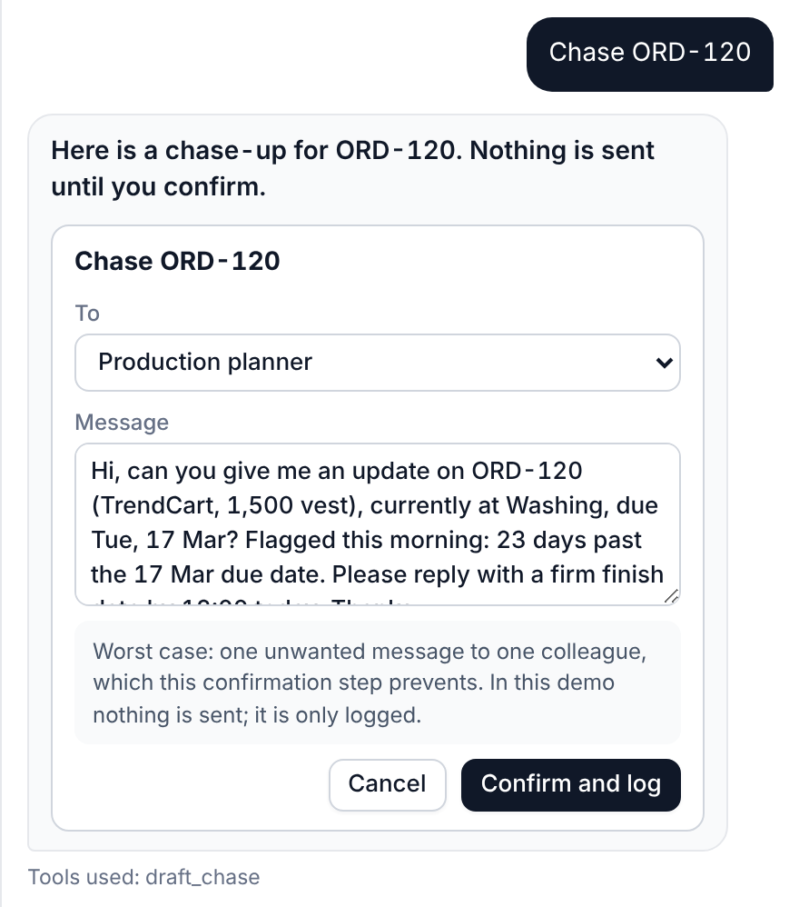
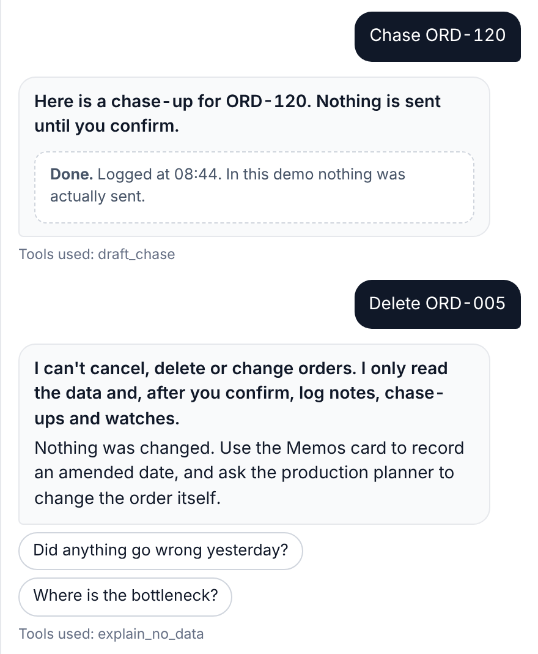
Backup: it acts only after you confirm
BACKUP
Preview: the card states the worst case
Then logged, and some things refused
Preview, confirm, log
Nothing is sent until you press Confirm. In the demo it is only logged.
A confirmation key covers one order and one text, expires in 15 minutes, and confirming twice does nothing.
It cannot cancel, delete or change an order, and says so.
It speaks first rarely: one briefing at 07:00, plus watches you set and a stage that misses its target 3 days running.
Every action, its worst case and what it cannot do: docs/actions_and_limits.md. What may interrupt the manager: docs/alert_triggers.md.
Notes:
Backup. Use if asked about safety or alerts.
'Chase ORD-120' does not send anything. It drafts a message to the production planner, shows the worst case in plain words (one unwanted message to one colleague), and waits. Confirm, and it is logged; in this demo nothing is actually sent. The backend adds a confirmation key tied to one order and one text that expires after 15 minutes, re-reads the order before acting, and ignores a second confirmation.
Right picture: 'Delete ORD-005' is refused. The chat reads the data; it never changes an order.
On alerts: one briefing at 07:00; otherwise only the watches the manager set and a stage that missed its target three days running. A test checks docs/alert_triggers.md against the code.

Slide 12
Backup: the 12 first-pass failures, by cause
BACKUP
5
fell to “I can't answer that”
No rule matched, though the data could answer: a count of orders in progress (Q01), two short follow-ups with no order in them (Q11, Q12), “the other one” (Q19), “Email the customer…” (Q36).
What they have in common
All 12 were routing mistakes. One stated a wrong date (Q31); the scorer passed it and the invented-number check caught it.
Guessing was the commonest wrong move (Q17, Q18, Q35): the brief says ask, do not guess.
The worst was Q35: a destructive request answered like a lookup, so the manager could not tell whether anything had happened.
Probing the tool boundaries found three more: the manager's own number ignored (“Is 800 pieces from assembly normal?”), a stalled customer, and “Show me all orders”.
6
answered by a close but wrong rule
Status instead of stage (Q04); orders instead of pieces (Q09); “Is it late?” listed late orders (Q17); “the Harbor Knits order” taken as the customer (Q18); a past date read as next year's (Q31); “Delete ORD-005” answered as a lookup (Q35).
1
a wording problem
The reminder's first sentence did not say in words that nothing is set up until you confirm (Q34). It matters for voice, where there is no card to see.
Every case, what it said and the fix: docs/failure_analysis.md. A test checks that page against the recorded run.
Notes:
Backup. Use if asked about errors or about how we tested.
The course asks for at least ten failure cases, each analysed. These are the 12 questions the dashboard chat got wrong the first time: 24 of 36 right. Five fell to 'I can't answer that', six were answered by a close but wrong rule, one was a wording problem. Six more come from the bait questions, analysed in the same document.
One stated a wrong date: a past date read as next year's. The tools were never the problem; the routing was. Fixing a case meant adding or widening a rule, never changing a calculation. That is the cost of narrow typed tools: reliable numbers, and a router that has to be taught each phrasing.
A live language model will fail differently, with classification mistakes and rate limits, so none of this analysis applies to it until we run the live batch.

Slide 13
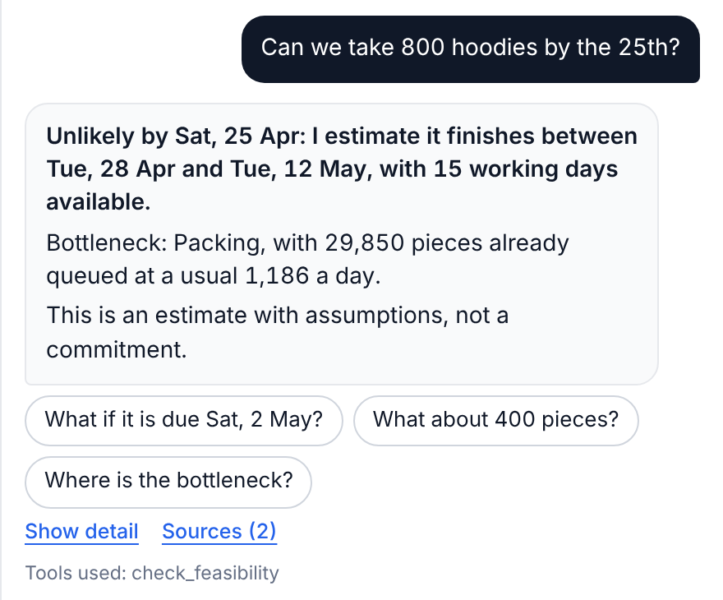
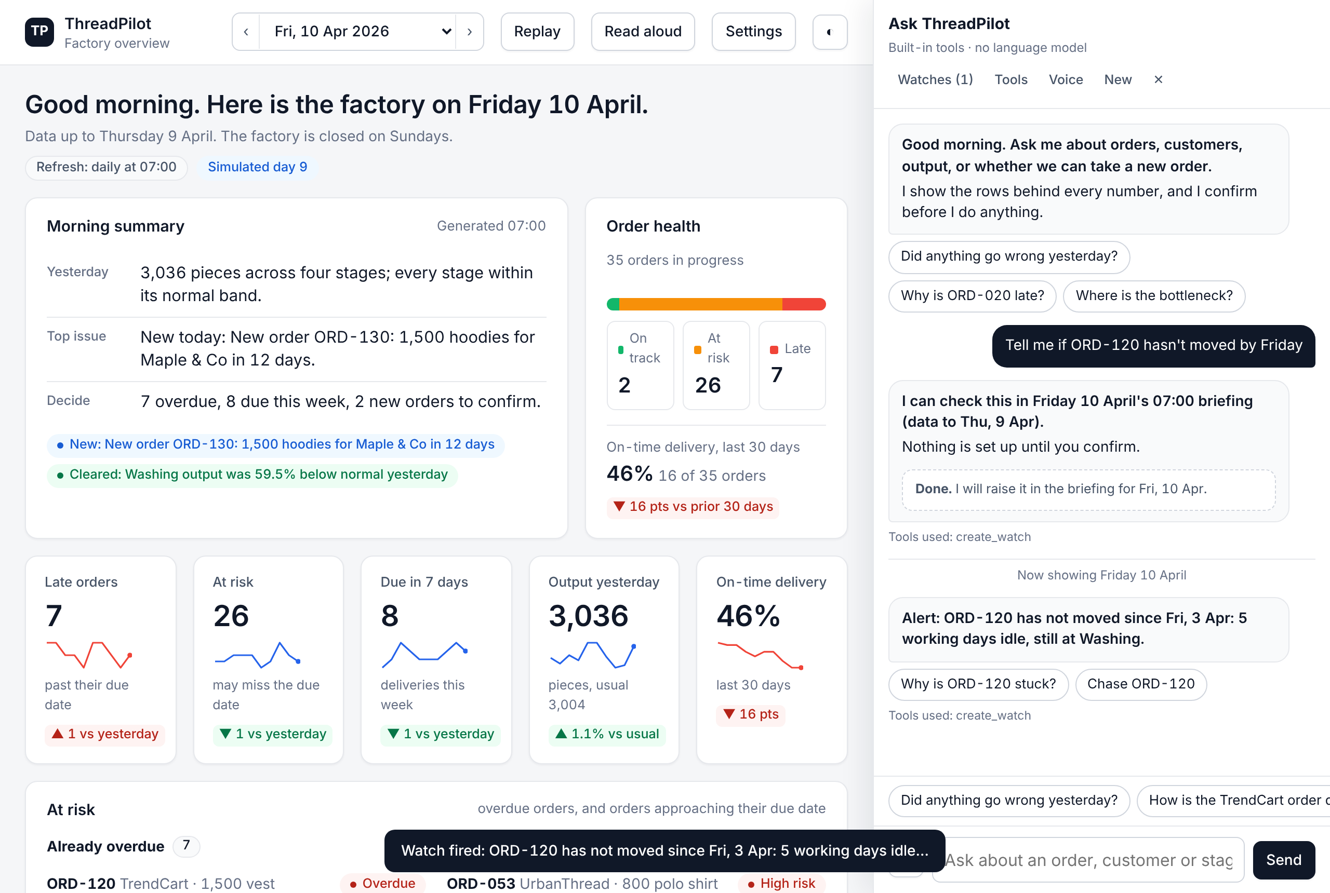
Backup: an estimate, and a watch that fires
BACKUP
“Can we take 800 hoodies by the 25th?”
A watch set yesterday fires in the next morning's briefing
Unlikely by Sat 25 Apr: between Tue 28 Apr and Tue 12 May. The range is widened by 3 working days each end, because tested on 180 simulated orders the narrower one held the real finish only 7 times in 10 (now 94%).
Confirmed on 9 April. On 10 April the briefing re-checks the data, finds no activity since 3 April and raises the alert. Nothing is sent outside the system.
Notes:
Backup. Use if asked about estimates or alerts.
Feasibility never answers a plain yes: it gives a date range, the bottleneck stage and the assumptions, and a follow-up like 'What about 400 pieces?' changes one input. A missing date or quantity is asked for.
Watches: confirmed with a card, evaluated once each morning against that morning's data, logged either way (fired or cleared). If the condition is no longer true, the watch clears itself. Backend reminders run on a 30-second loop and store one in-app notification when the condition is unmet; they send nothing outside the system.

Slide 14
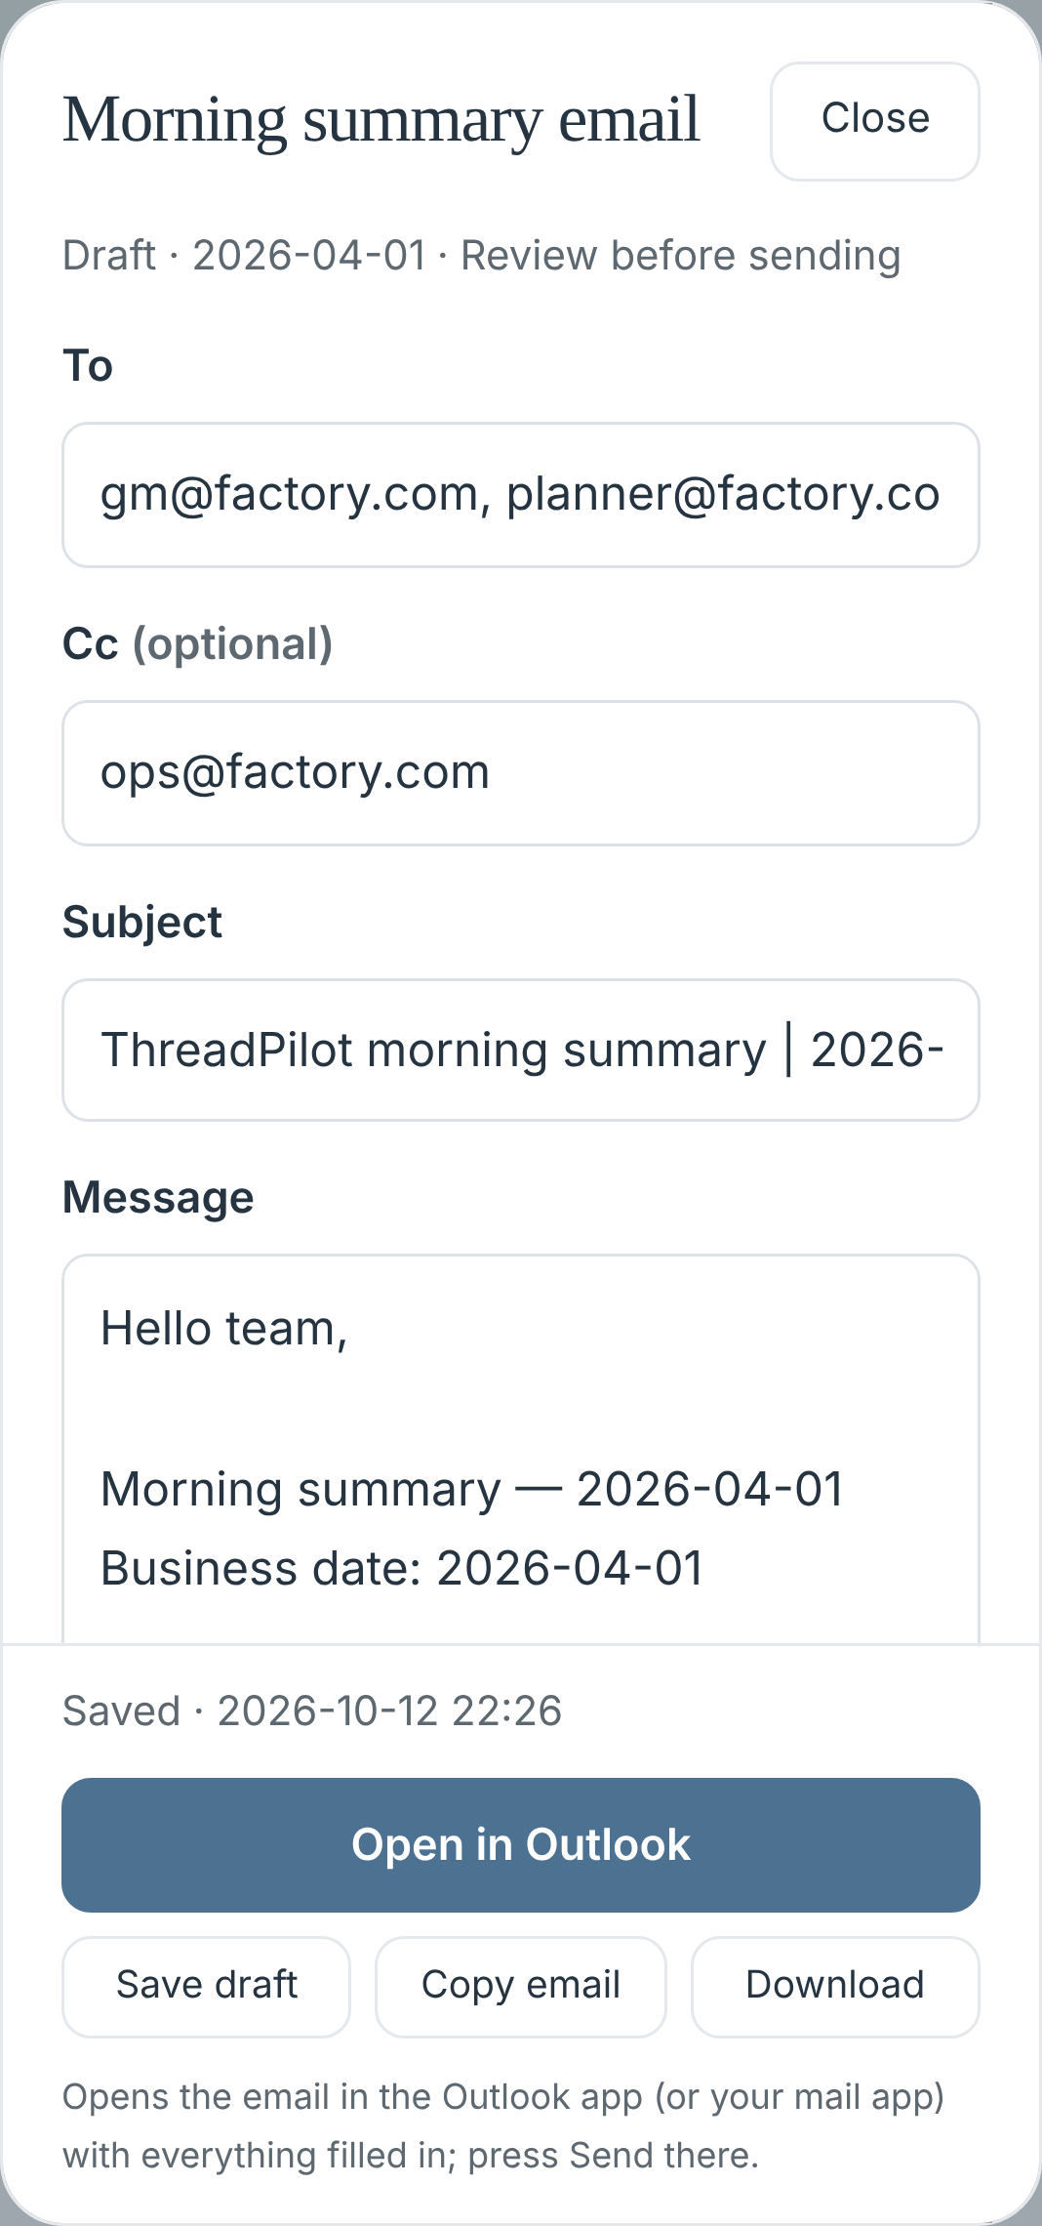
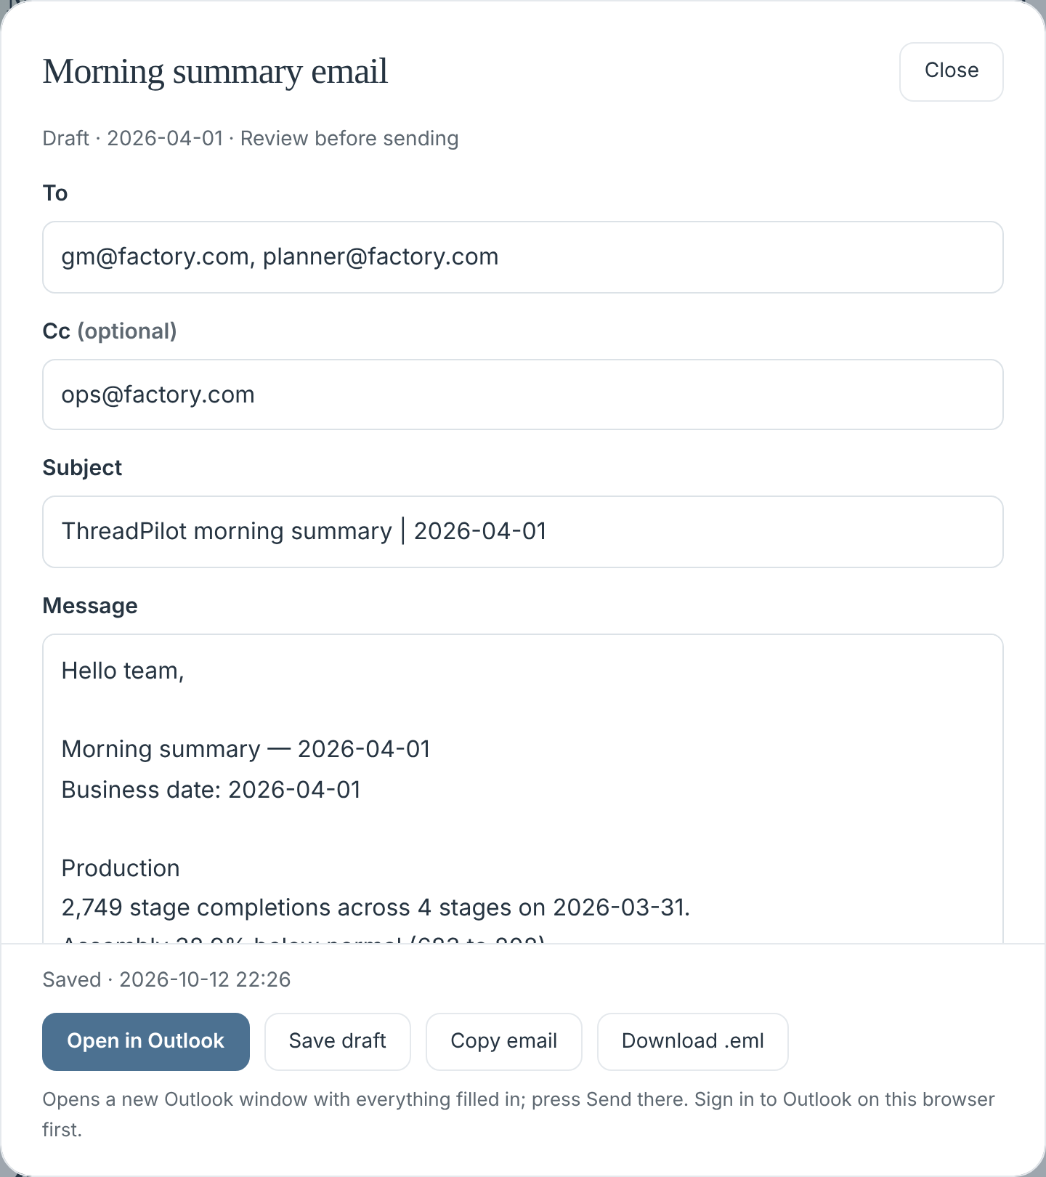
Backup: the morning email, sent from Outlook
BACKUP
On a phone
On a laptop
Morning email
Written from the 07:00 briefing; recipients carried over from the last one. Open in Outlook: a filled-in Outlook window, the manager presses Send. One-click sending needs a one-time Microsoft app registration (send-only permission).
Phones
No page scrolls sideways from 320 to 390 px. The briefing page was 878 px wide on a 390 px phone; a new test found it, and it is fixed.
A shared link
At most 40 model questions a minute per visitor; a rejected API key now says so; cover photo 2.4 MB to 195 KB.
Tested: 198 and 136 tests pass on the merged code (pull request #4).
Not yet tried: a real Outlook window with a team account.
Setup and security: docs/outlook_setup.md.
Notes:
Backup. Use if asked about phones, email or the public link.
The morning summary becomes an email written from the briefing. The manager reviews it and presses Open in Outlook: Outlook opens with the recipients, subject and text filled in, and they press Send there. Nothing is sent by ThreadPilot itself. One-click sending from inside ThreadPilot is built and tested, but it needs a one-time Microsoft app registration, so it is off until someone does that.
Phones: a new test checks every page at phone widths; it found that hidden screen-reader labels made the briefing page 878 px wide on a 390 px phone. Fixed.
Shared link: a per-visitor limit protects the OpenAI credit; a wrong key gives a clear message instead of a generic error.

Slide 15
Backup: the business case, line by line
BACKUP
1. Planner time: what a person does today, per factory day
2. Lateness avoided (simulated)
Task (likely case) | Minutes | Per day | With ThreadPilot
Morning report | 30 | 1 | 5 min
Order status call-back | 10 | 3 | 1 min
Can we take this order? | 45 | 0.5 | 10 min
Why did a stage drop? | 30 | 0.5 | 5 min
Chase-up message | 10 | 1 | 2 min
Re-check a reminder | 10 | 1 | 0 min
Weekly KPI report (share per day) | 20 | 1 | 5 min
Same simulated factory, same random problems, run twice: noticed by a weekly check vs by the 07:00 briefing. Over about 88 orders, total lateness fell by 30.5 working days every two months (95%: 18 to 43). Priced at 1% of the order a day late (half of URBN's vendor rate) on an average order of US$5,515: S$72 per order-day.
A year, likely case | SGD
Planner time freed | S$18.4k
Late penalties avoided | S$13.1k
Running ThreadPilot | −S$1.9k
Net value | S$29.6k
Each time is a range (low, likely, high), drawn 10,000 times. Result: 73 hours a month today, 11 with ThreadPilot, so 62 saved (51 to 75), at S$24.6 an hour (planner S$48k a year + CPF).
Hiring a full-time assistant instead: about S$49.1k a year.
Estimates, not measurements: no planner has been timed and prices are assumed (the data has none). Every input and its source: docs/business_case.md.
Notes:
Backup. Use if asked how the business value was calculated.
Left: the planner's work today, from the brief's five questions and its 'half hour every morning'. Each task has a low, likely and high time; drawing 10,000 combinations gives about 62 hours a month saved, between 51 and 75. At a Singapore planner's pay plus CPF that is about S$18.4k a year.
Right: the lateness number. We run the same simulated two months twice with the same random problems, once noticed by a weekly check and once by the briefing. Adding up how many working days every order finished late, the briefing version is about 30 days lower, every two months, across about 88 orders. The 95% range 18 to 43 comes from 40 different runs. We price a day of lateness at half of Urban Outfitters' published 2% a day vendor penalty.
Be clear: these are estimates. The next step is to time a real planner for a week.

