Slide 1

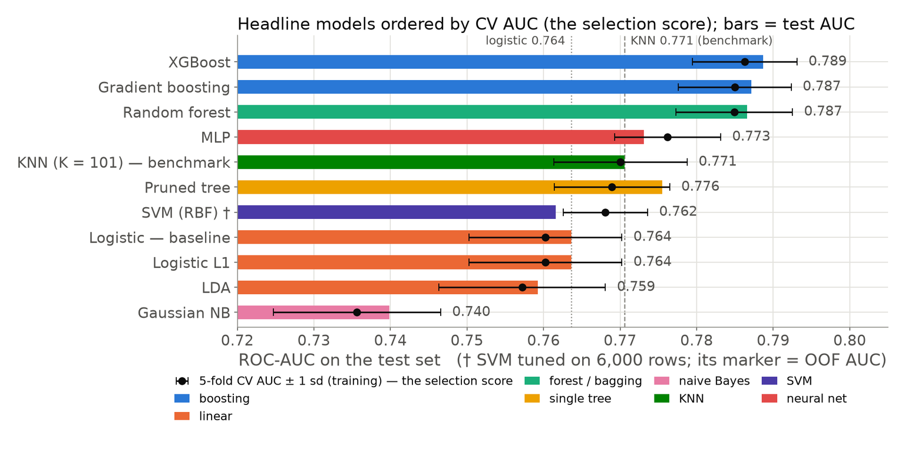
Predicting Credit-Card Default: Eleven Classifiers, One Protocol
Threshold choice matters more than the model; chosen on training CV, the test set only reports.
RUAN Hangjing · G2607546F
LU Xinyu · G2603537D
LI Jingwen · G2607526K
MH6805 Machine Learning in Finance
Group B19 · 27 October 2026
Contribution (draft, to confirm): RUAN 29% — KNN benchmark, logistic family, clustering, nested-CV pass · LU 29% — tree, forest, boosting, SHAP/PDP/monotone · LI 42% — SVM/MLP/discriminants, imbalance, leakage, protocol and freeze, cost analysis, deck. Per-section table in the report.
Figure: test AUC (bars) with 5-fold CV standard deviation, models ordered by training CV AUC; results/aggregate_summary.json.
Data: UCI Default of Credit Card Clients (Yeh & Lien 2009), doi:10.24432/C55S3H, CC BY 4.0; 29,965 clients after de-duplication, seed 2607526.
Data & Problem
Protocol
Models
Results
Business & Future
01
Notes:
[0:22 · RUAN Hangjing] Good morning, we are Group B19. Our question: who will miss next month's card payment? Eleven classifiers, one protocol, and what a risk manager should do with the result. I cover data and protocol; LU the tree family and the business reading; LI the other models, imbalance and the operating point.
【0:22 · RUAN Hangjing】早上好，我们是 B19 组。问题是：谁会在下个月逾期还卡？十一个分类器、一套规程，以及风控经理该怎么用结果。我讲数据和规程，LU 讲树模型家族和业务解读，LI 讲其余模型、类别不平衡和决策阈值。

Slide 2
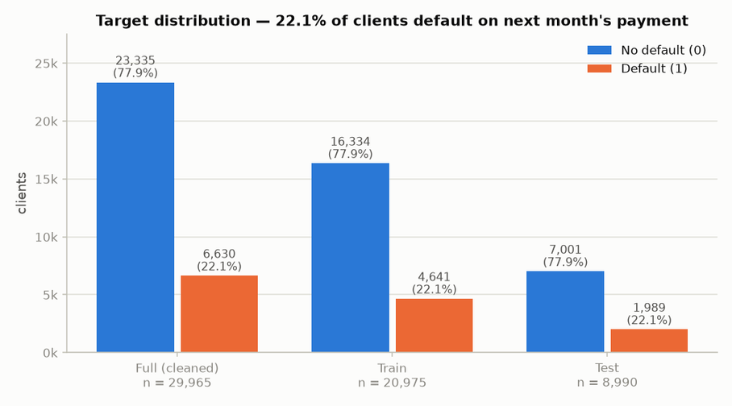
Data & Problem: 29,965 Clients, 22.1% Default Next Month
Accuracy is not the yardstick — “never default” already scores 0.779.
CLIENTS
DEFAULT RATE
29,965
22.1%
35 duplicates dropped from 30,000
no missing cells; Taiwan 2005
6,630 of 29,965 clients
majority-class accuracy 0.779
PREDICTORS
ONE SPLIT
29
70/30
23 raw + 6 engineered: utilisation,
pay ratio, delay counts, bill trend
20,975 train / 8,990 test
seed 2607526, saved to disk
Yardsticks: ROC-AUC and average precision (random = 0.221), never accuracy alone.
Errors are priced: a missed defaulter costs 5 false alarms — one point of a 1:1–20:1 range swept later.
results/eda_summary.json, eda_data_quality.csv, data/processed/split_meta.json; UCI Default of Credit Card Clients (Yeh & Lien 2009), doi:10.24432/C55S3H, CC BY 4.0.
Data & Problem
Protocol
Models
Results
Business & Future
02
Notes:
[0:33 · RUAN Hangjing] Thirty thousand Taiwanese card holders from 2005; 35 duplicates dropped, 29,965 left, no missing cells. Twenty-three raw fields plus six engineered from utilisation, repayment and delay. One stratified 70/30 split, saved to disk: 20,975 training, 8,990 test. Twenty-two per cent default, so "never default" is already 77.9 per cent accurate. We judge by ROC-AUC and average precision and price the errors: a missed defaulter costs five false alarms — one point of a range we sweep later.
【0:33 · RUAN Hangjing】2005 年台湾 3 万名信用卡客户；去掉 35 条重复后剩 29,965 人，没有缺失值。23 个原始字段，加 6 个由使用率、还款和逾期构造的特征。分层 70/30 只切一次并存盘：训练 20,975，测试 8,990。违约率 22%，“全判不违约”已有 77.9% 的准确率。我们用 ROC-AUC 和平均精度评价，并给错误定价：漏掉一个违约者等于五次误报——这只是稍后要扫描的区间中的一个点。

Slide 3
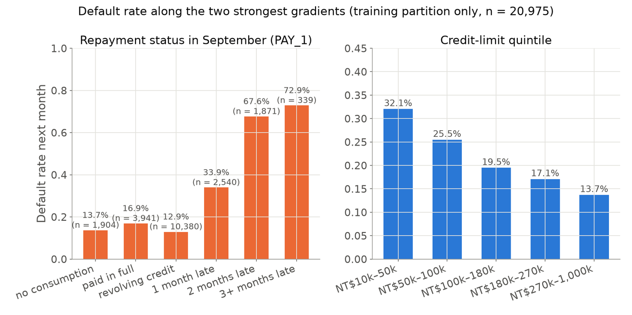
EDA: Repayment Behaviour Is the Signal, Demographics Are Noise
Two months late → 67.6% default, revolving → 12.9%: a step no straight line draws.
67.6%
default when two months late in September — vs 33.9% one month late and 12.9% for revolving clients
Credit limit protects: 32.1% default in the lowest quintile, 13.7% in the highest · months delayed alone: AUC 0.724 · utilisation U-shaped: 24% → 14% → 28%
→ Behaviour beats demographics; the step and the U are shapes trees can draw and a straight line cannot.
Training partition only (n = 20,975; the test set was not inspected); results/eda_summary.json (default_rate_by, univariate_auc); figures/slides/s_eda_gradients.png.
Data & Problem
Protocol
Models
Results
Business & Future
03
Notes:
[0:36 · RUAN Hangjing] Everything here uses training rows only. Behaviour beats demographics: one month late defaults 34 per cent, two months late 68, revolving clients 13. Credit limit protects — 32 per cent default in the lowest quintile, 14 in the highest. Two shapes matter: the jump from one to two months late, and the U in utilisation — 24 per cent at zero, 14 at moderate use, 28 near the limit. A straight line in log-odds draws neither, so we expect trees to beat linear models.
【0:36 · RUAN Hangjing】这页只用训练行。行为比人口属性有用：逾期一个月违约 34%，两个月 68%，循环信用客户 13%。额度是保护因素——最低五分位违约 32%，最高 14%。两个形状要紧：从逾期一个月到两个月的跳跃，以及使用率的 U 形——零使用 24%，中等 14%，接近满额 28%。对数几率里的直线两个都画不出，所以我们预期树模型赢过线性模型。

Slide 4
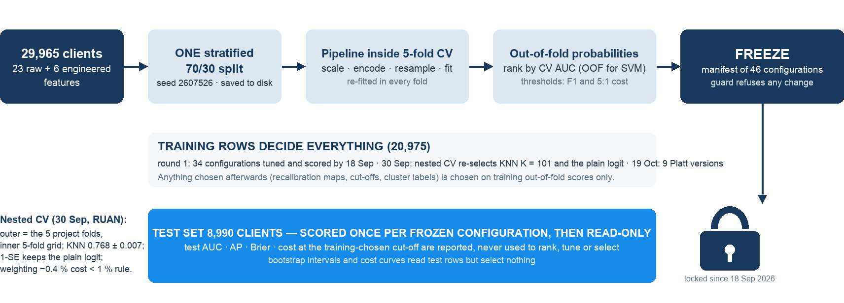
Protocol: Chosen on Training CV, Frozen, Scored Once on Test
Every choice on 20,975 training rows; 46 frozen configurations; the test set only reports.
Rule: models ranked by training CV AUC, cut-offs from training out-of-fold scores; a changed configuration is refused before any test label is read.
results/frozen_manifest.json (46 entries: 34 by 18 Sep, 2 adopted from the 30 Sep pass, 9 Platt on 19 Oct, 1 leakage control), nested_cv_summary_repro.json, knn_v2.json; code/freeze.py --check passes.
Data & Problem
Protocol
Models
Results
Business & Future
04
Notes:
[0:46 · RUAN Hangjing] One split, saved to disk; the test set enters no decision. Preprocessing and resampling sit inside every fold. Models are ranked by five-fold training CV AUC; cut-offs come from training out-of-fold probabilities. Each configuration was scored once on the test set and frozen: 34 models plus the leakage control by 18 September, two re-scored in RUAN's 30 September second pass, nine Platt versions on 19 October — 46 entries; a guard refuses changed configurations. After the professor's comment we added nested CV, hyper-parameters chosen inside each outer fold: it re-selected the same KNN and logistic settings, so first-round tuning did not flatter CV. The test set only reports.
【0:46 · RUAN Hangjing】只切一次并存盘，测试集不参与任何决策。预处理和重采样都放在折内。模型按训练集五折 CV 的 AUC 排序，阈值取自训练集折外概率。每个配置在测试集上只打分一次并冻结：9 月 18 日前 34 个模型加 1 个泄漏对照，RUAN 9 月 30 日第二轮复核了 2 个，10 月 19 日 9 个 Platt 版本——共 46 条，配置一改动守卫程序就拒绝重新打分。收到教授评语后我们加了嵌套 CV，超参数在每个外折内部选：它重新选出同样的 KNN 和逻辑回归设置，说明第一轮调参没有美化 CV 数字。测试集只负责报告。

Slide 5
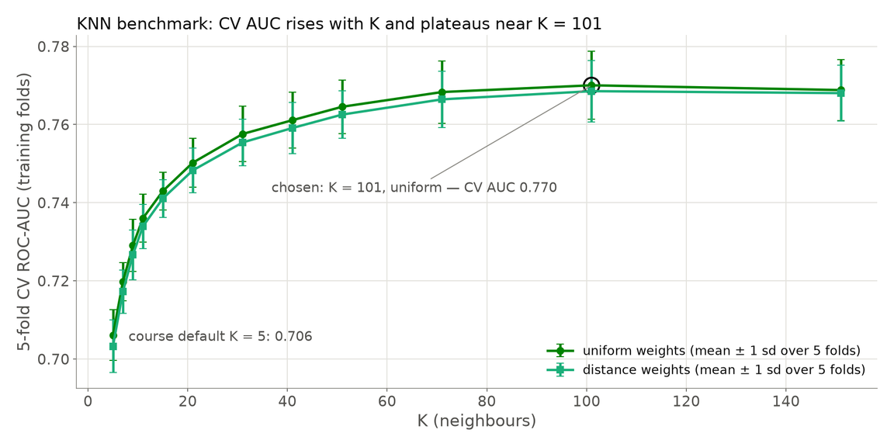
Benchmark and Linear Family: KNN 0.770, Logistic 0.760
KNN with K = 101 is the bar; plain, lasso and ridge logistic all sit one point below it.
  KNN K = 101, uniform (benchmark): CV 0.770 (sd 0.009) · test 0.771 · AP 0.542
  KNN K = 5: CV 0.706 · test 0.709 — one noisy neighbour dominates each vote
  Logistic plain / L1 / L2: CV 0.760 · test 0.764 · AP 0.523 — shrinkage buys nothing
  Nested CV (30 Sep): KNN 0.768 ± 0.007, K = 101 re-selected; 1-SE rule keeps the plain logit
  Class weighting: −0.4% cross-fitted 5:1 cost, below the 1% rule → not adopted
Rule: every later model must beat KNN 0.770 on training CV — or explain why it does not.
results/knn.json (cv_table), knn_k5.json, logistic.json, logistic_family_summary.csv, nested_cv_summary_repro.json; CV = 5-fold on 20,975 training rows; test n = 8,990; figure: figures/slides/s_knn_k.png.
Data & Problem
Protocol
Models
Results
Business & Future
05
Notes:
[0:43 · RUAN Hangjing] KNN is the course benchmark; every model is placed against it. Best of 24 settings: K equals 101, uniform — CV 0.770, test 0.771, average precision 0.542; K equals 5 would score only 0.706. Plain logistic sits one point lower, CV 0.760, test 0.764; lasso and ridge change nothing, since 20,975 rows and 32 columns need no shrinkage — additive log-odds cannot bend the utilisation U or the two-months step. Nested CV gives KNN 0.768 and logistic 0.760 and re-selects both frozen choices; class weighting would cut cross-fitted cost by only 0.4 per cent, below our 1 per cent rule.
Hand-over: “LU will now show what trees add on top of this linear ceiling.”
【0:43 · RUAN Hangjing】KNN 是课程基准，所有模型都和它比。24 个设置里最好的是 K = 101、等权重——CV 0.770，测试 0.771，平均精度 0.542；K = 5 只有 0.706。朴素逻辑回归低一个点，CV 0.760、测试 0.764；lasso 和 ridge 毫无变化，因为 20,975 行、32 列不需要收缩——可加的对数几率弯不出使用率的 U 形和逾期两个月的台阶。嵌套 CV 给出 KNN 0.768、逻辑回归 0.760，重新选中两个冻结配置；加类别权重只能把交叉拟合成本降 0.4%，低于预设的 1% 门槛。
交接：“接下来 LU 展示树模型在这条线性天花板之上还能加多少。”

Slide 6
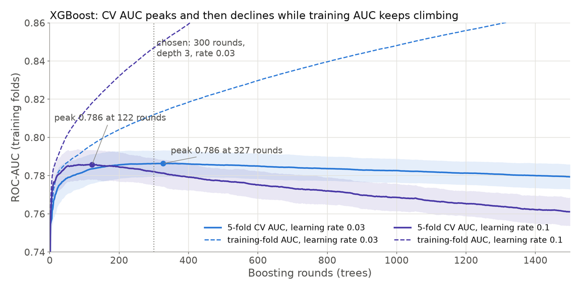
Tree Family: Pruning, Averaging and Boosting Climb to CV 0.786
One pruned tree ties KNN; 500 averaged or 300 boosted depth-3 trees add 0.016–0.017 CV AUC.
ONE TREE: 2,791 → 17 LEAVES
Grown to purity: CV AUC 0.615 (memorises) → pruned on training CV: CV 0.769, test 0.776; root split MAX_DELAY > 1.5
RANDOM FOREST
500 trees, ≥ 20 clients per leaf: CV 0.785, test 0.787 — averaging removes the variance a single tree memorises
XGBOOST — CV WINNER
depth 3, rate 0.03, 300 rounds: CV 0.786, test 0.789, AP 0.578 — fits in 0.5 s against 19.7 s for the forest
XGBoost − forest +0.002 [−0.001, +0.005] on the paired bootstrap: a tie — XGBoost kept as CV winner, forest as fallback.
results/tree_full.json, tree_pruned.json, tree_rules.txt, random_forest.json, xgboost.json, xgb_learning_curve.csv, auc_bootstrap_ci.csv (B = 500); CV = 5-fold on 20,975 training rows; test n = 8,990; figure: figures/slides/s_xgb_learning_curve.png.
Data & Problem
Protocol
Models
Results
Business & Future
06
Notes:
[0:41 · LU Xinyu] A tree grown to purity has 2,791 leaves and CV AUC 0.615 — it memorises. Cost-complexity pruning on training CV cuts it to 17 leaves, root split maximum delay above one month: CV 0.769, tying KNN, test 0.776. Averaging 500 bootstrap trees with at least 20 clients per leaf removes the variance: forest CV 0.785, test 0.787. Boosting shallow trees, depth three, rate 0.03, 300 rounds, gives XGBoost CV 0.786, test 0.789, our CV winner. Its bootstrap gap to the forest, 0.002, includes zero: a tie, but XGBoost fits in half a second instead of twenty.
【0:41 · LU Xinyu】长到纯的树有 2,791 个叶子，CV AUC 0.615——它在死记硬背。按训练 CV 做代价复杂度剪枝，砍到 17 个叶子，根节点是“最大逾期超过一个月”：CV 0.769 与 KNN 打平，测试 0.776。500 棵自助树取平均、每叶至少 20 个客户，把方差消掉：森林 CV 0.785、测试 0.787。提升浅树，深度 3、学习率 0.03、300 轮，得到 XGBoost 的 CV 0.786、测试 0.789，CV 冠军。它和森林的自助差距 0.002 含零：打平，但 XGBoost 半秒拟合完，森林要二十秒。

Slide 7
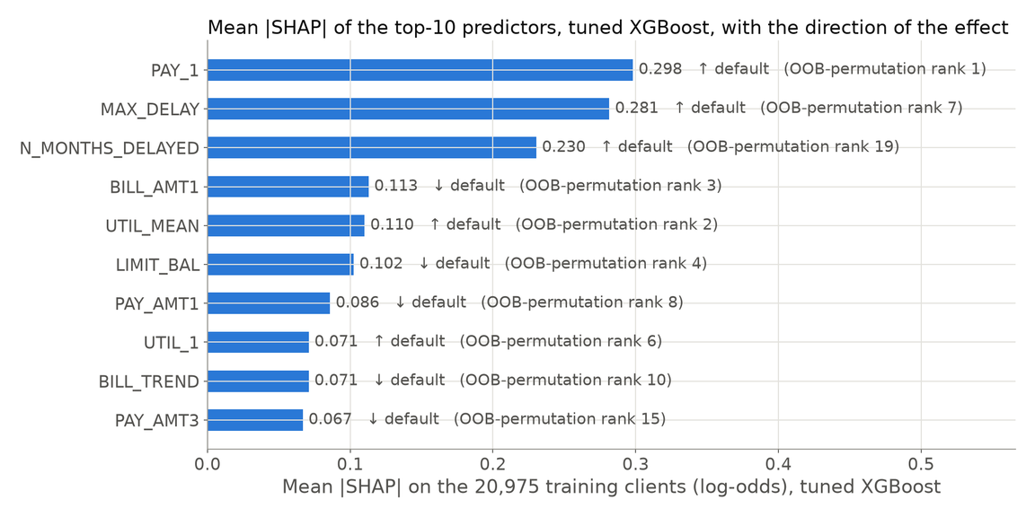
Interpretation: Repayment Delay Drives the Score
Three delay features carry the model; monotone constraints remove 24 wrong-direction steps for −0.002 AUC.
• TreeSHAP on the 20,975 training rows: PAY_1 0.298 · MAX_DELAY 0.281 · N_MONTHS_DELAYED 0.230; bills, utilisation and limit at a third of that
• Drop-column refit of the forest agrees: removing PAY_1 costs the most out-of-bag AUC, 0.785 → 0.779
• Partial dependence keeps the utilisation U: minimum 0.204 at utilisation 0.08
• Monotone XGBoost (11 features up, 2 down): wrong-direction steps 24 → 0; test AUC 0.789 → 0.787
• Beyond the syllabus — XGBoost, TreeSHAP, PDP/ICE, monotone constraints, Platt, paired bootstrap — used to explain, never to select
results/shap_importance.csv (TreeSHAP on training rows only; test set not read), rf_refit_drop_column.csv (OOB), pdp_summary.json, monotone_summary.json; Lundberg & Lee (2017); figure: figures/slides/s_importance.png.
Data & Problem
Protocol
Models
Results
Business & Future
07
Notes:
[0:43 · LU Xinyu] What drives the score? TreeSHAP on the training rows — the test set is not read — puts the three delay features first: last month's status, maximum delay, months delayed, mean absolute SHAP 0.298, 0.281, 0.230; bill, utilisation and limit follow at a third of that. A drop-column refit of the forest agrees: removing PAY_1 costs the most out-of-bag AUC, 0.785 to 0.779. For a regulator we fitted a monotone-constrained XGBoost — eleven features forced up, two down: all 24 wrong-direction steps vanish for 0.002 AUC. These tools go beyond the syllabus; we use them to explain, never to select.
Hand-over: “LI takes over with the models that did not beat the benchmark — and why.”
【0:43 · LU Xinyu】分数由什么决定？在训练行上做 TreeSHAP——不读测试集——前三都是逾期特征：上月状态、最大逾期、逾期月数，平均绝对 SHAP 0.298、0.281、0.230；账单、使用率和额度只有三分之一。森林的逐列删除重拟合给出同样结论：去掉 PAY_1 损失的袋外 AUC 最大，0.785 到 0.779。为监管需要我们拟合了单调约束的 XGBoost——11 个特征强制向上、2 个向下：24 步反向移动全部消失，代价 0.002 的 AUC。这些工具超出大纲；我们用它们解释，从不用来选模型。
交接：“接下来 LI 讲没有赢过基准的模型，以及为什么。”

Slide 8
SVM, MLP, Discriminants: Only the Network Clears the Benchmark
MLP CV 0.776 beats KNN 0.770; RBF SVM 0.761, LDA 0.757, QDA 0.751 and NB 0.736 fall below.
MODEL
MECHANISM
SELECTION AUC · TEST AUC · AP
01
MLP 32-64-32-1, EARLY STOP
logistic plus learned kinks; 4,225 weights
CV 0.776 · test 0.773 · AP 0.551 — above KNN
no-stopping twin (74,497 weights): held-out AUC 0.760 at epoch 1 → 0.700 at 200; CV 0.692
02
RBF SVM C = 1, γ = 0.01
margin loss ranks the tail poorly; tuned on 6,000 rows
OOF 0.761 · test 0.762 · AP 0.494 — below KNN
subsample CV 0.768 not comparable; Platt probabilities; 47 s refit
03
LDA / QDA
Gaussian class densities on skewed amounts
CV 0.757 / 0.751 · test 0.759 / 0.755 — below KNN
AP 0.525 / 0.516; LDA tracks the logit direction (cosine 0.93); QDA shrinks covariances to the grid edge
04
GAUSSIAN NAIVE BAYES
independence fails: six bill columns correlate at 0.80–0.95
CV 0.736 · test 0.740 · AP 0.504 — lowest; Brier 0.203
results/mlp.json, mlp_overfit.json, svm_rbf.json, lda.json, qda.json, naive_bayes.json, eda_summary.json; selection = 5-fold CV AUC on training rows (OOF AUC for the subsample-tuned SVM); test n = 8,990.
Data & Problem
Protocol
Models
Results
Business & Future
08
Notes:
[0:49 · LI Jingwen] Three more families, all against KNN. The tuned network — 32-64-32-1, early stopping, 4,225 weights — is the only one above it: CV 0.776, test 0.773. Its over-parameterised twin, 74,497 weights and no stopping, shows why: held-out AUC peaks at epoch one and falls to 0.700 by epoch 200; CV 0.692. The RBF SVM was tuned on a 6,000-row subsample because kernel SVMs scale quadratically: out-of-fold AUC 0.761, test 0.762, and the lowest average precision, 0.494 — a margin classifier ranks the tail poorly. LDA tracks the logit at 0.757; QDA 0.751; naive Bayes 0.736 — Gaussian densities fail on skewed amounts and bills correlated at 0.80 to 0.95. Flexibility pays only when regularised.
【0:49 · LI Jingwen】再看三个家族，仍和 KNN 比。调好的网络——32-64-32-1、早停、4,225 个权重——是唯一超过基准的：CV 0.776，测试 0.773。它的过参数化孪生版本，74,497 个权重、不早停，说明了原因：留出集 AUC 第 1 轮就封顶，到第 200 轮跌到 0.700；CV 0.692。RBF 核 SVM 在 6,000 行子样本上调参，因为核 SVM 开销按平方增长：折外 AUC 0.761，测试 0.762，平均精度 0.494 全组最低——间隔分类器尾部排序差。LDA 紧跟逻辑回归，0.757；QDA 0.751；朴素贝叶斯 0.736——高斯密度遇上偏态金额和相关 0.80 到 0.95 的账单列就失准。灵活性只有加了正则才有回报。

Slide 9
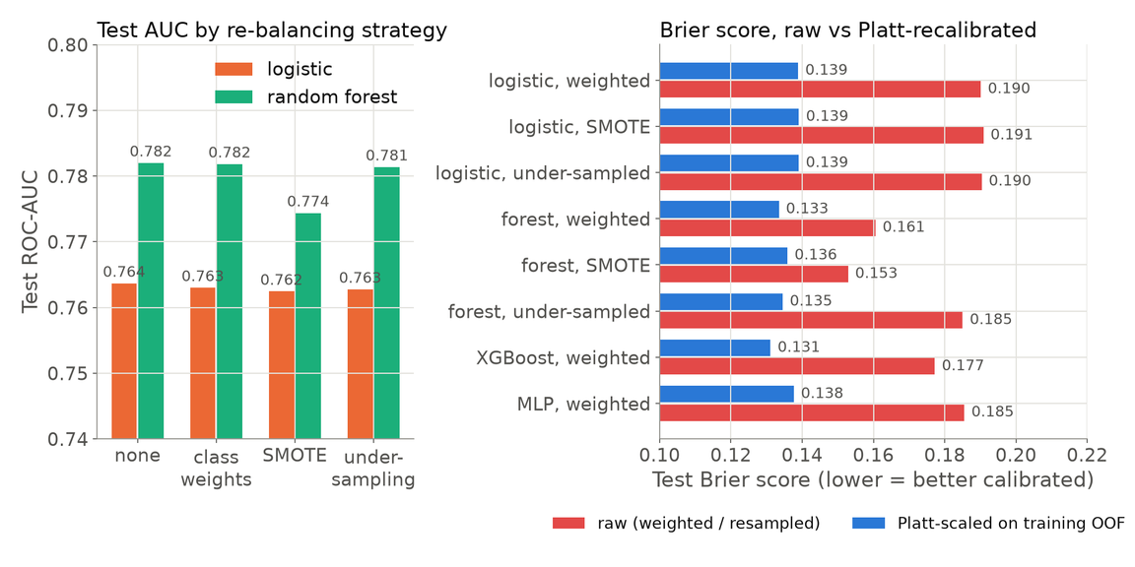
Imbalance: Re-sampling Moves the Threshold, Not the Ranking
Four strategies move logistic test AUC by about 0.001; Platt on training OOF restores calibration.
WHAT WE COMPARED
none · class weights · SMOTE · random under-sampling, inside the folds only
for logistic regression and random forest (eight runs, frozen 16–18 Sep)
WHAT HAPPENED
• Logistic test AUC 0.764 → 0.762 across all four; forest with SMOTE 0.782 → 0.774
• Balanced logit at 0.5 = plain logit at 0.22 on 99.4% of test clients
• Weighting breaks calibration: mean p 0.44 vs prevalence 0.22; Brier 0.138 → 0.190
Our fix: keep the natural prior, choose the cut-off on training OOF scores, Platt-recalibrate anything weighted.
Platt on training OOF returns weighted XGBoost’s Brier 0.177 → 0.131 and the 5:1 cut-offs to 0.14–0.19; all nine versions scored once on 19 Oct and frozen.
results/imbalance_comparison.csv, imbalance_threshold_equivalence.csv, recalibration.csv (nine Platt versions frozen 19 Oct); samplers inside the folds (imblearn Pipeline); Chawla et al. (2002); Platt (1999); test n = 8,990.
Data & Problem
Protocol
Models
Results
Business & Future
09
Notes:
[0:48 · LI Jingwen] Weights, SMOTE and under-sampling ran inside the folds only. For logistic the four strategies move CV and test AUC by about 0.001; for the forest SMOTE loses 0.006 to 0.008 — synthetic points blur the leaves. Re-balancing does not re-rank clients: the balanced logit at 0.5 decides like the plain logit at 0.22 for 99.4 per cent of test clients. What it breaks is calibration — mean predicted probability 0.44 against a 0.22 prevalence, Brier 0.138 to 0.190. Platt scaling fitted on training out-of-fold scores repairs it: weighted XGBoost's Brier returns from 0.177 to 0.131 and the 5:1 cut-offs return to 0.14–0.19; nine versions scored once on 19 October and frozen.
【0:48 · LI Jingwen】类别权重、SMOTE 和欠采样都只在折内做。逻辑回归的四种策略 CV 和测试 AUC 只差约 0.001；森林用 SMOTE 反而 CV 掉 0.006、测试掉 0.008——合成点把叶子糊掉了。重新平衡不改变客户排序：加权逻辑回归在 0.5 的判决与朴素逻辑回归在 0.22 的判决，在 99.4% 的测试客户上一致。它破坏的是校准——平均预测概率 0.44，真实违约率 0.22，Brier 从 0.138 到 0.190。在训练集折外分数上拟合的 Platt 缩放把它修回来：加权 XGBoost 的 Brier 从 0.177 回到 0.131，5:1 阈值回到 0.14 到 0.19；九个版本 10 月 19 日各打分一次并冻结。

Slide 10
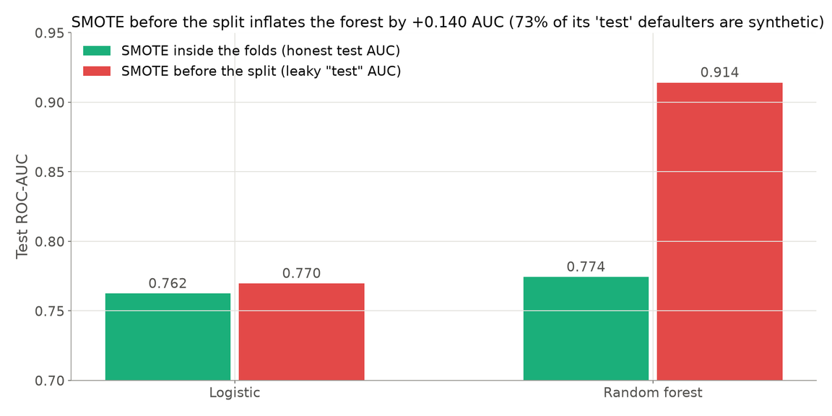
Leakage Control: SMOTE Before the Split Fakes 0.914 AUC
Honest forest 0.774; the same forest “tested” on 73% synthetic defaulters scores 0.914.
WHY IT LEAKS
SAME LEARNERS, TWO ORDERS OF OPERATIONS
SMOTE first, split second: synthetic defaulters land on both sides
73% of the leaky test defaulters are copies of training defaulters
The forest recognises its own neighbours; a straight line cannot memorise
Forest: honest 0.774 → leaky 0.914 (+0.140); logistic 0.762 → 0.770 (+0.007) — leakage flatters the flexible model most.
results/imbalance_leakage_demo.csv — quarantined negative control (slug imb_leaky_smote_demo in frozen_manifest.json); 16,705 synthetic rows; honest runs keep every sampler inside the fold.
Data & Problem
Protocol
Models
Results
Business & Future
10
Notes:
[0:30 · LI Jingwen] One deliberate mistake, quarantined as a negative control. Over-sample first, split second, and the forest reports a test AUC of 0.914 against an honest 0.774 — 73 per cent of its "test" defaulters are synthetic copies of training defaulters, so it recognises its own neighbours. Logistic barely moves, 0.770 versus 0.762: a line cannot memorise. Leakage flatters the flexible models most, which is why every sampler here sits inside the fold.
【0:30 · LI Jingwen】故意犯一次错，隔离成负对照。先过采样再切分，森林报出 0.914 的“测试” AUC，诚实的数字是 0.774——它“测试集”里 73% 的违约者是训练违约者的合成副本，它认出的是自己的邻居。逻辑回归几乎不动，0.770 对 0.762：直线背不住样本。泄漏最会吹捧灵活模型，所以这里所有采样器都放在折内。

Slide 11
Ranking by Training CV: Boosting Leads Logistic by 0.025
Above KNN: XGBoost, GBM, forest, MLP; the pruned tree ties it; SVM, logistic, LDA, NB fall below.
1 · Above the benchmark
2 · Tied with KNN
3 · Paired bootstrap
4 · Top three are one group
XGBoost CV 0.786 · test 0.789 · AP 0.578
pruned tree CV 0.769 vs 0.770
vs logistic +0.025 [+0.018, +0.031]
vs KNN +0.018 [+0.012, +0.024]
XGB − forest +0.002 [−0.001, +0.005]
Order = training CV AUC (the selection score; OOF AUC for the subsample-tuned SVM) · bars = test AUC on 8,990 clients, markers = CV ± 1 sd · results/aggregate_summary.json, model_comparison_main.md, auc_bootstrap_ci.csv (B = 500).
Data & Problem
Protocol
Models
Results
Business & Future
11
Notes:
[0:34 · LI Jingwen] The whole field, ordered by the selection score — training CV AUC — with test AUC as bars. Four models beat the benchmark: XGBoost, gradient boosting, random forest, MLP; the pruned tree ties it; RBF SVM, logistic, LDA and naive Bayes fall below. On the paired bootstrap of 8,990 test rows XGBoost beats logistic by 0.025 and KNN by 0.018, intervals clear of zero; its gap to the forest, 0.002, includes zero — the top three are one group.
【0:34 · LI Jingwen】全部模型按选择分数——训练 CV AUC——排序，柱子是测试 AUC。四个模型超过基准：XGBoost、梯度提升、随机森林、MLP；剪枝树与之打平；RBF SVM、逻辑回归、LDA 和朴素贝叶斯在基准之下。在 8,990 行测试集的配对自助法上，XGBoost 领先逻辑回归 0.025、领先 KNN 0.018，区间不含零；它与森林的差距 0.002 含零——前三名是一个梯队。

Slide 12
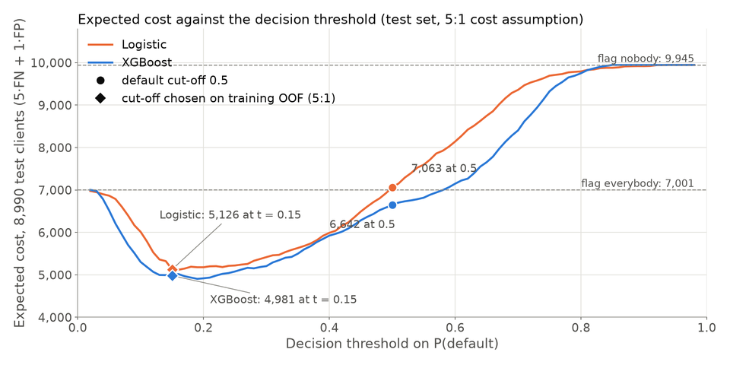
Operating Point: the Cut-off Saves 1,937, the Model 145
At 5:1, re-thresholding logistic saves 1,937 [1,604, 2,218]; switching to XGBoost saves 145 [−18, 299].
CUT-OFF SAVING
MODEL SAVING
1,937
145
logistic cut-off 0.5 → 0.15 at 5:1
95% CI [1,604, 2,218]
logistic → XGBoost, own cut-offs
95% CI [−18, 299] includes 0
5:1 CUT-OFF
DEGENERATE END
0.15
20:1
chosen on training OOF scores
closed form 1/(1+5) = 0.17
optimal cut-off 0.01 flags 99.9%
the trivial rule, not a model result
5:1 is one point of a 1:1–20:1 sweep: the threshold saving grows with the ratio (684 at 3:1, 7,121 at 10:1), the model
saving stays in the low hundreds (87–420). Fix the cut-off from the cost ratio first; the model comes second.
results/threshold_vs_model_saving.csv (cut-offs on training OOF; paired bootstrap B = 1,000 on the 8,990 test rows, reporting only), cost_sensitivity.csv; logistic cost 7,063 at 0.5, 5,126 at 0.15; XGBoost 4,981 at 0.15; figure: figures/slides/s_cost_vs_threshold.png.
Data & Problem
Protocol
Models
Results
Business & Future
12
Notes:
[0:46 · LI Jingwen] At 5:1, logistic at the default 0.5 costs 7,063 units. Moving the cut-off to 0.15 — chosen on training out-of-fold scores, near the closed form one over one plus five — saves 1,937 units, interval 1,604 to 2,218. Switching to XGBoost at its own cut-off saves a further 145, interval minus 18 to 299: it includes zero. Five to one is one point of a 1:1 to 20:1 sweep: the threshold saving grows with the ratio, the model saving stays in the low hundreds, and at 20:1 the optimal cut-off is 0.01 — flag almost everyone. Fix the cut-off from the cost ratio first; the model comes second.
Hand-over: “LU closes with what this means for the bank and what we would do next.”
【0:46 · LI Jingwen】5:1 下，逻辑回归用默认 0.5，成本 7,063 个单位。把阈值移到 0.15——在训练集折外分数上选的，接近闭式解 1/(1+5)——节省 1,937 个单位，区间 1,604 到 2,218。再换成 XGBoost 用它自己的阈值，只多省 145，区间负 18 到 299，含零。5:1 只是 1:1 到 20:1 扫描中的一个点：阈值节省随比率增长，换模型的节省始终停在一两百，到 20:1 最优阈值是 0.01——几乎标记所有人。先按成本比率定阈值，选模型是第二位。
交接：“最后由 LU 讲这对银行意味着什么，以及我们接下来会做什么。”

Slide 13
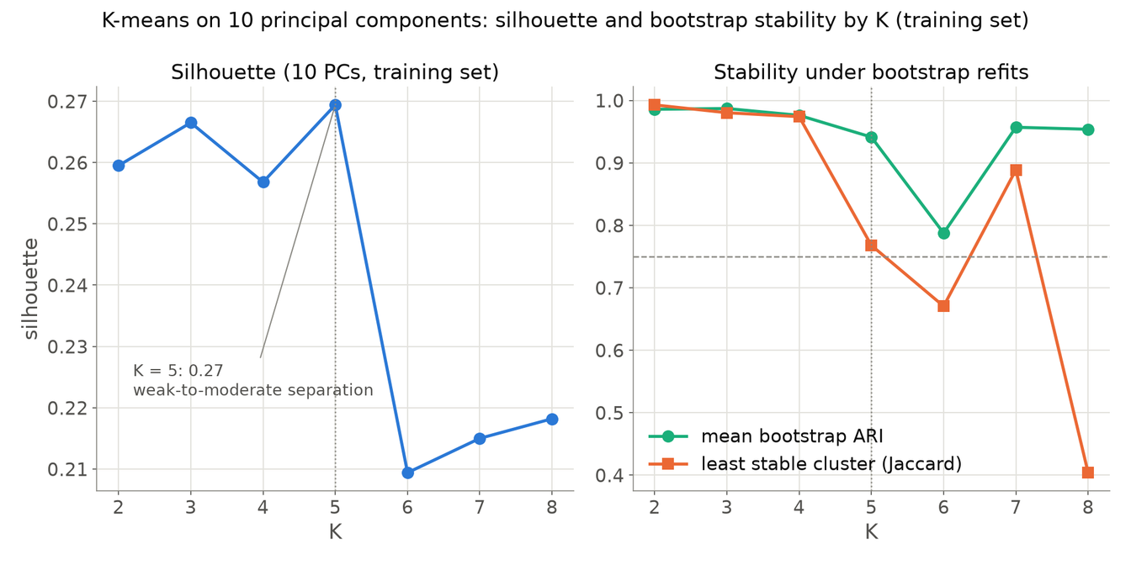
Business: a Map for Policy, a Cut-off for Decisions
K-means K = 5 on 10 PCs is stable but adds no AUC: it describes clients, it does not score them.
CLUSTER STABILITY (TRAINING ROWS ONLY)
WHAT WE FOUND
• PCA: 10 PCs = 81.8% of variance; K = 5, silhouette 0.269 (weak-to-moderate)
• Stable: bootstrap ARI 0.957 [0.745, 0.990], Jaccard 0.79–0.97; K-sweep with fewer draws (figure): 0.941 / 0.768
• Cluster label as extra predictor: ΔAUC and ΔAP below 0.001, intervals include 0 → not adopted
• Deploy: XGBoost or forest ranking; cut-off from the cost ratio; Platt if weighted
• Explain: logistic or the 17-rule tree; monotone XGBoost where regulation demands
A map for policy, not a better model: rank with XGBoost, cut off by the cost ratio, recalibrate anything weighted.
results/unsupervised_summary_repro.json, kmeans_profiles_repro.csv, kmeans_selection_repro.csv, cluster_incremental_folds_repro.csv (RUAN’s 30 Sep analysis reproduced 21 Oct on training rows; the test set was not consulted).
Data & Problem
Protocol
Models
Results
Business & Future
13
Notes:
[0:48 · LU Xinyu] Recommendation: rank with XGBoost; set the cut-off from the bank's own cost ratio, about one over one plus r. At 5:1 that is 0.15: it flags 49 per cent of clients and takes XGBoost's test cost from 6,642 to 4,981. Re-estimate the ratio and recalibrate quarterly; explain with logistic or the 17-rule tree. Clustering is secondary. Ten principal components keep 81.8 per cent of variance; K equals 5 has the best silhouette, 0.269, and is stable: bootstrap ARI 0.957, 0.941 in the sweep plotted. As an extra predictor the label moves AUC by one ten-thousandth, interval across zero: by the pre-fixed rule, not used. A map for policy, not a better model.
【0:48 · LU Xinyu】先说建议：用 XGBoost 排序，阈值按银行自己的成本比率定，约等于 1/(1+r)。5:1 下就是 0.15：标记 49% 的客户，XGBoost 的测试成本从 6,642 降到 4,981。每季度重估比率并重校准；用逻辑回归或 17 条规则的树解释。聚类是次要分析。10 个主成分保留 81.8% 的方差；K = 5 的轮廓系数最高，0.269——弱到中等——而且稳定：自助 ARI 0.957，图上的 K 扫描是 0.941。把簇标签当额外预测变量，AUC 只变万分之一，区间跨零，按预先定好的规则不采用。它是做政策的地图，不是更好的模型。

Slide 14
Limitations and Next Steps: One Split, One Assumed Cost Ratio
The ranking is honest but narrow: one split, one seed, a 2005 Taiwan sample and an assumed 5:1.
01
02
03
WHAT WE FOUND
LIMITATIONS
NEXT STEPS
XGBoost CV 0.786, test 0.789: top three tied
The cut-off saves 1,937; the model 145
Re-balancing shifts thresholds, not ranks
Clusters describe clients, they do not score them
One 70/30 split, one seed: gaps below 0.005 sit inside bootstrap noise
5:1 assumed; bill-and-margin anchors imply 9.6–40, hence the sweep
Taiwan 2005, one-month horizon; PAY_1 observed one month before the label
Repeated splits; nested CV for every family
Loss-given-default pricing of the errors
Drift monitoring with periodic recalibration
Per-client uncertainty intervals
Data & Problem
Protocol
Models
Results
Business & Future
14
Notes:
[0:39 · LU Xinyu] Limitations: one split, one seed — the top-three gaps, 0.002 or less, sit inside or at the edge of bootstrap noise. The 5:1 ratio is assumed; the data's bill and margin anchors imply 9.6 to 40, hence the sweep; it stops at 20:1 because the rule is already "flag everyone" there. Taiwan 2005, one-month horizon, PAY_1 observed one month before the label: early warning, not scoring from scratch. Next: repeat the split, extend nested CV to every family, price errors from loss-given-default data, monitor drift. Thank you — we welcome your questions.
【0:39 · LU Xinyu】局限：一次切分、一个种子——前三名之间 0.002 以内的差距都在自助噪声之内或边缘。5:1 是假设；数据里账单和利差的锚点推出 9.6 到 40，所以展示整段扫描；扫描到 20:1 为止，因为那里的规则已经是「全部标记」。2005 年台湾、一个月窗口，PAY_1 在标签前一个月观察到：这是预警，不是从零评分。下一步：重复切分、把嵌套 CV 推广到每个家族、用违约损失率数据给错误定价、做漂移监控。谢谢大家，欢迎提问。

Slide 15
Appendix · Nested CV, Platt, Cost Sweep, Settings and References
NESTED CV (RUAN, 30 Sep; reproduced 21 Oct on training rows only) — outer = the five project folds, inner 5-fold grid
KNN K = 101 uniform: nested AUC 0.768 (sd 0.007) → frozen choice confirmed · Logistic plain 0.760 (SE 0.005), 5:1 OOF cut-off 0.17, cross-fitted cost 12,195 → kept by the 1-SE rule · ridge 0.760 / lasso 0.760 within 1 SE · class-weighted 0.761, mean p 0.44 (mis-calibrated) · weighted + Platt 0.761, cost 12,247: −0.4% < 1% rule → not adopted
PLATT RECALIBRATION (19 Oct, nine weighted or resampled models) — maps fitted on training out-of-fold scores, thresholds cross-fitted; Brier returns to the unweighted twins (weighted XGBoost 0.177 → 0.131); 5:1 cut-offs 0.14–0.19; each calibrated version scored once on the test set and frozen
COST SWEEP (threshold saving vs model saving, paired bootstrap B = 1,000 on the 8,990 test rows) — 1:1: 0 vs 87 [44, 131] · 3:1: 684 [541, 830] vs 127 [47, 214] · 5:1: 1,937 [1,604, 2,218] vs 145 [−18, 299] · 10:1: 7,121 [6,395, 7,791] vs 420 [187, 646] · 20:1: 20,335 [18,909, 21,621] vs 150 [−52, 333], cut-off 0.01 flags 99.9%
TUNED SETTINGS (5-fold CV AUC on 20,975 training rows, seed 2607526) — XGBoost depth 3, learning rate 0.03, 300 rounds · Random forest 500 trees, ≥ 20 clients per leaf, sqrt features · Pruned tree 17 leaves (cost-complexity path) · KNN K = 101 uniform · Logistic plain; L1/L2 at their CV optimum keep all 32 columns · RBF SVM C = 1, γ = 0.01, balanced weights (6,000-row tuning subsample) · MLP 32-64-32-1 with early stopping
REFERENCES — Yeh, I.-C. & Lien, C.-H. (2009). Expert Systems with Applications 36(2) · James, Witten, Hastie & Tibshirani, An Introduction to Statistical Learning · Breiman, L. (2001). Random forests. Machine Learning 45 · Chen, T. & Guestrin, C. (2016). XGBoost. KDD · Chawla, N. V. et al. (2002). SMOTE. JAIR 16 · Lundberg, S. & Lee, S.-I. (2017). A unified approach to interpreting model predictions. NeurIPS · Platt, J. (1999). Probabilistic outputs for support vector machines · Hofmann, H. (1994). Statlog German Credit, UCI · Pedregosa, F. et al. (2011). Scikit-learn. JMLR 12 · Code, data and results: github.com/jingwen013-design/mh6805-credit-default
Data & Problem
Protocol
Models
Results
Business & Future
A1
Notes:
[A1 · not spoken; RUAN for nested CV, LI for Platt and the sweep] If asked about the professor's comment: the nested layer chooses hyper-parameters inside each outer fold and reproduces the plain five-fold figures within one standard error — KNN 0.768 against 0.770, logistic 0.760 against 0.760 — and the pre-registered rules re-select the configurations frozen on 16 September, so nothing was re-scored. If asked about calibration: the Platt map is fitted on training out-of-fold scores only and applied once to the frozen test scores on 19 October.
【A1 · 不讲，备问；嵌套 CV 由 RUAN 答，Platt 和扫描由 LI 答】若被问到教授评语：嵌套层在每个外折内部选超参数，复现出与普通五折相差不到一个标准误的数字——KNN 0.768 对 0.770，逻辑回归 0.760 对 0.760——预先登记的规则重新选中了 9 月 16 日冻结的配置，因此没有任何模型被重新打分。若被问到校准：Platt 映射只在训练集折外分数上拟合，10 月 19 日对冻结的测试分数只应用一次。

