Slide 1
CityCycle NYC
A Data-Driven Investment Case for Citi Bike Expansion
TTPR Summer 2026 | Nathan | Jenny | Nosaifa

Slide 2


Team and Roles
Nathan — Data Engineer & Backend
Pipeline · ETL · Revenue modeling · MTA integration
Jenny — Data Analyst & Dashboard
Streamlit dashboard · Plotly charts · UX design
Nosaifa — ML Engineer & Forecast
XGBoost · Feature engineering · Cross-validation

Slide 3
About Project. Business Problem
The Problem
Global Context
Citi Bike is a $196M/yr business — but 50% of stations are at capacity.
MTA subway delays push commuters toward alternatives. No data-driven expansion plan exists.
China's dockless bike-share proved demand but failed globally (no docks, no gov partnership).
Citi Bike's dock-based model works. SF, DC, Chicago confirm it.
▸ 8.3M residents depend on aging transit
▸ Lyft leaves revenue on the table
▸ City planners lack demand forecasts
▸ $11.3M/yr unrealized net profit

Slide 4
Project Impact
Market Scale
By the Numbers
Cost of Inaction
$5B+ global market
growing 12% annually
NYC = largest system in Americas
$196M/yr
annual revenue
60.9M trips
in our dataset
50%+ stations
at capacity
Without expansion:
▸ Riders lost to competitors
▸ $11.3M/yr unrealized profit
▸ Underserved neighborhoods

Slide 5
Project Objectives
Project Goals
Success Metrics
1. Build XGBoost demand forecast
Predict daily station-level trips
2. Identify expansion opportunities
MTA transit + bike demand scoring
3. Calculate expansion ROI
NPV, IRR, payback period
4. Build interactive dashboard
For government decision-makers
MAE < 12 trips/day
Achieved: 11.24 ✓
Beat baseline > 30%
Achieved: 42.5% ✓
CV MAE < 10
Achieved: 9.35 ✓
Break-Even Analysis
250 stations × $128K = $32M
Net profit: $11.3M/yr
Payback: 17 months

Slide 6



Data Sources & Data Quality
Trip Data
Transit & Weather
Pricing & Revenue
Citi Bike trip records (2+ years)
60.9M trips · station · timestamp · rider type
MTA subway ridership + delays
NOAA weather · NYC open data
$239 annual / $4.49 single ride
$17.5M Citi sponsorship
Data Quality
Feature Engineering
Null stations dropped (<0.1%)
Weather forward-filled ≤2 days
23 features engineered:
Lags · rolling means · weather · MTA scores

Slide 7





Analytical Methods
Python / Pandas
Streamlit / Plotly
ETL pipeline · feature engineering · Parquet I/O
9-tab interactive dashboard on Streamlit Cloud
XGBoost / scikit-learn
Financial Modeling
Demand forecast · 3-fold time-series CV · early stopping
NPV/IRR cash flow · MTA opportunity scoring

Slide 8
AI Usage
How we used AI as a pair-programmer across the full project lifecycle.
Claude Code (Anthropic)
AI pair-programmer for dashboard,
modeling, ETL, and optimization.
Dashboard Development
9-tab Streamlit app with Plotly
charts, maps, and interactive filters.
XGBoost Modeling
Feature engineering, hyperparameter
tuning, 3-fold time-series CV.
Code Review & Testing
All code reviewed, stress-tested,
and co-authored by the team.

Slide 9
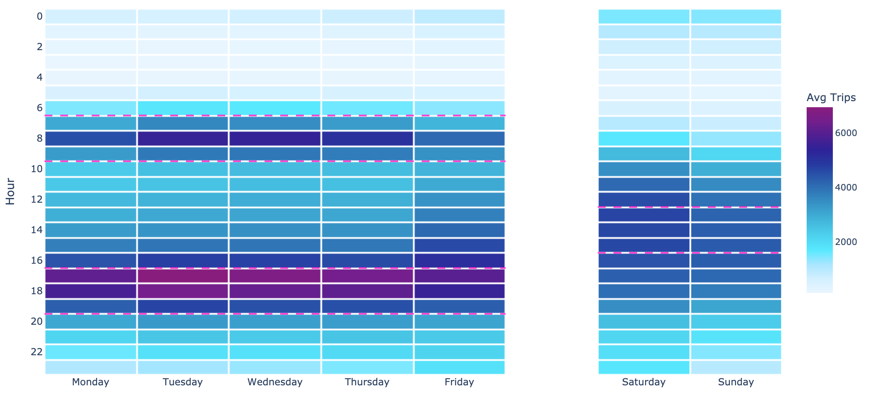
Data Analytics Insights
Patterns from 60.9M trips across 2,476 stations.
$196M
50%+
42.5%
better than baseline
0.987
prediction correlation
stations at capacity
annual revenue

Slide 10
Interactive Streamlit Dashboard
9 tabs · real-time filters · deployed on Streamlit Community Cloud
citibike-citycycle.streamlit.app

Slide 11
Predictive Insights
XGBoost Forecast
Expansion Priorities
Transit Opportunity Score
23 engineered features
Temporal lags, weather, MTA data
MAE: 11.24
Accuracy: 93%
Demand > capacity =
priority expansion zone
MTA scores rank locations
Score 0–100 combining:
MTA ridership + delay rates
+ bike station proximity
High = unmet transit demand

Slide 12
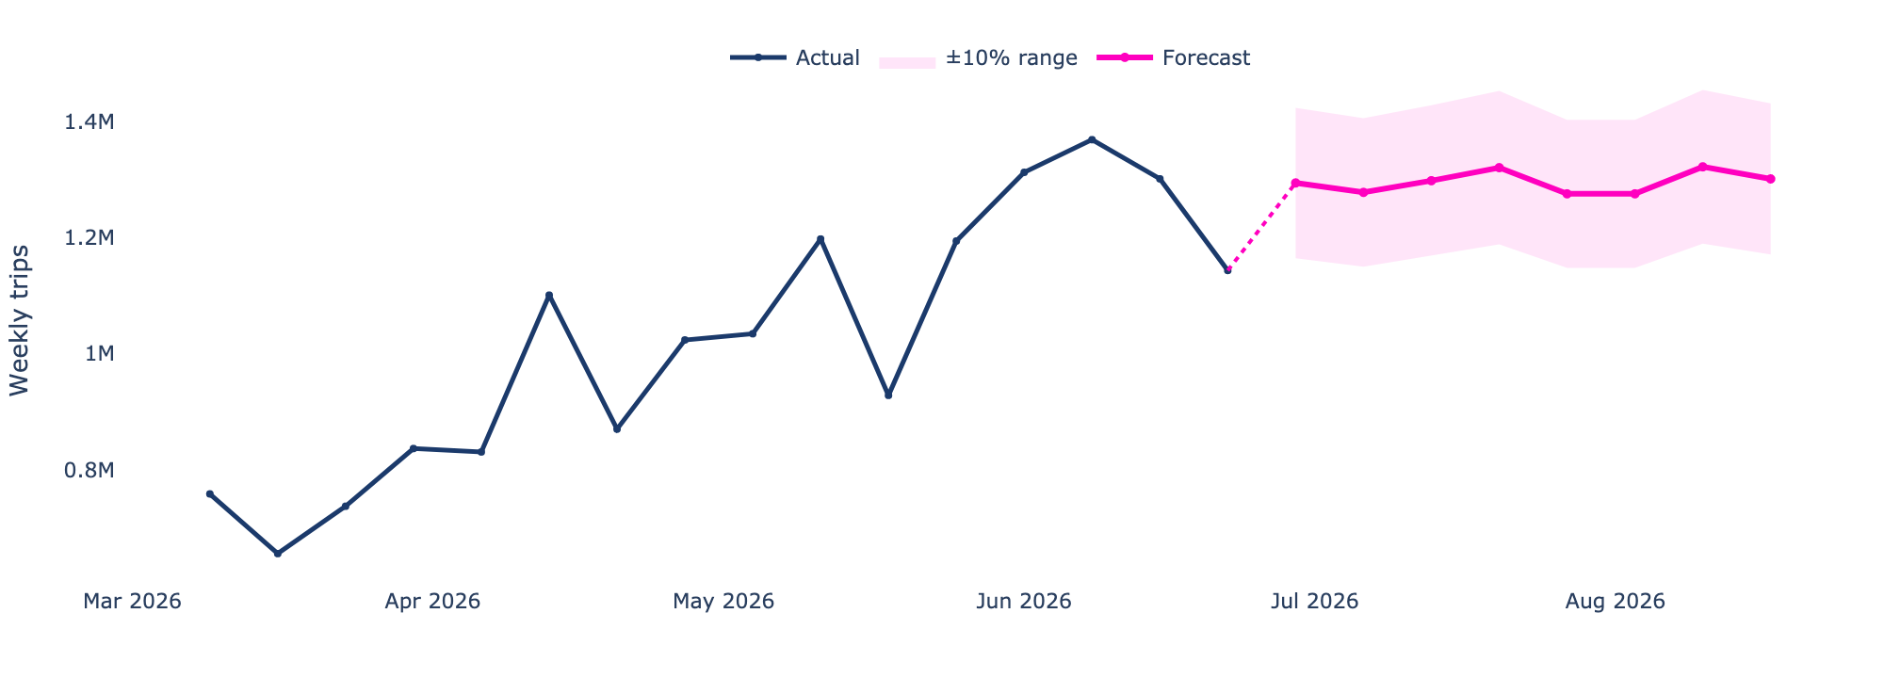
Live Dashboard Demo
citibike-citycycle.streamlit.app

Slide 13
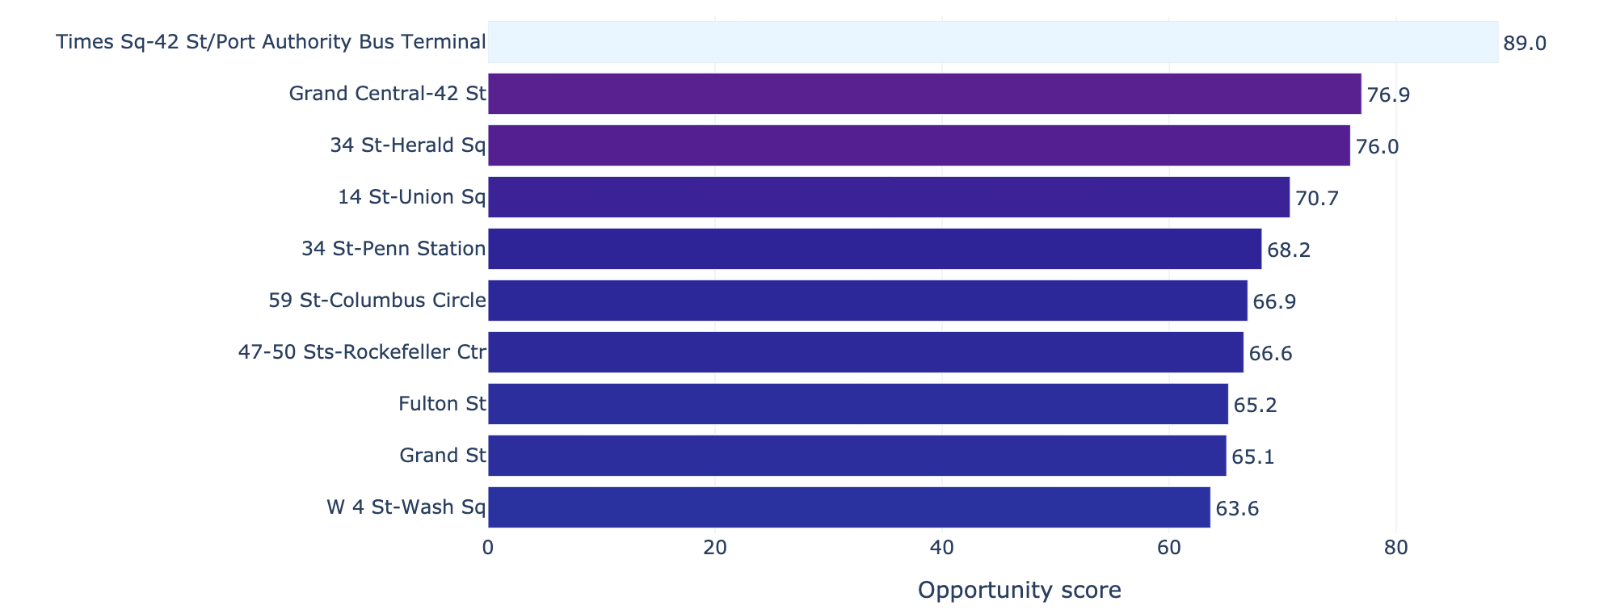
Results
Where to expand: Top 10 transit opportunity zones

Slide 14
Business Impact
The investment case in three numbers:
$11.3M/yr
net operating profit from 250 new stations
$32M total investment
17-month payback
Reduced congestion + lower emissions for 8.3M residents

Slide 15


Recommendations
End with clear, actionable strategy, not generic suggestions about “future research”. This slide proves that your team can think beyond the data and guide organizational decision-making.
Strategic Next Steps
Phase 1. Validate
50 stations in top MTA zones
Measure actual vs predicted × 6 months
Phase 2. Scale
200 remaining stations
Integrate real-time MTA delay feeds
Phase 3: Optimize

Slide 16



Executive Summary
The Problem
The Insight
The Value
50% of stations maxed out.
MTA deteriorating. 8.3M residents need options.
Demand is predictable.
XGBoost MAE 11.24. MTA data shows exactly where to expand.
250 stations → $11.3M/yr
17-month payback. The data says invest now.

Slide 17
Thank You
Nathan · Jenny · Nosaifa
citibike-citycycle.streamlit.app
Questions?

