Slide 1
Ancestral Transcriptome Inference based on RNA-Seq and ChIP-seq data
Jingwen Yang
2018/03/25

Slide 2
1. Introduction
Ancestral state reconstruction along a phylogenetic tree constitutes a central part in comparative methods in evolutionary biology
One would trace the evolutionary changes of gene regulation if the ancestral patterns of transcriptome state can be constructed
By means of RNA-seq or/and ChIP-seq data, evolution of tissue expression or TF-binding profiles or the relations between such two molecular phenomics has been wildly studied in various lives

Slide 3
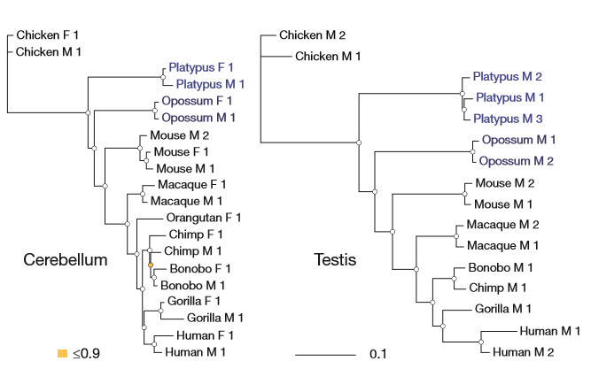
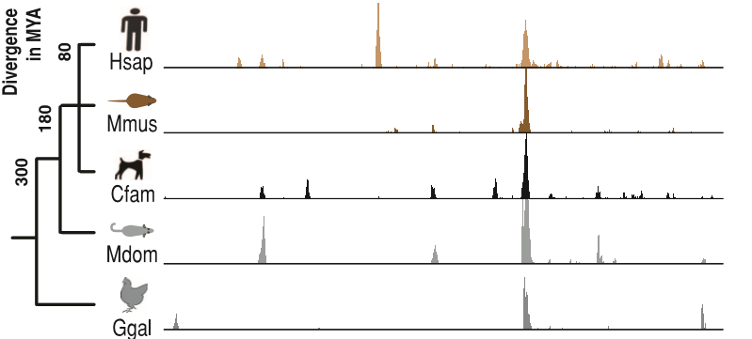
1. Introduction
Brawand et al. showed that the expression phylogeny of each tissue largely reflected the evolutionary relatedness of these species
Schmidt et al. reported that genomic regions occupied by CEBPA which are all conserved in human, mouse, dog and opossum make up only a small proportion.

Slide 4
1. Introduction
Ancestral transcriptome inference based on RNA-seq and ChIP-seq data is very helpful to unravel the complexity of gene regulation and expression.
Integrated, statistically sound, and computationally efficient analytical framework which can be applied to the transcriptome datasets is still limited and remains challenging.
The concept of Bayesian-based comparative methods for gene expression evolution, is helpful to establish a bridge between massive Omics data and phylogenetic analysis
Gu X 2004. Statistical framework for phylogenomic analysis of gene family expression profiles. Genetics 167: 531-542.

Slide 5
1. Introduction
In this research:
We reported an updated version of ancestral inference originally developed by Gu 2004. The new version can deal with both RNA-seq and ChIP-seq data.
A case study using the binding data for three liver-specific TFs and liver expression data in four closely related mouse strains is discussed.
Together with TreeExp, all these programs are under the framework of Evolutionary Analysis of Molecular Phenomes (EAMP for short).

Slide 6
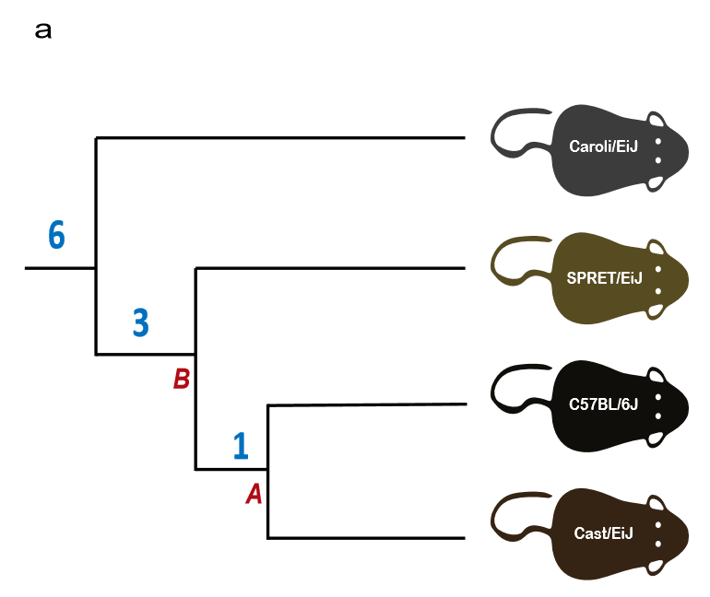
2. Materials and Methods
2.1 RNA-seq and ChIP-seq datasets used in mice species.
CAR
SPRET
BL6
CAST
RNA-seq data for liver tissues：ArrayExpress accession number E-MTAB-1091
ChIP-seq data for CEBPA, HNF4A and FOXA1：ArrayExpress accession number E-MTAB-1414

Slide 7

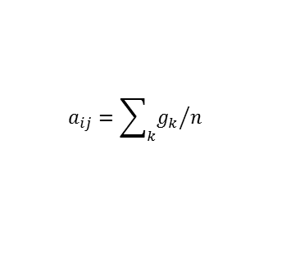

2. Materials and Methods
2.2 Data pretreatments and quantification
For RNA-seq analysis:
TPM (transcript per million) was taken as expression level.
Gene with TPM less than 1 in any species was removed.
A pseudocount of 1 added prior to the log-transformation.
For ChIP-seq analysis:
Mean binding intensity was taken as binding score.
Gene with TF binding scores equals to 0 for all species was excluded.
Binding scores were quantile-normalized and log-transformed.
$$g_{k}$$
TSS
$$a_{ij}={\sum_{k}{g_{k}}}/n$$
$±$10kb
After data pretreatments:
12416 genes were identified as expressed in at least one mouse species
over 20000 genes (varies between TFs) bound by the TF in at least one species
12138 genes are then used to perform the comparison of expression and TF binding profiles.

Slide 8
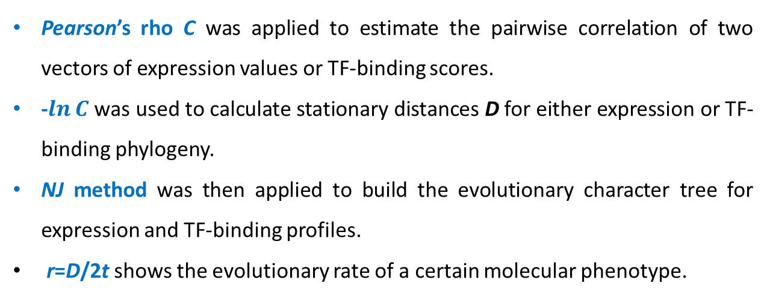
2. Materials and Methods
2.3 Phylogenetic analysis of transcriptome phenotypes
Pearson’s rho C was applied to estimate the pairwise correlation of two vectors of expression values or TF-binding scores.
-$\ln{C}$ was used to calculate stationary distances D for either expression or TF-binding phylogeny.
NJ method was then applied to build the evolutionary character tree for expression and TF-binding profiles.
r=D/2t shows the evolutionary rate of a certain molecular phenotype.

Slide 9
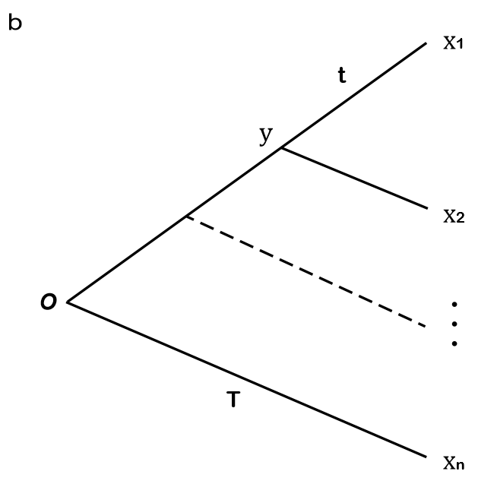



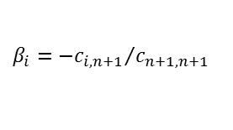
3. Results and Discussion
3.1 Principle of ancestral transcriptome inference
Let X be the molecular phenotype related to transcriptome. Under the assumption of independent evolution between lineages, it has been shown that the joint density of x=(x₁,…,x_{n}) under a given phylogeny follows a multivariate normal distribution, with the mean vector μ and the variance-covariance matrix V
Let y be the expression variable at the ancestral (internal) node of interest. According to the Bayes rule, the posterior density P(y|x₁,..., x_{n}) can be computed as follows
$$P\left(y | x_{1}, ···, x_{n}\right)=\frac{P(x_{1}, ···, x_{n}, y)}{P(x_{1}, ···, x_{n})}$$
The posterior mean of y conditional of x₁,..., x_{n} is given by
$$\left(y | x_{1}, ···, x_{n}\right)=E\left(y | x_{1}, ···, x_{n}\right)=β_{0}+\sum_{i=1}^{n}{β_{i}x_{i}}$$
where
$β_{i}={−c_{i,n+1}}/{c_{n+1, n+1}}$
$$β_{0}=θ_{t}(1+β_{1}+β_{2}+ ··· +β_{n})$$
In short, the posterior mean prediction for the ancestral value is a linear function of current gene value.

Slide 10
3. Results and Discussion
3.2 Implementation and software
R package
AnceTran (https:github.com/jingwyang/AnceTran)
README
AnceTran can perform analyses of transcriptome evolution based on RNA-seq expression data or ChIP-seq TF binding data
The main functions includes:
Optimized input formatting and normalization
Pair-wise distance evaluation
Transcriptome character tree construction
Ancestral transcriptome state inference.

Slide 11
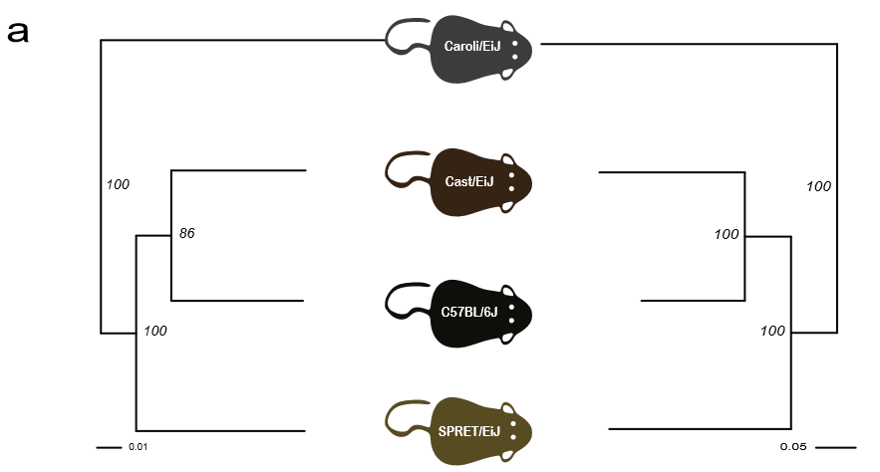
3.3 Case-study: Large-scale RNA-seq and ChIP-seq data analysis in mice
(i).Phylogenetic signals of transcriptome profiles in mice species

Slide 12
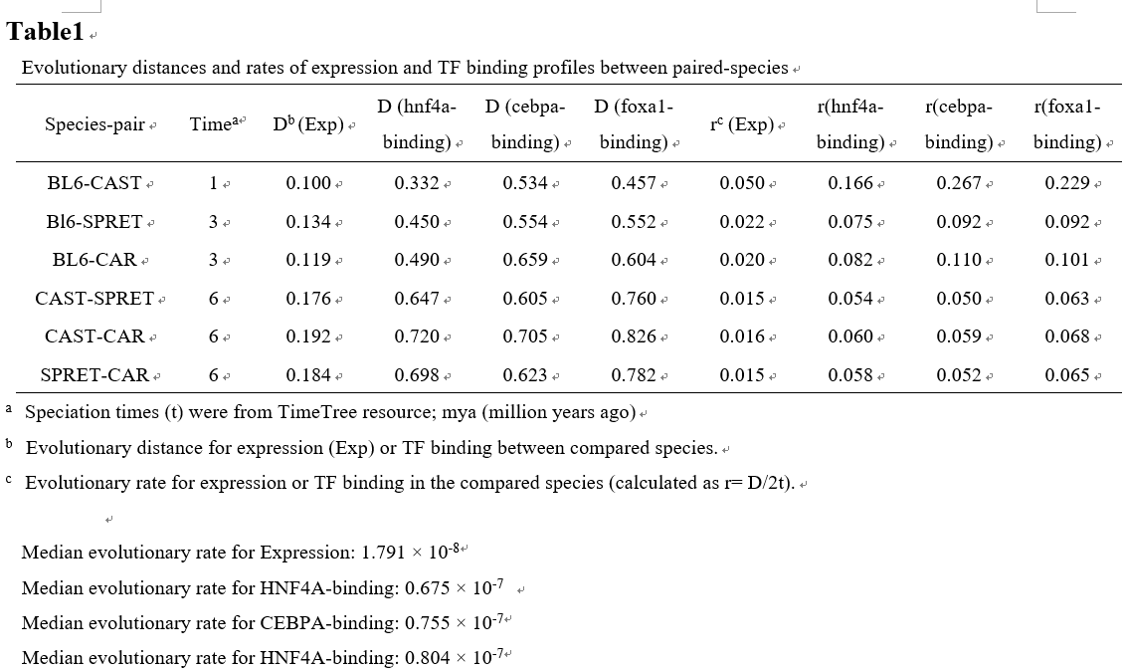
3.3 Case-study: Large-scale RNA-seq and ChIP-seq data analysis in mice
(i).Phylogenetic signals of transcriptome profiles in mice species

Slide 13
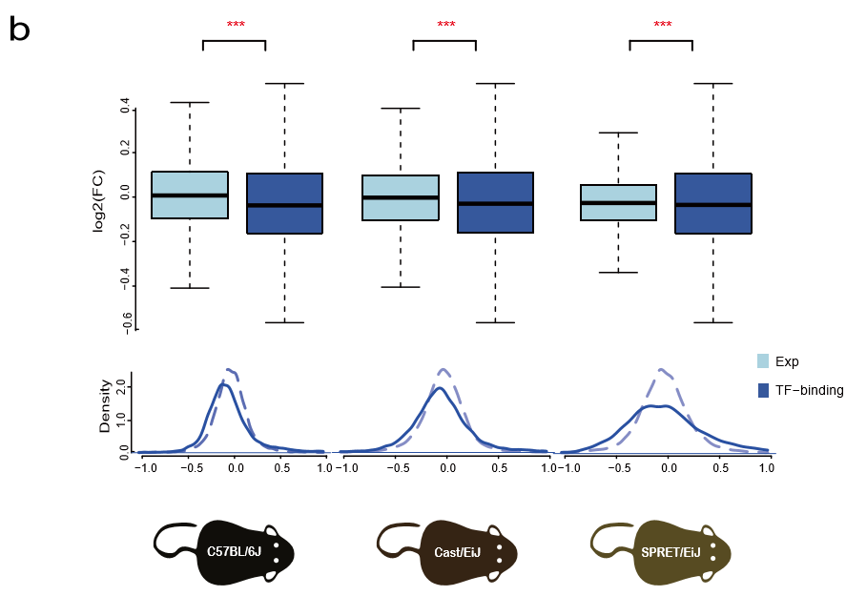
3.3 Case-study: Large-scale RNA-seq and ChIP-seq data analysis in mice
(ii).Ancestral transcriptome inference for expression value and TF-binging state
CAR
B
SPRET
CAST
BL6

Slide 14
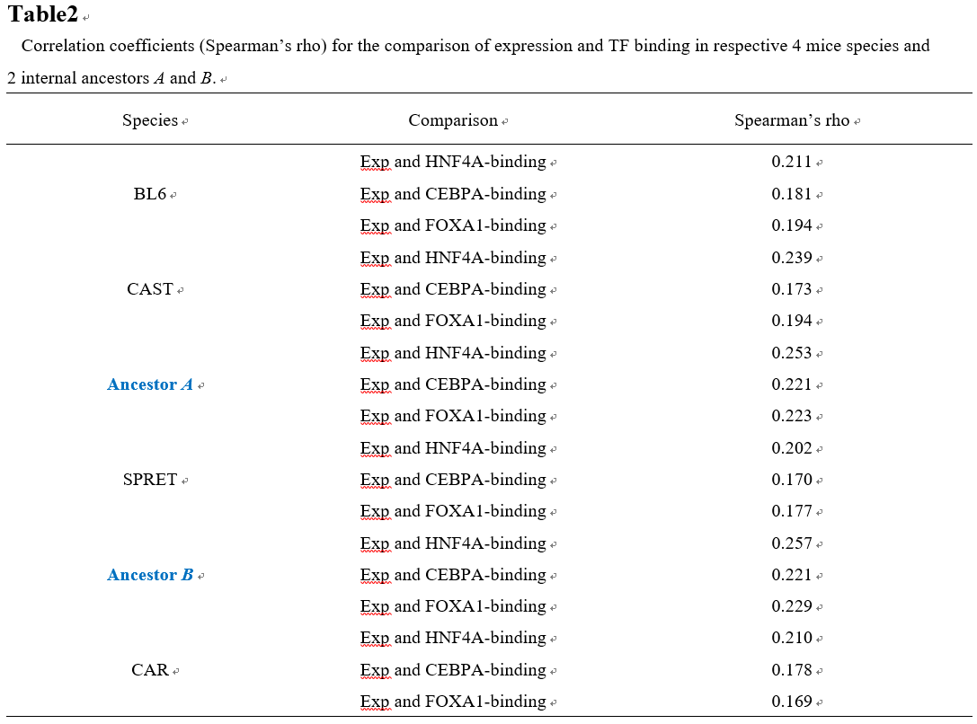
3.3 Case-study: Large-scale RNA-seq and ChIP-seq data analysis in mice
(iii).Relatively weak links between gene expression and TF binding state

Slide 15
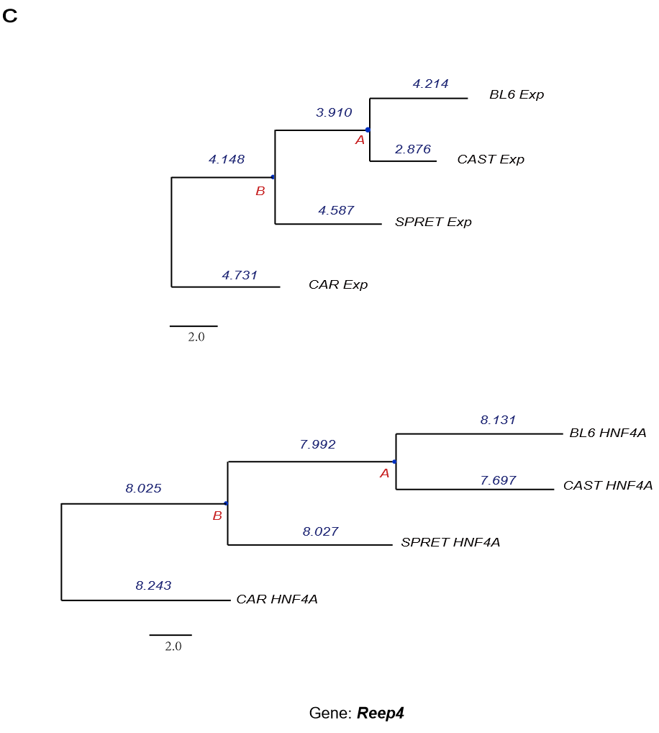
3.3 Case-study: Large-scale RNA-seq and ChIP-seq data analysis in mice
(iii).Relatively weak links between gene expression and TF binding state
log2FC
A to BL6：0.304
A to CAST：1.034
log2FC
A to BL6：0.139
A to CAST：-0.295

Slide 16
3.4 Some technical issues
Statistical reliability of empirical Bayesian estimates
The number of species (n) that determines stochastic variance (V_{stoc})
The number of biological replicates (m) that determines sampling variance (V_{samp})
Var(y) ≈ V_{stoc}+V_{samp，}
V_{stoc} ≈ σ²_{y|x}=1/c_{n+1,n+1，}
V_{samp}=σ²/m
Effects of phylogenetic structure
The inferred ancestral value is phylogenetic-sensitive
Extension to many-to-many orthologous genes
Dosage effect
Expression compensation
Model assumption
OU model will underestimate the true strength of stabilizing selection if the transcriptome optimum is subject to random variation.
Estimation bias may occur if the fitness consequence by mutations to lower expression is more severe than that to higher expression

Slide 17
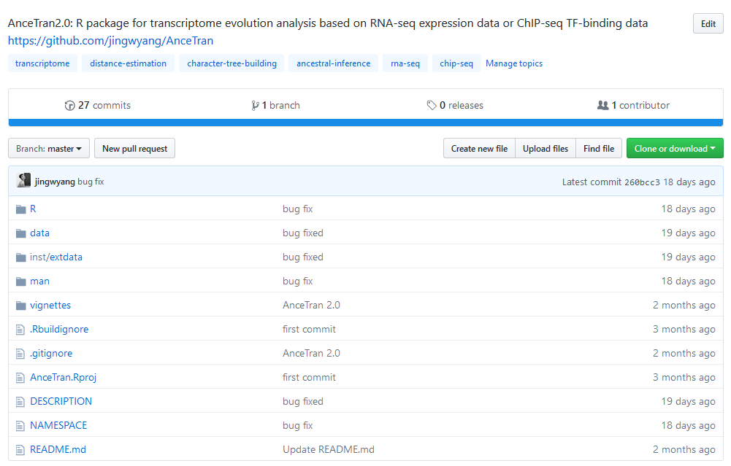
R package: AnceTran (https://github.com/jingwyang/AnceTran)

Slide 18
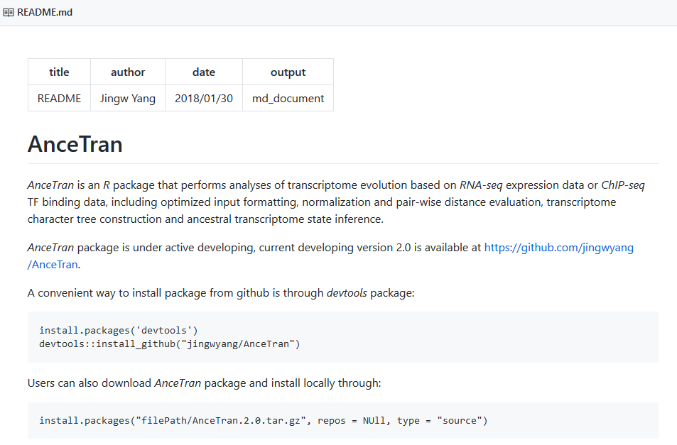
R package: AnceTran (https://github.com/jingwyang/AnceTran)

Slide 19
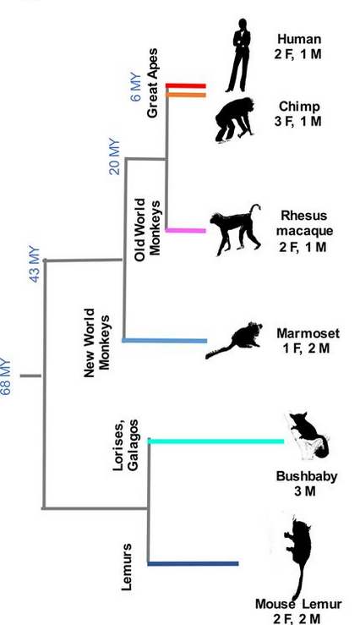
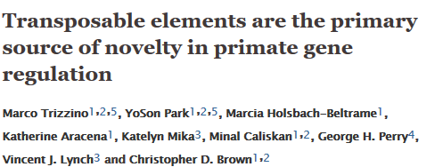
Further exploration of other types of Molecular Phenomes···
like chromatin accessibility profiles
Data Type:
Liver RNA-seq
Liver ChIP-seq (H3K27AC, H3K4me1)
Species:
Human, Chimp, Macaque, Marmoset Bushbaby, Mouse Lemur
Data Resource:
BioProject;
Accession numbers:
PRJNA349047 (RNA-seq)
PRJNA349046 (ChIP-seq)

Slide 20

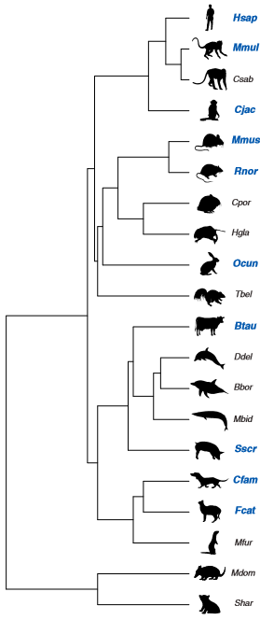
Data Type:
Liver ChIP-seq (H3K27AC, H3K4me3)
Species:
Human, Macaque, Vervet, Marmoset, Mouse, Rat, Guinea pig, Naked mole rat, Rabbit,
Tree shrew, Cow, Dolphin, Sei whale, Sowerby’s beaked whale, Pig, Dog, Cat, Ferret, Opossum, Tasmanian Devil
Data Resource:
ArrayExpress
Accession number:
E-MTAB-2633

Slide 21
Thanks

