Slide 1


View-Volume Network for Semantic Scene Completion from a Single Depth Image
Yuxiao Guo¹, Xin Tong²
¹University of Electronic Science and Technology of China
²Microsoft Research Asia

Slide 2
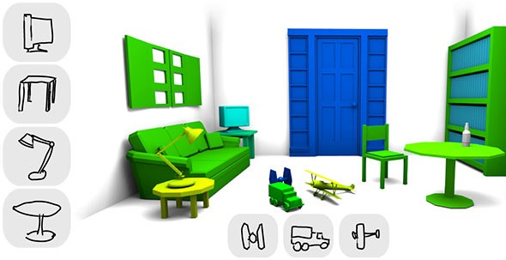
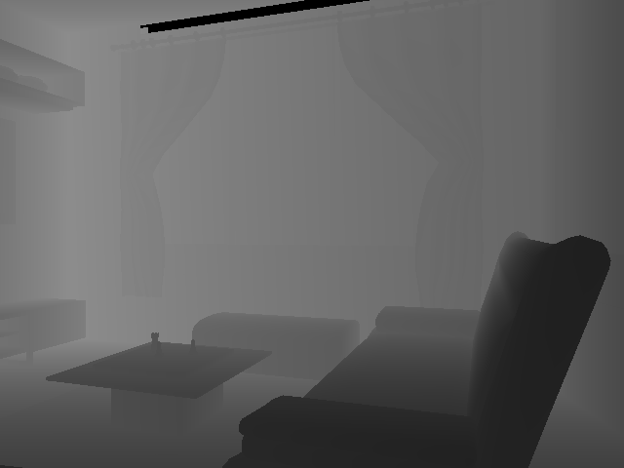
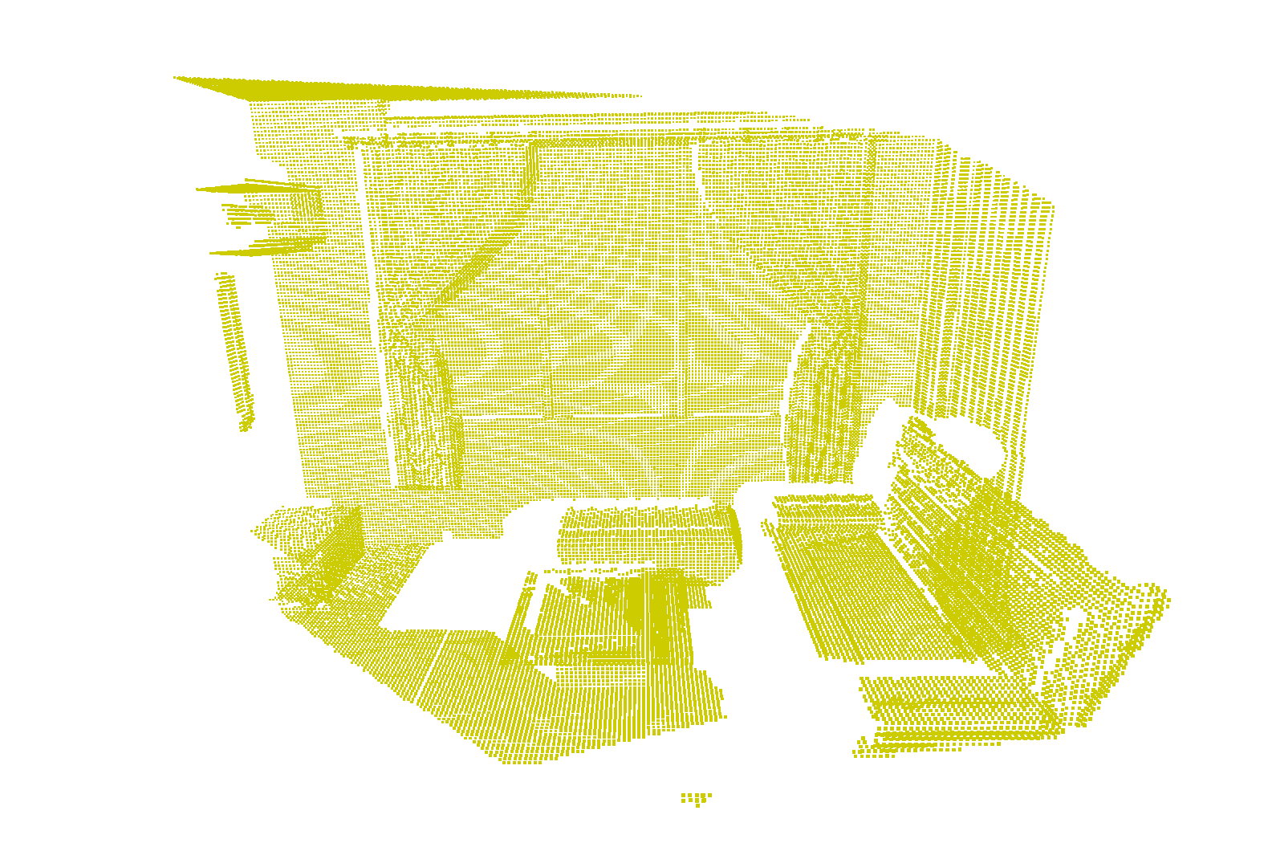
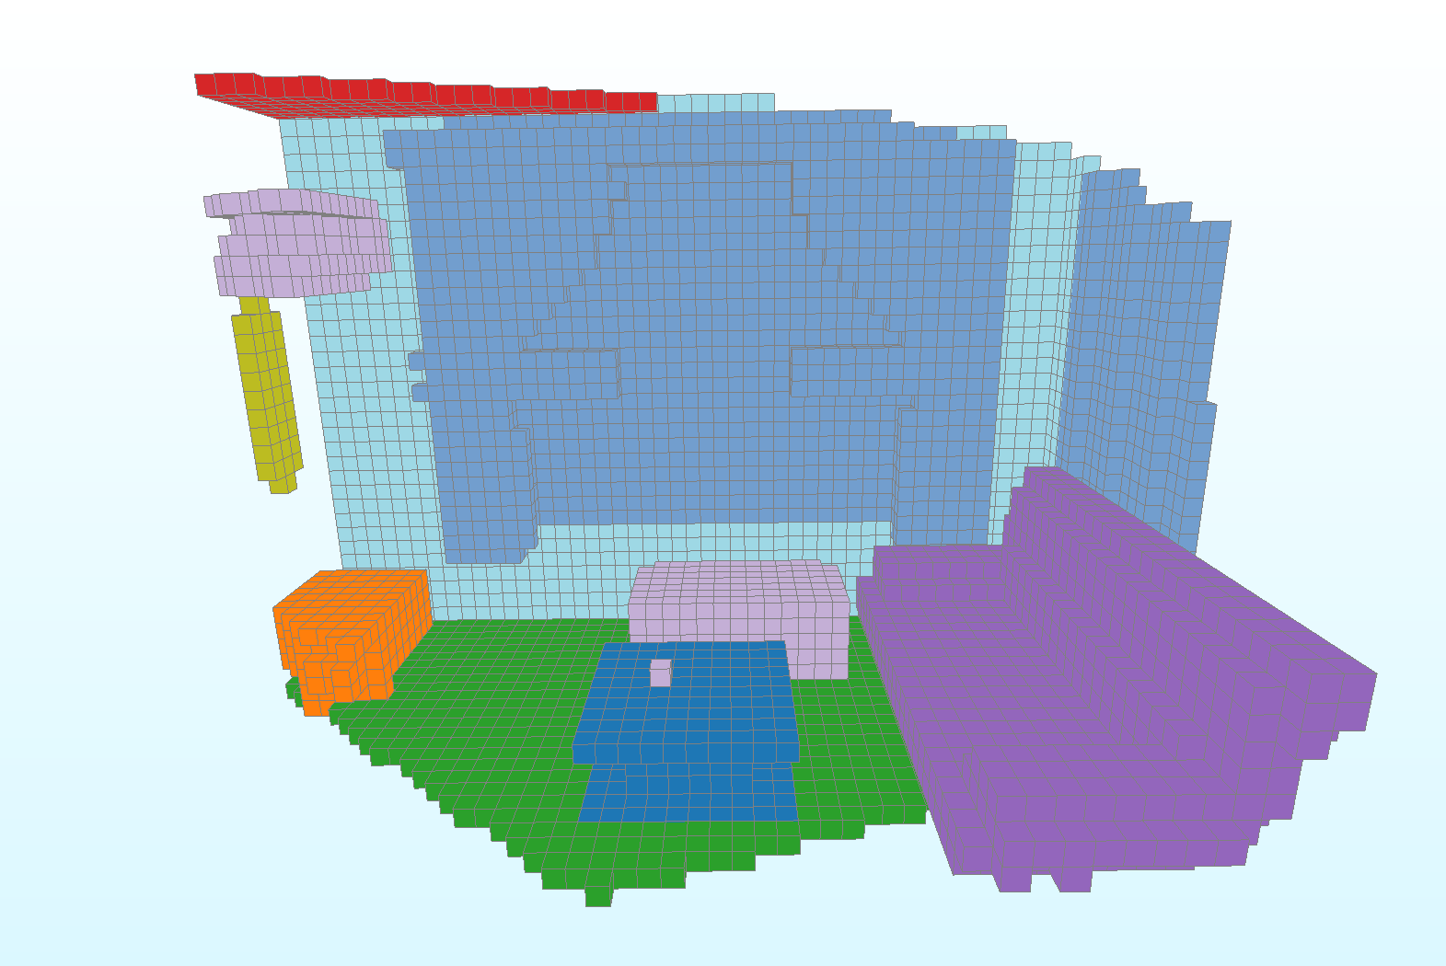
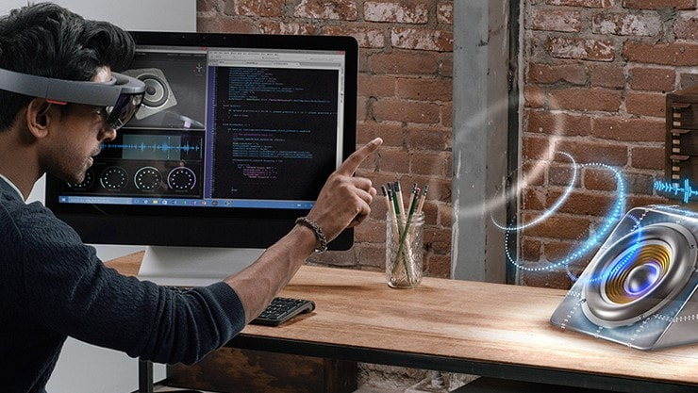
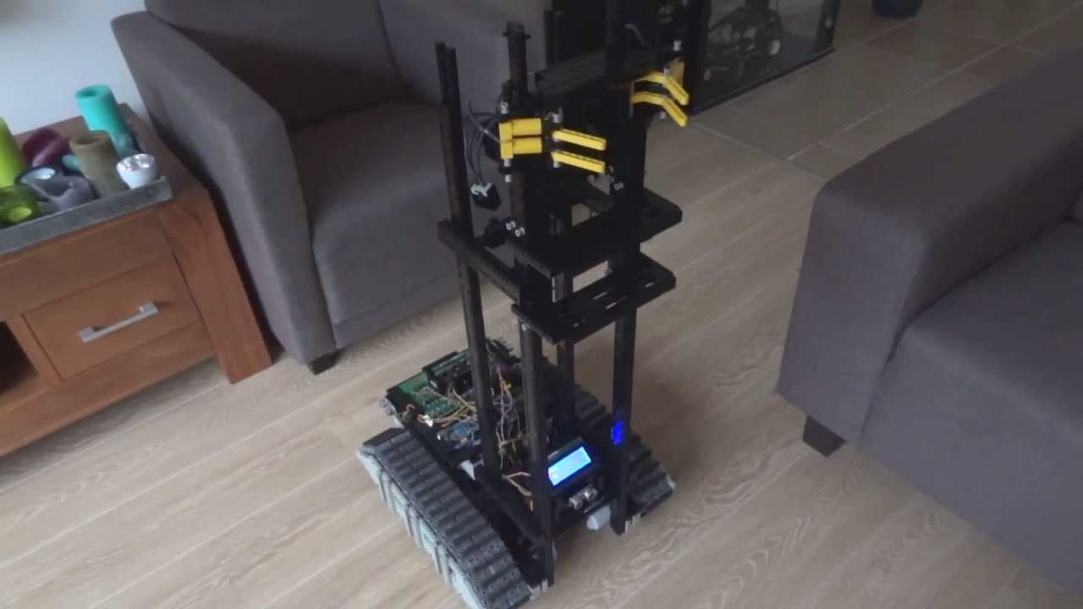
Introduction
Reconstruct and understand the 3D Scene from a depth image
Complete invisible 3D shapes
Predict semantic labels
?
Object retrieval
Local geometric details + Global 3D context
AR/VR
Robot navigation
Notes:
60s

Slide 3
Related work
2D CNN based methods
Use the depth image as the extra channel of 2D CNN.
Computation efficiency; Utilize typical 2D CNN methods;
Unable to infer invisible part of the 3D scene.
3D CNN based methods
Convert depth into volumetric representation and design 3D CNN.
Straight-forward; End-to-end solution;
Expensive computational and memory cost.
2D-3D hybrid representation methods
Learn a common code representation (via RNN, 2D-3D auto-encoder).
Work fine on 3D object level applications.
The capacity of code limits its extension.
Notes:
30s

Slide 4
Key idea
View-volume pipeline:
Project learned 2D features into volume
2D View CNN
View Projection
3D Volume CNN
Learn local features
Organize 3D global context
We want the proposed novel framework to satisfy:
Fully utilize the details from high-resolution images
Support extract features from multi-channel inputs
Avoid heavy 3D convolution in high-resolution volume
Notes:
We believe there is no difference between 2D and 3D CNNs in fine-level features extraction.
3D CNN only exists in lower resolution could save lots of computational resource.

Slide 5
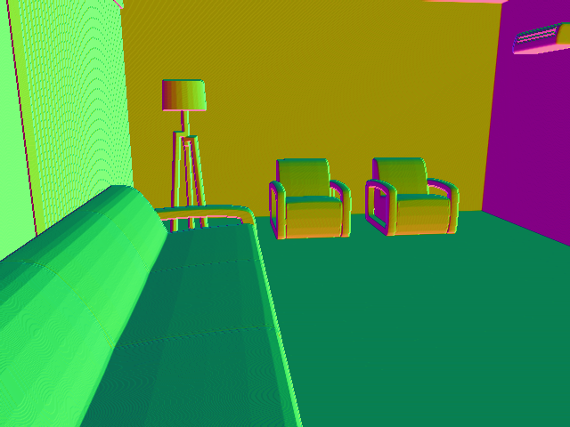
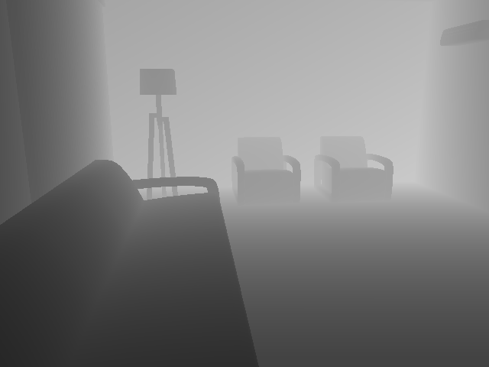
View-volume framework
Res2D(8,1)
Pooling
Res2D(16,1)
Pooling
Res3D(32,1)
Pooling
Backbone
60x36x60
View Projection
640x480
160x120
120x72x120
60x36x60
60x36x60
VVNetR backbone
Res3D(64,1)
Conv(c,3,1,d)
BatchNorm
Conv(c,3,1,d)
BatchNorm
Plus
Res3D(64,2)
Res3D(64,2)
Res3D(64,2)
Concat
Conv(128,1,1,1)
Conv(128,1,1,1)
Conv(12,1,1,1)
Conv(c,3,1,d)
Conv(c,3,1,d)
Plus
Conv(12,1,1,1)
Res3D(64,1)
Pooling
Res3D(128,1)
Res3D(128,2)
Res3D(128,2)
Concat
Deonv(128,3,1,1)
Conv(128,1,1,1)
Project 2D features into 3D volume with following steps:
Up-sample feature maps to input depth resolution
Project 2D features into volume with corresponding depth guidance
Average projected features within a voxel
Multi-scale residual concatenate structure to enlarge reception field
Use depth to derive normal then concatenate them as input signal
A standard residual network component to extract image features
A standard residual network component to extract volume features
ResNet2D(c, d)
ResNet3D(c, d)
30x18x30
60x36x60
*c stands for the output feature channels of convolution; d stands for dilation stride of convolution.
Notes:
150s

Slide 6
View-volume fusion tradeoff
View
Projection
VVNetR120
640x480
320x240
120x72x120
60x36x60
30x18x30
VVNetR60
View
Projection
640x480
320x240
160x120
60x36x60
30x18x30
VVNetR30
View
Projection
640x480
320x240
160x120
80x60
30x18x30
Notes:
View-volume structure provides flexible fusion timing choice.

Slide 7
Validation—proposed framework
 | Scene Completion |  |  | Semantic Scene Completion
Network | prec. | recall | IoU | ceil. | floor | wall | win. | chair | bed | sofa | table | TVs | furn. | objs. | avg.
SSCNet | 76.3 | 95.2 | 73.5 | 96.3 | 84.9 | 56.8 | 28.2 | 21.3 | 56.0 | 52.7 | 33.7 | 10.9 | 44.3 | 25.4 | 46.4
SSCNet* | 90.4 | 89.7 | 82.0 | 97.8 | 88.2 | 59.4 | 37.3 | 39.3 | 77.9 | 68.9 | 48.3 | 31.5 | 56.8 | 44.9 | 59.1
SSCNet*-half | 90.5 | 89.5 | 81.9 | 97.8 | 88.0 | 60.8 | 34.8 | 39.8 | 77.5 | 69.5 | 47.8 | 29.8 | 56.0 | 44.8 | 58.8
VVNet120-half | 90.7 | 89.6 | 82.1 | 97.9 | 85.2 | 59.4 | 47.5 | 44.2 | 77.4 | 71.1 | 49.3 | 34.2 | 58.2 | 49.0 | 61.3
VVNet120-depth | 90.6 | 89.6 | 82.0 | 97.6 | 84.8 | 58.6 | 44.5 | 44.8 | 77.6 | 70.7 | 48.8 | 33.2 | 57.8 | 46.2 | 60.4
VVNet120 | 90.8 | 90.0 | 82.5 | 97.9 | 85.4 | 58.6 | 49.2 | 45.3 | 79.2 | 71.8 | 50.3 | 37.3 | 62.0 | 50.9 | 62.5
VVNetR120 | 90.8 | 91.7 | 84.0 | 98.4 | 87.0 | 61.0 | 54.8 | 49.3 | 83.0 | 75.5 | 55.1 | 43.5 | 68.8 | 57.7 | 66.7
Analysis:
Performance of different variant VVNet design on SUNCG dataset
Does higher image resolution help?
Higher-resolution image helps learn local features
Does multi-channel input help?
Extra channels will help extract better features
Does view-volume network work?
Perform better results compared with SSCNet
Does larger reception field help?
Larger reception field still improves results
* SSCNet [Song et al. 2017]. Shuran Song, Fisher Yu, Andy Zeng, Angel X Chang, Manolis Savva and Tomos Funkhouser. Semantic Scene Completion from a single depth image. CVPR 2017.
Notes:
60s

Slide 8
Validation—Tradeoffs
 | Scene Completion |  |  | Semantic Scene Completion
Network | prec. | recall | IoU | ceil. | floor | wall | win. | chair | bed | sofa | table | TVs | furn. | objs. | avg.
VVNetR120 | 90.8 | 91.7 | 84.0 | 98.4 | 87.0 | 61.0 | 54.8 | 49.3 | 83.0 | 75.5 | 55.1 | 43.5 | 68.8 | 57.7 | 66.7
VVNetR60 | 90.6 | 92.5 | 83.7 | 97.6 | 86.7 | 60.2 | 54.4 | 47.2 | 80.7 | 75.0 | 53.8 | 39.4 | 66.9 | 56.1 | 65.3
VVNetR30 | 88.8 | 90.2 | 81.0 | 98.0 | 86.4 | 55.6 | 54.8 | 41.8 | 78.0 | 72.1 | 48.7 | 31.6 | 63.2 | 51.8 | 62.0
Performance of VVNetR120, VVNetR60 and VVNetR30 on SUNCG dataset
 | Training |  | Inference
Network | Memory | Speed | Speed
SSCNet* | 852M | 912ms | 578ms
VVNet120 | 846M | 386ms | 75ms
VVNetR120 | 712M | 375ms | 74ms
VVNetR60 | 336M | 194ms | 51ms
VVNetR30 | 246M | 156ms | 45ms
VVNet and its variant networks reduce memory and computation cost compared with pure 3D CNN method
Later fusing between view and volume networks will lead faster speed and less memory, but lower accuracy
Memory footprints and computational time of
different networks
Notes:
30s

Slide 9
Comparison—NYU & NYUCAD
 | Scene Completion |  |  | Semantic Scene Completion
Method | prec. | recall | IoU | ceil. | floor | wall | win. | chair | bed | sofa | table | TVs | furn. | objs. | avg.
[Lin et al., 2013] | 58.5 | 49.9 | 36.4 | 0.0 | 11.7 | 13.3 | 14.1 | 9.4 | 29.0 | 24.0 | 6.0 | 7.0 | 16.2 | 1.1 | 12.0
[Geiger et al., 2015] | 65.7 | 58.0 | 44.4 | 10.2 | 62.5 | 19.1 | 5.8 | 8.5 | 40.6 | 27.7 | 7.0 | 6.0 | 22.6 | 5.9 | 19.6
SSCNet | 59.3 | 92.9 | 56.6 | 15.1 | 94.6 | 24.7 | 10.8 | 17.3 | 53.2 | 45.9 | 15.9 | 13.9 | 31.1 | 12.6 | 30.5
SSCNet* | 69.7 | 81.3 | 59.8 | 16.1 | 94.8 | 27.0 | 10.1 | 20.6 | 53.2 | 50.1 | 16.7 | 14.3 | 35.5 | 13.0 | 31.9
VVNet120 | 68.4 | 83.2 | 60.0 | 19.2 | 94.4 | 27.2 | 13.8 | 19.1 | 54.0 | 49.3 | 17.1 | 11.2 | 35.3 | 12.4 | 32.1
VVNetR120 | 69.8 | 83.1 | 61.1 | 19.3 | 94.8 | 28.0 | 12.2 | 19.6 | 57.0 | 50.5 | 17.6 | 11.9 | 35.6 | 15.3 | 32.9
VVNetR60 | 68.3 | 85.1 | 60.9 | 21.6 | 94.5 | 28.6 | 12.9 | 19.7 | 56.3 | 51.0 | 17.2 | 10.4 | 35.2 | 15.6 | 33.0
Performance of different semantic scene completion methods on NYU dataset
Method | prec. | recall | IoU
[Zheng et al., 2013] | 58.5 | 49.9 | 36.4
[Firman et al., 2015] | 65.7 | 58.0 | 44.4
SSCNet | 59.3 | 92.9 | 56.6
SSCNet* | 69.7 | 81.3 | 59.8
VVNet120 | 68.4 | 83.2 | 60.0
VVNetR120 | 69.8 | 83.1 | 61.1
VVNetR60 | 68.3 | 85.1 | 60.9
VVNet and its variant structure achieve the best performance among all the methods.
*[Lin et al., 2013] Dahua Lin, Sanja Fidler and Raquel Urtasun. Holistic Scene Understanding for 3D Object Detection with
RGBD Camera. ICCV 2013.
*[Geiger et al., 2015] Andreas Geiger and Chaohui Wang. Joint 3D Object and Layout Inference from a Single RGB-D image
*[Zheng et al., 2013] Bo Zheng, Yibiao Zhao, Joey C. Yu, Katsushi Ikeuchi and Song-Chun Zhu. Beyond Point Clouds: Scene
Understanding by Reasoning Geometry and Physics. CVPR 2013.
*[Firman et al., 2016] Michael Firman, Oisin Mac Aodha, Simon Julier and Gabriel J. Brostow. Structured prediction of un-
Observed voxels from a single depth image. GCPR 2015.
Performance of different scene completion methods on
NYUCAD dataset
Notes:
15s

Slide 10
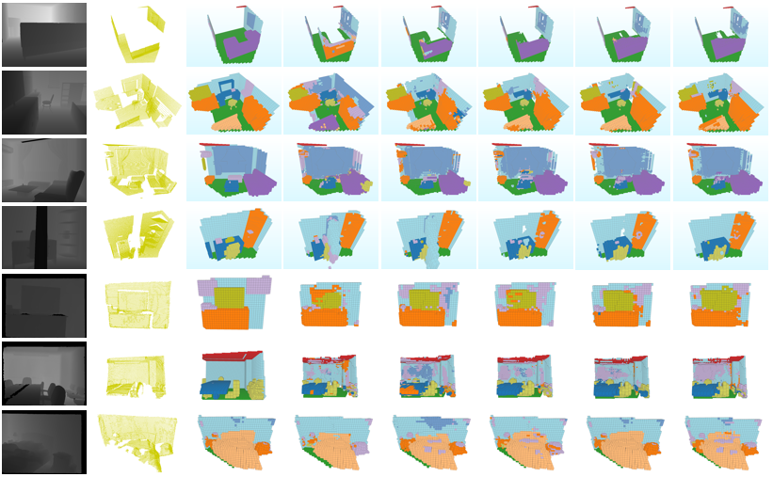
Visualization
Depth
Observed
GT
SSCNet
SSCNet*
VVNet120
VVNetR120
VVNetR60
ceil.
floor
SUNCG
wall
win.
chair
bed
sofa
table
NYU
TVs
furn.
obj.
Notes:
15s

Slide 11
Conclusion
Propose a view-volume CNN for semantic scene completion from a single depth image
Provide a general and flexible framework for fusing 2D and 3D CNNs for efficient 3D learning
Significantly improve the accuracy and reduce the computation cost
Feature work
Explore the trade-offs between 2D and 3D CNNs, using more 2D CNNs instead of 3D CNNs
Extend view-volume framework to multiple-view applications
Notes:
60s

Slide 12
Thanks!

