Slide 1
Demographic Statistics By Zip Code
GROUP 3
Ruichun Chen
Xin Jing
Wenhui Li
Wenzhe Xu
De Yi Huang

Slide 2
Jobs:
Ruichun Chen ---- Team Coordination, Main Function, BST Algorithms, Debug
Xin Jing ---- BST Algorithms, Delete Manger, Undo delete, File Out, BST Debug
Wenhui Li ---- Hash List Algorithms, Test and Debug, Code Integration.
Wenzhe Xu ---- Hash List Algorithms, Test and Debug, Output Formatting
De Yi Huang ---- File I/O

Slide 3
Demographic
The purpose of this program is to look at the population distribution in California, and our data includes the total population, the population of African American, Asian, Hispanic, and White.
This program has zip code as primary key, city name as secondary key, and county name.
Search and Delete the population distribution by zip code and city name
Print out the sorted and unsorted demographic
Read data from the file and insert them to two trees and a hash table

Slide 4
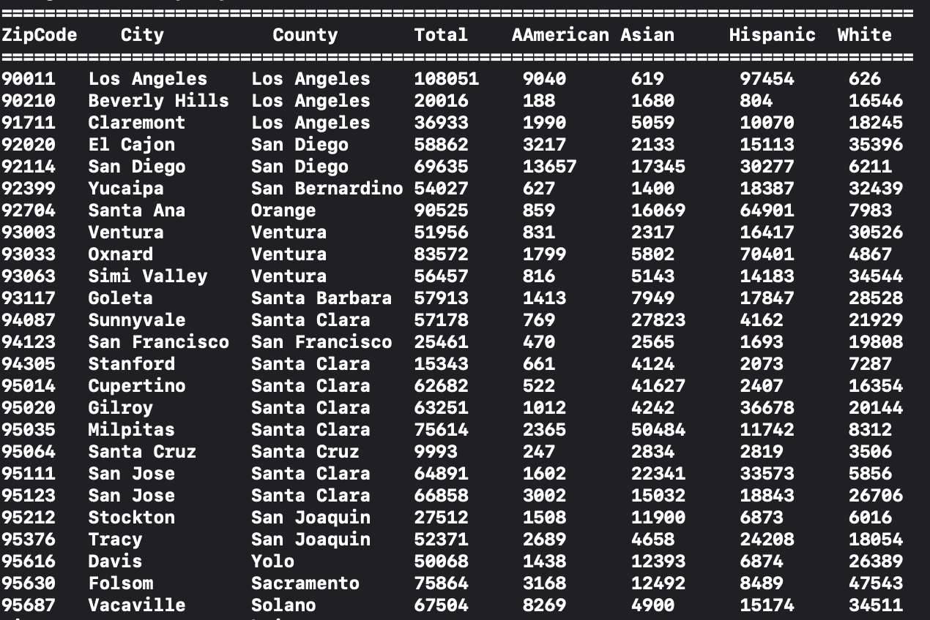
data

Slide 5
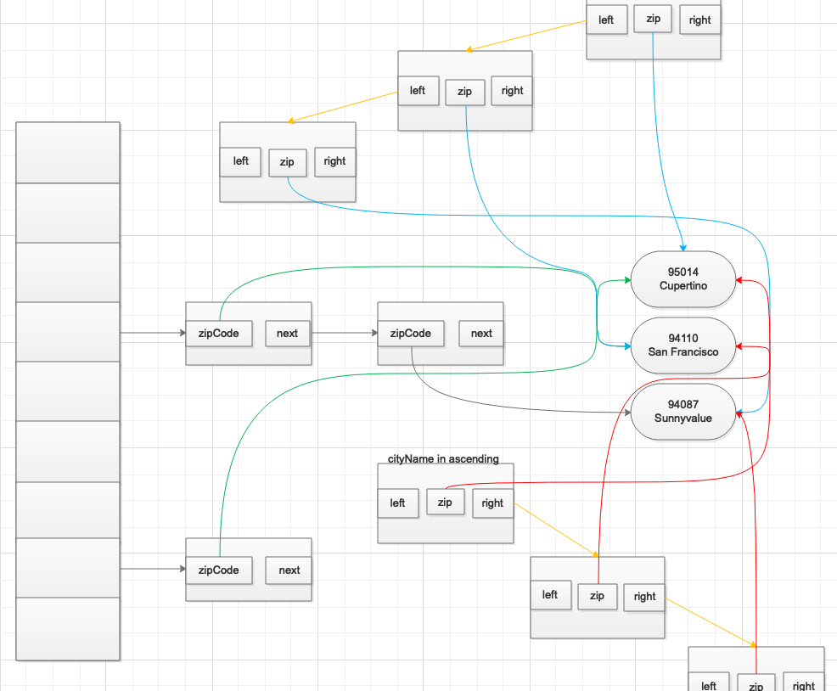
Hash and tree DESIGN
Collision Resolution Method: Linked List

Slide 6
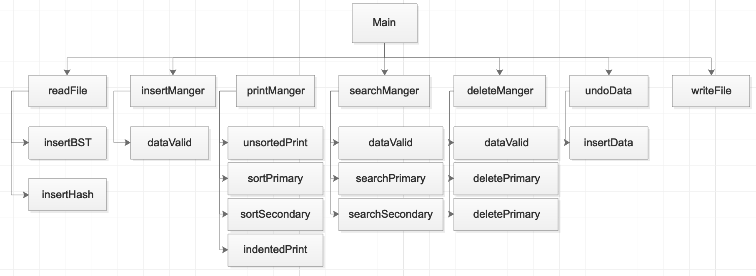
Structure Chart

Slide 7
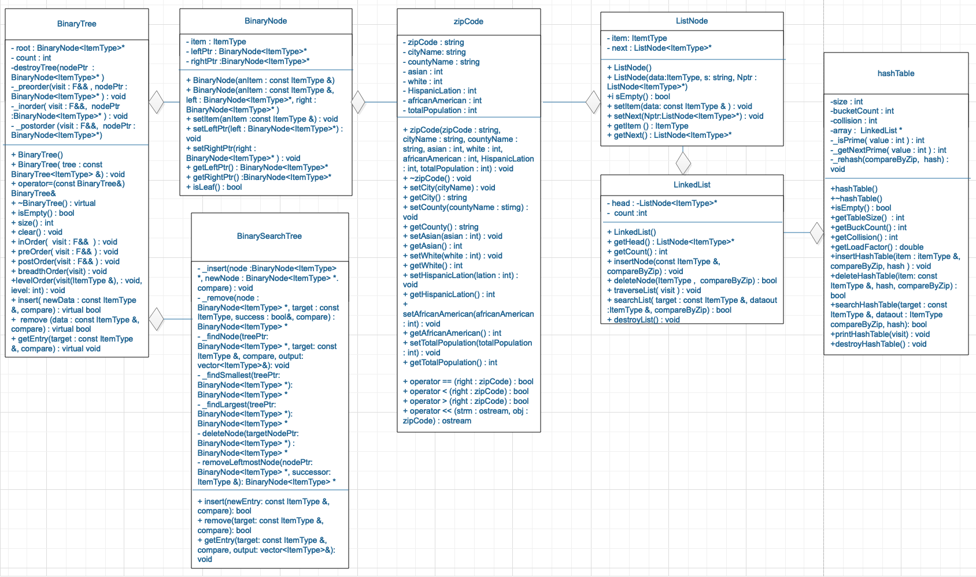
Structure Chart

Slide 8
Hash function
int goodHash(Zipcode* zip, int tableSize)
{
long int sum = 0;
string key = zip->getZipCode();
for (int i = 0; i < key.length(); i++)
{
sum += key[i] * key[i] * key[i] * (i + 1);
}
return sum % tableSize;
}
int badHash(Zipcode* zip, int tableSize)
{
long int sum = 0;
string key = zip->getZipCode();
for (int i = 0; i < key.length(); i++)
{
sum += key[i];
}
return sum % tableSize;
}

Slide 9
Run program

Slide 10
Q&A
Any Question?

Slide 11
Thank you

