Slide 1



Complexity
Event scenario
Production level
Attendees
Solution
Webcams or
screen share
Schedule meeting
Simple
Team meetings
Up to 1,000
Webinars
Virtual conferences
Could be custom
production
Up to 20,000
Webinar
Leadership townhall
Custom
Production
only
Complex
Public broadcasts
Up to 100,000
Live event
…
..

Slide 2


…
Organizer
Producer
Presenter
Moderator
Attendee

Slide 3
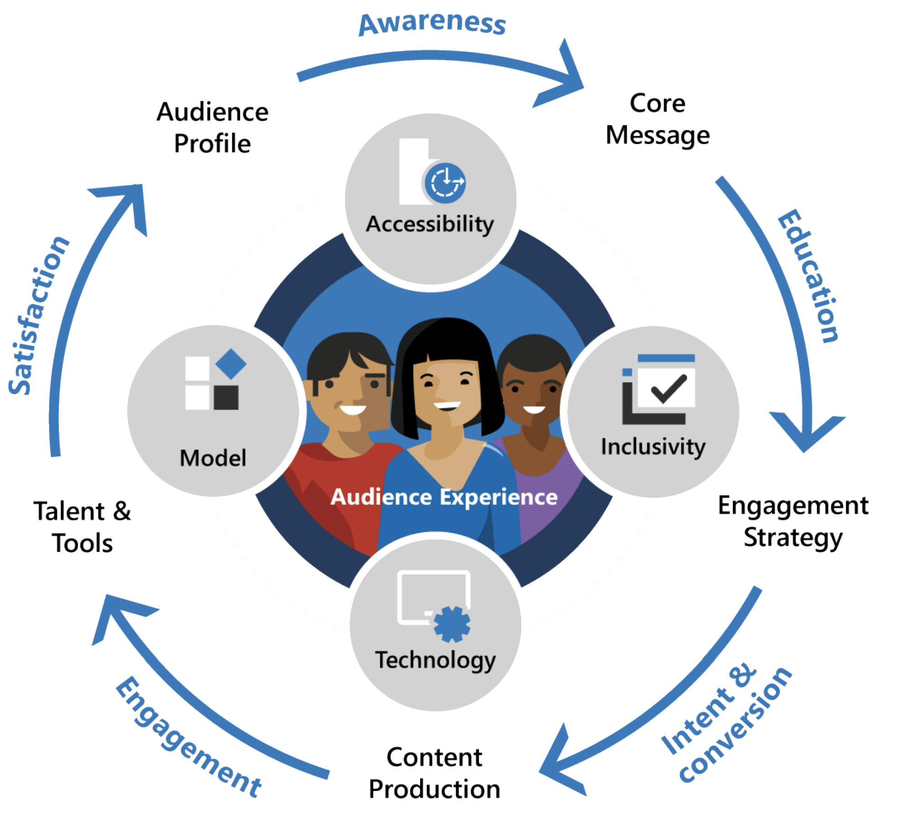

Slide 4





Slide 5
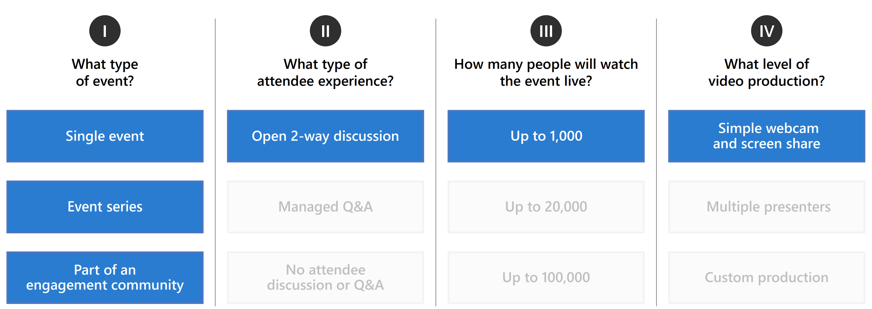
Managed Q&A
Up to 20,000
Multiple presenters

