Slide 1
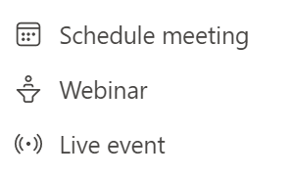
Complexity
Event scenario
Production level
Attendees
Solution
Webcams or
screen share
Schedule meeting
Simple
Team meetings
Up to 1,000
Webinars
Up to 20,000
Webinar
Could be custom
production
Virtual conferences
Leadership townhall
Custom
Production
only
Complex
Public broadcasts
Up to 100,000
Live event

Slide 2


…
Organizer
Producer
Presenter
Moderator
Attendee

Slide 3
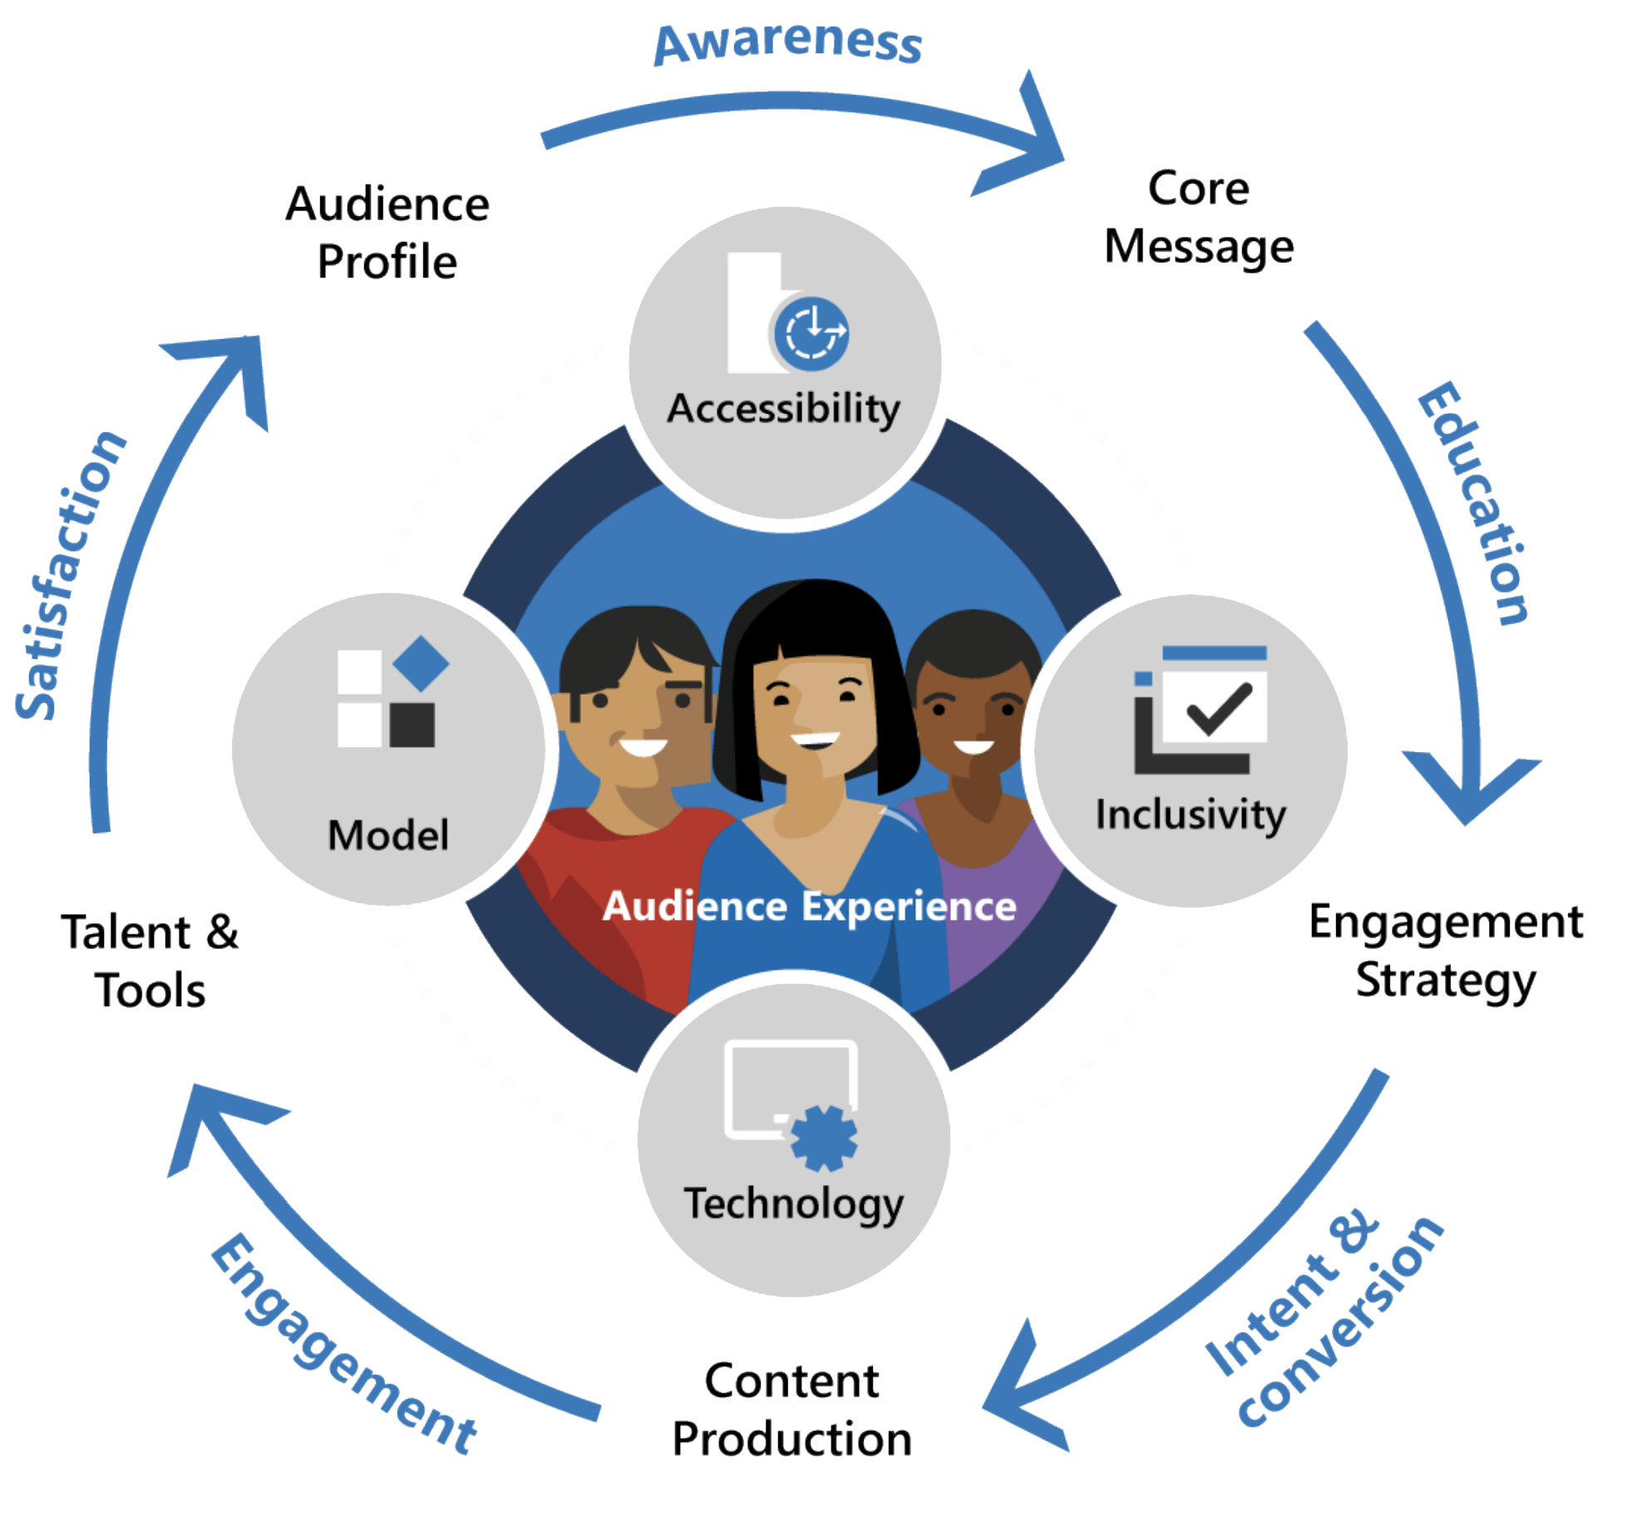

Slide 4





