Slide 1



Complexity
Event scenario
Production level
Attendees
Solution
Simple
Team meetings
Webcams or
screen share
Up to 300
Live event in
Teams
Webinars
Could be custom
production
Live event in
Yammer
Virtual conferences
Leadership townhall
Custom
Production
only
Live event in
Stream
Complex
Public broadcasts
Up to 100,000

Slide 2


…
Organizer
Producer
Presenter
Moderator
Attendee

Slide 3
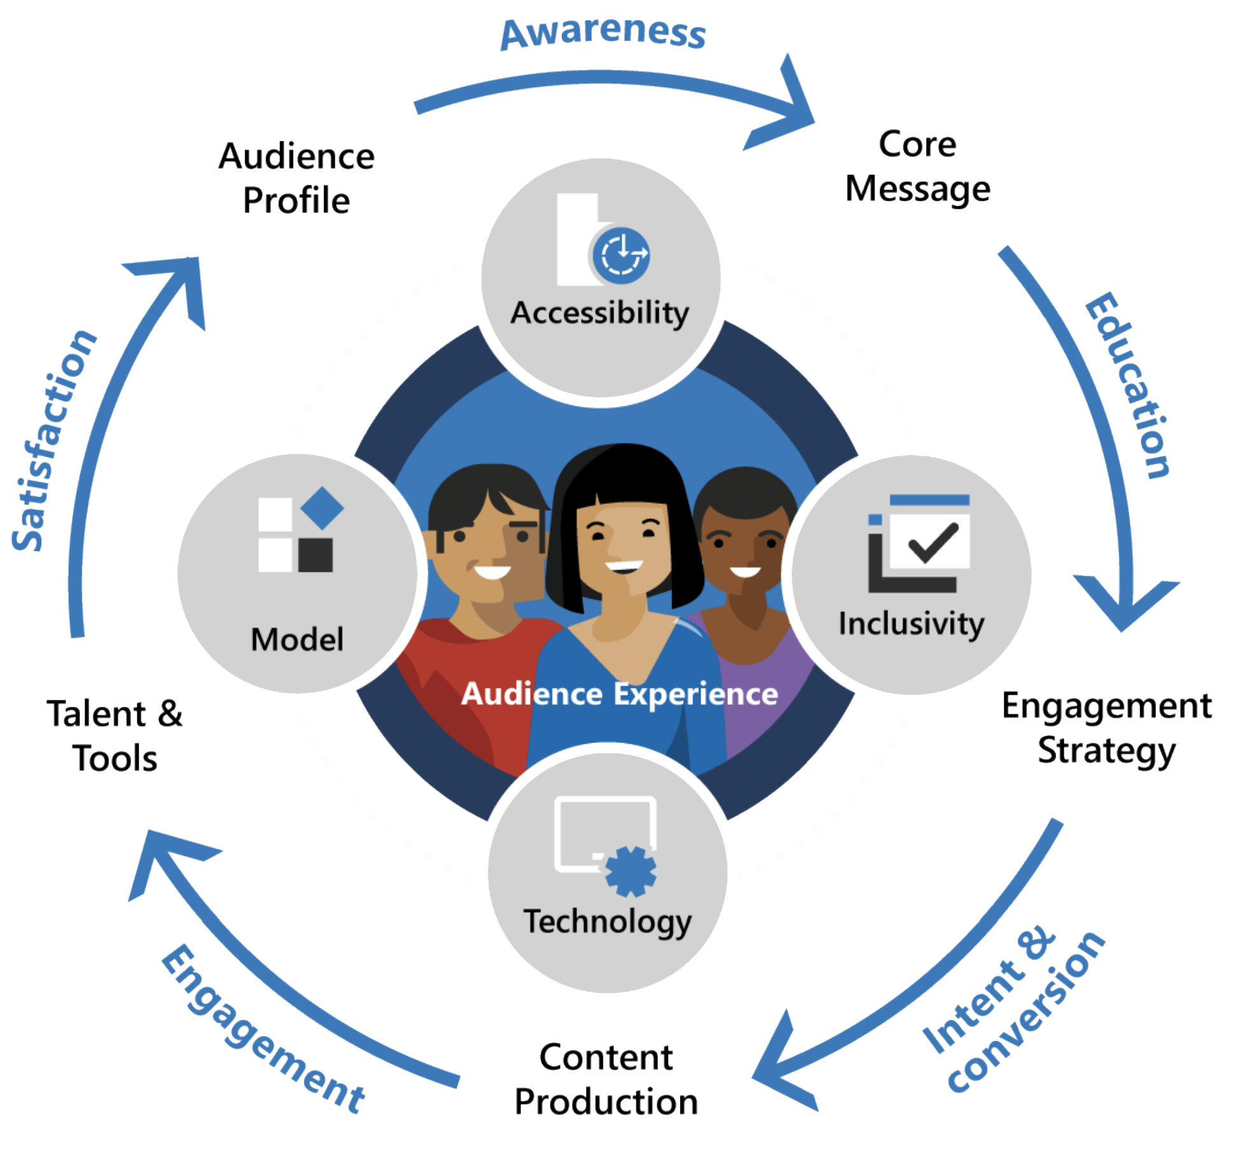

Slide 4


