Slide 1



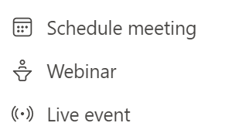


Complexity
Event scenario
Production level
Attendees
Solution
Simple
Team meetings
Webcams or
screen share
Up to 1,000
Webinars
Could be custom
production
Live Event
Virtual conferences
Leadership townhall
Live Event
Custom
Production
only
Complex
Public broadcasts
Up to 100,000
Live Event

Slide 2


…
Organizer
Producer
Presenter
Moderator
Attendee

Slide 3
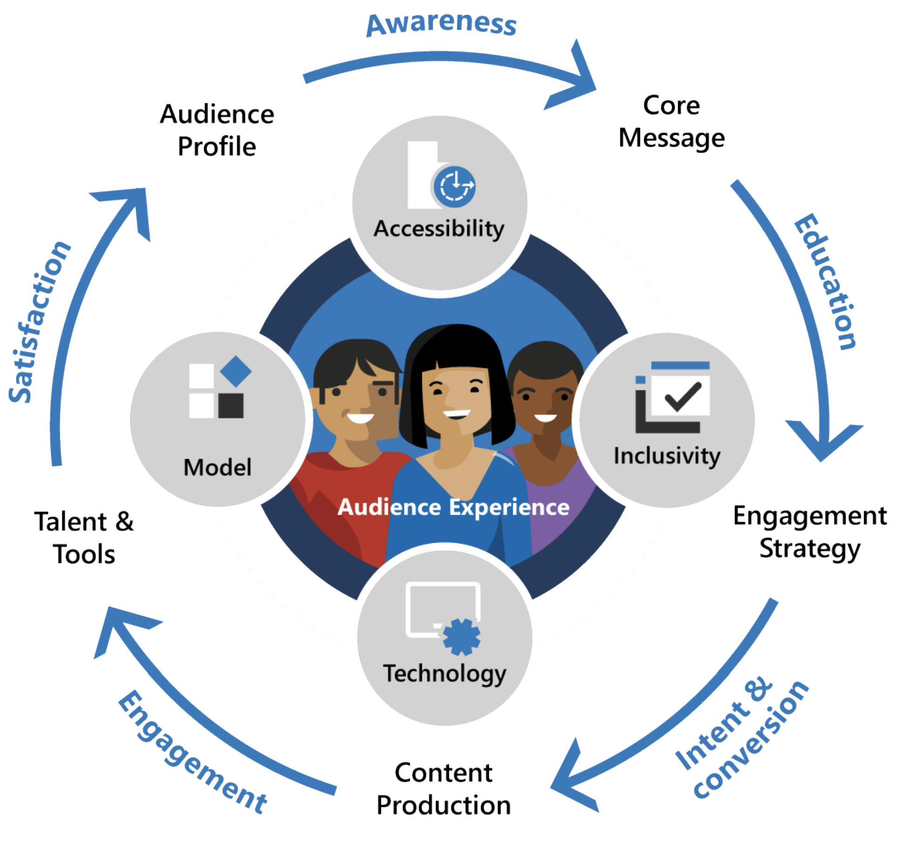

Slide 4


