Slide 1



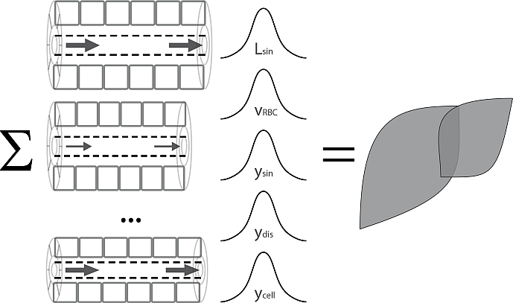
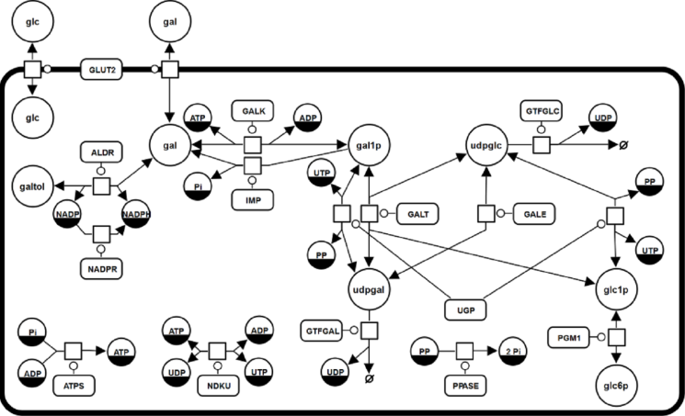
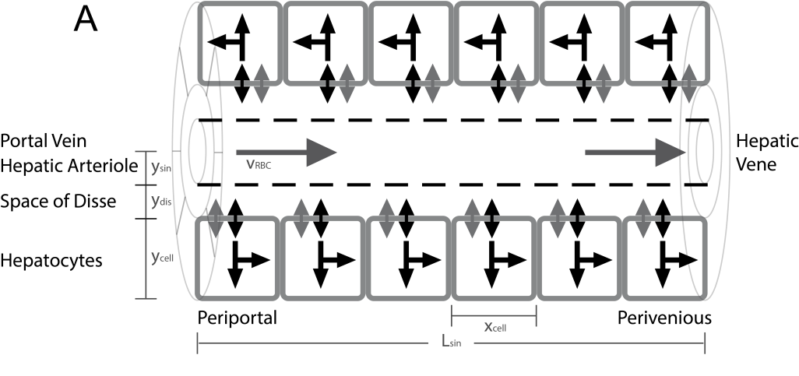
From Hepatocytes to Whole Liver Function:
A Multi-scale Model of Human Galactose Metabolism
König M. & Holzhütter HG.

Slide 2
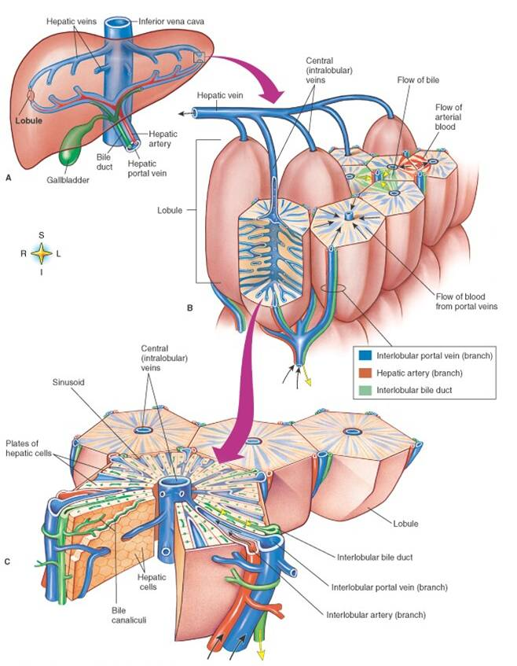
Liver Architecture
Liver
liver structured in parallel subunits (liver lobule)
liver lobulus consists of network of sinusoids connecting hepatic artery and portal vein with the central vene (periportal → perivenous)
Sinusoidal Unit consists of central sinusoid surrounded by hepatocyes separated by the space of Disse
Lobulus
Sinusoidal Unit

Slide 3
Tissue-scale –
Sinusoidal Unit

Slide 4
Tissue-Scale: Sinusoidal Unit

Slide 5
D

Slide 6
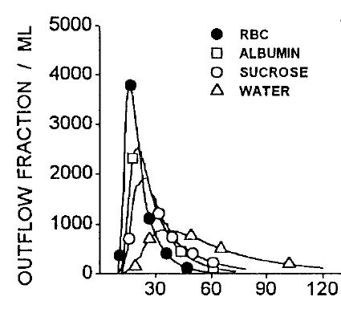
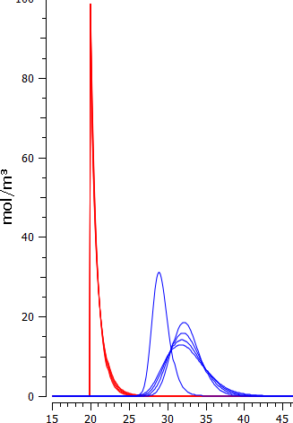
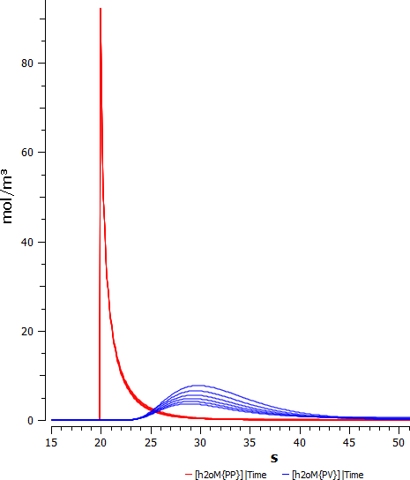
Multiple-Indicator Dilution Simulation
WATER: varying exchange
rates with hepatocytes
periportal
perivenous
RBC
periportal
perivenous
ALBUMIN
time [s]
time [s]

Slide 7
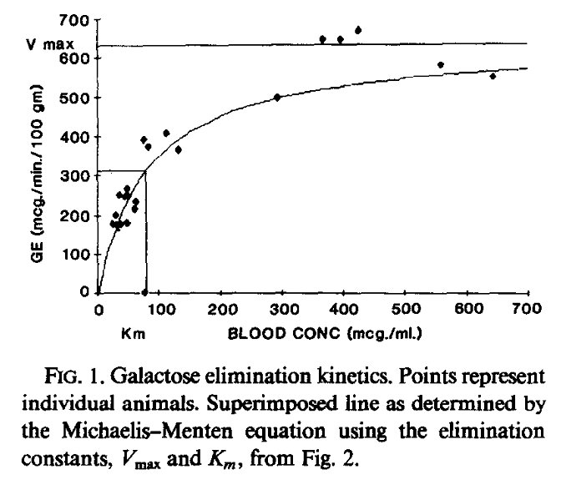
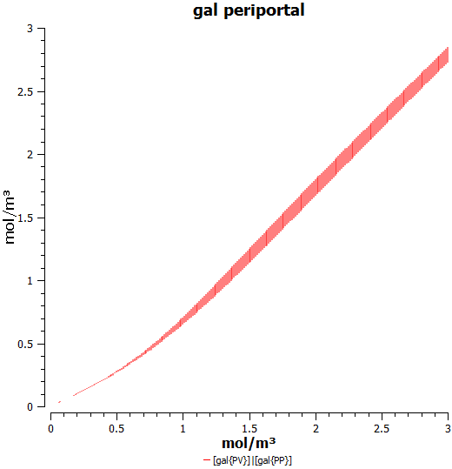
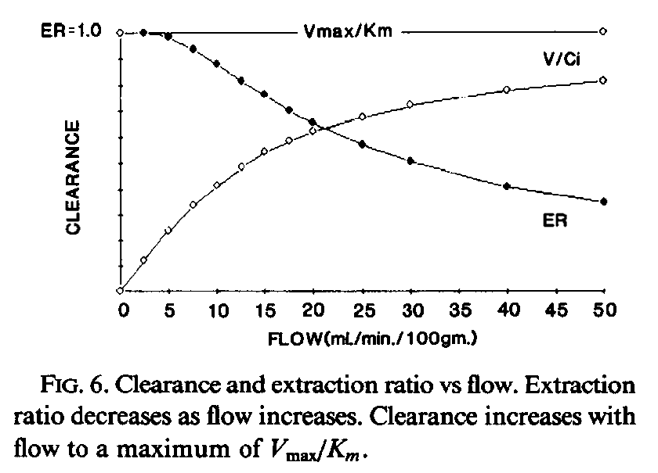
Work in Progress
TODO: Improving Integration Times
generation of optimized C++ code for solver

Slide 8
Organ-scale –
Whole Liver Metabolism

Slide 9
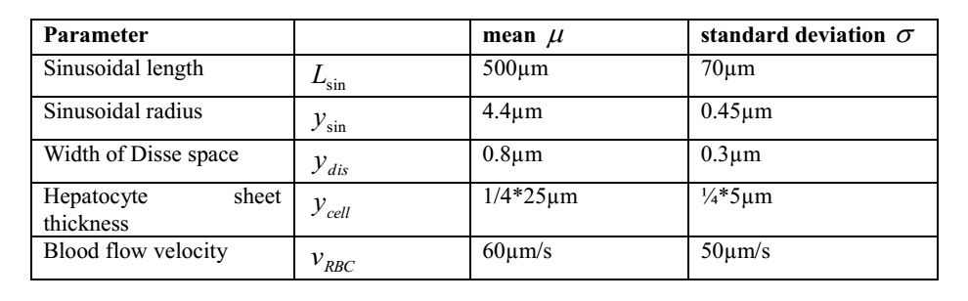
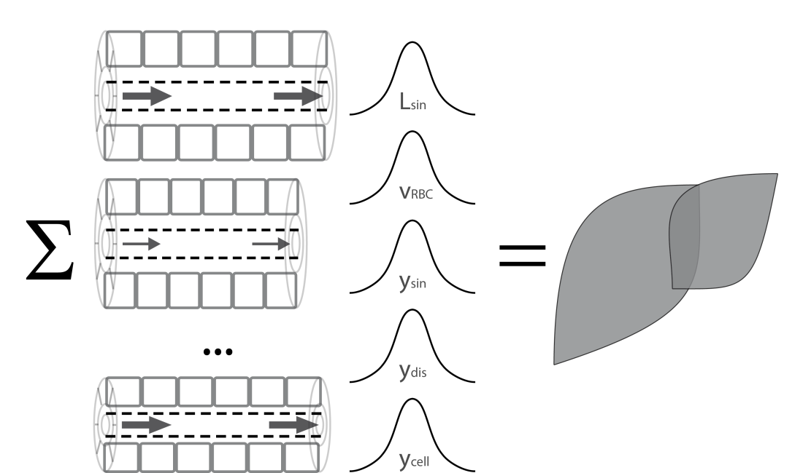
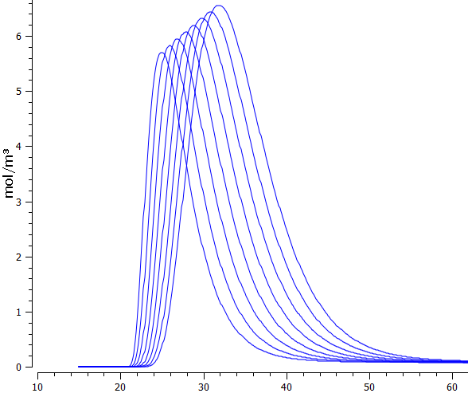
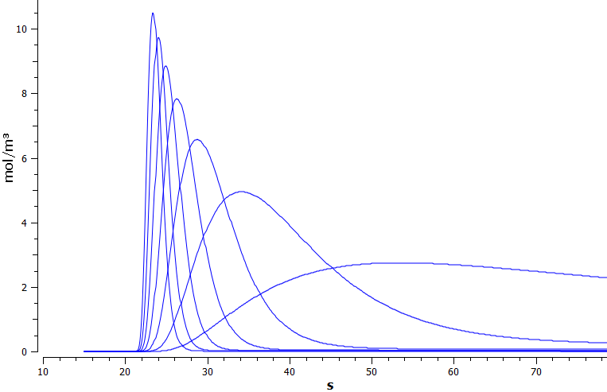
Organ-Scale
whole liver modelled by integrating heterogeneous contribution of sinusoidal units differing in blood-flow and tissue-architecture
Variation of sinusoidal
length
Variation of blood flow
time [s]

Slide 10
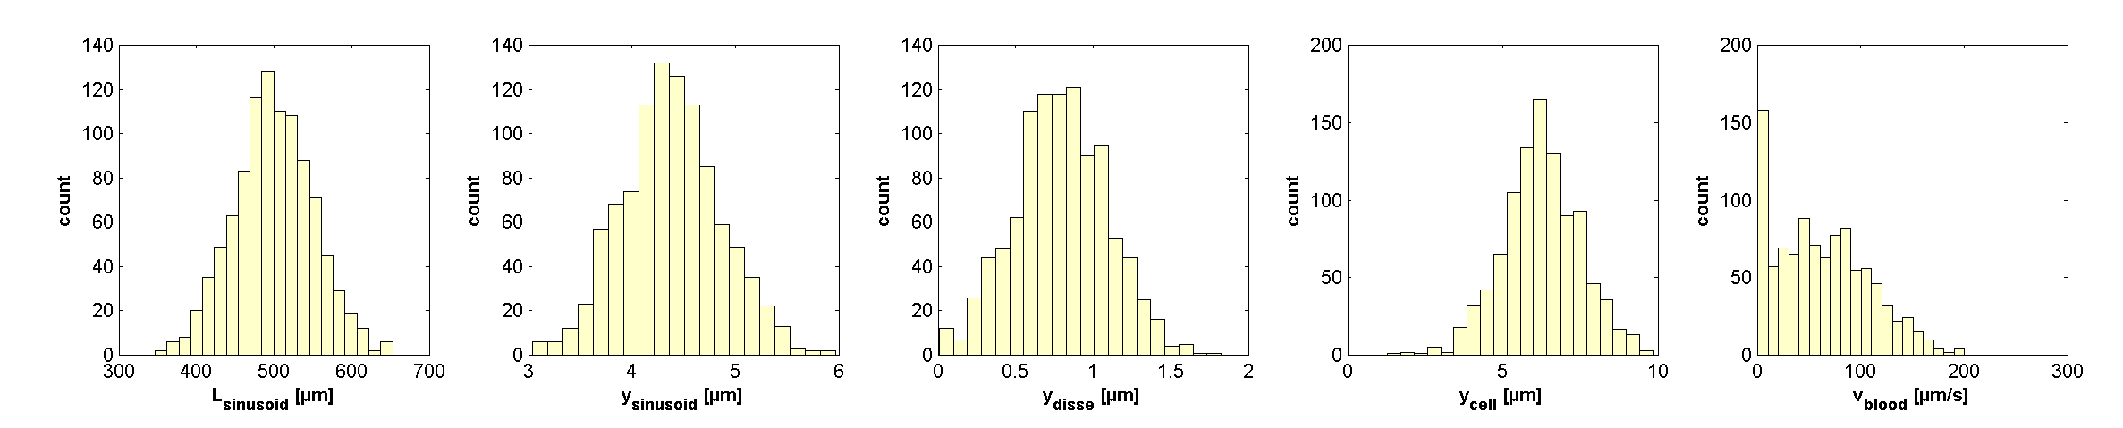
WORK in Progress
Calculation of distributions of sinusoidal units
  optimized C++ integration routines
  parallelization & integration
Simulations of alterations
  Galactosemias
  homogeneous
    changes in GEC during aging
    changes in GEC dring CCL4 intoxication
    changes in GEC during
  heterogeneous
    local perfusion inhomogenities

Slide 11
Cellular Scale - Hepatocytes

Slide 12

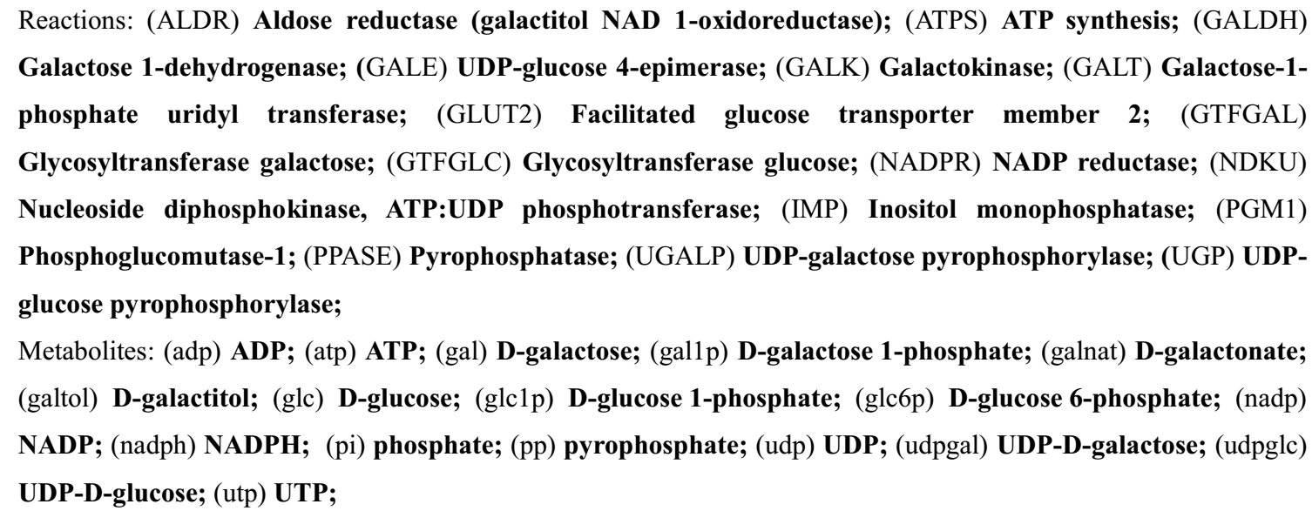
Galactose Metabolism
liver most important organ for whole-body metabolism and clearance of galactose
Main enzymatic steps
  Galactokinase (GALK) phosphorylation of galactose (gal) to galactose 1-phosphate (gal1p) catalysed
  Galactose-1-phosphate uridyl transferase (GALT)
  conversion of gal1p to UDP-galactose (udpgal)
  UDP-galactose 4´-epimerase (GALE)
  interconversion of udpgal and UDP-glucose (udpglc)
  Galactose can enter glycolysis as glucose-1 phosphate (glc1p)
  Galactose can be incorporated in glycoproteins and glycolipids as udpgal

Slide 13
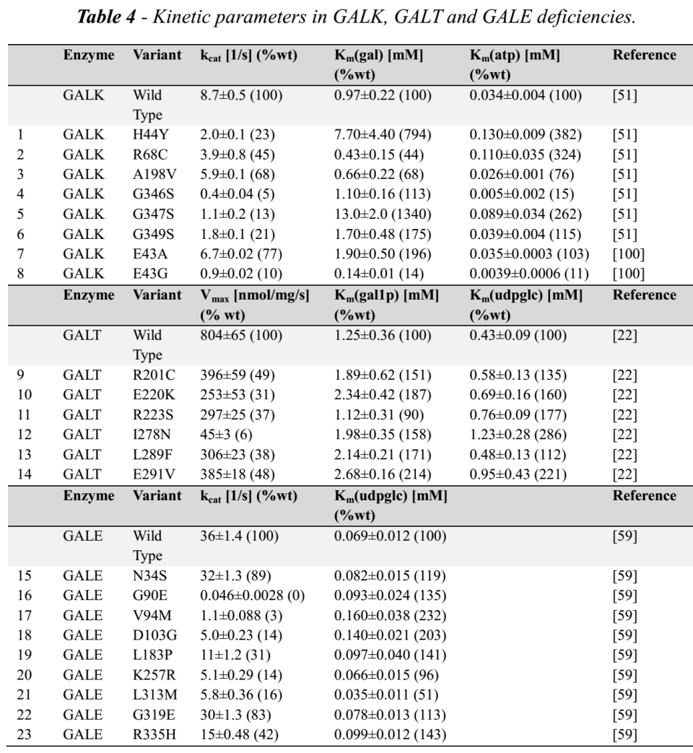
Galactosemias
caused by deficiencies in either GALK, GALT or GALE
untreated as well as treated patients with galactosemia show accumulation and/or depletion of specific metabolites, and often abnormalities of glycosylation
implementation
via measured alterations in kinetic properties in human protein mutations

Slide 14
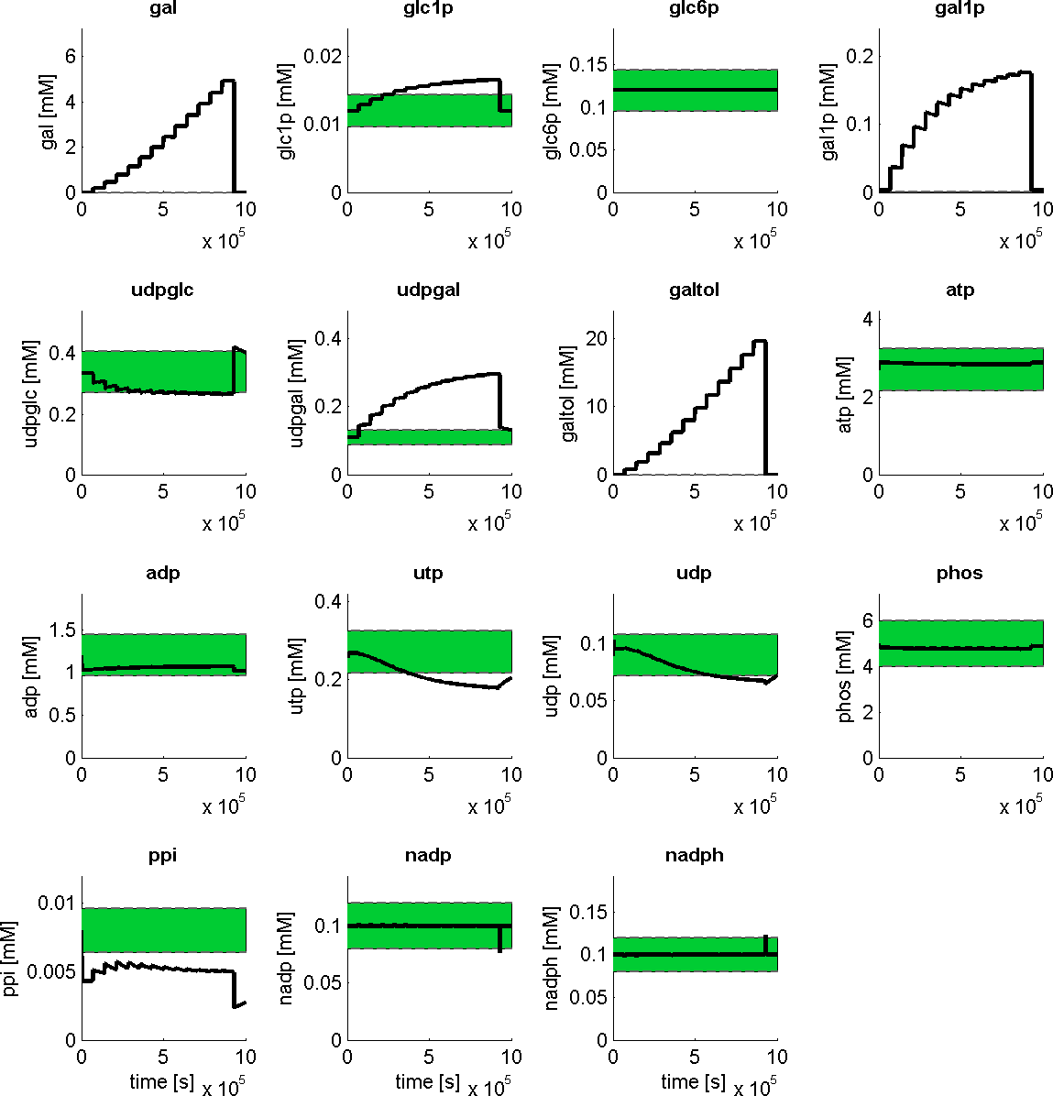
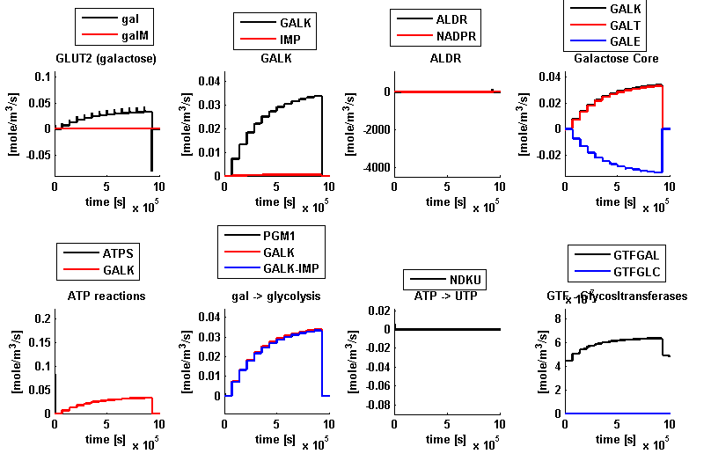
Hepatocyte Model
Reproduces
  metabolic concentrations normal state
  altered metabolite levels during galactose challenge
  saturation of clearance capacity

Slide 15
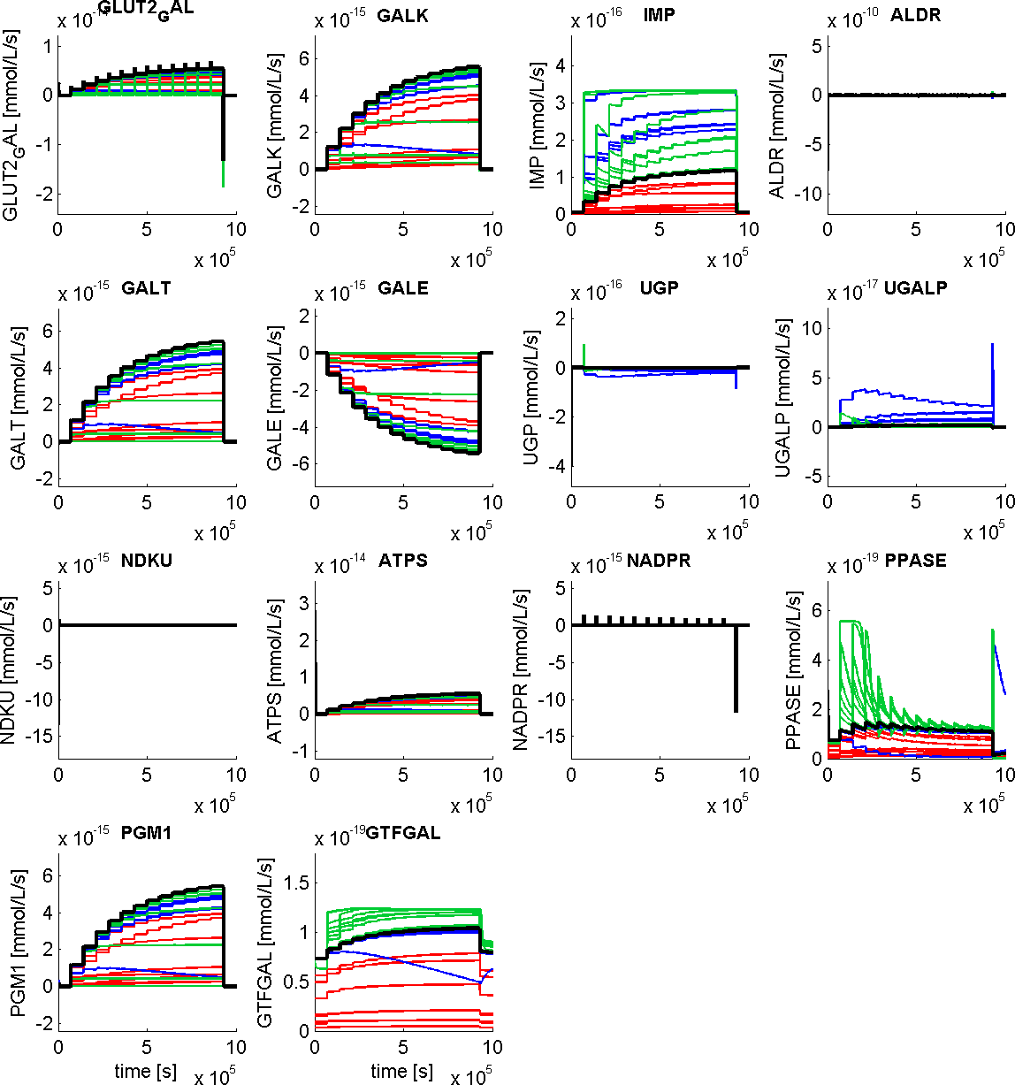
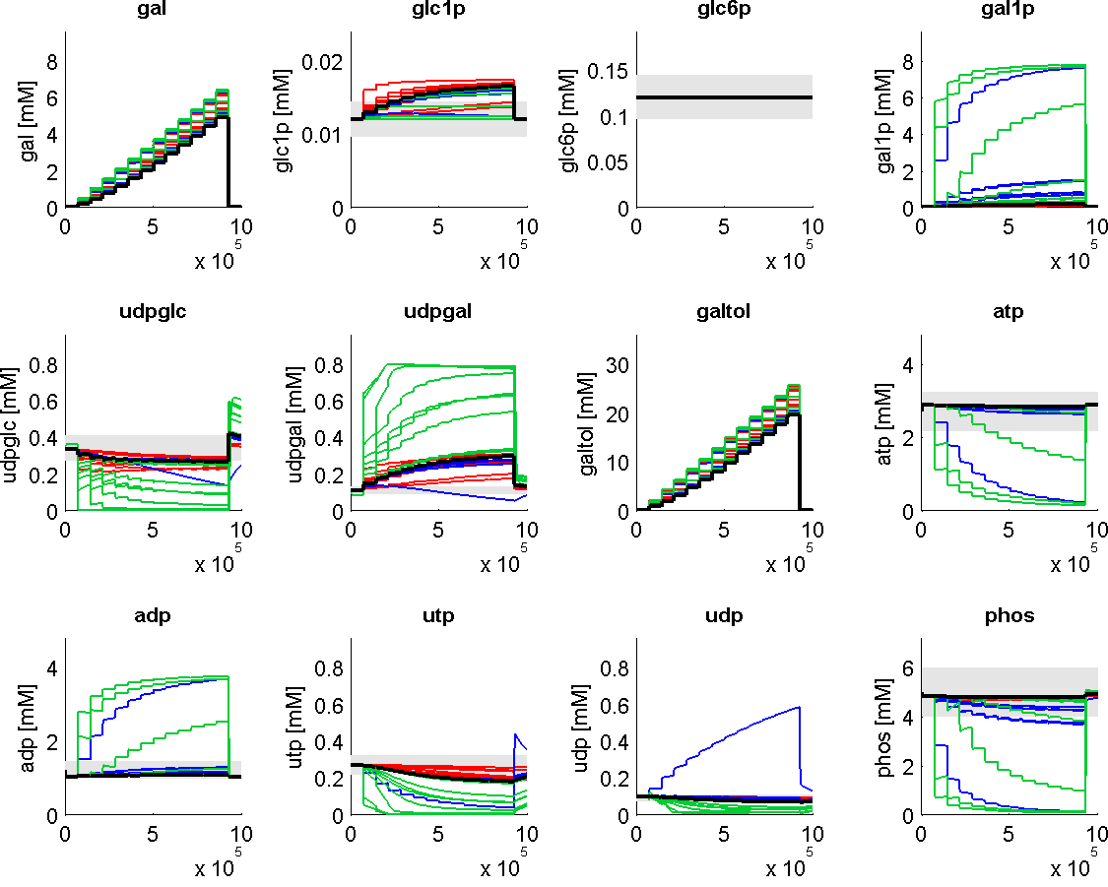
Galactosemia (GALK, GALT, GALE)
  marked alterations in metabolite levels
  galactitol accumulation
  shift of udpglc/udpgal level
  reduced galactose clearance
  energetically challenged

Slide 17
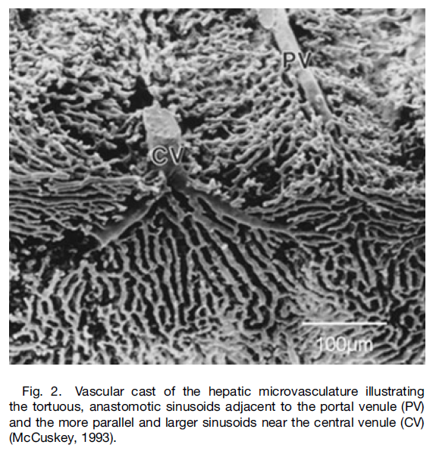
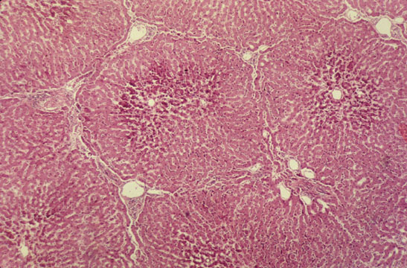

Slide 18
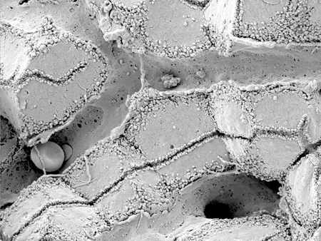
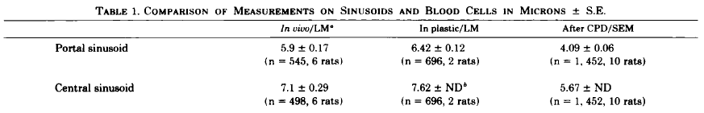
Sinusoid
Scanning electron micrograph showing fenestrated sinusoids and hepatocytes in a mouse liver.
http://www.easloffice.eu/jhep/contest/website/see_photos.html
principal vessels for exchange between blood and hepatocytes
~ 6-8µm diameter
periportal sinusoids are narrower and more tortuous than the wider and straighter central ones
Sinusoid network is heterogeneous
  near portal vene arranged as interconnecting polygonal networks
  farther away from portal vein organized as parallel vessels terminating in the central vein
  short intersinusoidal sinusoids connect adjacent parallel sinusoids
Scanning electron microscope observations on the structure of portal veins, sinusoids and central veins in rat liver. Wisse, E.; De Zanger, R. B.; Jacobs, R. & McCuskey, R. S.; Scan Electron Microsc, 1983, 1441-1452
The liver sieve: considerations concerning the structure and function of endothelial fenestrae, the sinusoidal wall and the space of Disse. Wisse, E.; De Zanger, R. B.; Charels, K.; Van Der Smissen, P. & McCuskey, R. S. Hepatology, 1985, 5, 683-692

Slide 19
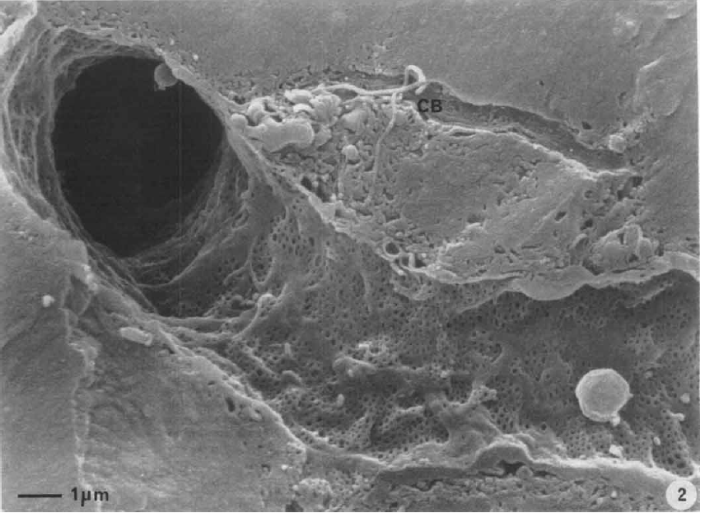
Endothelial Fenestrae
liver sinusoids unique capillaries
  open pores (fenestrae) in sinusoidal wall
  lack basal membrane underneath endothelium
fenestrae act as sieving barrier between blood and heptocytes
  morphological & physiological evidance that fenestrae act as a dynamic filter
  important role in lipid metabolism (namely chylomycrons)
Liver sinusoidal endothelial cells (LSEC) constitute sinusoidal wall
  numerous endocytotic vesicles
  effective uptake of a wide variety of substances from blood via receptor-mediated endocytosis (Braet, 2004)
  transcytosis transport across the endothelium to surrounding tissue
  scavenger system
Contribution of high-resolution correlative imaging techniques in the study of the liver sieve in three-dimensions. Braet, F. et al; Microsc Res Tech, 2007, 70, 230-242
Structural and functional aspects of liver sinusoidal endothelial cell fenestrae: a review. Comp Hepatol, Braet, F. & Wisse, E., 2002, 1, 1
The liver sieve: considerations concerning the structure and function of endothelial fenestrae, the sinusoidal wall and the space of Disse. Wisse, E.; De Zanger, R. B.; Charels, K.; Van Der Smissen, P. & McCuskey, R. S. Hepatology, 1985, 5, 683-692

Slide 20
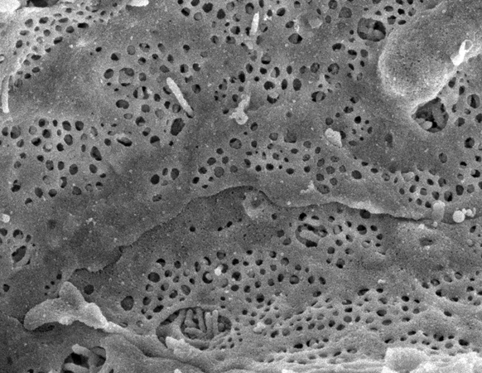
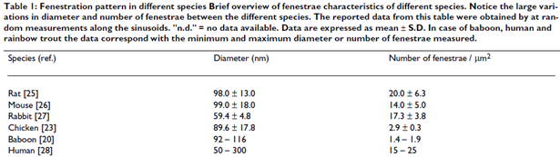
Fenestrae
Scanning electron micrograph of hepatocyte microvilli protruding through the sinusoidal endothelial cell fenestrations.
diameter ~50-200nm
ultrastructure same across species
  groups of fenestrae arranged in so called sieve plates
differences periportal & perivenious
  diameter decreases (110.7 to 104.8nm)
  frequency increases (9 to 13 per µm2)
  increased porosity from pp to pv from 6 to 8%
number and diameter may vary between individuals & within single indiviuum under various physiological and pharmacological circumstances

Slide 21
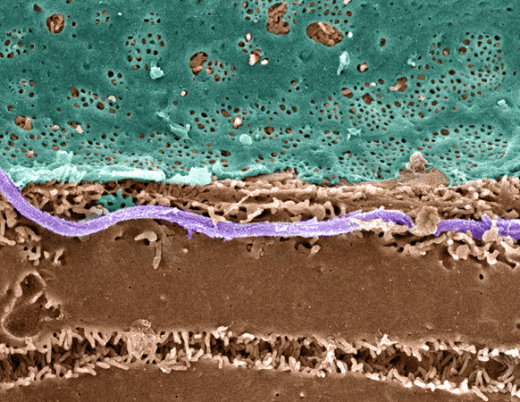
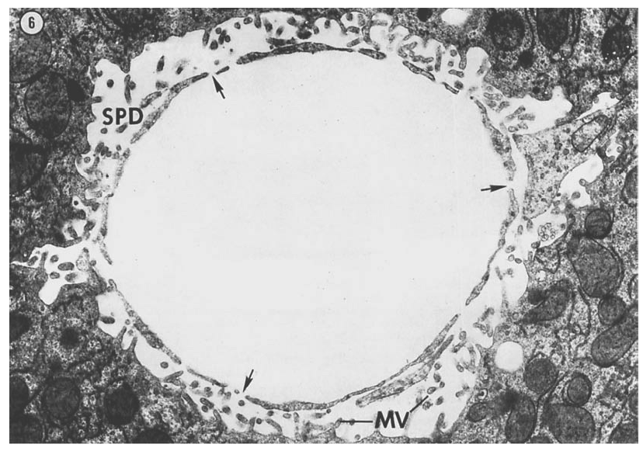
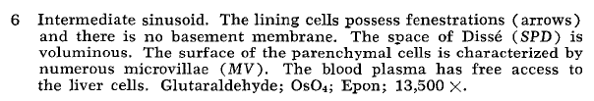
Space of Dissé
Pseudo-colored Scanning EM of an hepatic plate, accentuating the fenstrated sinuoidal endothelium (blue), hepatocyte (brown) and a collagen fibril (lavender).
Hepatocytes surface enlarged via microvilli.
The fine structure of rat liver sinusoids, space of Dissé and associated tissue space.
Burkel, W. E. & Low, F. N.; Am J Anat, 1966, 118, 769-783
http://www.easloffice.eu/jhep/contest/website/see_photos.html

Slide 22
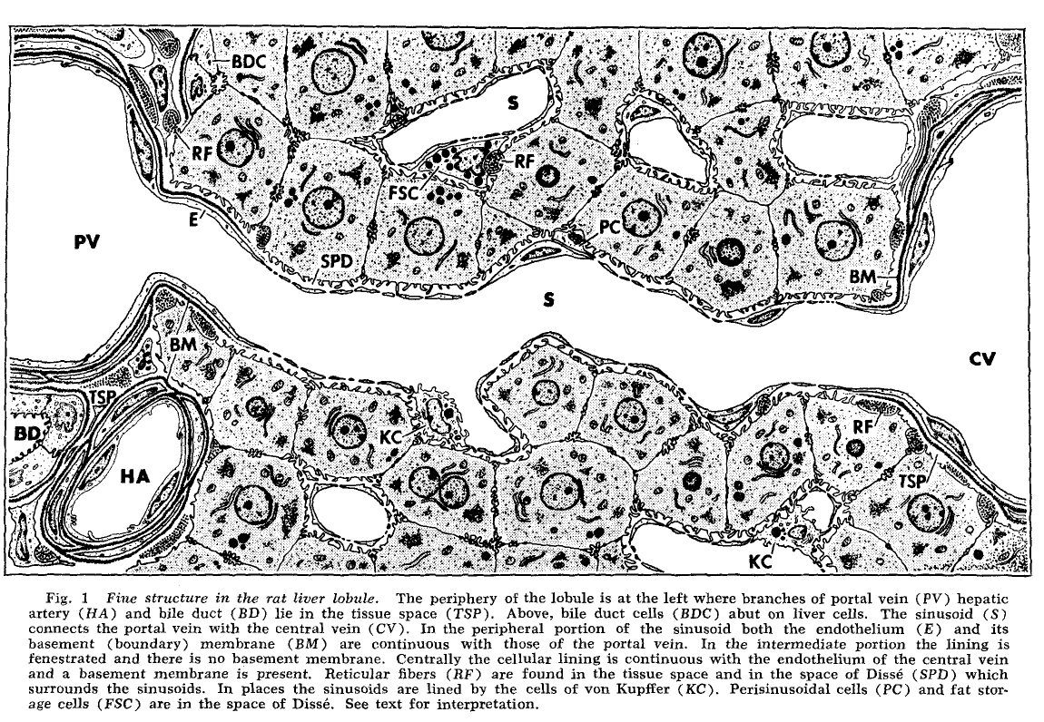
Sinusoid Ultrastructure
fenestraetion & absence of basement membranes provide direct access of blood plasma to hepatocytes
The fine structure of rat liver sinusoids, space of Dissé and associated tissue space.
Burkel, W. E. & Low, F. N; Am J Anat, 1966, 118, 769-783

Slide 23
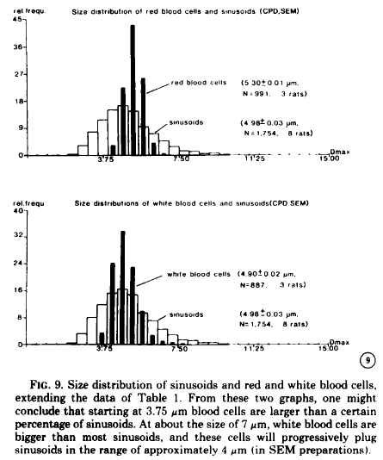
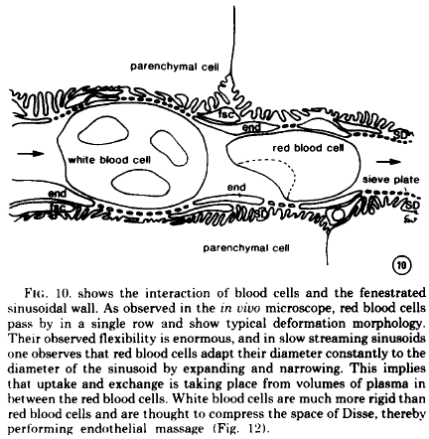
Tight Sinusoids
The liver sieve: considerations concerning the structure and function of endothelial fenestrae, the sinusoidal wall and the space of Disse. Wisse, E. et al; Hepatology, 1985, 5, 683-692

Slide 24
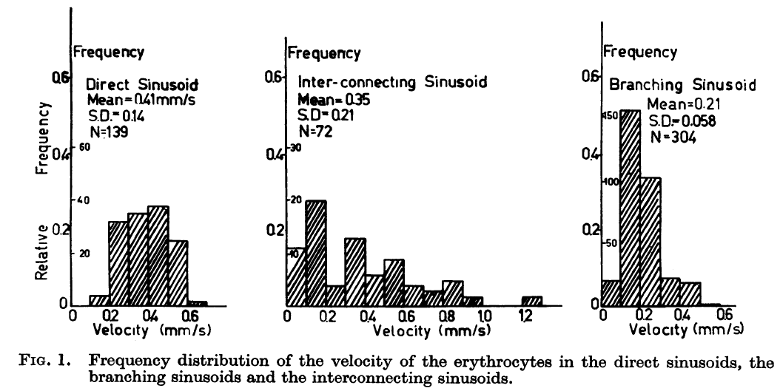
Blood Flow
The terminal hepatic microcirculation in the rat.
Koo, A.; Liang, I. Y. & Cheng, K. K.; Q J Exp Physiol Cogn Med Sci, 1975, 60, 261-266
Intermittence of blood flow in liver sinusoids, studied by high-resolution in vivo microscopy. MacPhee, P. J.; Schmidt, E. E. & Groom, A. C.; 1995, 269, G692-G698

Slide 25
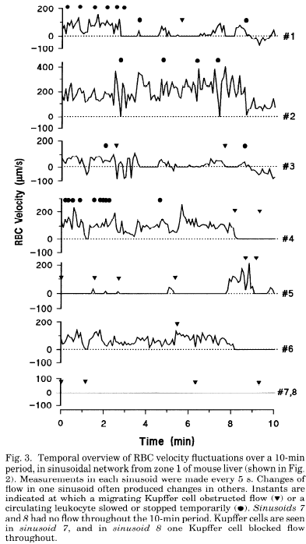
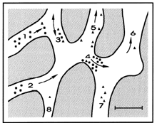
Blood Flow
The terminal hepatic microcirculation in the rat.
Koo, A.; Liang, I. Y. & Cheng, K. K.; Q J Exp Physiol Cogn Med Sci, 1975, 60, 261-266
Intermittence of blood flow in liver sinusoids, studied by high-resolution in vivo microscopy. MacPhee, P. J.; Schmidt, E. E. & Groom, A. C.; 1995, 269, G692-G698

Slide 26
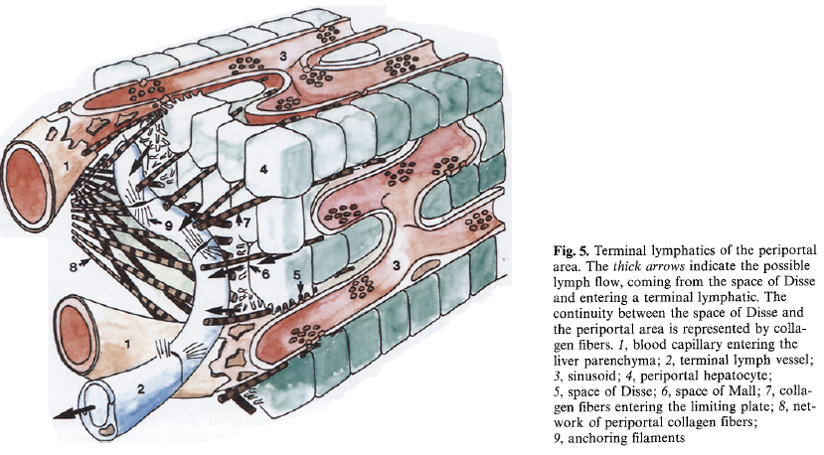
Lymph
substantial amount of hepatic lymph is generated in space of Dissé
  space of Dissé is continuos with the tissue space at both ends of the sinusoid !
  high protein content of hepatic lymph
lymphatic vessels originate as blind-ending capillaries in the connective tissue spaces (portal tracts) associated with the portal veins and hepatic arteries
  fluid contained in these lymphatics flows toward the hepatic hilus and eventually into the cisternae chyli
Lymph circulation in the liver.
Ohtani, O. & Ohtani, Y.; Anat Rec; 2008, 291, 643-652
The lymphatics of the liver.
Trutmann, M. & Sasse, D. ; Anat Embryol (Berl), 1994, 190, 201-209

